Slide 1
Neutrino plans in Europe:
— Report on workshop 01Oct—03Oct09:
European Strategy for Future Neutrino Physics

Slide 2
Contents:
Background and workshop’s goals
Detector development
Large-scale infrastructures
Conclusions

Slide 3
Background and workshop’s goals
Neutrino plans in Europe

Slide 4

CERN and neutrino physics: historical:
In the past, neutrino experiments at CERN have made substantial contributions to the field:
  This year’s headline:
    EPS prize for Gargamelle
    collaboration’s discovery
    of neutral currents
  But also:
    V-A nature of weak
    charged current
    Neutrino-nucleon deep
    inelastic scattering and
    determination of structure
    functions
    …

Slide 5
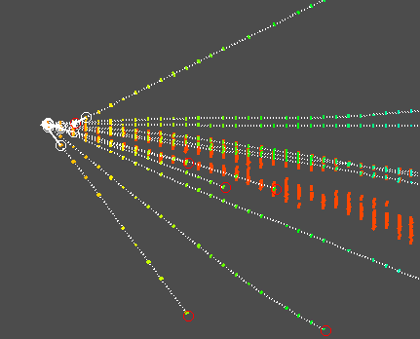
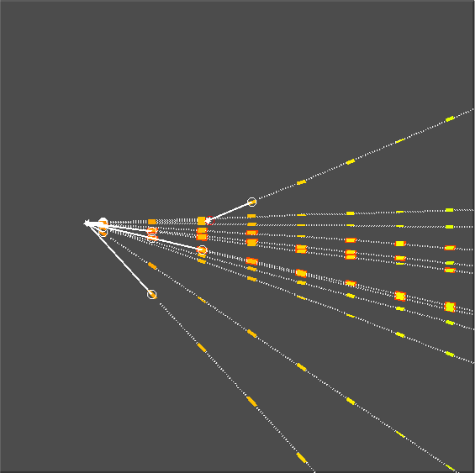
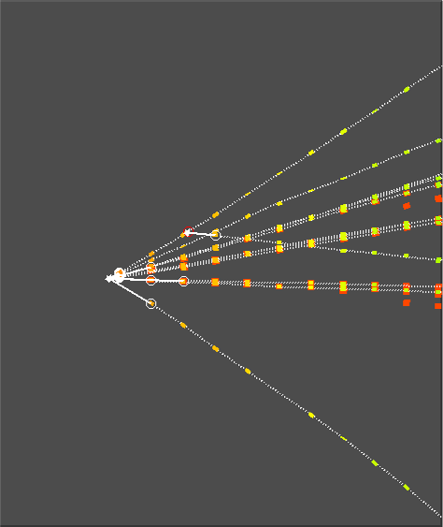
CERN and neutrino physics: present:
OPERA:
  Measurement of charm production
  Direct observation of ν_{τ} appearance

Slide 6
History of European/CERN involvement:
Study of Muon Collider in US lead to the proposal that stored muons could be used to generate high-energy neutrino beams [Geer, 1998]
Recognised by CERN and ECFA as an option for CERN:
  B Autin, A Blondel and J Ellis, Prospective Study of Muon Storage Rings at CERN,CERN 99-02, ECFA 99-197
First NuFact workshop in Lyon 1999:
  Jointly sponsored by ECFA and ICFA
Led to the ECFA/CERN study of a Neutrino Factory:
  A Blondel et al (ed), ECFA/CERN studies of a European neutrino factory complex, CERN-2004-002, ECFA-04-230, Apr 2004
In the rest of the world around this time … :
  US NF&MC Collaboration made a number of feasibility studies of a Neutrino Factory
  In Japan, NuFact-J working group made a Neutrino Factory study exploiting FFAGs
Beta-beam concept proposed in 2002
  P. Zucchelli, A novel concept for a anti-nu/e / nu/e neutrino factory: The beta beam, Phys.Lett.B532:166-172,2002
    Perhaps stimulated by ECFA/CERN study/European Neutrino Group physics working group activities

Slide 7
European Commission programmes:
FP6:
  BENE [Beams for European Neutrino Experiments]:
    NA, part of CARE [Coordinated Accelerator R&D in Europe]
  Beta-beam: conceptual design of ‘CERN baseline scheme’
    Part of EURISOL Design Study
FP7:
  EUROnu Design Study:
    Super beam, Beta beam, and Neutrino Factory
      Conceptual design, cost, performance, risk, and schedule
      Covers aspects of super, beta beams and Neutrino Factory
        Resouces limitted!
          IDS-NF leverages additional effort into Neutrino Factory w/p
          Not clear that production of CDR for all three facilities is feasible given available resources
  Laguna Design Study
    Underground laboratory, large H2O, or Lar detector
      APEC[ASPERA] – relationship with ECFA?
  Neu2012 Networking Activity:
    Part of EUCARD [European Coordinated Accelerator R&D]
  Transnational Access to MICE:
    Also part of EUCARD
  LAGUNA Design Study
    Water Cerenkov, Liquid Argon & Scintillator Detectors

Slide 8
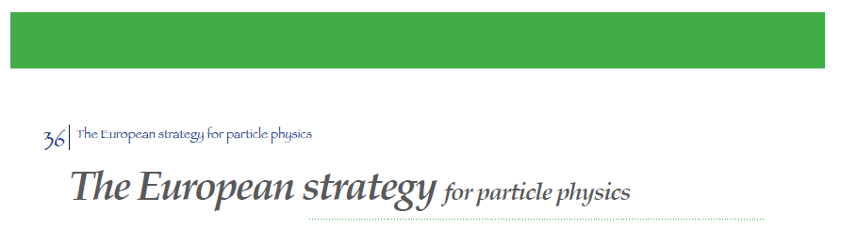
June 2006 Lisbon
b
‘Studies of the scientific case for future neutrino facilities and the R&D into associated technologies are required to be in a position to define the optimal neutrino programme based on the information available in around 2012; Council will play an active role in promoting a coordinated European participation in a global neutrino programme
  And
[…] it is vital to strengthen the advanced accelerator R&D programme; a coordinated programme should be intensified, to develop the CLIC technology and high performance magnets for future accelerators, and to play a significant role in the study and development of a high-intensity neutrino facility.
a

Slide 9
Goals of the workshop:
To begin the process of establishing a roadmap for a coherent European participation in future Neutrino Physics
To examine those techniques which potentially can substantially improve precision over that expected from current and future experiments in construction.
To stress the substantial technical problems associated with each technique
To devise plans for the European contribution to the R&D necessary to enable decisions to be taken around 2012 – 2013.
To consider the role of CERN in future international neutrino activities
To bring to light synergies between the neutrino area and other areas of physics
To suggest a procedure for future coordination and development of European activities in the Neutrino area
Principal aim:
  To position the European Particle Physics Community to be a major players in the period 2015 – 2030

Slide 10
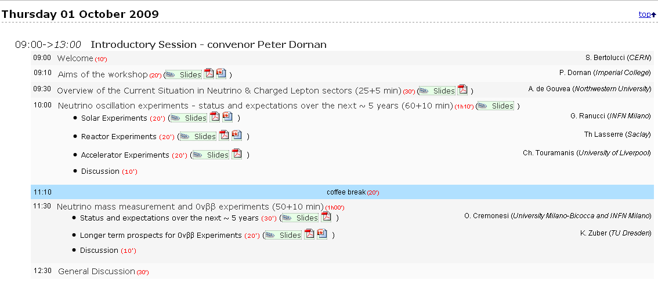
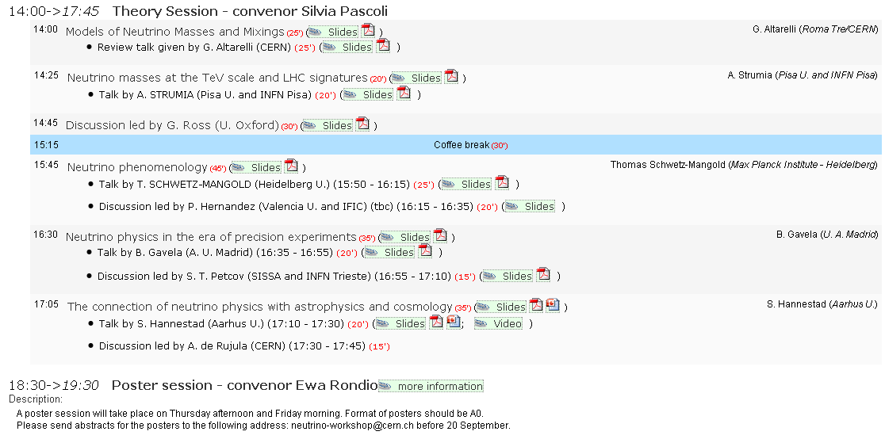
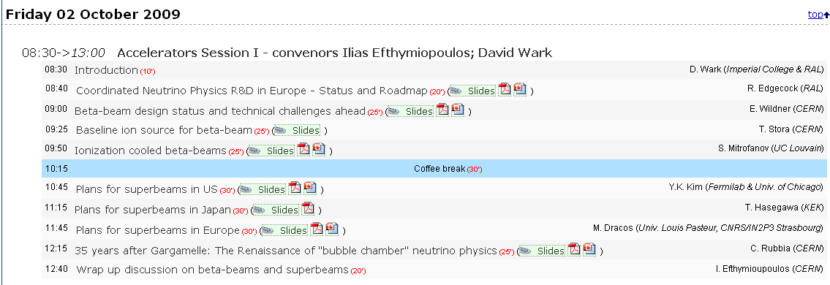
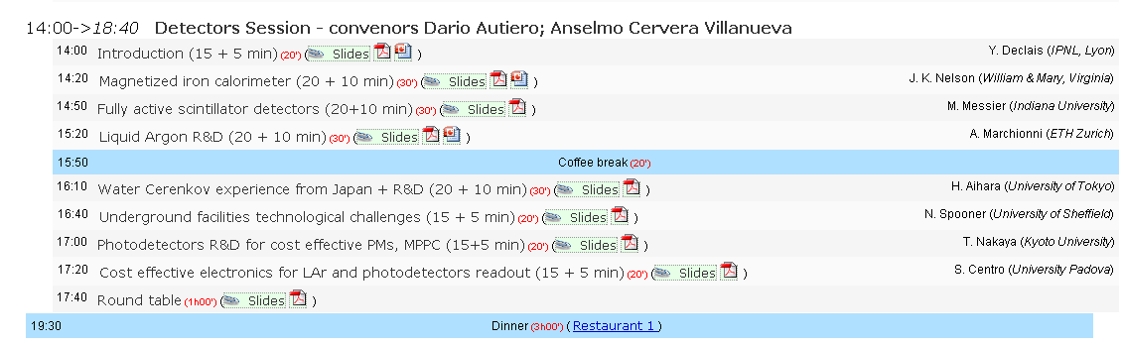
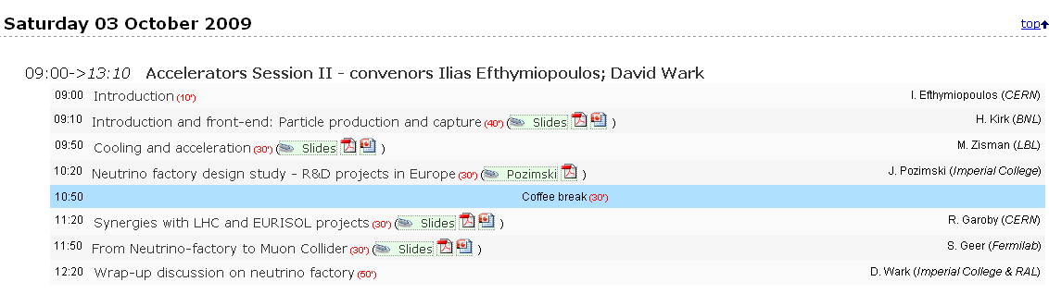
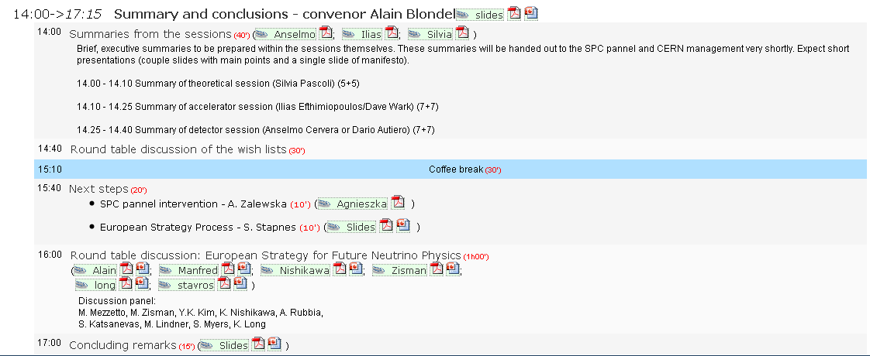

Slide 11
Summary of workshop:
Necessarily selective:
  Implies some subjectivity!
Broad classification of areas covered:
  Theory/phenomenology;
  Low background: ν-mass, 0ν2β;
  Detector development;
    Including test beams
  Small infrastructures:
    Experiments that can be mounted at CERN or elsewhere
  Large accelerator infrastructures:
    Super-beam, beta-beam, Neutrino Factory
I will concentrate on 3 and 5

Slide 12
Disclaimer:
The official summary will come in December when the SPC neutrino panel reports!

Slide 13
Detector development
Neutrino plans in Europe

Slide 14
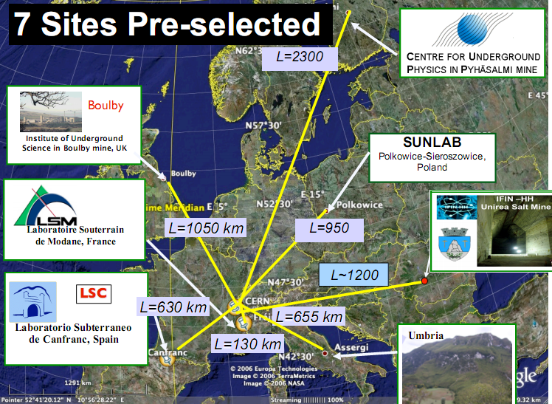
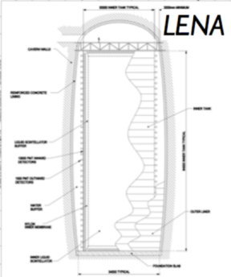
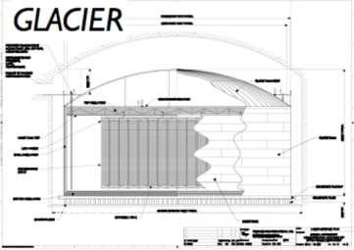
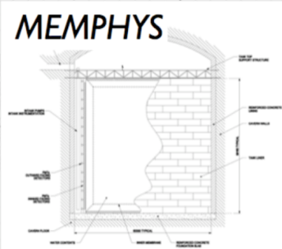
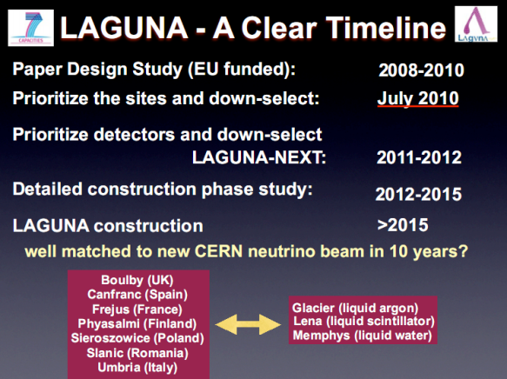
Search for European Deep Underground lab site: LAGUNA
Seven sites preselected
Consideration of three technologies:
  Water Cherenkov (Memphys)
  Liquid argon (Glacier)
  Liquid scintilator (LENA)

Slide 15
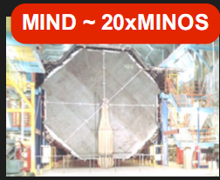
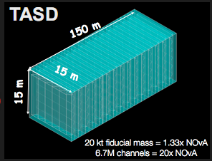
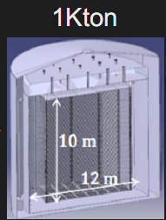
Technologies and R&D:
Magnetised Iron Neutrino Detector (MIND):
  Require to reduce energy resolution:
    Sampling fraction, segmentation, magnetic field
  Good to reduce cost per channel:
    Scintillator, photo-detector, and electronics
Totally Active Scintillator Detector (TASD):
  Motivation: ‘wide band Neutrino Factory’
    Offers low energy threshold, excellent energy resolution
    Potentially:
      Electron charge identification
      Statistical tau identification
    Require to ‘prove in simulation’ and then in a test beam!
  Critical:
    Magnetisation of large volume with no iron (Neutrino Factory application)
    Reduction of cost per channel:
      Scintilaltor, photo-detector, and electronics
  Require test-beam exposure of large-scale prototype
Liquid argon time-projection chamber:
  Critical:
    Demonstration of long drift distance
    Magnetisation of large volume with no iron (Neutrino Factory application)
    Electronics and readout
    Automatic reconstruction
  Require test-beam exposure of large scale prototype

Slide 16
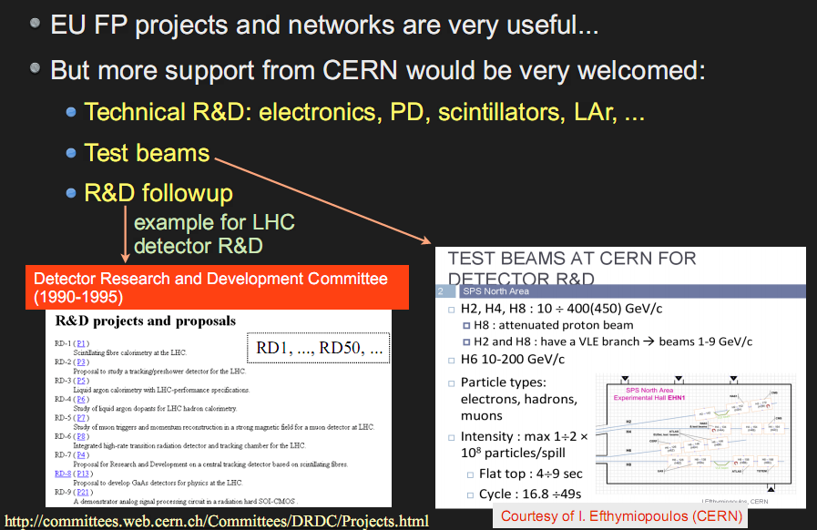
Possible contributions from CERN/Europe:

Slide 17
Large accelerator infrastructures
Neutrino plans in Europe

Slide 18
CERN context: required upgrade to proton complex:
To realise full potential of LHC require to:
  Increase reliability of LHC injector chain
  Increase performance of injector chain to deliver maximum luminosity in LHC
Strategic issue:
  SPL: low or high power?
    LHC injector:
      LP-SPL sufficient
    LHC and world-leading neutrino programme:
      HP-SPL required

Slide 19
High-power SPL: flexibility and breadth:
High-power SPL has potential to serve:
  sLHC, EURISOL, high-power neutrino programme
System ‘upgrade’ requirements wrt LP-SPL:
  Upgrade of infrastructure (cooling water, electricity, cryogenics etc.)
  Replacement of klystron power supplies,
  Addition of 5 high b cryomodules to accelerate up to 5 GeV (p production for Neutrino Factory)?
Clear consensus and strong ‘push’ from ν-community: keep option of HP-SPL

Slide 20
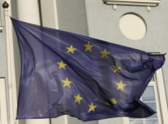
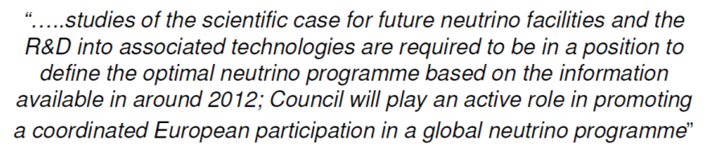


EUROnu: Design Study for 2nd generation facility:
EUROnu
IDS-NF
SB
BB
NF

Slide 21
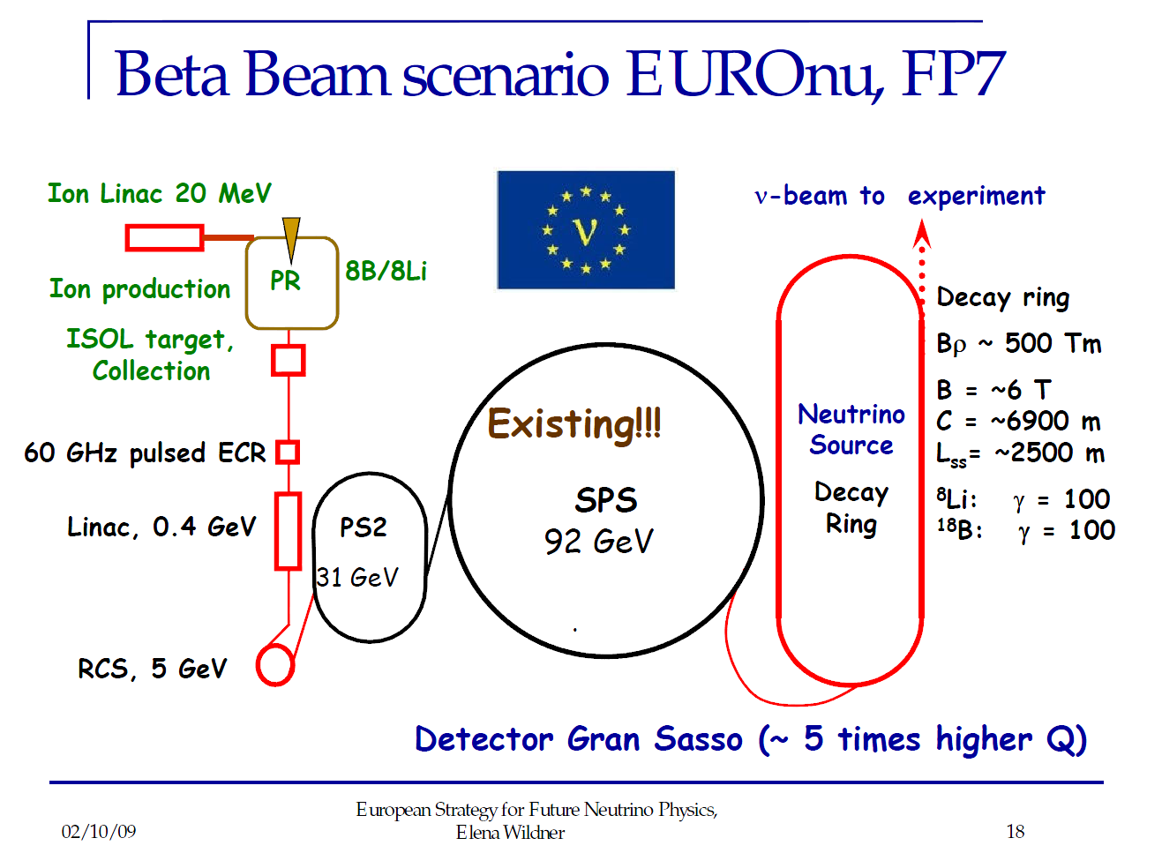
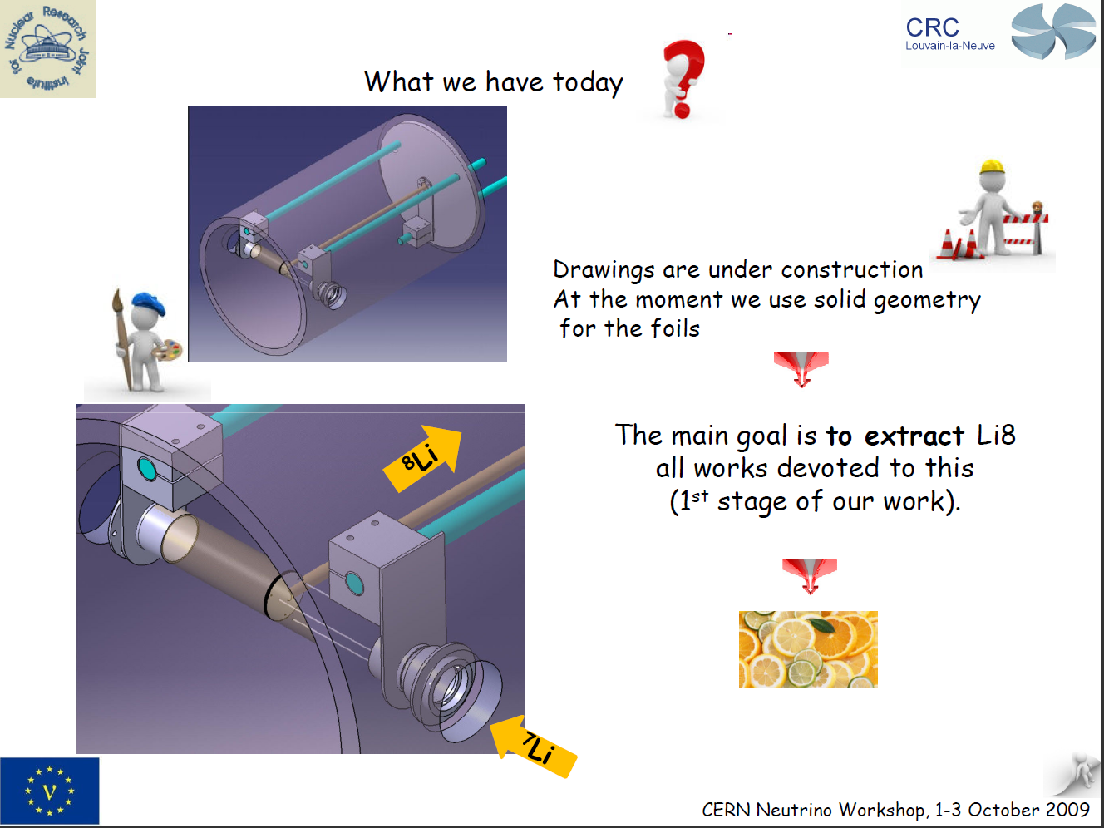
Beta beam design study:
Baseline (He/Ne; γ=100) studied within Eurisol DS
Possibility of B/C under study within EUROnu
Require evaluation of benefit of use of PS2, SPS for beta beam
  Alternative may give better performance
CERN expertise, and R&D in Europe (e.g. UCL), needs to be maintained
  Demonstration of feasibility of required ion flux important

Slide 22
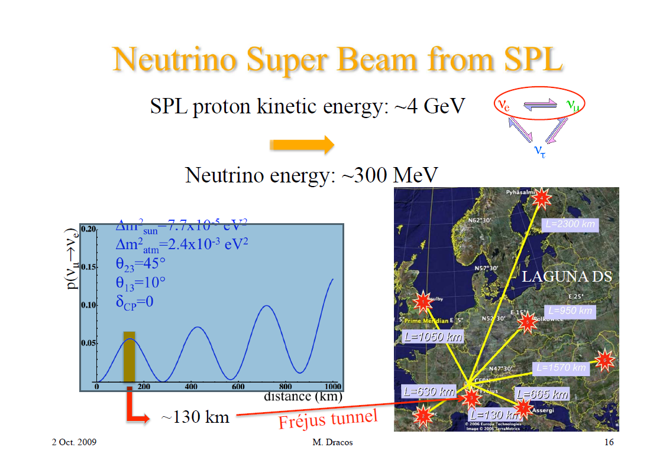
SPL—Frejus superbeam:
Various scenarios:
  EUROnu study CERN—Frejus
  Other possibilities could be studied
    Too little resource!
  High-power SPL is the key element for each of the scenarios

Slide 23
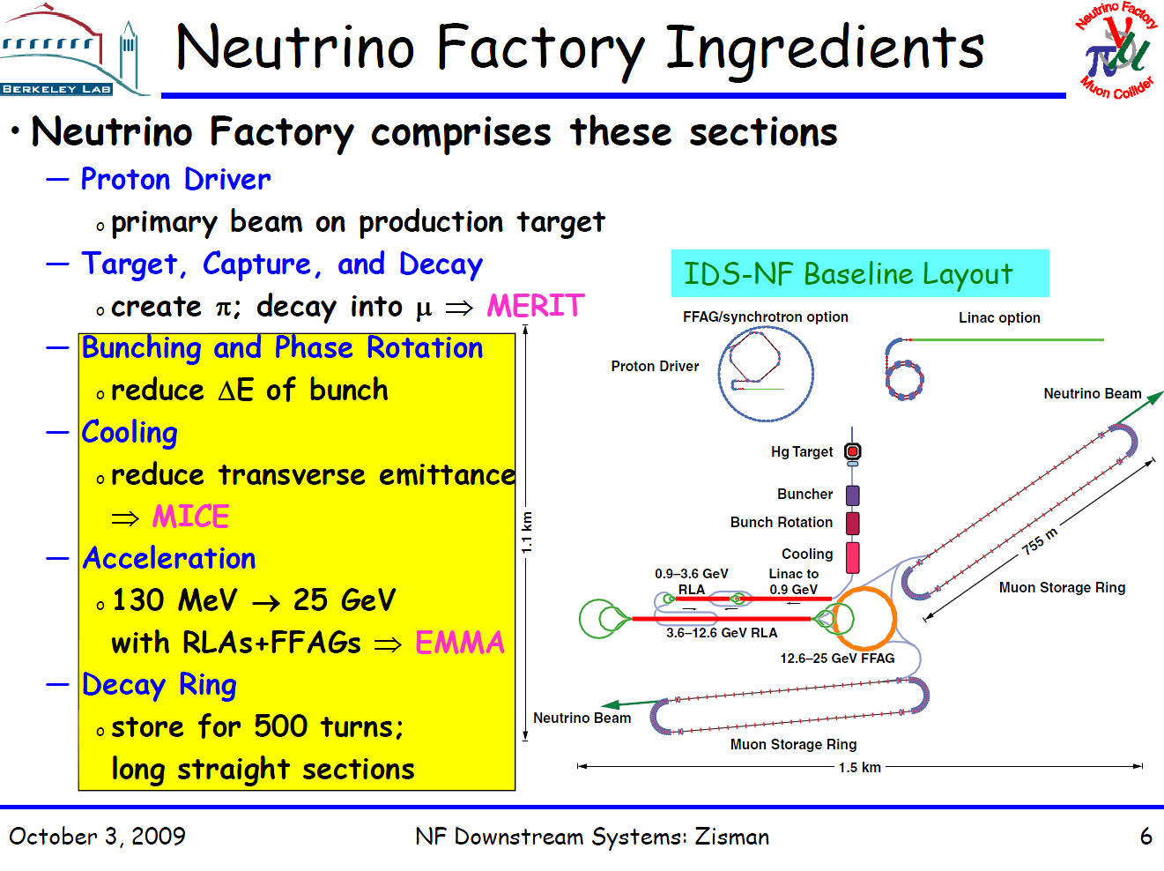

Slide 24
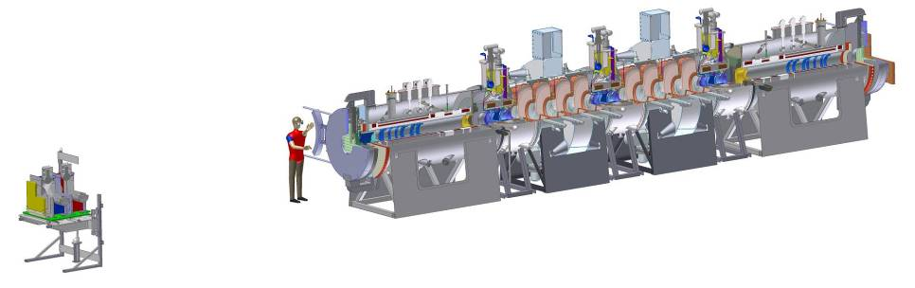
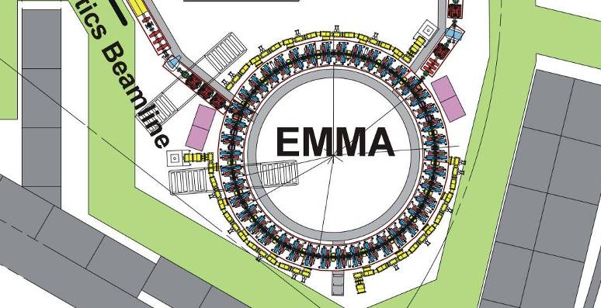
Neutrino Factory R&D programme:
High-power target
Ionisation cooling
MICE
(under construction at RAL)
MERIT (took data CERN)
Rapid acceleration:
RF cavity development
EMMA
(under construction at DL)
MuCool (part of US NFMCC)

Slide 25

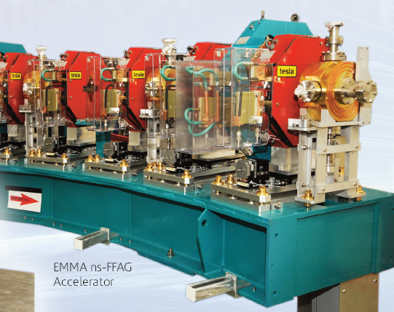
Neutrino Factory R&D programme:
High-power target
Ionisation cooling
MERIT (took data CERN)
MICE (under construction at RAL)
Rapid acceleration:
RF cavity development
EMMA (under construction at DL)
MuCool (part of US NFMCC)

Slide 26
Conclusions
Neutrino plans in Europe

Slide 27
Goals of the workshop:
To begin the process of establishing a roadmap for a coherent European participation in future Neutrino Physics
To examine those techniques which potentially can substantially improve precision over that expected from current and future experiments in construction.
To stress the substantial technical problems associated with each technique
To devise plans for the European contribution to the R&D necessary to enable decisions to be taken around 2012 – 2013.
To consider the role of CERN in future international neutrino activities
To bring to light synergies between the neutrino area and other areas of physics
To suggest a procedure for future coordination and development of European activities in the Neutrino area
  As an integrated part of the implementation of the European strategy for Particle Physics it will be necessary to establish an organisation and follow-up structures for the key R&D areas. This requires coordination with the Strategy Secretariat of the European Session of Council and appropriate means to achieve this will be discussed.

Slide 28
R-ECFA likely to:
Recognise Design Study initiatives:
  EUROnu, IDS-NF, …
Help set and create conditions for timely completion of Design Study initiatives:
  Request/receive
  and comment on
  design reports:
    In case of IDS-NF:
      IDR in 2010
      RDR in 2012/13
  Monitor
  intermediate
  milestones:
    Organise follow-up
    workshops along
    the lines of the
    CERN workshop

Slide 29
But we need an international approach:
YKK: emphasised need for
international cooperation
Bertolucci

Slide 30
W/s demonstrated a vibrant, energetic community with a wealth of ideas and established activities!
Next generation, long-baseline facility:
  Well-rehearsed scientific branch point: θ₁₃:
‘incremental’?
θ₁₃ ‘large’
SB, βB, [LE]NF
θ₁₃ ‘large’
T2K, NOvA
D-Chooz, D-Bay, Reno, …
θ₁₃
sng(Δ m₃₁), δ, …
‘discovery’?
θ₁₃ ‘small’
βB, NF
θ₁₃ ‘small’
Significant investment:
no. of facilities limited
  Require consensus, and well-articulated, case
    Sensitivity comparison exists
    Precision comparison required
    International approach to manage risks
      E.g. muon-physics programme

Slide 31
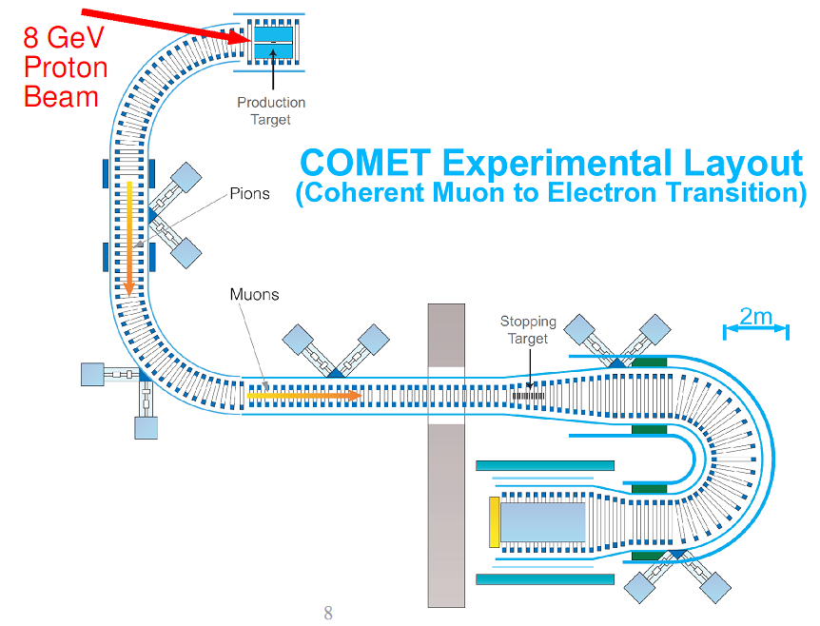
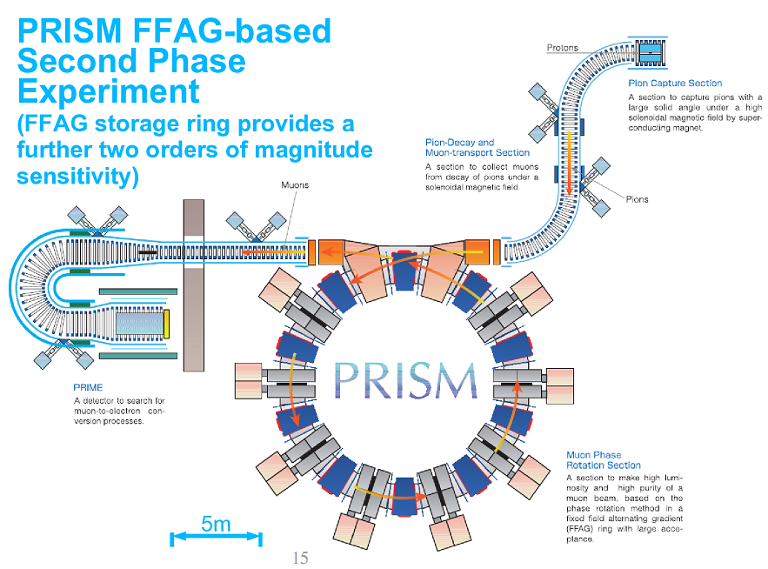
Lepton flavour violation:
mu2e

Slide 32
Conclusions:
YKK: emphasised need for
international cooperation
Bertolucci

