Slide 1
HINS Superconducting Spoke Cavity Development
Bob Wagner
L. Ristori†, G. Apollinari, E. Borissov, I. V. Gonin, T. N. Khabiboulline, A. Mukherjee, T. H. Nicol, J. Ozelis, Y. Pishchalnikov, D. A. Sergatskov, R. Wagner, and R. Webber, Fermilab, Batavia, IL
AAC Meeting
November 16-17, 2009

Slide 2
Outline
325 MHz SC Spoke Resonators in Project X and HINS
RF design of SSR1
Fabrication of prototypes at Zanon (SSR1-01) and Roark (SSR1-02)
Chemistry and HPR of unjacketed (no helium vessel) cavities
CW tests of the unjacketed SSR1-01 and SSR1-02 in the VTS
Tuning issues for SSR1 operation in HINS (Pulsed, 4.4 K)
Helium vessel with prototype slow/fast tuner.
Preparing SSR1-01 for tests with the helium vessel and tuner.
Power coupler and the Superconducting Spoke Cavity Test Facility
Upcoming SSR1 activities
Issues in re-using jacketed SSR1 in CW Project X.

Slide 3
325 MHz SC Spoke Resonators in Project X and HINS
Spoke cavities for Project X and recent HINS plans:
Quantity | SSR1 | SSR2 | TSR
Beta design | 0.21 | 0.40 | 0.62
Nominal E_{acc} (MV/m) | 10 | 10 | 10
Output Energy (MeV) | 30 | 120 | 420
# Cryomodules | 2 (2 HINS) | 3 | 7
# Cavities / Cyromodule | 9 | 11 | 6
# Cavities (total) | 18 (18 HINS) | 33 | 42

Slide 4
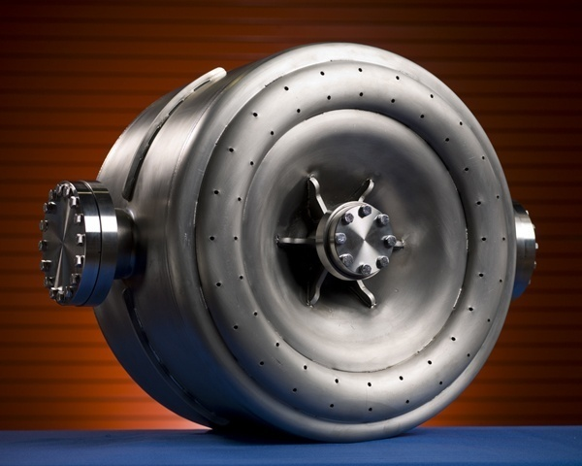
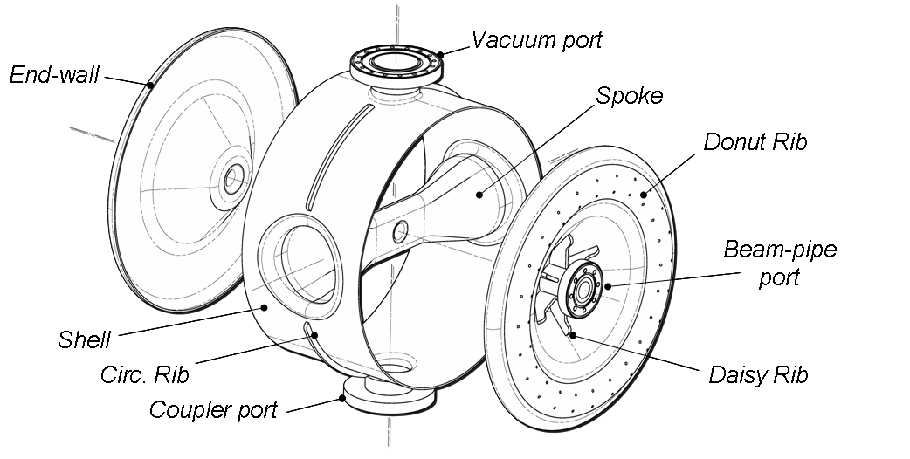
RF design of SSR1
Quantity | Value
Operating temperature | 4.4 K
Accelerating gradient, E_{acc} | 10 MV/m
Q₀ at accelerating gradient | > 0.5x10⁹
Beam pipe, Shell ID | 30 mm, 492 mm
Lorenz force detuning coefficient | 3.8 Hz/(MV/m)² (with He vessel)
E_{peak}/E_{acc} * | 2.56
B_{peak}/E_{acc} * | 3.87 mT/(MV/m)
G | 84 Ω
R/Q₀ | 242 Ω
Geometrical Beta, β_{g} | 0.21
SSR1-02,
the 2nd SSR1 prototype.
Fabricated
by Roark.
* Minimizing these ratios was a design goal.

Slide 5
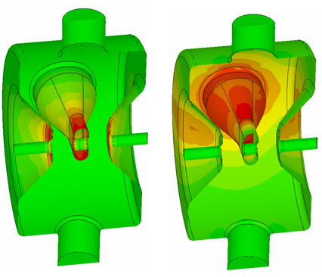
RF design of SSR1
The above dimensions were varied in MWS to optimize the RF design.
E_{acc} = Total accelerating voltage divided by L_{eff} = L_{iris} = (2/3)βλ = 135 mm
Surface electric (left) and magnetic (right) fields in SSR1.
The field strength increases as the color changes from green to yellow to red.

Slide 6
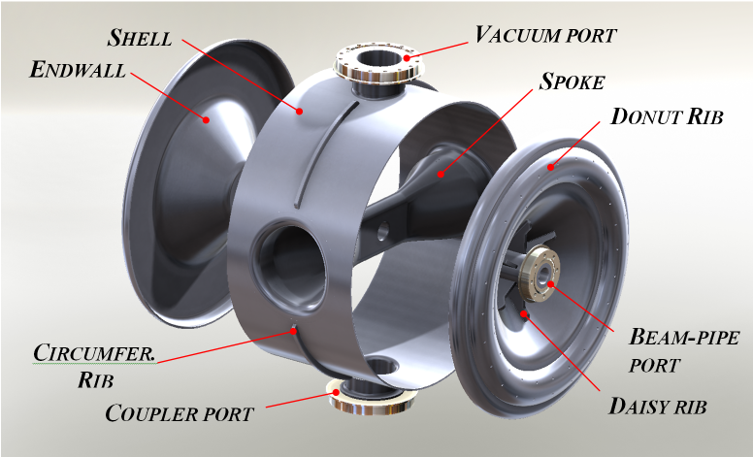
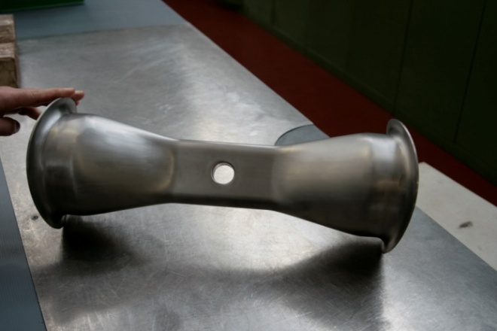
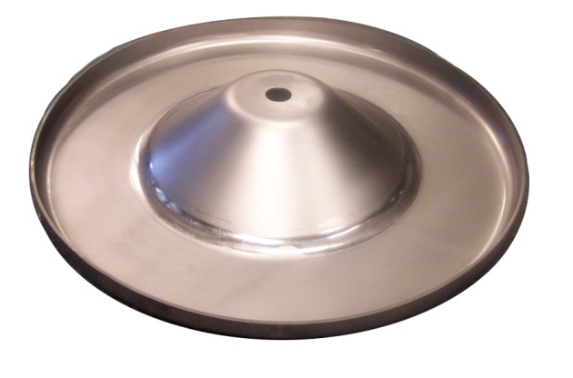
Fabrication of prototypes at Zanon and Roark
Spoke deep drawn in halves then e-beam welded.
Roark: endwall deep drawn in one piece. Zanon: two pieces, welded
Port holes in shell formed with branch puller.
Zanon ground interior (RF side) welds smooth, while Roark finished them with a cosmetic pass.
Trimmed shell length in steps to reach warm tune within ~100 kHz.
Both vendors achieved cell to cell field flatness of better than 1%.

Slide 7
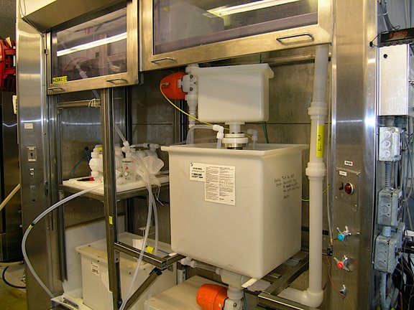
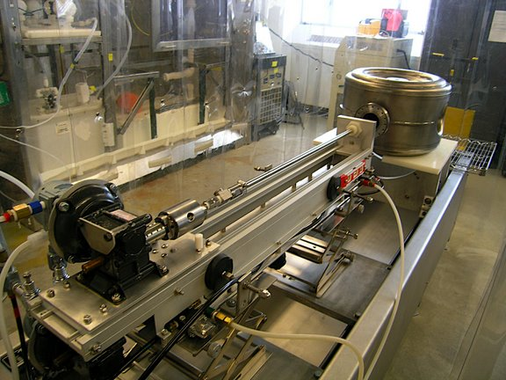
Chemistry and HPR of unjacketed cavities at ANL G150
BCP: two 80 minute sessions
  Between sessions, flip top to bottom and replace acid.
Remove 120 microns at 15-16°C
HPR: 6 ultra-pure water jets, two each at +40°, 90°, and -40°
2 hrs water time with cavity in 8 different orientations.

Slide 8
CW tests of unjacketed
SSR1-01 in the VTS
For the first cool down of SSR1-01, Q₀ was measured as a function of temperature, T, as T was lowered from 4 K to 2 K at E_{acc} = 2 MV/m.
This data was used to obtain the surface resistance, R_{S}(T) = R₀ + R_{BCS}(T), and a fit residual resistance of R₀ = 5.1 nΩ.
The reduction of helium bath pressure with T was used to map the pressure dependence of the cavity’s resonant frequency (discussed later in the talk).
Not shown is Q₀ .vs. E_{acc} , which was stopped at 6 MV/m due to multipacting (we were likely “impatient”). The Q₀ level was quite flat out to 5 MV/m.

Slide 9
CW tests of unjacketed
SSR1-01 and SSR1-02 in the VTS
SSR1-01: Q₀ vs. E_{acc} at 2.0 K and 4.4 K from the fourth cold test.
During cool down, a 7 hr hold at 100 K produced a large Q₀ drop, confirming Q disease.
Subsequently baked SSR1-01 at 600 C for 10 hours at Jlab.
SSR1-02: Q₀ vs. E_{acc} from the first cold test of SSR1-02.
Effects of Q disease should not appear on first cooldown.
X-rays increase at MP barriers, then disappear after punch through.

Slide 10
Tuning issues for SSR1 operation in HINS
Typical HINS or Pulsed Project X operation
  Pulses of ~1 ms, 5 Hz, 9 mA
  SSR1 Q_{L}: 8.4x10⁵
  SSR1 loaded bandwidth: 388 Hz
  LHe at 4.4 K (p ~ 900 torr)
  Tune variation due to LHe pressure regulation (with helium vessel):
    ± (465 to 930) Hz for dp = ± (.25 to .5) psi [± (12.9 to 25.8 torr)]
    Slow variation: minutes to hours
  Lorentz Force Detuning (LFD) at 10 MV/m (with helium vessel):
    3.8 Hz/(MV/m )² x 10 MV/m = 380 Hz
    Response on the order of pulse rise time (100 microsecond).
  Correct for both pressure variations and LFD with piezoelectric actuators (“fast tuner”) pushing near the beampipe, where the tune is sensitive due to high E. The “slow tuner” will act at the same location.

Slide 11
Helium vessel with prototype slow and fast tuner
Two piezo actuators “in series” with slow tuner arms (pivot with 5:1 mech. advantage).
Stepping motor with harmonic drive,1:100 ratio (0.9 Hz/step).
Presently plan to have a tuner on each end.
Low profile along beam required due to close proximity to solenoid.
SSR1-01 inside 316L stainless steel (SS) helium vessel with tuner.
Vessel TIG welded to SS flanges (brazed to niobium ports).
Fabricated according to ASME pressure vessel code.
Bellows between endwall and collar welded to beampipe flange.

Slide 12
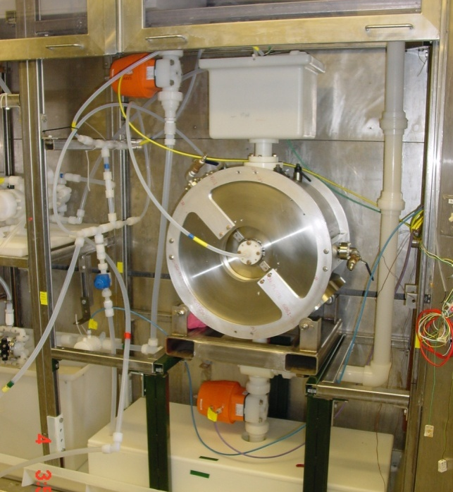
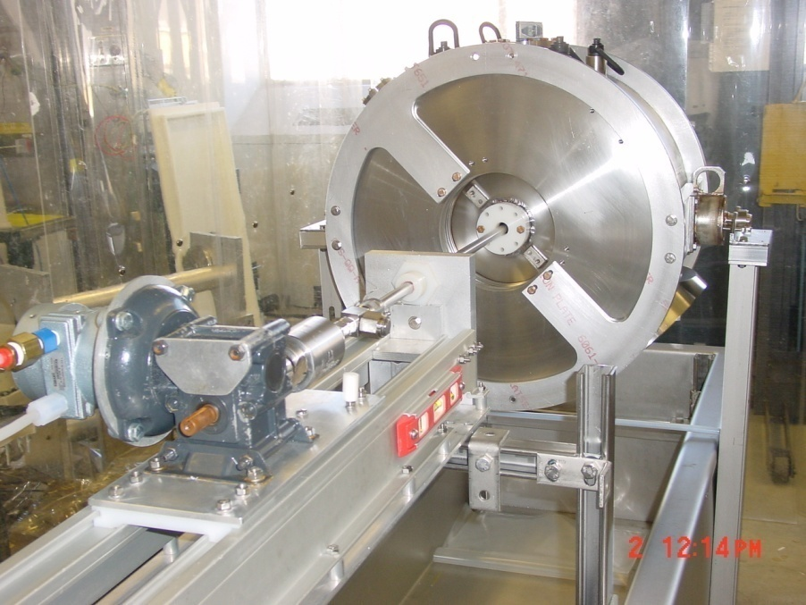
After VTS CW tests, prepare SSR1-01 for CW and Pulsed tests of jacketed cavity
10 hr, 600 ° C vacuum bake for hydrogen degassing at Jlab (Thanks Jlab).
Adjust cavity tune at room temperature: fixture to inelastically stretch or compress at beam pipes (capable of ± 250 kHz).
Weld on the helium vessel: argon purge and temperature and frequency monitoring.
Degreasing, flash BCP and HPR (completed 11-10-09).

Slide 13
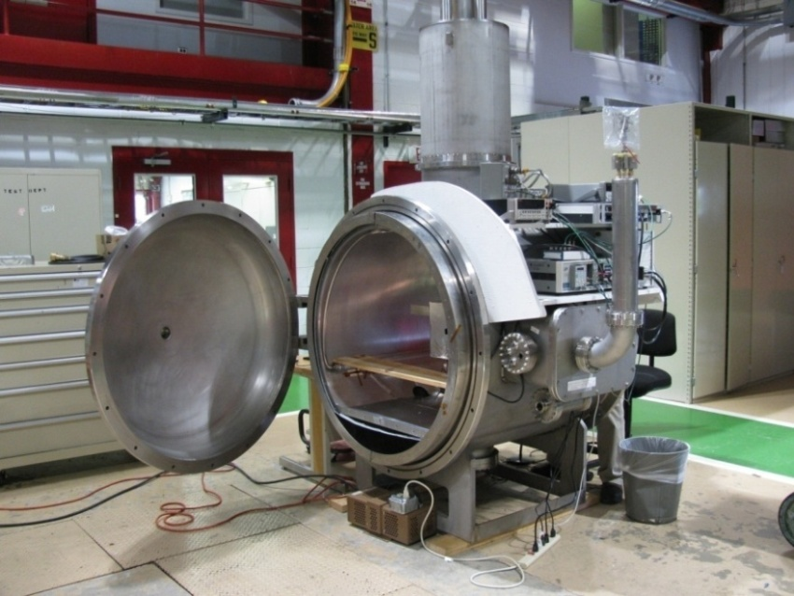
Power Coupler and Superconducting Spoke Cavity Test Facility(SSCTF)
The input coupler is a 50 ohm coaxial design.
Two ceramic windows, one warm, one cold.
Two tested prototypes: average power of 4.2 kW (2 Hz, 3 ms, 700 kW) for two hours.
The cryostat is ready for installation into the SSCTF cave.
200 W solid state supply for CW tests.
2.5 MW Klystron operational for pulsed tests.
The LLRF and 4.4 K cryogenics should be ready for CW and Pulsed tests of the jacketed SSR1-01 in January.

Slide 14
Upcoming SSR1 activities
CW measurements of jacketed SSR1-01 with fixed power input antenna.
  Q₀ .vs. E_{acc}, LFD coefficient, pressure sensitivity, Q disease cured?, operate slow turner, compensate for pressure variations with fast tuner.
Pulsed measurements of jacketed SSR1-01 with Power Coupler.
  Punch through multipacting barriers easily?, Measure LFD, compensate for LFD with fast tuner.
Two more SSR1 prototypes from IUAC (India) should be completed soon.
All niobium sheets are in house for the production SSR1 cavities. QC inspections are in progress.
Placing an order with Roark for 10 more cavities.

Slide 15
Issues in re-using cavities in CW Project X.
SSR1 and power coupler designs are fine for 1 ma CW operation of SSR1.
4.4 K (900 torr) Pulsed (1 ms, 5 Hz, 9 mA) → 2 K (20 torr) CW (1 ma)
  SSR1 Q₀ : ~1x10⁹ → ~1x10¹⁰ (cryo power bill reduced)
  SSR1 loaded Bandwidth: ~388 Hz → ~43 Hz
  dp: ±(.25 - .5)psi [±(12.9 - 25.8)torr] → ±(0.005 - .01)psi [±(.25 to .5)torr]
  Tune variation due to dp: ±(465 - 930)Hz → ±(9 to 18)Hz
  LFD: ~380 Hz → Not an issue.
If we just cool down and seat the tuners in the same way, the tune would be off by ~340 kHz.
  Beyond the range of our present slow tuning.
  Tune off in the direction where not much more room-temperature inelastic tuning is possible (if you remove the cavities from the cryomodule).
  May have to anneal the niobium to do further tune adjustment.
  Needs further study.

