Slide 1
Additional Topics for LHC
R. Assmann and F. Schmidt, CERN
Tevatron Accelerator Studies Workshop
Fermilab
13-14.01.2010

Slide 2
First LHC Beam Experience
After long wait time, finally we got an excellent first beam commissioning with LHC, November – December 2009.
Here to represent LHC accelerator physics and LHC machine coordination (in addition to collimation role).
See beam commissioning page:
http://www.cern.ch/lhc-commissioning/news/LHC-news.htm
Summary talk S. Myers for first beam measurements:
http://indico.cern.ch/conferenceDisplay.py?confId=76398
Detailed review of first beam experience and commissioning plan for 2010 next week in Evian (LHC Beam Commissioning Workshop):
http://indico.cern.ch/conferenceDisplay.py?confId=76921
Here just a few slides for your entertainment (courtesy of LHC team)…

Slide 3
Milestones 2009 LHC Beam Commissioning
Date | Day | Achieved
Nov 20 | 1 | Each beam circulating. Key beam instrumentation working.
Nov 23 | 4 | First collisions at 450 GeV. First ramp (reached 560 GeV).
Nov 26 | 7 | Magnetic cycling established (reproducibility).
Nov 27 | 8 | Energy matching.
Nov 29 | 10 | Ramp to 1.18 TeV.
Nov 30 | 11 | Experiment solenoids on.
Dec 04 | 15 | Aperture measurement campaign finished. LHCb and ALICE dipoles on.
Dec 05 | 16 | Machine protection (Injection, Beam dump, Collimators) ready for safe operation with pilots.
Dec 06 | 17 | First collisions with STABLE BEAMS, 4 on 4 pilots at 450 GeV, rates around 1Hz.
Dec 08 | 19 | Ramp colliding bunches to 1.18 TeV
Dec 11 | 22 | Collisions with STABLE BEAMS, 4 on 4 at 450 GeV, > 10¹⁰ per bunch, rates around 10Hz.
Dec 13 | 24 | Ramp 2 bunches per beam to 1.18 TeV. Collisions for 90mins.
Dec 14 | 25 | Collisions with STABLE BEAMS, 16 on 16 at 450 GeV, > 10¹⁰ per bunch, rates around 50Hz.
Dec 16 | 27 | Ramp 4 on 4 to 1.18 TeV. Squeeze to 7 m.
LHC Beam
Commissioning
Team

Slide 4
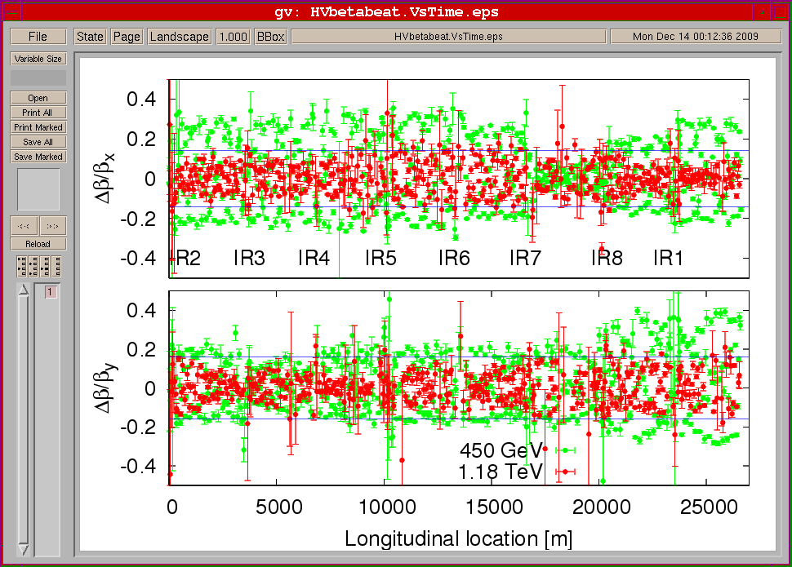
Beta-beat: 450 GeV and 1.18 TeV
LHC Beam
Commissioning
Team

Slide 5
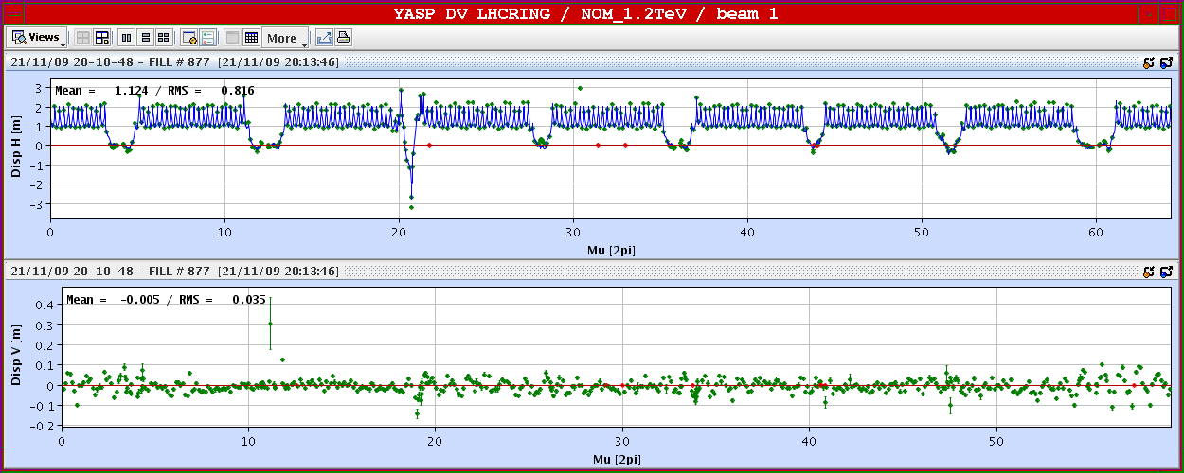
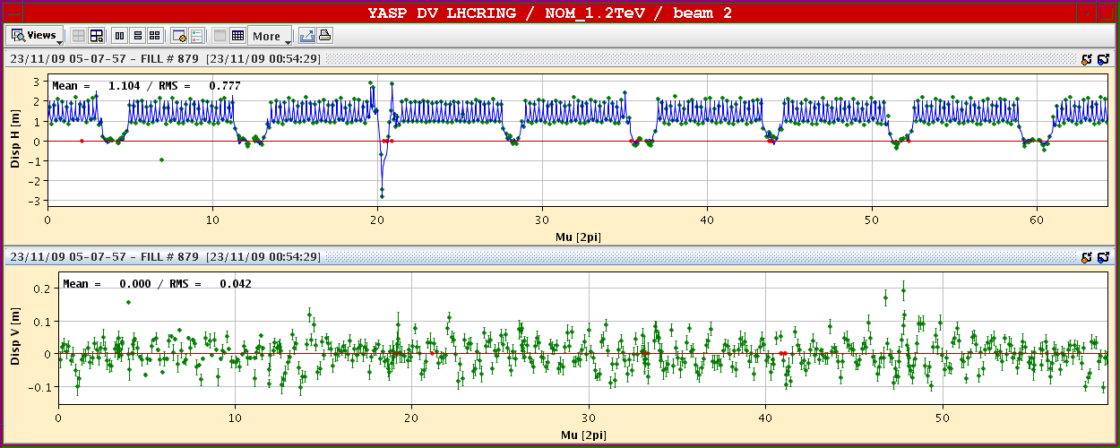
Dispersion
LHC Beam
Commissioning
Team

Slide 6
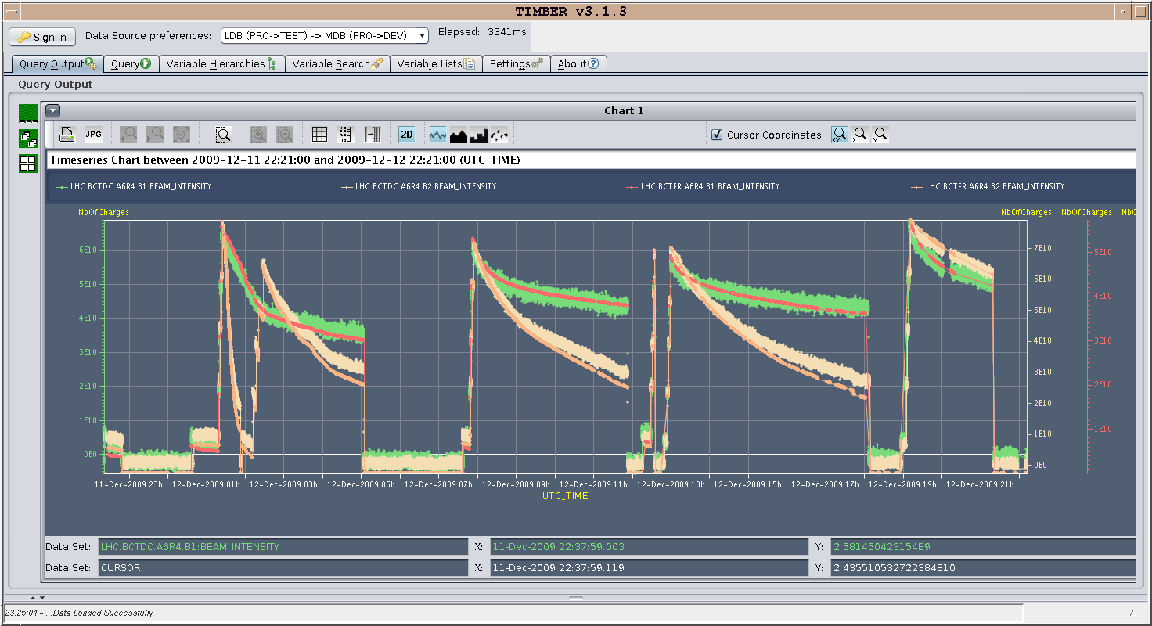
13.12.2009: 24 hours running - currents
LHC Beam
Commissioning
Team

Slide 7
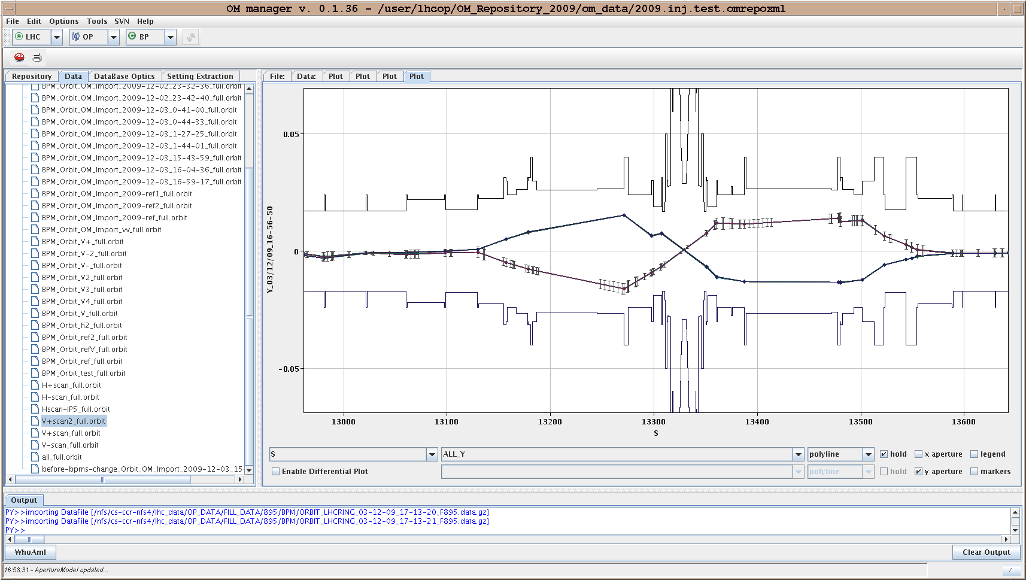
CMS Aperture (vertical)
LHC Beam
Commissioning
Team

Slide 8
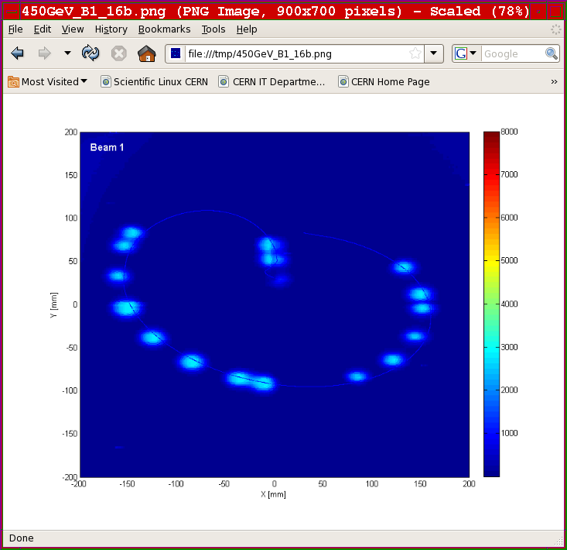
Beam Dump with 16 Bunches
LHC Beam
Commissioning
Team

Slide 9
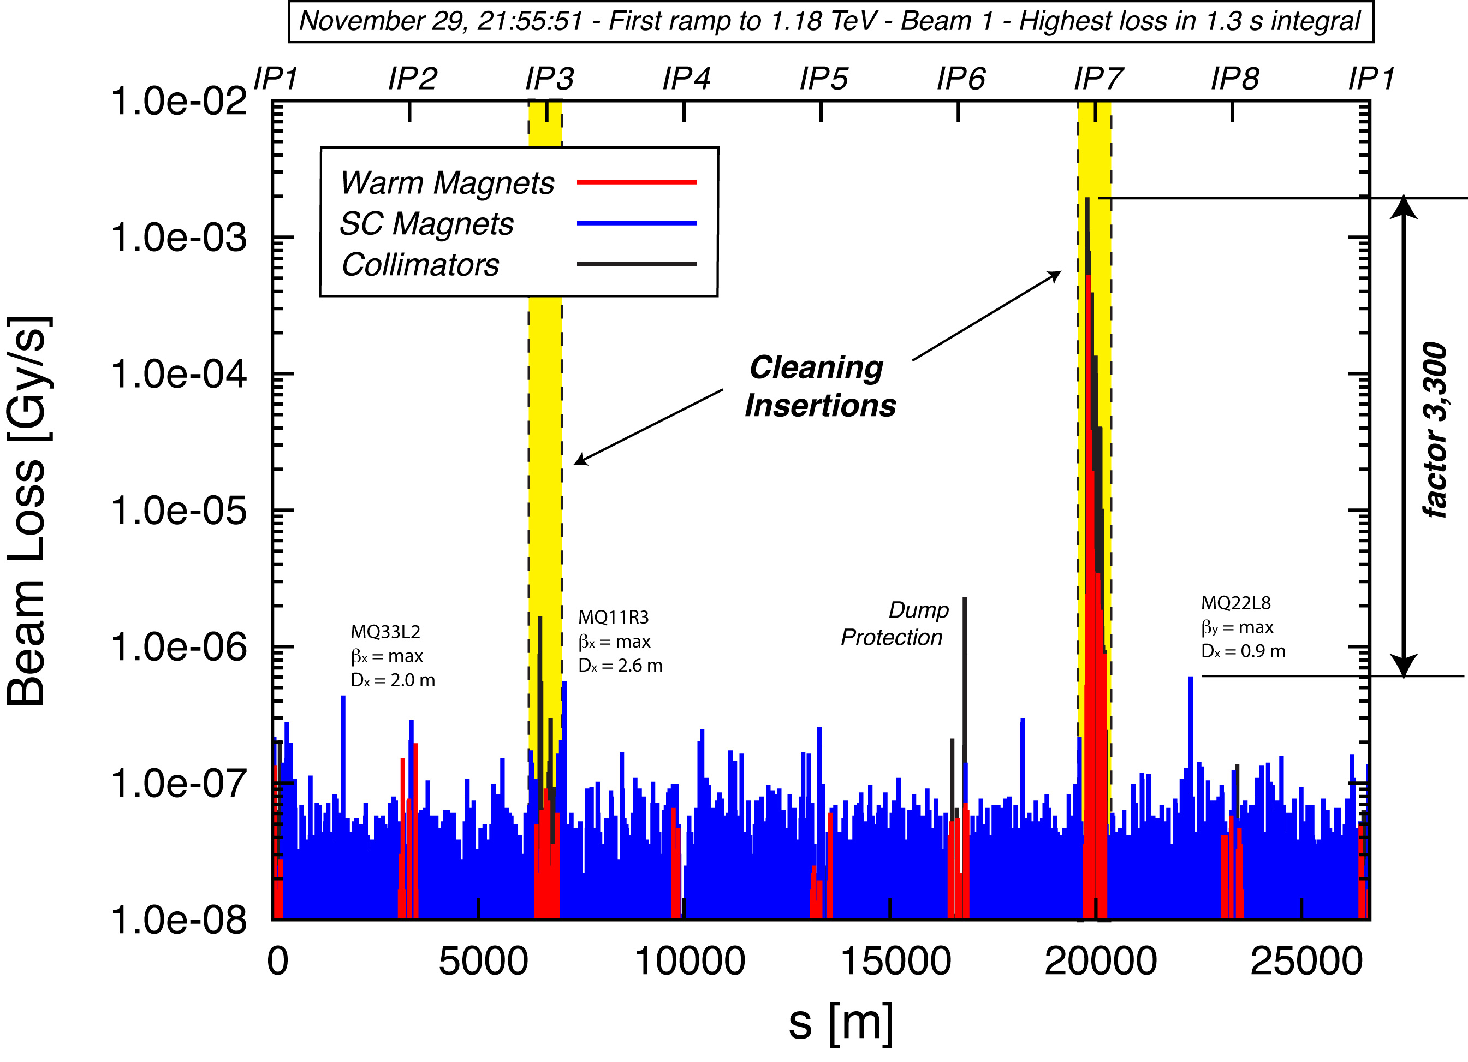
LHC Collimation Performance (Phase I System)
LHC Beam
Commissioning
Team

Slide 10
For Fun: Movie of Losses During First Ramp
LHC Beam
Commissioning
Team

Slide 11
Ramp 2 on 2 to 1.18 TeV: ~no Losses
LHC Beam
Commissioning
Team

Slide 12
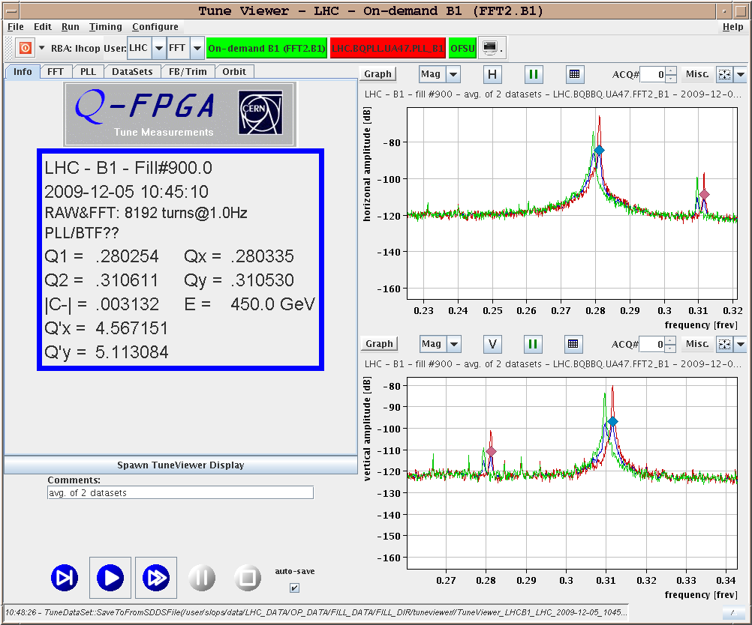
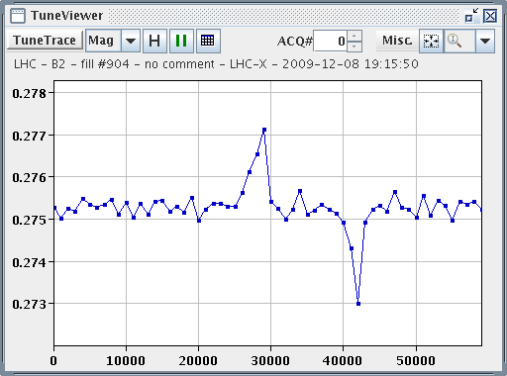
Q Q’ C and Q loop
LHC Beam
Commissioning
Team

Slide 13
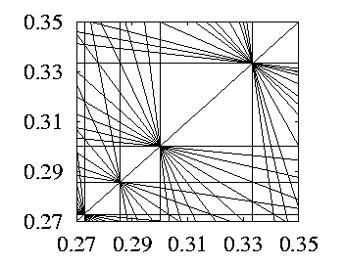
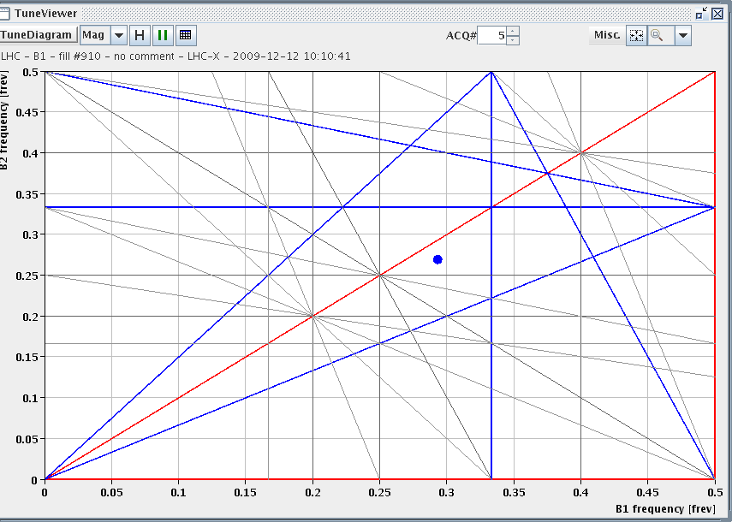
13.12.2009: Tune Adjustments for Beam2
B1: Q_{x} = 0.293, Q_{y} = 0.269; lifetime = 26h B2: Q_{x} = 0.297, Q_{y} = 0.267; lifetime = 5h
B1: Q_{x} = 0.293, Q_{y} = 0.269; lifetime = 25h B2: Q_{x} = 0.312, Q_{y} = 0.305; lifetime = 12h
1/3
3/10
3/11
2/7
LHC Beam
Commissioning
Team

Slide 14
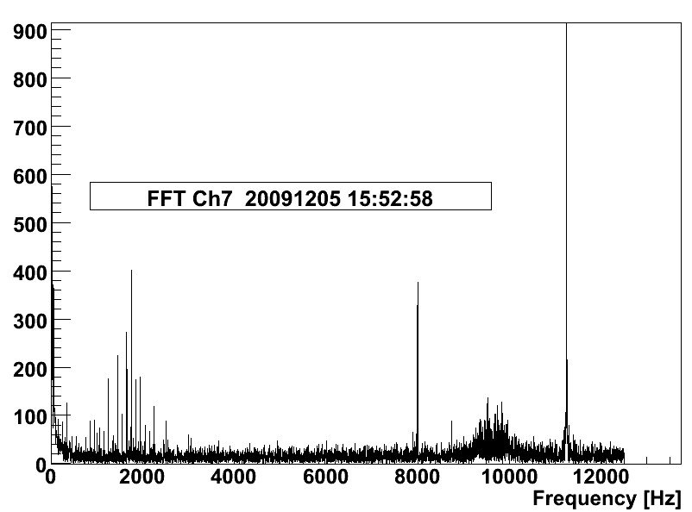
BLM freq spectrum for loss at collimator
LHC Beam
Commissioning
Team

Slide 15
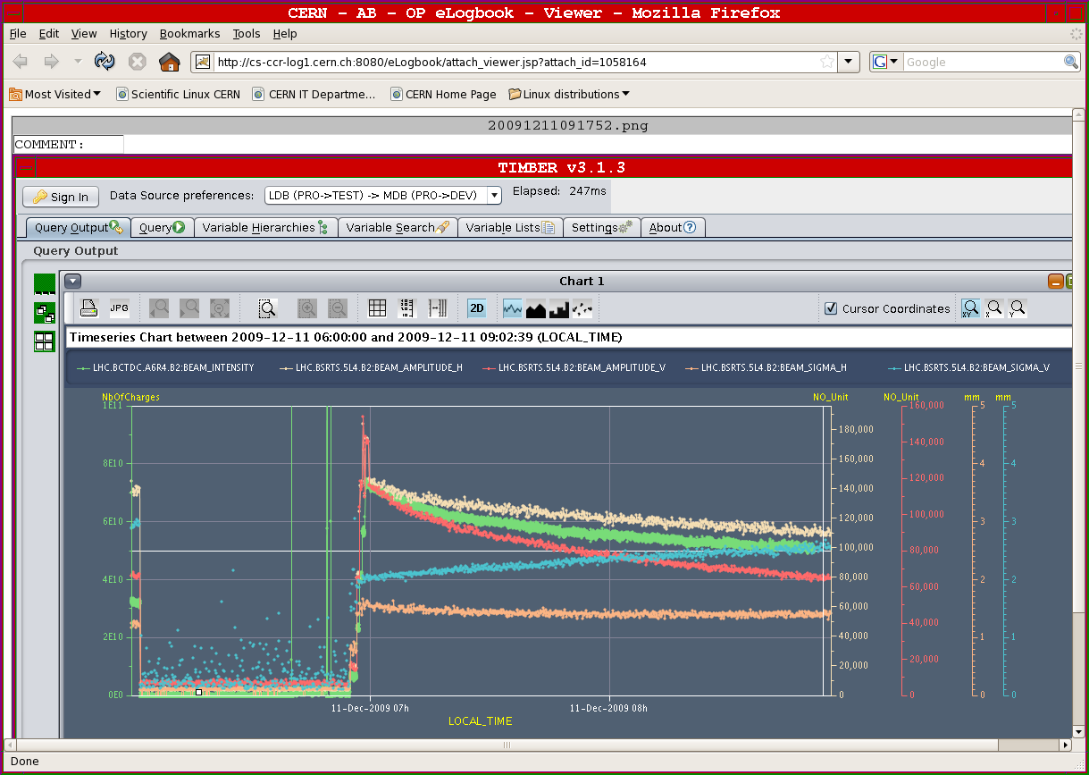
Vertical blow up beam 2 (low lifetime)
LHC Beam
Commissioning
Team

Slide 16
Focusing back on Tevatron…
Could continue for many more slides…
Not the goal of this presentation!
Sorry, if you are interested and also apologies to the CERN colleagues whose work was not shown.
Please refer to references given before, if you are interested! Watch Evian workshop on LHC beam commissioning next week:
http://indico.cern.ch/conferenceDisplay.py?confId=76921
Now, let’s focus back on Tevatron…

Slide 17
Why tests for LHC at TEVATRON?
Even as LHC is now available: LHC is not a test bed and machine development time in LHC must be limited.
Many CERN beam tests for LHC being done at SPS. However, SPS not very close to LHC: Tevatron much better.
Tevatron: low diffusion beams, super-conducting magnets, collisions and beam-beam effects. All not in SPS!
Strong CERN interest:
Use Tevatron for developing anc advancing generic R&D (crystal collimation, hollow e-beam lens, e-beam lens BB compensator, …) that can then later be used in LHC.
Tests with limited risk could be done with last Tevatron beam.
Still must realize limitations:
Difference in beam parameters, machine layout, hardware etc…
Require case-by-case analysis if Tevatron experiments are efficient for addressing LHC problems.

Slide 18
General Remarks
We are collaborating on some topics between CERN and Fermilab. Our support for these studies is a priori clear.
For additional tests:
Do not expect that we already bring a list of CERN requests for Tevatron beam time. Some preliminary ideas later…
Were are here at the moment mainly as observers, to understand possibilities and boundary conditions.
This meeting was already very useful for us to get more detailed information on the scope of this.
Take our remarks as preliminary comments and ideas.
We will go back to CERN and discuss there. List of CERN requests for mid-spring 2010. Update with 2010 beam experience in autumn 2010.
Total period of ~1-2 weeks of Tevatron beam for CERN?

Slide 19
Comments on Already Proposed Experiments
Very impressive and important list presented by you.
Can only reconfirm CERN/LHC support for several discussed topics (not exclusive, not in order of priority):
Beam-beam compensation, head-on and LR (if possible).
Studies for luminosity leveling (dynamic beta squeeze).
Flat bunch scheme, if possible.
Collimation efficiency improvement with bent crystals.
Indestructible beam scraper with hollow e-beam lens ➔ only LHC scraper solution pursued at the moment.
Fits well the goal to develop longer term innovative solutions for the LHC and its performance upgrades!
Priorities will depend on lessons learnt and issues from first LHC run.

Slide 20
Additional CERN Studies
Transverse resistive impedance from collimators: measure tune shift versus collimator position. (2 shifts)
Studying BB resonances using the AC dipole. (3 shifts)
Generate harmonic transverse perturbation in collision and measure emittance growth for a given frequency. (2 shifts)
IBS benchmarking. Measure emittance growth versus time for various intensities. (3 shifts)
Cross a resonance to split the beam and then study the beam-beam interaction between a split and an unsplit beam or two split beams. (3 shifts)
Measure equilibrium beam distribution by full scraping for reference comparison with LHC (low Tevatron intensity). (2 shifts)
Test cryogenic beam loss monitors. (done during scraping)
Backup ideas:
Installing the KEK crab cavity in the Tevatron if not approved the SPS.

Slide 21
AC Dipole Simulations (R. Miyamoto)

Slide 22
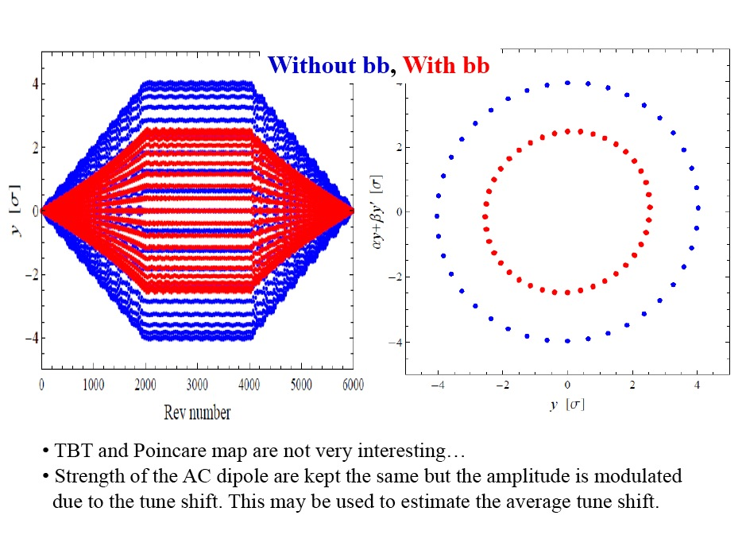

Slide 23
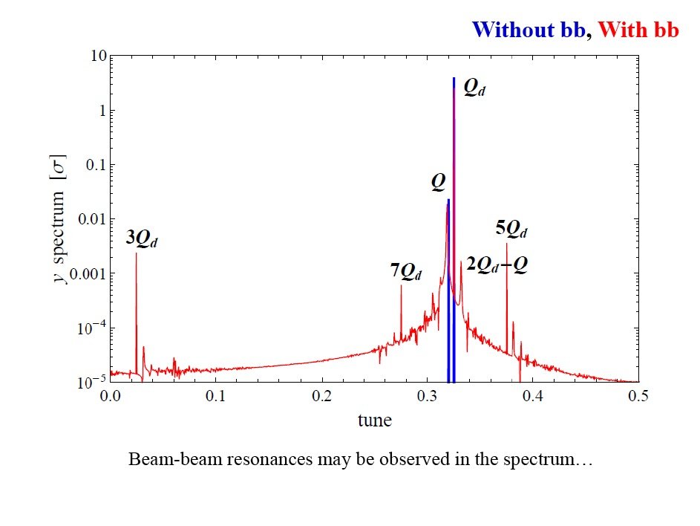

Slide 24
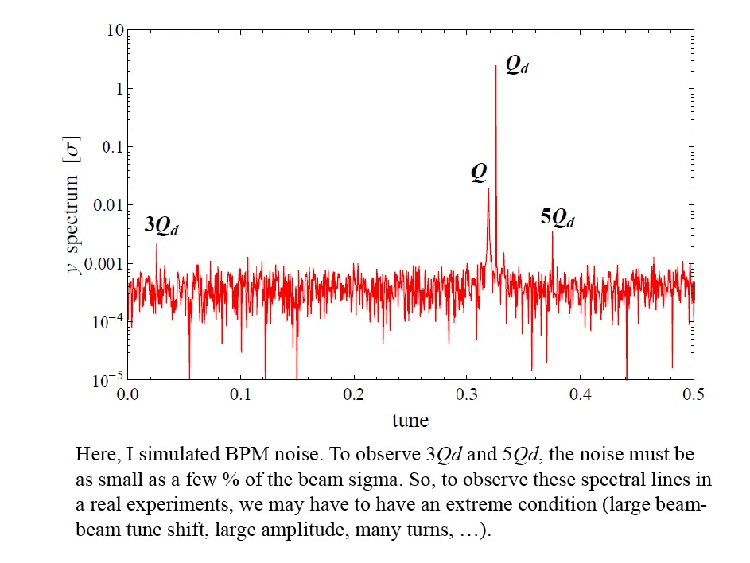

Slide 25
AC Dipole Study

