Slide 1
Studies of Flat Bunches in the Tevatron
Chandra Bhat
Fermilab (LARP)
Tevatron Accelerator Studies Workshop
January 13-14, 2010
Fermilab
Collaborators: C. Bhat, H-J. Kim, F.-J. Ostiguy, T. Sen, …

Slide 2
Outline
Background
Recent Beam Studies on Flat bunches
Proposal:
Study Flat bunch beam in the Tevatron
Theoretical Studies of Flat Bunches
Summary
Bunches with
Uniform Line-charge
Distribution

Slide 3
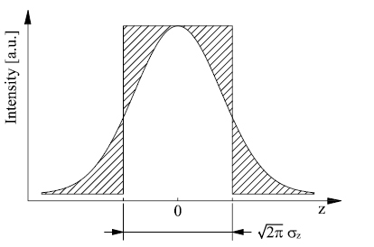
Motivation
There is on an going program at the LHC to upgrade the luminosity from its design value 1x10³⁴ cm⁻²sec⁻¹ to 1x10³⁵ cm⁻²sec⁻¹.This poses daunting challenges. It is, therefore, necessary to explore seriously all of the viable options.
The Large Piwinski angle or “Flat Bunch scheme” has the potential to yield 40% higher luminosity than Gaussian bunches for the same bunch intensity and the total beam-beam tune shift if the flat-bunch line intensity is kept the same as level as the Gaussian peak intensity.
(F. Ruggiero and F. Zimmermann (PRST-AB-Vol. 5, 061001 (2002)
The Piwinski angle φ, is given by,
Therefore by flattening the bunch and with an increase in bunch intensity one can reach the ultimate luminosity at LHC.
θ_{c} is crossing angle
σ_{z} is RMS bunch length
σ_{x} is RMS transverse size
Hence the interest in flat bunches !
Tevatron Accel. Studies Workshop, Jan. 13-14, 2010, Chandra Bhat

Slide 4
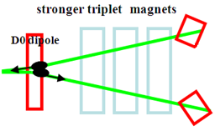
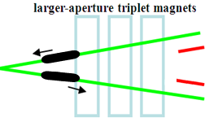
LHC upgrade paths with L≥ 10³⁵ cm⁻²sec⁻¹
(F. Zimmermann, CARE-HHH Workshop, 2008)
Full Crab Crossing (FCC)
L. Evans,
W. Scandale,
F. Zimmermann
I=1.7E11ppb
# of Bunch=2808
Bunch Spacing=25ns
β*~10 cm
Small-Angle
Crab Cavity
crab cavities with 60% higher voltage
→ first hadron crab cavities, off-δ β-beat ε⊥=3.75μm
Large Piwinski Angle (LPA)
F. Ruggiero, W. Scandale.
F. Zimmermann
I~6E11ppb
# of Bunch=1404
Bunch Spacing=50ns
β*~25 cm
Wire
Compensator
~4 time more beam/bunch!
long-range beam-beam wire compensation
→ novel operating regime for hadron colliders, beam generation
ε⊥=3.75 μm
Tevatron Accel. Studies Workshop, Jan. 13-14, 2010, Chandra Bhat

Slide 5
“Flat Bunches” Types and Generation
Flat Bunches come in two forms
ΔE
ΔE
Smaller ΔE
Larger ΔE
Δt
and
Δt
Δt
Δt
There are two distinct methods to create flat bunches
Barrier rf ← Like that in the Recycler
Resonant rf systems
Double, triple or multiple harmonic rf system
Longitudinal hollow bunches, Carli’s technique
Ideal one
Historically a lot of work has been done at CERN on beam in double harmonic systems. Currently, more studies are being carried out in the SPS by Elena Shaposhnikova & collaborators
It is very important to study the single and multi-bunch stability issues of beam in Double & Triple harmonic rf buckets.

Slide 6
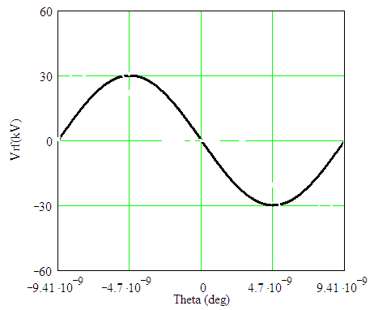
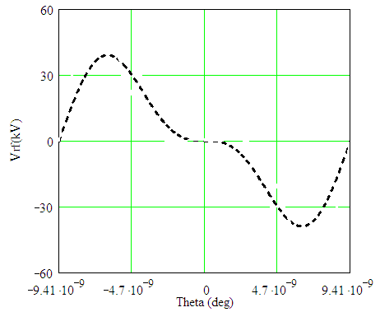
Flat Bunch with Double Harmonic RF waves (A simple schematic view of the concept)
Beam in
Single Harmonic RF wave
Beam in
Double Harmonic RF wave
Bucket Boundary
Bucket Boundary

Slide 7
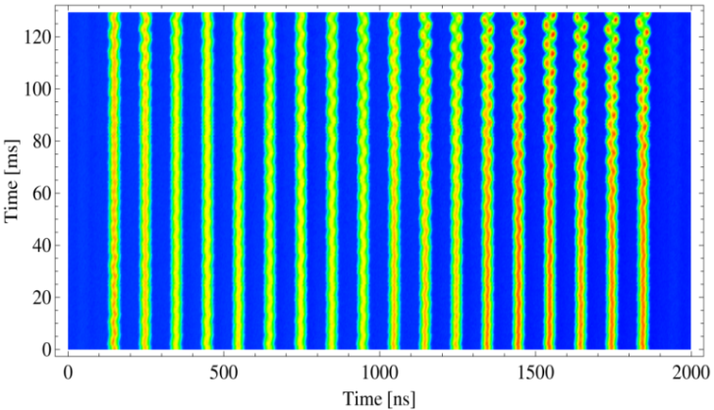
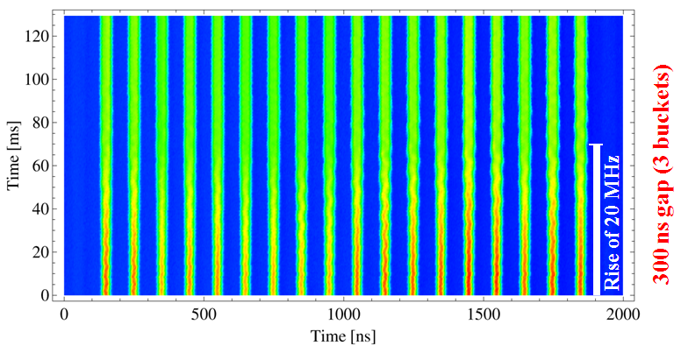
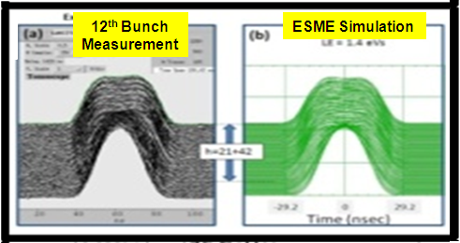
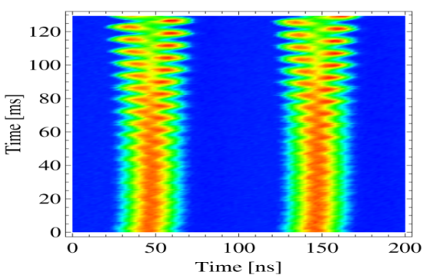
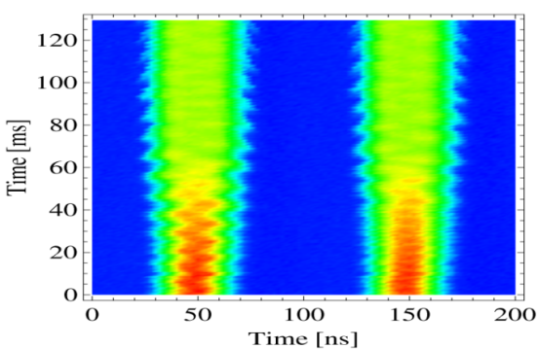
PS Studies at 26 GeV:
Stable Flat Bunches using Double-harmonic rf System
using LHC25
C. Bhat, H. Damerau, S. Hancock, E.Mahner, F.Caspers
10 MHz RF system only, 32 kV at h = 21
Vrf(h=21)=31kV and Vrf(h=42)=16 kV
h | Vrf
21 | 32kV
42 | 0
h | Vrf
21 | 32kV
42 | 16kV
Std.
Bunches
Flat
Bunches
h₂/h₁=2
V₂/V₁=0.5
LE(4σ)= 1.45 eVs I=840E10/batch
Bunches in single harmonic RF
Bunches in Double harmonic RF
Last two bunches
h = 21
h = 21+42
Conclusions
Beam in h=21 showed coupled bunch oscillations
Beam in DOUBLE HARMONIC rf became stable (~for 120 ms)
C. M. Bhat, et. al.,
PAC2009

Slide 8
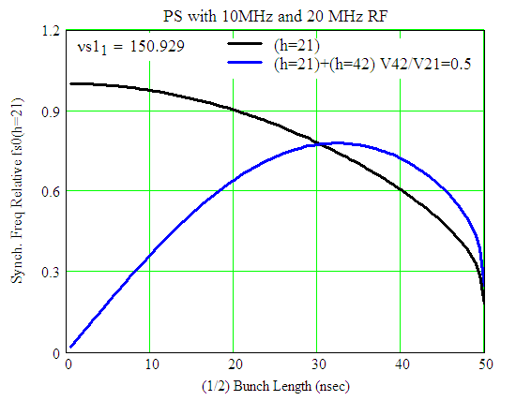
Beam Stability Criterion in the Longitudinal Phase Space
Large synchrotron frequency spread improves the stability.
If
inside the bucket, then the particles in the vicinity of this region can become unstable against collective instabilities.
As the slope of the rf wave is reduced to zero at the bunch center, the bunch becomes longer and synchrotron frequency spread is greatly increased. This increases Landau damping against coupled bunch instabilities.
November 2008 Study
No Landau Damping
V. I. Balbekov (1987)
fsyn/fsyn(h=1@bunch length=0)
Stable Beam
July 09 Study
A. Hofmann & S. Myers, Proc. Of 11th Int. Conf. on HEA, ISR-Th-RF/80-26 (1980)
Tevatron Accel. Studies Workshop, Jan. 13-14, 2010, Chandra Bhat

Slide 9
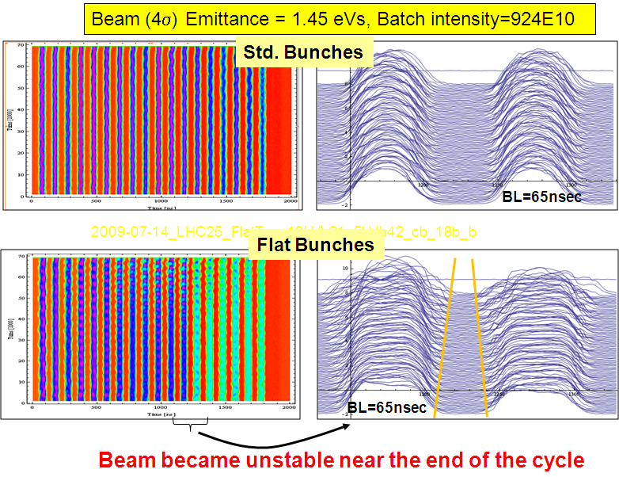
Examples from the July 09 Studies A first look
h | Vrf
21 | 10kV
42 | 0kV
h | Vrf
21 | 10kV
42 | 5kV
Some remarks on the PS studies:
PS is not a storage ring and all of its RF were tuned for standard operation.
Instability studies were carried out to a maximum duration of 140 ms.
Hence, it is important to carry out Flat Bunch studies in a storage ring.
Tevatron Accel. Studies Workshop, Jan. 13-14, 2010, Chandra Bhat

Slide 10
Flat bunch beam stability at the Tevatron at 150 GeV
Tevatron is an ideal place for the flat bunch studies
It is world’s best storage ring with many hours of beam lifetime. Well understood lattice.
Available RF: 53MHz. 106MHz and 159MHz rf systems can be added
Multiple bunches ← one can study a few bunches to 100s of bunches with 18 nsec bunch spacing.
Bunch intensity~6x10¹⁰ protons ← bit low but, that is fine
Have necessary diagnostics to monitor the beam dynamics both in longitudinal as well as transverse space
Wall Current Monitor for measurements on longitudinal profiles
Flying wire and ion profile monitors
Add OTR ←Alex Lumpkin is planning to add in the abort-line
to study transverse dynamics of flat bunches
Tevatron Accel. Studies Workshop, Jan. 13-14, 2010, Chandra Bhat

Slide 11
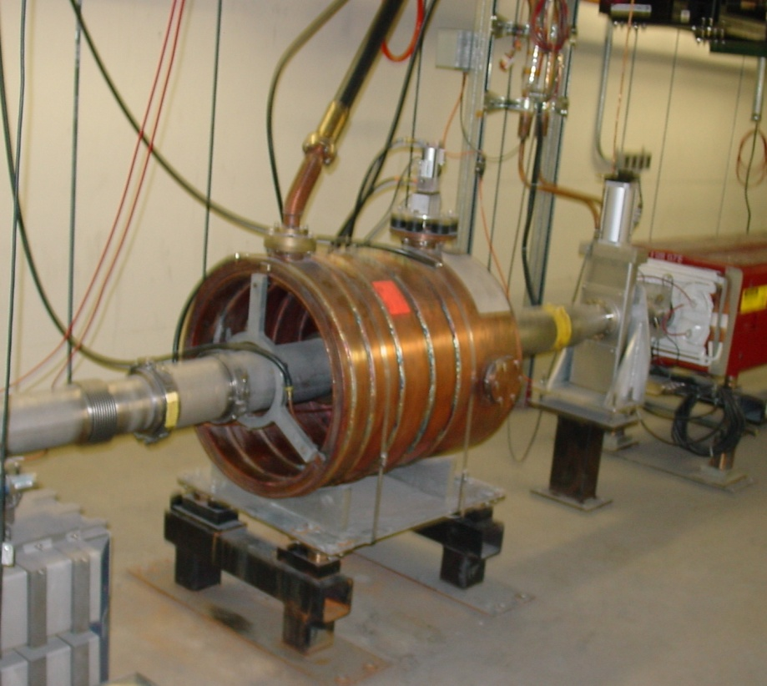
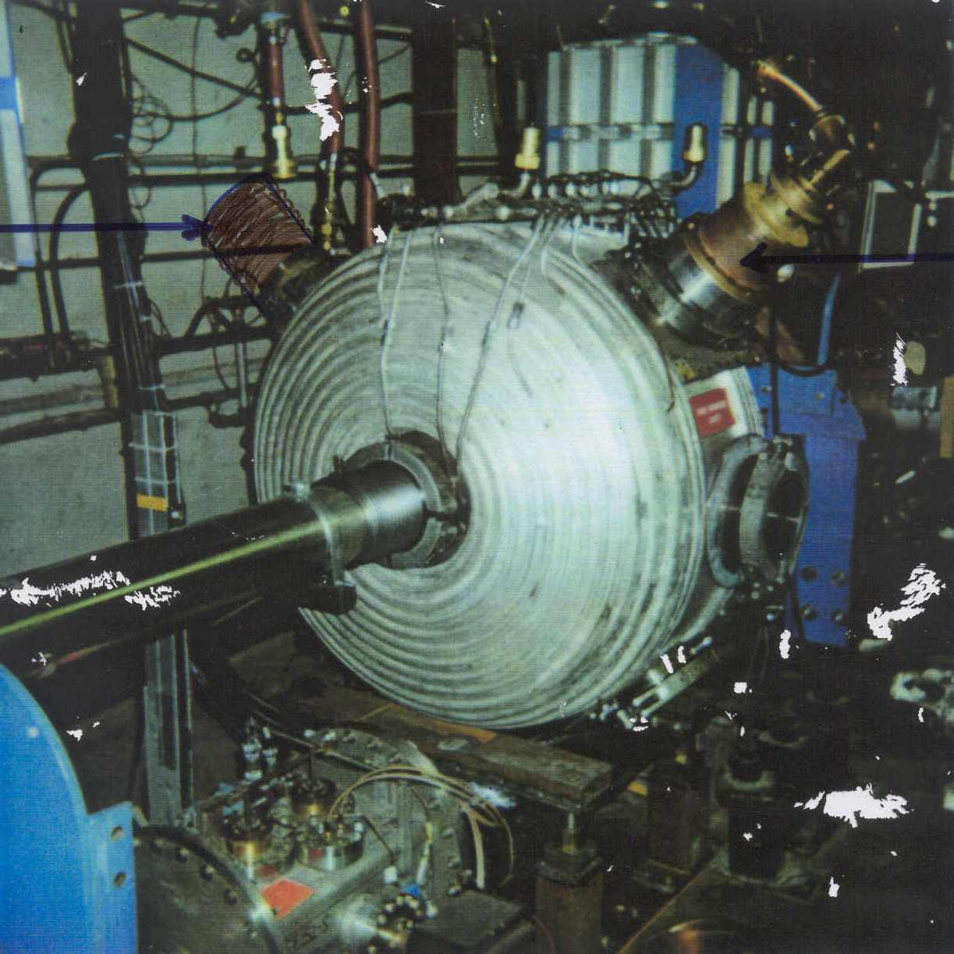
106 MHz and 159 MHz RF Cavities
106 MHz RF cavity in the MI
159 MHz RF cavity in the MR
Tunner
PA
Currently in the MI
Used during proton and pbar coalescing
Parameters:
Frequency= 106 MHz fixed, tuned at 150 GeV
Vrf = ~9kV (maximum of 16kV)
Need some repair on water cooling
Currently in MI60 building
Used for Focus-Free Tran. crossing studies
Parameters:
Frequency= 159 MHz, tunable
Vrf = up to 250kV

Slide 12
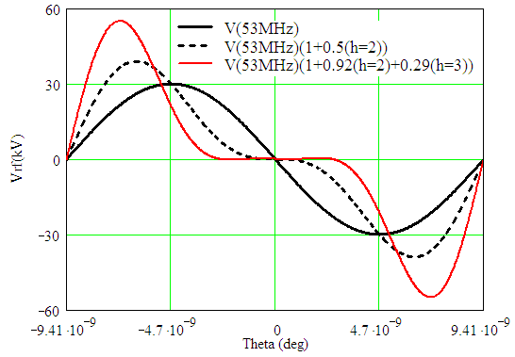
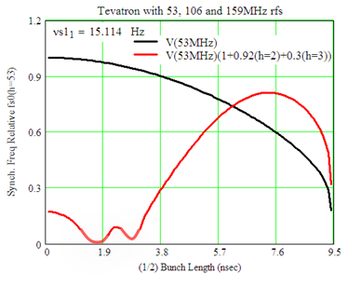
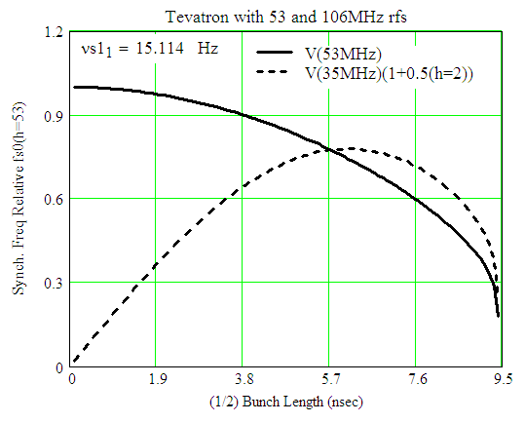
Tevatron Flat bunch Studies
Scenario-I
RF wave forms
Synchrotron Tune
No Landau
Damping
No Landau
Damping
0.1 eVs Bunch
0.1 eVs Bunch
V(53MHz)≤30kV
V(106MHz)≤15kV
V(159MHz)≤20kV
Stable Region
h=1+2+3
Stable Region
h=1+2
Beam Energy = 150 GeV
Beam Bunch Area ≈ 0.1 eVs (Beam from the Booster+a few% growth in the MI)
Available Bucket Area = 0.7 eVs (53MHz RF wave)
= 0.57 eVs (53MHz+106MHz RF waves)
= 0.47 eVs (53MHz+106MHz+159MHz RF waves)
Limits the available Bucket Area

Slide 13
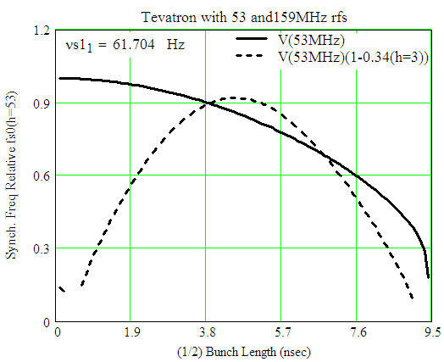
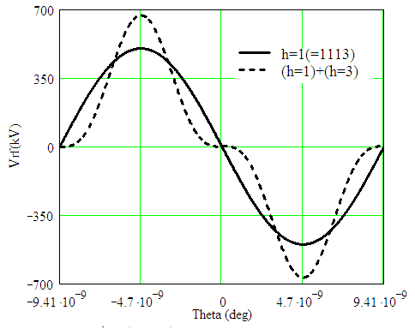
Tevatron Flat bunch Studies
Scenario-II
RF wave forms
Synchrotron Tune
No Landau
Damping
0.1 eVs
Bunch
V(53MHz)≤700kV
V(159MHz)≤250kV
Stable Region
h=1+3
Beam Energy = 150 GeV
Beam Bunch Area ≈ 0.1 eVs (Beam from the Booster+a few% growth in the MI)
Available Bucket Area = 2.98 eVs (53MHz RF wave)
= 2.66 eVs (53MHz+159MHz RF waves)
This may be more favorable and need to phase only two RF systems

Slide 14
Proposal Theoretical Investigations of Flat Bunch Scenarios for the LHC Luminosity Upgrade C. Bhat, H-J. Kim, F.-J. Ostiguy, T. Sen
As a part of LARP program we have a

Slide 15
Issues for Theoretical Investigations
Proposing to do theoretical investigations on the following issues --
For creation of flat bunches, investigate the use of
multiple harmonic cavities (perhaps 2 to 3 harmonics) and
Specify
Optimal RF parameters
Beam intensity limits
Reevaluate impedance budget and constraints
If flat bunches are to be produced in one of the LHC upstream machines, explore beam instability issues for acceleration up to 7 TeV.
Single-bunch and multi-bunch instability issues.

Slide 16
Issues for Theoretical Investigations (cont.)
What are the optimal bunch and beam parameters for the LPA scheme with due consideration of the following
Integrated luminosity (i.e. luminosity and lifetime)
Emittance growth from beam-beam interactions, IBS
Instability growth rates
Beam loading compensation
Event pile-up: number, space and time resolution of events per bunch crossing
Beam losses
Investigate possible locations and effects due the cavities in the machine lattices.
A hybrid scheme that would allow the FCC scheme to benefit from some of the advantages of flat bunches. This would be worth exploring.
Lower peak intensity decreases the e-cloud effect and space-charge effects
Lower momentum spread
Possibly better event resolution (spatial and time) in the detectors

Slide 17
Acknowledgements
LARP
CERN
Frank Zimmermann
Elena Shaposhnikova
Steven Hancock
Gianluigi Arduini ← Inputs on beam instability in the LHC upstream accelerators.
Elias Metral, Giovanni Rumolo ← Accelerator operation issues
Jim MacLachlan ← Simulation issues
Oliver Brüning
Heiko Damerau
Thomas Bohl ← RF issues
Tevatron Accel. Studies Workshop, Jan. 13-14, 2010, Chandra Bhat

Slide 18
Summary
We propose to carry out flat bunch studies in the Tevatron using multiple harmonic rf systems
Tevatron is an ideal place for the flat bunch studies
It is world’s best high energy storage ring
Available RF for beam studies are : 53MHz, 106MHz and 159MHz rf systems
Double harmonic rf
Triple harmonic rf
Multiple bunches
Have necessary diagnostics to monitor both longitudinal as well as transverse dynamics
This effort will be the one of the most important contribution to the LHC luminosity upgrade using LPA scheme

Slide 19
Backup Slides

Slide 20
Existing Simulation Tools
ESME
This is a 2D code to study longitudinal beam dynamics in (ΔE, Δt)-phase space in synchrotrons. We will use it to address
Flat bunch creation and acceleration with single and
multiple harmonic rf systems,
Longitudinal single and multi-bunch instability
Beam loading issues.
Beam-beam code BBSIM
This code will be used to study the impact of beam-beam interactions on the emittance growth. Comparisons between a longitudinal Gaussian profile and a flat profile will be made for the LPA and for the FCC schemes.
Vlasov solver
This will be used to investigate long term beam stability and particle losses. Also, 1) extract spectral information and 2) help establish the optimal ratio of harmonic amplitudes and bunch length, in the presence of realistic impedances.

Slide 21
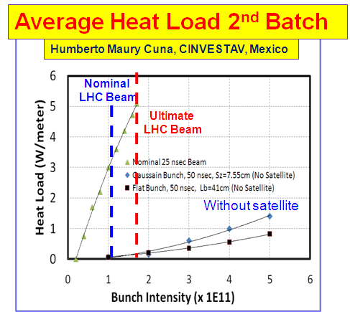
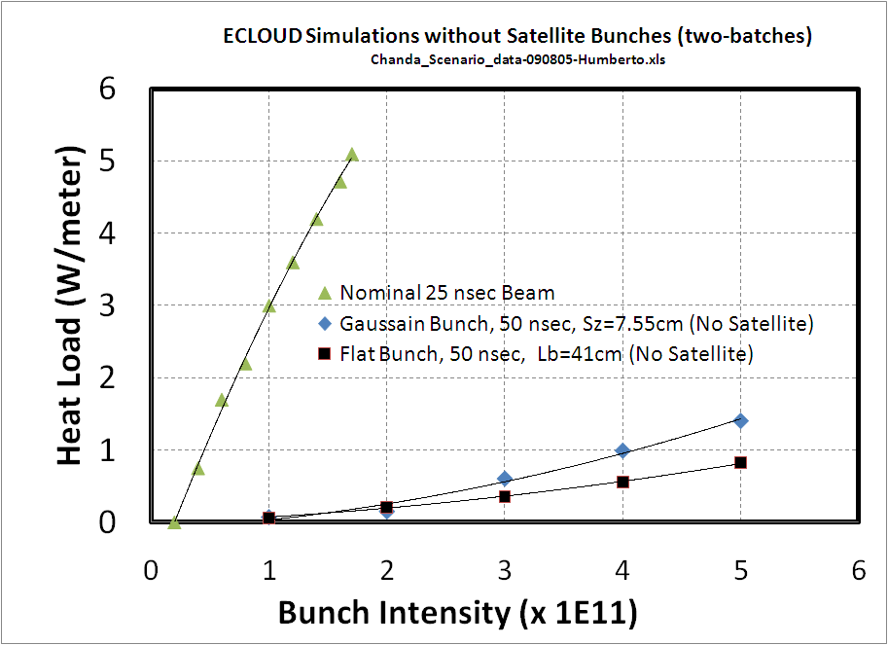
ECLOUD Simulations for Gaussian and Flat bunches
Average Heat Load 2nd Batch
Humberto Maury Cuna, CINVESTAV, Mexico
Frank Zimmermann (CERN) and Humberto Maury Cuna, (CINVESTAV, Mexico)
Nominal
LHC Beam
Ultimate
LHC Beam
Conclusions:
The estimated heat load from the e-cloud effects on LHC cryogenics with flat bunches is about two times smaller than that with Gaussian bunches at the same bunch int..
Without satellite
Without satellite →
50 nsec
Tevatron Accel. Studies Workshop, Jan. 13-14, 2010, Chandra Bhat

