Slide 1
ESCC Meeting Opening Notes
Phil DeMar
Winter 2010 JointTechs meeting
February 3, 2010

Slide 2
Logistics & Stuff
Wireless SSID: Marriott_Conference
Username: joint
Password techs
70 Registrants – A record!
Meeting Today & Tomorrow: Here…
Breaks & Thursday lunch in atrium directly outside
Focus session this evening; 6:30pm-8:30pm:
PerfSONAR deployment discussion(s)
Held in Ballroom 1
Free food; free food; free food…

Slide 3
ESCC Activities since last meeting
2009 customer satisfaction evaluations completed
Site Coordinators survey
Site-level (NLCIO) perspective of ESnet services
ESnet collaborative services upgrade survey completed
DNSsec deployment survey
Site feedback on implications for local IPv6 support

Slide 4
ESnet Satisfaction Survey(s) QA
ESCC-level survey:
Collection process: I distribute, then harass you…
14 responses: 10 OS Labs; 3 NNSA Labs; 1 OS partner Lab
CIO-level survey:
Collection process: NLCIO Chair distributes; I harass you; you nudge your CIO
13 responses: 7 OS Labs; 1 NNSA Lab; 4 OS partner Labs; 1 other
Improvements in the survey process?
Distribution process (particularly CIO-level survey)?
Time lines (5-10 work days)?
Other…

Slide 5
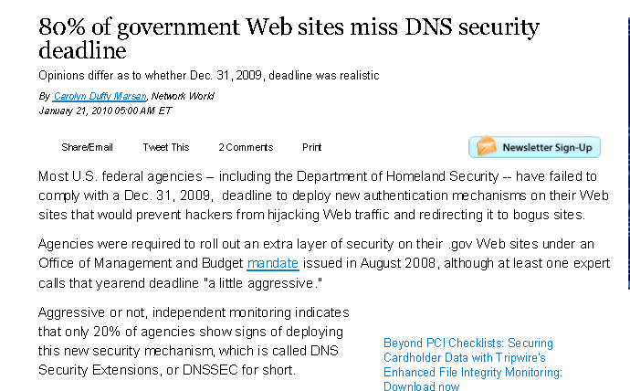
DNSsec deployment follow-on & QA…
ESCC role in site DNSsec planning:
DNSsec Deployment Guidelines document (July)
Deployment survey (October)
Technical forum / sharing planning & experiences
What happened?
What next?
QA:
what was useful?
what wasn’t?

Slide 6
Looking to the future…
Upcoming JointTechs program support:
Historically, ESCC provides a co-chair for each topic area
Salt Lake City: Scott Pinkerton, Brian Tierney, Dantong Yu
Summer 2010: looking for volunteers….
Next ESCC meeting focus session topic:
NAC?
Circuit deployment & support
End-to-end performance analysis
Other?
New National Lab liaison role in Internet2 – George Brett

