Slide 1
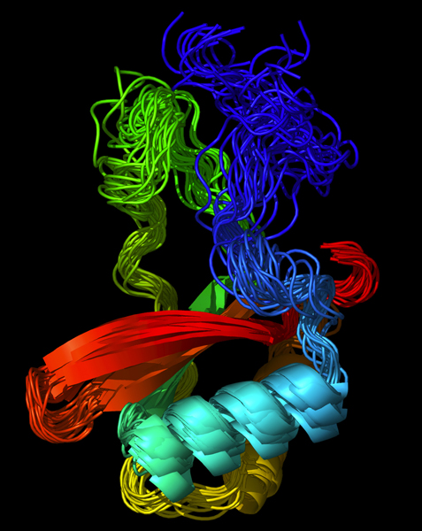
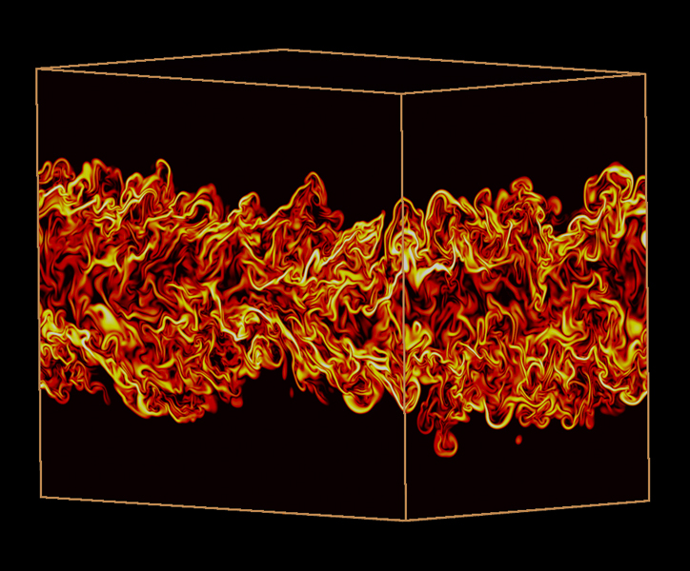
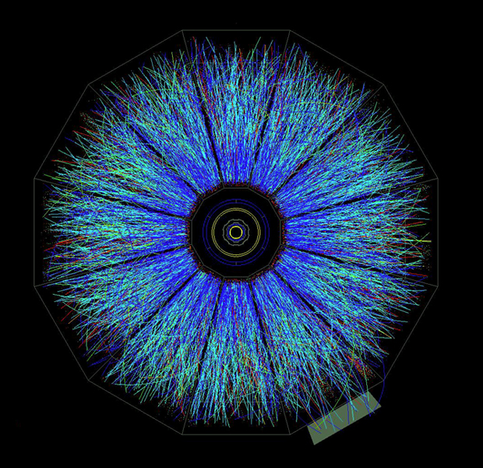
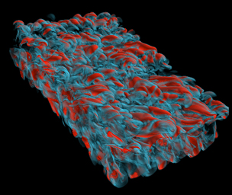
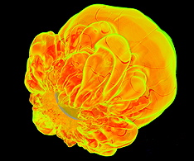
Magellan
Brent Draney
ESCC
February, 2010

Slide 2
NERSC Target Workloads
Batch Queued
Workload Analyzer
Eucalyptus
Hadoop
Private Cluster(s)
Science and Storage
Gateways
Public or Remote
Cloud
ANI
Magellan Cluster
Notes:
Science gateways
S3 storage
Phasing

Slide 3
Argonne Software Architecture
Data-intensive Applications
Bringing complex science-based software stack
Standardized cloud virtual machines
Developing new science-based cloud infrastructures
HPC Linux VM
HADOOP MapReduce/PVFS
Eucalyptus (EC2 & S3)
Argonne Breadboard Toolkit (“raw provisioning”)
Hardware

Slide 4
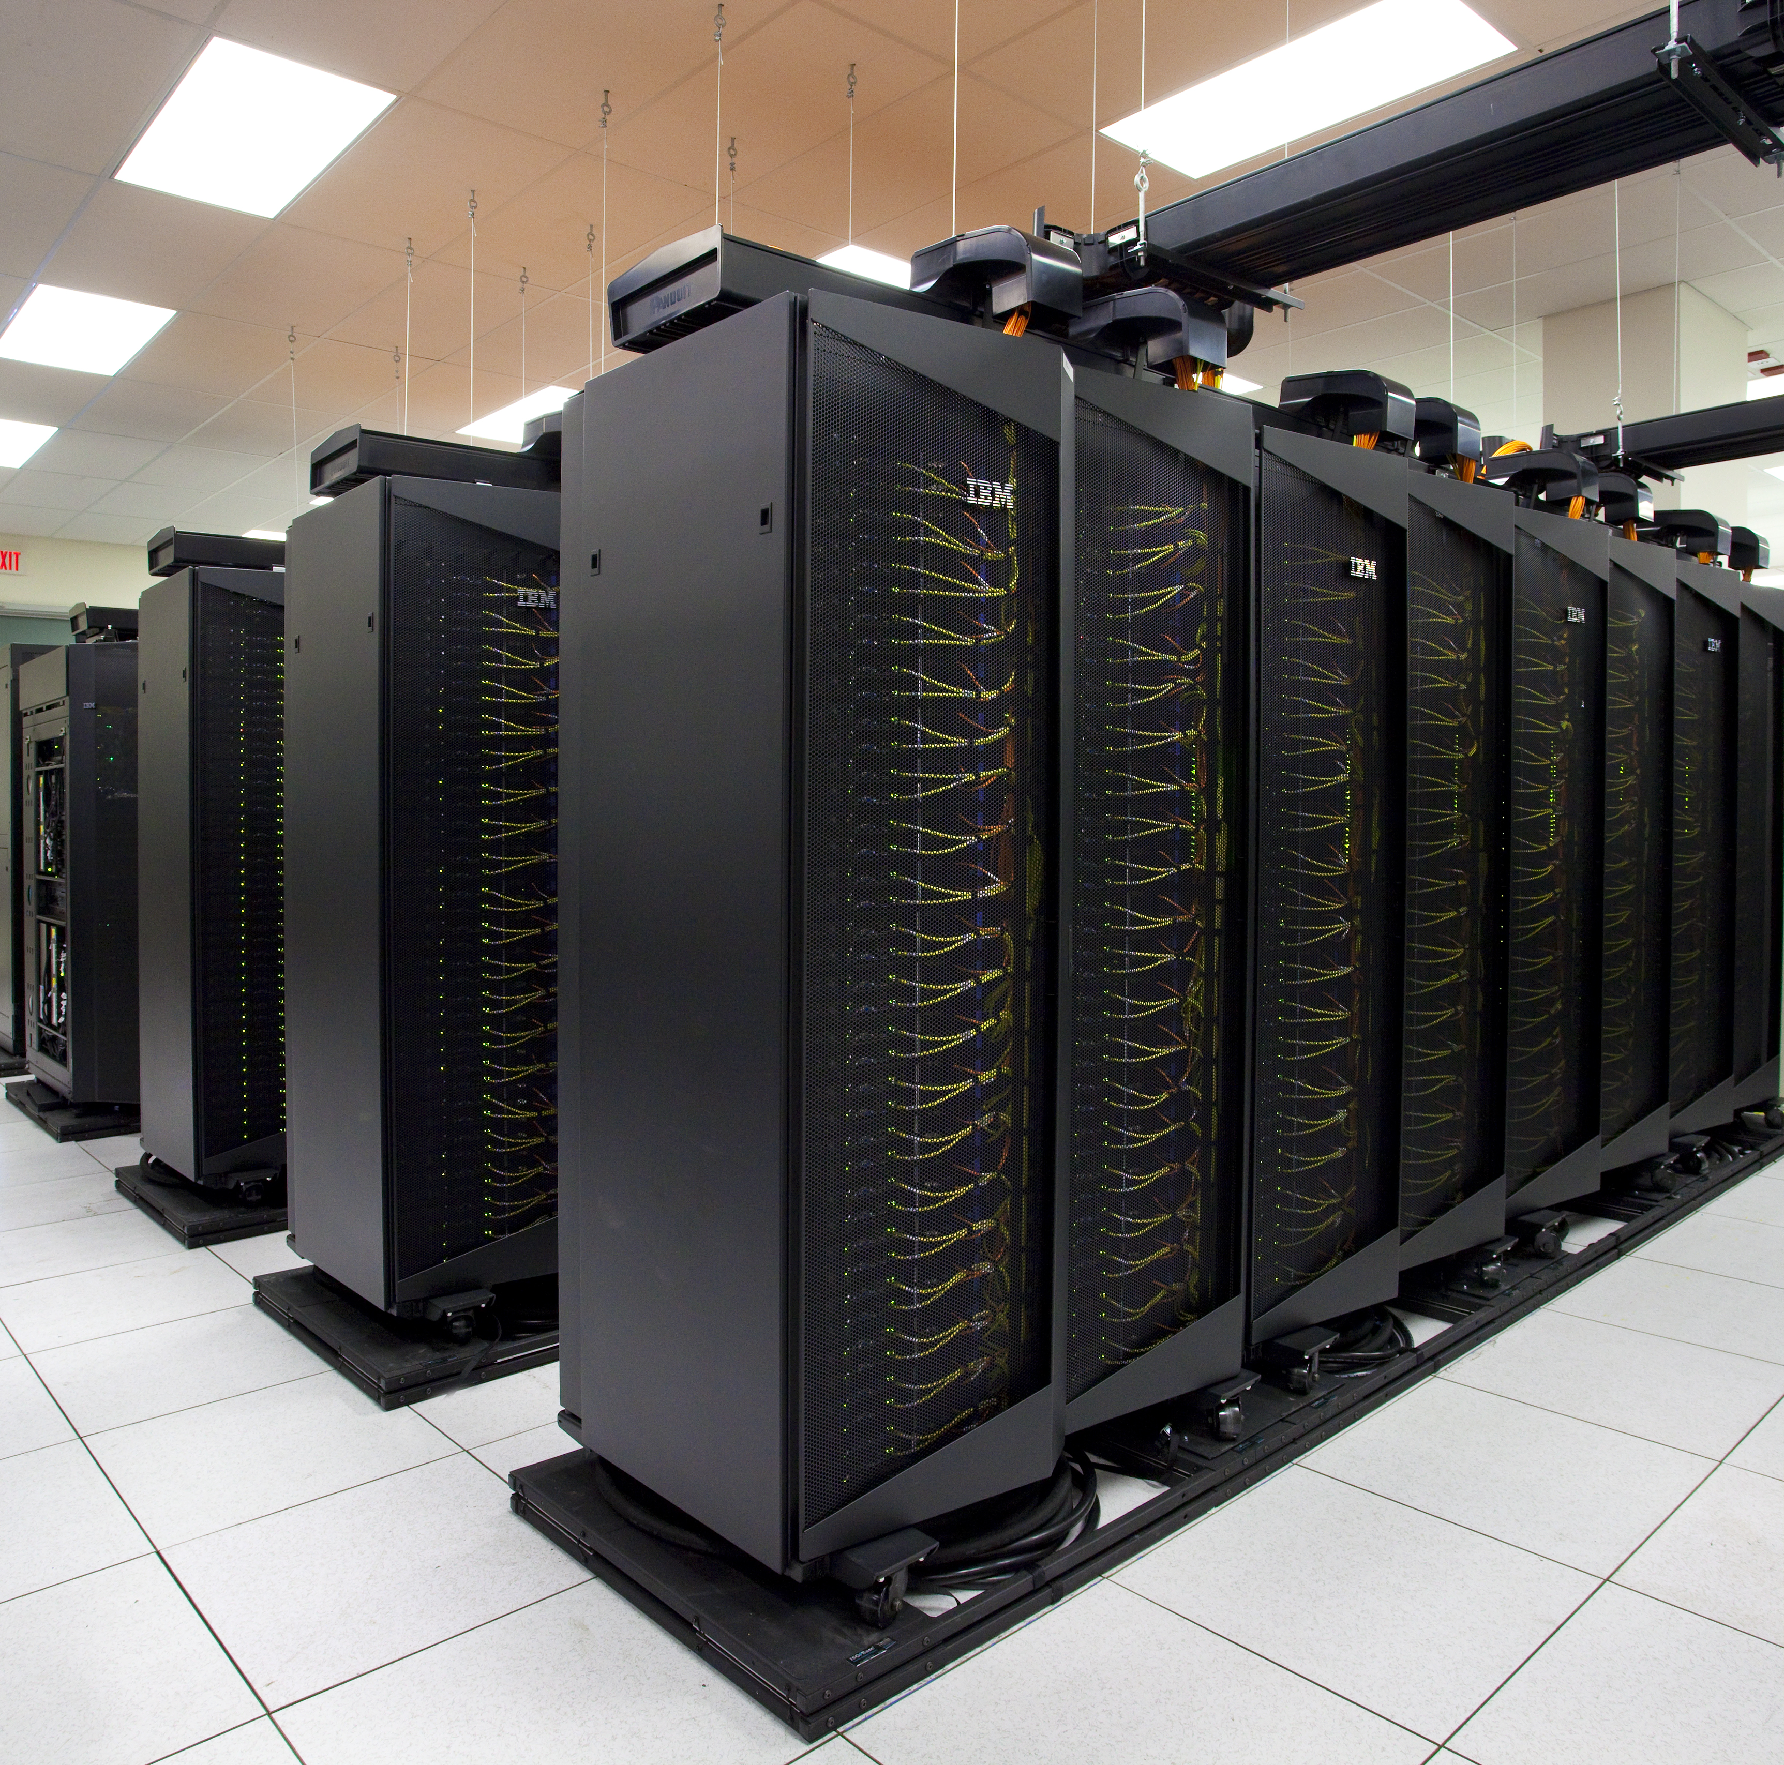
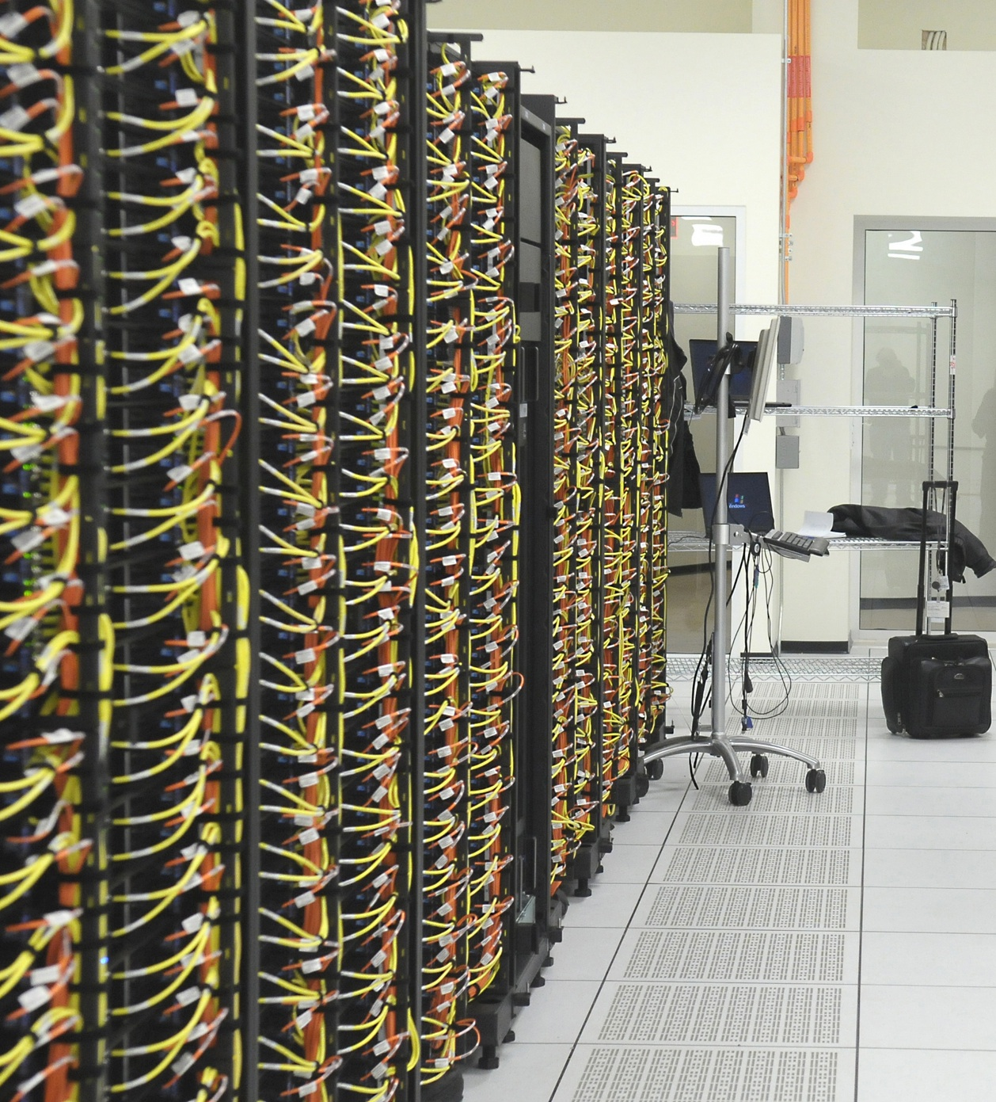
Magellan NERSC ALCF

Slide 5
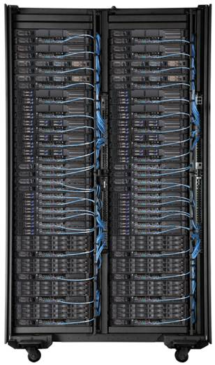
Magellan@NERSC Cluster
720 nodes, 5760 cores in 9 Scalable Units (SUs) ➔ 61.9 Teraflops
SU = IBM iDataplex rack with 640 Intel Nehalem cores
QDR IB Fabric
18 Login/network
nodes
Network
Login
I/O
14 I/O nodes
10G Ethernet
Network
Network
I/O
8G FC
Internet
Load Balancer
100-G Router
NERSC Global Filesystem
HPSS (15PB)
1 Petabyte with GPFS
ANI

Slide 6
Magellan@NERSC Cluster
ESnet router
SDN
10G
IP
10G
Border Router
Core Router
Load Balancer
Magellan Switch
Nodes

Slide 7
Magellan@NERSC Cluster
ESnet 100G
100G
NERSC 100G Router
Up to 32 10G
Connections in
16 Gateway Nodes
10G
Nodes

Slide 8
Argonne Magellan Cloud Hardware – Current
Compute
504 Compute Nodes
Nehalem Dual quad-core 2.66GHz
24GB RAM, 500GB Disk
QDR IB link
Totals
4032 Cores, 40TF Peak
12TB RAM, 250TB Disk
QDR InfiniBand Switch
File Servers (/home) 160TB
Temporary Switch
ESnet
10Gb/s
Login Nodes

Slide 9
Argonne Magellan Cloud Hardware – Final
Compute
504 Compute Nodes
Nehalem Dual quad-core 2.66GHz
24GB RAM, 500GB Disk
QDR IB link
Totals
4032 Cores, 40TF Peak
12TB RAM, 250TB Disk
QDR InfiniBand Switch
File Servers (8) (/home) 160TB
Aggregation Switch
ESnet
10Gb/s
Active Storage
~100 Compute/Storage Nodes
~10TB FLASH/SSD Storage
~500TB Disk Storage
Login Nodes (4)
Router
ANI
100 Gb/s
Gateway Nodes (~20)

Slide 10
ANI Network Map Steve Cotter/JT210

Slide 11
Magellan/ANI End to End

Slide 12
Mid-range codes on Amazon EC2
Lawrencium Cluster – 64 bit/Dual sockets per node/8 cores per node/16GB memory, Infiniband interconnect
EC2 – 64 bit/2 cores per node/75GB,15GB and 7GB memory, Laboratory Research Computing (LRC)
Code | Slow down factor
FMMSpeed. Fast Multipole Method. Pthread parallel code with ½ GB IO | 1.3 to 2.1
GASBOR. A Genetic algortihm ab initio reconstruction algorithm. Serial workload, minimal I/O (KB) | 1.12 to 3.67
ABINT. DFT code that calculates the energy, charge density and electronic structure for molecules and periodic solids. Parallel MPI, minimal I/O. | 1.11 to 2.43
HPCC. HPC Challenge Benchmark | 2.8 to 8.8
VASP. Simulates property of systems at the atomic scale. MPI parallel application | 14.2 to 22.4
IMB. Intel (formerly Pallas) Memory Benchmark . Alltoall among all MPI threads | 12.7 to 15.79
Notes:
Consistent with Xen performance – 6 to 9% difference in general
Memory and I/0 is extra difference

Slide 13
Performance Comparison of Hadoop and Task Farming
Evaluated small-scale problem (2500 sequences) on multiple platforms (Limited by access and costs)
Similar per-core performance across platforms

Slide 14
Thank you!

