Slide 1
Replica by Molding and Local grinding Repair
for 9-cell cavity.
K. Watanabe, H. Hayano (KEK)
20/April/2010, TTC meeting @FNAL

Slide 2
Content
1. Recent KEK setup for inspection, molding, grinding
2. How to take a replica for 9-cell cavity.
(Techniques , Problems and Countermeasure)
3. Local grinding Repair
4. KEK MHI-08 repair trial
5. FNAL AES-03 repair trial
6. JLab LG-01 repair trial
7. Summary

Slide 3
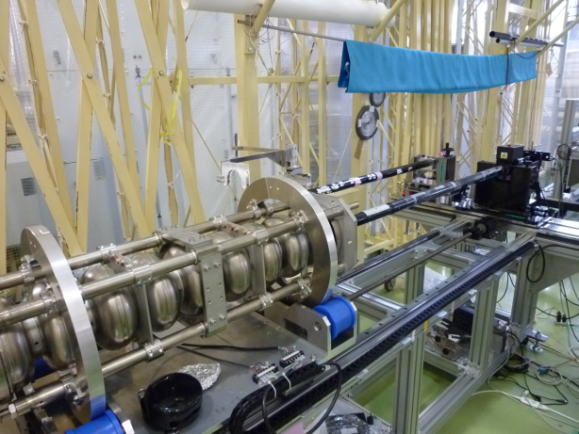
Recent of KEK setup for Inspection, Replica taking and Local Grinding
Two cylinder support jigs are easy exchangeable by sliding
Local Grinder machine, Replica taking tool and another camera system
Main Inspection Camera system
Both of Camera cylinder rotation and cavity rotation are possible.

Slide 4
How to take a replica for 9-cell cavity

Slide 5
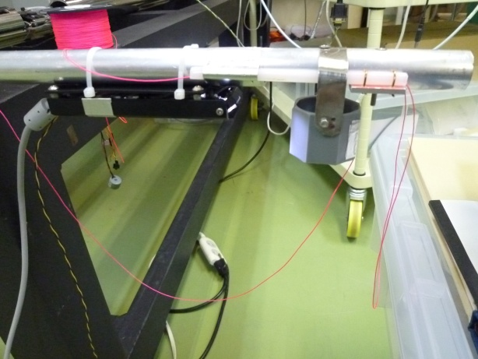
Tool: Silicon Tank and USB camera on the stick
String to get a replica from inside cavity.
This string is touched in the iris.
The string is soft material, the iris has no damage.
USB camera with two LED light
The LED light works by four dry buttery.
Silicon Tank and turn-over string
USB camera
with
LED light
Silicon tank
Diameter of Stick is 20 mm.
Stick length is 1300 mm.
The height of holder is optimized for the stage of Kyoto camera.
325 mm

Slide 6
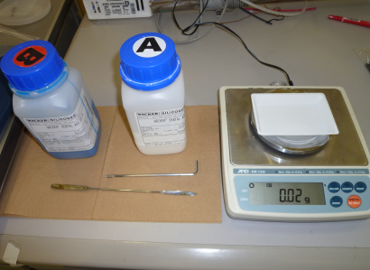
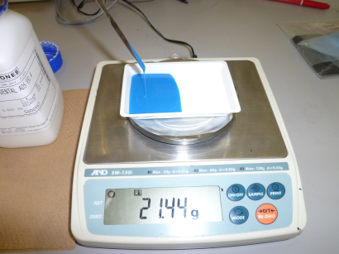
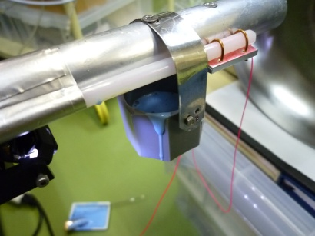
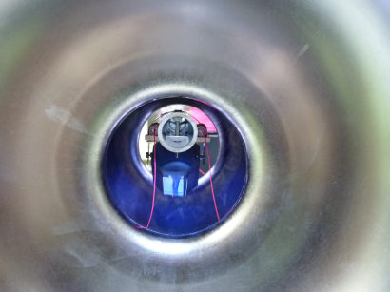
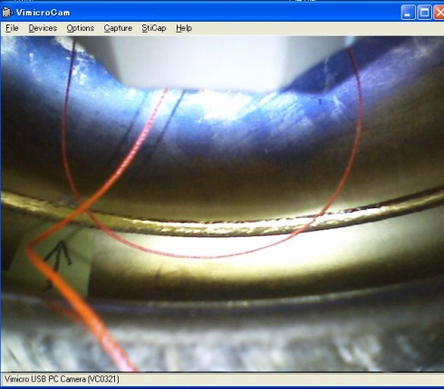
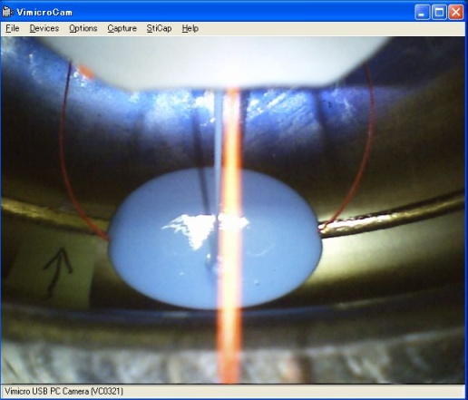
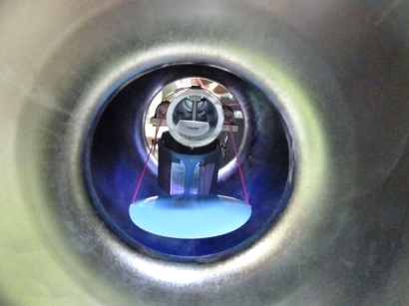
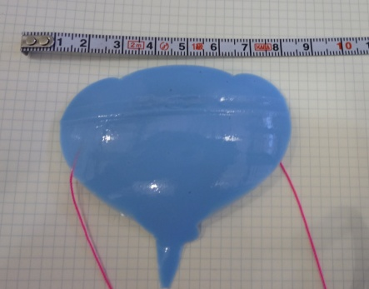
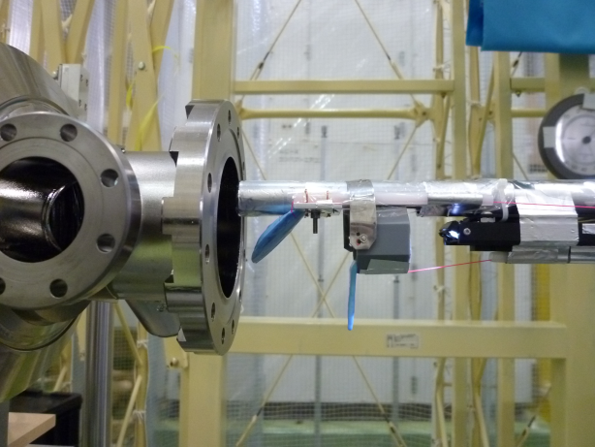
Flow of molding
1. Set the Silicon rubber
2. Measure the weight
(A : B, 1:1) and Mix A and B
3. Pour silicon rubber to the tank. And clean up around the tank.
4. Position to the target, and throw the silicon rubber to the target.
5. Image of USB camera shows pick-up string there, before throwing silicon.
6. After throwing silicon,
Wait 30 min to harden.
7. Pick-up molding rubber by the strings pulling out.
Time : step 1 ~ 6 -> less than 7 min,
Wait 30 min to harden the silicon rubber
step 7 ~ 8 -> less than 5 min.
8. Pull-out molding rubber.
To take one molding, we need to keep the time <1 hour.

Slide 7
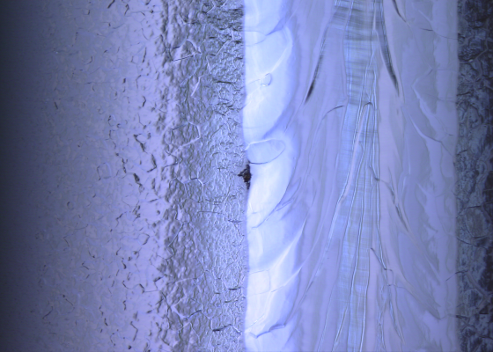
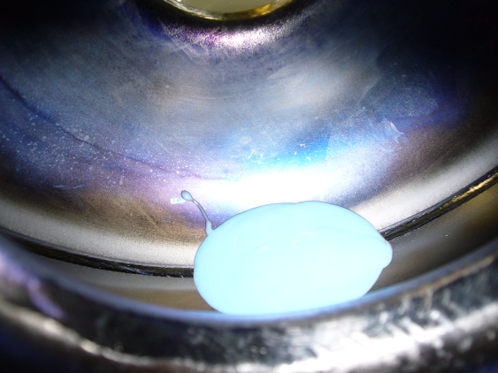
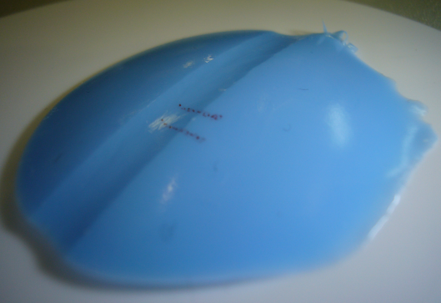
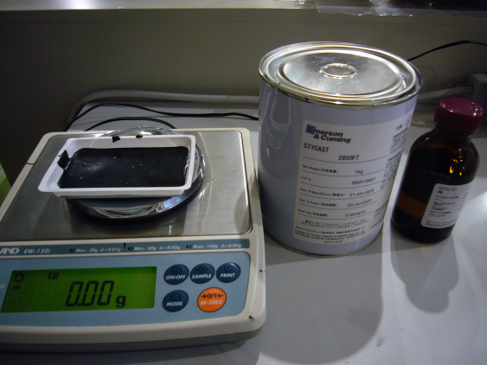
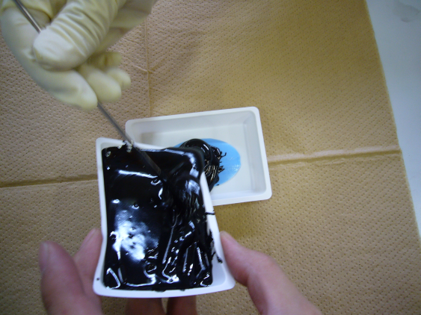
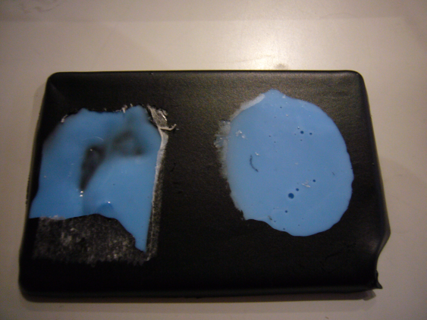
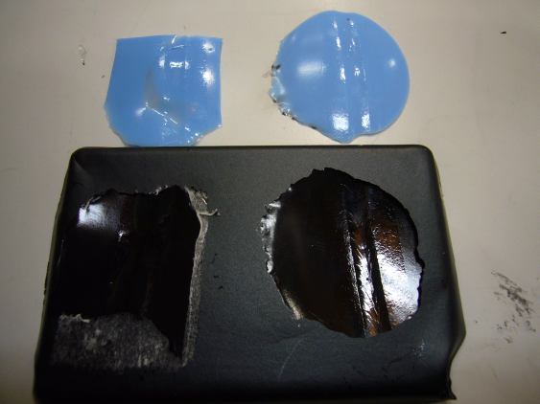
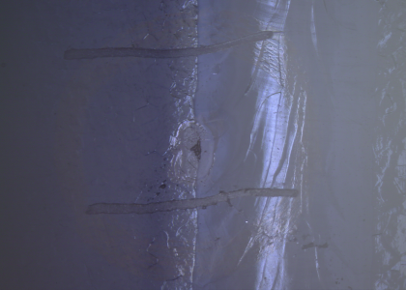
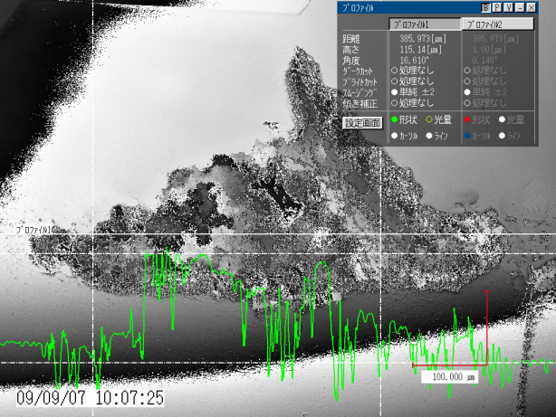
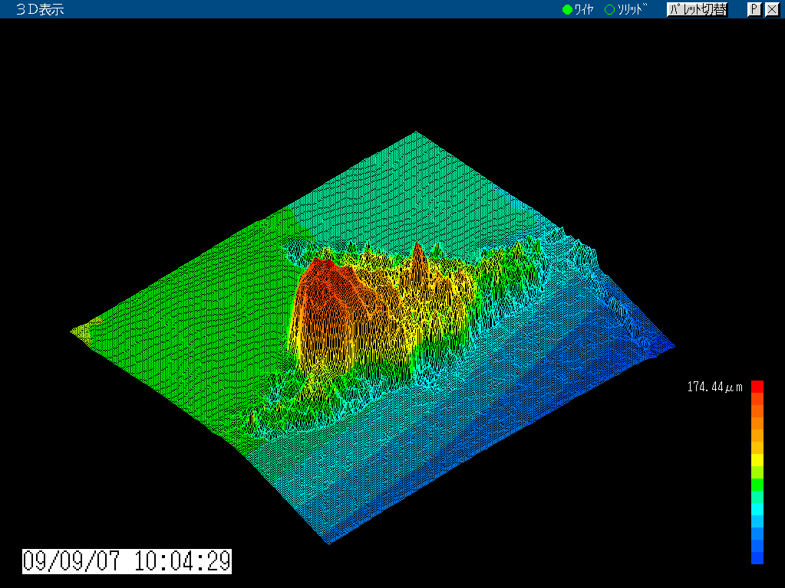
Making replica by Stycast
1. Find the defect.
2. take molding of the defect by special tool.
3.Copy to the stycast.
4. After hardening of the stycast, check the shape by camera system.
5.analysis by laser microscope or surface roughness measuring machine.

Slide 8
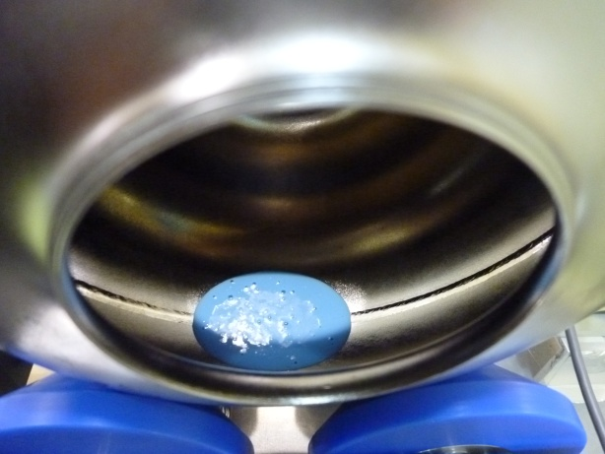
The size of replica
70 mm (cover 39 deg. longitudinal angle) x 40 mm
pickup string

Slide 9
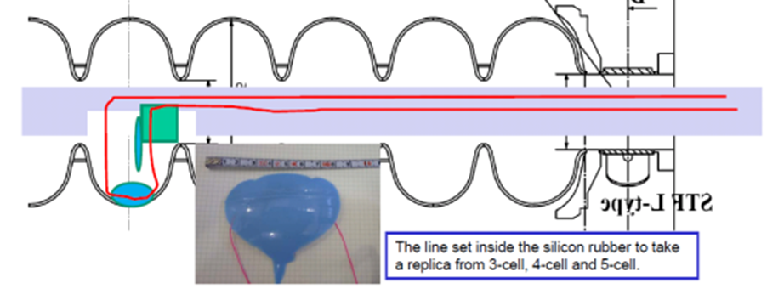
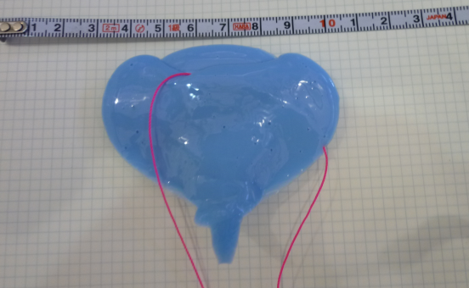
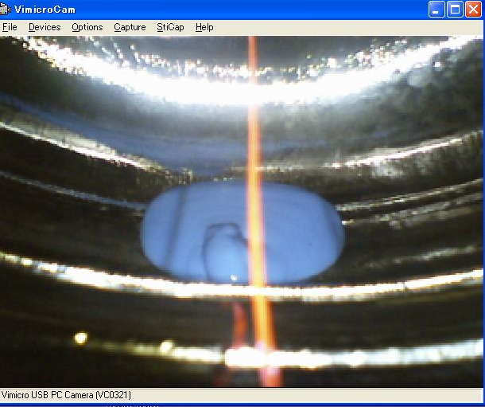
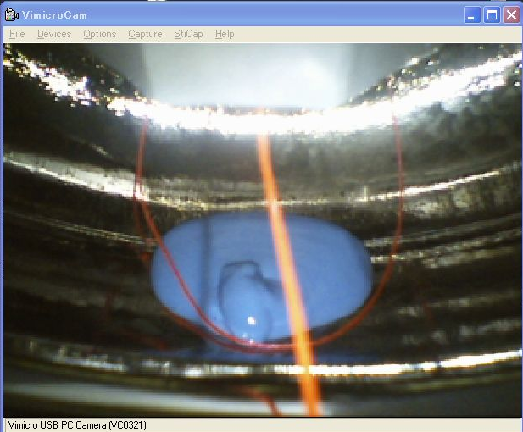
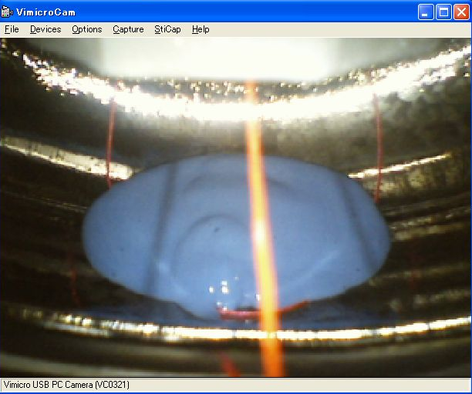
Trouble and counter measure (1)
Failed to pick-up, and silicon fell down!!
1st : The string was off to the silicon rubber due to the string location was bad in this time.
The silicon rubber was left to the 5-cell (or 4-cell, or 3-cell)…………
In the 1-cell and 2-cell, we can rescue the silicon rubber by human’s hand.
2nd : To rescue the silicon rubber from the 5-cell, try again set the string and silicon rubber on the target.
We can rescue the replica from 5-cell easily.

Slide 10
Trouble and counter measure (2)
Some time, there is a broken piece of the replica on the iris part due to the replica touch to the iris.
To cleaning this piece, we use wiping by sponge with water.
If one forget the cleaning of the tank wall after pouring the silicon rubber, then the silicon rubber drops to the iris part or other part.
We can avoid these trouble to do work with carefull attention.

Slide 11
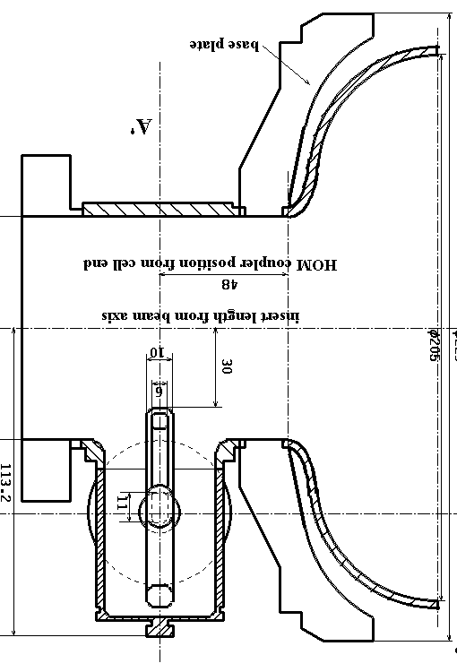
Trouble and counter measure (3) : (Caution !!!!!!!!!!)
If the silicon rubber drop to the HOM coupler, it is very dangerous.
In this case, to rescue the replica from the HOM coupler is very difficult.
To remove the silicon rubber from inside HOM coupler, we need the special tool to cut the silicon rubber into pieces inside the HOM coupler.
The silicon rubber move to the tank, and go to target.
Touch the tank to HOM coupler, and rotate the tank, drop the silicon rubber to the HOM coupler and 1-cell.
Silicon rubber
Caution, the location of HOM coupler
when do the replica work for real cavity.

Slide 12
Local Grinding Repair

Slide 13
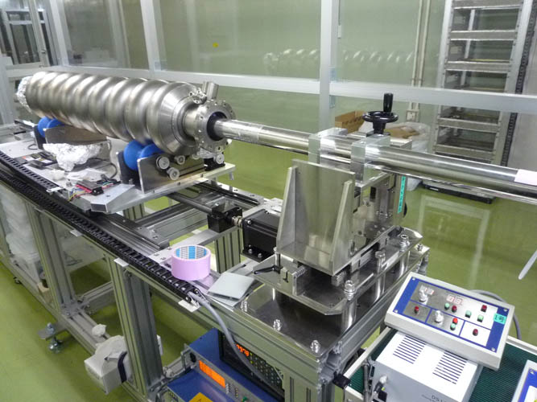
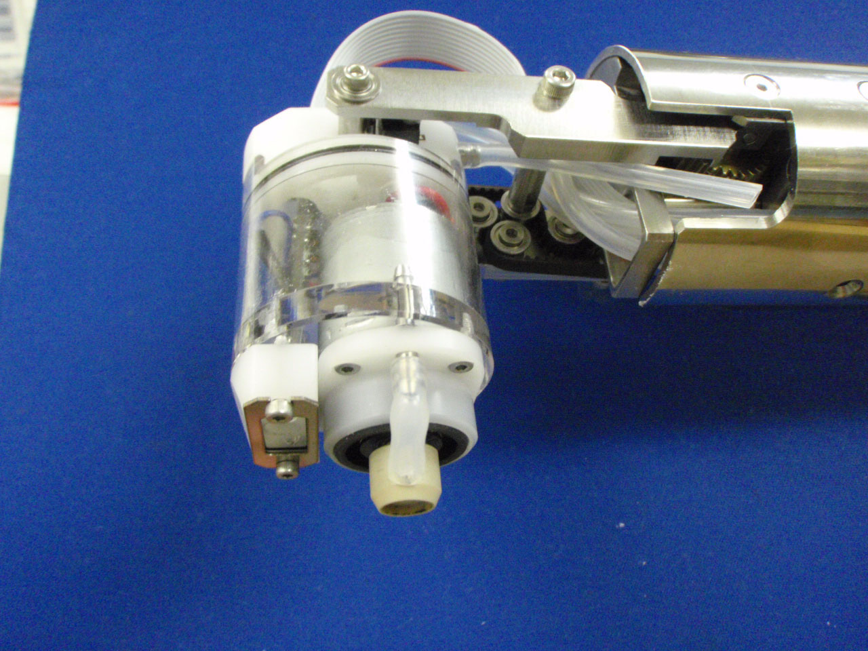
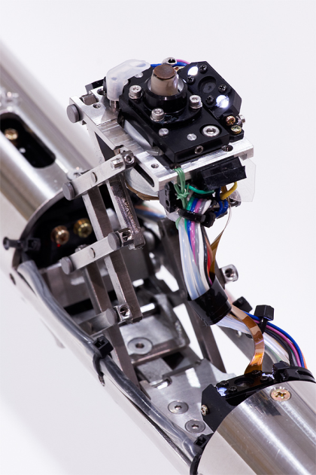

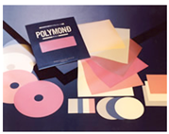
Two type of Grinders
Grinder for slope surface
heat resistance resin
Diamond particle
Polymond+water for grinding
Grinder for equator
Material for grind：Diamond seat #400 - #3000
(particle size = 40 ~ 3 um), (POLYMOND)

Slide 14
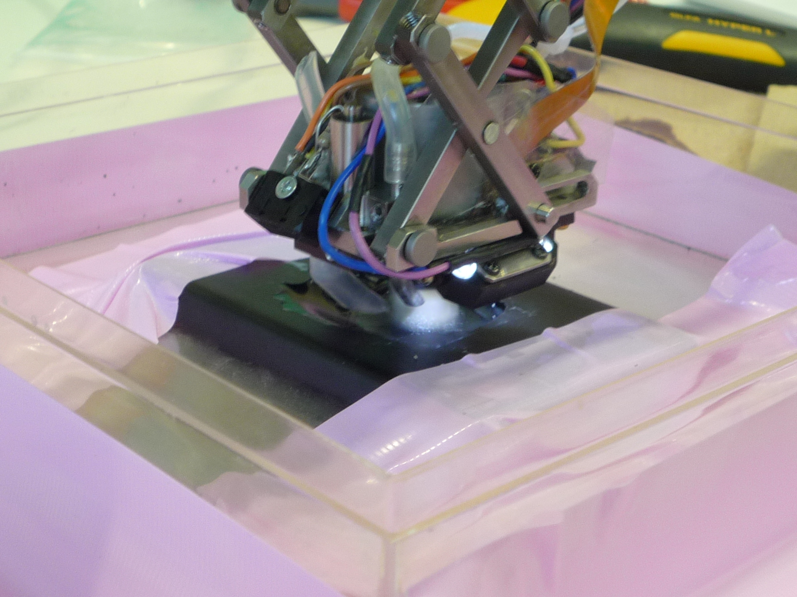
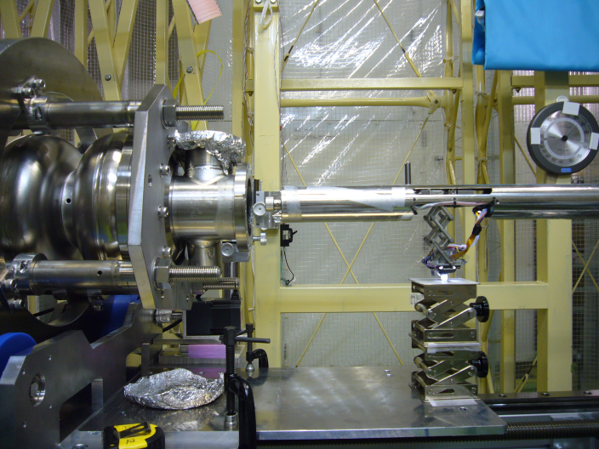
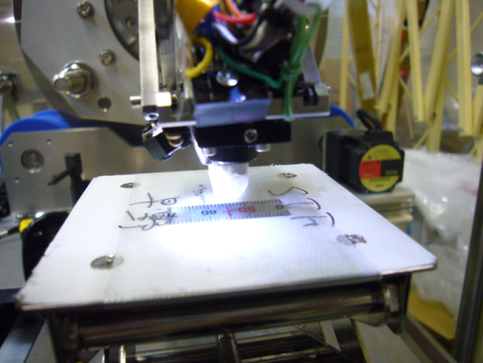
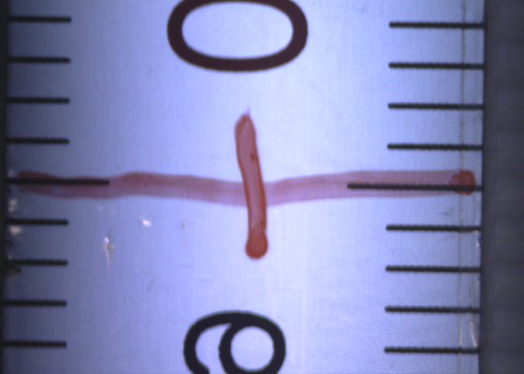
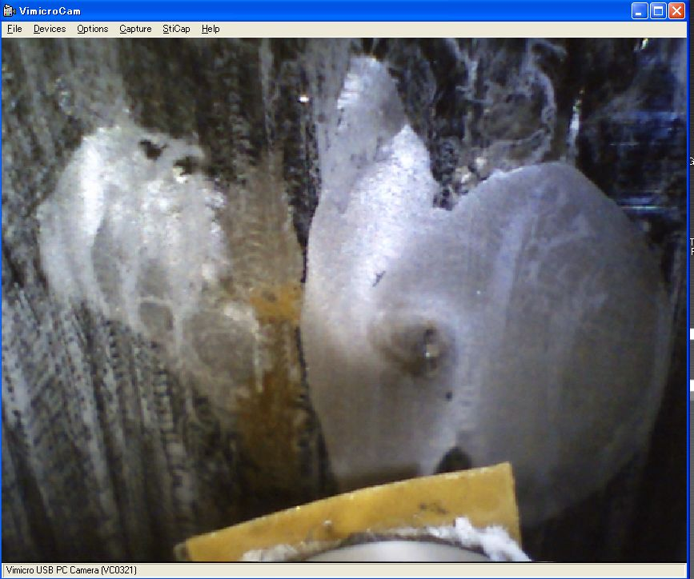
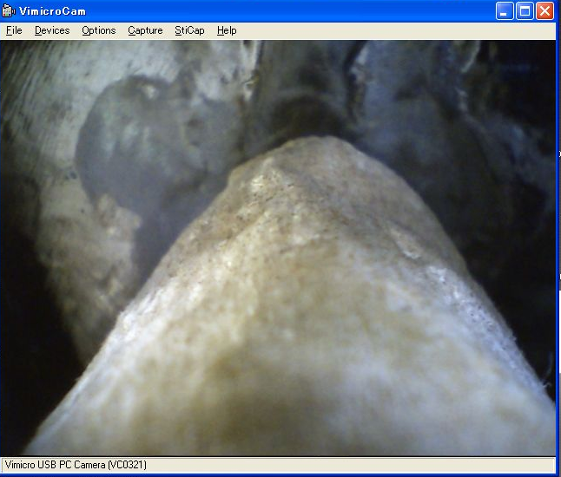
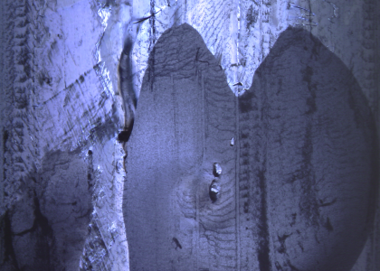
How to Grind for equator (1)
0.Grinding test using the replica, and check the shape after grinding.
1. Grinder head positioning to the target. The target monitered by using camera system.
Diamond sheet on the head
Wiping.
image capture by Kyto-camera
2. Repeat diamond sheet grinding with water, cleaning and taking a image by camera system until removing the defect.

Slide 15
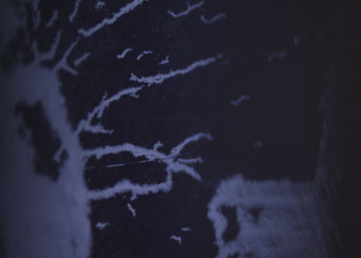
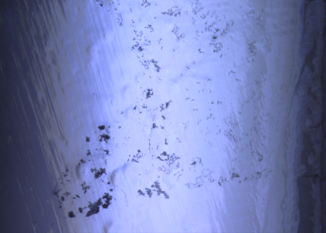
How to Grind for equator (2)
To remove grinding dust, FM-20 degreser with Ultra-sonic was applied.
Additional rinse, FM-20 with Ultra-sonic
7 hours, 50 C
Many dust was removed, however little bit remained.
FM-20 with Ultra-sonic was done to cleaning the dust, that is occur by grind.

Slide 16
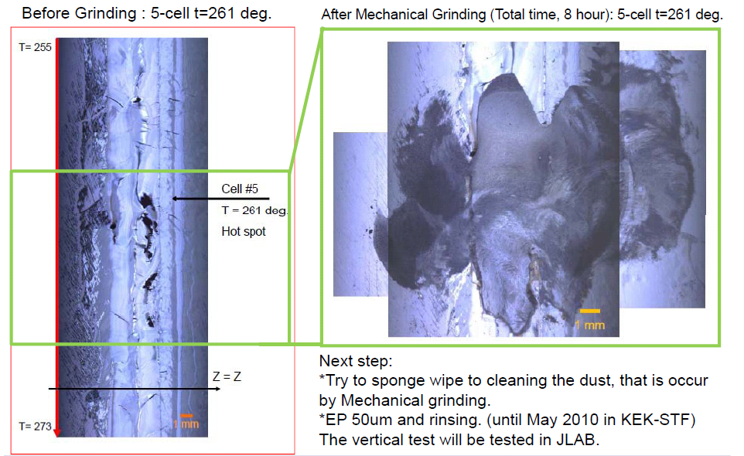
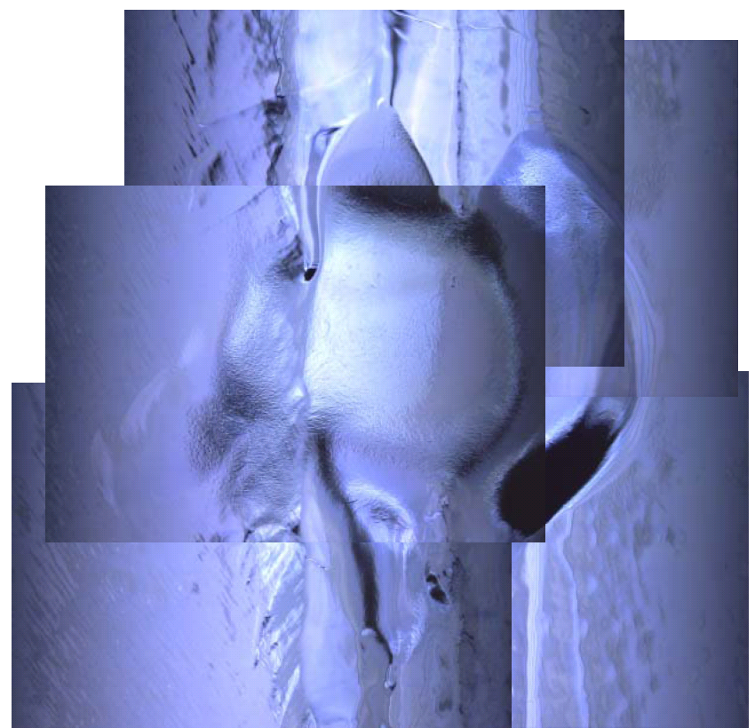
How to Grind for equator (3)
Before EP finish
After EP 50um
Apply EP 50 um for smooth surface finish.

Slide 17
KEK MHI-08 repair trial

Slide 18
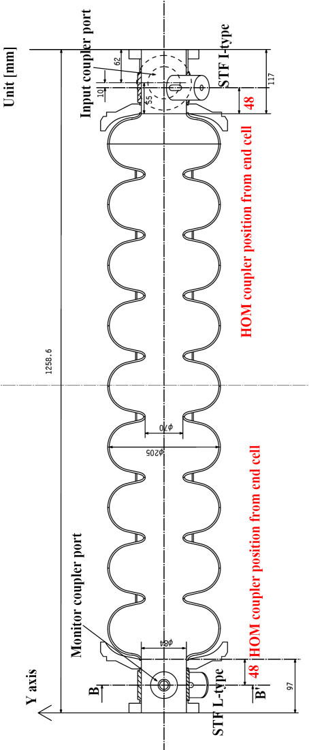
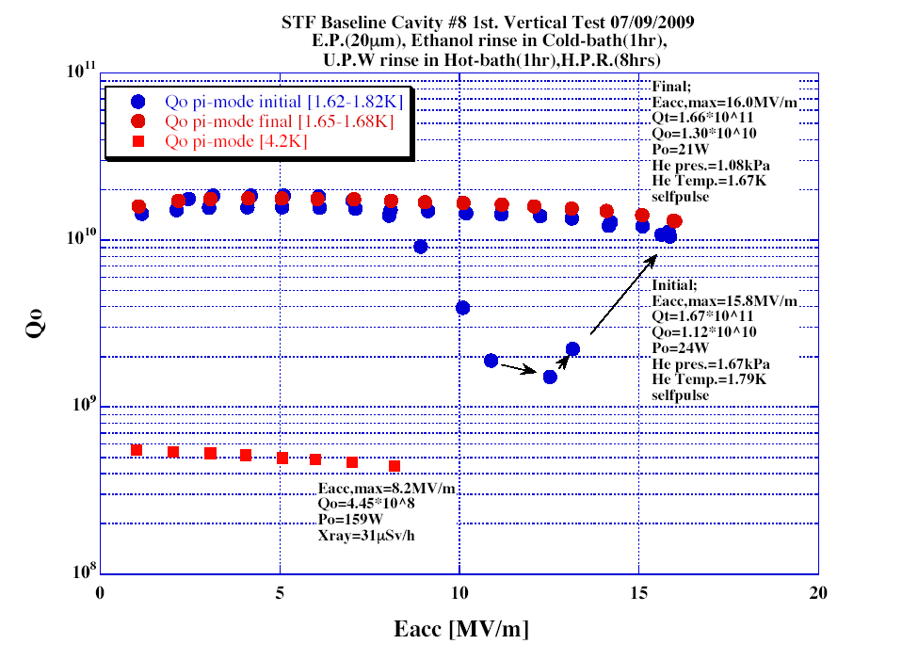
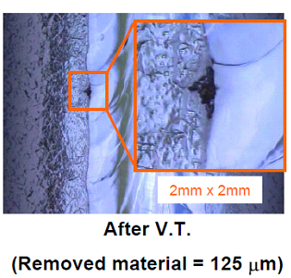
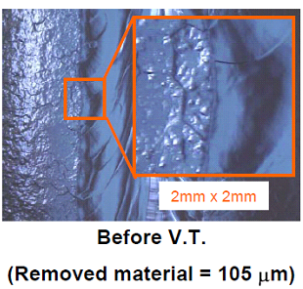
MHI-08 : The location of target for Grinding
Cell#2 equator, t=172 deg. Pit
Quench = 16 MV/m
125 um removed.
cell#2 equator, 180deg.
The cavity was quench at 16 MV/m on the cell #2 equator. The defect was made after EP-2 process.
18
Notes:
18

Slide 19

MHI-08 : Make a replica and shape analysis for Hot Spot
Copy to stycast.
Shape analysis by Laser microscope.
Test of the grinding for the target.
Make a replica by silicon rubber.
#2-cell、T=172deg
Result of shape analysis by Laser microscope. : Pit type deep defect, depth = 115 μm.
Image size：745um x 559um
19
Notes:
19

Slide 20
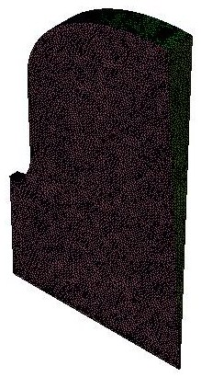
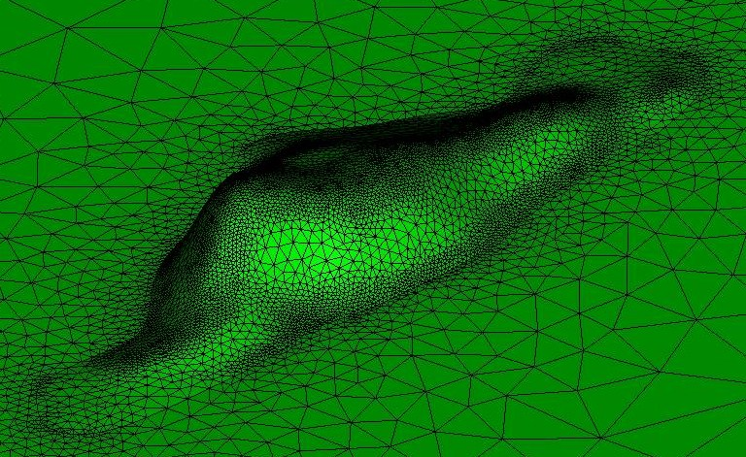
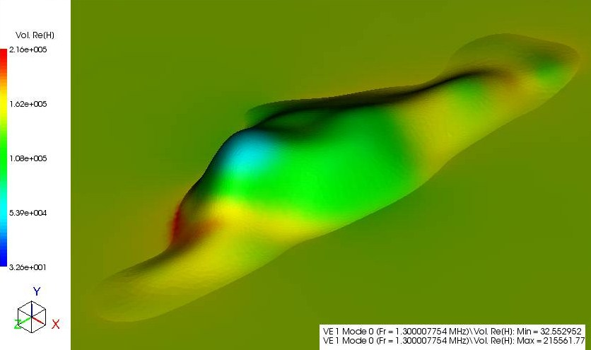
High-Resolution Field Analysis by Morozumi
500 µm
β=1.5
Moro SRF Structure Simulations

Slide 21









MHI-08 : Grinding of the defect : cell #2 equator t = 172deg
In this case, the defect type was pit at the boundary between
EBW seam and HAZ.
History of the Grinding, (0) before Grinding.
(1) 1st Grinding #400, 58 min
(2) 2nd Grinding #400, 76min（Total 134min）
(3) 3rd Grinding #400, 70min（Total 204min）
(4) 4th Polishing #1000, 60min （Total ：264min）and EP (20 +30 um)
(4) Before EP-2 and 2nd V.T.
~0.3mm
Target
EBW seam at equator
The defect was removed completely.
(0) Before grinding
(1) After 1st Grinding
(2) After 2nd Grinding
(3) After 3rd Grinding
21
Notes:
21

Slide 22

MHI-08 : 2nd V.T. result
Progress work after 1st V.T. (June 2009):
* Inspection after 1st V.T.
* Make a replica and shape analysis
* Local Grinding (One equator)
* Cleaning by water and wiping before EP process
* EP 20um, 50mA/cm2 (Air) at KEK-STF
1st water rinsing (Air) 90 min, HPR 2 hour
* Inspection after EP 20um
* Local Grinding to obtain narrow edge around circle.
* EP 30um, 50mA/cm2 (Air) at KEK-STF
1st water rinsing (Air) 90 min, HPR 2 hour
* Inspection after EP 30um, check the grinding location
Field flatness measurement = keep the flatness.
* EP 20um, 50mA/cm2 (Air) at KEK-STF
1st water rinsing (Air) 90 min
FM-20 (2%) 50 C 1hour
Hot bath 50 C 1hour
HPR 9 hour, baking 100 C 48 hour
* 2nd Vertical test at KEK-STF. The gradient was raised
to 27 MV/m. The quench was occurred at other location.
Quench = 27 MV/m
195 um removed.
22
Notes:
22

Slide 23
FNAL AES-03 repair trial

Slide 24
AES-03 : The location of target for Grinding
Equator: three places (1-cell t=200, 4-cell t=306, 5-cell t=187)
Iris: 20 places (see the map of the iris part.)
The Quench location was “cell#4 equator, near t=306 degree” at 20 MV/m measured by FNAL and JLAB.
The cavity was tested by JLAB, FNAL and LANL in America labs before send to KEK-STF.
The history of AES-03 is summaries by Camille Ginsburg (FNAL). http://tdserver1.fnal.gov/project/ILC/S0/web/Cavity_Listing.asp
24
Notes:
24

Slide 25




AES-03 : Quench location, cell #4 equator, t=306 degree
Before Grinding
Two times Grind, #1000, 18 V, 10 + 20min, Total 30 min grind
Bump
After Grinding and EP 50um
Before Grinding
View of USB camera at Grinder head
Removed the bump
25
Notes:
25

Slide 26




AES-03 : Example: Scratch #1-#2iris t=106deg.
After Grinding
Before Grinding
After Grinding + EP-50um
Before Grinding
26
Notes:
26

Slide 27


AES-03: V.T. results, improvement by grinding
Progress work after receiving at KEK (Sep 2009):
* Inspection (Shape analysis of defects)
* Local Grinding (20 Irises and three Equators)
* Cleaning by water before EP process
* EP 50um, 50mA/cm2 (Air) at KEK-STF
1st water rinsing (Air) 90 min
FM-20 (2 %) 50 degC 1hour
HPR 4.5 hour
Pumping to Vacuum, N2 purge
* Inspection after EP 50um
* HPR and pumping to Vacuum and Back to FNAL (Dec 2009)
Progress work in FNAL
* 2 times V.T. at FNAL (Jan 2010)
*HPR rinsing at FNAL before 1st V.T.
* HPR at ANL and Baking 120 C, 48 hour before 2nd V.T.
1st
2nd
27
Notes:
27

Slide 28
JLab LG-01 repair trial

Slide 29



JLAB LG-01 : History of the cavity.
After the baseline test with quench limit at ~ 20 MV/m, the cavity was light EP treated - and the quench limit was raised to 30 MV/m. T-mapping found the quench location at the equator EBW of the cell#5. This cavity was then sent to KEK for local grinding.
29
Notes:
29

Slide 30
Progress work at KEK for JLAB LG-01 cavity
2009/Dec : The JLab LG-01 cavity was received at KEK.
2009/Dec/17 : Inspection “As received” was done.
[ development of molding tool ]
2010/Mar/09 : The replica for cell #5 equator (Area was t = 240 ~ 280 deg. ) before Local Grinding, was taken.
2010/Mar/12 ~ April/08 : Local Grinding for cell #5 equator.
Cleaning by Car washer spray and FM-20 with Ultrasonic.
2010/April/14 : EP 50um with Air-flow, FM-20 (2%) 50 C 1 hour, Hot bath 50 C 1 hour and HPR 3 hours.
[ a break: TTC meeting, Jlab visit, holiday season in Japan, etc ]
2010/May : Inspection after EP 50 um, is scheduled.

Slide 31

The location of target for Grinding
The welding seam was flaw in hot spot and other locations. Take a replica at cell-#5 using by special tool. The Local Grinding was made on cell #5 equator pit.
31
Notes:
31

Slide 32



Shape analysis of the replica at cell#5
Measured by FORMTRACER CS-5000 (Mitutoyo)
The defect looks like a funk hole
32
Notes:
32

Slide 33


After Local Grinding of cell #5 equator t= 261 deg.
Before Grinding : cell #5 t=261 deg.
After Mechanical Grinding (Total time, 8 hour)
After EP 50um
33
Notes:
33

Slide 34
Summary of 9-cell cavity repair
Labs | Method | Cavity name | Results
DESY | Local Grinding (KEK) | AC71 | 26MV/m (string???) -> 30 MV/m
FNAL | Local Grinding (KEK) | AES-03 | 20 MV/m (Bump, scratch) -> 34 MV/m
JLAB | Local Grinding (KEK) | JLAB LG-01 | 30 MV/m (Pit) -> will be tested.
KEK | Local Grinding(KEK) | MHI-08 | 16 MV/m (Pit) -> 27 MV/m
34
Notes:
34

