Slide 1





MULTILAYER films applied to SRF
Anne-Marie VALENTE-FELICIANO
On behalf of the
HEPTHF Collaboration

Slide 2
SRF Thin Films Collaboration
Films creation:
Jlab: A-M Valente-Feliciano, J. Spradlin, L. Phillips
W&M: A. Lukaszew, D. Beringer
Material and RF characterization:
Jlab: A-M Valente-Feliciano, J. Spradlin, L. Phillips, X. Zhao, B. Xiao, A. Wu
W&M: A. Lukaszew, D. Beringer, S. , R. Outlaw, O. Trofinova
NSU: K. Seo
ODU: H. Baumgart, D. Gu
Black Labs LLC: R. Crooks
Under DOE HEP Grant ARRA & U.S. DOE Contract No. DE-AC05-06OR23177

Slide 3
Thin Films: SIS Multilayers
Alex Gurevich, Appl. Phys. Lett. 88, 012511 (2006)
Taking advantage of the high –Tc superconductors with much higher H_{c} without being penalized by their lower Hc1…
Higher-T_{c}SC: NbN, Nb₃Sn, etc
Multilayer coating of SC cavities:
alternating SC and insulating layers with d < λ
Nb
Higher T_{c} thin layers provide magnetic screening of the Nb SC cavity (bulk or thick film) without vortex penetration
Strong increase of H_{c1} in films allows using RF fields > H_{c} of Nb, but lower than those at which flux penetration in grain boundaries may become a problem
Strong reduction of BCS resistance because of using SC layers with higher Δ (Nb₃Sn, NbN, etc)
Possibility to move operation from 2K to 4.2K
Insulating
layers

Slide 4
Thin Films applications:
Nb, Alternative Materials & Multilayers
Use of SRF Thin Films
Single Layer
Nb, high κ
Multi-Layers
S-I-S-I-S
Substrate
Cu, Al …
Substrate
Bulk Nb
Nb film (>1μm thick)
major system simplifications.
highest level of quality assurance and reliable performance.
Use of substrates with higher thermal conductivity
Bulk-like performance Nb film
function at higher temperatures or higher fields
Suppression of vortex entry in multilayer structures
for cavity operation at 4.2K or higher
high κ superconducting films
  NbN, Nb₃Sn, MgB₂, S-I-S-I-S…
  Accessible almost only via deposited or synthesized films.

Slide 5
Approach
SIS Multilayer Structures:
Nucleation studies of NbTiN, NbN on dielectrics like MgO, Al₂O₃ and reciprocately.
Creation and characterization of a set of NbTiN , NbN…/insulator/Nb samples by UHV multi-target energetic ion deposition with well-controlled, incremented thickness. The variation of rf field properties with temperature as a function of thickness of the superconducting overlayer will provide a direct test of the Gurevich delayed flux entry model.

Slide 6
Tailoring for optimum RF performance
Careful characterization of the attained composition and microstructure
Close association with resulting rf surface impedance and superconducting properties

Slide 7
Connecting Structure & Performance for SRF Surfaces
The chemistry of the involved species
  Reactivity
  Stoichiometric sensitivity
  Reaction process temperatures
Crystal structure dependence on substrate structure
Influence of deposition energy on resulting structure
Sensitivity to the presence of contaminating species
Stabilization of desired film against subsequent degradation
Deposition Control
involves understanding of
Characterization of deposited film surfaces
In-situ crystallographic structure characterization – Reflection high-energy electron diffraction (RHEED), Scanning Tunneling Microscopy (STM)
Large area crystallographic structure – X-ray diffraction (XRD)
10 nm-scale crystallographic texture within ~ 50 nm of surface – Electron backscatter diffraction (EBSD)
Topography – stylus profilometry, atomic force microscopy (AFM), optical profilometry
Near surface (< 8 nm) chemistry – X-ray photoelectron spectroscopy (XPS)
Micro-contaminant defects – Secondary ion mass spectrometry, with standards (SIMS)
Structural cross-section of film – Transmission electron microscopy (TEM), Focused Ion Beam (FIB)

Slide 8
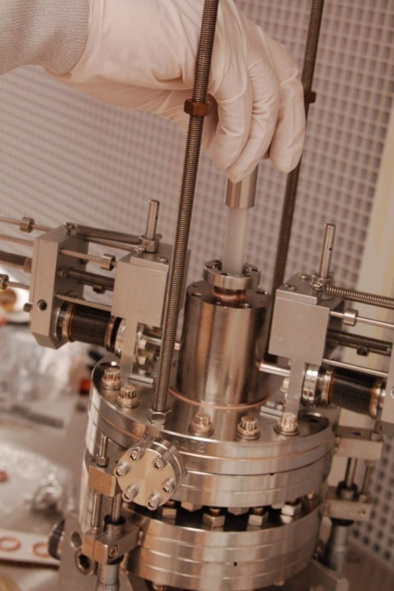
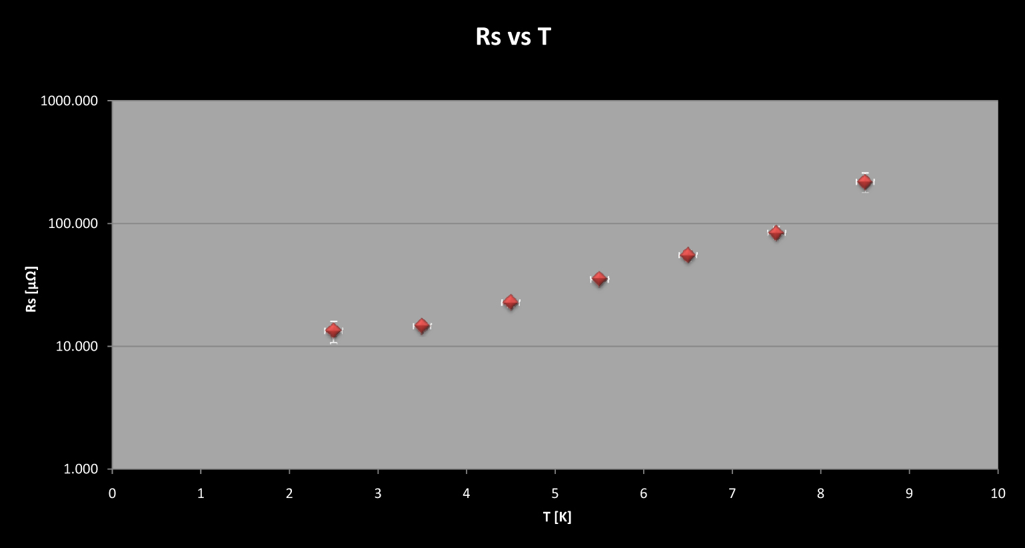
Connecting Structure & Performance for SRF Surfaces
Measurement with the SIC cavity
(TE₀₁₁ sapphire-loaded cylindrical Nb cavity) Surface impedance as a function of magnetic field and temperature from 1.9 K to 4.8 K.
Normal state surface impedance at 10 K, from which the surface value of electronic mean free path and surface H_{c1} can be determined.
Superconducting penetration depth, λ, at low field will be measured by carefully tracking the cavity frequency with temperature as the sample temperature is swept slowly back and forth across the transition temperature (SIC sensitivity: 30 Hz/nm) while the rest of the cavity is held at 2 K.
MATERIAL PROPERTIES
Tc – easy coarse measure of intragrain quality of the film
RRR – convenient assessment of aggregate defect density

Slide 9
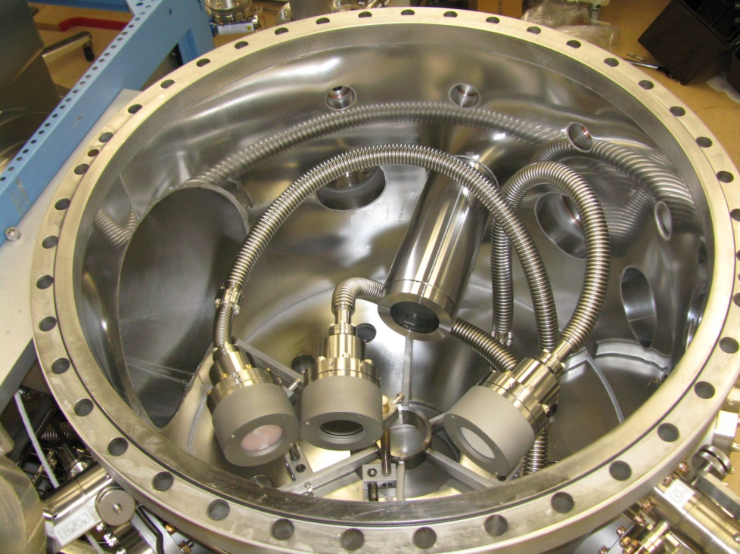
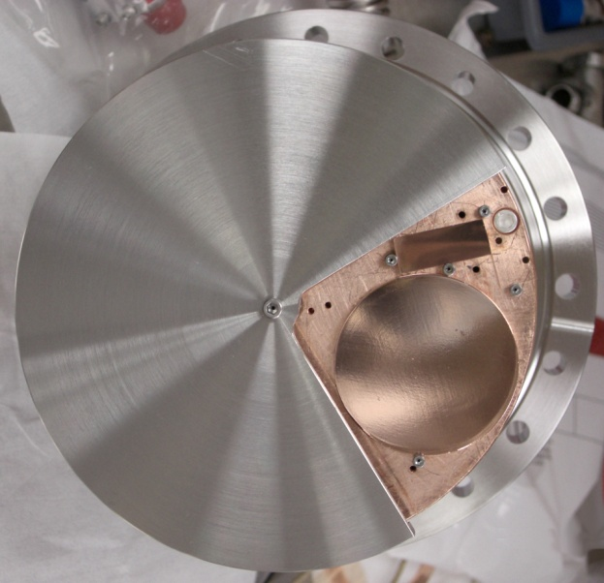
New UHV Multi-technique deposition system under commissioning @ JLab
A unique, versatile thin film deposition system
enabling multiple coating techniques in-situ
Designed to enable rapid exploration of the production parameter space of:
              Nb films
              Alternative material films like NbN, NbTiN
              S-I-S multilayer structures based on these compounds
NbTiN, NbN, Mo₃Re, V₃Si coatings
with Reactive Sputtering and
High Power Pulse Magnetron Sputtering in self-sputtering mode
& MgO coating with RF sputtering

Slide 10
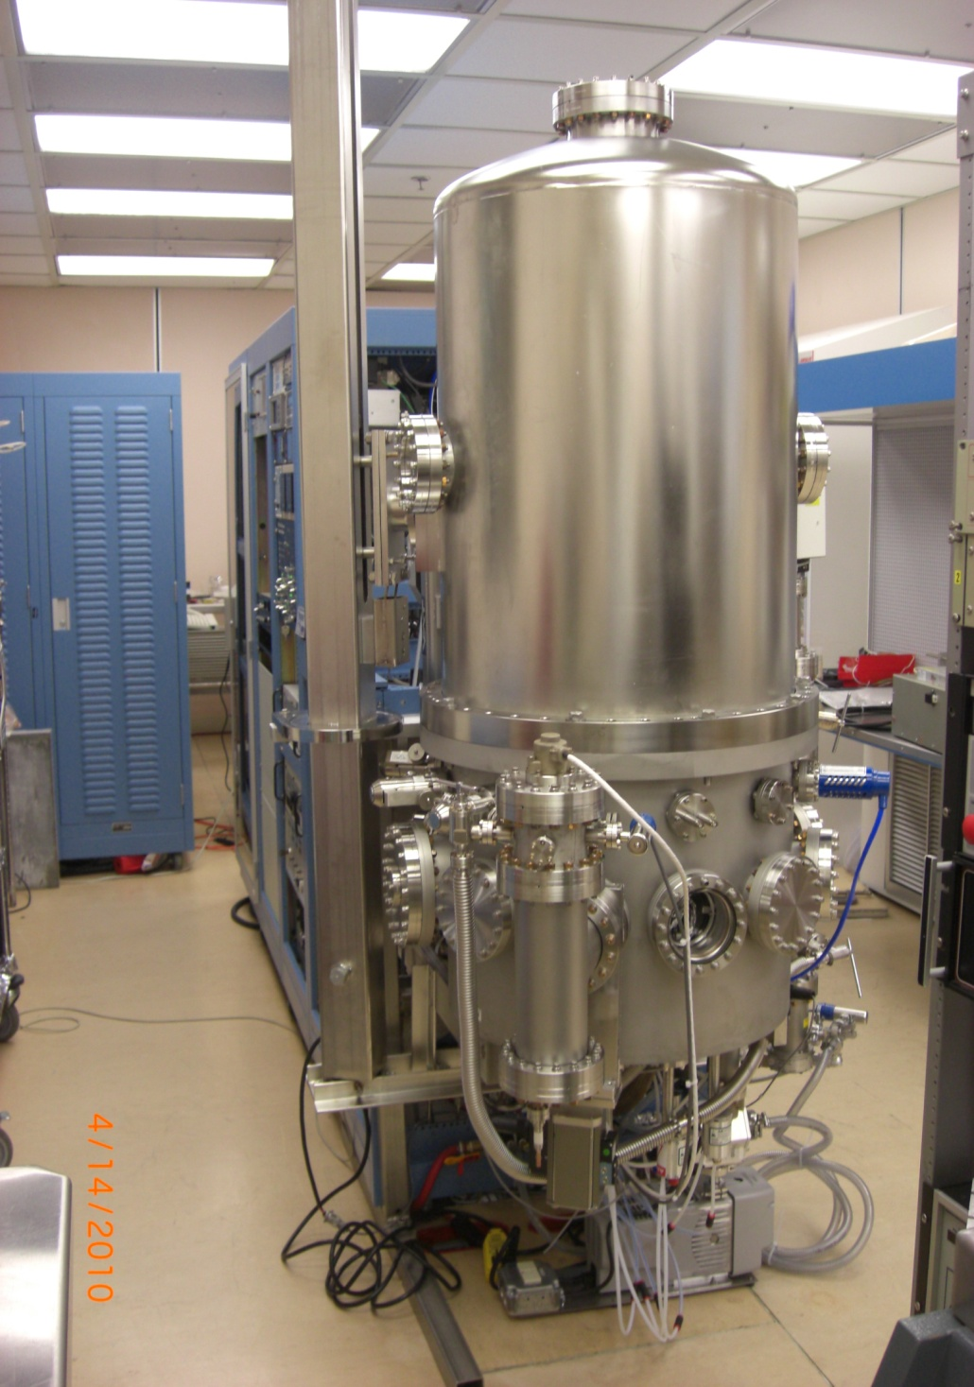
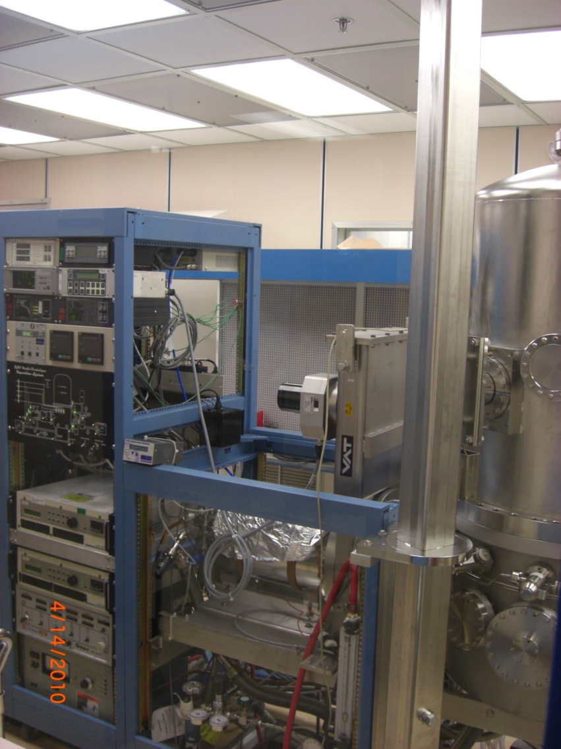
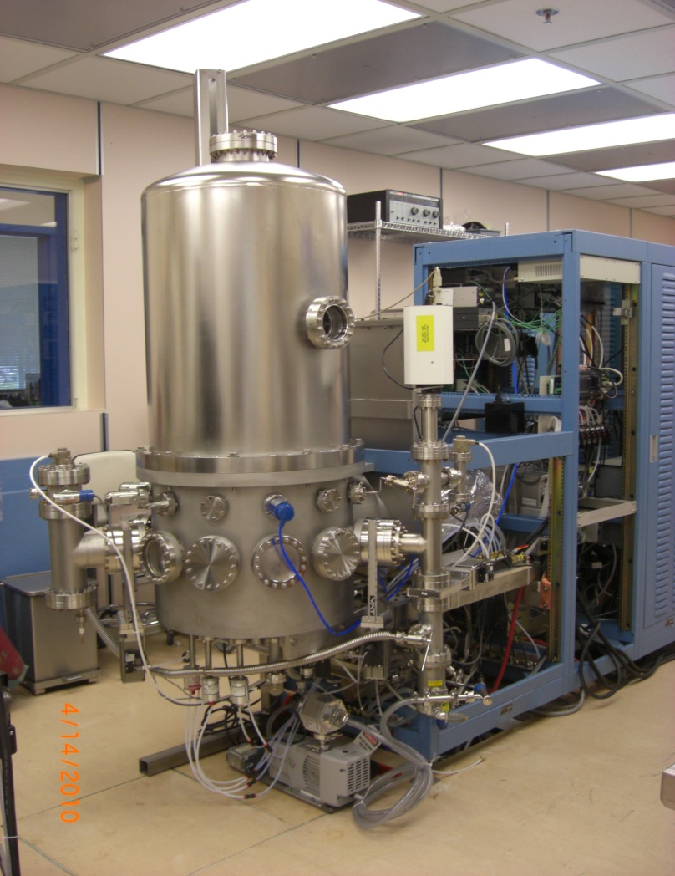
Thin Films: Alternative Materials
Base pressure without baking
2x10⁻⁹Torr
UV desorption system
NEG chamber
3 magnetrons (DC, RF)
Self-sputtered magnetron
Ion source
RGA chamber with differential pumping
Thickness monitors
Substrates

Slide 11
Multilayers & Alternative Materials
Study of growth modes of
Superconductor/ Insulator
&
Insulator/superconductor
Substrates :
Single crystal Nb
Poly crystalline Nb
thick Nb/Cu films
Alternative Materials:
NbTiN, NbN
Nb3Sn, V3Si, Mo3Re
Insulator:
Al2O3, MgO, AlN
according to
lattice mismatch
between
I and S materials
Multilayer: S/I/Nb and S/I/S/I/…/S/I/Nb

