Slide 1
Laser re-melting technique at FANL
M. Ge, G. Wu, J. Ruan, J. Ozelis, T. Nicol, D. Sergatskov, D. Hicks, L. Cooley
Fermi National Accelerator Laboratory
TESLA TECHNOLOGY COLLABORATION MEETING
April 19th ~ 22th, 2010
Fermilab, IL, USA

Slide 2
outline
Motivation
Technical approaching
Cavity test results

Slide 3

Cavity RF performance statistic
The data was from Jlab and DESY 9-cell cavity activity summarized by R.L. Geng and C.Ginsburg

Slide 4
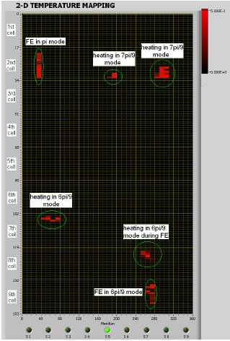
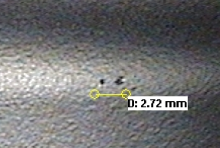
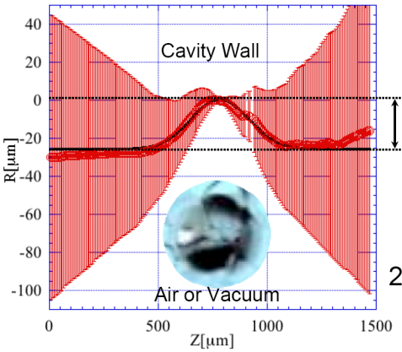
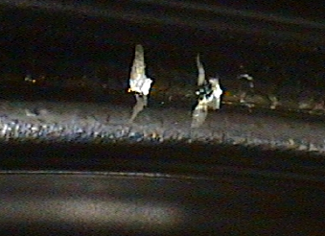
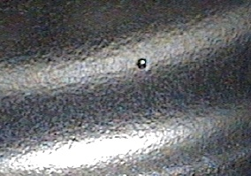
Surface defects (Pits and Bumps) caused quench Identified by Thermometry and Optical Inspection
500 μm
Bump found by KEK Optical Inspection with CCD camera in AES 9-cell cavity with thermometry (Jlab and FNAL) Quench at 18 MV/m
26 um
500 μm
Pit found by KEK optical inspection with CCD camera in AES #1cavity Quench at ~ 18 MV/m
Defects in cavity AES003 correlated to heating detected by T-mapping

Slide 5
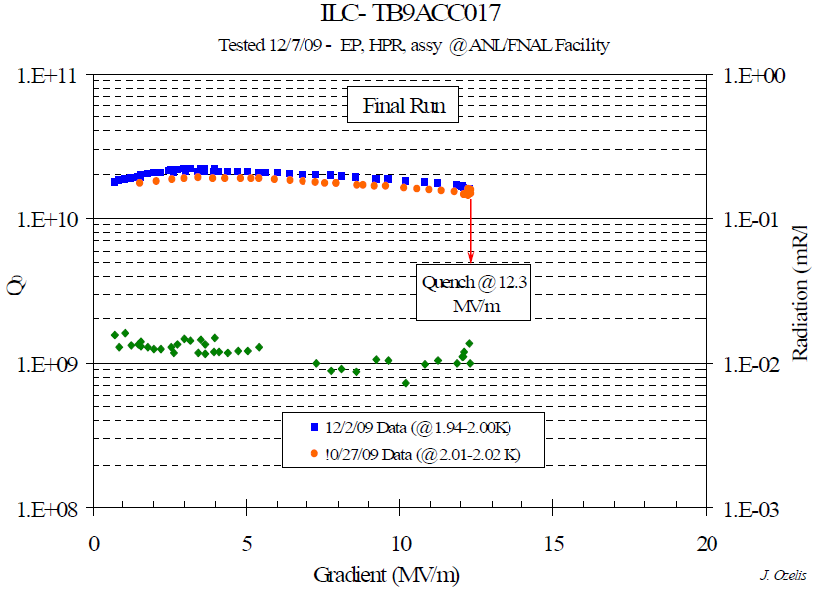
1.3GHz 9-cell cavity TB9ACC017
Y-Y’
X-X’
EB-Welding seam
X-X’
Y-Y’
TB9ACC017 quenched at 12.3MV/m, Pit was found at Cell #4 equator 180 deg region (quench location), the pit is 150 µm deep and 200 µm wide on the top.

Slide 6
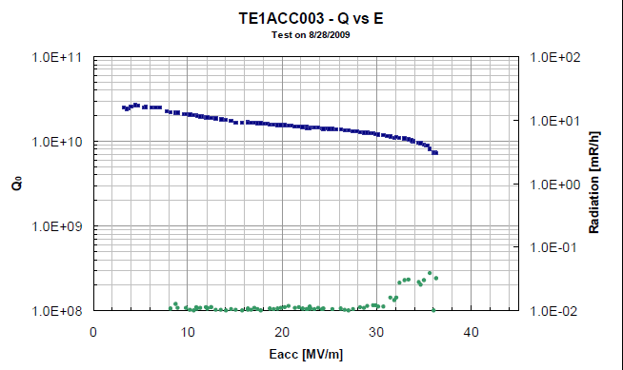
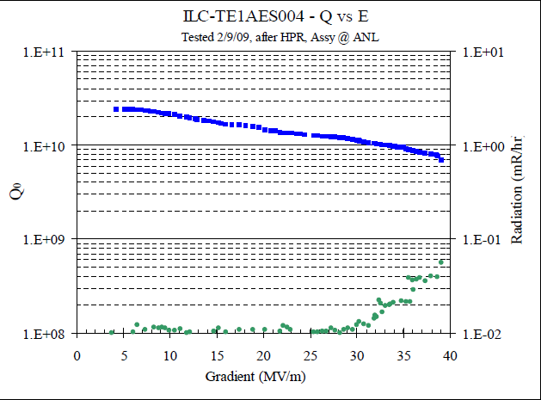
Experience from Fermilab 1.3GHz
single-cell cavity activity
Equator
welding seam
HAZ
36MV/m quenched at pit region
TE1ACC003
Diameter: 400µm,Depth: 60µm
Equator welding seam
TE1AES004
Diameter: 1300µm, Depth: 60µm
A 15µm tiny bump in the center.
39MV/m quenched at pit region
Notes:
6

Slide 7
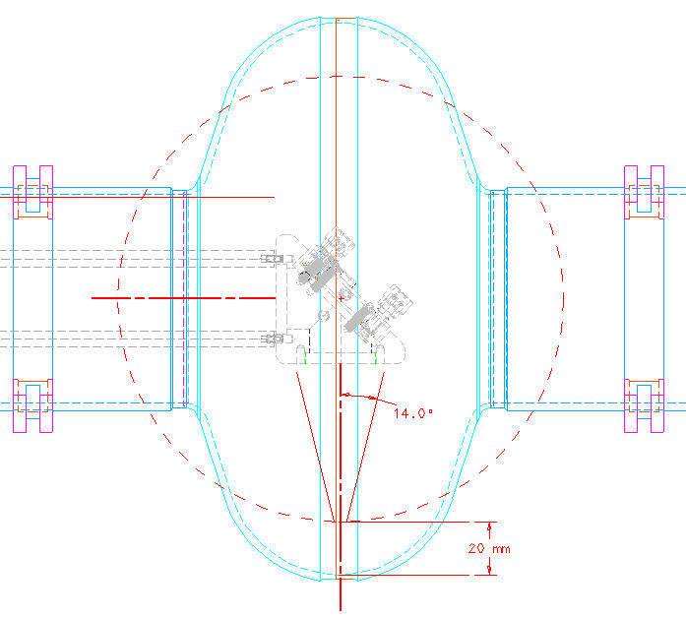
Laser repair tool
Goals:
Try to push cavity gradient from 20MV/m limited by pits to 40MV/m.
Cavity
Laser beam
Mirror

Slide 8
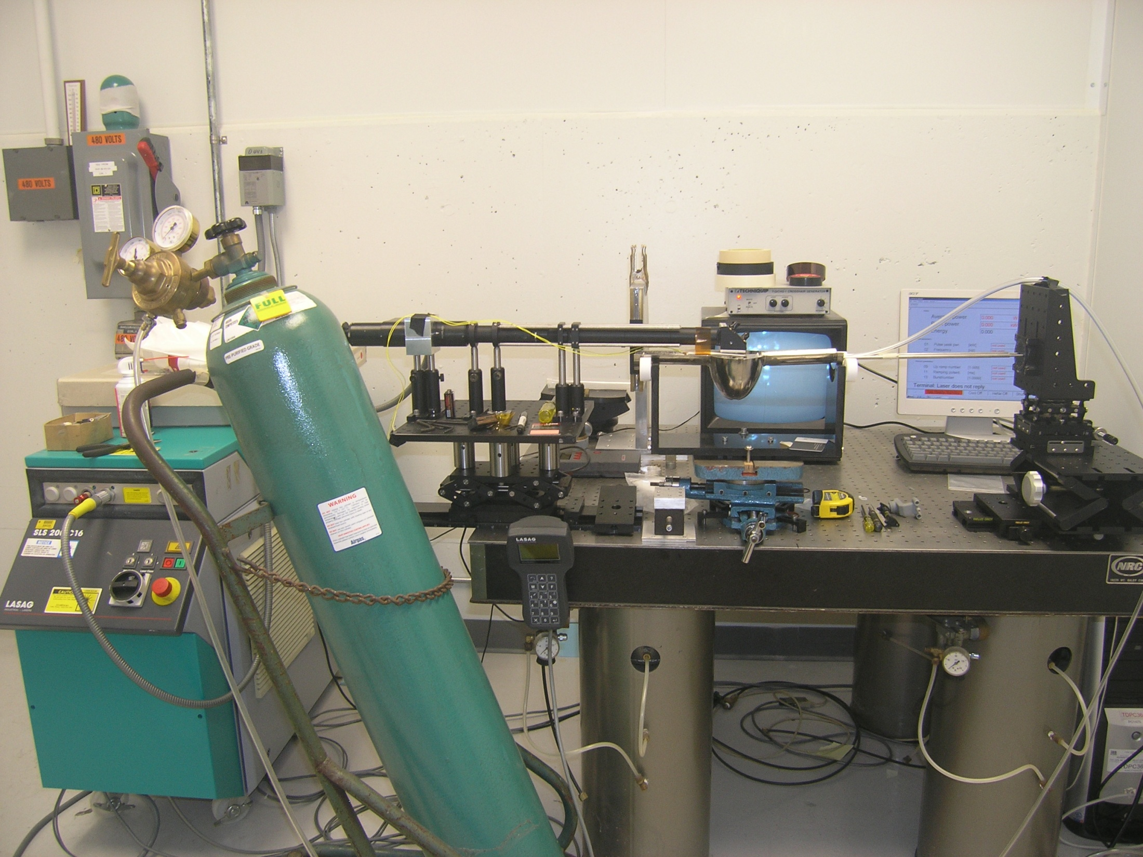
CCD camera
Laser beam deliver line
Monitor
Gas nozzle holder
Rotation stage
V-block with rollers
Laser focus platform
X-Y stage
Laser source
Ar gas cylinder
8

Slide 10
Profile Comparison before and after laser re-melting
Manmade pit
After re-melting the pit profile changed from 120µm deep to 30µm flat

Slide 11
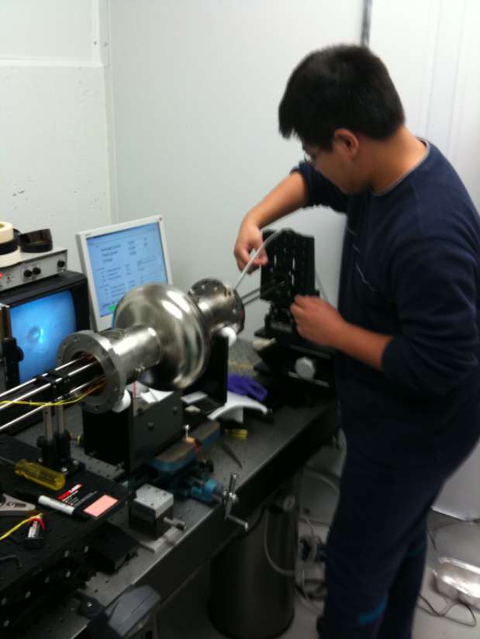
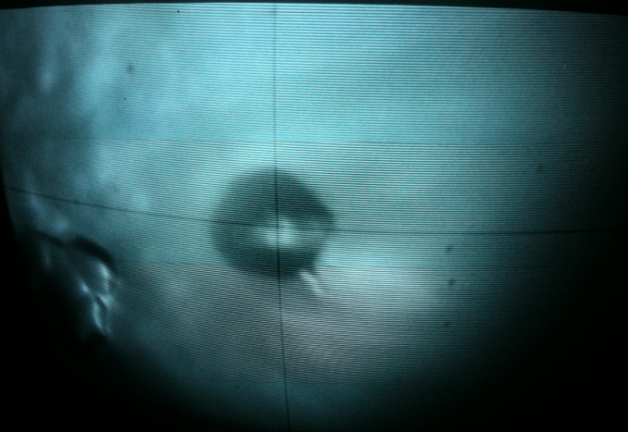
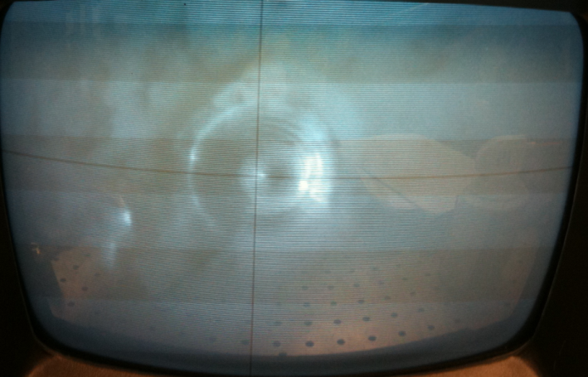
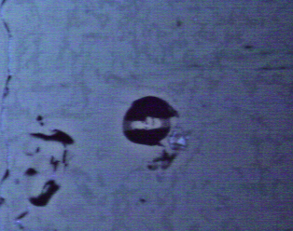
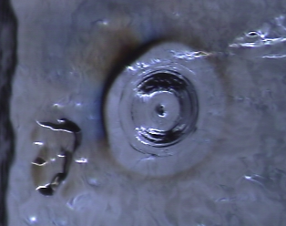
Laser processing of 1.3GHz single-cell cavity TE1ACC003
Screenshot of the monitor before and after laser re-melting
The Pit before re-melting
After re-melting
Images was taken from Kyoto Optical Inspection machine

Slide 12
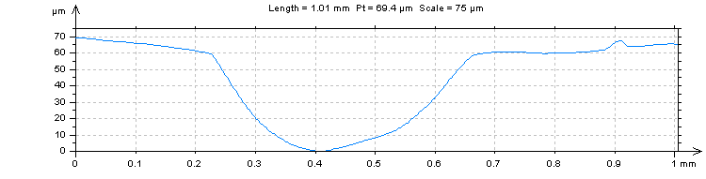
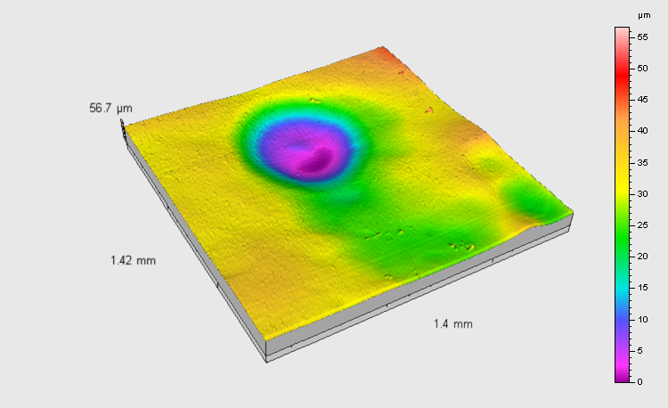
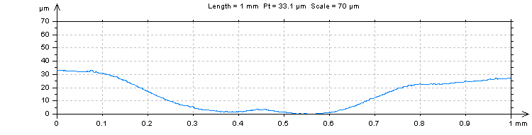
Profile comparison before and after Laser processing
400µm in diameter
60 µm in depth
700µm in diameter
30 µm in depth
The pit profile changed from 60µm deep to 30µm flat
after re-melting and 50µm light EP

Slide 13
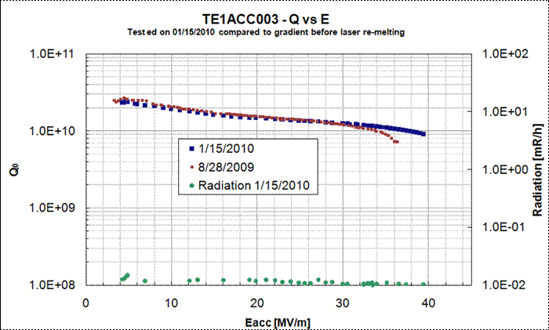
TE1ACC003 vertical test results before and after laser processing
After Laser processing: EP 20µm+HPR+120C baking;
Gradient achieved 39.4MV/m, quenched at molten region;
After flux trapped into cavity, cavity quenched at 32MV/m.

Slide 14
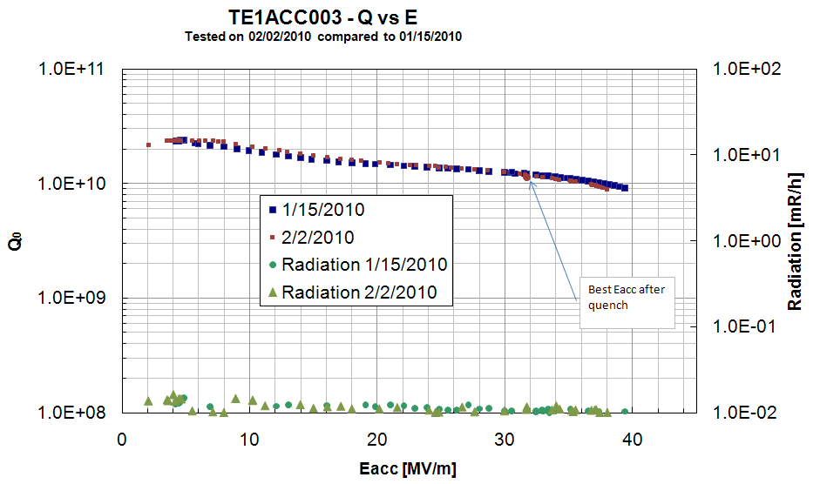
To confirm flux trapping
Cavity was warmed up to room temperature and cooled down to 2K

Slide 15
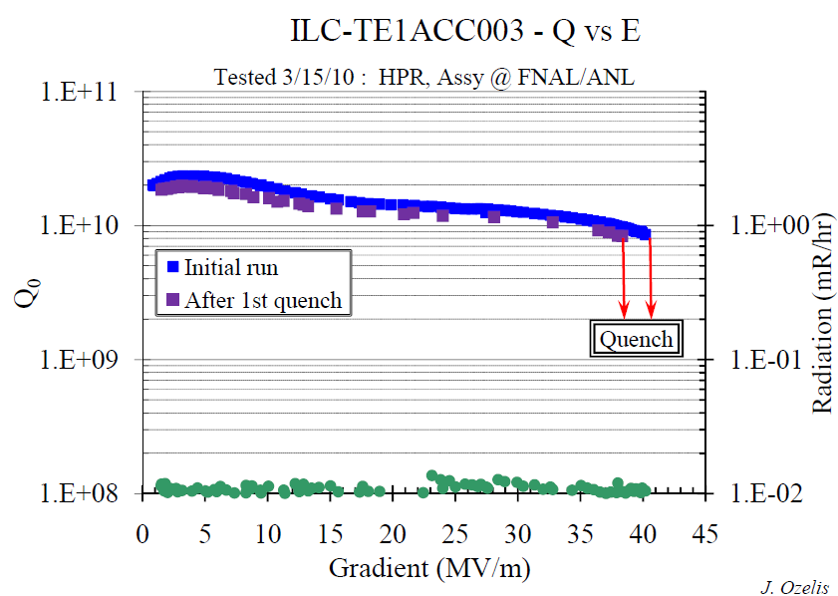
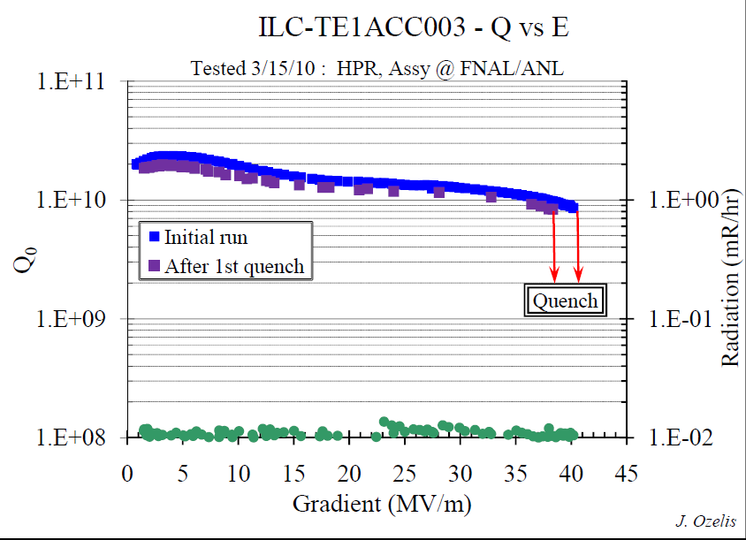
After another light EP (20 micron)
Cavity was EP’d another 30µm+HPR+120C baking;
Gradient achieved 40.3MV/m, quenched at molten region;
Cavity quenched at 38MV/m after first quench.

Slide 16
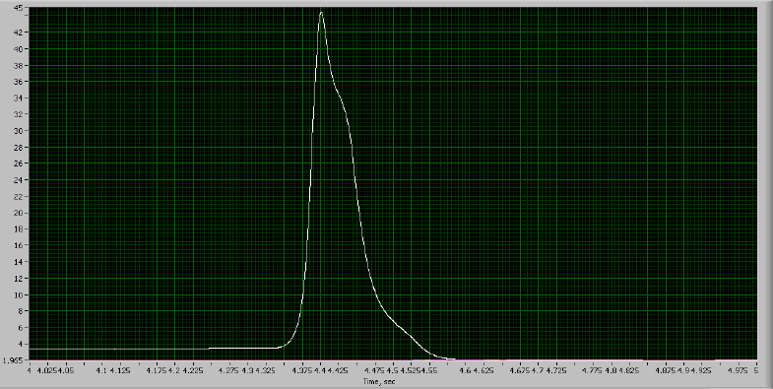
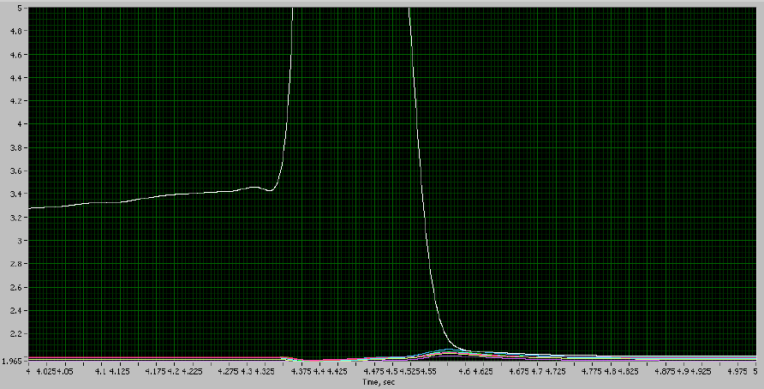
Fast thermometer response on the laser spot
Pre-heating was observed

Slide 17
Summary
Successfully re-melted pit inside 1.3GHz single-cell cavity.
Cavity gradient achieved nearly 40MV/m.
Flux trapping degraded gradient from 39MV/m to 32MV/m.
Flux trapping was improved by additional light EP. (totally about 50µm EP).

Slide 18
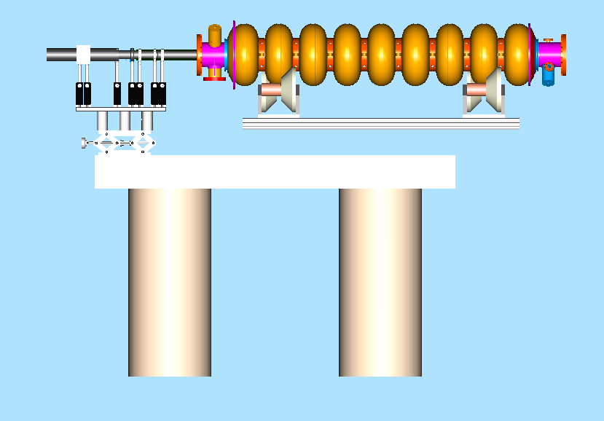
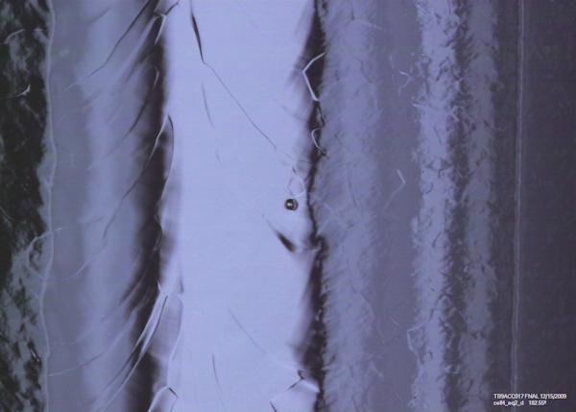
The next step
Produce manmade pit in cavity and recover by laser
Extend system to 1.3GHz 9-cell cavity.
Surface analysis via Nb coupons and samples cut off from single-cell cavity.
Pit in 1.3GHz 9-cell cavity TB9ACC017
Quenched at 12.3MV/m.

