Slide 1
Networking Update
Andrew Rader
January 2010

Slide 2
NOvA update
Soudan Mine update
FNAL network update
Network Support
Budgeting

Slide 3
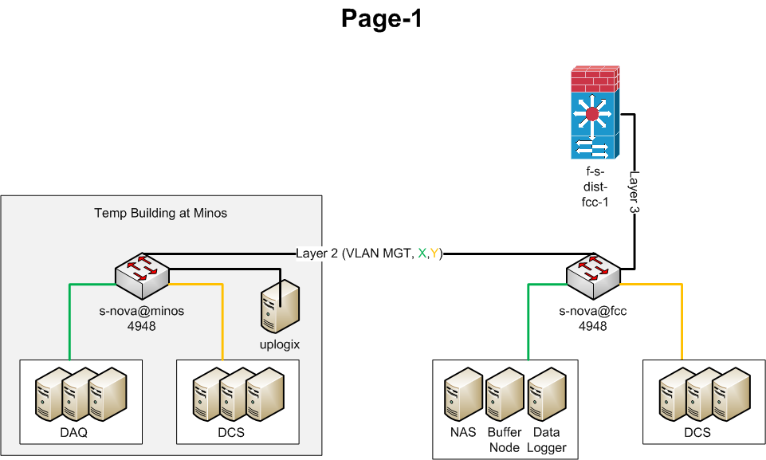
NOvA Networking

Slide 4
Soudan Mine Services
DNS/DHCP: new Infoblox server going production in the coming months.
New console access device with disaster recovery capabilities being installed.
Local NTP server.

Slide 5
Soudan Mine Networking
Equipment is near end of life / end of support.
Upgrade this year was cut from the budget.
Upgrade is high priority for FY 2011.
Need new router and new access switches to support all internal links at 1 gigabit.

Slide 6
FNAL MINOS Network
Current switch is due for upgrade to support new experiments.
Upgrade will increase capacity and provide redundancy (as budgets permit).
Current uplink is two X 1-gigabit, with one active and one standby.
Current uplinks are sufficient for current traffic.
Planning for future:
Channel together the two uplinks
Add more as needed

Slide 7
Uplink from Tunnel to Surface

Slide 8
12th Floor Control Room
Current 3750 switch is nearing capacity.
Adding second 3750 to provide some level of redundancy.

Slide 9
Network Support
24x7 support for all critical connections
Loss of experimental data
Large clusters of systems down
8x5 support for other network issues
Single user or small workgroup can’t connect
VPN support, other end client issues
Please route all requests through the servicedesk.

Slide 10
Value Added Services
Network design and implementation consultation.
Network installations.
Networking equipment hardware maintenance and spares pool.
Network infrastructure support, fiber optic plant engineering.
Proactive network health monitoring.
Troubleshooting and support services.

Slide 11
BLI’s for Networking
Please include Budget Line Items for Networking when you plan.
Please request budgetary estimates from Networking.
Please bring us into the loop sooner rather than later!

Slide 12
Help Us to Help You!
What are your expected bandwidth requirements over the next year? 5 years?
How many network ports will you need underground in the next year? 5 years?
Please don’t bring in network cables and switches from off-site. Please use Computing Division provided cables and equipment. They have been tested and certified. You also benefit from our value added services.

Slide 13
Q & A ?

