Slide 1
Box Cavity Status and Box Button cavity Design Al Moretti Friday talk, 01/05/10

Slide 2
Current Status and Plans for the Orthogonal Box cavity
The Orthogonal box cavity has been connected to its ¼ waveguide coupling section through a Tin seal and successfully vacuum leak checked in the A0 test lab, Figures 1, 2 and 3.
The “Test” WG Power Coupling Section, Figure 4 , has been attached to a Network Analyzer and measurements were made of the match, Frequency, and Qo. The measured results were in very good agreement with the simulation.
The rotatable (to over 12 Degrees in very small steps) magnet support frame and the transfer support carrier fame have been completed, Figure 5. Installation of the support frames in the MTA hall is scheduled for the week February 14 th.
The vacuum system has been designed with a Flexible vacuum hose section that allows full rotation. All parts are on hand; installation and testing schedule for the week of February 21 st.
Installation of signal cables, Flexible WG sections to accommodate the rotation, Figure 6 and calibration scheduled to be completed also by the week of Februar 21 st. Operation will begin shortly after.

Slide 3
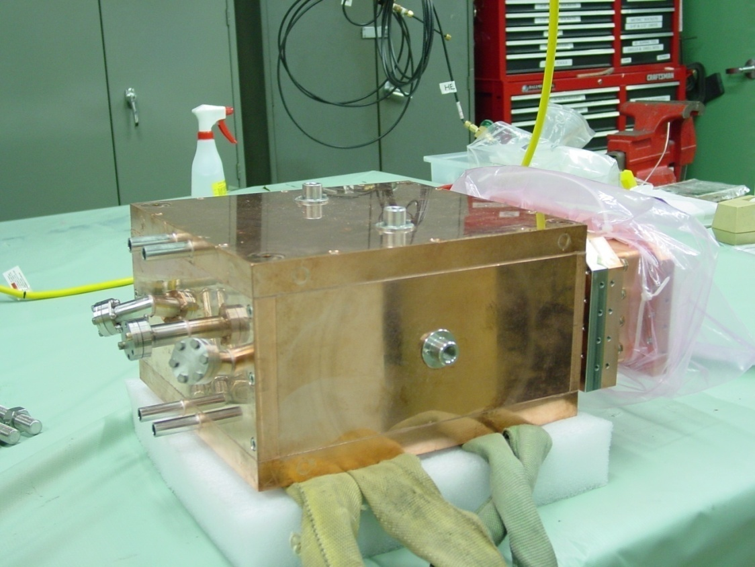
Picture of the Orthogonal Box Cavity in A0 Test Lab connected to the End ¼ height Waveguide Coupling Piece after successful Vacuum Leak Check
Compound Tin Seal Location
Pickup ports
Sapphire Viewing port location
Water cooling tubes
End ¼ height Waveguide Coupling Piece
Figure 1

Slide 4
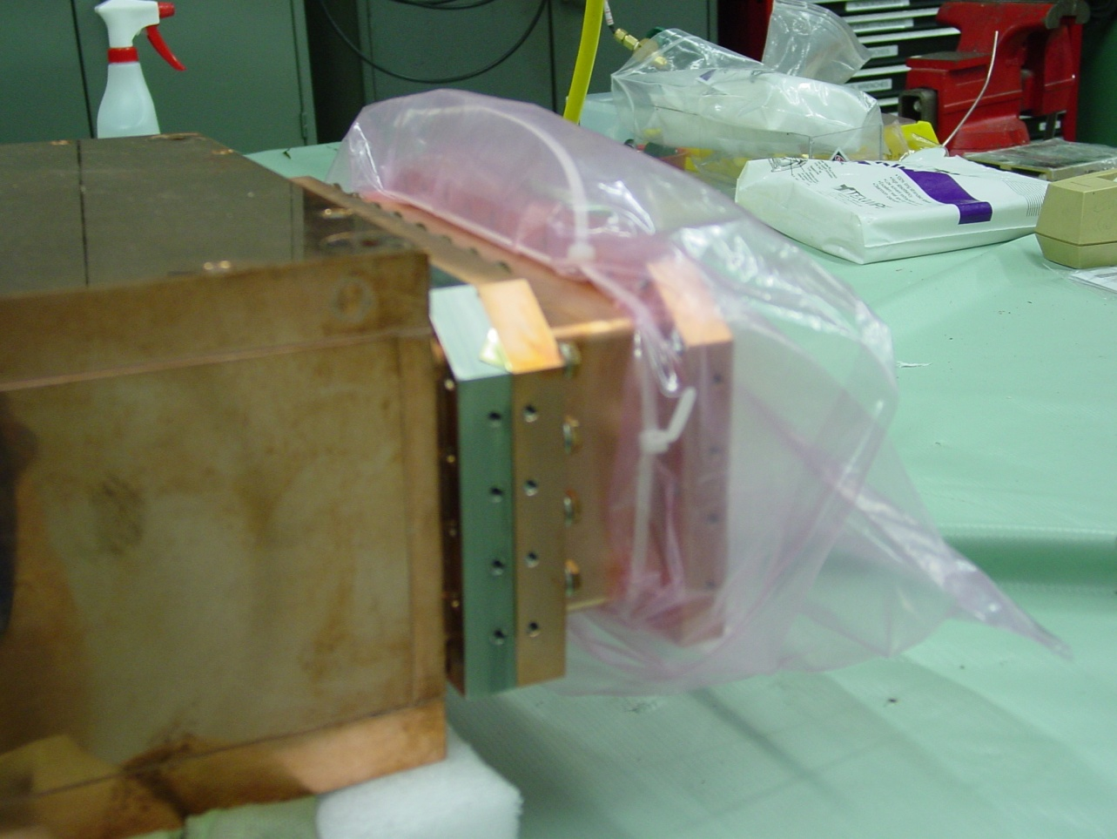
Close-up view of the ¼ height Waveguide Coupling Piece
Figure 2.

Slide 5
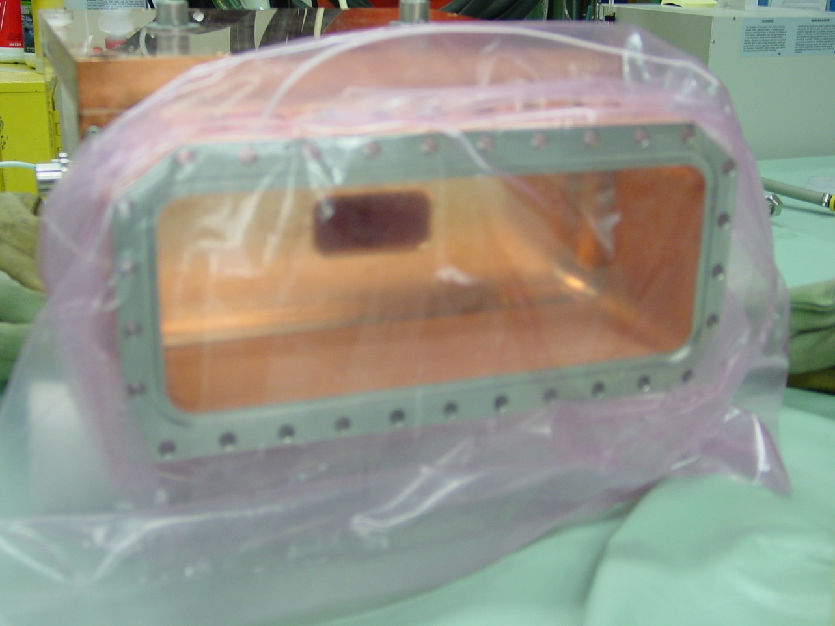
End View of the Coupling Aperture through the Waveguide Coupling Section.
Flange that connects the Box cavity and ¼ height WG coupling Section to the LBL Power WG Section.
Groove used to support the special compound tin vacuum seal.
Figure 3.

Slide 6
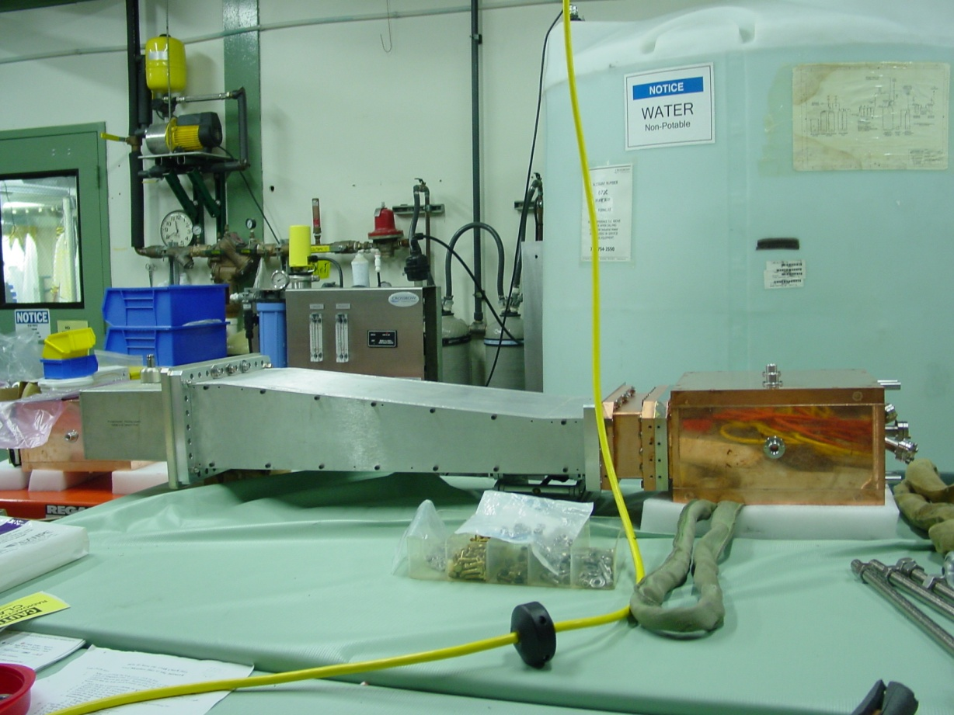
Box Cavity attached to Tapered waveguide coupler and type N connector to WG Adapter.
Network analyzer measurements:
Fo = 805.08 MHz;
Simulation Fo=806.2 MHz
Qo= 26,400;
Simulation Qo= 27,400
β= 0.9 coupling factor;
Simulation β= 1.06.
These values are preliminary and may change when attached to the LBL stepped WG coupler and mounted in the magnet.
Type N to WG Adapter
“Test” Tapered WG Coupler
¼ height WG Coupling Cell
Cavity
Figure 4.

Slide 7
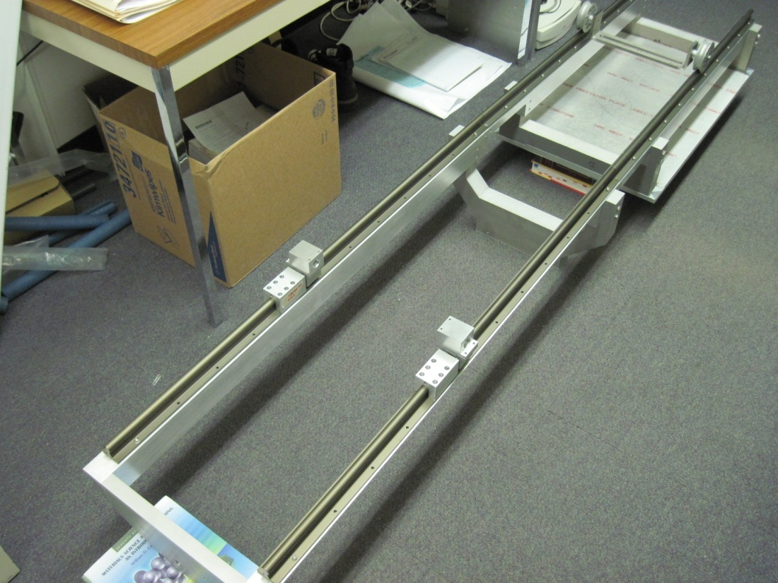
View of the Orthogonal Cavity rotational magnet support Frame next to the transfer support carrier fame .
Transfer support carrier fame
Rotational magnet support Frame
Figure 5.

Slide 8
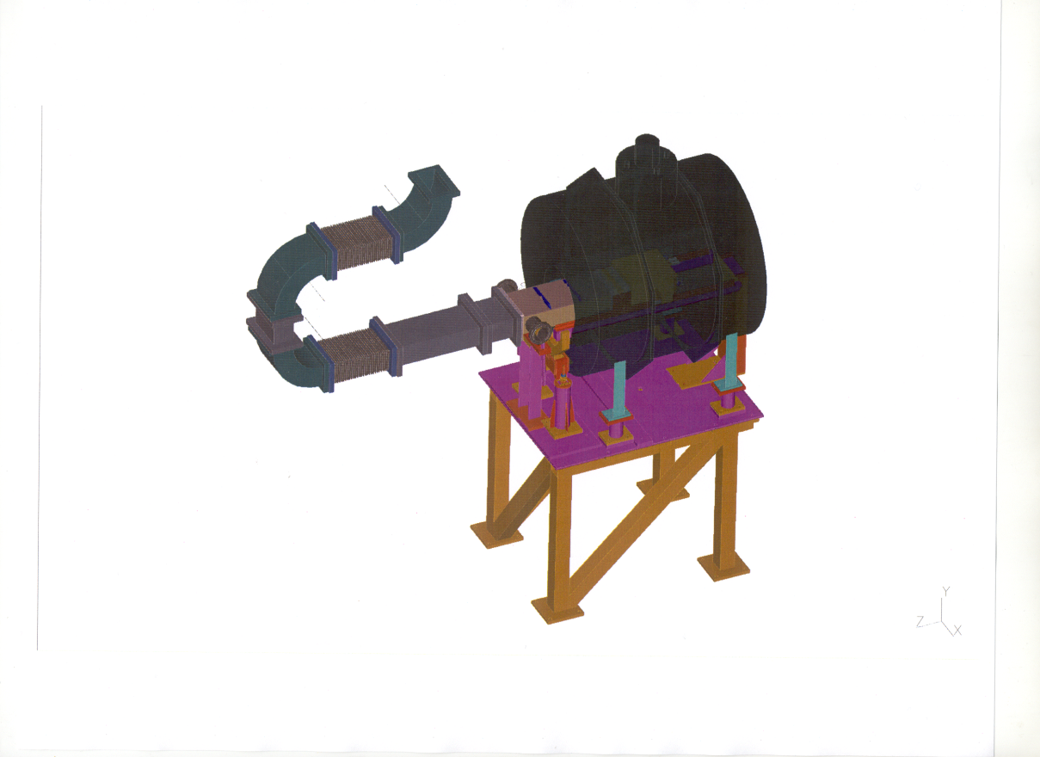
Layout of the Rotation Waveguide attachment
Attached to High power klystron
The waveguide rotation apparatus design consists (3) 90 Deg Elbows,
(2) Straight sections of WG and (2) 0.46 m Flexible WG sections. A precision digital level which reads tilt angles in degrees will be use the measure rotation angle.
Flexible WG
Figure 6.

Slide 9
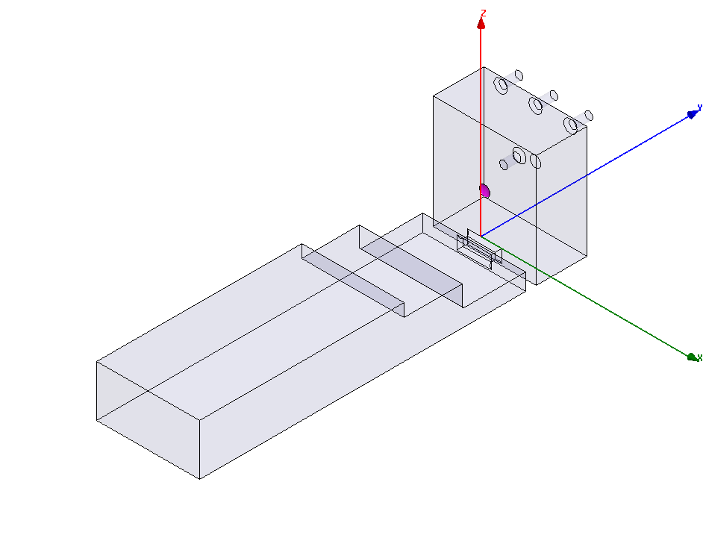
Parallel Box Cavity Simulation as a Button Cavity
Simulation of the parallel box cavity as a button :
Two button design,
Accommodating the “ standard” Button and Palmer’s Button design.
The gradient enhancement factors were the same as in the LBL button button cavity, 1.7 and 3 respestivily.
Required a double set WG transition to accept the standard LBL button attachment design

Slide 10
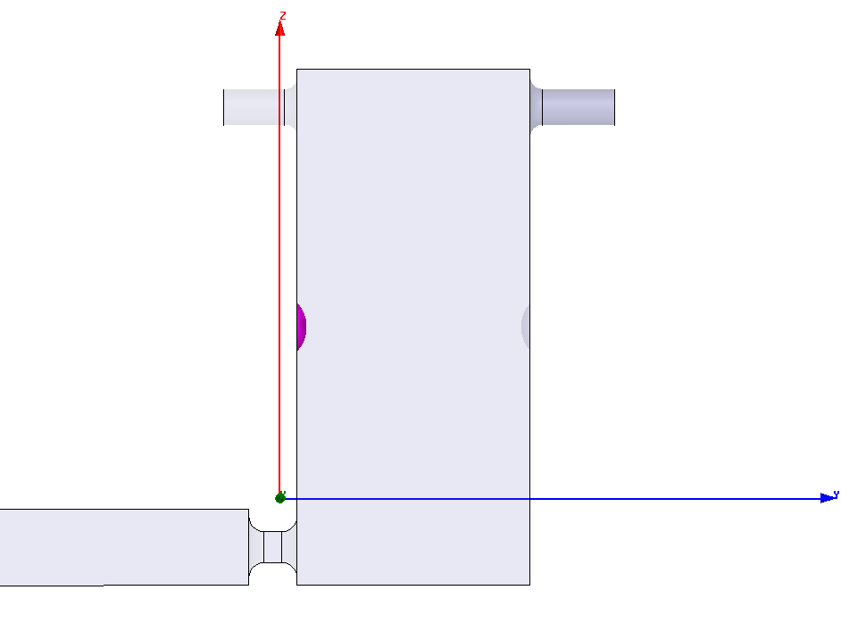
Closer View of the Buttons in the cavity
Buttons

Slide 11
Summary
The orthogonal box cavity is in the final phase for installation, calibration and cabling. Operation and RF commissioning with high priority could begin the last week of February.
A parallel box cavity for testing “standard” button and Palmer’s “button” design has been HFSS simulated with very good results.

