Slide 1
Review of Jan’10 High Pressurizing Hydrogen gas filled RF cavity run and Status of beam test
Muons, Inc.
K. Yonehara
APC, Fermilab

Slide 2
Goal of HPRF project
Study hydrogen plasma physics
Demonstrate High Pressure RF cavity under high radiation condition
Investigate RF breakdown from different aspect

Slide 3
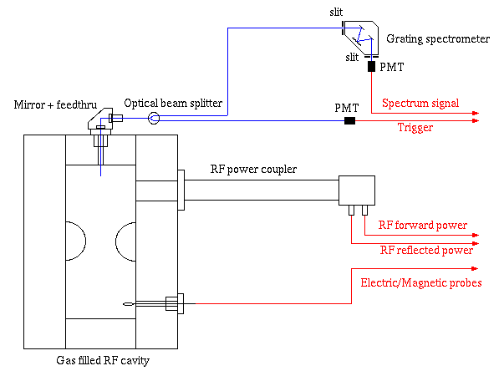
New optical system for Jan10 run
Gap = 3 cm
PMT
Trigger
We have higher intensity trigger light than in
previous measurement

Slide 4
Improvement from previous test
Isolate trigger light from spectrometer light
More spectroscopic light (factor 3)
Put trigger fiber near plasma region
Expect more sensitivity
Debug averaging measurement method with digital oscilloscope
Found this debug during the test
Occasionally DAQ was triggered by second peak of optical trigger signal
It was solved by setting DAQ timing window properly

Slide 5
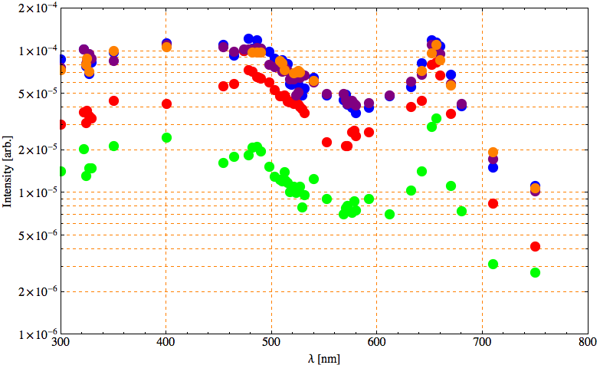
HPRF spectrum
H-β (486 nm)
H-α (656 nm)
1500 psi (metallic BD)
1310 psi (metallic BD)
1120 psi (metallic BD)
930 psi (gas BD)
540 psi (gas BD)
Neutral Cu line (~325 nm)
Cu lines (510 ~ 525 nm)
Calibrated by PMT response for wavelength
Intensity = Integrated spectrum signal/Integrated trig signal

Slide 6
Summary in spectroscopic measurement
Clearly see H-α and H-β lines
Trigger PMT works and increase spectrometer light intensity (× 3)
Pressure dependent broadband background
Background level seems to be saturated at metallic breakdown region
We do not see clear Cu lines

Slide 7
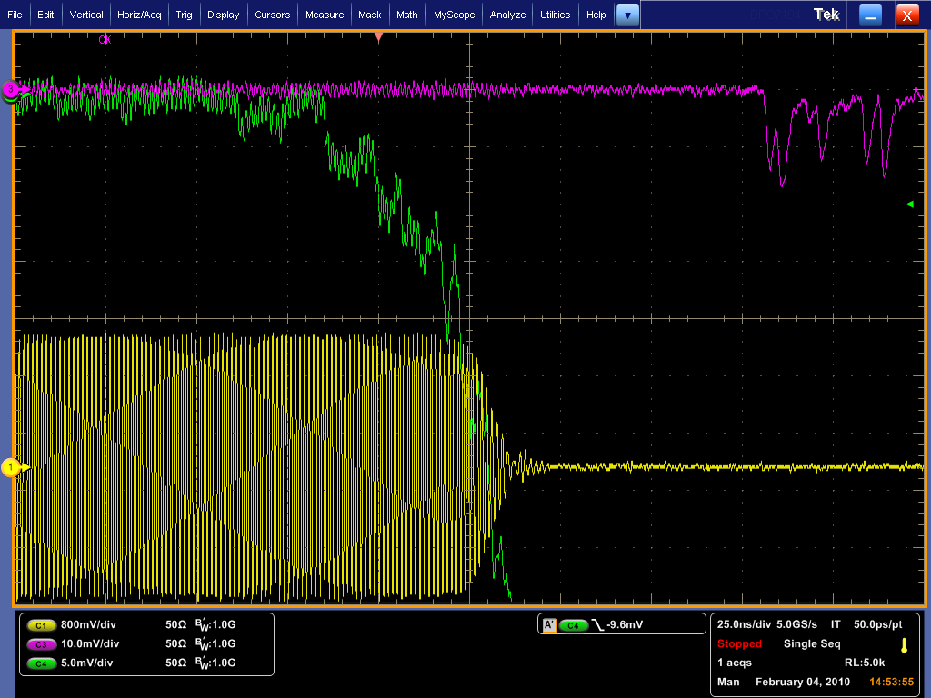
Precursor light in Trigger PMT
Trigger PMT starts detecting
some light before breakdown
This is first time we captured
precursor light
Trigger PMT locates closer to
hydrogen plasma region
We have higher light intensity
than before
Spectrometer PMT has slow
response because of low
light intensity
Spectrometer PMT (λ=656 nm)
Trigger PMT (take white light)
Breakdown!
Magnetic field pick up coil

Slide 8
Preparation for beam test
Collimator design
Start making engineering drawing
Diagnostic system
Search available beam profile monitor by using luminescence screen
Circulator
Will be delivered around end of April
DAQ & trigger system
Trigger signal from Linac RF to synchronize Klystron
Beam trigger byBPM
Hydrogen & Radiation Safety
Wait output from radiation safety committee
Obtain permission from DoE

