Slide 1
CILogon Project www.cilogon.org
Jim Basney jbasney@illinois.edu
This material is based upon work supported by the National Science Foundation under grant numbers 0850557 and 0943633. Any opinions, findings, and conclusions or recommendations expressed in this material are those of the authors and do not necessarily reflect the views of the National Science Foundation.

Slide 2
CILogon Project Goals
Foster secure, usable authentication for cyberinfrastructure (CI)
Provide community-driven software support:
MyProxy (http://myproxy.ncsa.uiuc.edu)
GridShib (http://gridshib.globus.org)
Now focused on GridShib CA
GSI-OpenSSH (http://grid.ncsa.uiuc.edu/ssh)
Provide a new service that issues digital credentials to the NSF research community

Slide 3
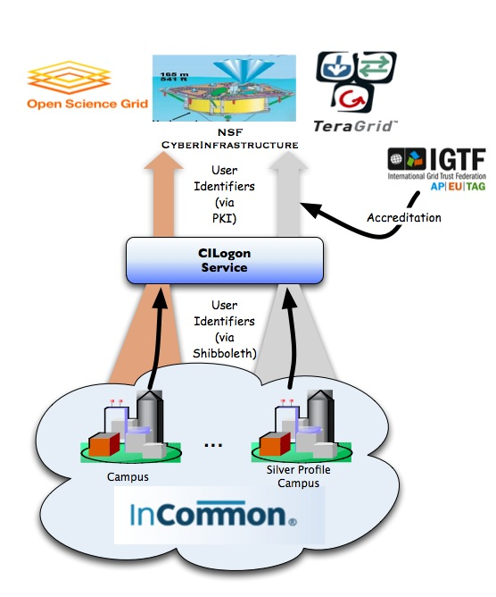
CILogon Service
Facilitate campus login to NSF CI
Leverage researchers’ existing identities at their home institution
Ease identity management for researchers and CI providers
Bridge from:
Identity credentials issued by research institutions participating in the InCommon Federation using Shibboleth/SAML web browser single sign-on
Bridge to:
X.509 PKI credentials that satisfy the requirements of NSF CI projects

Slide 4
CILogon Service: Timeline
September 2009:
Federated Login to TeraGrid Deployed (https://go.teragrid.org)
CILogon Project Start
April 2010 (Planned):
Prototype Service Deployed
TAGPMA Accreditation
September 2010 (Planned): Operational Service Deployed

