Slide 1
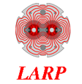
fermilab program results and next steps
LARP Collaboration Meeting 14
Fermilab, April 26-28
Guram Chlachidze

Slide 2
outline
Introduction
Single Nb₃Sn quadrupole coil test in a “magnetic mirror”
structure
  Effect of coil pre-stress on magnet performance
  Complementary to study performed by LARP (TQS03)
Development and test of a quadrupole magnet with
“dipole style” collars
  Reduction of assembly time and of the risk of coil damage
Future plans

Slide 3
Introduction
Fermilab, along with other US National Laboratories, is developing a new generation of accelerator magnets based on Nb₃Sn super-conductor
  Study and optimization of Nb₃Sn strands and cables, insulation
  Fabrication of coils and other components with various design and processing features
  Fabrication and test of a series of model magnets
  Nb₃Sn coil technology scale-up
Recent technology developments within Fermilab’s base High Field Magnet (HFM) program include
  Quadrupole mirror structure to test single quadrupole coils in a real magnetic field environment
  Assembly and test of a Technology Quadrupole (TQC) with a dipole style collar design and coil alignment

Slide 4
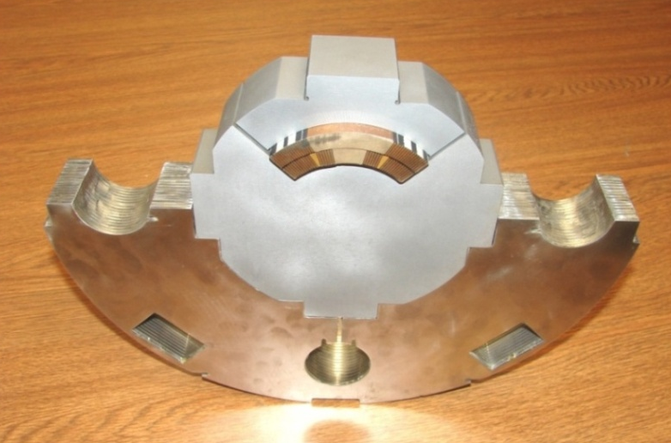
TQ mirror structure
The “Magnetic Mirror” concept was developed for the HFM dipole and now expanded to include the 90-120-mm quadrupoles
  Long mirror dipoles (LM01, LM02) were built and successfully tested for the Nb₃Sn coil technology scale-up
Design details and first test results were presented at LARP Collaboration Meeting 13 (Port Jefferson, November 2009) by Rodger Bossert
  http://larpdocs.fnal.gov/LARP-public/DocDB/DisplayMeeting?conferenceid=69
Specific coil and cable features can be tested and optimized efficiently, in a short time period
  Re-assembly turnaround time is about 3
  weeks
  2.5 months required for construction of
  a mirror magnet with a new coil
  (compare to ~ 6 months for a quadrupole
  magnet)
Simplified structure – coil to coil
interactions not present – an intermediate step to speed up overall magnet development time

Slide 5
TQ mirror DESIGN FEATURES and HIstory
Mirror | COIL # | STRAND | CABLE | INSULATION | COIL POLE
TQM01 | 19 | RRP 54/61 | LBNL | S2-Glass Sleeve | Bronze
TQM02 | 17 | RRP 54/61 | LBNL | S2-Glass Sleeve | Bronze
TQM03: a, b, c | 34 | RRP 108/127 | FNAL | E-Glass Tape | Titanium
TQM01 and TQM02 mirror magnets were tested in Jan.-April 2009
Test results were presented at CEC/ICMC and MT-21 in 2009
      Coil quench performance in the mirror structure found consistent with the performance in TQS and TQC models
  TQM03 magnets tested in Jun.-Aug. 2009 and Feb.2010
  3 variations with different coil pre-loads
  Cable based on RRP-108/127 strand was fabricated at Fermilab
  E-Glass tape was used for cable insulation instead of expensive S2-Glass sleeve

Slide 6
Coil pre-Stresses in Quadrupole mirror
MIRROR | Measured warm stress (MPa) | Air Gap (mils) | Predicted Cold stress (MPa)
TQM01 | 100 | 4 | 90
TQMO2 | 100 | 6 | 110
TQM03a | 100 | 5 | 100
TQMO3b | 105 | 8 | 145
TQM03c | 135 | 10 | 185
Gauges bonded directly to coils confirmed
pre-loads at room temperature, however
these gauges are not compensated at LHe
temperatures. Therefore, cold pre-loads
are assumed from FEM analysis
Next mirror magnet (TQM04) will be equipped with gauges connected in a full-bridge configuration on Titanium pole and will be
compared to analysis

Slide 7
TQM03 Quench training
~97% of SSL
~92% of SSL
4.5 K
1.9 K
4.5 K
SSL at 4.5K ~ 13.0 kA
1.9K ~ 14.4 kA

Slide 8
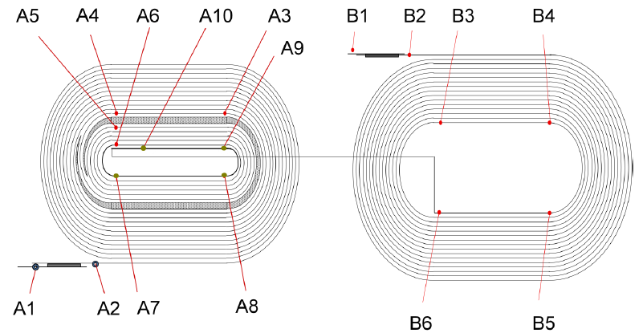
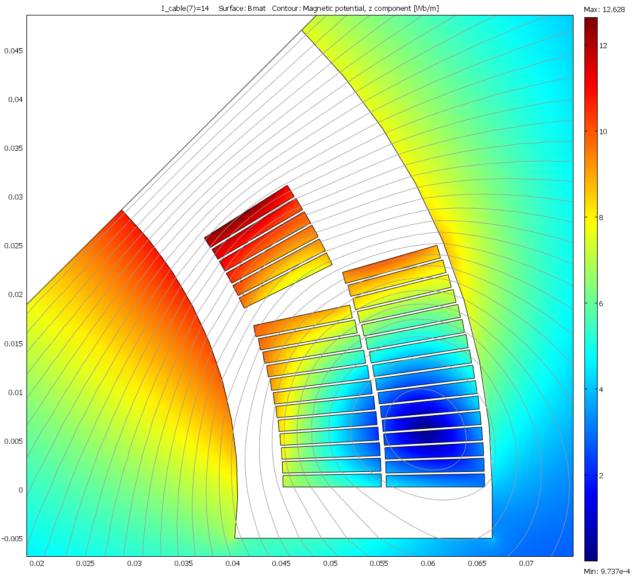
Quench locations
10 T
6 T
2 T
Coil cross section with flux density
distribution in mirror magnet at 14 kA
TQM03b - all quenches in A10_B2
TQM03c - 4.5 K quenches in A10_B2
1.9 K quenches in A2_A3
TQM03a

Slide 9
TQM03 Ramp rate dependence
4.5 K
C
B
A
C
B
A
1.9 K

Slide 10
TQM03 temperature dependence
Ramp rate : 20 A/s

Slide 11
Summary of TQM03 models
A “magnetic mirror” structure for quadrupole coil evaluation has been developed and successfully employed in testing at Fermilab
Coil with Nb₃Sn RRP-108/127 strand and new cable insulation (E-Glass tape) demonstrated excellent quench performance and improved stability at 1.9 K
  RRP 108/127 is now LARP baseline strand
  E-glass insulation is considered for long LQ coils
Coil pre-stress up to ~185 MPa does not introduce significant degradation in conductor I_{c} (consistent with TQS03 test data).
However noticeable degradation of conductor stability at 1.9 K was observed (TQM03c)
Next : New Nb₃Sn coil (RRP 108/127) with cored conductor is ready for test in mirror structure (TQM04)

Slide 12
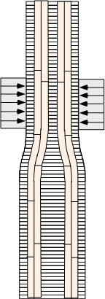
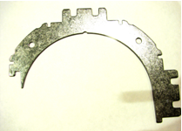
TQC magnet with dipole style collars
Feasibility of quadrupole support structure and collaring procedure based on traditional quadrupole-style collar have been demonstrated in several TQC model magnets
  Requires additional horizontal to vertical handling of the coils
  Collaring using short vertical 4-jaw press with partial coil
  compression along the length
  Time consuming process with many (~6-8) passes and some
  risk of damage to coils
Dipole style collar design
  Collaring using full-length horizontal press
  Collaring in a single pass reducing coil degradation risks and
  construction time

Slide 13
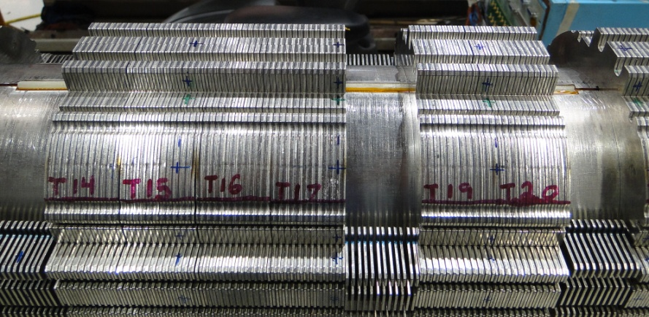
TQc02eb test at fermilab
Magnet was built with Nb₃Sn coils (RRP 54/61) already tested in both shell and collar structures
  4 variations of TQS02 magnet were tested at Fermilab and CERN
  TQC02Ea with coils 20,21,22 and 23 previously tested at Fermilab
Standard shim configuration with a target stress of ~120 MPa at 4.5 K
First time dipole style collars
are used in TQC magnet
Coil alignment key installed
Test at 4.5 K and 1.9 K included magnet training, ramp rate
and temperature dependence study

Slide 14
TQC02Eb Quench History
~211 T/m
~217 T/m
4.5 K
1.9 K
4.5 K

Slide 15
TQC02E and TQS02 performance at 4.5 K

Slide 16
TQC02Eb Ramp Rate dependence
4.5 K
1.9 K

Slide 17
TQC02Eb Temperature Dependence

Slide 18
Summary on TQC02Eb test
The first Technology Quadrupole with a dipole style collar design - TQC02Eb - was built and tested successfully at Fermilab
TQC02Eb reached ~211 T/m field gradient at 4.5 K and ~217 T/m at 3.2K temperature
Coil quench performance in magnets of shell (TQS02) or collar (TQC02E) structure is consistent
Multiple handling and test cycles demonstrates that the TQ Nb₃Sn coil design is robust
Magnetic field measurements do not show any significant distortions related to the dipole style collar design in TQC02Eb

Slide 19
Conclusions and future plans
The quadrupole mirror structure, developed at Fermilab, has confirmed the
expected technical performance and high efficiency
The mirror concept can be easily adapted to test long LQ or 120-mm
diameter HQ coils
Future Plans:
A Nb₃Sn coil (RRP 108/127) with stainless steel cored conductor is ready for test in the mirror structure (TQM04)
  Standard S2-Glass sleeve insulation
  Titanium pole pieces
Work on a long mirror structure for LQM01 in progress
  Mirror structure is available
  Fabrication of long coil with Nb₃Sn 114/127 strand and E-Glass insulation has started
  Cold test expected in September 2010
Mirror structure for HQ coil test is available
  Choice of coil and schedule under discussion
Test of TQ coil impregnated with liquid polyimide (MATRIMID) – TQM05 (planned for FY 2011)

Slide 20
Conclusions and Future plans
Dipole style collar design and collaring process were developed and
successfully tested at Fermilab using TQ coils
  Performance consistent with the test results from shell structure magnets (TQS02a/c) or collared structure magnet with a quadrupole style collar (TQC02Ea)
  Dipole style collar configuration can easily be adopted for long structures
Next steps:
  Test of Nb₃Sn coils made of RRP-108/127 strand using dipole style collars (expecting TQS03 coils in May)
  Test of 4-m long quadrupole based on dipole style collars
  (recycle LARP LQ coils, planned for FY 2011)

Slide 21
Backup slides

Slide 22
Magnetic Design - SSL
The estimated magnet quench currents based on the “reference” current density of 2800 A/mm^2 at 4.5 K and 1.9 K are shown below. This SSL is based on the mirror magnetic features and the presentation by Paolo Ferracin, “TQ Performance Overview” on Sept. 8, 2008 at the TQ discussion teleconference.
SSL in TQS, TQC and TQM structures compared.
Magnet | Iss (kA) | Iss (kA)
 | 4.3K-4.5K | 1.9K
TQM01 (2800 A/mm^2) | 13.0 | 14.4
TQS02 (2800 A/mm^2) | 13.8 | 15.1
TQC02 (2800 A/mm^2) | 13.9 | 15.1

Slide 23
TQM03 Quench training
1.9 K
1.9 K
1.9 K
1.9 K
4.5 K
4.5 K
4.5 K

Slide 24
TQM03 temperature dependence

Slide 25
TQm03 RRR Data

Slide 26
TQM01/02/03 mirrors
TQM03a (RRP 108/127)
TQM01 (RRP 54/61)
TQM02 (RRP 54/61)

Slide 27
TQC02Eb: RRR Data
Coils 22, 23
Coils 20, 28
TQC02E RRR

Slide 28
Magnetic measurements at 4.5 K
Measured gradient 111 T/m at 6500 A. Reference radius ~ 1inch
TF = 17.1 T/m/kA
TQC02Eb averaged body harmonics
n | TQC |  |  | TQS
 | calc | measured |  | calc | measured
 |  | 01 | 02E |  | 01 | 02
b₃ | - | 2.01 | 1.07 | - | -1.46 | 2.98
b₄ | - | -1.90 | -2.92 | - | -0.52 | 1.31
b₅ | - | 0.58 | -2.11 | - | 3.06 | -1.45
b₆ | 0.90 | 1.71 | 2.72 | 5.00 | 5.40 | 6.23
b₇ | - | 0.07 | -0.37 | - | 0.07 | 0.05
b₈ | - | 0.01 | 0.12 | - | -0.11 | -0.13
b₉ | - | 0.04 | 0.08 | - | 0.02 | 0.10
b₁₀ | 0.00 | -0.06 | -0.02 | -0.04 | 0.02 | -0.05
a₃ | - | -1.72 | 1.17 | - | 4.41 | 0.66
a₄ | - | 0.62 | 1.47 | - | -1.99 | 0.82
a₅ | - | -1.33 | -3.31 | - | 0.71 | -1.50
a₆ | - | -0.10 | 0.59 | - | -0.37 | 0.12
a₇ | - | 0.10 | -0.09 | - | -0.11 | -0.01
a₈ | - | -0.03 | -0.19 | - | -0.18 | -0.10
a₉ | - | 0.08 | 0.11 | - | -0.02 | 0.02
a₁₀ | - | 0.00 | -0.08 | - | 0.00 | -0.08
 | b | a
3 | -3.57 | 4.71
4 | -3.34 | -0.29
5 | 0.20 | -0.76
6 | -0.62 | 0.05
7 | 0.03 | 0.10
8 | -0.07 | 0.10
9 | 0.06 | -0.02
10 | 0.01 | 0.02

