Slide 1
Status of Thermodynamics Modeling of New LHC Quadrupole Magnets
Dariusz Bocian
I would like to thank people who have share their data and helped during the course of this work:
G. Ambrosio, F. Borgnolutti, F. Cerutti, P. Fessia, M. Lamm, A. Mereghetti, E. Todesco, J. Tompkins, A. Zlobin
LARP CM14, April 27, 2010

Slide 2
OUTLINE
Motivation
Modeling of heat flow in the magnet
    Network model construction
    Helium modeling
New inner triplet magnet model
    New model features
Future plans
    Model validation
    Magnets simulation
Conclusions

Slide 3
MOTIVATION
Particles coming from proton-proton collision debris impact the inner triplet magnets
→ energy deposition in the coils.
Heat flow paths and heat flow barriers identification in the magnet
→ need to give a feedback to the magnet design.
CERN design → enhanced insulation scheme → open helium paths between the bath and the cable
→ study of magnet thermodynamic required
Thermal studies of LARP Nb₃Sn LHC upgrade magnet
→ implement the same method as developed for CERN design

Slide 4
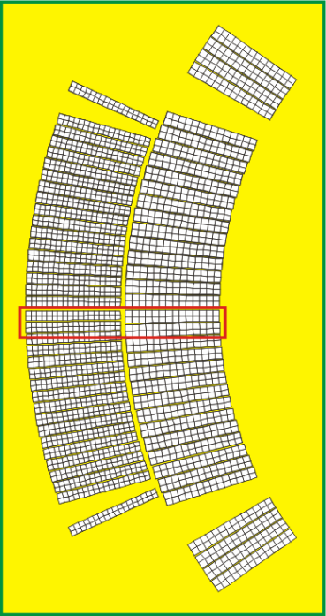
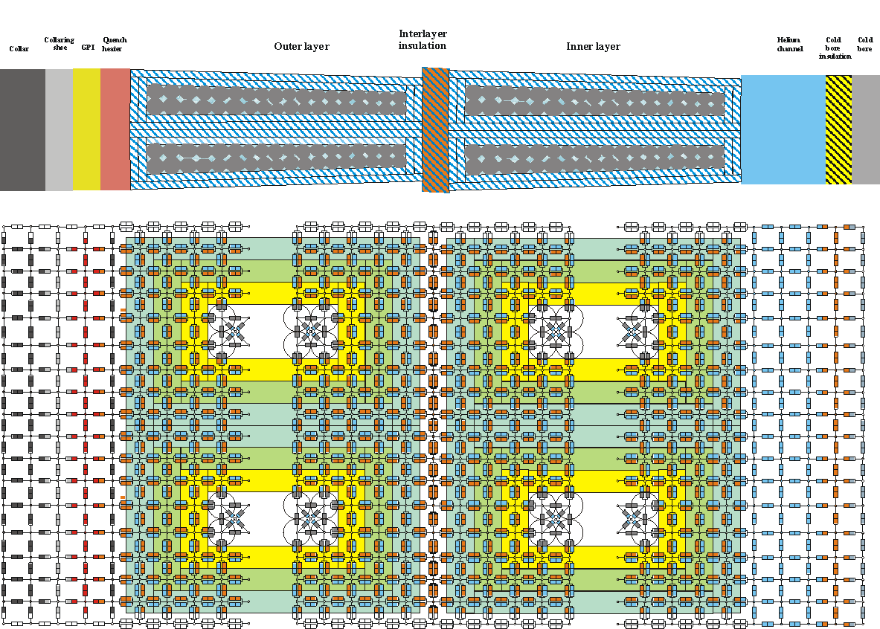
Network Model - Coil
coil model

Slide 5
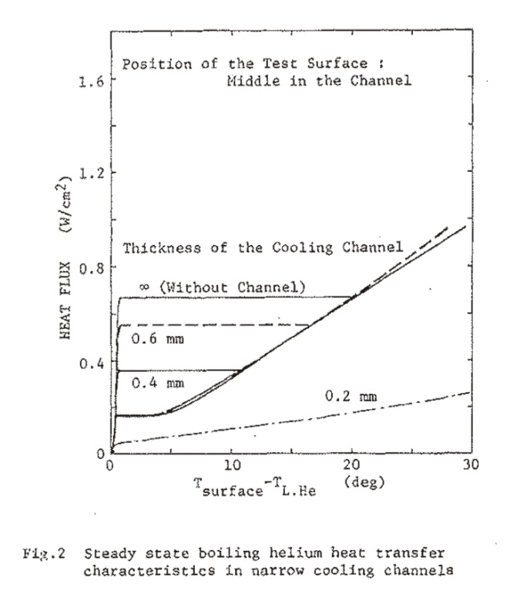
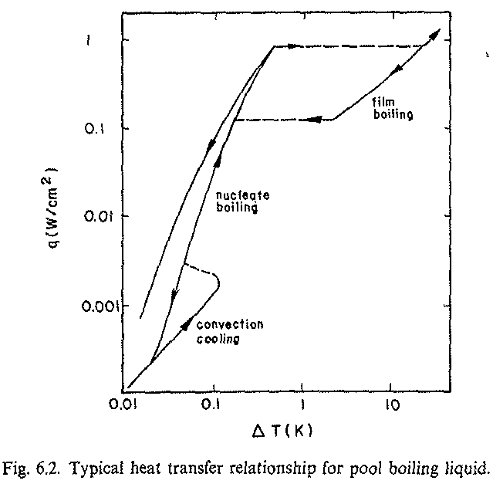
Helium in the magnet
Superfluid helium
The heat flow in He II is calculated according formulae
[Claudet et al., CRYOGENIE et ses applications en supraconductivite, IIF/IIR]
and X(T) is an experimental results fitting
Normal fluid and gaseous helium
In case of channels inside of the cable and μ-channels which are of the order of 0.2 mm and 0.07 mm respectively, a typical nucleate boiling flux becomes much lower than that for helium bath which is 10 000 W/m² [1]. The gaseous phase in the narrow channels is described by a constant heat transfer coefficient and is of the order of 70 W/m²/K as extrapolated from [2]. The convective heat transfer in steady state mode is restricted to heat fluxes not greater than a few mW/cm² [3] as it is only relevant for large volumes. In case of helium inside the cable and in the μ-channels this mode is negligible.
[1] S.W. Van Sciver, Helium Cryogenics.
[2] M. Nishi et all., Boiling helium heat transfer characteristics in narrow cooling channel, IEEE TRANSACTIONS ON MAGNETICS, VOL. MAG-19, NO. 3, MAY 1983.
[3] C. Schmidt, Review of steady state and transient heat transfer in pool boiling helium I.
The heat conductivity of superfluid helium is very high at low heat currents, but since it is non-linear it can be much reduced at high heat currents.
(W. F. Vinen. Superfluidity. CERN CAS School on Superconductivity, 1995.
At high heat currents the superfluid helium in the channel can „quench” resulting in transition to the normal fluid helium means that heat evacuation from the coil is reduced significantly resulting in quenching of the magnet.

Slide 6
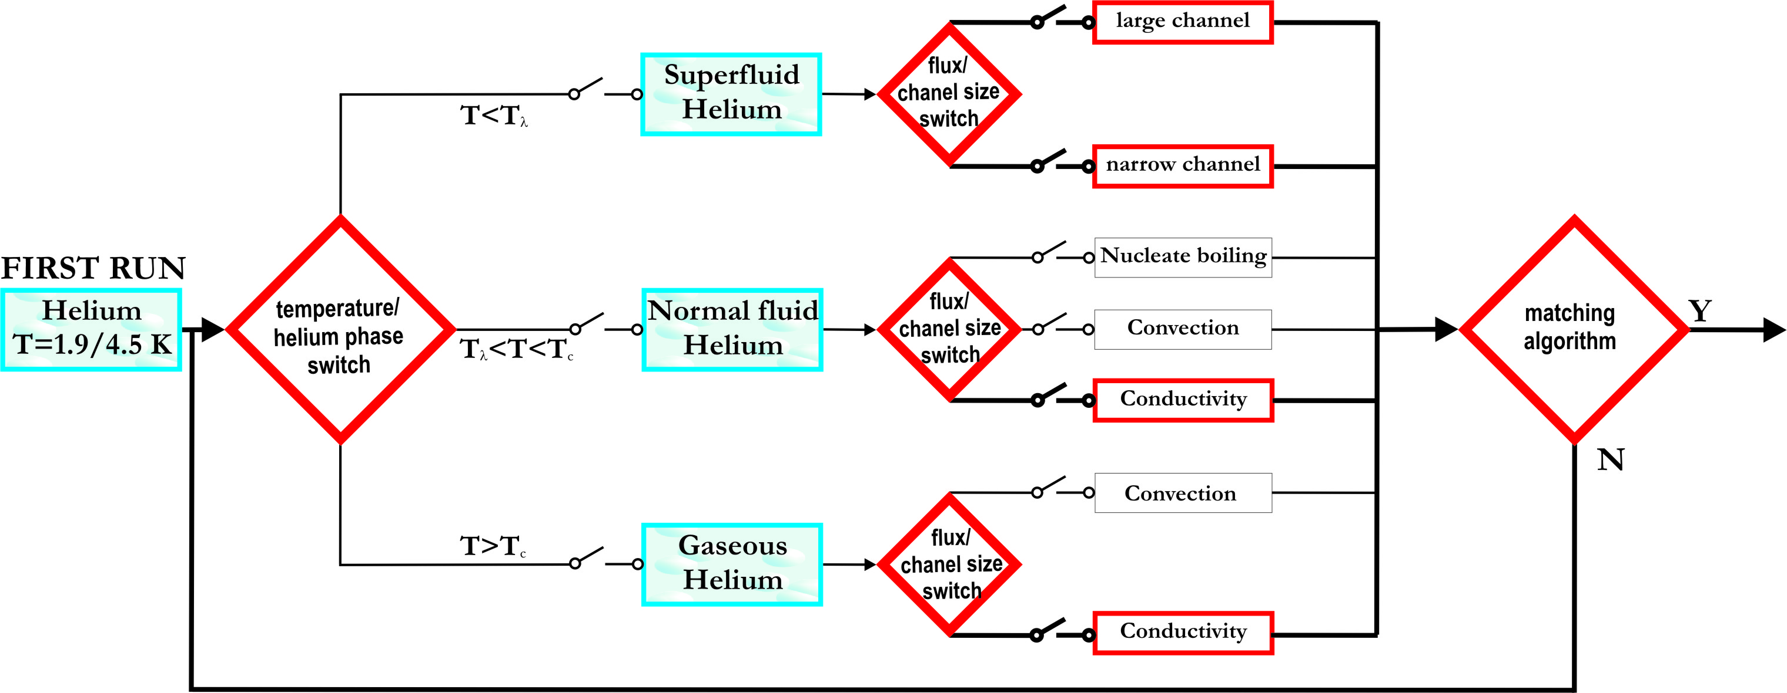
Network Model - Helium
Helium modeling

Slide 7
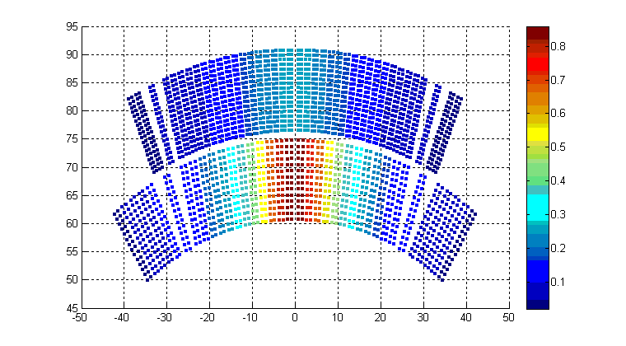
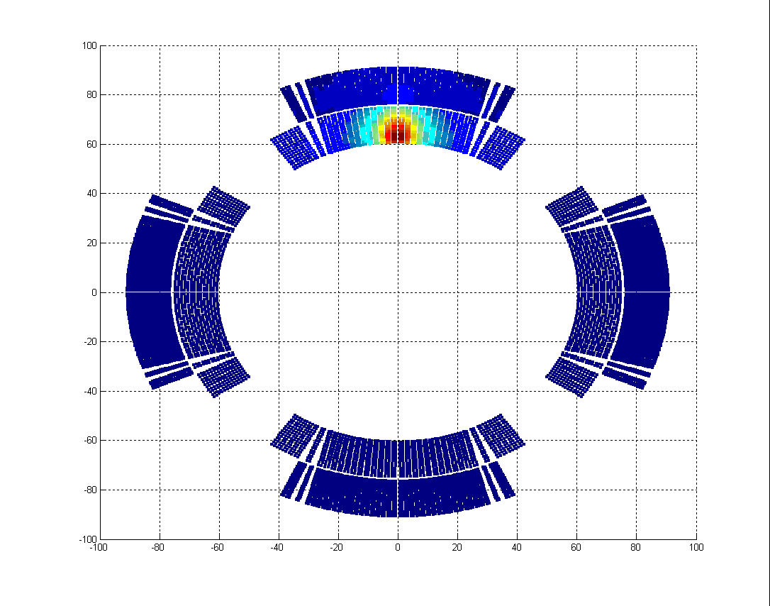
Network Model - features
  New features
can implement any type of cable insulation
can implement any insulation topology
can implement any type of strand material
can implement internal/external heat sources
  Model output
NM result – temperature distribution in the coil
  Heat load/flow in the model
working on interface Fluka/ NM and Mars/NM
working on heat flow vector readout from Network Model

Slide 8
Network Model Validation
Model validation
EXPERIMENT
Heat source
- quench heaters
- inner heating apparatus
heat
MAGNET
measured
quench current
VALIDATION
END
HEAT SOURCE
MODEL
heat
MAGNET
MODEL
predicted
quench current
More details:
D. Bocian, B. Dehning, A. Siemko, Modeling of Quench Limit for Steady State Heat Deposits in LHC Magnets,IEEE Transactions on Applied Superconductivity, vol. 18, Issue 2, June 2008 Page(s):112 – 115; CERN-AB-2008-006, 2008;
D. Bocian, B. Dehning, A. Siemko, Quench Limit Model and Measurements for Steady State Heat Deposits in LHC Magnets, IEEE Transactions on Applied Superconductivity, vol. 19, Issue 3, June 2009 Page(s):2446 – 2449;

Slide 9
Future plans - Network Model Validation
  CERN design - enhanced insulation
cable stack data
measurement with magnet model – in future
  LARP design
experiment with heater at the magnet mid-plane
cable stack experiment ?
  LHC nominal design
cable stack data

Slide 10
Future plans – Magnets simulation
Table 1: Cables parameters
 | unit | Inner layer | Outer layer
w | mm | 15.100 | 15.100
thick in | mm | 1.736 | 1.362
thick out | mm | 2.064 | 1.598
rad. insulation | mm | 0.160 | 0.160
az. insulation | mm | 0.135 | 0.145
n. strand |  | 28 | 36
strand diameter | mm | 1.065 | 0.825
Cu/Sc ratio |  | 1.65 | 1.95
I_{ss} | A | 14800 (10T) | 14650 (9T)
ΔI_{ss}/ΔB | A/T | 4680 (10T) | 4050 (9T)
Nb3Sn/bronze/copper |  | 27% / 27% / 46% | 27% / 27% / 46%

Slide 11
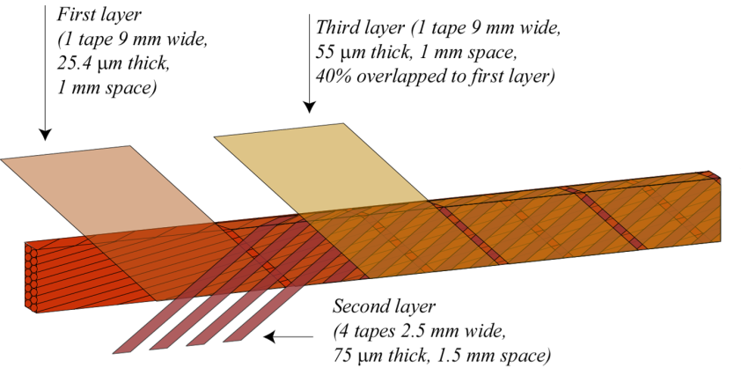
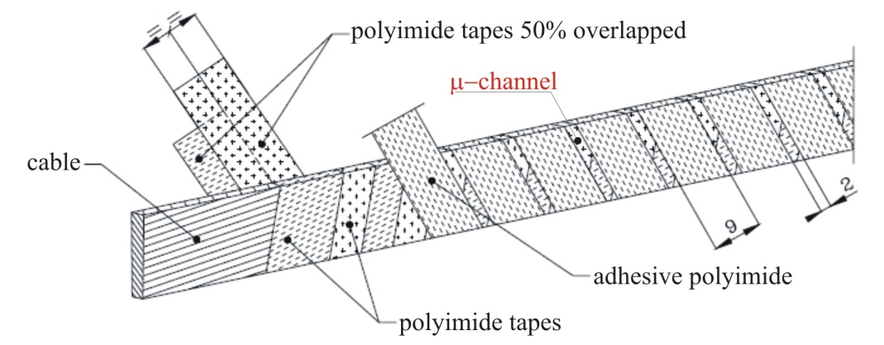
Future plans – Magnets simulation
Courtesy D. Tommasini
The enhanced insulation:
one 9 mm tape with 1 mm spacing
four 2.5 mm tapes with 1.5 mm spacing
one 9 mm tape with 1 mm spacing
Details: M. La China, et al., Phys. Rev. Spec. Top. Accel. Beams 11 (2008)
The nominal LHC cable insulation:
two 11 mm tapes overlapping by 50%
one 9 mm tape with 2 mm spacing
Nominal parameters for current and phase I design of LHC inner triplet
 | Current design | Phase I design
Operating temperature [K] | 1.9 | 1.9
Nominal gradient [T/m] | 205 | 120
Aperture diameter [mm] | 70 | 120
Quadrupole length [m] | 5.5 / 6.37 | 10
Nominal parameters for current and enhanced LHC cable insulation
 | Nominal |  | Enhanced
 | Cable 1 | Cable 2 | Cable 1 | Cable 2
Radial thickness | 0.150 | 0.150 | 0.160 | 0.160
Azimuthal thickness | 0.120 | 0.130 | 0.135 | 0.145

Slide 12
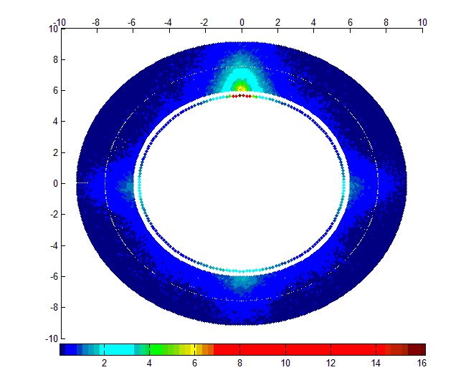
Future plans – Heat load
A combining particle tracking, FLUKA shower simulations in a single magnet coil
The inner triplet quadrupole FLUKA simulations were ran with a thick Beam Screen (BS) in Q1 (10.15 mm extra stainless steel shield added to the usual 2mm thick BS).
L=2.5*10³⁴ cm⁻²s⁻¹
Energy deposits in selected bin of magnet cross section with peak value. Magnet has been divided
longitudinally into 108 bins (~10 cm)

Slide 13
Conclusions
Work on thermal behavior of IT quadrupole magnets
is on going
Enhanced model is ready for validation with measurements
  CERN enhanced insulation design
  LARP quadrupole design
  Additional validation for nominal LHC insulation is welcome
Next step will be magnet simulation for different coil topology

Slide 14
Conclusions
Network Model simulation of 3 magnet designs:
CERN NbTi + nominal insulation
CERN NbTi + enhanced insulation
LARP Nb3Sn + G10 insulation (Replace conductor and insulation in phase I model)
 |  | ΔT(1) | ΔT(2) | ΔT(3)
Temperature margin |  | 2.7 K (12.69 kA) | 2.7 K (12.69 kA) | 6.2 K (factor ~2.3¹)
L=2.5*10³⁴ cm⁻²s⁻¹ (Total: 7 W/m) | Cable (max. HL - midplane) | 0.85 K
 | Helium channel | 0.1 mK
L=10³⁵ cm⁻²s⁻¹ (multiply phase I heat load by factor 4 → 28 W/m) | Cable (max. HL - midplane) | 3.4 K (~11 kA)
 | Helium channel | 0.4 mK
¹ F. BORGNOLUTTI, Superconducting Quadrupoles to Increase the Luminosity of the Large Hadron Collider, PhD thesis

Slide 15
EXTRAS

Slide 16
Backup - Electrical equivalent
The analogy of the equivalent thermal circuit
Thermal circuit |  |  | Electrical Circuit
T | [K] | Temperature | V | [V] | Voltage
Q | [J] | Heat | Q | [C] | Charge
q | [W] | Heat transfer rate | i | [A] | Current
κ | [W/Km] | Thermal Conductivity | σ | [1/Ωm] | Electrical Conductivity
R^{Θ} | [K/W] | Thermal Resistance | R | [V/A] | Resistance
C^{Θ} | [J/K] | Thermal Capacitance | C | [C/V] | Capacitance
The analogy between electrical and thermal circuit can be expressed as:
steady-state condition Temperature rise ⇔ Voltage difference
transient condition Heat diffusion ⇔ RC transmission line

Slide 17
Backup - Non beam loss heat loads
A. Siemko, 14th “Chamonix Workshop”, January 2005
Heat generated by electrical sources
  For main dipole during ramp (R. Wolf) [J/m]
    Hysteresis loss 240
    Inter-strand coupling (Rc = 7.5 μΩ) 45
    Inter-filament coupling (τ = 25ms) 6.6
    Other eddy currents (spacers, collars..) 4
    Resistive joints (splices) 30
  Total (per meter) ~325
The first estimations shows contribution at the level of 0.5 mW/cm³
A detailed studies are ongoing (A. Verweij, R. Wolf)

Slide 18
Heat transfer simulation
  Input data – magnet components
conductor composition
cable insulation
coil insulation
magnet geometry
  Input data - thermal
heat load map
solid material thermal properties
helium properties
  Simulation output
temperature map in the coil
heat flow in the coil

