Slide 1
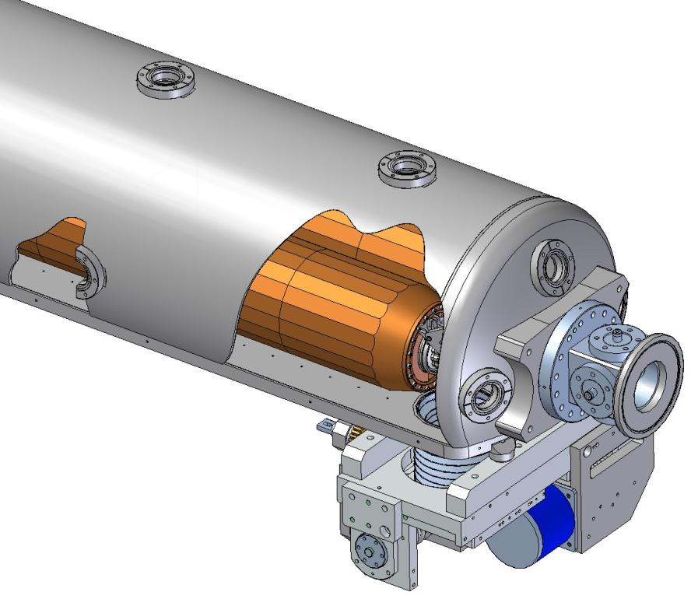
Status of Phase II Rotatable Collimator
US LHC Accelerator Research Program
BNL - FNAL- LBNL - SLAC
27 April 2010
LARP Collaboration meeting 14
Jeffrey C. Smith/SLAC
With
John Amann, Gene Anzolone, Lew Keller, Steve Lundgren, Tom Markiewicz, Reggie Rogers, Liling Xiao, Andrew Young
SLAC

Slide 2
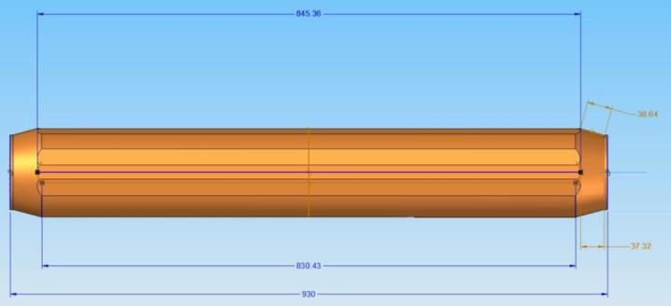
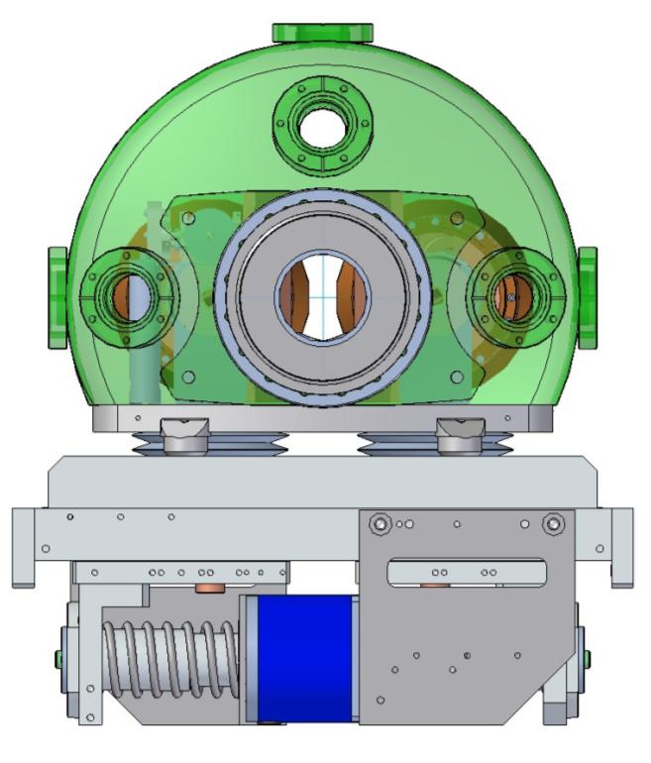
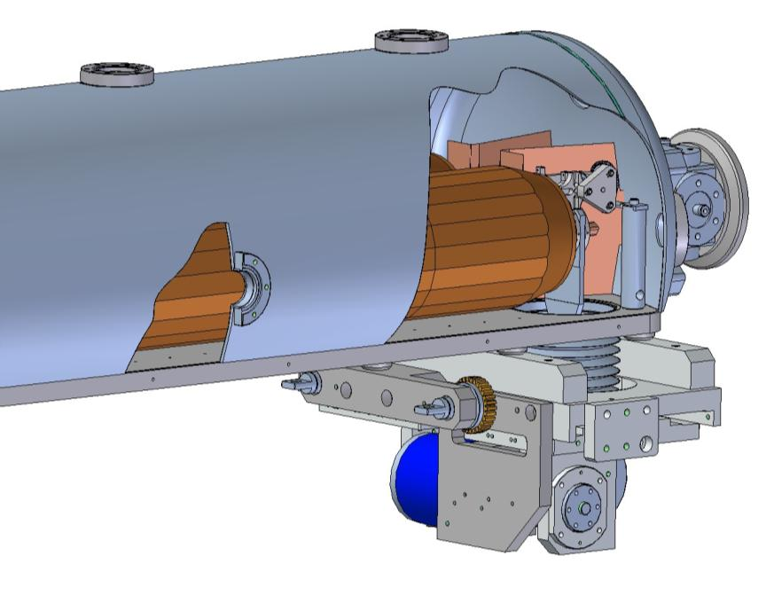
RC Prototype Design (for SPS)
beam

Slide 3
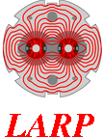
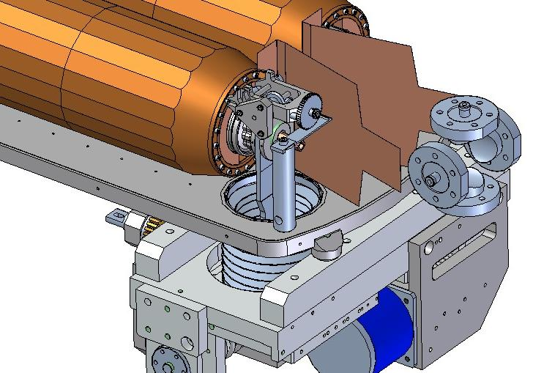
SLAC design details
RC-1 Jaw (Glidcop)
RF foils carry image current and shields Rot. Mech.
Tank geometry allows a 60mm
facet-to-facet gap in fully retracted
Jaw position
BPM assemblies at each end are fiducialized to Collimator
RC-0 Jaw (copper)
Ratchet Gear Drive
LHC IR7
Style BPM Buttons
4 per end
Base Plate
Flex Support
Drive Mechanism
Ferrite could
mount to Base
Plate facing Jaw
facet

Slide 4
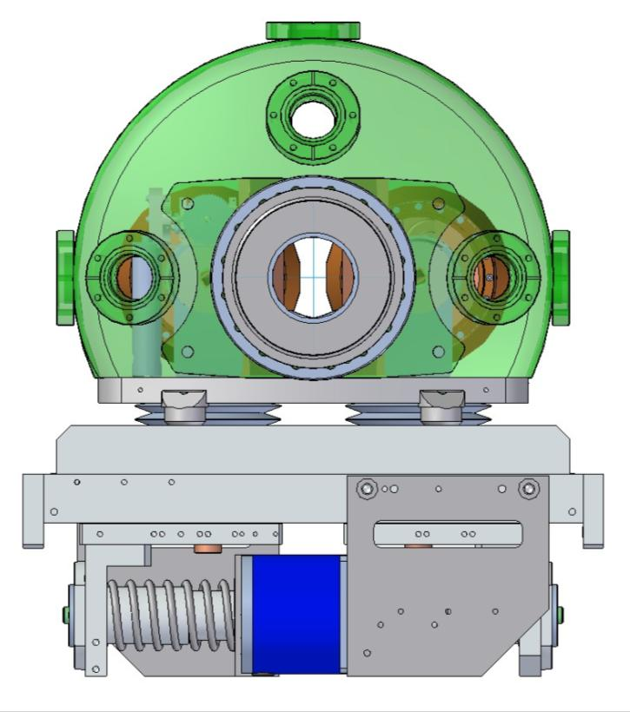
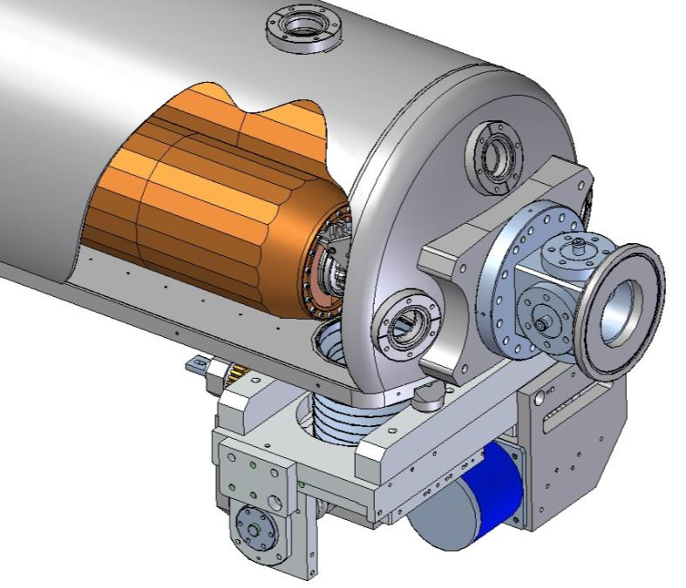
Proposed Collimator/BPM Aperture Dimensions
Standard 61 mm diam. IR7 LHC buttons
Defines maximum aperture of collimator
Do not anticipate any coupling of modes
in the tank with the 40 Mhz Buttons signal
61 mm
61 mm

Slide 5
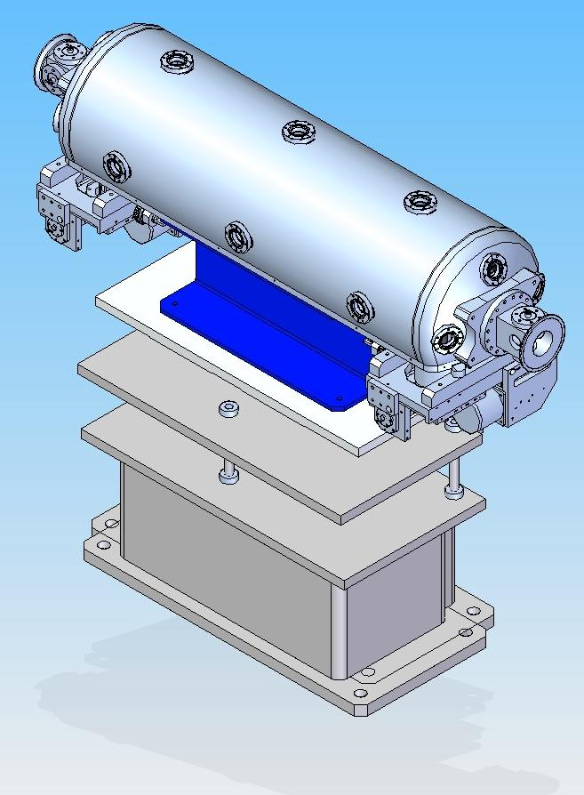
SPS Mounting
Mounting, interconnects and orientation for SPS installation have been determined and agreed on by CERN
Defined in Interface Document
CERN provides most cabling, water lines and mounting structure

Slide 6
Fabrication Update
  First jaw from thermal tests over a year ago (RC-0) will be used in the SPS prototype.
Second Jaw (RC-1) FINISHED!
Photos of final assembly follows…

Slide 7
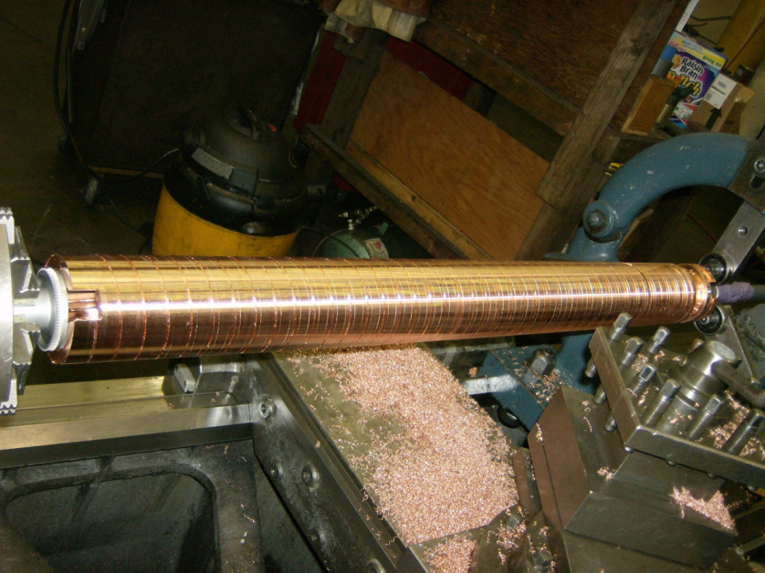
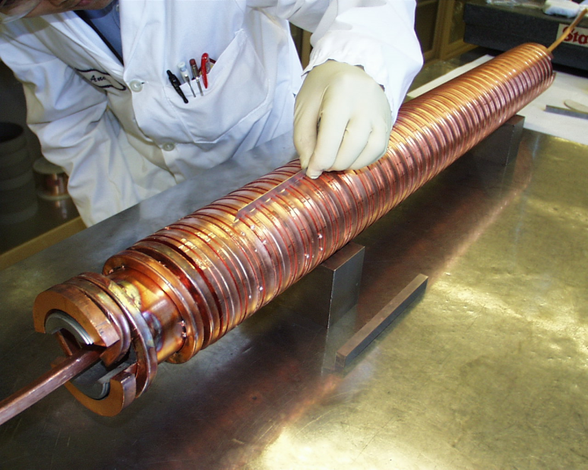
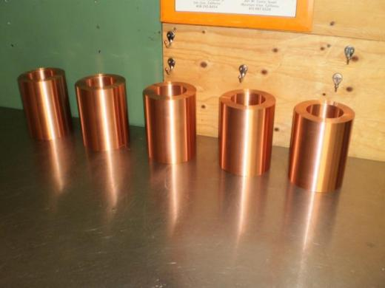
Status at CM13 last December…
Mandrel ready for jaw surface
cylinders for final brazing
Final Machining
First cuts
cooling coil wound and brazed
Jaw surface cylinders

Slide 8
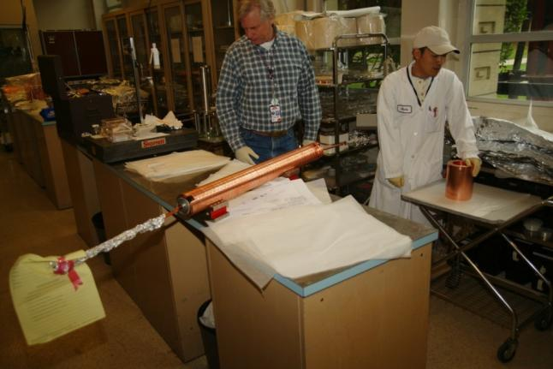
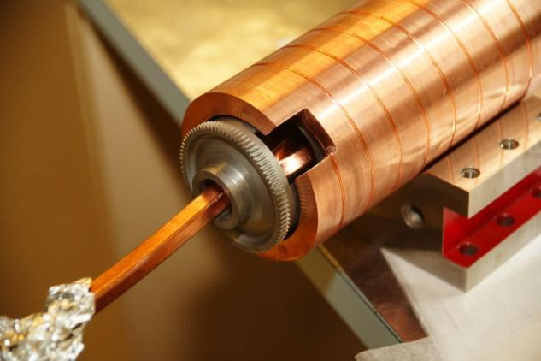
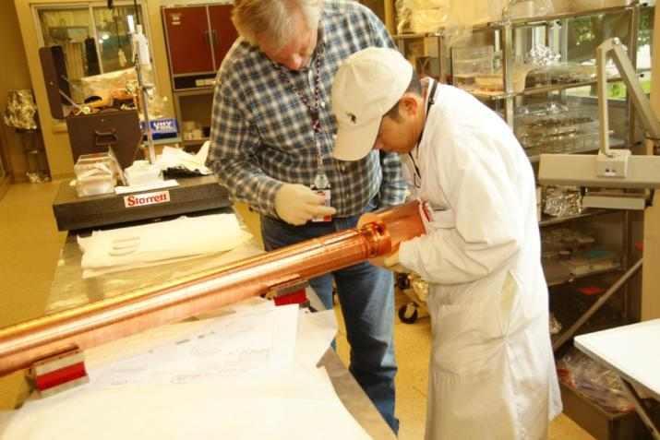
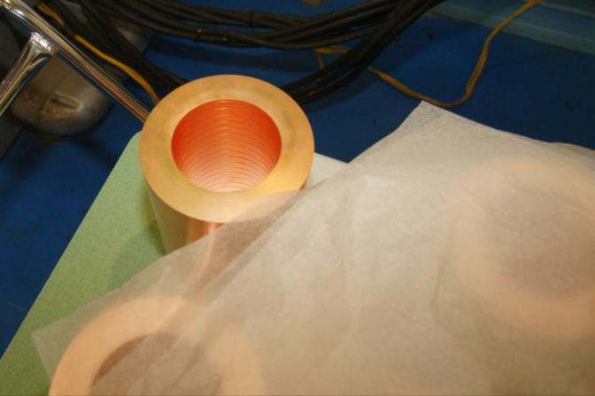
RC1 (second) Jaw Final Brazing Preparation

Slide 9
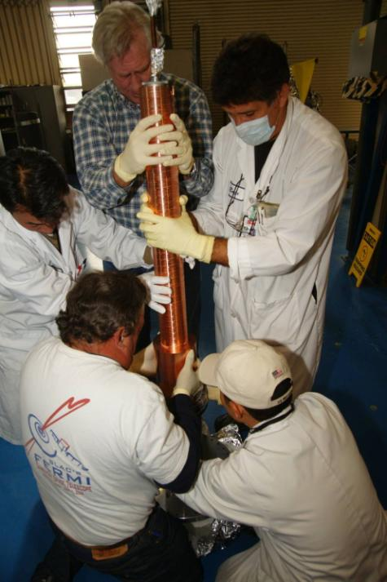
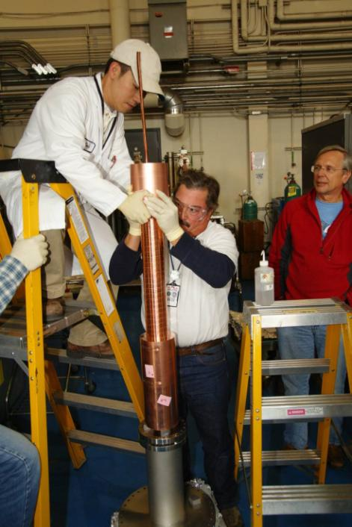
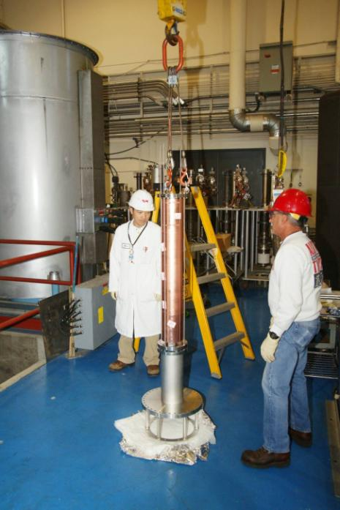
Mounting Jaw Cylinders
Mounting on stand
Sliding on Cylinders
Attached to Crane
Brazing Oven

Slide 10
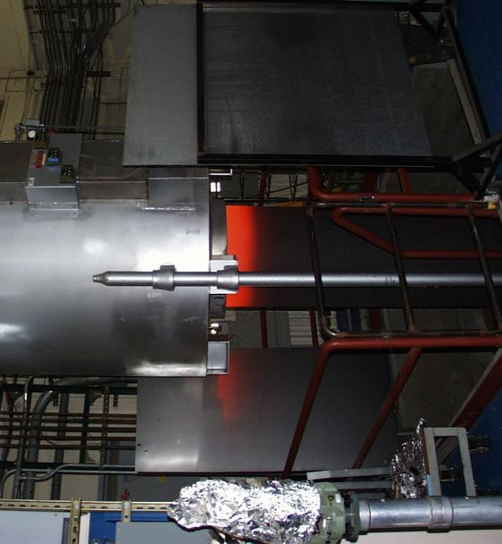
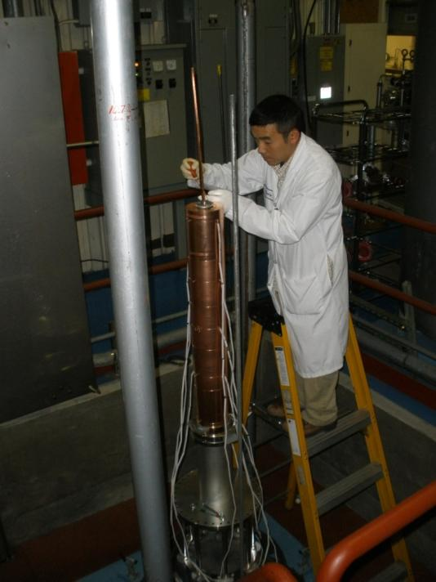
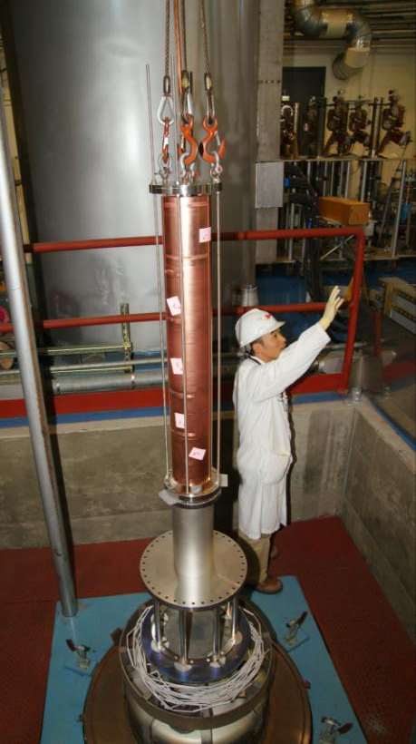
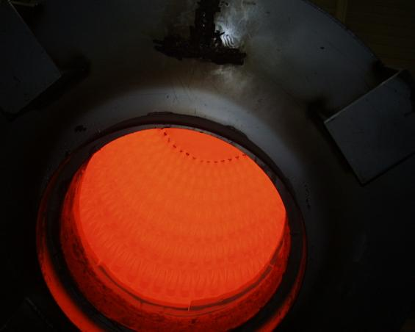
Brazing
Final Preparations
In oven pit
Removing Oven after braze
Jaw inside
hot retort
Looking inside hot oven!

Slide 11
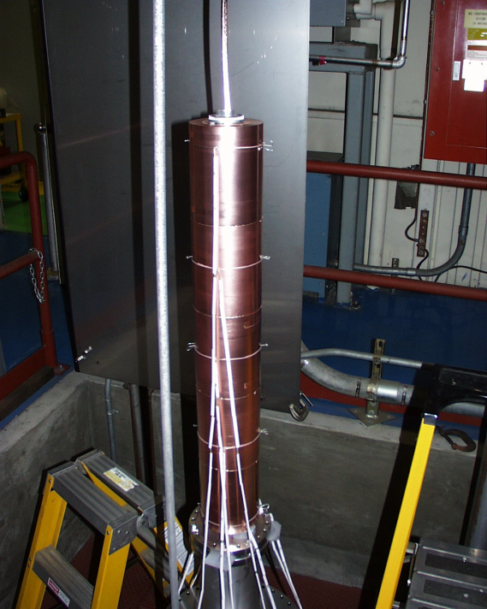
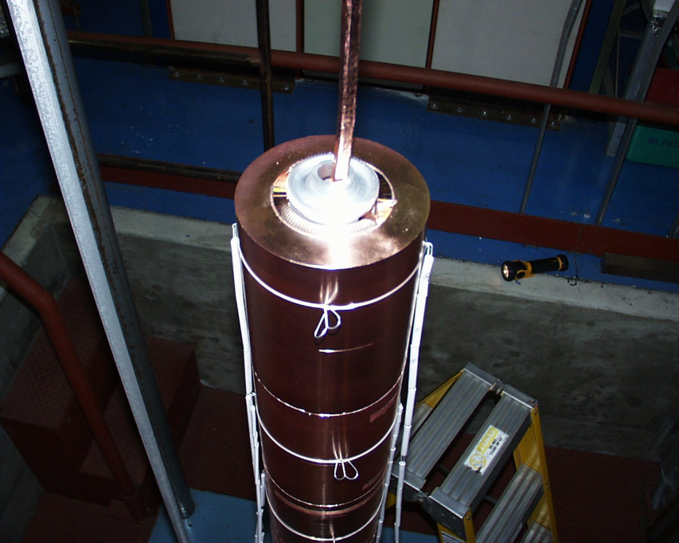
Results
After cool-down retort removed.
Braze looks good!

Slide 12
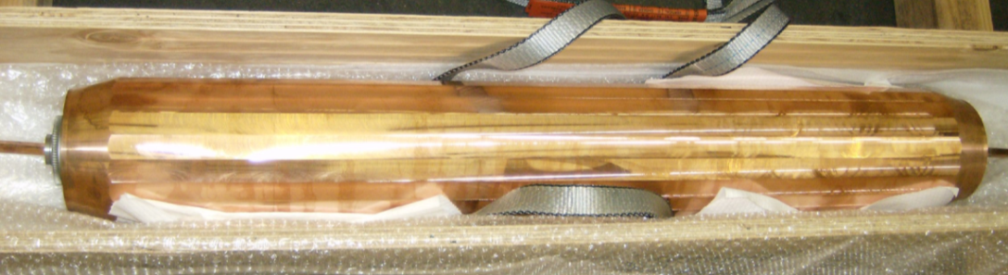
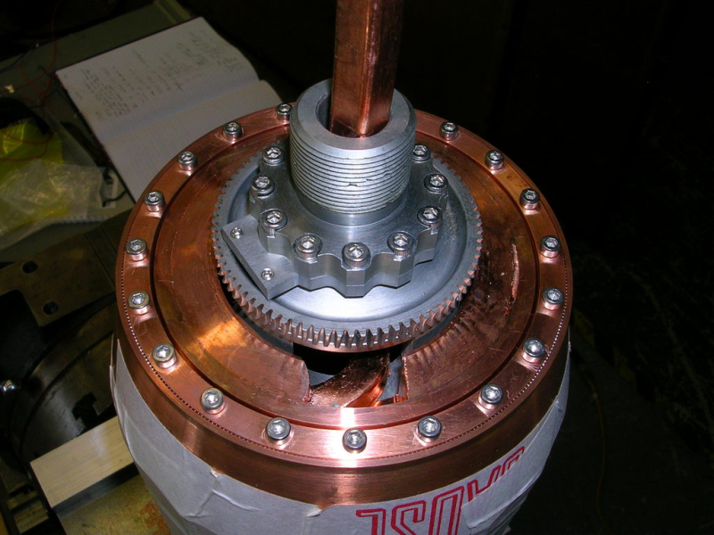
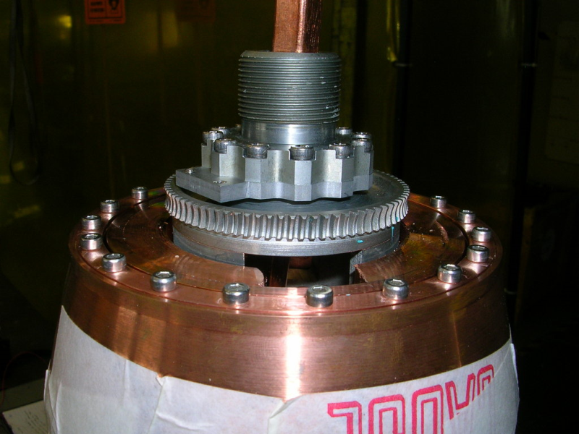
RC-1 Finishing touches
Machine facets
Machine tapers and ends
Assemble end parts and bearings

Slide 13

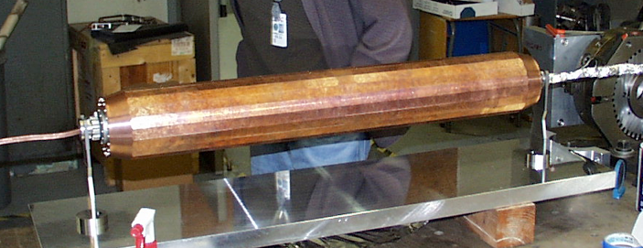
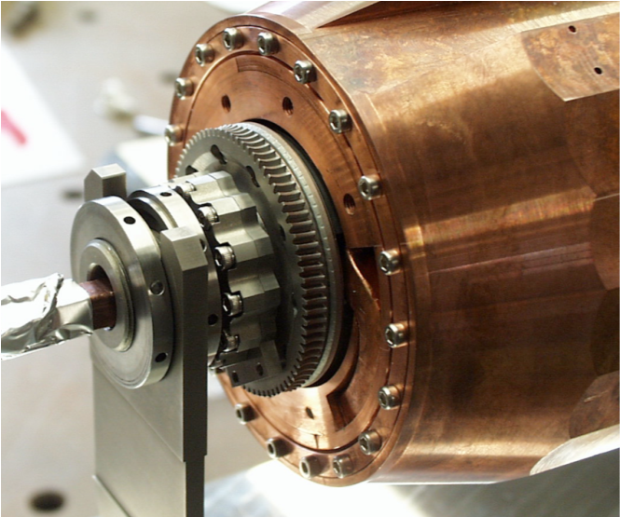
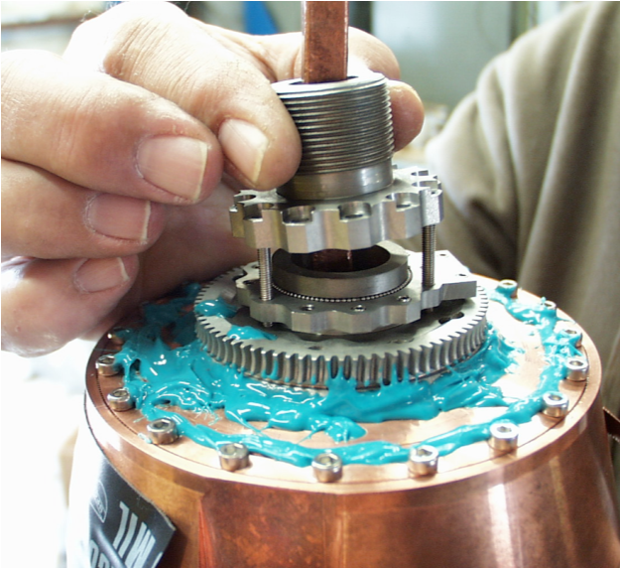
First Jaw (RC-0) End Assembly
Full jaw and bearings on support ready for CMM then installation
First jaw bearings and supports finished and installed
~300 1 mm Rhodium coated SS balls for image current
~100 1 mm ceramic balls for load support

Slide 14
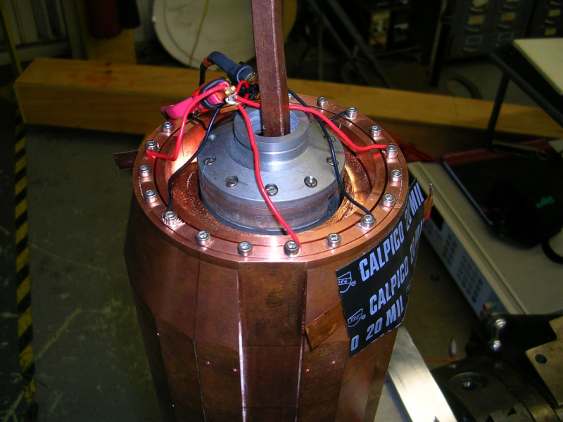
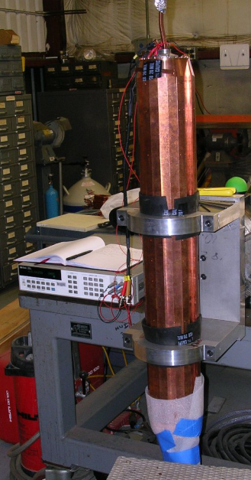
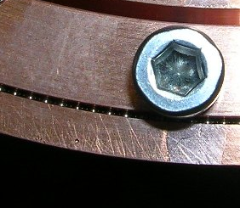
Bearing Contact Resistance
Measured resistance across Rhodium coated SS bearing using 4-wire method
Target ~1 mOhm across contact
Target achieved but requires a very well machined bearing race and just the right amount of tightness on the screws
~300 1 mm Rhodium coated SS balls for image current

Slide 15
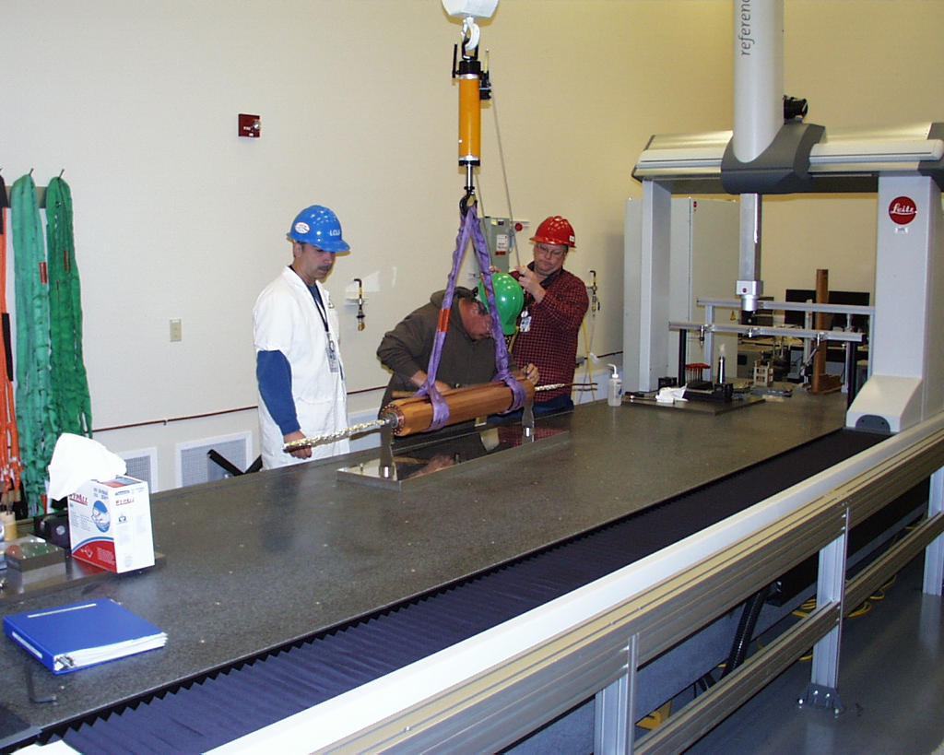
CMM
CMM to give:
  Surface profile for each facet
    confirm within 25 micron surface flatness
  Find axis of rotation and concentricity of each facet
  Gravity sag (Should be very small)

Slide 16
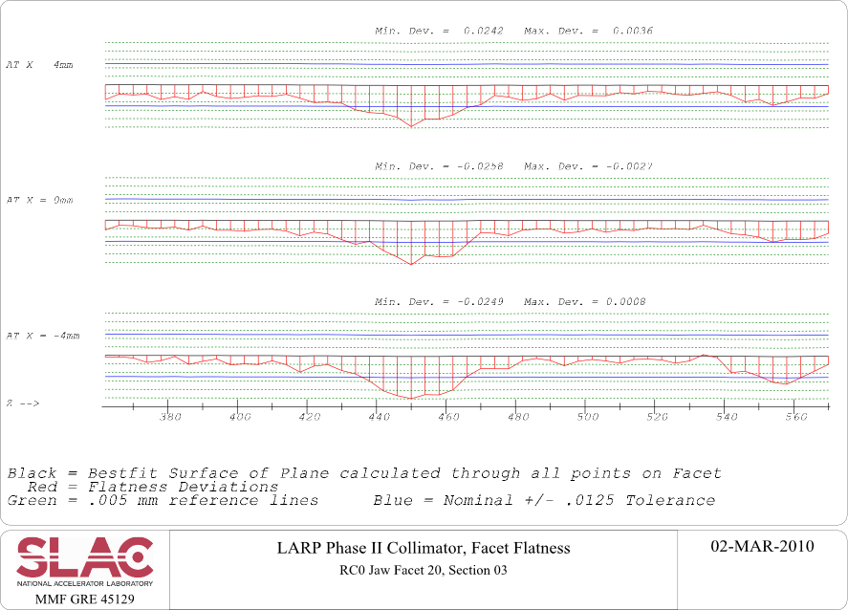
CMM results: First Jaw (RC-0)
Lots of data produced by CMM group.
Summary:
  Looking at central 8 mm of each facet (all the beam will see)
  Worst facet flatness: 50.6 microns
  Stats: 38.5 ±10.3 microns
  Generally exhibits a bowed shape where outer edges flair out

Slide 17
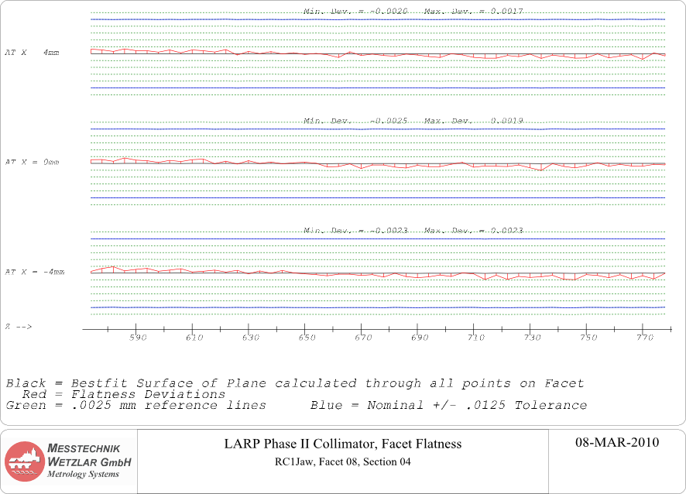
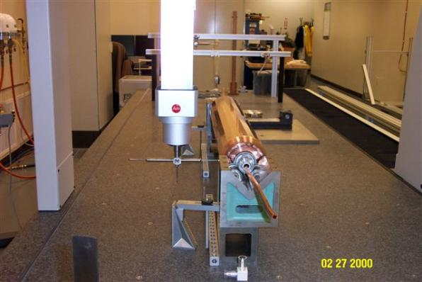
CMM results: Second Jaw (RC-1)
Second Jaw (RC-2) was machined to much greater precision
Summary:
  Worst Facet: 10.8 microns!
  Stats: 8.25 ± 1.45 microns
This is excellent!

Slide 18
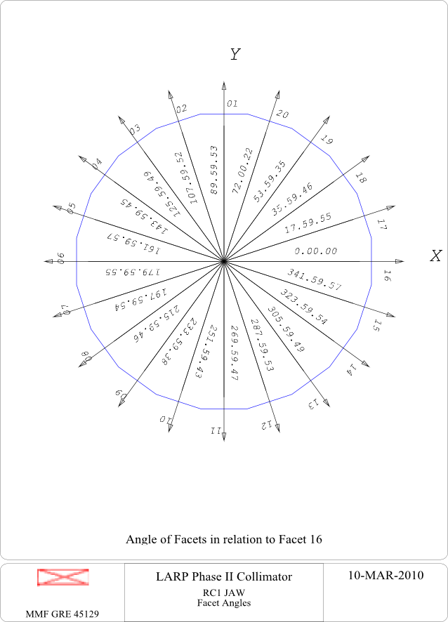
Facet offset and angles
Also measured width between each pair of facets and concentricity about rotation axis for RC-0 and RC-1.
This will give the new jaw edge with respect to beam axis after jaw rotation
Concentricity comparable to flatness values in previous slides
  RC-1 much better than RC-0
  This says that there is little run-out and flatness dictates alignment of facets.
Angles of each facet also measured and within arcseconds of a perfect icosagon (20 sided polygon)

Slide 19
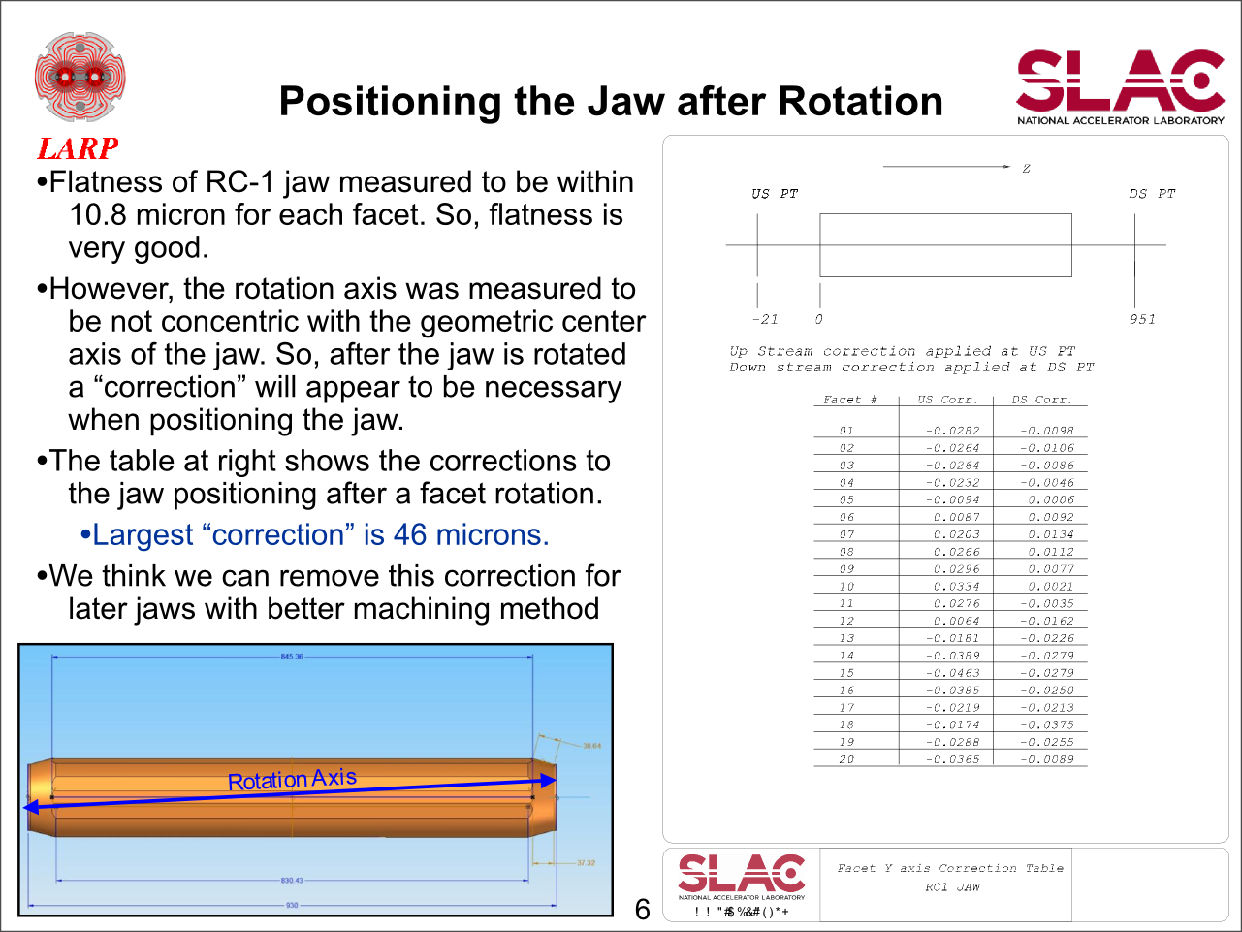

Slide 20
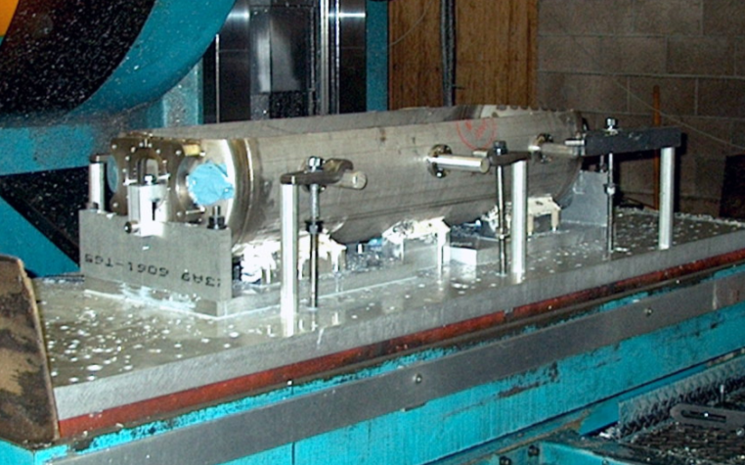
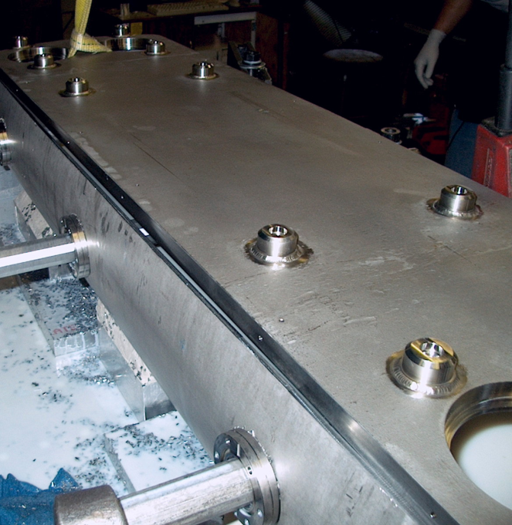
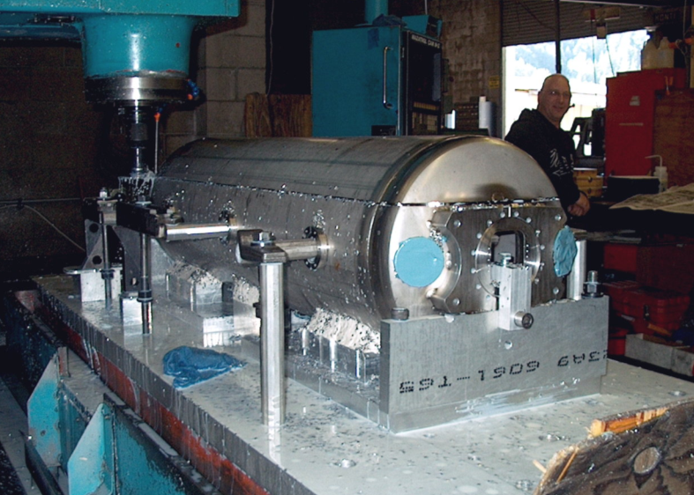
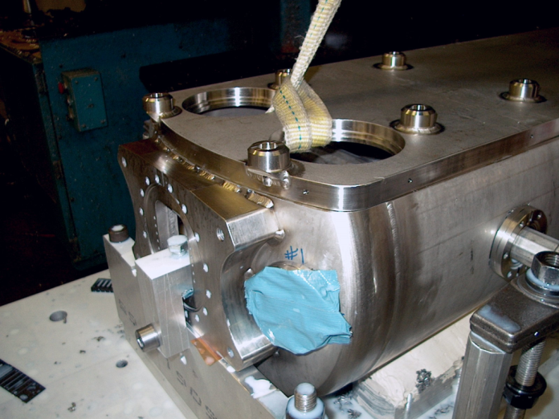
Vacuum chamber finished

Slide 21
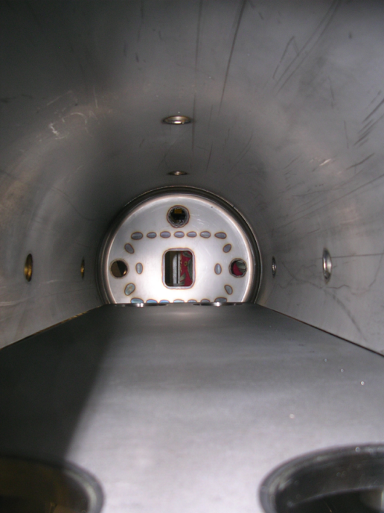
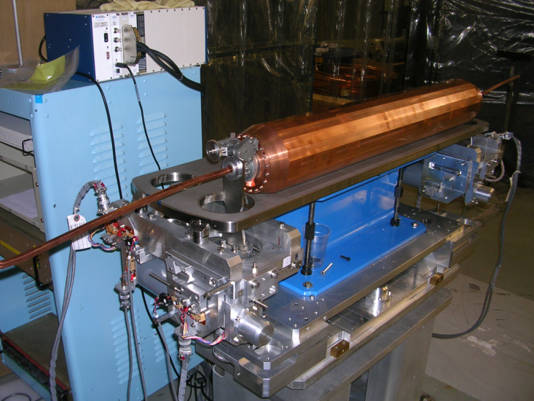
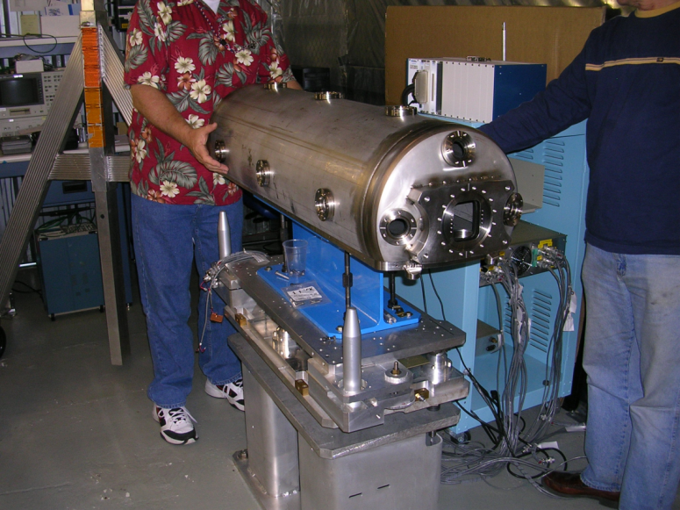
Mounting Jaws and Chamber

Slide 22
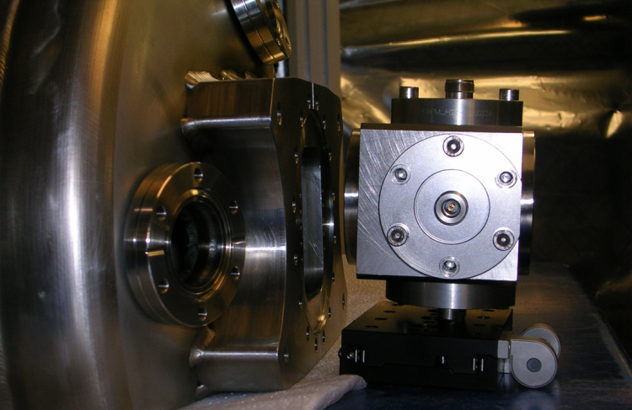
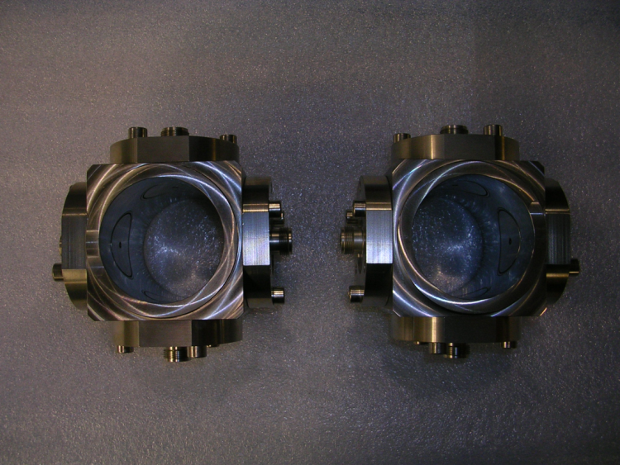
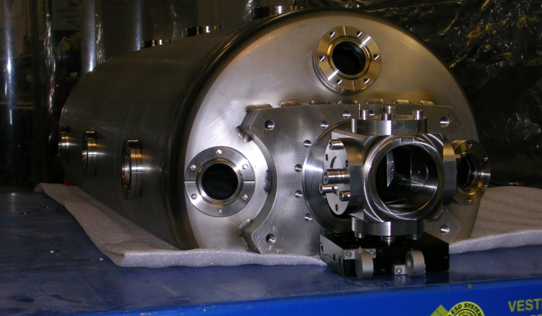
BPMs
BPM end assemblies
Using standard LHC IR7 61 mm diam. buttons
To be tested with full assembly for coupling to any trapped modes at 40 Mhz (anticipate no coupling)

Slide 23


Jaw Rotation
Jaw rotation after accident will be performed with a ratcheting mechanism with Geneva gear for precision rotation
  512 ratchets per facet rotation
  Ratcheting performed by over-retracting the jaw so that ratchet hits actuator.
  No extra motor or linear actuators required, simply use motors for moving jaws in and out

Slide 24



Jaw Rotation Mechanism Test
Temporary ratchet actuator

Slide 25
Ratchet Test Movie
Rotation of jaw has been tested using ratchet system
view 1
view 2
view 3
Looks good!

Slide 26



Trapped Modes Analysis
Studies continuing by Advanced Computation Department at SLAC on simulating trapped modes in chamber.
R_beampipe=30.5mm
Jaw’s opening=2mm / 60mm
26

Slide 27



Two Jaw Gaps
Longitudinal Modes
fully inserted jaws
fully retracted jaws
Acceptable for
LHC installation
Modified current design
Increasing the height of the EM foils can reduce the lower longitudinal modes R/Q effectively, thus reduce the beam heating.
L. Xiao, March 1, 2010
27

Slide 28


Two Jaw Gaps
Transverse Modes
Lowest mode is a concern, R/Q is very large
The transverse modes have stronger R/Q_T for fully inserted jaws than for fully retracted jaws. Three possible solutions: 1) change geometry (reduce R/Q) 2) Reduce Q (cavity size or ferrite) 3) pull up lowest order mode
28

Slide 29




Lowest Transverse Modes
E-field
Gap=2mm, F=62.9MHz, R/Q_T=5.5e6ohm/collimator
Gap=60mm, F=75.4MHz, R/Q_T=3.3e2ohm/collimator
150
6
yoffset@ 0.5mm
yoffset@ 0.5mm
Gap=2mm
Gap=60mm
There are strong Ey fields between the two jaws for fully inserted jaws.
29

Slide 30




Modifications to
Minimize Transverse Modes
fully inserted jaws
fully retracted jaws
h
Adding two plates on the top and bottom to form a closed waveguide for the fully inserted jaws, thus suppressing the dangerous gap modes.
Beam in double-ridge waveguide with Fc~c/(2*h)=2.5GHz for fully inserted jaws
No gap Modes < 2GHz
Beam in two pairs of the parallel plates with larger gaps. Strong fields locate between the jaw surface and the base plates.
TT2-111R Ferrite will also be added below each jaw to minimize Q-factor. The combination of ferrite and some suppression structure should make the transverse impedance acceptable
Ferrite tiles

Slide 31



Stretched-Wire Impedance Measurements
Stretched wire measurements will be used to measure longitudinal and transverse impedance
  A singe wire centered and displaced from center
  Two wires exciting only the dipole mode
Short reference pipe
for testing
wire
Matching network

Slide 32
Schedule for SPS Installation
Between now and August
  Install 2nd jaw on supports on baseplate
    Rebuild RF bearing race on one side
  Measure torque to translate jaws
  Rotation drive tests
  Final CMM measurements at nominal gap for all 20 rotations
  Weld flanges to BPM housings & bolt to tank
  Stretched wire BPM/impedance/mode tests with RF foils in place before tank is welded
  Disassemble & weld bellows to jaw supports & to baseplate
  Reassemble jaws on baseplate (Cu tubing now bent down & brazed) & test again
  Weld vacuum tank
  Vacuum bakeout
  Immobilize, protect, install shock monitors and do paperwork for shipping
Ship in August
CERN preps and equips for SPS installation September – November
Installation in SPS during December 2010 shutdown
SPS studies 2011

