Slide 1
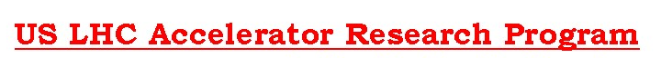
Long Quadrupole Results & Status
Giorgio Ambrosio
Fermilab
LARP Collaboration Meeting 14
Fermilab
April 26-28, 2010
Task Leaders:
Fred Nobrega (FNAL) – Coils
Jesse Schmalzle (BNL) – Coils
Paolo Ferracin (LBNL) – Structure
Helene Felice (LBNL) – Instrumentation and QP
Guram Chlachidize (FNAL) – Test preparation and test
Notes:
1

Slide 2
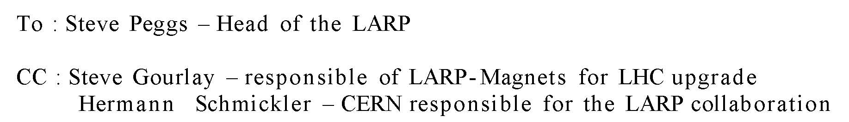
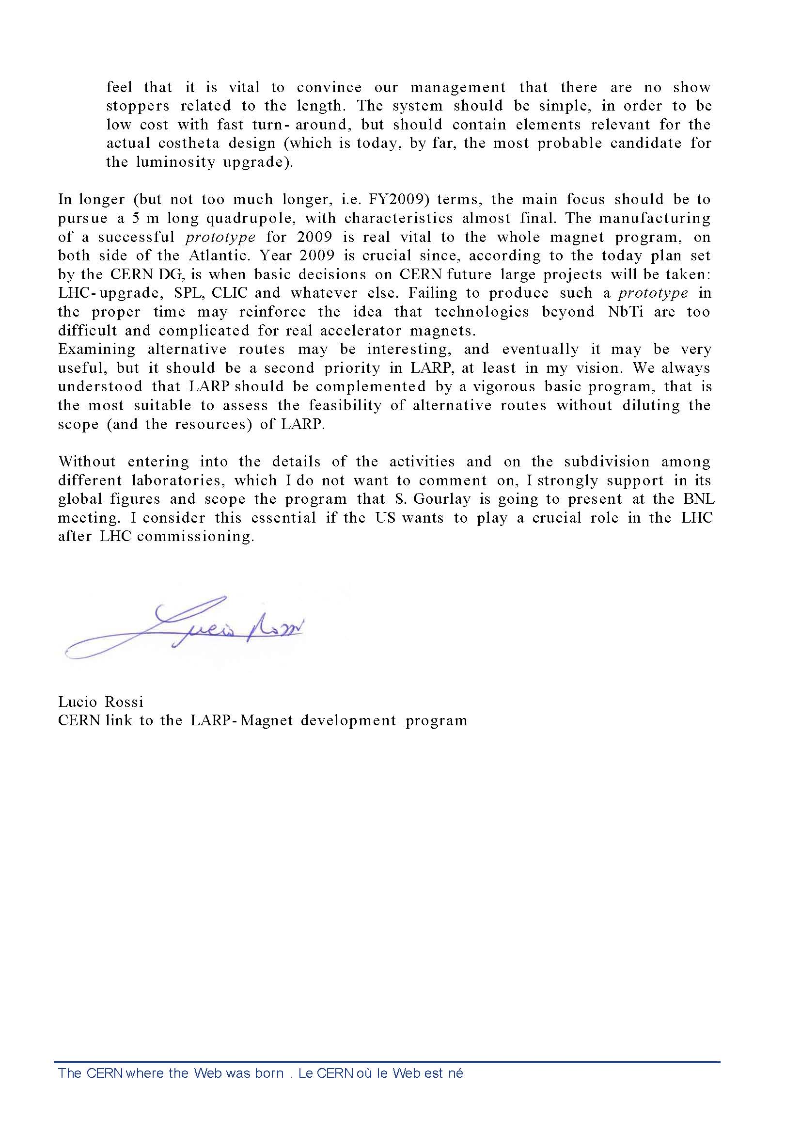
Historic background
We need a successful Long Quadrupole by the end of 2009!
Five years ago … just before CM 4 …
April 2, 2005
…
…
LARP CM14 - FNAL, Apr. 26-28, 2010
G. Ambrosio - Long Quadrupole

Slide 3
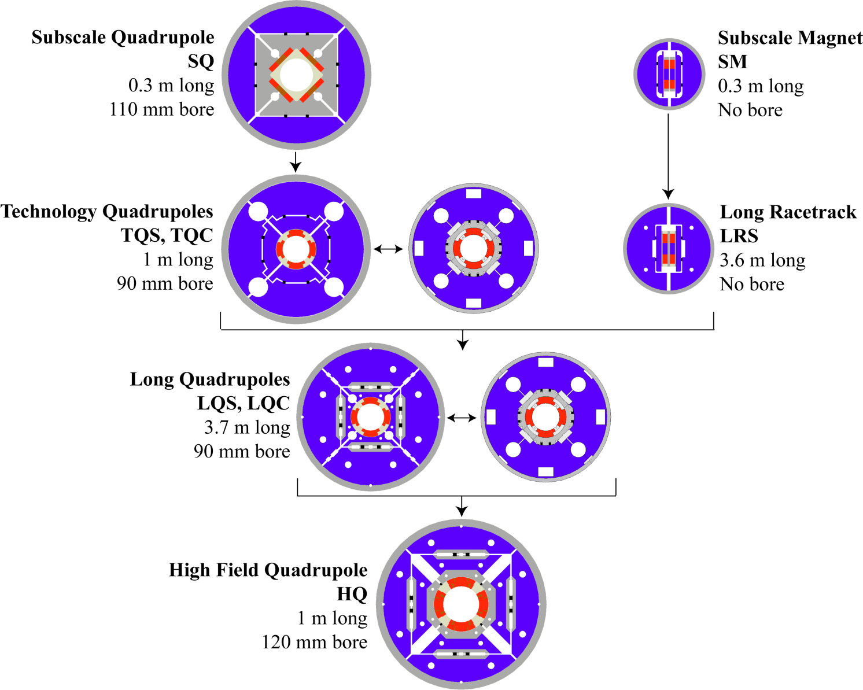
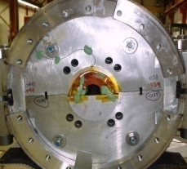
LARP R&D
FNAL Core progr.
Long Mirror
LM02
3.6 m long
No bore
“S”: Shell-based support structure
“C”: Collar-based support structure
LARP CM14 - FNAL, Apr. 26-28, 2010
G. Ambrosio - Long Quadrupole

Slide 4
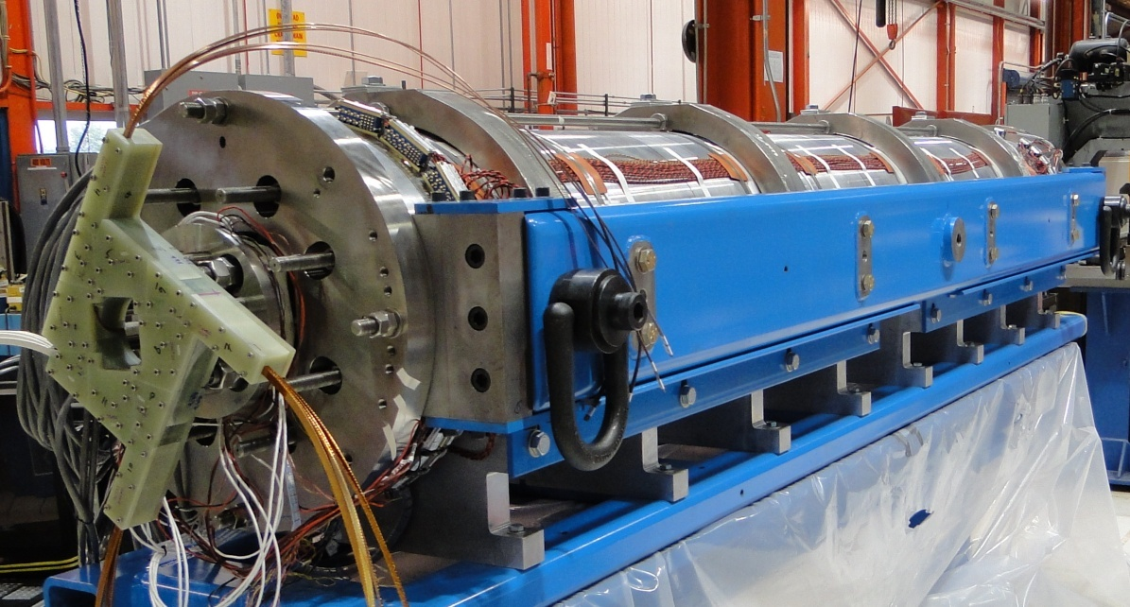
Long Quadrupole
Main Features:
Aperture: 90 mm
magnet length: 3.7 m
Target:
Gradient: 200+ T/m
Goal:
Demonstrate Nb₃Sn magnet scale up:
  Long shell-type coils
  Long shell-based structure (bladder & keys)
  LQS01 was tested in Nov-Dec 2009
  LQS01b test start in May
LQS01 SSL | 4.3 K
Current | 13.9 kA
Gradient | 242 T/m
Peak Field | 12.4 T
Stored Energy | 473 kJ/m
LQ Design Report available online at:
https://plone4.fnal.gov/P1/USLARP/MagnetRD/longquad/LQ_DR.pdf

Slide 5
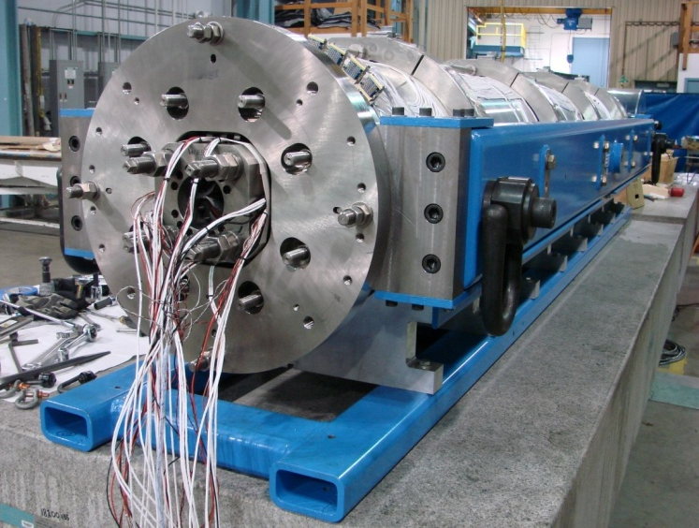
LQS01 Assembly
LQS01 assembled and pre-loaded
Strain gauge readings:
on the structure (shell & rods) are on target
on the coils are lower than expected with large scattering
  Seen also in TQS models; possibly caused by coil/pads mismatch
293 K | σ_{y} (MPa) | σ_{z} (MPa)
Shell measured | +33 ±8 | +3 ±7
Shell target | +34 | +6
Pole measured | -12 ±11 | +14 ±17
Pole target | -49 | -14
Rod measured | n/a | +60 ± 3
Rod target | n/a | +63
Comparison of measurements and targets
LARP CM14 - FNAL, Apr. 26-28, 2010
G. Ambrosio - Long Quadrupole

Slide 6
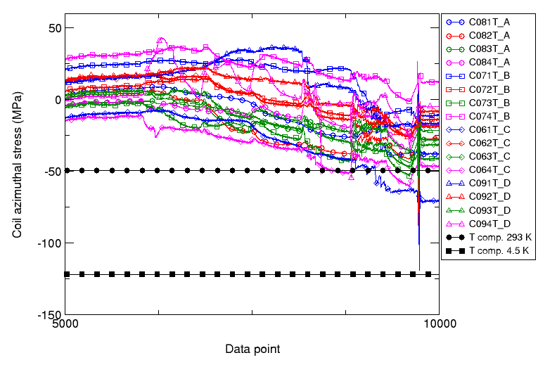
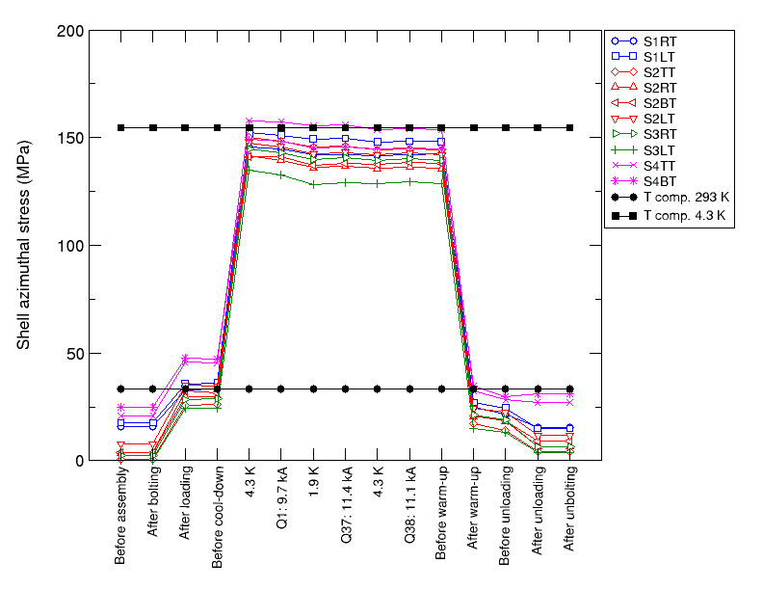
LQS01 Cooldown
Delta stress on the pole lower than expected
Stress on the shell close to expected value
  Stress distribution in the coil different from the computed one
Azimuthal stress (MPa) in the coil poles during cool-down:
values measured (colored markers)
and computed (black markers) from a 3D finite element model
Azimuthal stress (MPa) in the coil shell:
values measured (colored markers)
and computed (black markers) from a 3D finite element model

Slide 7
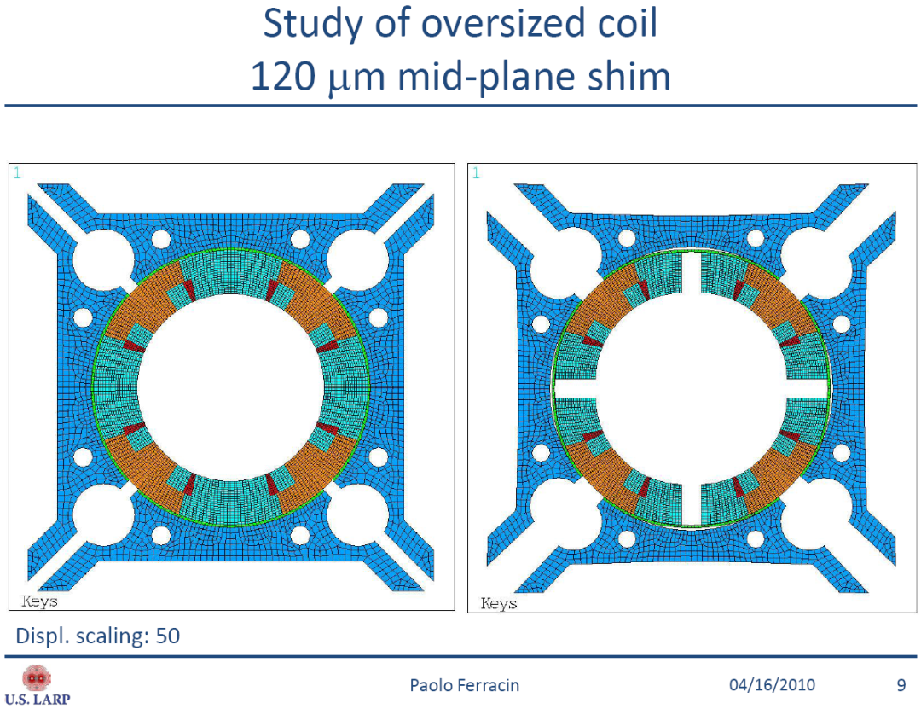
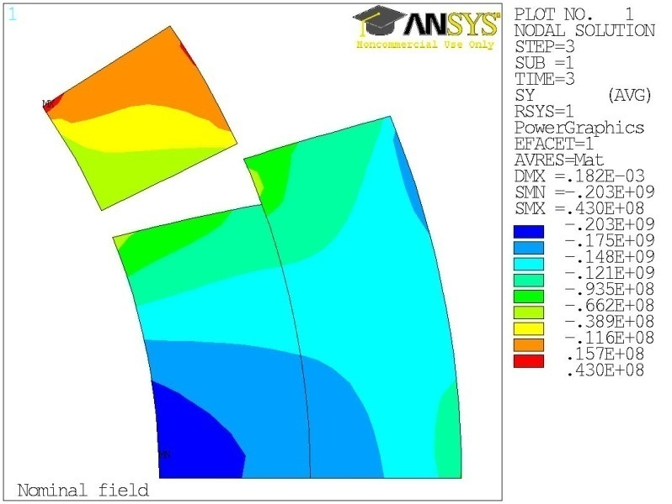
FEM Analysis
FEM model with azimuthally oversized coils
  bending due to coil-pad mismatch
  Lower stress in the pole
    Consistent w measurement
  Higher stress on midplane
    Risk of damage above 200 T/m
Less stress
More stress

Slide 8
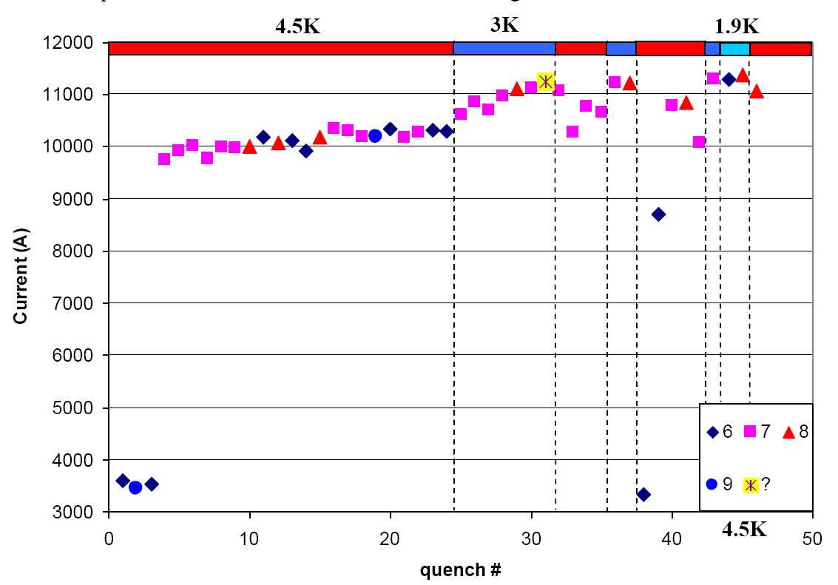
LQS01 Quench History
First quenches at high ramp rate (200 A/s)
  Trying to avoid QPS trips due to voltage spikes
Slow training at 4.5K
  “apparent plateau”
Faster training at 3 K
  Reached 200 T/m (11.2 kA)
  Above 200 T/m at 3K and 1.9K
  Almost 200 T/m at 4.5K after “conditioning”
200 T/m
200 A/s
Test report available online at:
https://plone4.fnal.gov/P1/USLARP/MagnetRD/longquad/report/TD-10-001_LQS01_test_summary.pdf

Slide 9
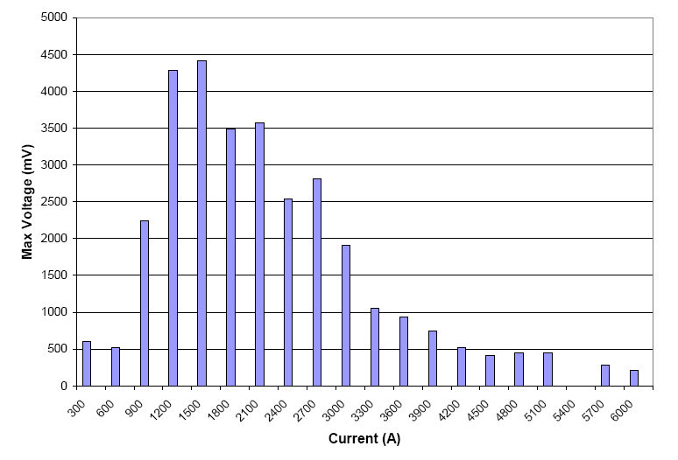
Voltage Spikes
Large voltage spikes
  Due to flux jumps
    Seen in TQ magnets using RRP 54/61
  Larger than in TQs
  ➔Variable quench detection threshold
  ➔Variable ramp-rate for training
    200 A/s ➔ 3 kA
    50 A/s ➔ 5 kA
    20 A/s ➔ 9 kA
    10 A/s ➔ quench
Will be eliminated or significantly reduced by using RRP 108/127
Maximum Voltage Spike amplitude at 4.5 K with 50 A/s ramp rate

Slide 10
Max Quench Current vs. Temp.
200 T/m at 3 K and 1.9 K
200 T/m
At the end of test
After the training
at 3.0 K
After the initial
training at 4.5 K

Slide 11
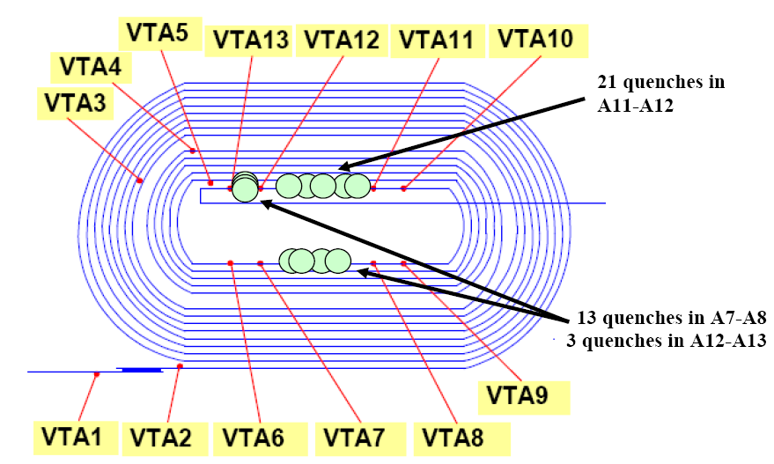
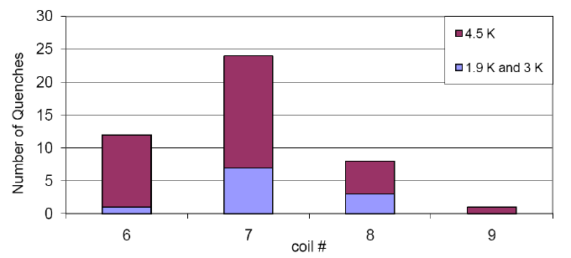
Quench Location
All quenches in pole turns
  Except high ramp-rate quenches
  No preferred location
All coils participating
  Largest number in coil 07
    Smallest I_{c} margin

Slide 12
Magnetic Measurement
Magnetic measurement at 4.5K:
  Z-scan (no return end)
  Eddy current loops
  Dynamic effects
  Stair-step
# | Injection ( 0.66 kA) | 100 T/m (5.3 kA) | 10 kA
b_3 | 3.34 | 2.29 | 2.61
b_4 | 7.72 | 6.73 | 6.93
b_5 | 0.06 | 0.17 | -0.08
b_6 | -33.31 | 9.89 | 7.47
b_7 | 0.05 | -0.06 | -0.11
b_8 | -0.28 | -0.98 | -0.38
b_9 | 0.08 | 0.19 | 0.13
b_10 | 0.56 | 0.35 | -0.47
a_3 | 2.03 | 2.28 | 2.28
a_4 | 6.28 | 1.94 | 2.11
a_5 | -0.50 | -0.51 | -0.65
a_6 | -1.14 | -0.12 | -0.29
a_7 | 0.17 | 0.29 | 0.14
a_8 | 0.12 | 0.08 | 0.06
a_9 | -0.29 | -1.09 | -0.16
a_10 | 0.05 | 0.37 | 0.12
Geometrical harmonics at 12.3, 100 and 179 T/m field gradient.
Results are presented at 22.5 mm reference radius, which corresponds to the official radius adopted for LHC (17 mm) corrected for the increase in the magnet aperture from 70 to 90 mm.
An 81.8 cm long tangential probe was used.

Slide 13
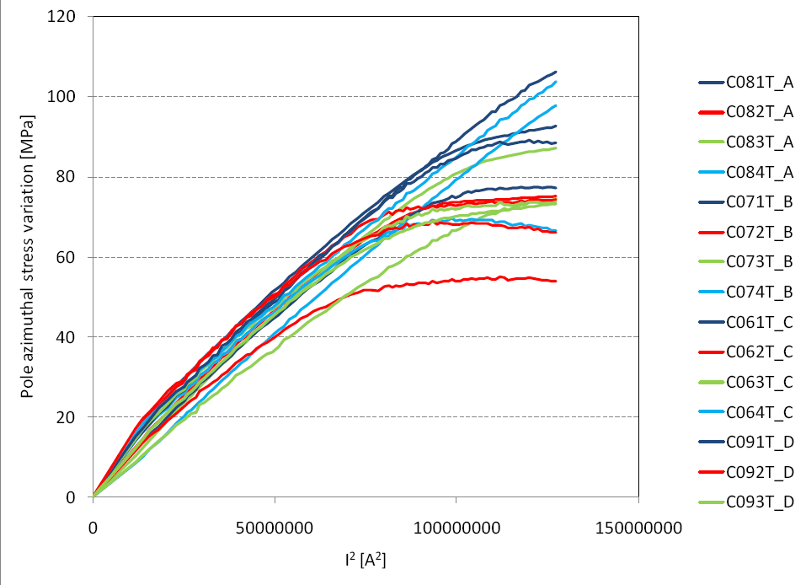
Test Data Analysis
LQS01 was affected by long training above 10 kA @ 4.5 K
  Shown by:
    Quench history and locat.
    Ramp rate dependence
    Temperature dependence
    Strain gauges
    Voltage rise during quench
At the end of test
After the training
at 3.0 K
After the initial
training at 4.5 K

Slide 14
Re-assembly Plan
The test data analysis was consistent with the FEM analysis showing:
  Insufficient pre-load on pole
    ➔ Long training
  Excessive pre-load on midplane
    ➔ Risk on degradation on midplane
Further testing above 200 T/m could have damaged coils without providing useful information
Plan:
  Disassembly and check coil-pads mismatch
  New assembly with same coils and optimized shims

Slide 15
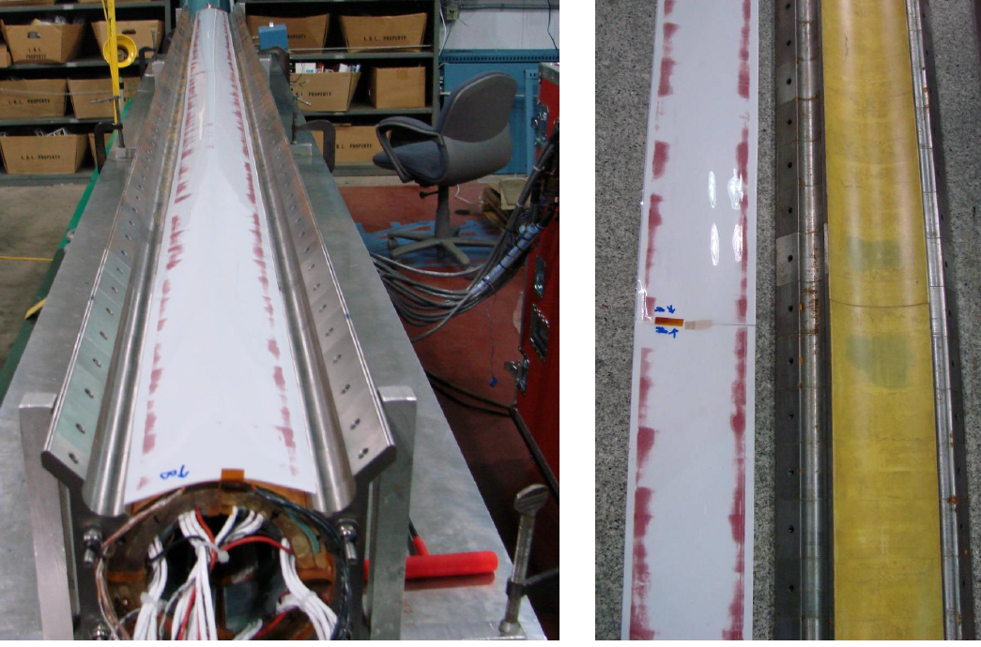
LQS01 Disassembly
Test with pressure-sensitive paper confirmed coil-pads mismatch
Contact points
Contact points

Slide 16
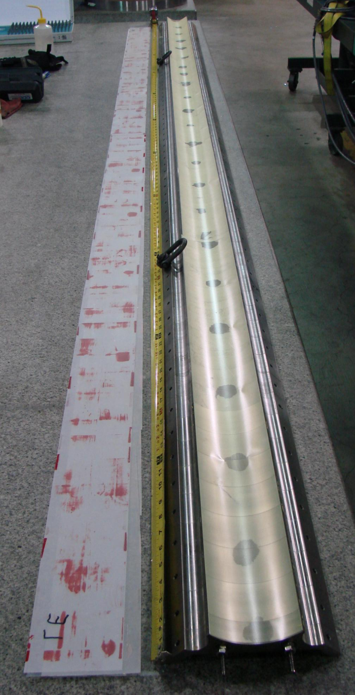
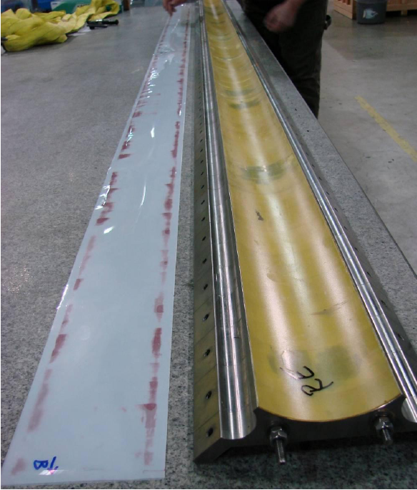
Reduced Shims for LQS01b
New assembly with thinner shims between coils and pads:
  LQS01: 762 um
  LQS01b: 381 um
LQS01b
LQS01

Slide 17
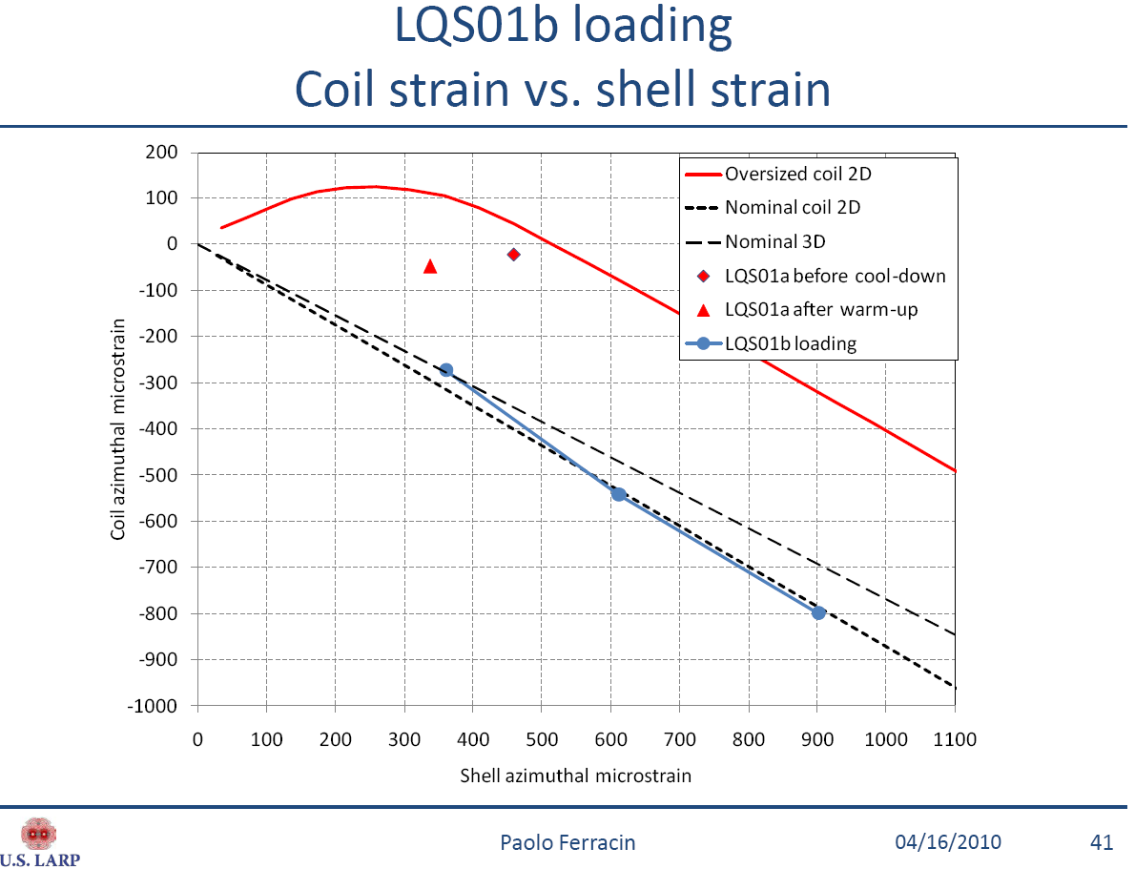
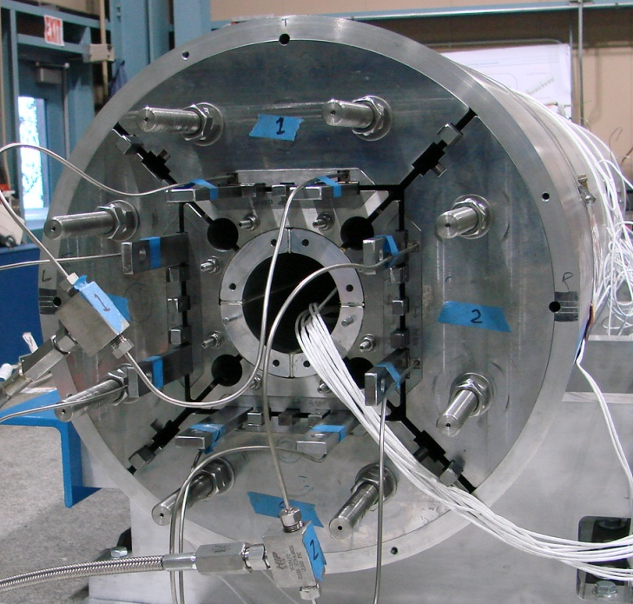
LQS01b Loading
New shims give correct ratio between strain in the shell and strain in the coils
LQS01
LQS01b

Slide 18
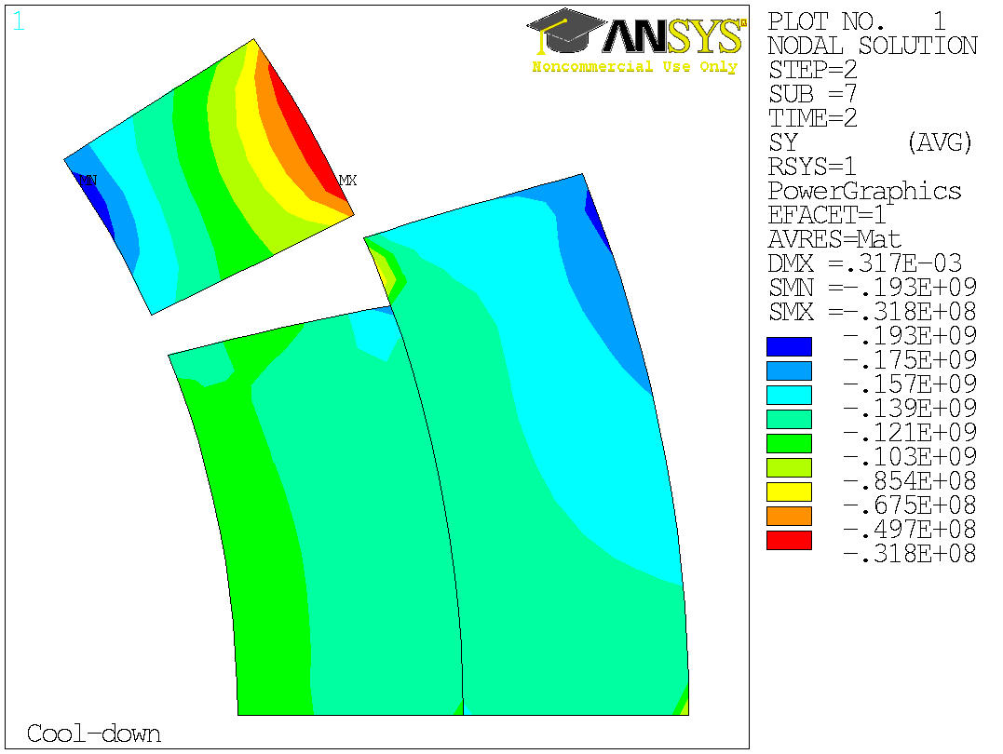
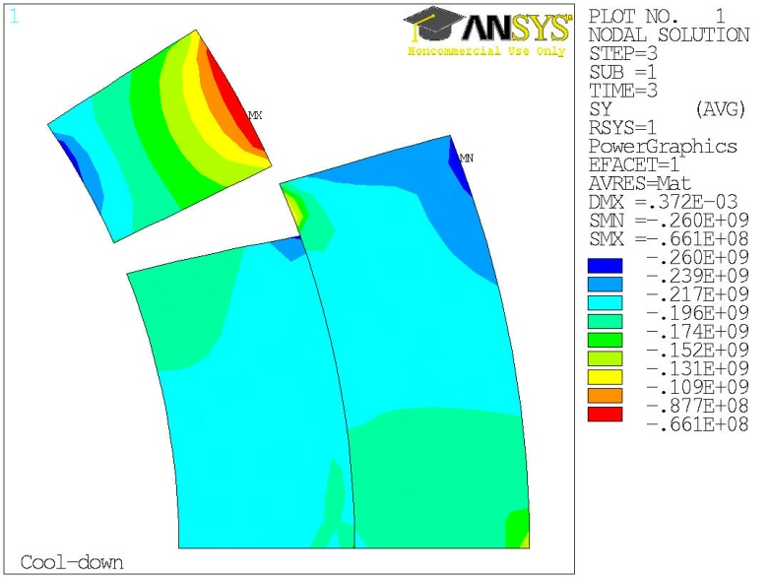
LQS01b Pre-load
LQS01b
Target pre-load at cold:
  Pole: 160 ± 30 MPa
    Same as TQS03b
  Inner layer: 193 ± 30 MPa
    Lower than TQS03c
  Outer layer: 186 ± 30 MPa
    Lower than TQS03c
Delta based on sensitivity analysis
  Coil mid-plane variation: ± 50 μm
  Shell inner-radius variation: ± 65 μm
TQS03c

Slide 19
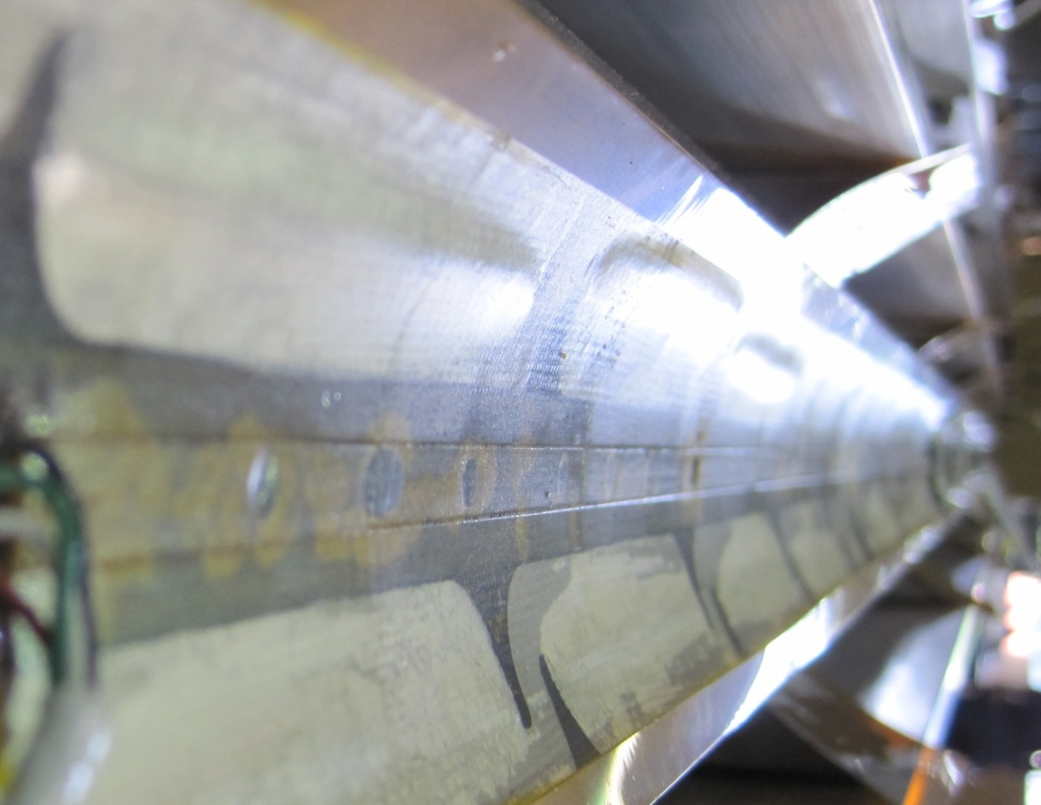
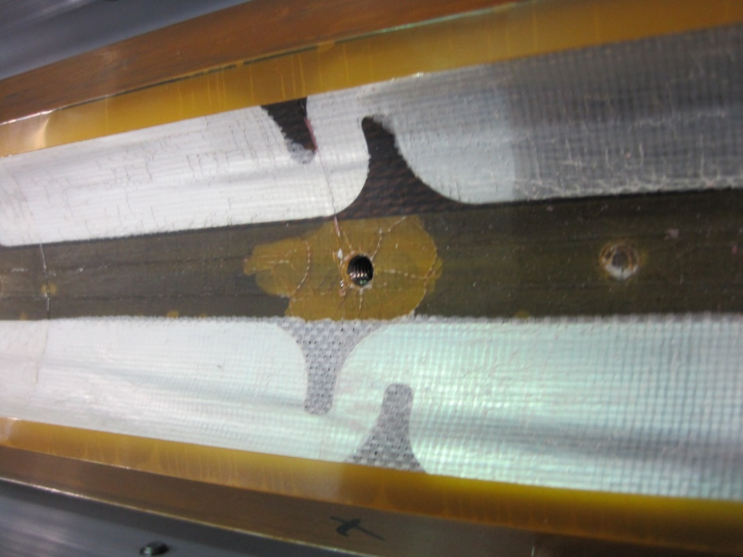
Coils after Test
Delamination on coils Inner Diameter
  Heater – coil
  Insulation – heater
  Insulation – coil
Possible causes:
  Superfluid helium + quench
    Seen in TQ coils
  Heat from heaters on ID
    Only in LQ coils
Plans:
  Strengthen insulation
  Change heater location

Slide 20
Plans
LQS01b with LQS01 coils
  GOAL: reproduce TQS02 performance
    Check shims
    Check effects of “TQS03b-preload”
    Perform Quench Protection studies (possibly disruptive)
LQS02 with 4 new coils (54/61 strand)
  GOAL: reproduce TQS02 performance
    Address reproducibility
    Effect of thermal cycle (memory)
LQS03 with 4 new coils (108/127 strand) and new cable insulation (glass tape)
  GOAL: reproduce TQS03 performance
    Smaller Voltage Spikes
    Better 1.9 K performance
2nd half of May
November 2010
June 2011
Plus additional reassembly if needed

Slide 21
Conclusions
The first Nb₃Sn Long Quadrupole (LQS01) reached the 200 T/m target at 3 K and 1.9 K
  although training was not completed
Next LQ models aim at:
  Achieving short-model performances
  Demonstrating reproducibility & memory
  Demonstrating accelerator-quality conductor and cable insulation
    Smaller voltage spikes & no length issues
Need still some R&D:
  Protection heaters for inner layer

Slide 22
Extra Slides

Slide 23
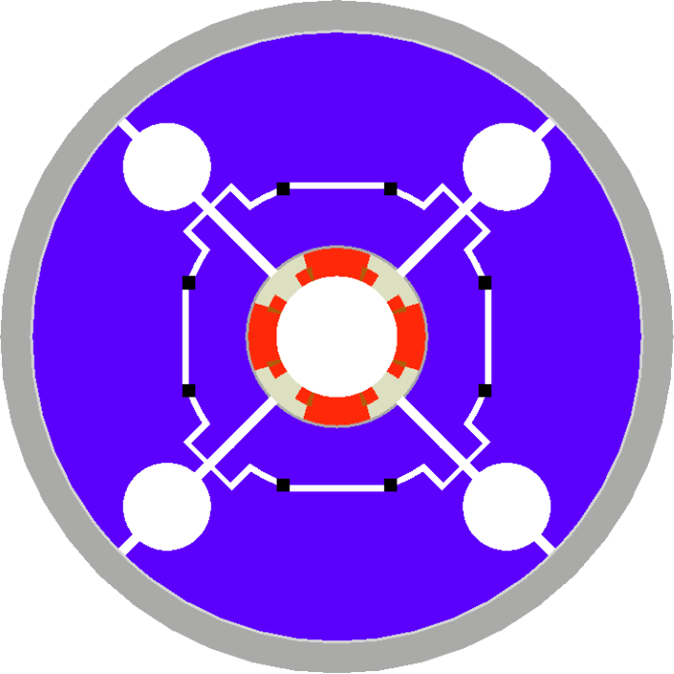
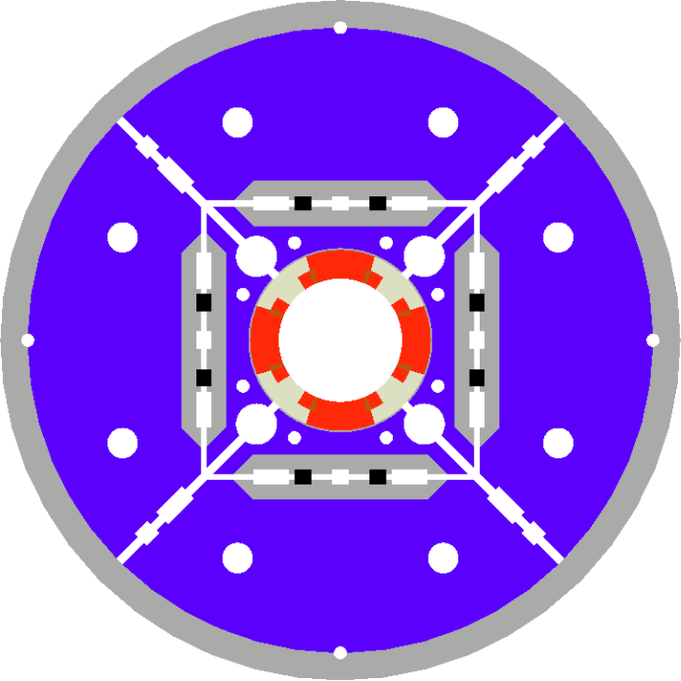
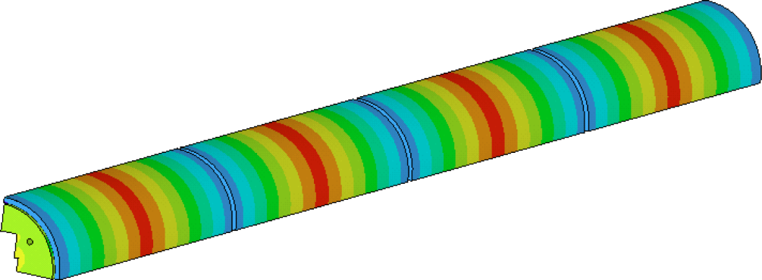
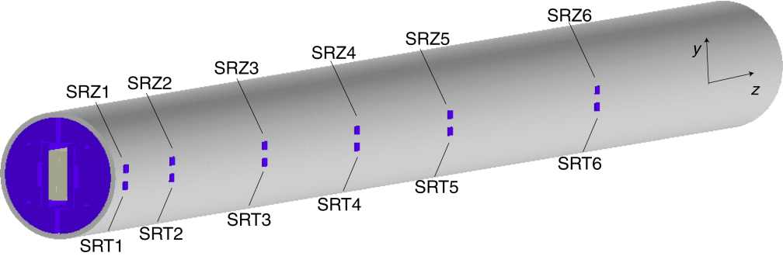
From TQS & LRS to LQS
LQS is based on TQS
and LRS
TQS Modifications:
  Added masters
  Added tie-rods for yoke & pad laminations
  Added alignment features for the structure
  Rods closer to coils
  Rods made of SS
  Segmented shell (4)

Slide 24
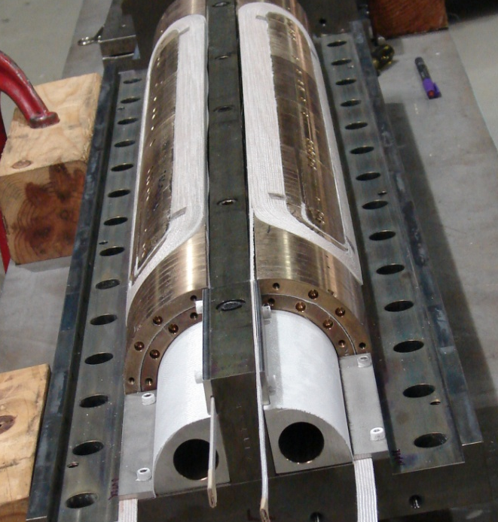
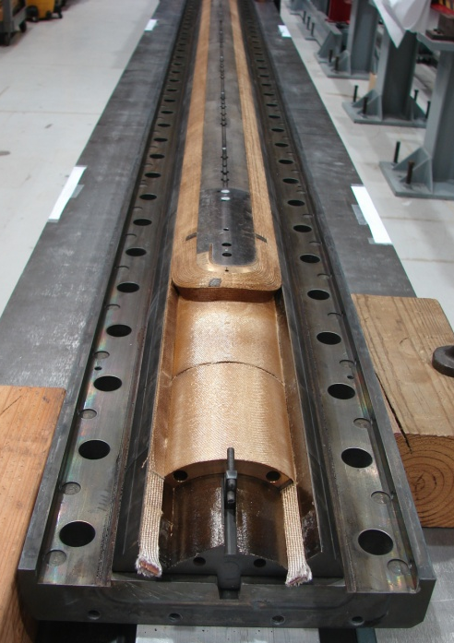
LQ Coil Design & Fabrication
Coil design:
  LQ coils = long TQ02 coils with gaps to accommodate different CTE during HT
Fabrication technology:
  From 2-in-1 (TQ coils) to single coil fixtures (LQ)
  Mica during heat treatment
  Bridge between lead-end saddle and pole
Cross-section of TQ/LQ coil

Slide 25
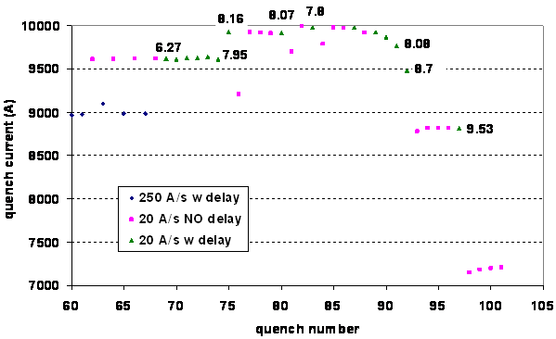
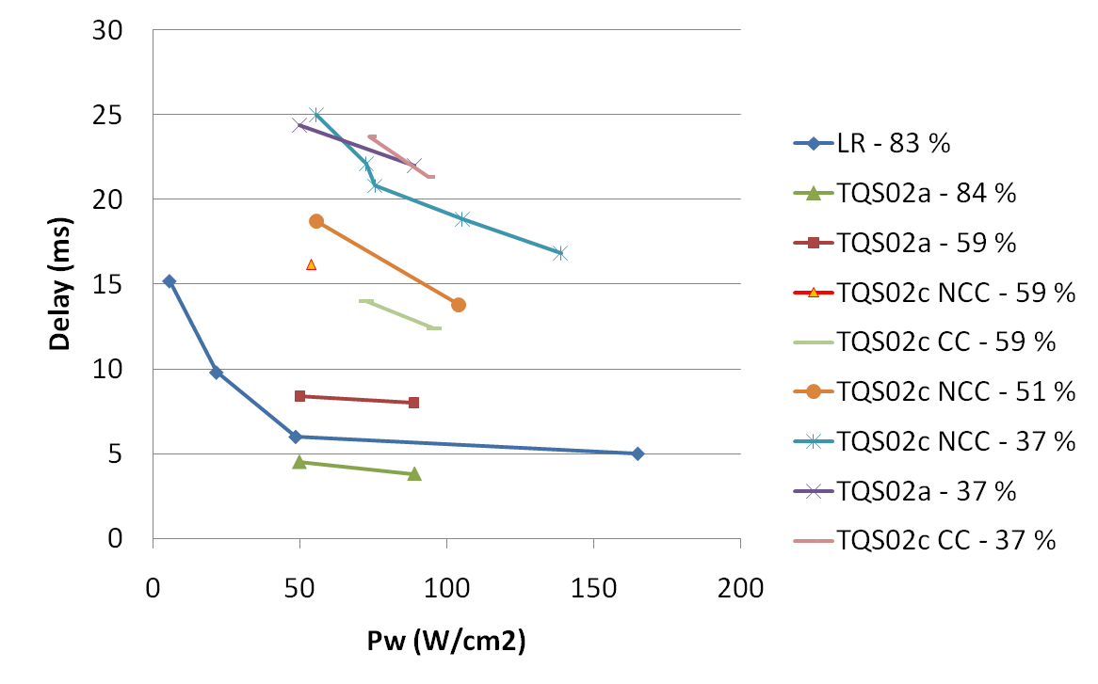
Quench Protection
Very challenging!
J in copper = 2900 A/mm²
at 13.9 kA (4.3 K SSL)
Goal:
  MIITs < 7.5 ⬅➔ Temp ~ 380 K (adiabatic approx)
Quench protection param. (4.5 K) – conservative hypothesis
  Dump resistance: 60 mΩ (extract ~1/3 of the energy; V_{leads} ~ 800 V)
  100% heater coverage (➔ heaters also on the inner layer)
  Detection time: ~5 ms based on TQs with I > 80% ssl
  Heater delay time: 12 ms based on TQs with I > 80% ssl
LARP Collab. Mtg 10 – Port Jefferson, Apr. 23-25, 2008
Long Quadrupole Overview – G. Ambrosio
25
Notes:
25

Slide 26
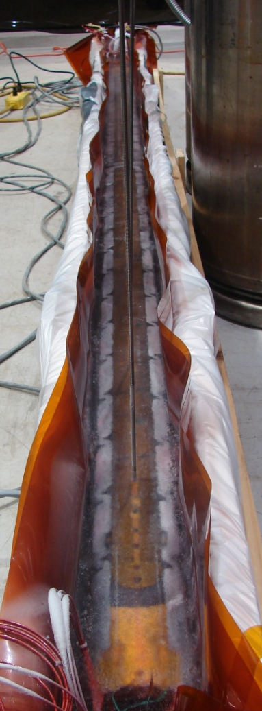
Instrumentation
Voltage taps: 13 IL + 7 OL
Two protection heaters on each layer
  Large ss strip with narrow heating areas
    Successfully tested on Long Racetrack
  “Bubbles” may cause coil-heater shorts
    ➔ test at 4.5, and 3.0 K (1.9K at the end)
Coil strain gauges: 4 IL
  Gauges instrumented with wires
Structure strain gauges:
  Shell: 10 (two full bridges each)
  Rods: 4 (two half bridges each)
Test at LN of
Protection Heaters
LARP CM14 - FNAL, Apr. 26-28, 2010
G. Ambrosio - Long Quadrupole

Slide 27

Test Preparation
J in copper = 2900 A/mm²
at 13.9 kA (4.3 K SSL)
Quench Detection System with Adaptive Thresholds
  To allow using low threshold at high current avoiding trips due to voltage spikes at low current
  Both DQD and AQD
Symmetric Coil Grounding
  To reduce peak coil-ground voltage
    LQ needs larger dump resistance than TQ magnets (60 vs 30 mOhm)
Reconfiguration of the Magnet Protection System
  Additional Heater-Firing-Units for all LQ heaters (16)
Modified Strain Gauge Readout System
  To reduce noise and sampling time
All new systems tested all together two weeks ago
Upgrades passed LQS01 Test Readiness Review

