Slide 1
LQ Goals and Plans Giorgio Ambrosio Fermilab
LARP Collaboration Meeting 14
Fermilab
April 26-28, 2010
Task Leaders:
Fred Nobrega (FNAL) – Coils
Jesse Schmalzle (BNL) – Coils
Paolo Ferracin (LBNL) – Structure
Helene Felice (LBNL) – Instrumentation and QP
Guram Chlachidize (FNAL) – Test preparation and test
Notes:
1

Slide 2
GOALS
Next LQ models goals:
Achieve short-model performances
LQS02 ➔ TQS02 gradient at 4.5K (~220 T/m)
LQS03 ➔ TQS03 gradient at 1.9K (~240 T/m)
Demonstrate reproducibility & memory
LQS02 ≥ LQS01/b
Demonstrate accelerator-quality conductor & cable insulation
LQS03 ➔ Smaller voltage spikes & no length issues
Need still some R&D:
Protection heaters for inner layer

Slide 3
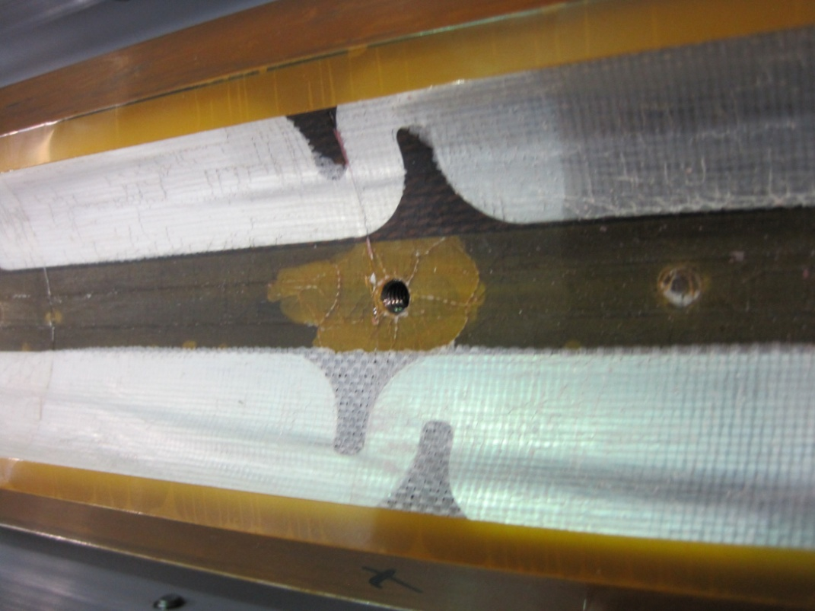
Coils after Test
Delamination on coils Inner Diameter
Heater – coil
Insulation – heater
Insulation – coil
Also one heater-coil short
Possible causes:
Superfluid helium + quench
Seen in TQ coils
Heat from heaters on ID
Only in LQ coils
Plans:
Strengthen insulation
Not good for cooling
Change heater location
Best solution

Slide 4
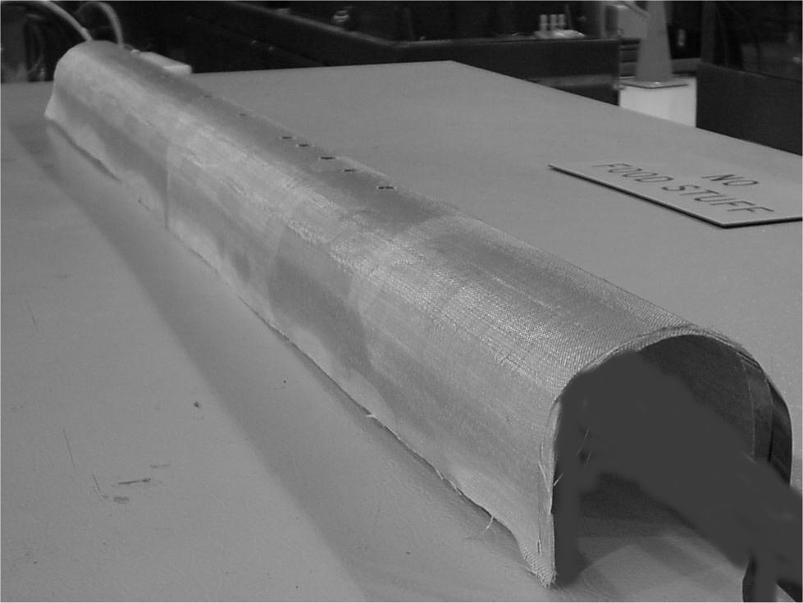
Intra-Layer Heaters
Set heaters between inner and outer layer
Glued by ceramic binder in a sandwich between two S2 or ceramic cloths
Could be developed and demonstrated in single 1m coils (TQ/HQ) tested in mirror structure

Slide 5
Plans
LQS01b with LQS01 coils
GOAL: reproduce TQS02 performance
Check shims
Check effects of “TQS03b-preload”
Perform Quench Protection studies (possibly disruptive)
LQS02 with 4 new coils (54/61 strand)
GOAL: reproduce TQS02 performance
Address reproducibility
Effect of thermal cycle
LQS03 with 4 new coils (108/127 strand) and new cable insulation (glass tape)
GOAL: reproduce TQS03 performance
Smaller Voltage Spikes
Better 1.9 K performance
2nd half of May
November 2010
June 2011
Additional reassembly if needed

Slide 6
Schedule
LQS01b
LQS02
LQS03

Slide 7
Conclusions
Next LQ models aim at:
Achieving short-model performances
LQS01b/02/03
Demonstrating reproducibility & memory
LQS02/03
Demonstrating accelerator-quality conductor and cable insulation
Smaller voltage spikes & no length issues
LQS03
Need still some R&D:
Protection heaters for inner layer
LQS02 coil #13 with reinforce ID insulation
TQ/HQ coil in mirror structure

