Slide 1
Optimization Study of Neutrino Factory front end
Ben Freemire
MAP Friday Meeting
6/4/10

Slide 2
Current Work
Rick Fernow’s ICOOL code for the ISS front end (Study 2a)
1000 muons
Varied RF gradient and phase
Selected phase for each gradient that produced maximum number of surviving particles

Slide 3
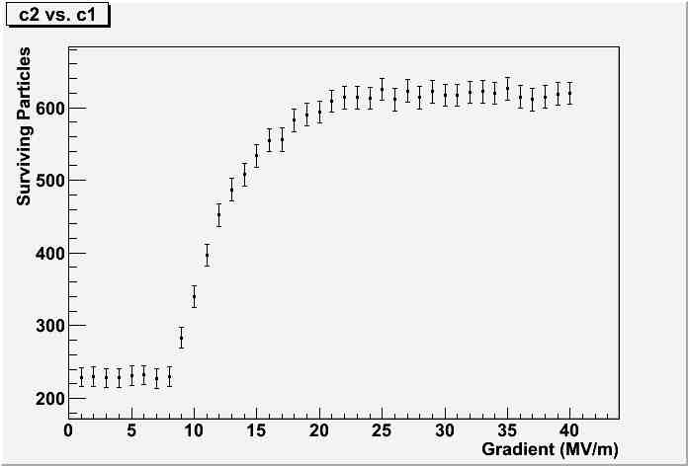

Slide 4
Future Plans
Vary absorber thickness
Add additional absorbers/cavities
Fix phase and optimize gradient/thickness

