Slide 1
Tevatron Stabilization & Decommissioning
Ron Moore / Paul C. Czarapata
DOE S&T Review
July 2010

Slide 2
Outline
Last year’s S&T recommendation and response
Updates to last year’s plan
Our plans
Summary

Slide 3
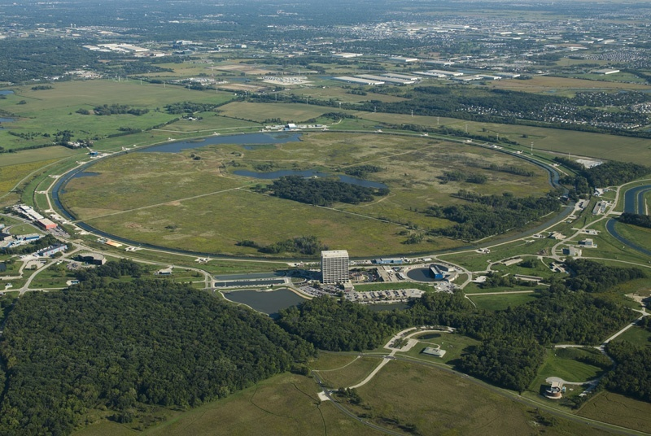
The Big Picture

Slide 4
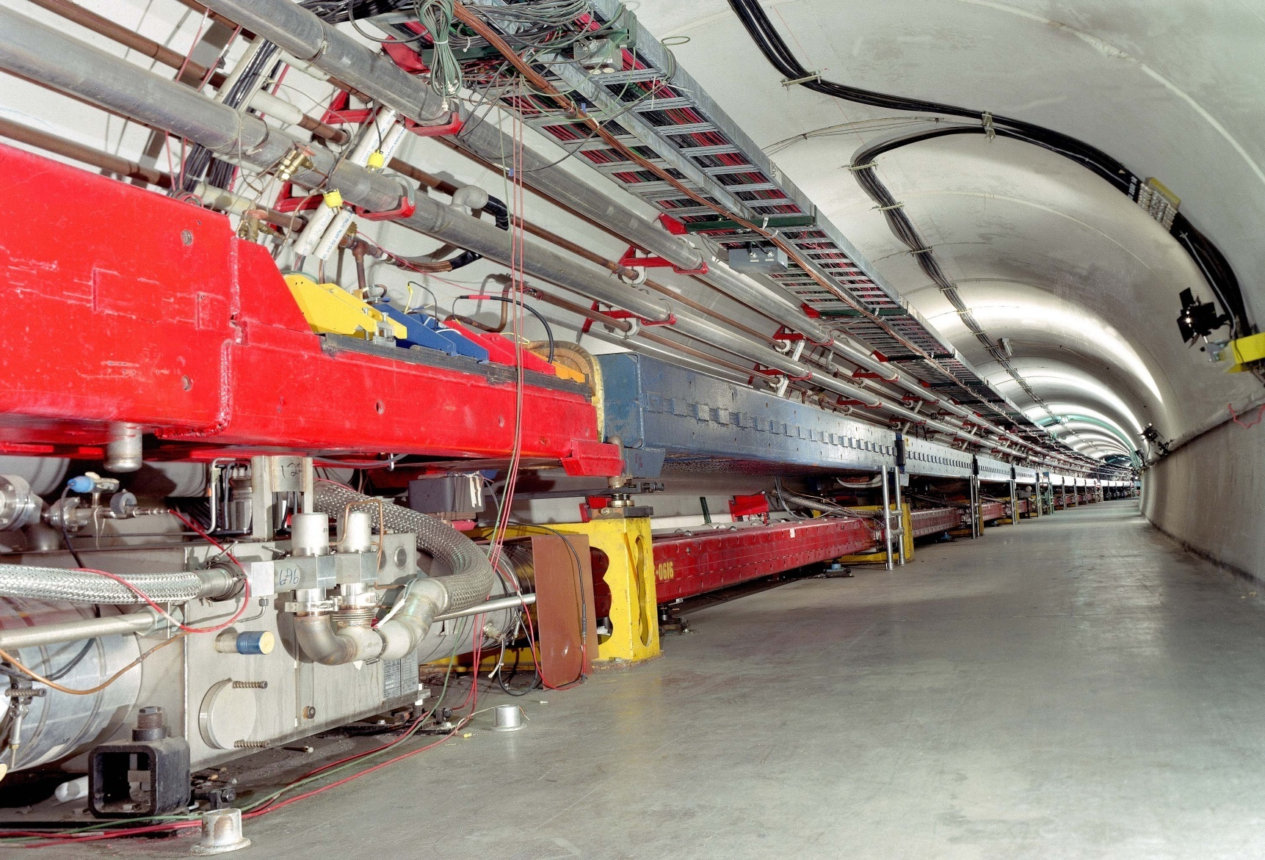
Scale of the Problem
6.28 km of copper bus &
Stainless steel waterlines
Old Main Ring
Tevatron

Slide 5
FY09 S&T Recommendation
Recommendation: (paraphrased)
The lab should revisit the “cost – benefit” analysis to determine if it is necessary and cost effective to keep the Tevatron cold
What we have done:
Refined last year’s estimate for the manpower, cryogens, electricity and cost to build replacement Tevatron components
Updated cost & manpower required to completely strip the tunnel of Tevatron components and to remove all electrical infrastructure.(nearly “green field”)

Slide 6
Response to S&T Finding
We asked Technical Division to develop an “estimate” to produce new Tevatron magnets.
Tevatron Reconstruction (Contingency 0%)
First Unit $1,500 K
Next 50 $ 200 K
Each Subsequent Unit (949 ea.) $120 K
TOTAL ≈ $124 M (caveats below)
The above assumes 750 dipole and 250 quadrupole magnets. Spool pieces are NOT INCLUDED. "First Unit" includes all design, tool-up and the first edition. "Next 50 Units" involves all learning curve and mass production processes.
Schedule, superconductor lead-time and design iterations are not considered.

Slide 7
The Plan
We proposed to keep the Tevatron in cold stand-by for two years after the collider program ends and believe we had received agreement from the Science & Technology review committee the past two years.
This is still our plan.
If the decision is made at some time to remove the Tevatron components, we have the information to do so and have the effort estimates which can be scaled to “then year” dollars.

Slide 8
J. Theilacker
CNR = Central Nitrogen Refrigerator

Slide 9
The Best Choice – 80 ºK Why?
300 ºK non-ODH
Appears to be the cheapest but suffers from the uncertainty of power outages and potential magnet loss.
300 ºK ODH
Same as above but increased cost due to helium flow.
80 ºK CNR On
Keeps machine stable BUT requires more intensive manpower to keep nitrogen plant running.
80 ºK CNR Off
Requires less maintenance, keeps the machine stable and mimics what we have done during other machine shutdown periods. Allows the best chance of bringing the machine back into operation. Suffers increased nitrogen deliver cost.

Slide 10
Cold Storage Details
Cryostat and beam tube vacuum to be maintained; gas flowing through cryo circuits; LCW flowing
Maintenance on these systems must continue
~600 person-hrs/year just for mech support techs
cryo support not included here
We do not have any rational way to predict the number of devices that would be lost if we warmed up and then suffered a loss of site power or had a major vacuum leak.

Slide 11
Reduce, Reuse, Recycle
Various people/projects have plans to scavenge Tevatron infrastructure
NOvA, Project X, New Muon Lab (NML), Magnet Test Facility (MTF), Mu2e
RF, BPM electronics, cryogenic equipment
Resurrecting the Tevatron would require replacement of those parts

Slide 12
ANU/NOvA Needs from Tevatron
RF anode power supply $616K
transformer, switches, cap bank, etc.
HLRF system $1400K
modulators, amplifiers, combiners, etc.
LLRF systems (some from Recycler) $76K
crates, CPUs, DDS, etc.
BPM electronics $600K
CPUs, EchoTek cards
Various controls infrastructure $70K
Spreadsheets in back-up slides
P. Derwent

Slide 13
Other Cryogenic Needs from Tevatron
New Muon Lab
6 MYCOM compressors $4,200K
3 30,000 gallon GHe storage tank $450K
1 20,000 gallon LN₂ storage dewar $300K
For use with new 2 K plant in support of linac
For use with SLAC 4.5 K plant in support of Cryomodule testing
Project X
11 30,000 gallon GHe storage tank $1,650K
1 50,000 gallon LN₂ storage dewar $750K
1 11,000 gallon LHe storage dewar $500K
For use in cryogenic auxiliary systems

Slide 14
Other Cryogenic Needs from Tevatron
MTF
1 MYCOM compressor $700K
For use as purification loop compressor for SRF activities
Mu2e
3 MYCOM compressors $2,100K
2 Satellite refrigerators $1,200K
1 30,000 gallon GHe storage tank $150K
1 20,000 gallon LN₂ storage dewar $300K
In support of the three superconducting solenoids

Slide 15
What about the Big “D” (Decommissioning) ?
We have a detailed list of the ring components
We have the manpower estimates
Both mechanical and electrical
We have time estimates
We have an estimate of the support costs
We do not have a place to put the material!
We do not have the costs to remove the tunnel sections and floor (green earth)
We have not accounted for Service Building components
We do not have shipping or other ancillary costs

Slide 16
Tunnel Component Totals – Tevatron only
775 Dipoles
223 Quadrupoles
208 Spool pieces with Correctors
13 Beam scrapers
26 Electrostatic separators
8 RF Cavities (some RF removed for ANU, more on this later)
36 Cryogenic Isolation Valves
5 Flourinert® pump skids
229 Ion pumps
49 Sublimation pumps
310 Vacuum valves
350 Vacuum gauges
43 Various Beam diagnostics
Variety of tunnel support (sump pumps, air handlers, phones, etc.)
And all the wiring and buss work
389 remaining Main Ring magnets
Does not include CDF or DØ detectors

Slide 17
Tevatron mechanical removal (direct costs) technician estimate (sample)
D. Augustine

Slide 18
Electrical Costs (direct) for complete removal of ALL services
House | Location | Device Description | Quantity | Special Removal Concerns | Disconnection In Man Hours | Remove From Tunnel In Man Hours | Cost in Dollars |  | Total Man Hours
F-4 | Tunnel | Cable Tray Plus Wire | 2112 Feet | Must validate that all cable inside of cable tray is de-energized | 300 | 120 | $37,800 |  | 420
 |  | Galvanized Channel Brackets | 528 |  | 100 | 120 | $19,800.00 |  | 220
 |  | 4" Copper Bus/*4 | 2816 Feet | Bus is very heavy, approxiately 10 lbs per foot. Must use lifting device. | 400 | 180 | $52,200.00 |  | 580
 |  | 4' Light Fixtures | 70 |  | 32 | 48 | $7,200.00 |  | 80
 |  | Ridgid Conduit | 2112 Feet |  | 104 | 96 | $18,000.00 |  | 200
 |  | Panel Boards | 2 |  | 16 | 20 | $3,240.00 |  | 36
 |  | Sump Pumps | 1 |  | 8 | 10 | $1,620.00 |  | 18
 |  | Emergency Lights | 10 |  | 10 | 12 | $1,980.00 |  | 22
 |  | 15 kva Transformer | 1 |  | 8 | 10 | $1,620.00 |  | 18
 |  | Stairwell/Misc. | 500 Feet |  | 160 | 20 | $16,200.00 |  | 180
 |  |  |  |  | 34140 | 13578 | $4,294,620 |  | 47718
J. Ranson

Slide 19
Some typical numbers
Main Ring Magnets
Unused and sitting | 388
Used | 375 | Time to pick mag in Min. | Total time in min. | Total time in hours | Total time in days (6hrwd)
Totals | 763 | 90 | 68670 | 1144.5 | 190.75
Main ring Magnet disconnect | no of magnets | time to disconnect hrs | tot T in hours | 6hrwd | T in days
 | 375 | 1 | 375 | 6 | 62.5
 | No. of Stands | no. of stands per load | no loads per day | stands out per day | no. of days to remove
Main Ring Magnet Stands | 1526 | 6 | 2 | 12 | 127.1666667
 | No of interfaces | time to disconnect 1 IF | total time in mins | T to disc one mag | time in hours to disc | 6hrwd | time in days to disconnect
Tev Disconnect Magnets | 1358 | 60 | 81480 | 60 | 1358 | 6 | 226.3333333
Tevatron Magnet Removal |  | Time to pick mag in Min. | Total time in min. | Total time in hours | Total time in days (6hrwd)
Total | 1359 | 90 | 122310 | 2038.5 | 339.75
Tev Mag stands | No. of Stands | no. of stands per load | no loads per day | stands out per day | no. of days to remove
 | 2718 | 12 | 2 | 24 | 113.25
 | no of straights | time to disconnect hrs | tot T in hours | 6hrwd | T in days
D. Augustine

Slide 20
Summary Costs full Excel sheets available
Technician, Iron Workers, Rad Safety, etc.
Total charge for Fermi FTE | Iron Worker Charges | Material Charges
$3,957,440.00 | $234,000.00 | $1,538,916.00
Electrician Costs
House | Location | Device Description | Quantity | Special Removal Concerns | Disconnection In Man Hours | Remove From Tunnel In Man Hours | Cost in Dollars |  | Total Man Hours
 |  |  |  |  | 33840 | 13538 | $4,264,020 |  | 47378
Total = $9,994,376 ≈ $10M
Only gets it to the surface! (Where to haul it, store it, scrap it?)
NOTE THESE ARE DIRECT COSTS
D. Augustine

Slide 21
Magnet Storage
A Tevatron dipole is:
21 feet long 18 inches wide
8700 pounds
775 Installed
Removal and storage in a warehouse would require a building ≥ 5000 ft²
Two such buildings would be needed
one for dipoles
one for quadrupoles & other devices
The current cost for warehouse space is approximately $150 to $200 per ft². Of course larger would be better!
15000 ft² @ $200/ ft² = $3M

Slide 22
Magnet Disposal
May be possible to dispose of Tevatron magnets as low-level rad waste at site in NV
Example cost for dipoles (B. Arnold, ES&H)
Hauling = $880 per magnet (5 per truck = $4400)
Disposal = $531 per magnet (22.92 ft³ @ $23.19/ft³)
Total for 775 dipoles ≈ $1.1M
Most radioactivity contained to stainless steel beampipe
May be possible to extract pipe, scrap more material locally?
Hotter components (collimators, abort dump blocks) may need local storage

Slide 23
Summary
Current plan to keep Tevatron cold after Run 2
Have effort and cost estimates
≈ $4M / year for cryo operating costs @ 80K
Revaluate plan after 2 years
Have estimates for dismantling the Tevatron and removing infrastructure from tunnel
$10M to get all to surface (CDF and D0 not included)
Component storage/disposal a separate issue

Slide 24
ANU/NOvA Tevatron Needs

Slide 25
ANU/NOvA Tevatron Needs

