Slide 1
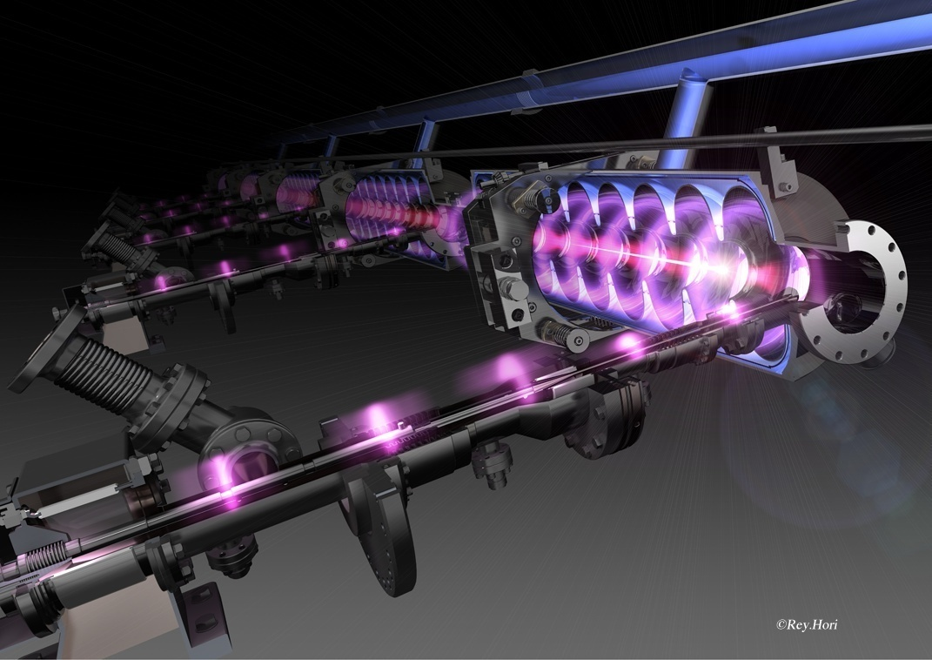
SRF Activities at FNAL
FNAL DOE S&T Review
Bob Kephart
FNAL, July 13, 2010
Photo: H. Hayano, KEK

Slide 2
Superconducting Radio Frequency
SRF is an enabling technology envisioned for use in many new applications of interest to the Office of Science
Most new accelerator projects assume use of SRF
  Project X, ILC, Muon Collider
  ATLAS upgrades at ANL, FRIB, CBEAF upgrade
  Future SRF based light sources
  Medical and industrial accelerators, ADS and ATW, etc
Why?
  Because of the dramatic improvements in achievable gradients (e.g. 35 MV/M for ILC)
  SRF is efficient at translating wall power into beam power so highly attractive for high beam power applications

Slide 3
History of SRF at FNAL
History:
2005: choice of SRF technology for the ILC
  Gave a strong impetus to build SRF capability
  Collaboration as part of the TESLA Collaboration (3.9 GHz CM)
  Realization: U.S. must master ILC SRF technology (developed @ DESY)
2006-7
  EPP2010 and HEPAP strong endorsement of ILC R&D
  ILC Global Design Effort (GDE) emphasis on cavity gradient & yield
  Fermilab: growing interest in SRF linac, Proton Driver→ Project X
  Development of an ANL/FNAL cavity processing facility at ANL
  Development of complementary SRF infrastructure at FNAL
2008: FY08 Omnibus Bill stops effort for ~ 1 yr
2009-present
  2009-10: ILC and SRF funding restored
  2009 ARRA funds! $ 52.7 M for SRF infrastructure and industrialization
  Lots of Infrastructure commissioned and in use
  Lots of technical Progress!

Slide 4
FY10: New Directions
Realization that timescale for ILC is later that envisioned
Increased focus on Project X
But… the Project X design has changed:
  ICD1, a 8 GeV pulsed linac ➔ evolved
  ICD2, a 3 GeV CW linac for an enhanced rare decay program plus a 3-8 GeV accelerator (pulsed linac or RCS) to MI for neutrinos
ILC /PX 1.3 GHz pulsed linac R&D continues
  ILC R&D remains part of the national program and FNAL is playing a big role, Lots of technical progress!
  Pulsed 1.3 GHz linac remains part of Project X R&D
  Favored path to a high power proton source from main injector

Slide 5
FY10: New Directions
Realigning the HINS front end R&D with PX
  Evolving into PX chopper and instrumentation test facility
  325 MHz spoke resonators are still part of Project X
    but now will operate CW at 1.8 K (vs pulsed at 4.5 K)
    needs test & fabrication infrastructure (started by HINS)
Project X now envisions 650 MHz cavities
  Two new families of 650 MHz elliptical cavities Beta = 0.6 & 0.9
  Operating CW at 1.8 K (CW better for rare decay program)
  Cost effective; provides larger aperture; better transit time match
  Much of the infrastructure we have built is useful
  But some changes/additions are needed

Slide 6
FY11: Merge FNAL SRF efforts
Project X
HINS
ILC R&D
SRF Infrastructure
FY11: Consolidate the SRF parts of these efforts
  Personnel Management: Many personnel are shared
  Technical Management: Optimized development & infrastructure
  Financial Management: Manage SRF across 3 B&R’s
  Communication: Speak with one voice to SRF collaborators
  Alignment: Naturally enhances PX and ILC alignment
Moving towards integrated management in FY11
  Funded from 3 B&R’s: ( see Steve’s talk)
SRF parts were managed independently

Slide 7
ILC R&D Goals
Mission:
Work with the GDE Americas Regional Team (ART) to develop the ILC design & gain approval of the project
Goals:
Participate in the Technical Design Phase (now→ 2012)
Participate in Accelerator Physics, Conventional Facilities Design, and global systems work to further the ILC design
Work towards GDE SRF goals
  S0: Cavity gradient of 35 MV/m; good yield
  S1: Cryomodules with average gradient > 31.5 MV/m
  S2: One or more ILC RF unit with ILC beam parameters
Perform R&D and value engineering to reduce costs
Become a trusted international partner
>50% of ILC program is SRF R&D, FNAL is a major player
SRF !

Slide 8
Project X R&D Goals
Goals:
  Pick configuration in Early 2010
  Complete baseline design, cost and schedule estimates in 2012
  Technical component and infrastructure development
Linac (325 MHz)
  High speed variable chopping patterns (325 MHz)
  SRF spoke resonator development
  RF control of multiple SRF cavities from single klystron
Linac (650 MHz)
  Demonstrate: Beta = 0.6 and 0.9 Cavities @ 20 MV/M CW
Linac (1.3 GHz)
  SRF Cavity & CM development coordinated with ILC
  2-3 GeV: ILC cryomodules operated 1 mA CW
  3-8 GeV: ILC CM operated pulsed 25 MV/m gradient
  Long pulse operation: 1 mA x 25 msec x 2.5 Hz
H⁻ transport, multi-turn injection, space charge, e-cloud, civil, etc
SRF !
8

Slide 9
Project X: Initial Configuration 2
3 GeV High Intensity Program (2.8 MW)
3 GeV
CW SRF Linac
1 ma H⁻ or Protons
Recycler
Linac: 1 mA x 5 ms @ 10 Hz
6 pulse per fill
3 → 8 GeV
Pulsed Linac
(or RCS)
Laser Stripping
8 GeV fast spill (200 KW)
1.6 x 10 ¹⁴ Protons / 1.4 sec
LBNE (2.2 MW)
120 GeV Fast extraction
1.6 x 10 ¹⁴ Protons / 1.4 sec
Upgradeable to ~3-4 MW
Main Injector
1.4 Sec cycle
Upgradeable to ~0.7-1.0 sec
Single turn
transfer
At 8 GeV
3-8 GeV linac would be 1300 MHz pulsed ➔retains
synergy with ILC R&D but long pulse R&D needed

Slide 10
Project X Linac’s
Design based on 3 families of 325 MHz Spoke resonators, two families of 650 MHz elliptical cavities, then 1300 MHz ILC cavities
Ion source, RFQ
SSR0
SSR1
SSR2
β=0.6
β=0.9
ILC
MEBT
325 MHz, 2.5-160 MeV
1.3 GHz
2-3 GeV
650 MHz,
0.16-2 GeV
3-8 Gev Linac is very similar to ILC. Same cavities, similar cryomodules. However pulse width is 5-25 ms vs 1.5 ms for ILC (1 ma x 25 ms fills Main Injector)

Slide 11
Project X: 3 GeV CW linac
Section | Freq | Energy MeV | Number of cav/magn/CM | Type of
SSR0 (β_{G}=0.11) | 325 | 2.5-10 | 26/26/ 1 | Single spoke cavity, Solenoid
SSR1 (β_{G}=0.22) | 325 | 10-32 | 18 / 18/ 2 | Single spoke cavity, Solenoid
SSR2 (β_{G}=0.4) | 325 | 32-160 | 44 / 24 / 4 | Single spoke cavity, Solenoid
LB 650 (β_{G}=0.61) | 650 | 160-520 | 42 / 21 / 7 | 5cell cavity, doublet
HB 650 (β_{G}=0.9) | 650 | 520-2000 | 96 / 12 / 12 | 5cell cavity, doublet
ILC 1.3 | 1300 | 2000-3000 | 64 / 8 / 8 | 9-cell cavity, quad
290 Cavities, 34 cryomodules

Slide 12
Project X: 3-8 GeV Pulsed Linac
Section | Freq | Energy MeV | Number of cav/magn/CM | Type of
ILC 1.3 | 1300 | 3000-8000 | 400/ 25 / 25 | 9-cell cavity, quad
Gradient Goal for Px pulsed linac ~ 25 MV/m (lower than ILC but will try for higher), yield is still an issue.
1 mA 5 ms beam pulse @ 10 Hz (Upgradeable to CW?)
400 9-cell 1300 MHz TESLA/ILC type cavities
Construction of Project X would substantially contribute to U.S. industrialization of SRF for ILC or other future projects

Slide 13
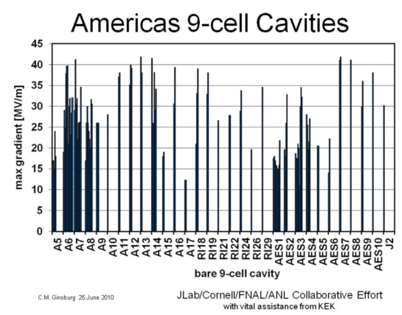
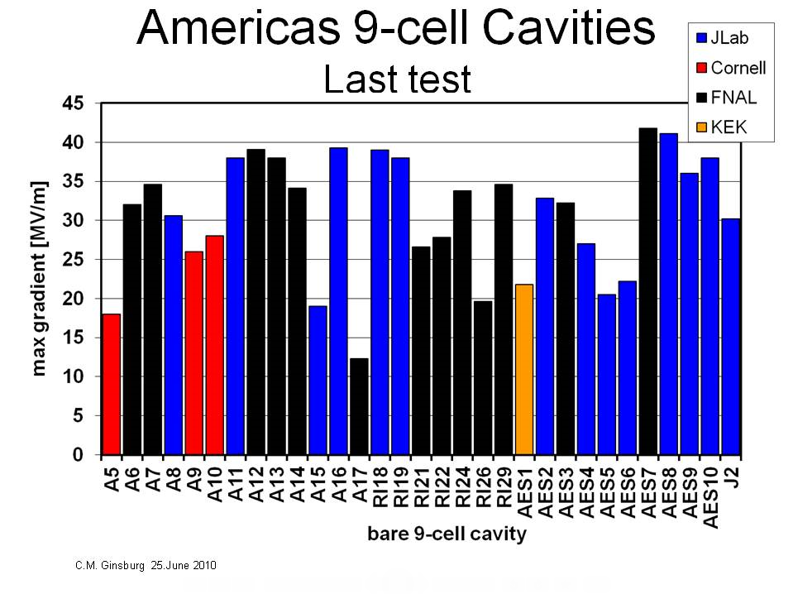
1.3 GHz Joint Development Strategy
Project X shares 1.3 GHz technology with the ILC
  Project X requires 33 ILC-like cryomodules.
    In detail they will not be identical to ILC:
    Gradient: 25 MV/m (but try for higher)
    Yield/Q0 both important for cost
Close coordination of Project X & ILC R&D
  Developing U.S. cavity vendors
  Improving cavity gradient and yield!
  Up to now most EP & tests from JLAB
  New ANL-FNAL infrastructure operational and contributing to statistics, will double U.S. EP and test throughput
Px: 4 year construction ➔1 CM/month
  Building extensive infrastructure at FNAL, JLAB, ANL, etc for both Project X and ILC R&D
ILC
Px
U.S.
13

Slide 14
SRF Accomplishments
Steady progress on SRF infrastructure at FNAL
  Several new SRF facilities now in full operation
ANL/FNAL processing Facility
  Works! Processing single and 9 cell cavities
Vertical Test Stand; tests bare cavities
  Works! 95 tests so far, 45 in FY10 (achieved design test rate of 5/month)
  Upgrades to add two more VTS cryostats in progress
Horizontal Test Stand; tests dressed cavities (unique in U.S.)
  Works ! HTS-1 Commissioned: Testing dressed production cavities
  Additional HTS-2: design in progress, 650 MHz capability
Cryomodule Assembly Facility
  Works! Cavity dressing infrastructure complete and in use
  Works! 2 CM assembled in MP9 & ICB: CM1(1.3 GHz) & FLASH(3.9 GHz)
Excellent progress on RF unit test facility at New Muon Lab
More on all of this in the slides that follow

Slide 15
SRF Accomplishments
ILC Cavities:
  Using ANL and JLAB EP facilities “flat out” to process cavities
  Tuning, cavity dressing, ½ all VTS and all HTS tests at FNAL
  Progress! In improving yield of high gradient 1300 MHz cavities!
PX cavities: Testing 325 MHz spokes, Designing 650 MHz cavities
Cryomodules:
  CM1 being installed at NML
  CM2 parts in hand, have 8 VTS qualified cavities and 2 HTS qualified cavities need 8 good ones, assembly in FY10
  Type IV CM design ~ complete; parts ordered with ARRA funds
SRF Materials:
  Improved diagnostics (thermometry, 2nd sound, optical inspection)
  Understanding reasons for poor performers (e.g. weld pits)
  Demonstrated 3 different cavity repair techniques, all successful!
    tumbling, laser re-melt pit, local grinding, followed by EP, HPR

Slide 16
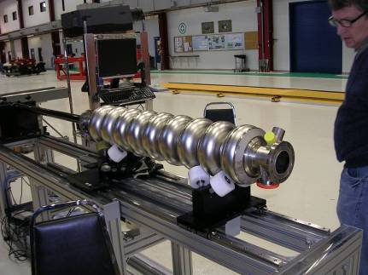
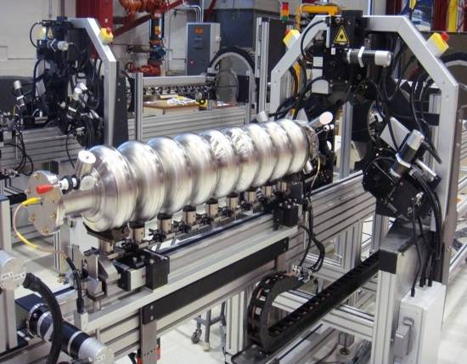
SRF: New Infrastructure
KEK/Kyoto optical inspection system, commissioned in 2009
In routine use examining cavity as it arrives from vendor and after each step of processing
Automated Cavity tuning machine
DESY/FNAL/KEK collaboration
FNAL: electronics and software
FNAL machine in routine use
2 machines at DESY, one at KEK
Optical Inspection Machine
Cavity tuning machine

Slide 17
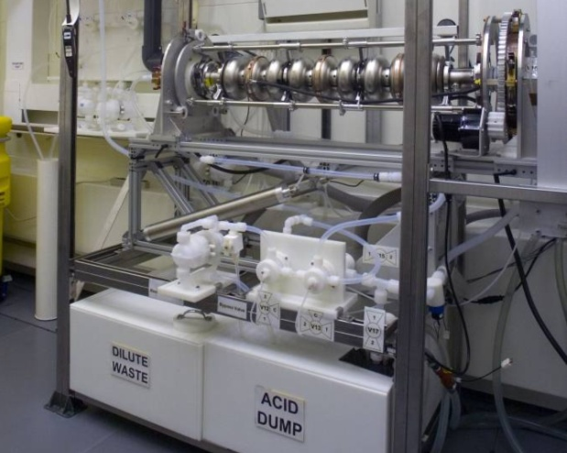
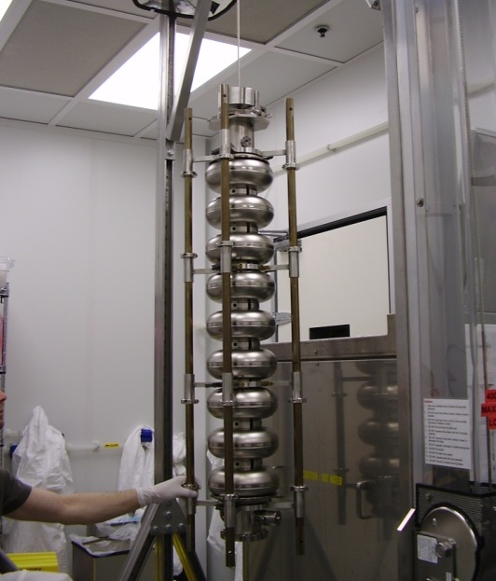
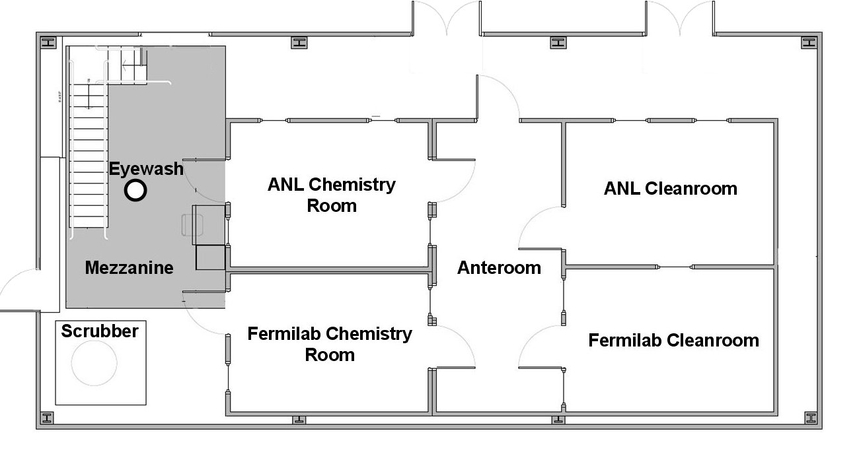
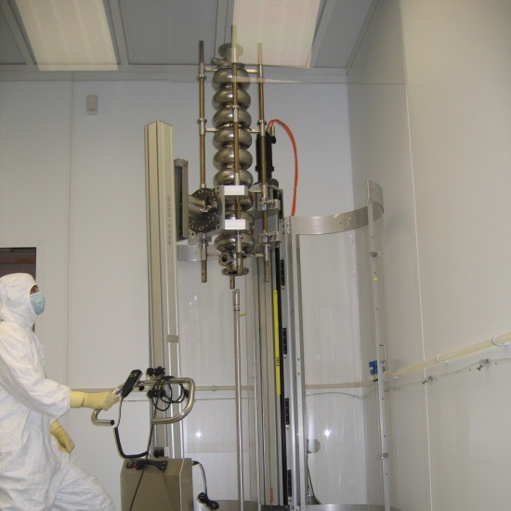
Cavity processing at Argonne
Joint facility built by ANL/FNAL collaboration
Complete @ ANL in Mar 2009
Excellent single cell EP results
EP processing of 9-cells has started
Together with Jlab, ANL/FNAL facility represents the best cavity processing facilities in the US for ILC or Project X
Ultrasonic Cleaning
Electropolishing
High-pressure
rinse

Slide 18
Cavity processing at ANL/FNAL
4 FNAL processing technicians and 2 new ANL eng associates
  Two FNAL techs trained on extended assignments to JLAB
24 cavity test preps Jan-May 2010
  10 one-cell preps
  9 nine-cell vertical preps
  5 horizontal test preps
6 bulk EP, 11 light EP
68 HPR cycles
Test Highlights:
TB9AES007: 41.8 MV/m 9-cell (processed/tested at Jlab) was rinsed and assembled at ANL, tested at FNAL: results in agreement
TB9RI029 : ANL EP; tested at FNAL 34.6 MV/m w/o FE
TB9AES009: was FE-free at 35 MV/m in HTS
20+ single-cell processes FE-free in a row—up to 42 MV/m
Multiple 30+MV/m 9-cell processed through ANL/FNAL facilities

Slide 19
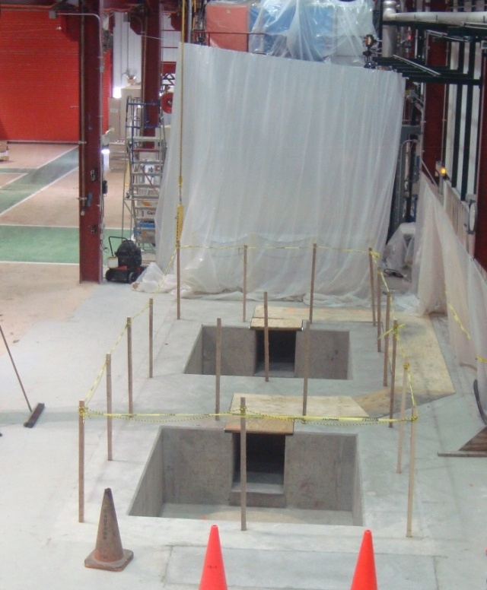
FNAL VTS: Test of Bare 1.3 GHz Cavities
VTS 2-3
Civil construction
Goal
VTS-1 Operational
Increasing VTS-1 throughput
Also upgrading IB1 Cryogenics system (ARRA)
VTS-2/3 Civil const done
Cryostats being fabricated in industry
Larger dia➔ 650 & 325 MHz capable
~Triples throughput of IB1 (ARRA)

Slide 20
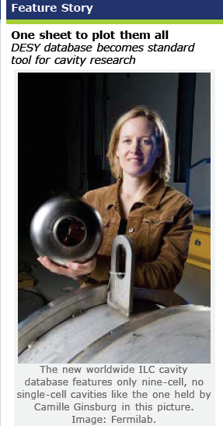
Creation of an ILC Global Database
FNAL playing leadership role
Global Data Base Team formed in 2009:
  Camille Ginsburg (Fermilab)
  Rongli Geng (JLab)
  Zack Conway (Cornell University)
  Sebastian Aderhold (DESY)
  Yasuchika Yamamoto (KEK)
Activities
  Selected DESY-DB and Cavity dataset
  ILC Database is now fully functional
  Web-based, support by FNAL/DESY,
  Contains data from all three regions: 92 cavities
  Mar 2010: - 2nd update of cavity yields

Slide 21
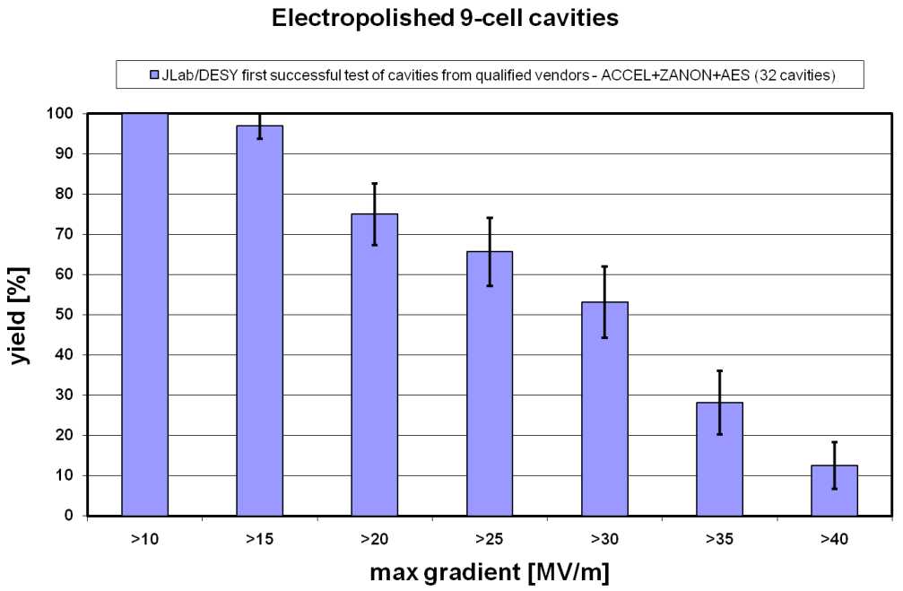
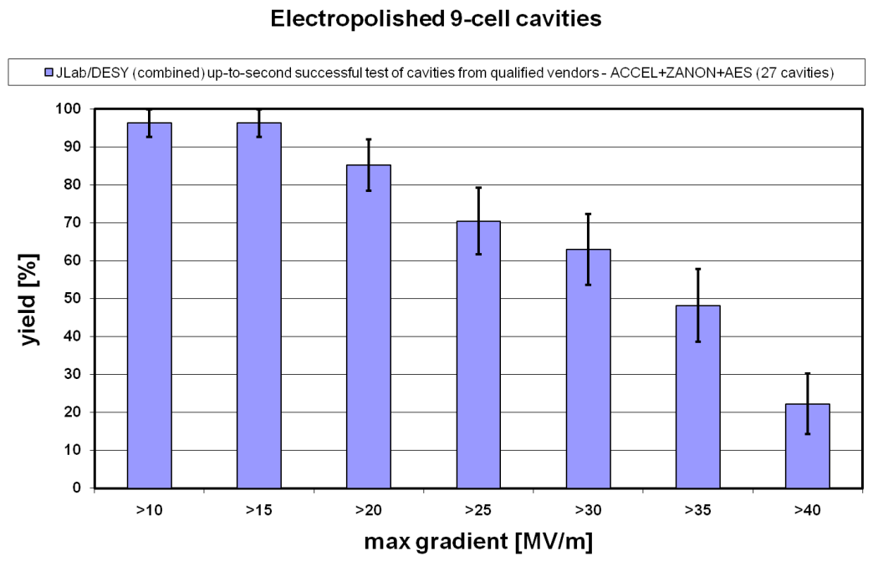
Vertical Test ‘Production’ Yield
1st pass
2010 ILC target
2nd pass

Slide 22
SRF Industrialization
Fermilab is engaged in vendor development with three North American cavity vendors:
  AES, Niowave/Roark, and PAVAC
Also engaged in industrialization of cryomodule parts, surface processing, RF equipment
U.S. participation in the construction of ILC would require a large scale up of these efforts
Likely that, Project X or other similar projects are the near-term path to U.S. SRF industrialization for a future ILC project

Slide 23
U.S. Cavity inventory and procurements
ARRA funds have been key to cavity industrialization
But… one time shot of funds

Slide 24
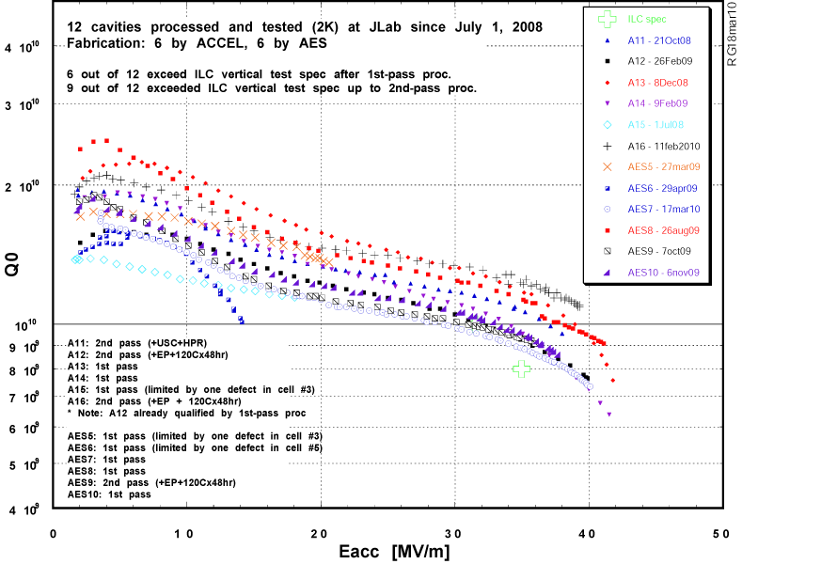
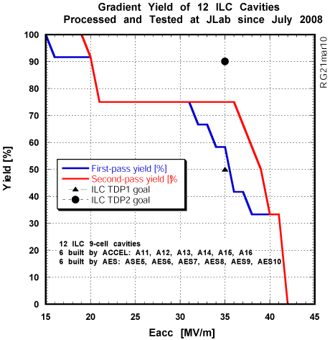
Most Recent 9-cell Results at JLab
6 cavities built by ACCEL and 6 by AES
ILC
Courtesy of R Geng
AES 2nd batch has 75% yield > 35 MV/M
But… of course low statistics

Slide 25
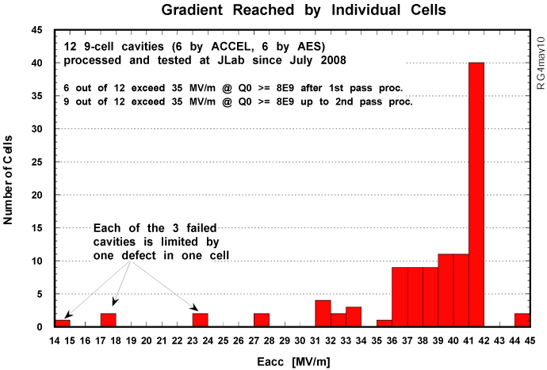
Courtesy of Geng

Slide 26
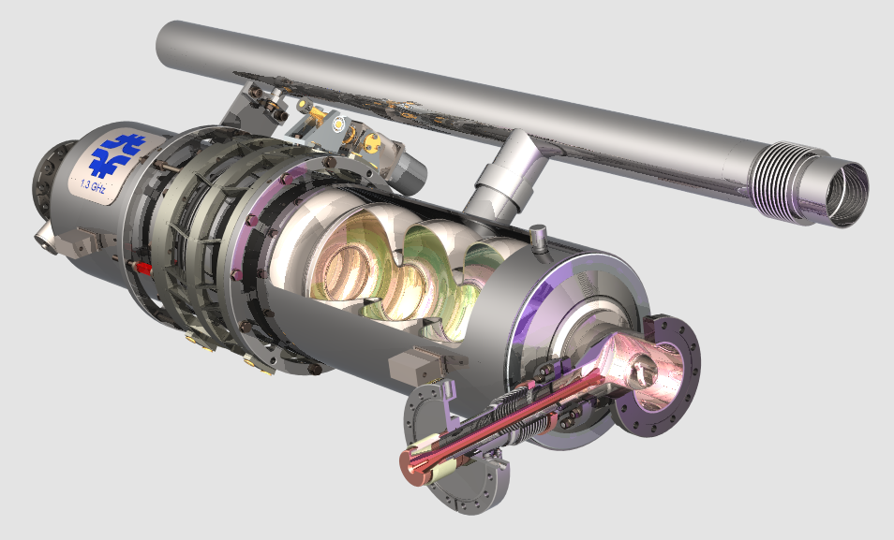
Dressed Cavities
Infrastructure commissioned, 8 dressed so far
INFN blade tuner, 6 tested in HTS so far

Slide 27
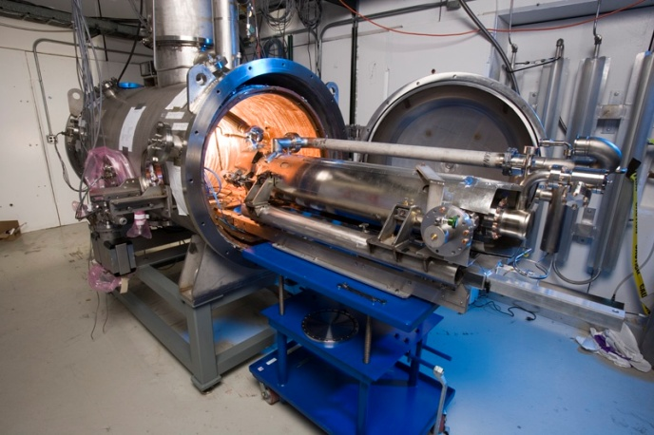
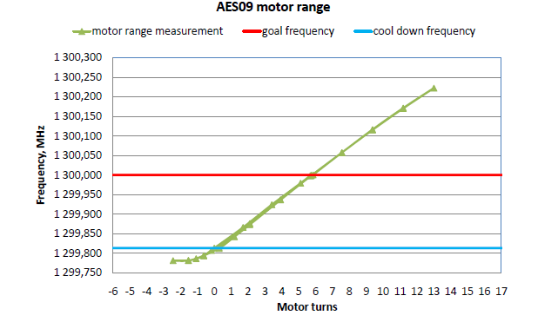
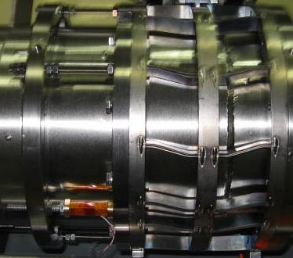
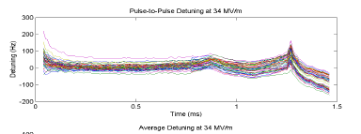
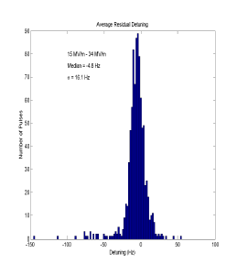
HTS-1: Dressed Cavity Tests
5 dressed 3.9 HZ cavities for DESY CM
Commissioned for 1.3 GHz cavities
  2 tests+2 high gradient for S1-global CM
  2 high gradient qualified for CM-2
  more in queue
HTS is also a test bed for studies of tuners and LLRF
U.S. built Blade tuner
Slow tuner performance
Fast tuner

Slide 28
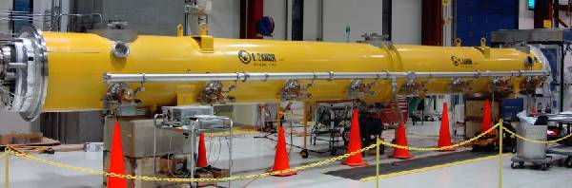
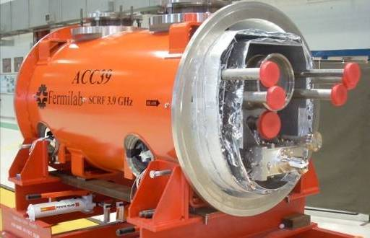
FNAL Cryomodules
Cryomodule 1 built from DESY kit, Installed in NML
3.9 GHz Cryomodule
Designed/built at FNAL for DESY
Installed and Operating in FLASH
Cryomodule 2: cold mass parts from Europe in hand, accumulating the required 8 HTS tested cavities

Slide 29
Project X Cavities: Accomplishments
325 MHz Spoke resonators ( HINS )
  Designed/built two SSR1 (beta = 0.21)
    One built by Roark (U.S. Industry), one by Zannon (Europe)
    Design =10 MV/m; Tested > 30 MV/m Eacc, a real achievement!
  1st SSR1 is being dressed
  Two more SSR1 being fabricated in India, 10 on order from Roark
  Built HTS facility to test dressed cavities at 4 K with pulsed 325 MHz RF
  Design of spoke resonator cryomodule is starting
650 MHz Elliptical cavities (Project X)
  Preliminary design of cavity shapes for Beta = 0.6 and 0.9
  Single cell design close to complete, working on 5 cell design
  Ordered Nb and plan single cell order in FY10

Slide 30
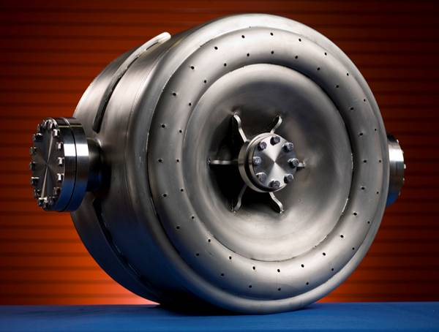
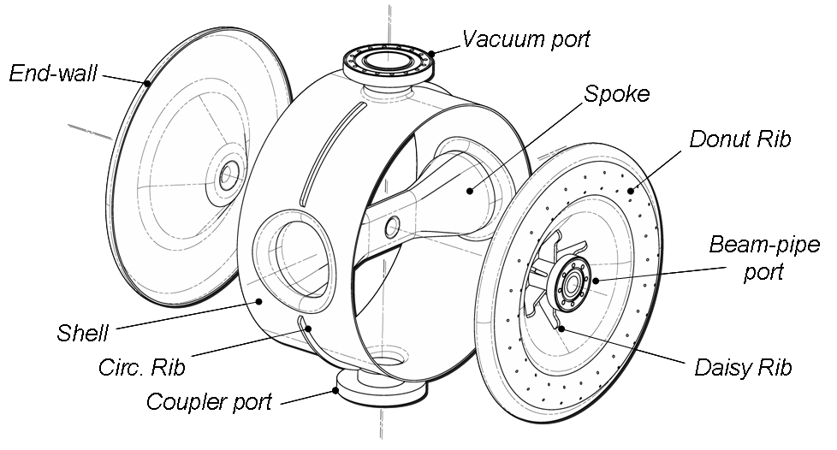
HINS 325 MHz Single Spoke
Design Parameters
Quantity | Value
Operating temperature | 4.4 K
HINS accelerating gradient, E_{acc} * | 10 MV/m
Q₀ at accelerating gradient | > 0.5x10⁹
Beam pipe, Shell ID | 30 mm, 492 mm
Lorenz force detuning coefficient | 3.8 Hz/(MV/m)² (with He vessel)
E_{peak}/E_{acc} * | 2.56
B_{peak}/E_{acc} * | 3.87 mT/(MV/m)
G | 84 Ω
R/Q₀ | 242 Ω
Geometrical Beta, β_{g} | 0.21
SSR1-02,
the 2nd SSR1 prototype.
Fabricated
by Roark.
Original
Plan
* E_{acc} is the total accelerating voltage divided by L_{eff}, where L_{eff} = (2/3)βλ = 135 mm, the distance between the edges of the accelerating gaps at the two endwalls.
Notes:
30

Slide 31
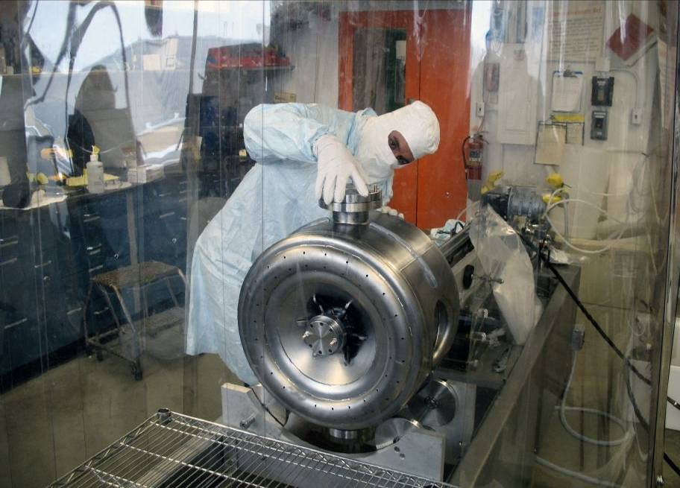
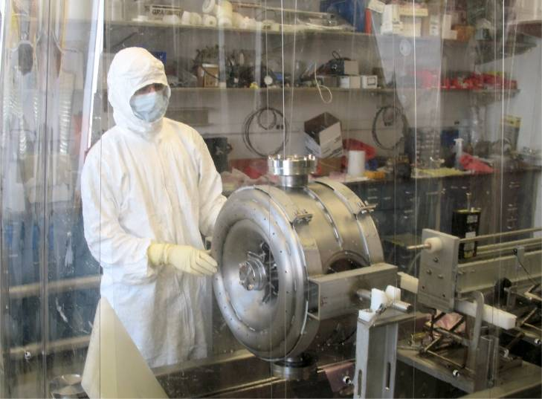
HINS: A pair of FNAL single spoke cavities processed at ANL
Chemical polishing, high-pressure rinsing in G150 by Argonne and Fermilab SRF staff
Cold testing performed at Fermilab
Both cavities have achieved world leading performance

Slide 32
Spoke Resonator VTS of bare cavity
Project X
Operating
Point
15 MV/M
@2 K
1.E+11
Q @ 2K
Q @ 4K after 2K run
Radiation @ 2K
Radiation @ 4K after 2K run
Jump thru MP barrier
1.E+10
from 24 to 33MV/m
1.E+01
MP from ~11 MV/M
1.E+09
1.E+00
Q₀
Radiation
(mR/hr)
1.E+08
1.E
-
01
1.E+07
1.E
-
02
0
5
10
15
20
25
30
35
E
acc
(MV/m)
Q₀ .vs. E_{acc} and x-ray intensity as measured at the top of the VTS
Notes:
32

Slide 33
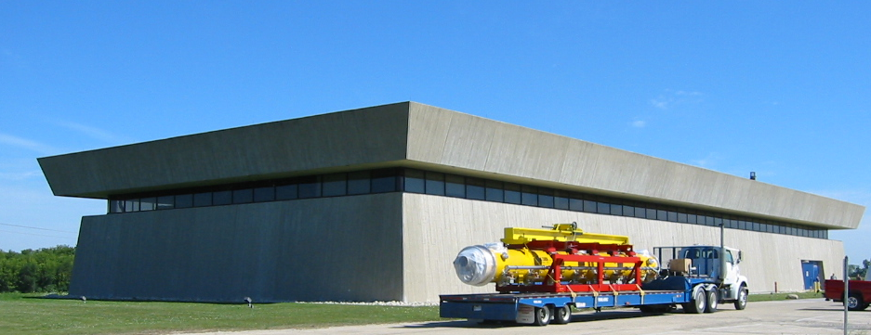
New RF Unit Test Facility at Fermilab
An important facility for both Project X & ILC R&D
1st Cryomodule moving to NML

Slide 34
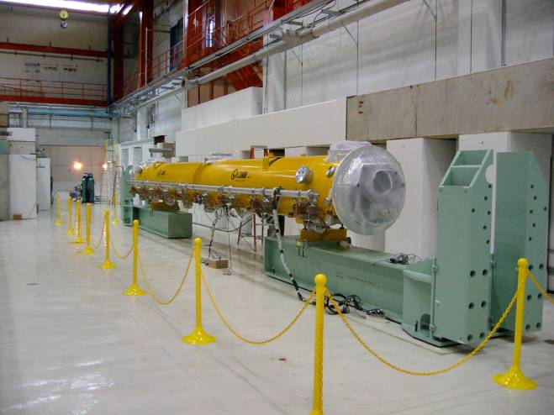
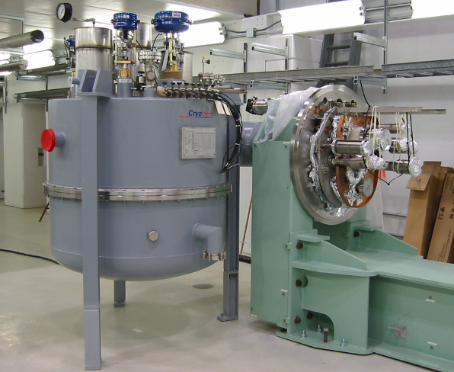
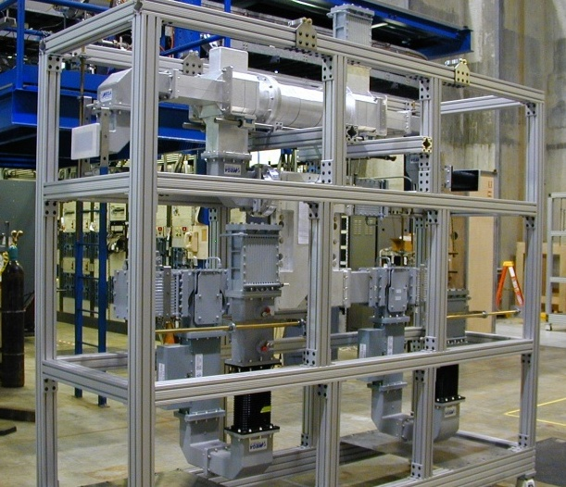
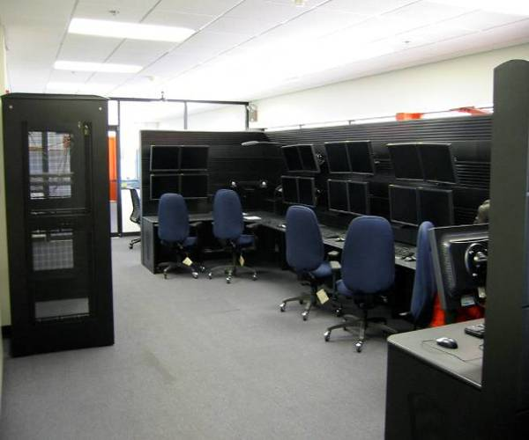
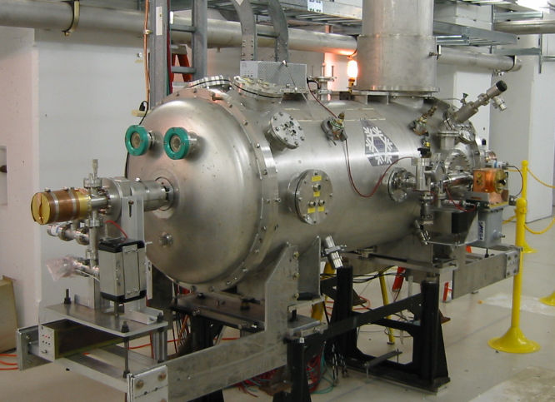
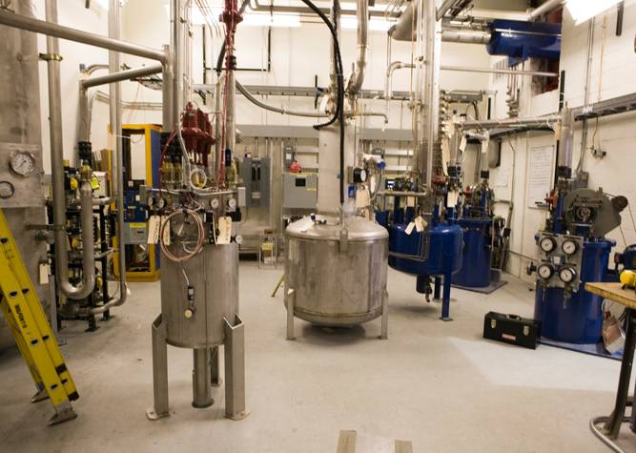
Progress at NML
1st Cryomodule Test fit
CM Feed Can
RF dist system from SLAC
Control Room
Capture Cavity II @ NML
He Refrigerators(2)
Cryo operational, CM1 cool down this summer

Slide 35
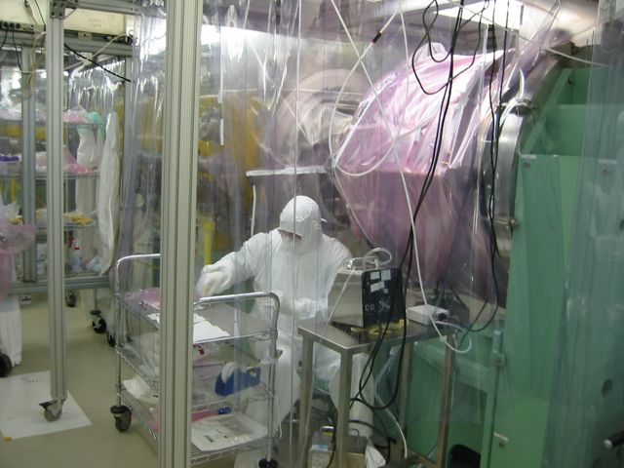
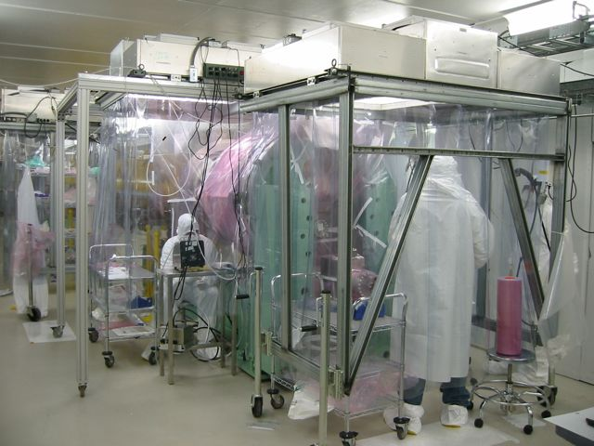
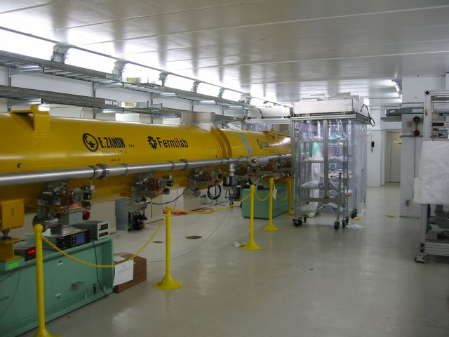
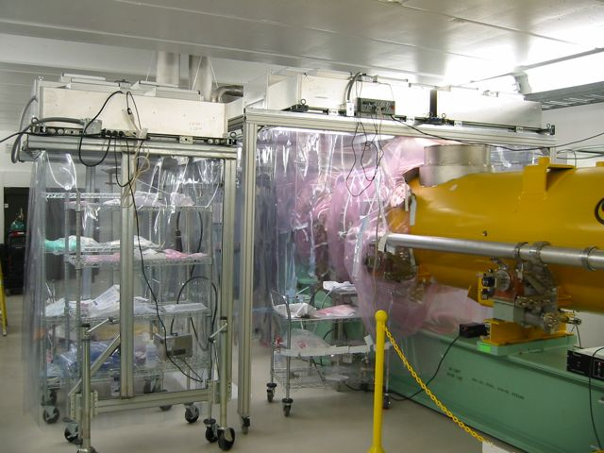
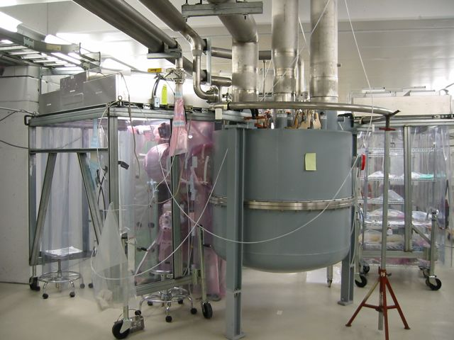
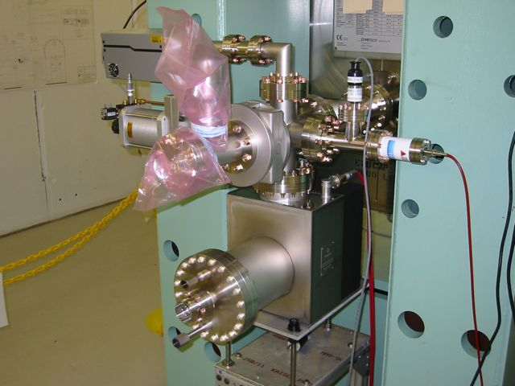
NML CM1 Vacuum Work

Slide 36
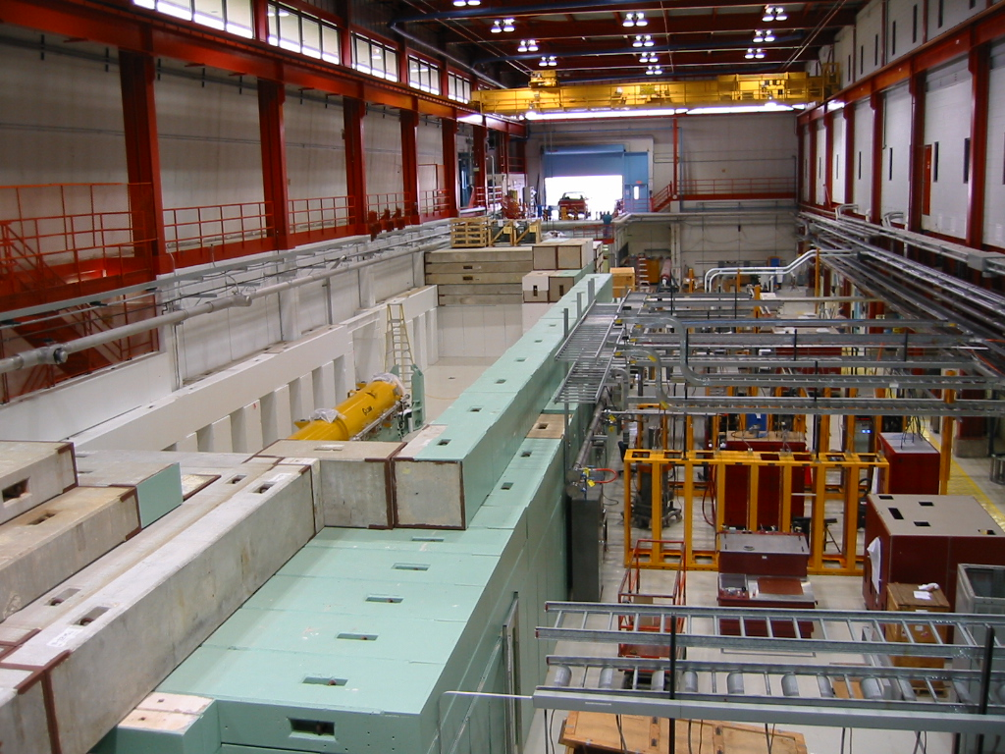
RF Unit Test Facility at NML

Slide 37
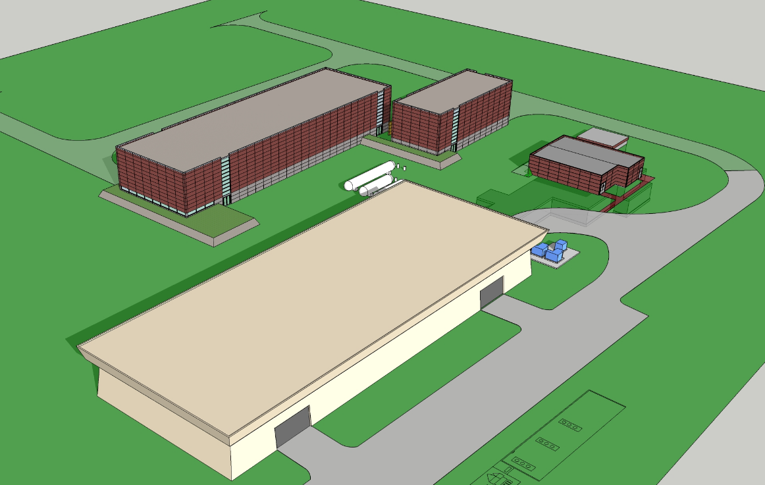
New buildings and Refrigerator (ARRA)

Slide 38
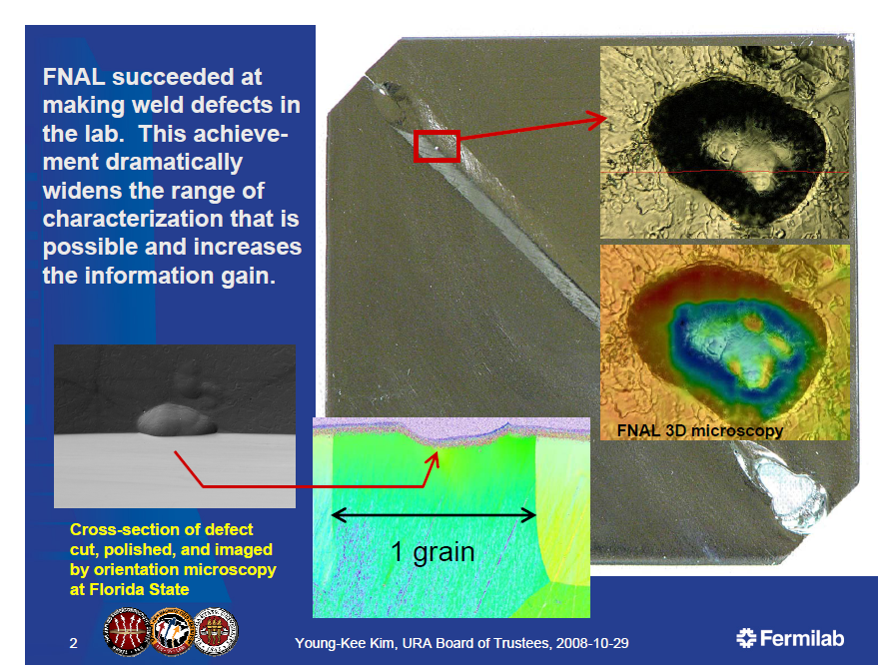
SRF materials R&D Program
Broad collaboration of materials scientists!
Example
  ANL,FNAL,U of C
  Cavities often limited by defects near EB weld
  Pits observed in samples after EP. Why?
  Diagnostic tools !
Pits appear after EP !

Slide 39
SRF: New Infrastructure
New single-cell temperature mapping system uses multiplexed diodes as sensing elements
New diode based system with 960 sensors and 62 wires can be installed in about 15 minutes
Traditional carbon resistor based system
Also implemented 2nd sound detectors developed at Cornell
Simple, can be incorporated into dressed cavity

Slide 40
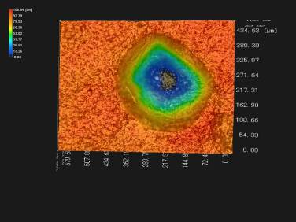
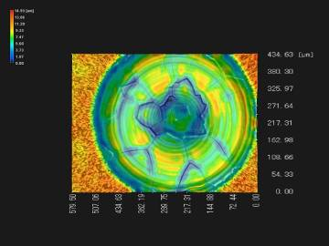
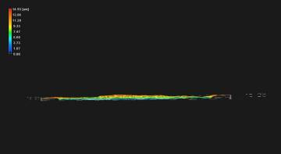
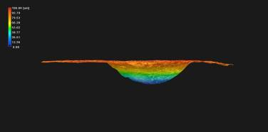
SRF: Laser Melting of Nb Surface
Preliminary experiments show a pit cannot be removed by BCP or EP, even after ~150 um removal
Fermilab is investigating: Laser Melting
Single cell worked at 40 MV/M after laser remelting
100 µm
14 µm

Slide 41
SRF ARRA Funds Accomplishments
Huge boost! $ 52.7 M of funding
  Including $ 8 M of funding for NML refrigerator (MIE)
  Mostly M&S, and mostly to industry and collaborators
$ 32 M obligated or RIPS by June 1, 2010
  Ordered two new vacuum ovens (one large enough for 650 MHz)
  Ordered Industrial EP facility (AES)
  Design study for eco-friendly cavity processing development
  Sent funds to JLAB for infrastructure upgrades, ANL for EP labor, SLAC for RF couplers and RF distribution systems
  Placed order for 40 1300 MHz cavities from industry
  Ordered $ 4.5 M of NML injector and beam line components
  $ 7 M RFP for NML refrigerator is out for bids
  NML buildings: Tunnel ext under const, refrig bldg bid in Aug

Slide 42
ARRA funds
Good Progress in obligating funds
Original plan focused on 1.3 GHz; making adjustments for 650 MHz cavities
Expect another $ 7 M RFP for NML refrigerator bldg in August

Slide 43
Reviews
DOE Review of GDE ART in Jun 10
DOE Review SRF in May 09
  Included plan for use of ARRA funds
FNAL Accelerator Advisory Committee
  Review of SRF, Project X, and HINS programs
Uniformly positive SRF comments at closeouts
  Excellent technical progress!
  Nice comments about FNAL contributions to ILC R&D
  HINS technical progress (of course questions about PX alignment)
  Effective collaborative activities ( MOU’s with 23 institutions!)
Page 43

Slide 44
SRF R&D in the future
Overarching goal of the SRF program remains
  To develop the SC accelerating structures and associated infrastructure at Fermilab in support of future accelerators
but… must revise our long term plan & goals to reflect:
  Delays and uncertainty in ILC time line
  The proposed technical changes in Project X
  Delayed schedule for Project X construction
  OHEP funding guidance

Slide 45
Approach to making a plan
Although a SRF “R&D and technology development program”, we manage the SRF effort with project-like tools (financial and planning) so given the changes we have to:
  Establish new technical goals and scope of work
  Write down a technically plausible schedule
  Resource load the tasks by fiscal year (as best we can for R&D efforts)
  Adjust the schedule to reflect funding guidance
Page 45

Slide 46
Integrated SRF Goals
Revised ILC SRF Goals:
  Retain the current ILC S0, S1, S2 goals
  Recognize that a string test in NML with beam, will take longer
    driven by availability of new ARRA funded refrigerator ~ 2013
  Materials R&D to improve gradient
New Project X Goals:
  Modify/test one Type IV 1.3 GHz cryomodule with CW
  Construct/test a 325 MHz CW spoke resonator cryomodule
  Construct/test a 650 MHz CW elliptical cryomodule
  Build associated 325 and 650 MHz CW infrastructure
  Industrial capability in place for Project X by ~FY15
Create an integrated plan
Plausible that we will be ready for FY15 PX start
Supported by 3 B&R codes

Slide 47
Integrated SRF Plan (Cryomodules)

Slide 48
Integrated SRF Plan (Infrastructure)

Slide 49
ES&H
No Safety related injuries or incidents
Considerable effort on Safety Analysis and Review (examples)
  Infrastructure Commissioning/Operations Reviews
    VTS, HTS, NML (CM 1 move, cryo system, electrical & RF power, etc)
  Safety reviews for cavity processing facilities
    ANF/FNAL Facility (EP procedures, HPR, fixtures, etc)
    Acid work: MDTL materials work, IB4 single cavity facility
  Equipment/Design Reviews
    3.9 GHz CM: Dressed cavity analysis and Cryomodule ORC
    Cryomodule 1: 1.3 GHz dressed cavity analysis and ORC (DESY kit)
    Cryomodule 2: 1.3 GHz dressed cavity analysis, corrector magnet
    package analysis, ORC (INFN/FNAL collaboration)
Working towards a SRF cavity standard (cavities are not ASME pressure vessels!)

Slide 50
Quality Control
QC is very important to achieve high gradients
  Fortunately we know how to do this!
  Putting travelers in place for all cavities & CM
FY09 two QC issues
  Biological contamination in ANL HPR manifold
    Subtle: Lost 6 wks while we understood this problem
    New manifold (better welds), better filters (more to do)
  Cavity handling
    Not subtle: Damaged a good nine cell cavity because it was not stored correctly (anecdotal stories: JLAB, DESY, Cornell)
    Response: Cavity handling stand down (~5 wks)
      Training, formal handoffs, procedures, new tooling
      Hopefully we have addressed this problem

Slide 51
Summary
Many accomplishments in the past year
SRF infrastructure built and in operation
  ARRA funds additional facilities
  Lots of SRF components in hand and testing
Starting to make significant impact on projects
  ILC, Project X, etc (Results at SRF09, TTC, IPAC, etc)
Strong National and International collaborative partnerships on SRF (23 MOU’s on SRF)
Review comments positive on SRF effort at FNAL
SRF materials & surface science is starting to provide understanding ➔ improved performance
Integrated plan for ILC/PX/SRF in FY11 and beyond

Slide 52
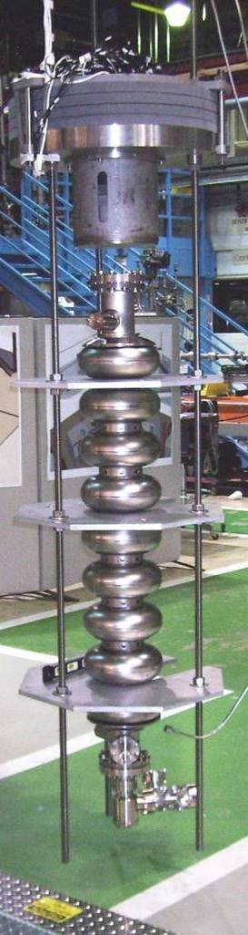
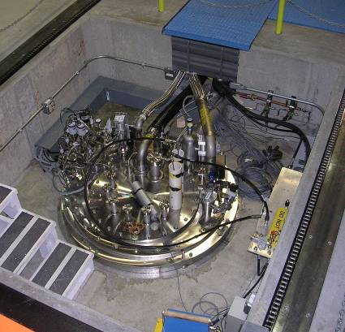







1st Dressed Cavity
New FNAL SRF infrastructure
Cavity tuning machine
VTS
HTS
VTS
String Assembly
MP9 Clean Room
Final Assembly
1st U.S. built ILC/PX Cryomodule

Slide 53
extras

Slide 54
Collaborations (23 MOU’s)
ANL: EP development and cavity processing
Cornell: Cavity processing & test, materials R&D
DESY: 3.9 GHz, cryomodule kit, FLASH
Dubna: cavity development, bimetallic joints
KEK: Cavity R&D, ATF II
MSU: Cavity cost reduction, hydro-form, TIG
TJNL: EP cavity processing and test, PX cavities
INFN: tuners, HTS, NML gun cathodes
TRIUMF: Vendor development (PAVAC)
SLAC: RF power, klystrons, couplers
CERN, DESY, KEK, INFN, etc: Type IV CM design
India: CM design, cavities, infrastructure, etc
China: Peking U, IHEP, cavity development
UC,NW,NHMFL, UN Reno, Cornell, DESY, KEK…: Materials R&D
Slide 54
Notes:
54

