Slide 1
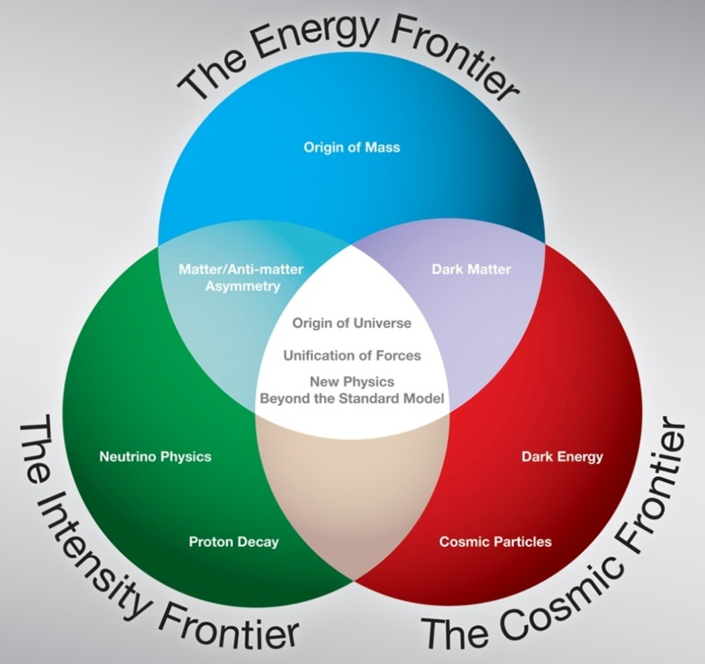
Reply to Recommendations and Comments (concerns) from 2009 DOE S&T Review
Young-Kee Kim
DOE S&T Review of Scientific User Facilities
July 12-14, 2010

Slide 2
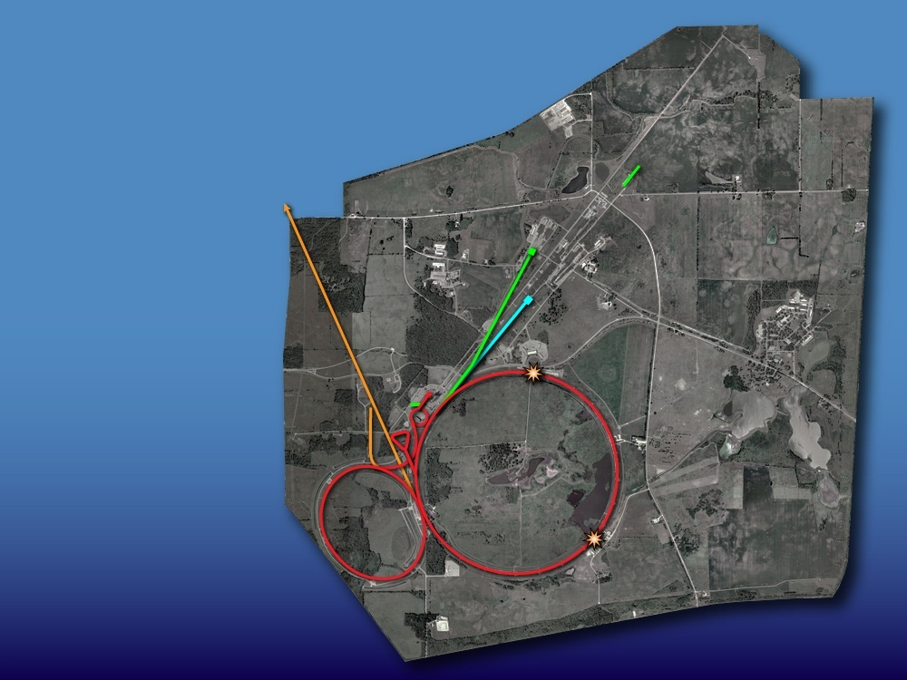
Fermilab Accelerator Complex
Operating Simultaneously
SCRF Test Facilities for Project X, ILC, Muon Collider, Accelerator Research
MINOS
Testbeam for Det.R&D
Muon Cooling Test Facility
SeaQuest
MINERvA
CDF
Neutron Cancer Therapy
MiniBooNE
Tevatron
Main Injector
DØ

Slide 3
S&T Review Subjects
Included in S&T Review | Not Included in S&T Review
Science: Tevatron (CDF, DØ) Neutrino Experiments (MiniBooNE, SciBooNE, MINOS, MINERvA) Accel./Det./Comp. Operations: Tevatron, Neutrinos, Testbeam, SeaQuest CDF, DØ, MINOS, MiniBooNE, MINERvA Accelerator Technology: Proton Plan, Project X, SRF (SRF/HINS/Project X/ILC integrated plan) Detector Technology: NOvA, MicroBooNE, Mu2e, LBNE | LHC Non-Accelerator Experiments Fermilab Scientists research on accelerator-based programs (proton- and lepton-based) Theory, Lattice QCD Generic Detector R&D Accelerator Science Generic Accelerator R&D ILC / ν Factory / Muon Collider Supporting Functions

Slide 4
Accelerator Operations
Recommendations:
  None
Comments:
  It would be useful to begin assembling a list of machine experiments – possibly at elevated risk – that could be done before the end of the run.
  → The list is assembled and will be reviewed by Accelerator Advisory Committee on July 28-30

Slide 5
Tevatron D&D
Recommendations:
  Perform a cost-benefit analysis for keeping the Tevatron in a “cryogenic stand-by” state for an extended time versus warm-up and purge followed by a later restart in the context of the planned program.
  → Options re-evaluated in detail. Details in breakout session (Paul Czarapata)

Slide 6
CDF/DØ: Physics & Operations
Comments on Physics
  The laboratory should formalize commitments of individuals to CDF and DØ to make sure that all essential support tasks are covered through FY 2011.
Comments on Operations
  The lab and collaborations need to retain the personnel that have been responsible for the good performance of the operation of the detectors up to now.
→ MOUs between Fermilab and collaborating institutions. Regular updates on MOUs & survey. Monitoring resources/commitments. Details (what’s needed vs available FTEs) will be presented by Bill Lee, Marco Verzocchi, and Ben Kilminster.

Slide 7
CDF/DØ: Physics & Operations (cont.)
Recommendations on Operations: None
Recommendations on Physics
  The lab. should continue to evaluate the optimum time for ending the Tevatron program that achieves the goal of ruling out the SM Higgs at 95% taking into account:
    Statistics for other Tevatron measurements, Starting up NOvA, Resources at the Lab for future expt.s and other activities, Deferred maintenance of collider components
→ being done
  Year 2009: running the Tevatron through FY2011
  Year 2010: new LHC schedule → CDF/DØ proposal of Run III (FY2012-14 running) → we are currently in the evaluating process (discussed at the PAC meeting, June 22-26. PAC report in the next slide)

Slide 8
CDF/DØ: Physics (cont.) – PAC Report
The PAC considers the proposed 3-year extension (Run III) to be an exciting and compelling physics opportunity with potentially historic importance. However, before making a recommendation, we would like to receive information on the following (in no special order) to address our concerns:
  Impact of the extended run on the physics capabilities of NOvA
  Impact of the extended run on the long-term program of the Laboratory
  Detailed impact on the Higgs analysis due to any detector degradation from the extended run
  Resolution on the Higgs mass that is achievable in case evidence for the SM Higgs is found. The current combined search shows an excess of one sigma significance over the broad mass range 100 to 155 GeV. Is this consistent with the behavior expected for a true signal?
  More detailed and up-to-date full-time equivalent personnel commitments of the collaborations for an extended run
  Projected increase in sensitivity which depends strongly on the successful achievement of anticipated improvements in the Higgs analyses. The PAC encourages the collaborations to report on the improvements that have already been accomplished compared to the presentations made to the PAC, and to provide updated projections.
Given this information, the PAC would be able to make a recommendation by early fall.

Slide 9
CDF and DØ: D&D
Recommendations:
  The lab should identify the owners of the detector components by the next S&T review with the goal of developing the D&D plan.
Comments:
  There should be a realistic estimate made of the resources and manpower to handle the D&D (including safety, security, and monitoring). A special issue is how to handle the dismantling of the DØ calorimeter and test calorimeter. There should be a call for proposals for salvaging equipment from the detector….. This should be a transparent process. The lab needs to produce a detailed plan for the CDF and DØ decommissioning.
→ Identified D&D as a project and made significant progress. Details in breakout session (G. Ginther and J. Lewis)

Slide 10
Intensity Frontier Physics
(SciBooNE/MiniBooNE/MINOS)
Recommendations: None
Comments:
  MINOS: Complete the analysis with the full 7x10²⁰protons on target dataset and estimate the improvements possible with additional running. An improved measurement of sin²(2θ₁₃) would be extremely valuable to the future of the neutrino program.
  →Done. Details in Jenny Thomas’s presentation
  MiniBooNE: The low energy excess ν_{e} events are not understood. … It seems unlikely that collecting additional data will improve the situation.
  → MiniBooNE running in anti-ν mode. (Evaluating the MiniBooNE proposal of running at a different location)

Slide 11
Future Accelerators
Considered
  Accelerators in support of neutrino and muon Programs (pre-Project X, proton plan)
  Project X
  Project X aligned Programs: ILC/SRF/HINS
  Muon Facility R&D
Recommendations:
  None

Slide 12
Future Accelerators
Accelerators in support of ν/μ Programs (pre-Project X)
Comments :
  Although the number of protons per pulse is not much higher than already achieved during present operation the proton throughput is about twice as large as presently. The challenge is therefore to reduce the beam losses in both machines by a factor of two.
  → Current focus is on making a plan for technical challenges. Task force commissioned (report by end of July) – this will be followed by a resource-loaded schedule. Details in breakout session (Paul Derwent)

Slide 13
Future Accelerators
Project X
Comments:
  The throughput for the MI will increase about six-fold compared to today's operation. The most significant challenges are a new MI RF system and the potential need to coat the inside of the MI vacuum chamber with a low-secondary-emission coating. Accumulation of the beam in the Recycler and subsequent transfer of the intense bunch-train to the MI may present significant challenges.
  → The Project X RD&D plan supports development to establish very high intensities in the Recycler and MI. Samples of coated beam pipe have been fabricated and will be tested in the MI. Details in breakout session (Sergei Nagaitsev)

Slide 14
Future Accelerators
Project X (cont.)
Comments:
  The scenario (a 2 GeV CW SC linac that accelerates both protons for μ & K experiments and H⁻ for further acceleration possibly in a Rapid Cycling Synchrotron to 8 GeV) would not allow for a future upgrade to 2-4 MW beam power at 8 GeV. With this in mind it appears prudent for the lab. to evaluate the limits of the present Booster with 2 GeV injection and to assess its potential to support Project X beam requirements.
  → It is not possible to support 2 MW from the current Booster, either for neutrino program or as a muon front end. We are evaluating a pulsed linac for 3-8 GeV acceleration as it provides a better match to a longer term neutrino program. Details in Steve Holmes’s presentation

Slide 15
Future Accelerators
Muon Facility R&D
Comments:
  It is important that a realistic simulation of the cooling channel based on at least one of these techniques is completed.
  → This is one of the deliverables in the MAP (Muon Accelerator Plan) proposal. The MAP proposal will be reviewed by DOE on August 24-26. Details in Steve Holmes’s presentation.

Slide 16
Future Detectors: NOvA
Recommendations:
  The laboratory should optimize its resources to minimize any additional delays in the NOvA construction and the accelerator NuMI beamline upgrade, which should achieve 700kW design operation.
  → Resources (Tevatron complex operaions, Project X, Mu2e, …) have been moved to maintain the schedule. Named commitments from divisions and we monitor them. Details in breakout session (Paul Derwent)

Slide 17
Future Detectors: Mu2e
Recommendations:
  Laboratory management and the collaboration should develop a plan that details the resources needed by both the project and the collaboration to successfully mount and execute the experiment.
  → Covered by preparation for CD-1 approval. Director’s review scheduled in Feb. 2010, and Lehman Review in March 2010. Details in breakout session (Ron Ray)

Slide 18
Future Detectors: Mu2e (cont.)
Comments:
  The collaboration urgently requires additional strength, with more substantial commitments from the collaborators. A substantial effort to attract international collaborators would also be appropriate. This may require consideration of and coordination with, a similar project being proposed in Japan.
  → Progress made: new institutions joined, International fellows (Italy), long-term visitor from CERN working on magnet, continued collaboration with the COMET collaboration and Japanese colleagues (support from US-Japan project funds). Details in breakout session (Ron Ray)

Slide 19
Future Detectors: Mu2e (cont.)
Comments on Physics:
  The Mu2e project may is very challenging and its schedule is aggressive. The lab should conduct a systematic review of the performance required of each of the critical components and what is required in terms of R&D and demonstrations to show that this performance is achievable. The actual experiment may need several tries to reach its full potential. The lab should ascertain the needs for long-term commitment of lab resources and personnel to see this through
  → Systematic reviews are done via regular OPMO meetings, magnet reviews. Details in breakout session (Ron Ray)

Slide 20
Future Detectors (LAr Strategy / LBNE)
Future Detectors: General Comments
  ArgoNeut, MicroBooNE and the 5 kiloton prototype as separate projects should be reevaluated to see if having a coherent multistage project would be more suitable.
Strategic Planning: Comments on Physics
  Lab should understand more clearly the roadmap to a decision between LAr and WC detectors for LBNE and the role that MicroBooNE plays as an R&D project.
Future Detectors: General Recommendations
  Lab should develop a detailed plan for development of the LAr/TPC technology with clear milestones for each aspect of this plan by the end of year. MicroBooNE should be considered as part of this development.
→ The LAr/TPC integrated plan submitted in Dec. 2009. This and other comments in breakout session (Jim Strait)

Slide 21
Strategic Planning
Comments on Accelerator:
  An overall plan that delivers the vision.
    How do the different components of the neutrino program coexist?
    What is the layout of Project X that meets all of the Mission Needs?
    What is the optimum investment in R&D towards a muon collider or a neutrino factory?

Slide 22
Fermilab Strategic Plan at the Three Frontiers
time
Energy Frontier
Tevatron LHC / LHC Upgrades ILC / μ Collider
(2011)
Det./Phys. Synergy:
ILC/CLIC/μ Collider
technology injector
protons
(2013)
injector
NuMI NuMI Project X ν Factory
(300kW) (700kW) 2MW (60-120GeV) for ν
Booster +3MW(3GeV)+200kW(8GeV)
Intensity Frontier
MINOS NOvA LBNE (ν to DUSEL)
MINERvA MINERvA (Proton Decay)
MiniBooNE MicroBooNE
SeaQuest (μ g-2) Mu2e Muon/Kaon/Nuclear/…
Cosmic Frontier
DM: CDMS/COUPP/(DarkSide)
(~10 kg → ~100 kg → ~ ton scale)
DE: (SDSS) DES JDEM or 4th gen DE
UHE Cosmic: Auger South Auger North (TBD)

Slide 23
1. Neutrino Run Plan
Strategic Planning: Recommendations
  The lab. should evaluate interference effects between MINOS, NOvA, & MINERvA in terms of low vs. medium energy and ν vs. ν and produce an integrated plan for all experiments in the neutrino program that also considers expected results from other experiments not at Fermilab.
Future Detectors: Recommendations
  Lab management should develop an integrated running plan that addresses the needs of all the ν experiments as a function of time.
Intensity Frontier (MINOS): Comments
  The laboratory needs to carefully plan in consultation with the collaboration the remaining MINOS running configuration to optimize the scientific impact of MINOS, taking into account the rest of the ν program.
_

Slide 24
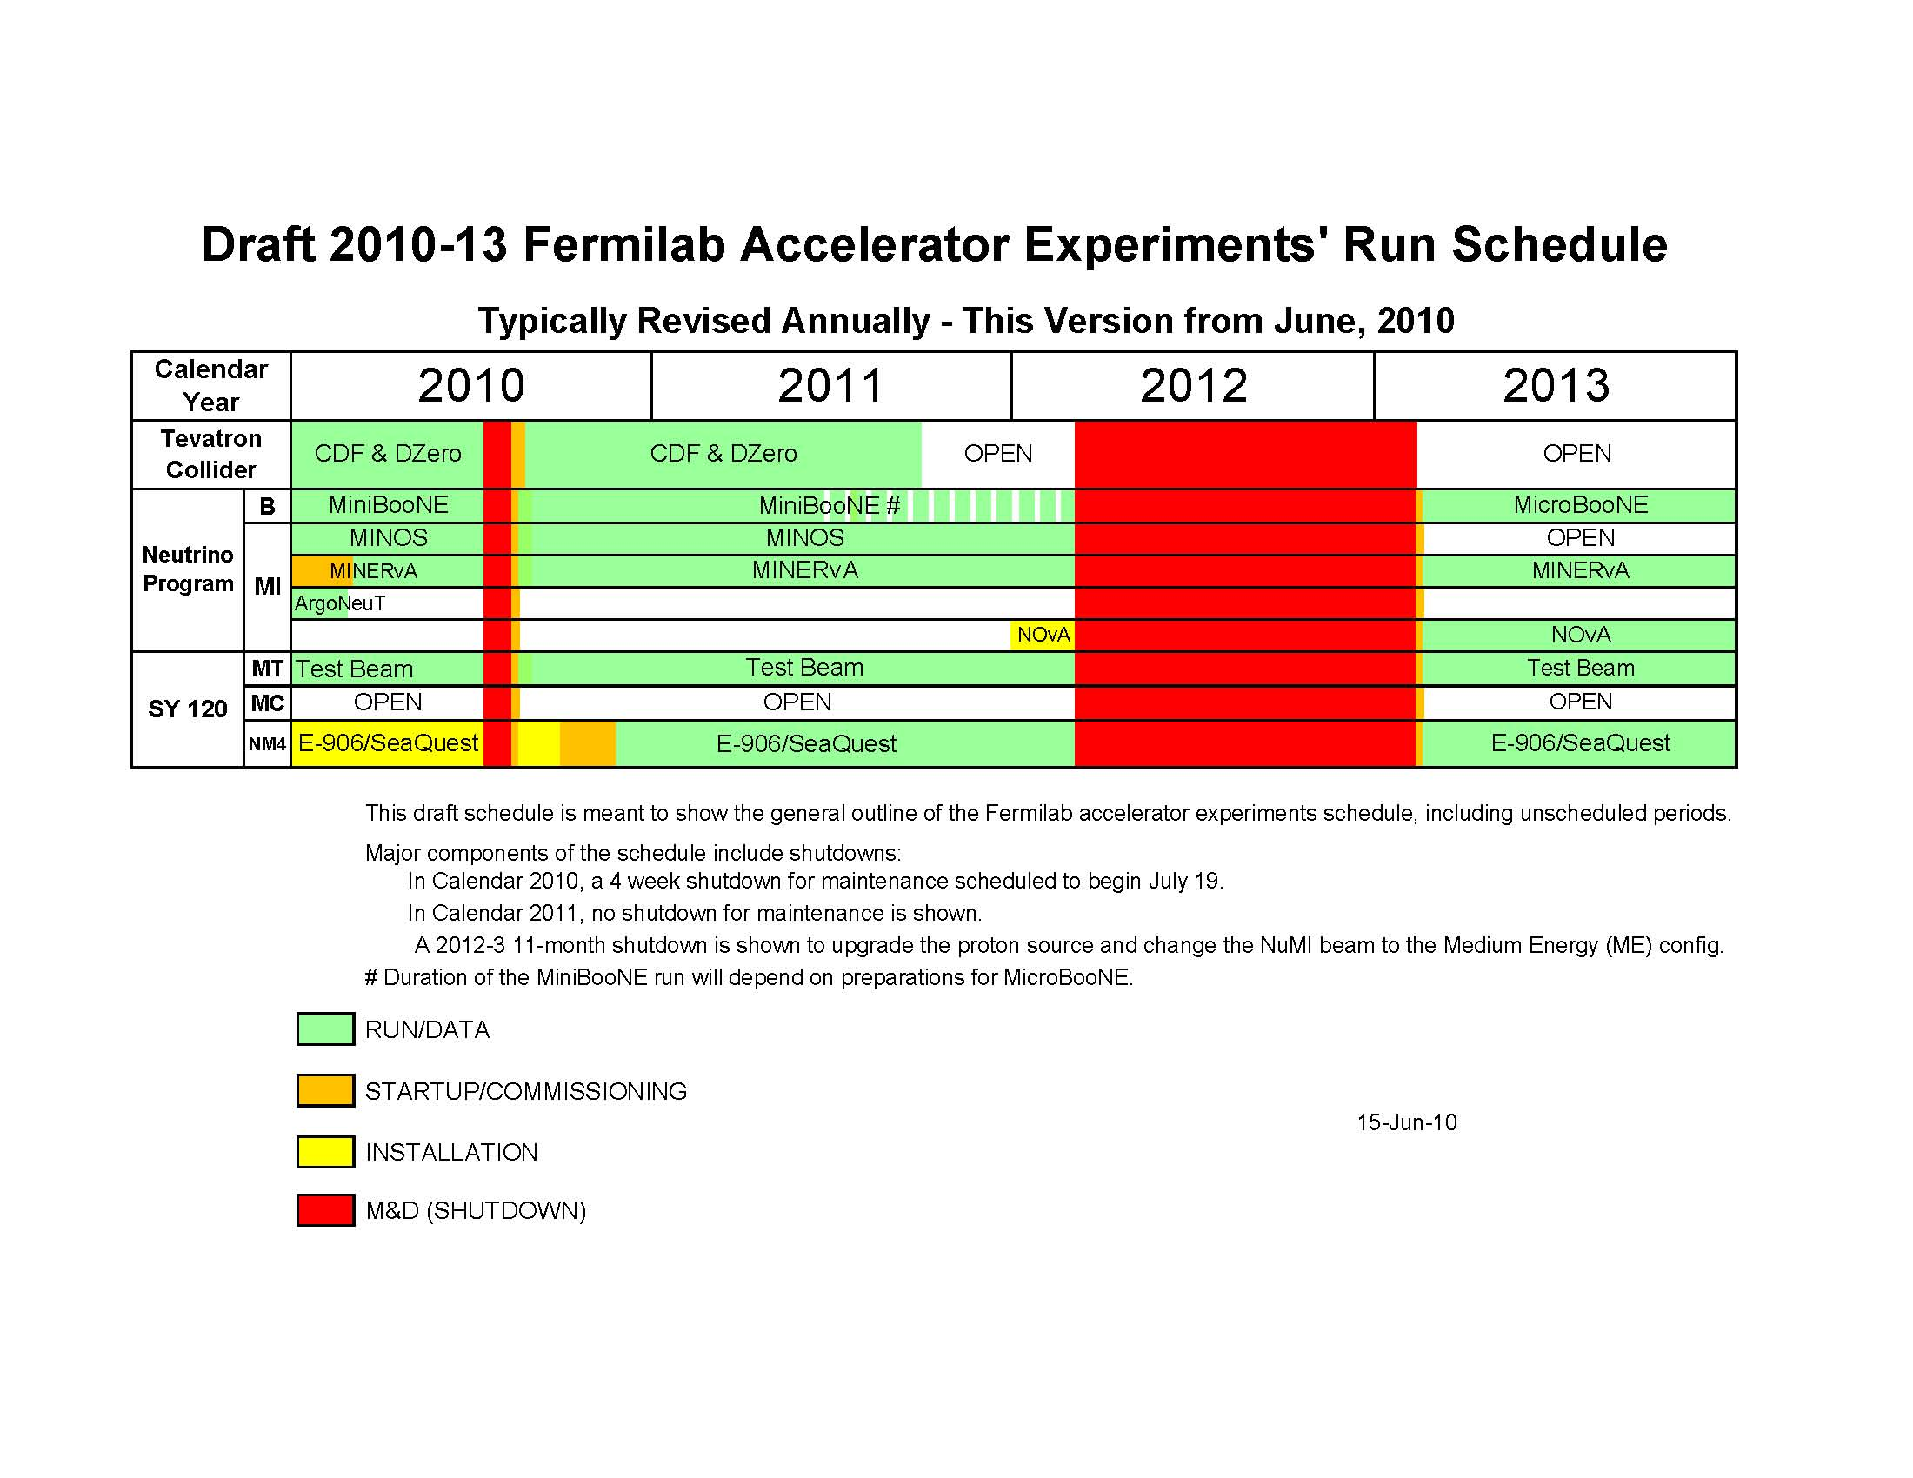
Draft 2010-13 Run Plan (as of June 2010)
PAC recommendations (accepted by the lab)
  NuMI: share the POT shortfall – MINOS & MINERvA receives ~90% of the requested POT for ν and ν running, respectively
  BNB: give MicroBooNE priority in the end schedule of MiniBooNE running (Spring 2011, MiniBooNe will get ~80% of its request)
Lab and neutrino experiments started discussing the detailed schedule and policy
_

Slide 25
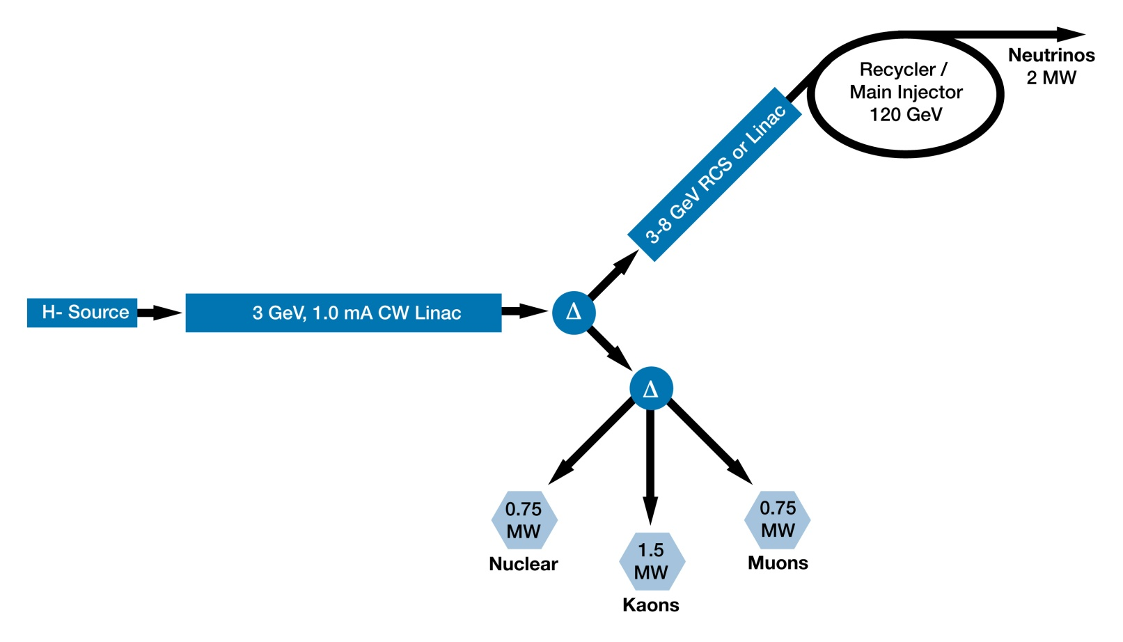
2. Layout of Project X
Details in Steve Holmes’s presentations

Slide 26
2. Layout of Project X (cont.)
Optimal beam parameters for physics
  Identified via various physics workshops and working group efforts (community’s involvement)
4th physics workshop
  Nov. 9-10, 2010: White paper
5th physics workshop (a series of mini workshops)
  Milestones:
    Aug 2010: one short document for each beamline with conceptual detector design
    Oct/Nov 2010: 4-5 mini workshops (4-5 working groups)
    Dec 2010: Yellow paper
  Webpage:http://www.fnal.gov/directorate/Longrange/Steering_Public/workshop-physics-5th.html

Slide 27
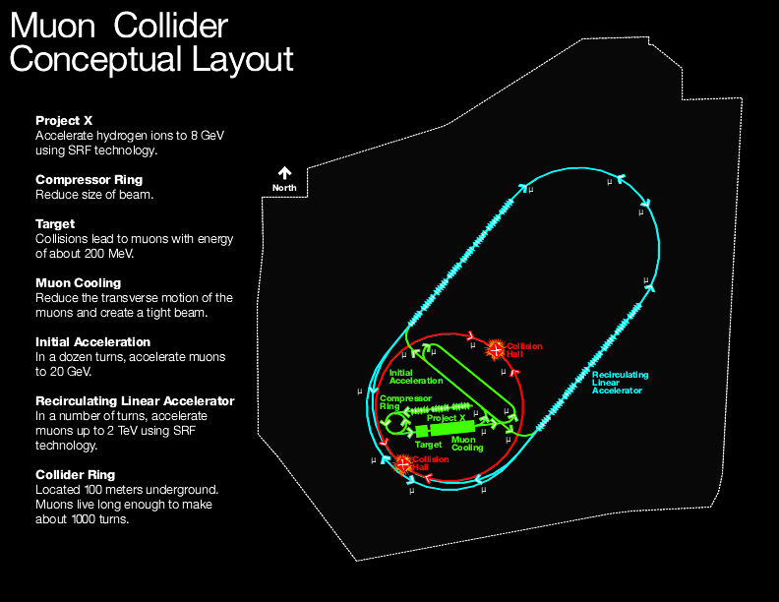
Muon collider layout
3. R&D Towards a ν factory / a muon collider
4 TeV Muon Collider / Neutrino Factory Conceptual Layout
http://www.fnal.gov/pub/muon_collider/
ILC/Project X
technology
Project X upgrade

Slide 28
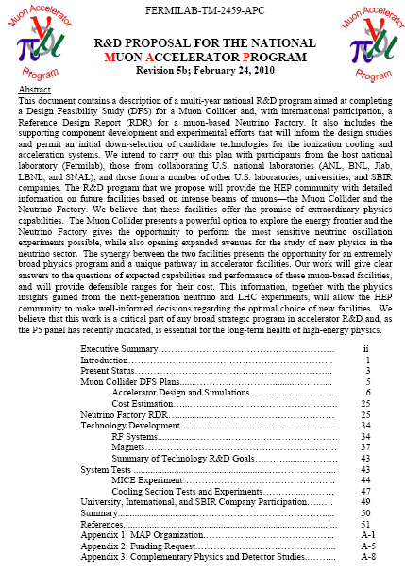
MAP Proposal
Submitted by Oddone on behalf of the MAP collab., on March 1, 2010.
214 participants (at birth) from 14 institutions:
  ANL, BNL, FNAL, JLab, LBNL, ORNL, SNAL, Cornell, IIT, UCB, Princeton, UCLA, UCR, U-Miss
Briefing to DOE (Apr, 2010)
DOE Review (Aug.24-26, FNAL)
→ Details in Steve Holmes’s presentations
Muon Collider Physics/Detector not included in MAP
1st workshop in Nov 2009, 2nd workshop in late fall 2010
(including the ILC/CLIC community)

Slide 29
Lepton Colliders: Detector and Physics
White Paper by 5 US national labs
  Goal:
    Although lepton collider options have very different levels of maturity and operational conditions, we believe that broad physics goals are similar and we need an objective physics comparison of the options and detector R&D in a coherent, efficient, and cost effective manner
  Presentation to DOE
    “KA12 (electron-based research) review”
  Communicated to leaders of US ILC/univ. community
  Plan to develop a National Strategy with a broader community

Slide 30
Workforce Planning
Strategic Planning
  Comments on Accelerator: The overall scope of the vision is ambitious and may well over-tax the staff in their ability to build and exploit everything that was presented. Once the overall plan is complete, OHAP (Organization and Human Asset Plan) should be continued, analyzing differences between resources available and needs. A plan should then be developed for retraining, redirecting, retaining, & recruiting the necessary workforce.
  Recommendations: Complete the OHAP including analyzing differences between the resources available and the needs from all projects and programs.
Future Detectors
  General Comments: Lab has identified the intensity frontier as its future emphasis and developed a project oriented plan to align its activities. We encourage lab to examine the balance between staff working on the energy frontier detectors and staff working on the intensity frontier detectors.

Slide 31
Workforce Planning: OHAP
Lab-wide staffing plan tool to support the strategic plan: analyze available resources and resources needs (in all disciplines / skills), and guide the evolution of workforce
Annual process (update annually) to be aligned with annual budget and changes in project timeline (e.g.LHC upgrades)
  launched Dec. 2006 and continue to improve the process
Resources are tight in most skills. Large gap in mechanical engineers and project support identified
  contract hires and a small number of staff hires
OHAP, Lab-wide WBS, and HR tools are being integrated
Scientists’s transition from energy frontier to intensity frontier
  Survey conducted (Nov-Dec 2009); individual plan for their research directions over the next 5 years. Results reasonably match with the lab. strategy although somewhat slower than what would be best.

Slide 32
Employees: Disciplines (June 2010)

Slide 33
Computing / IT(June 2010)

Slide 34
Engineers (June 2010)

Slide 35
Scientists (June 2010)
Including postdocs

Slide 36
Scientist Efforts (FTEs): 5-year plan survey (Dec.2009)
excluding postdocs
Lab Management
Accel. Operations
Accel. Science/Develp
Particle/Astro Theory
Det./Comp. R&D
Cosmic Frontier
Intensity Frontier
Energy Frontier
Tevatron accelerator
CDF
DZero

Slide 37
Scientist Efforts (FTEs): 5-year plan survey (Dec. 2009)
excluding postdocs
Lab Management
Accelerator Operations
Accelerator Science / Development
Particle/Astro Theory
Det. / Computing R&D
Cosmic Frontier
Intensity Frontier
CDF + DZero:
~30 FTEs
Energy Frontier

Slide 38
Scientists Efforts (FTEs): 5 year plan survey (Dec. 2009)
Excluding postdocs
FY 2009 FY 2014
Lab
Management
Lab
Management
Accelerator
Operations
Energy
Frontier
Accelerator
Operations
Energy
Frontier
Accelerator Science /
Development
Accelerator Science /
Development
Intensity
Frontier
Intensity
Frontier
Cosmic
Frontier
Cosmic
Frontier
Theory
Theory
Det
R&D
Det
R&D

