Slide 1
Project X/ILC/SRF
Integrated Plan
Steve Holmes
Fermilab
DOE Annual Science & Technology Review
July 12-14, 2010

Slide 2
Outline
Project X Current Status
PX/ILC/SRF Integrated Plan
Integrated Funding Profile

Slide 3

Project X Mission Objectives (unchanged)
A neutrino beam for long baseline neutrino oscillation experiments
  2 MW proton source at 60-120 GeV
High intensity, low energy protons
for kaon and muon based
precision experiments
  >1 MW operations simultaneous with
  the neutrino program
A path toward a muon source for
a possible future Neutrino Factory
and/or a Muon Collider
  Requires upgrade potential to 4 MW at ~5-15 GeV

Slide 4
Initial Configuration – 1: Issues
The originally established configuration featured strong alignment with ILC: 8 GeV superconducting pulsed linac
IC-1 does a great job of meeting the long baseline neutrino mission, but…
It does not provide a strong platform for mounting a low energy rare processes program
  Recycler is ill-suited to providing high intensity slow spilled beam
  Debuncher appears limited to <150 kW in this mode
  We believe there is a fundamental limit on the amount of beam power that can be delivered via a resonant extraction system
  Difficulties supporting multiple users with differing spill structure requirements
  These considerations have led to the development of IC-2

Slide 5
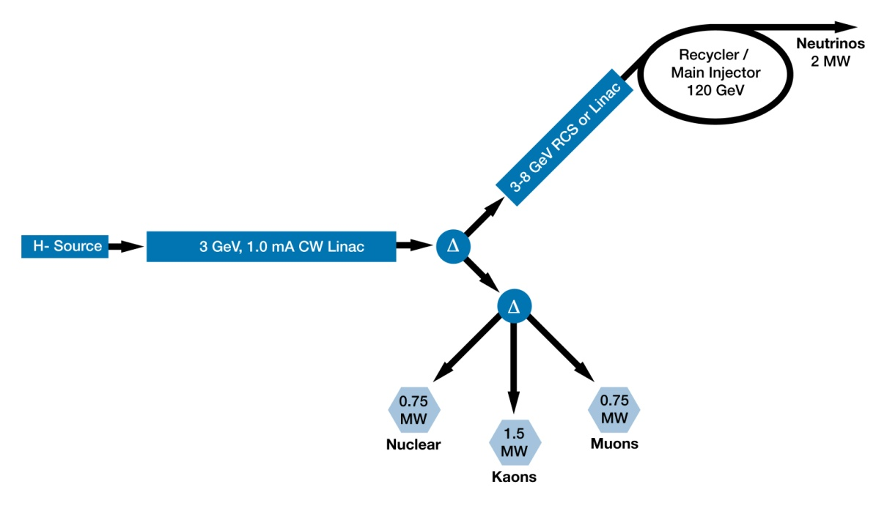
Initial Configuration-2
3 GeV CW linac provides greatly enhanced rare process program
  3 MW; flexible provision for beam requirements supporting multiple users
Options for 3-8 GeV acceleration: RCS or pulsed linac
  Linac would be 1300 MHz with 4-25 msec pulse length
Initial Configuration Document-2 in preparation for summer release

Slide 6
Initial Configuration-2: Performance Goals
Linac
Particle Type H⁻
Beam Kinetic Energy 3.0 GeV
Average Beam Current 1 mA
Linac pulse rate CW
Beam Power 3000 kW
Beam Power to 3 GeV program 2870 kW
RCS/Pulsed Linac
Particle Type protons/H⁻
Beam Kinetic Energy 8.0 GeV
Pulse rate 10 Hz
Pulse Width 0.002/4.3 msec
Cycles to MI 6
Particles per cycle to Recycler 2.6×10¹³
Beam Power to 8 GeV program 200 kW
Main Injector/Recycler
Beam Kinetic Energy (maximum) 120 GeV
Cycle time 1.4 sec
Particles per cycle 1.6×10¹⁴
Beam Power at 120 GeV 2200 kW
simultaneous

Slide 7
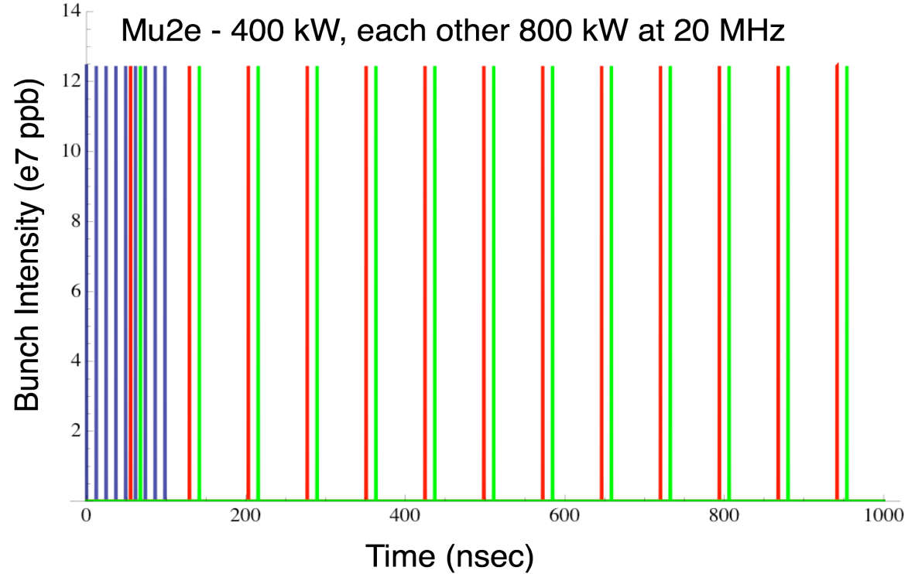
Initial Configuration-2: Operating Scenario
1 μsec period at 3 GeV
mu2e pulse (9e7) 162.5 MHz, 100 nsec 600 kW
Kaon pulse (9e7) 27 MHz 1200 kW
Nuclear pulse (9e7) 27 MHz 1200 kW
Separation scheme

Slide 8
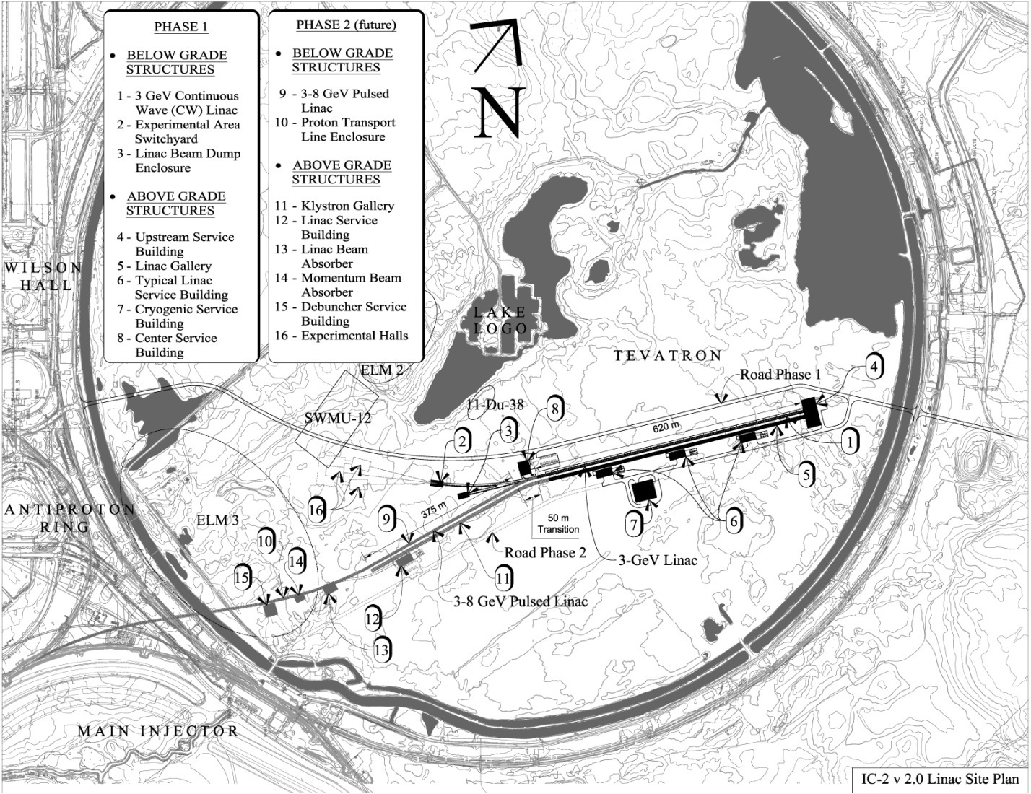
Initial Configuration-2: Provisional Siting
Page 8
Page 8

Slide 9
Initial Configuration-2: Technology Map
SSR0
SSR1
SSR2
β=0.6
β=0.9
ILC
325 MHz
2.5-160 MeV
650 MHz 0.16-2 GeV
1.3 GHz 2-3 GeV
Section | Freq | Energy (MeV) | Cav/mag/CM | Type
SSR0 (β_{G}=0.11) | 325 | 2.5-10 | 26 /26/1 | SSR, solenoid
SSR1 (β_{G}=0.22) | 325 | 10-32 | 18 /18/ 2 | SSR, solenoid
SSR2 (β_{G}=0.4) | 325 | 32-160 | 44 /24/ 4 | SSR, solenoid
LB 650 (β_{G}=0.61) | 650 | 160-520 | 42 /21/ 7 | 5-cell elliptical, doublet
HB 650 (β_{G}=0.9) | 650 | 520-2000 | 96 /12/12 | 5-cell elliptical, doublet
ILC 1.3 (β_{G}=1.0) | 1300 | 2000-3000 | 64 / 8/ 8 | 9-cell elliptical, quad

Slide 10
Project X: Collaboration Status
Multi-institutional collaboration established to execute the Project X RD&D Program.
  Fermilab as lead laboratory
  International participation via in-kind contributions, established through bi-lateral MOUs.
MOU outlines basic goals, and the means of organizing and executing the work. Signatories:
  ANL ORNL/SNS BARC/Mumbai
  BNL MSU IUAC/Delhi
  Cornell TJNAF RRCAT/Indore
  Fermilab SLAC VECC/Kolkota
  LBNL ILC/ART
Collaborator R&D responsibilities largely defined
Other interested parties: CERN, IHEP, Korea, ESS
Collaboration meeting 9/8-9

Slide 11
Project X/ILC/SRF Integrated Plan
Goals
Provide integrated management of all superconducting rf development activities at Fermilab
Provide coherent development of facilities and utilization of resources to meet the needs of the ILC, Project X, and ultimately Muon Accelerator Programs
Align HINS activities directly with Project X needs
Meet all commitments to the ILC program between now and FY2012

Slide 12
Project X/ILC/SRF Integrated Plan
Strategy
Bring all srf activities under the purview of the ILC/SRF Program Director
  ILC and Project X management define requirements
Redefine the High Intensity Neutrino Source (HINS) program to directly support the needs of Project X
Establish the General Accelerator R&D category as the primary funding source for srf cavity development outside of ILC applications.

Slide 13
Project X/ILC/SRF Integrated Plan
Strategy (cont.)
Establish a set of srf R&D deliverables that are distinguishable from infrastructure
Redefine the scope of the following programs consistent with the above strategy:
  SRF Infrastructure
  Project X R&D
  General Accelerator Development
  HINS
  ILC
  SRF Operations

Slide 14
Project X/ILC/SRF Integrated Plan
Plan
Discontinue the (HINS) program as a stand-alone R&D program
  Rescope the beam facility to support chopper and instrumentation development for Project X. Fund via Project X R&D
  Retain low beta cavity development within General Accelerator Development
  Eliminate HINS as a budget line item

Slide 15
Project X/ILC/SRF Integrated Plan
Plan (cont.)
Establish clear deliverables for the srf program over the period FY2010-15:
  Six 1300 MHz cryomodules, culminating in a CW Project X prototype. High power rf test.
  One 650 MHz cryomodule for Project X. High power rf test.
  One 325 MHz cryomodule for Project X. High power rf test.
  Complete Project X test facility at Meson Lab
  ILC rf unit test, with beam, at NML based on three (ultimately six) 1300 MHz ILC cryomodules

Slide 16
Project X/ILC/SRF Integrated Plan
Plan (cont.)
Establish a new SRF Operations line to support maintenance and operations of SRF facilities once infrastructure is complete and being utilized for ILC and Project X development.
Implement the plan starting in FY2011

Slide 17
Integrated SRF Plan: Project X and ILC

Slide 18
Project X/ILC/SRF Integrated Plan
Funding Plan
The funding plan is consistent with that presented at the DOE budget briefing as Scenario B (COL on FY2010).
  Supports primary deliverables of ILC and Project X, including preparations for a Project X construction start in FY2015.
Project X assumed critical decision dates
  CD-0: January, 2011
  CD-1: July, 2012
  CD-2: August, 2013
  CD-3: September, 2014

Slide 19
Project X/ILC/SRF Integrated Funding Plan
Core Technologies R&D |  | FY 10 | FY 11 | FY 12 | FY 13 | FY 14 | FY 15 | FY 16
KA1502011 | General Accelerator Development ops | 15,150 | 16,782 | 22,324 | 28,874 | 31,039 | 28,137 | 20,708
 | SRF Development Activities | 7,557 | 11,731 | 16,713 | 23,151 | 25,201 | 22,182 | 14,635
Total Core Technologies |  | 15,150 | 16,782 | 22,324 | 28,874 | 31,039 | 28,137 | 20,708
KA1102034 | R&D - Project X | 11,003 | 15,566 | 19,692 | 19,128 | 19,035 | 0 | 0
39KA | Project X Construction | 0 | 0 | 0 | 0 | 0 | 39,173 | 60,955
Total Project X |  | 11,003 | 15,566 | 19,692 | 19,128 | 19,035 | 39,173 | 60,955
KA1502012 | Superconducting RF | 20,500 | 16,866 | 5,900 | 0 | 0 | 0 | 0
KA1502012 | Superconducting RF - MIE | 0 | 3,200 | 0 | 0 | 0 | 0 | 0
Total SRF Infrastructure |  | 20,500 | 20,066 | 5,900 | 0 | 0 | 0 | 0
KA1502021 | Lab ILC Accel R&D | 11,321 | 10,650 | 10,650 | 5,325 | 5,485 | 5,677 | 0
Total ILC R&D (wo/GDE) |  | 11,321 | 10,650 | 10,650 | 5,325 | 5,485 | 5,677 | 0
Total |  | 57,974 | 63,064 | 58,566 | 53,327 | 55,558 | 72,986 | 81,664
KA 11 XX XX | Superconducting RF - operations | 0 | 0 | 11,000 | 11,220 | 11,444 | 11,673 | 11,907

Slide 20
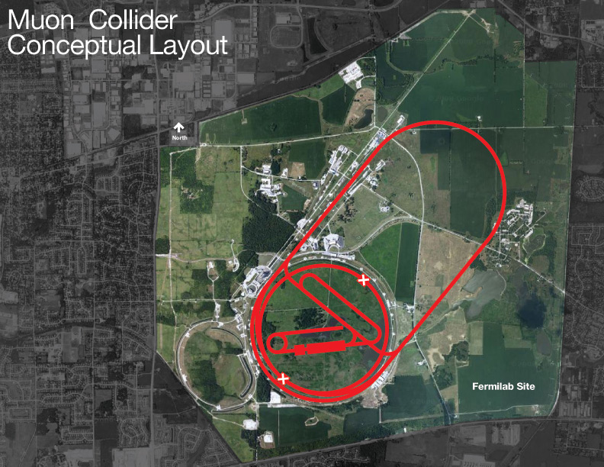
PX/NF/MC Evolution
Project X shares many features with the proton driver required for a Neutrino Factory or Muon Collider
  NF and MC require ~4 MW @
  10± 5 GeV
  Primary issues are related to
  beam “format”
      NF wants proton beam on
      target consolidated in a few
      bunches; Muon Collider
      requires single bunch
  Project X linac is not capable of
  delivering this format
It is inevitable that a new ring(s) will be required to produce the correct beam format for targeting.
MAP Collaboration formed, DOE Review in August

Slide 21
Strategy/Timeline
Next six months: Complete all preliminary design, configuration, and cost range information for IC-2
  ICD-2v2.0
  Cost estimate
  Updated RD&D Plan with resource loaded schedule
Continue conceptual development on outstanding technical questions
  Baseline concept for the chopper
  Concepts for marrying a 3-8 GeV pulsed linac to CW front end
  Injection into RCS or Recycler
Pursue R&D aimed at the CW linac
  Emphasis of srf development at all relevant frequencies
  Engage external collaborators and identify roles
Department of Energy has advised that the earliest possible construction start is FY2015
  Requires CD-0 in FY2011
We believe that we could construct Project X over a five year time period, assuming a commensurate funding profile
Project X could be up and running ~2020

Slide 22
Summary
Project X is central to Fermilab’s strategy for development of the accelerator complex over the coming decade
  World leading programs in neutrinos and rare processes
  Aligned with ILC and Muon Accelerators technology development;
  Potential applications beyond elementary particle physics
The design concept has evolved over the last year, providing significantly enhanced physics capabilities
  >2 MW at 60-120 GeV, simultaneous with 3 MW at 3 GeV
  Flexibility for supporting multiple experiments
  CW linac is unique for this application, and offers capabilities that would be hard/impossible to duplicate in a synchrotron
Project X and ILC (and HINS) srf activities are now integrated
The accelerator concept is sufficient to support CD-0
Details in Breakout Session (Nagaitsev & Kephart)

