Slide 1
LBNE
Jim Strait
Fermilab
DOE Annual Science & Review
July 12-14, 2010

Slide 2
Outline
Overview of LBNE (experiment, collaboration and project) and DUSEL
Technical progress in developing the Conceptual Designs for LBNE
Physics capabilities of LBNE
  Beam-base neutrino oscillation measurements
  Proton decay
Approaching configuration decisions:
Water vs. LAr and more
Summary

Slide 3

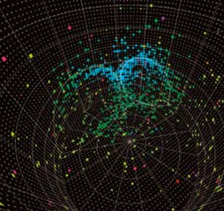
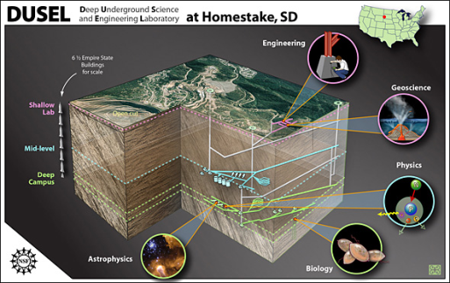
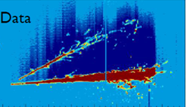
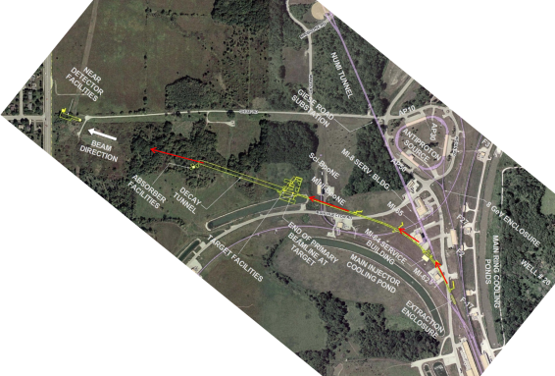
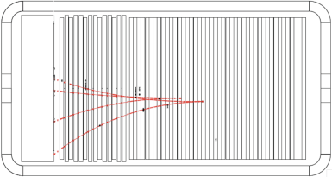
Sample with bullet points
Long Baseline Neutrino Experiment
First Bullet
Second Bullet
  More
  Yet more
  Still more
      Less important
        Trivial
New Neutrino Beam at Fermilab…
…Directed towards NSF’s proposed DUSEL
Precision Near Detector on the Fermilab site
100 kT fiducial volume Water Cherenkov Far Detector
17 kT fiducial volume Liquid Argon TPC Far Detector

Slide 4
LBNE and DUSEL
NSF & DOE have formed the DUSEL Physics Joint Oversight Group (JOG), and have agreed:
  NSF will steward DUSEL facility
  DOE OHEP will steward LBNE, including beam line, near and far detectors
  NSF will contribute to LBNE detector (& cavity)
Good communication and cooperation has developed between DUSEL and LBNE:
  Periodic meetings of Joint Agency Project Group involving DOE, NSF, DUSEL, LBNE, and Lab and UCB management
  Laboratory Oversight Group formed
  Regular DUSEL-LBNE coordination meetings
  Growing integration of DUSEL and LBNE teams for civil construction planning

Slide 5
LBNE Project Time Line
DOE CD-0 (Approve Mission Need) January 2010
CD-1 Review (Conceptual design, preliminary
cost and schedule range) December 2010
CD-1 (assuming successful CD-1 review) April 2011
CD-2 (Project baseline)
depending on funding . . . mid/late FY2013
CD-3 (start construction)
depending on funding . . . 2014 ~ 2015
Schedule for construction under development
=> estimate that project will be complete >~ 2020

Slide 6
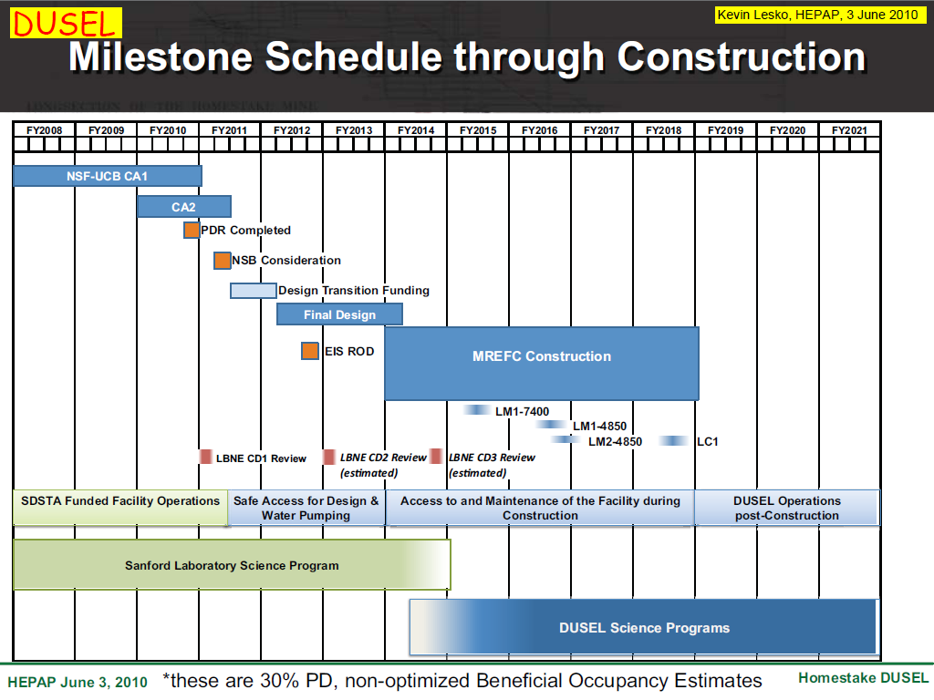
LBNE and DUSEL Project Schedules are well aligned.

Slide 7
Goals of LBNE
High-sensitivity measurement of ν_{μ} -> ν_{e} oscillations:
Measure sin²(2θ₁₃) to << 0.01
Determine the mass hierarchy:
Are ν₁ and ν₂ lighter or heavier than ν₃?
Search for CP violation in the neutrino sector
Use very massive neutrino detectors for:
Improved limits (or discovery!) of proton decay
Measurements using astrophysical neutrinos:
- Neutrinos from a supernova in (or near) our galaxy
- Diffuse supernova neutrino flux
- Atmospheric neutrinos
- Solar neutrinos
Further measurements of ν_{μ} disappearance
Precision neutrino cross-section measurements with Near Detector

Slide 8
Long-Baseline Neutrino Experiment Collaboration
Alabama: J. Goon, I Stancu
Argonne: M. D’Agostino, G. Drake. Z. Djurcic, M. Goodman, X. Huang, V. Guarino, J. Paley, R. Talaga, M. Wetstein
Boston: E. Hazen, E. Kearns, J. Raaf, J. Stone
Brookhaven: M. Bishai, R. Brown, H. Chen, M. Diwan, J. Dolph, G. Geronimo, R. Gill, R. Hackenberg, R. Hahn, S. Hans, D. Jaffe, S. Junnarkar, J.S. Kettell, F. Lanni, L. Littenberg, D. Makowiecki, W. Marciano, W. Morse, Z. Parsa, C. Pearson, V. Radeka, S. Rescia, T. Russo, N. Samios,R. Sharma, N. Simos, J. Sondericker, J. Stewart, H. Tanaka, C. Thorn, B. Viren, Z. Wang, S. White, L. Whitehead, M. Yeh, B. Yu
Caltech: R. McKeown
Cambridge: A. Blake, M. Thomson
Catania/INFN: V. Bellini, G. Garilli, R. Potenza, M. Trovato
Chicago: E. Blucher
Colorado: A. Marino, M. Tzanov, E. Zimmerman
Colorado State: B. Berger, J. Harton, W. Toki, R. Wilson
Columbia: L. Camillieri, C.Y. Chi, C. Mariani, M. Shaevitz, W. Sippach, W. Willis
Crookston: D. Demuth
Dakota State: B. Szcerbinska
Davis: R. Breedon, T. Classen, J. Felde, M. Tripanthi, R. Svoboda
Drexel: C. Lane, J. Maricic, R. Milincic, K. Zbiri
Duke: J. Fowler, J. Prendki, K. Scholberg, C. Walter
Duluth: R. Gran, A. Habig
Fermilab: D. Allspach, B. Baller, D. Boehnlein, S. Childress, T. Dykhuis, A. Hahn, P. Huhr, J. Hylen, M. Johnson, T. Junk, B. Kayser, G. Koizumi, T. Lackowski, C. Laughton, P. Lucas, B. Lundberg, P. Mantsch, J. Morfin, V. Papadimitriou, R. Plunkett, C. Polly, S. Pordes, G. Rameika, B. Rebel, D. Reitzner, K. Riesselmann, R. Schmidt, D. Schmitz, P. Shanahan, J. Strait, K. Vaziri, G. Velev, G. Zeller, R. Zwaska
Hawaii: S. Dye, J. Kumar, J. Learned, S. Matsuno, S. Pakvasa, M. Rosen, G. Varner
Indian Universities: V. Bhatnagar, B. Bhuyan, B. Choudhary, P. Gupta, A. Kumar, S. Mandal, S. Sahijpal, V. Singh
Indiana: C. Bower, W. Fox, M. Messier, J. Musser, R. Tayloe, J. Urheim
Iowa State: M. Sanchez
IPMU/Tokyo: M. Vagins
Irvine: W. Kropp, M. Smy, H. Sobel
Kansas State: T. Bolton, G. Horton-Smith
LBNL: R. Kadel, B. Fujikawa, D. Taylor
Livermore: A. Bernstein, R. Bionta, S. Dazeley, S. Ouedraogo
London-UCL: J. Thomas
Los Alamos: S. Elliot, V. Gehman, G. Garvey, T. Haines, D. Lee, W. Louis, C. Mauger, G. Mills, Z. Pavlovic, G. Sinnis, R. Van de Water, H. White
Louisiana State: N. Buchanan, T. Kutter, W. Metcalf, J. Nowak
Maryland: E. Blaufuss, R. Hellauer, T. Straszheim, G. Sullivan
Michigan State: E. Arrieta-Diaz, C. Bromberg, D. Edmunds, J. Huston, B. Page
Minnesota: M. Marshak, W. Miller
MIT: W. Barletta, J. Conrad, R. Lanza, P. Fisher
NGA: S. Malys, S. Usman
New Mexico: B. Becker, J. Mathews
Notre Dame: J. Losecco
Oxford: G. Barr, J. DeJong, A. Weber
Pennsylvania: J. Klein, K. Lande, A. Mann, M. Newcomer, R. vanBerg
Pittsburgh: D. Naples, V. Paolone
Princeton: Q. He, K. McDonald
Rensselaer: D. Kaminski, J. Napolitano, S. Salon, P. Stoler
Rochester: R. Bradford, K. McFarland
SDMST: X. Bai, R. Corey
SMU: J. Ye
South Carolina: S. Mishra, R. Petti, C. Rosenfeld
South Dakota State: K. McTaggert
Texas: S. Kopp, K. Lang, R. Mehdiyev
Tufts: H. Gallagher, T. Kafka, W. Mann, J. Schnepps
UCLA: K. Arisaka, D. Cline, K. Lee, Y. Meng, F. Sergiampietri, H. Wang
Virginia Tech: J. Link
Washington: S. Enomoto, J. Kaspar, N. Tolich, H.K. Tseung
Wisconsin: B. Balantekin, F. Feyzi, K. Heeger, A. Karle, R. Maruyama, D. Webber, C. Wendt
Yale: B. Fleming, M. Soderberg, J. Spitz
262 Scientists and Engineers
59 Institutions
… And still growing!
4 June 2010

Slide 9
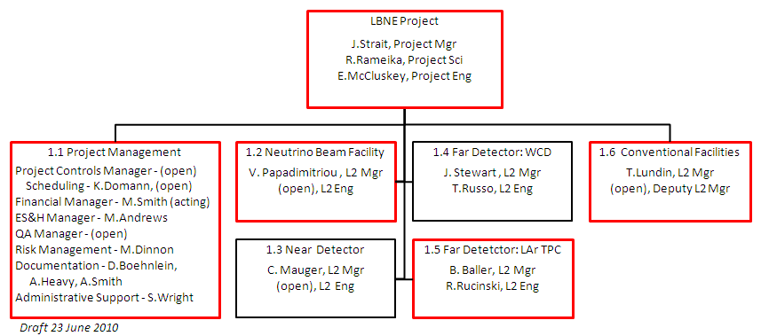
LBNE Project Organization
Fermilab has overall responsibility, and is lead lab for the beam, LAr TPC Far Detector, and Conventional Facilities
BNL is lead lab for Water Cherenkov Far Detector
LANL is lead lab for Near Detector

Slide 10

WBS 1.2 - New neutrino beam at Fermilab
Led by Fermilab with collaboration support.
Horn-focused ν beam, driven by Main Injector.
Primary beam tunable 60 to 120 GeV
Designed for initial P_{beam} = 0.7 MW,
upgradeable to ≥2 MW.

Slide 11
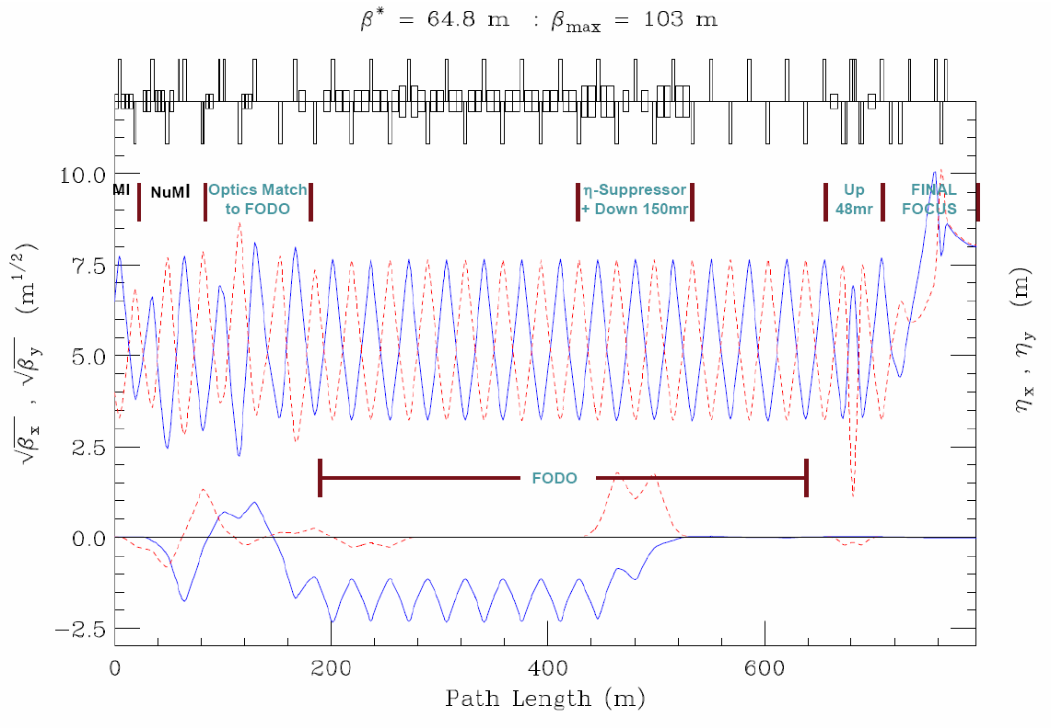
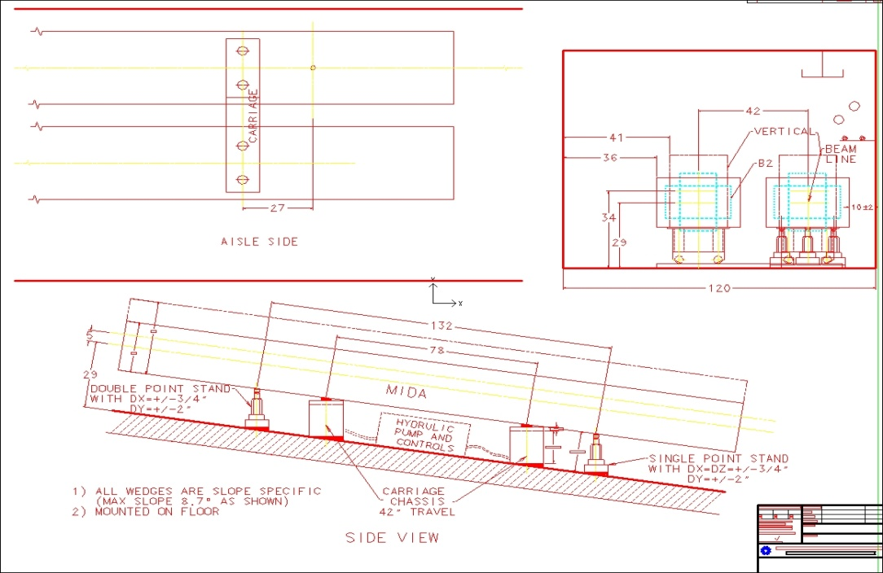
WBS 1.2 - New neutrino beam at Fermilab
Primary beam line design is well advanced:
  Optics design has been set
  Main magnet types have been chosen
  Beam laid out to thread through the busy area between the
  8 GeV lines, NuMI beam, and Main Injector
  Vacuum system and instrumentation designs
  Installation planning proceding

Slide 12
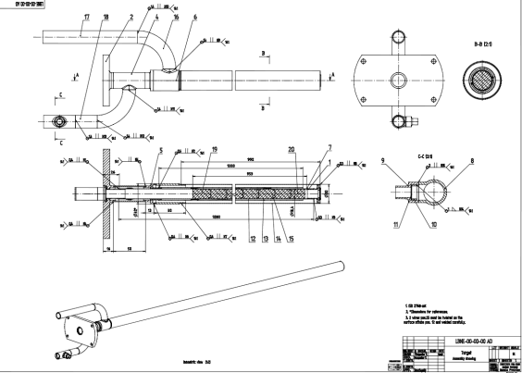
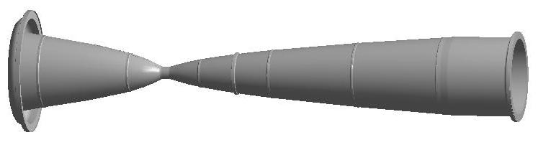
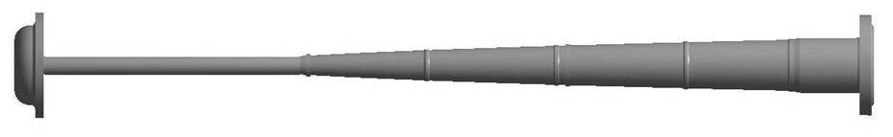
WBS 1.2 - New neutrino beam at Fermilab
Good progress on neutrino beam design.
  Target design development with IHEP Protvino (graphite) and RAL (Beryllium).
  Target material irradiation studies with BNL/BLIP
  Target cooling studies with ANL
  Horn system optimization work with BNL … 2-horn system chosen.
  Horn conductor engineering and modeling is advancing well.
  Remote handling planning with ORNL

Slide 13
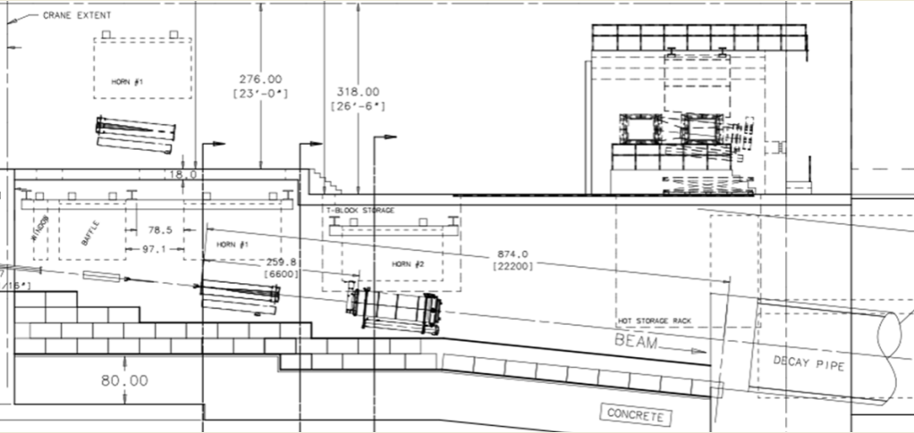
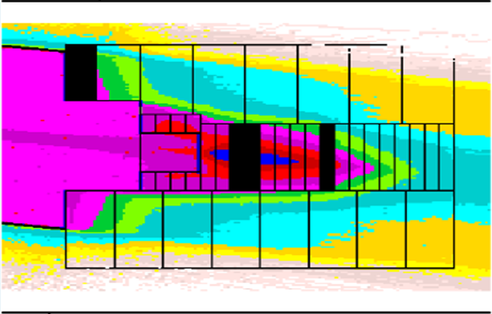
WBS 1.2 - New neutrino beam at Fermilab
Good progress on neutrino beam design.
  Decay pipe dimension set (4 m ID, 250 m length)
  Decay pipe cooling system preferred and alternate designs chosen
  Hadron absorber engineering and modeling proceeding well.

Slide 14
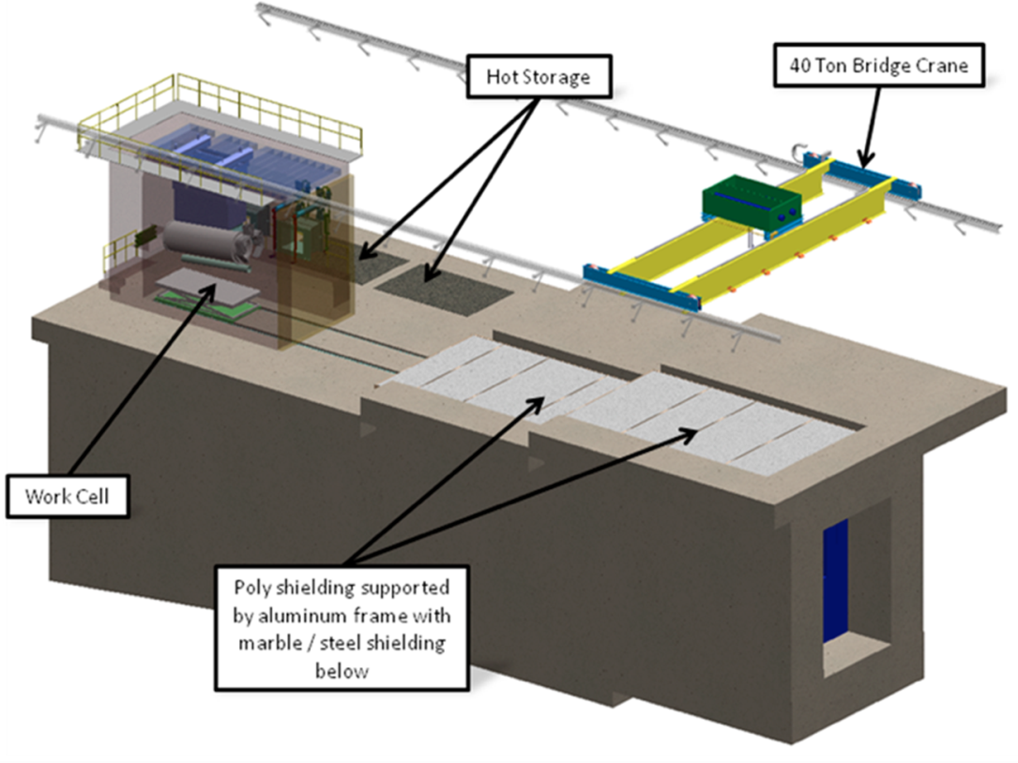
WBS 1.2 - New neutrino beam at Fermilab
Good progress on neutrino beam design.
  Shielding and tritium calculations are advancing, based on measurements and experience with NuMI.
  Requirements given to Conventional Facilities group to design beam enclosures and surface buildings.

Slide 15
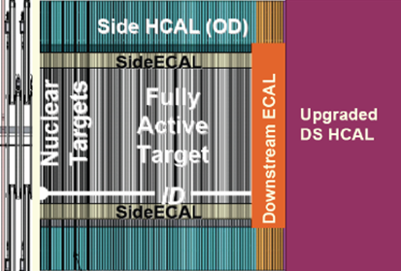
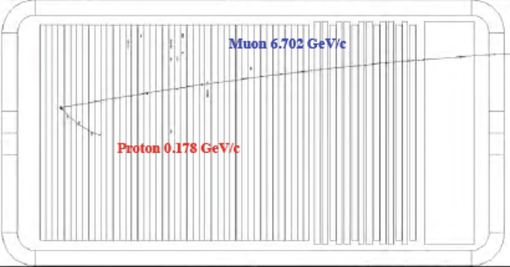
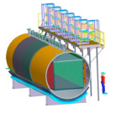
WBS 1.3 – Near Detector
Led by LANL with collaboration support
Small FNAL role
Neutrino detector to measure un-oscillated beam spectrum and neutrino cross sections needed to make the oscillation measurements.
Currently concentrating on physics studies to precisely define what is needed
Several options under consideration:
Scintillator tracker Straw-tube tracker LAr TPC

Slide 16
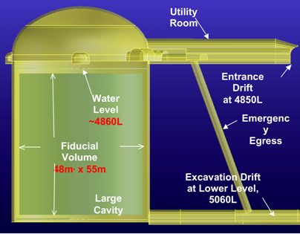
WBS 1.4 – Water Cherenkov Detector
Led by BNL with collaboration support.
Fermilab leads the PMT effort, and is active on the water system design and simulations.
Close coordination with NSF S4-funded design effort => integrated effort.
Designing 100 kT
Fiducial Volume
“Modules,” each
~ 4x Super-K

Slide 17
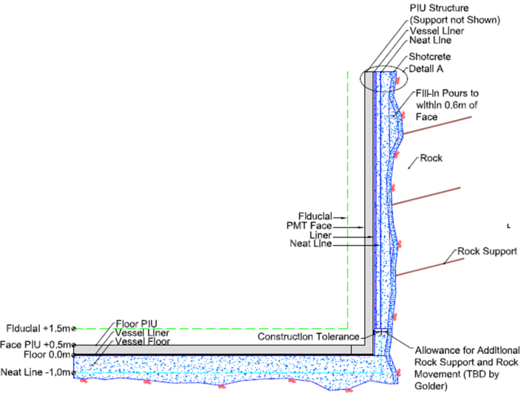
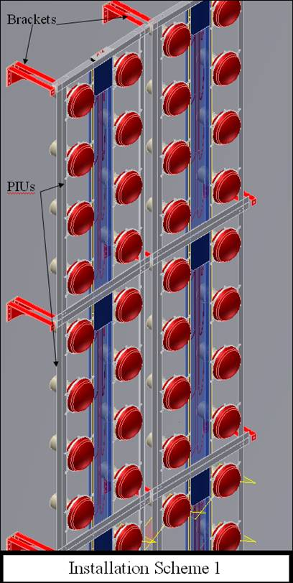
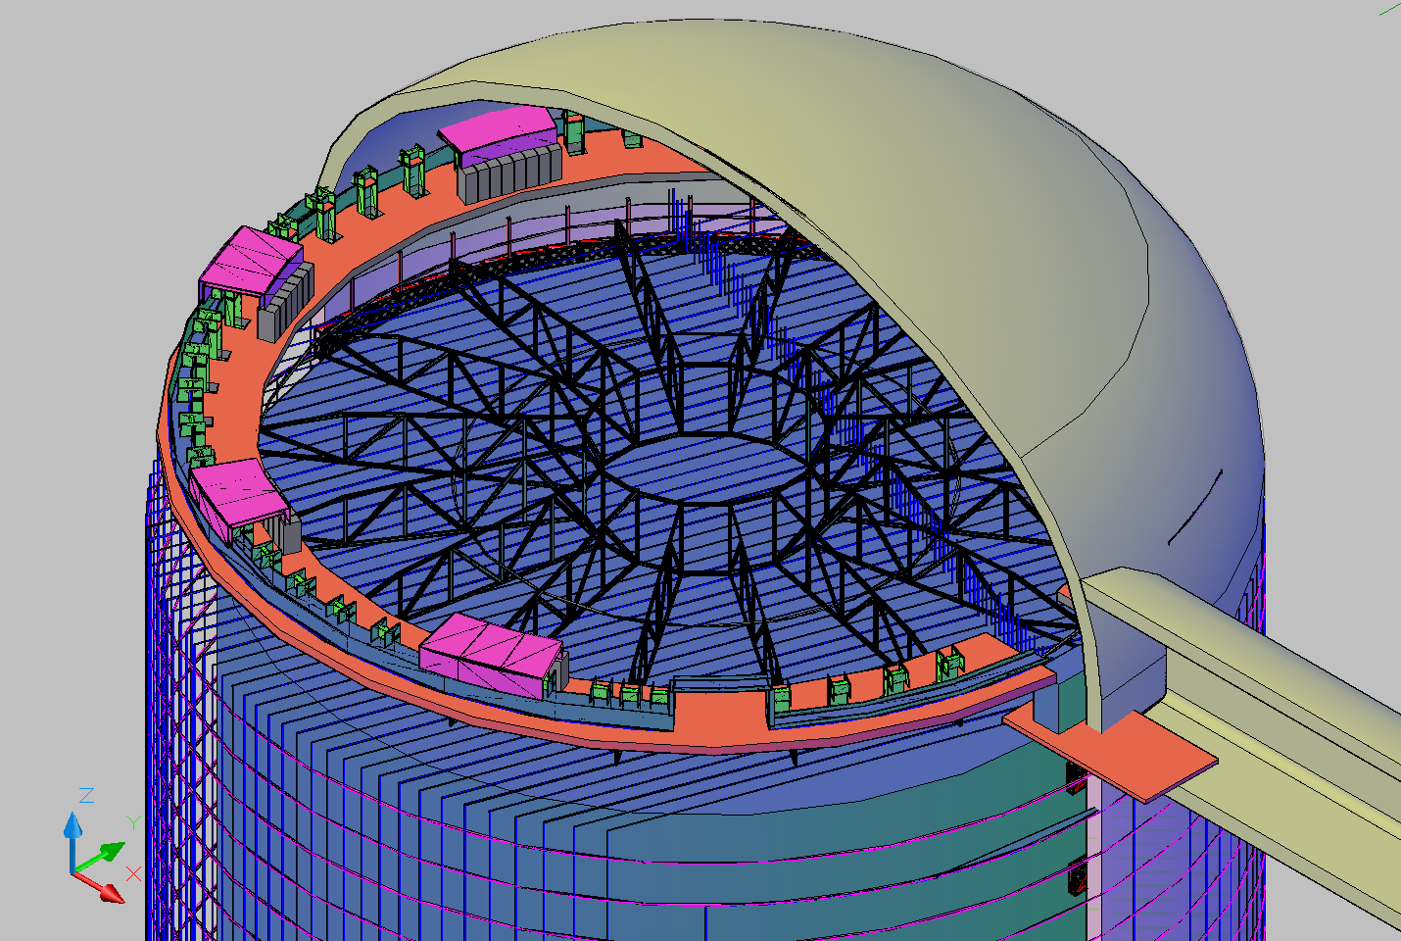
WBS 1.4 – Water Cherenkov Detector
Active work on
- Water tank and deck
- Water system
- Understanding PMT supply
- PMT mounting systems

Slide 18
WBS 1.5 – LAr TPC
Led by Fermilab with collaboration support.
BNL has important role in electronics and TPC mechanical engineering.
Designing ~17 kT fiducial volume modules ≅ same as 100 kT Water Cherenkov for oscillation physics.
Cryostat and Cryogenic System engineering studies done mainly by contracts with outside firms (quasi-industrial products)
Engineering options under study:
  Evacuable (modular) vs. Non-evacuable* (membrane) cryostat
  Vacuum vs. Passive* thermal insulation
  Depth 4850 ft vs. 800* ft vs. 300 ft.
  Cold* vs. Warm front-end electronics
_______________
*Reference Design

Slide 19
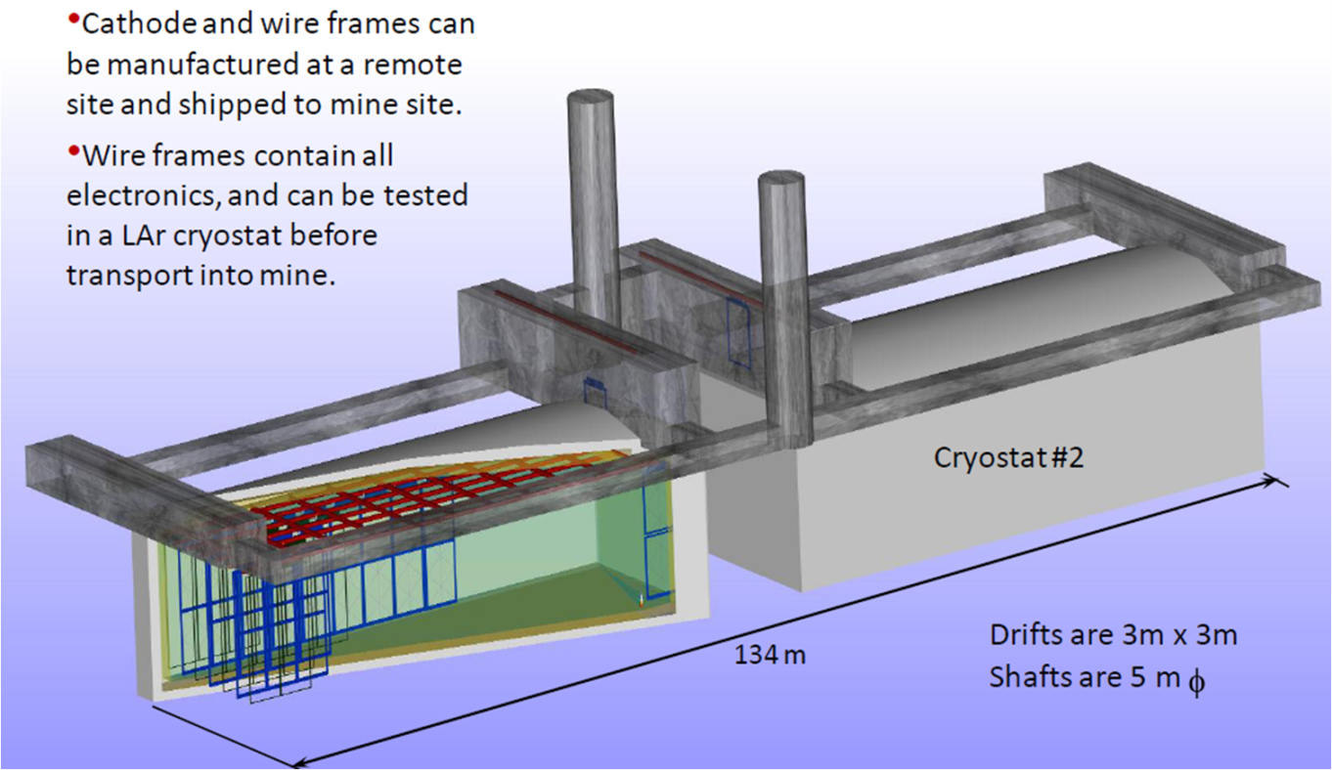
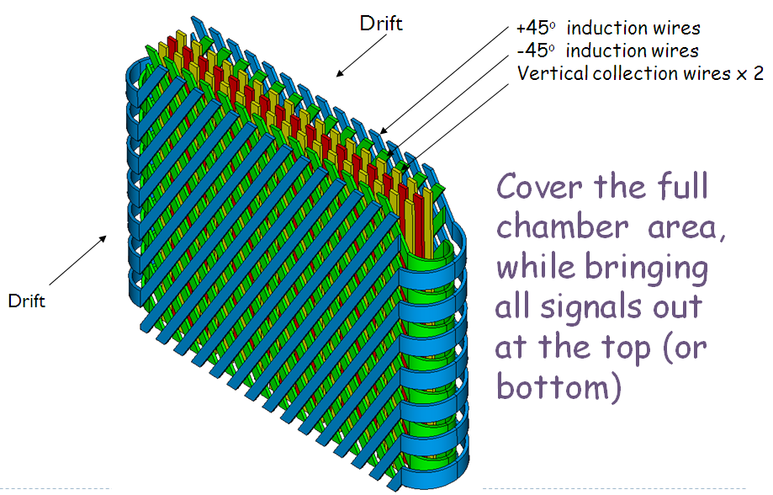

WBS 1.5 – LAr TPC
Rectangular cryostat with possible 2nd cavern for LAr storage or 2nd detector
TPC design – Anode Plane Assemblies

Slide 20
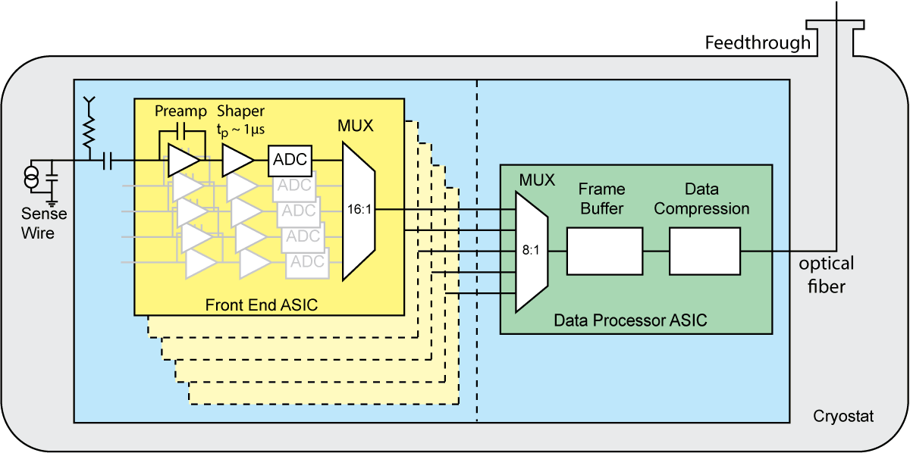
WBS 1.5 – LAr TPC
Cold Electronics Block Diagram

Slide 21
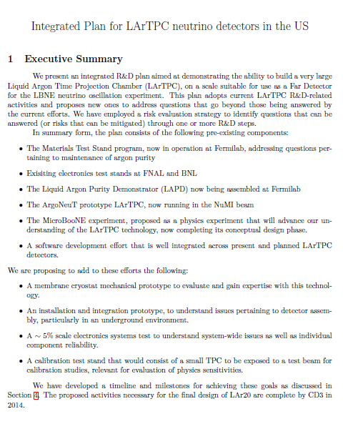
LAr Integrated R&D Plan
The LBNE LAr TPC
development benefits from work outside the Project that is part of the LAr Integrated R&D Plan.
2009 Recommendation
The laboratory should develop a detailed plan for development of the LAr/TPC technology with clear milestones for each aspect of this plan by the end of year. MicroBooNE should be considered as part of this development.

Slide 22
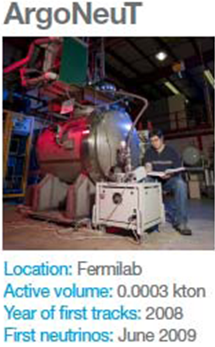
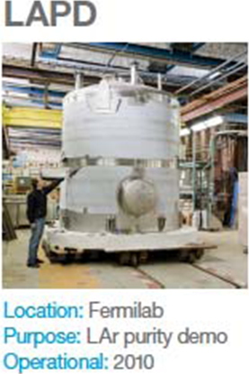
LAr Integrated R&D Plan
Task force: 10 from U.S. & Italy
  Development: Sep – Dec 09
  Director’s review – 23 Nov 09
  Submitted to DOE – 21 Dec 09
Plan elements:
  Materials Test Stand at Fermilab – Argon purity
  Electronics Test Stands at Fermilab and BNL
  Liquid Argon Purity Demonstrator at Fermilab – Test purity in 30 T capacity, non-evacuable cryostat.
  ArgoNeuT – Measure real neutrino interactions to use do develop reconstruction algorithms
  MicroBooNE – Scale up to 2.6 m drift; construct and perform full physics experiment and analysis
  LArSoft - Software development program to support analysis of ArgoNeuT, MicroBooNE and LBNE data.

Slide 23
LAr Integrated R&D Plan
Additional plan elements:
  Membrane Cryostat prototype – to evaluate and gain experience with this technology.
  Installation and Integration prototype – to understand installation issues in a realistic environment for a large underground detector.
  ~5% scale electronics systems test – to understand system-wide issues and component reliability.
  Test beam module.
The Integrated Plan is being executed as planned, subject to funding availability.

Slide 24
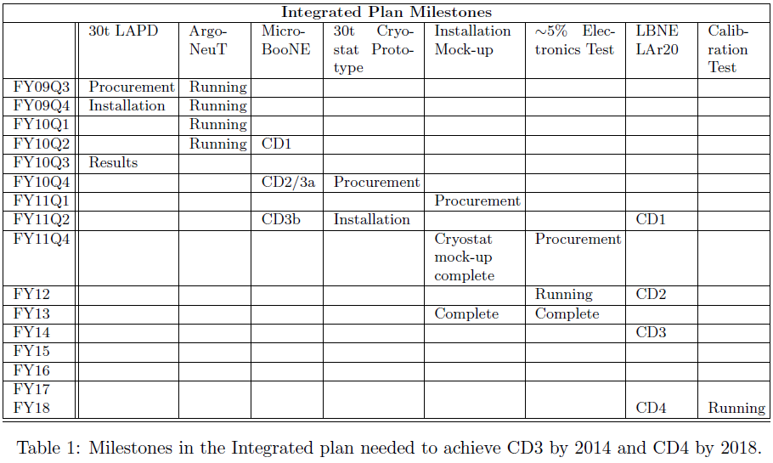
LAr Integrated R&D Plan - Milestones
Additional plan elements:
  Membrane Cryostat prototype – to evaluate and gain experience with this technology.
  Installation and Integration prototype – to understand installation issues in a realistic environment for a large underground detector.
  ~5% scale electronics systems test – to understand system-wide issues and component reliability.
  Test beam module.
The Integrated Plan is being executed as planned, subject to funding availability.

Slide 25
WBS 1.6 – Conventional Facilities
Led by Fermilab, with input from the rest of the Project and the Collaboration.
LBNE is responsible for underground and surface facilities at the near and far sites.
Very close coordination with all other sub-projects is required.
Very close coordination with DUSEL is required for all work at the far site.

Slide 26
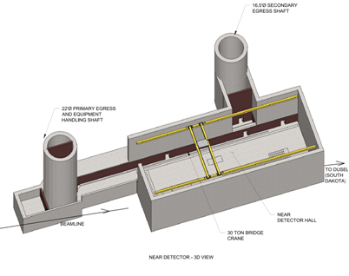
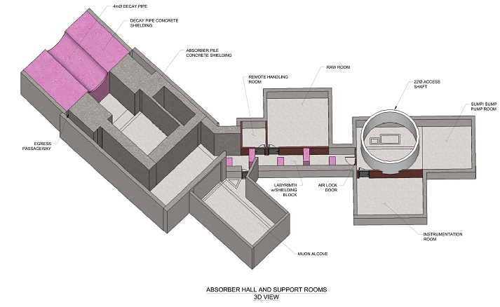
WBS 1.6 – Conventional Facilities
Underground and surface facilities for beam and near detector – design work proceding well.

Slide 27
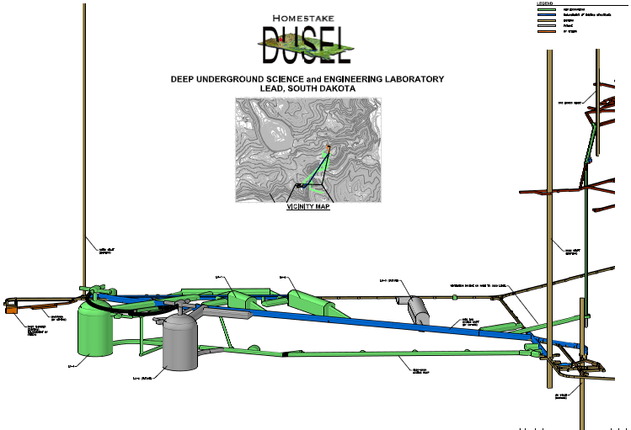
WBS 1.6 – Conventional Facilities
Underground and surface civil engineering for LBNE-specific facilities on/in the DUSEL site.
Currently rely on DUSEL for Large Cavity design for Water Cherenkov Detector.
Design for 2 caverns, but with infrastructure to enable a 3rd.

Slide 28
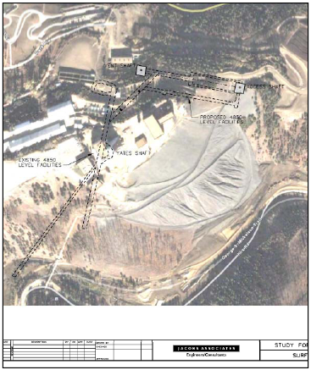
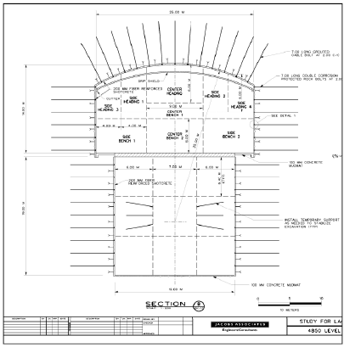
WBS 1.6 – Conventional Facilities
Independent studies for LAr cavities
Conceptual design studies done for 4850 ft and 300 ft
Design for 800 ft
recently launched

Slide 29
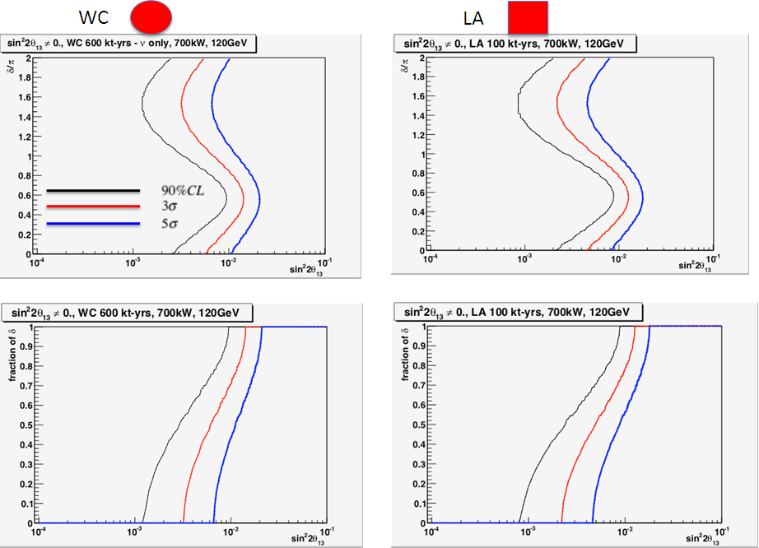
LBNE Physics Reach: ν_{μ} -> ν_{e} appearance

Slide 30
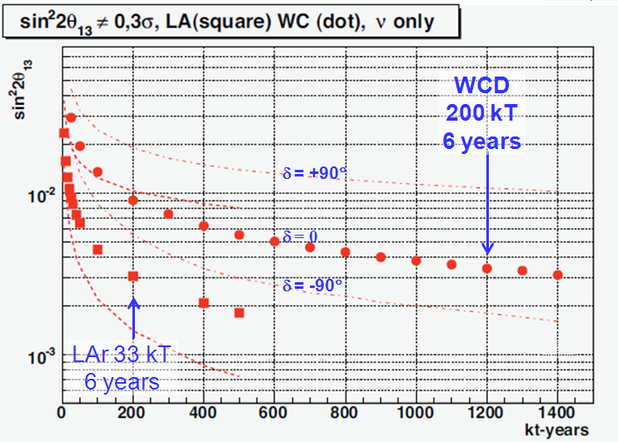
LBNE Physics Reach: ν_{μ} -> ν_{e} appearance
PRELIMINARY
Work in Progress

Slide 31
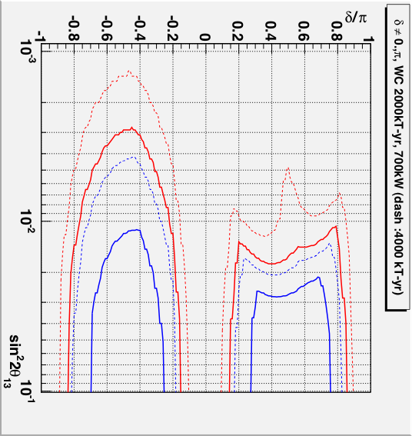
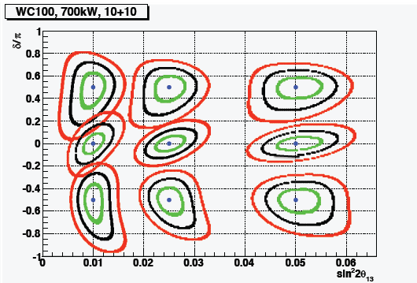
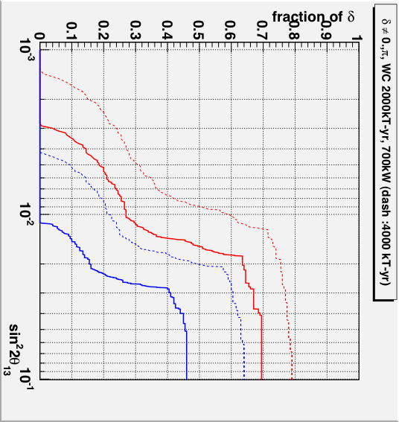
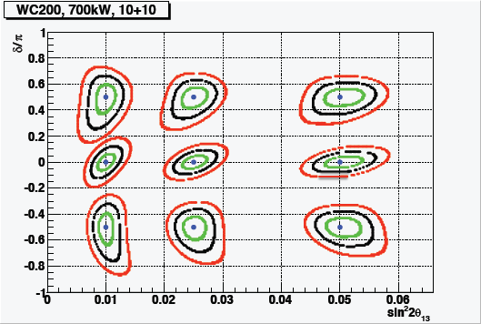
LBNE Physics Reach: CP Violation
3σ ––
5σ ––
1σ
2σ
3σ
PRELIMINARY
Work in Progress

Slide 32
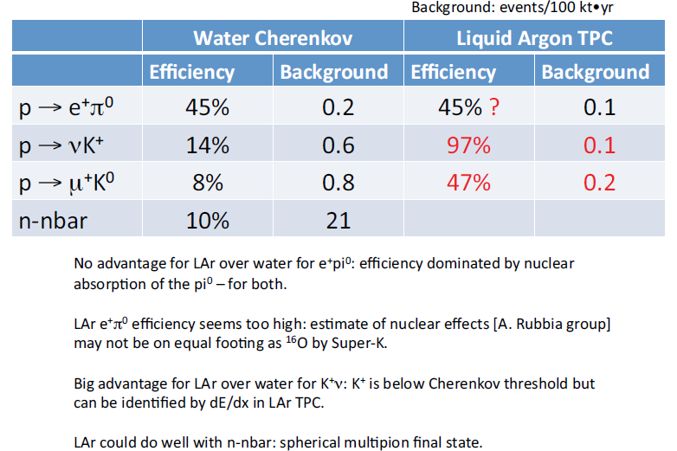
LBNE Physics Reach – Proton Decay
First Bullet
Second Bullet
  More
  Yet more
  Still more
      Less important
        Trivial
Ed Kearns, LBNE Collab. Mtg., 27 May 2010.

Slide 33
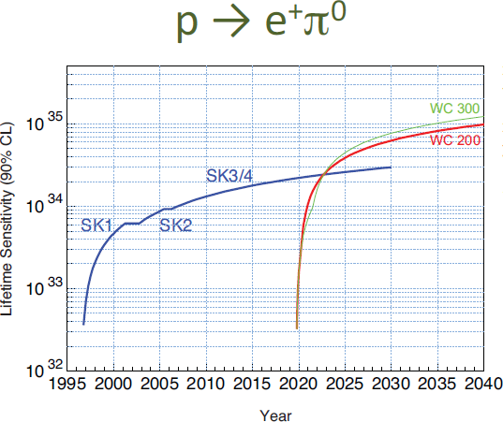
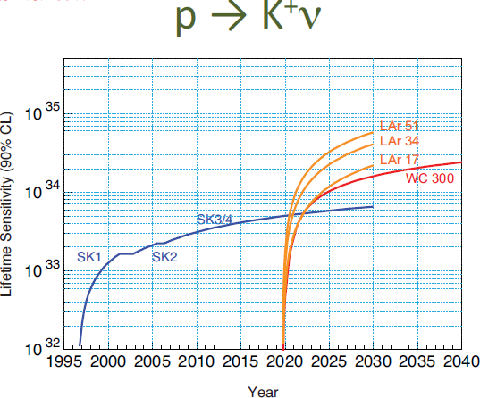
LBNE Physics Reach – Proton Decay
LAr 34
Ed Kearns, LBNE Collab. Mtg., 27 May 2010.

Slide 34
LBNE Configuration Decisions
LBNE has many configuration choices, for example:
  Water Cherenkov Detector vs. LAr TPC
  Near Detector configuration
  Investment in beam vs. near detector vs. far detector.
  Detector mass vs. photocathode coverage
Approach: Build an experimental complex to deliver the best possible science.
Based on the DOE mission need statement and the NSF objectives for DUSEL Physics, we consider that
Neutrino oscillations and proton decay should be most strongly considered in choosing the configuration for “the best possible science.”

Slide 35
LBNE Configuration Decisions
Inputs to the decision:
1) Determine physics sensitivities based on simulations of signal and background for each configuration.
2) Conduct risk analysis (technical, cost and schedule) for each detector technology and far-detector depth.
3) Estimate cost and schedule for each configuration.
4) Normalize far detector mass to common cost.
5) Estimate physics reach = f(t) for each configuration.

Slide 36
LBNE Configuration Decisions
Plan – Constitute the Collaboration Executive Committee as an advisory committee charged to:
  Evaluate the “input data”
  Weigh the relative importance of the inputs
  Produce a consensus report making recommendations concerning the configuration of experimental complex.
  “Too early to decide” is a possible outcome for some choices prior to CD-2.

Slide 37
Summary
LBNE, together with DUSEL, are planning a world-leading program in neutrino oscillations, proton decay and neutrino astrophysics.
Major progress has been made in the past year:
  Roles and relationships have been defined and established between DOE and NSF and between the DUSEL and LBNE Projects. The DUSEL and LBNE Projects are developing a strong partnership.
  A strong LBNE Project Team is in place and is working well. Fermilab, BNL and LANL are committed to the Project.
  The LBNE Science Collaboration is growing rapidly and working in close cooperation with the LBNE Project Team and DUSEL.
  Serious progress is being made in developing the Conceptual Design, as well as other prerequisites for CD-1.

Slide 38
END

Slide 39
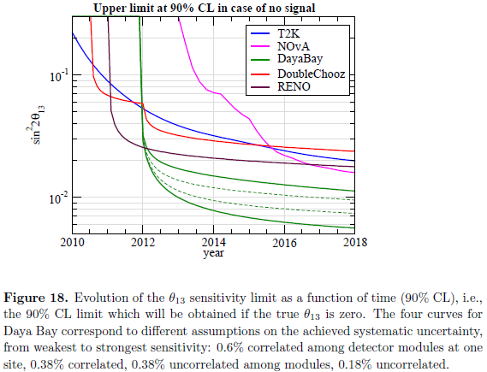
Neutrino Physics Strategy
LBNE, as currently planned, is sensitive to
CP violation discovery (δ ≠ 0 or π at ≥3σ) for sin²2θ₁₃ >~ 0.01.
By CD-2 (mid-2013) we are likely to have seen
θ₁₃ if sin²2θ₁₃ >~ 0.05,
or have a limit <~ 0.025.
θ₁₃ limits/discovery potential are likely to improve modestly between CD-2 and CD-3 (late 2014 or early 2015).
M.Mezzetto, T.Schwetz,
arXiv:1003.5800v1 [hep-ph] 30 Mar 2010

Slide 40
Neutrino Physics Strategy
If sin²2θ₁₃ is not known to be > 0.01 at CD-2 or CD-3 we could:
Continue the project to search for ν_{e} appearance, pushing to the lowest possible θ₁₃, and to execute the rest of the LBNE program. Utilize the higher beam power from Project X when it becomes available to extend the reach.
Build the far detectors to focus on proton decay and neutrino astrophysics, but not build the beam until θ₁₃ is found by others.
Continue project planning, but wait to start construction until θ₁₃ is found by others.

Slide 41
Neutrino Physics Strategy
Build low-energy neutrino factory, based on the Project X beam and aimed at DUSEL.
  θ₁₃ discovery down to sin²2θ₁₃ ~ 10⁻⁴ and CP violation discovery down to sin²2θ₁₃ ~ 10⁻³.
  International Design Study RDR due in 2012/2013, progress on Muon Accelerator Program => basis for decision.
  Requires magnetized detectors at DUSEL, which could be optimized also for proton decay and neutrino astrophysics.
Take advantage of new ideas that may arise.
Substantial study, and consultation with the funding agencies and the broader HEP community would be required to determine the best path to take.

