Slide 1
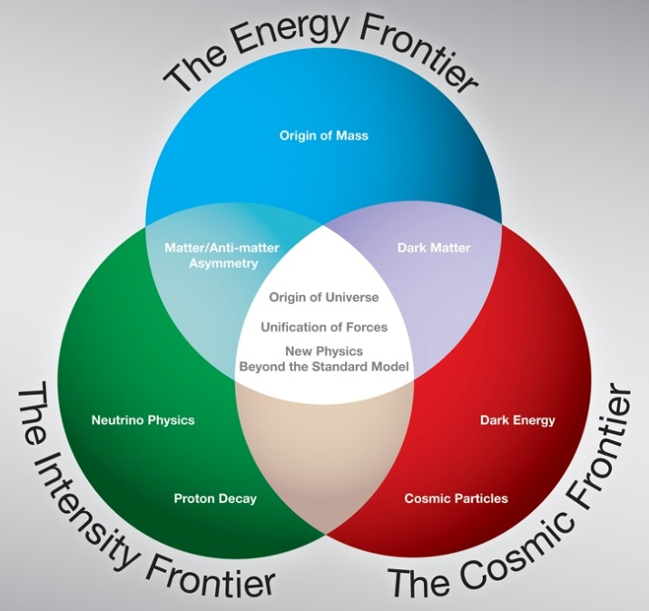
Q/A 2010 DOE S&T Review
DOE S&T Review of Scientific User Facilities
July 12-14, 2010

Slide 2
Tevatron Run Extension
Would an additional $30 M /year allow the lab to run Tevatron for FY 2012-14?
$30M in FY12 and higher in FY13/14
Is money the only issue?
Impact on the NOvA physics (700 kW → 500 kW or 300 kW)
Impact on future programs at Fermilab: not enough expertise / human resources for Mu2e, LBNE, Project X etc.
There was not a lot of information about Run III. Can the committee see the PAC report?
DOE S&T review webpage

Slide 3
User Community
How does the lab expect the user community to change after the Tevatron run ends? How big will the fixed target/neutrino community be?
We assume the technically limited timeline of our future projects (Mu2e, LBNE, Project X, Project X experiments, MAP). Note that these are very rough numbers.
Program | FY2010 | FY2013 | FY2016
Tevatron | 1,240 | 500 | 100
CMS | 200 | 300 | 300
MAP(Neutrino Factory / Muon Collider) |  | 100 | 100
Neutrino + Proton decay | 300 | 500 | 600
Muon | 100 | 200 | 200
Kaon |  | 50 | 200
Nuclear | 60 | 100 | 200
Particle Astro | 200 | 300 | 300
Testbeam / Detector R&D | 100 | 150 | 150
Theory | 100 | 100 | 100
Total | 2,300 | 2,300 | 2,250

Slide 4
Tevatron: Proposed Performance Metrics
FY2011
52 weeks scheduled
Design curve = 2.70 fb-1
Subtract: 2 weeks for unscheduled downtime
Subtract : 6 weeks for possible end of run accelerator studies
Subtract: 15% to get to 90% confidence level
Performance Metric: 2 fb⁻¹
FY2012
No scheduled collider operations

Slide 5
NuMI: Proposed Performance Metrics
FY2011
50 weeks scheduled
Design curve = 3.4E20
Base curve = 2.4E20
Take 2B+D weighted average to get 90% confidence
Performance Metric: 2.7E20
FY2012
22 weeks scheduled
No antiproton production
Design curve = 1.7E20
Base curve = 1.3E20
Take 2B+D weighted average to get 90% confidence
Performance Metric: 1.4E20

Slide 6
Intensity Frontier: Scientists
How many Fermilab scientific staff are involved in each of the new intensity frontier projects, NOvA, MicroBooNE, Mu2e, and LBNE?
Effort report in FY2010 (Oct 2009 – Jun 2010)
FTEs | NOvA | MicroBooNE | Mu2e | LBNE
All including joint appointees & Postdocs | 8.09 | 1.55 | 10.28 | 8.89

Slide 7
Scientist Efforts (FTEs): 5-year plan survey (Dec.2009)
excluding postdocs
Lab Management
Accel. Operations
Accel. Science/Develp
Particle/Astro Theory
Det./Comp. R&D
Cosmic Frontier
Intensity Frontier
Energy Frontier
Tevatron accelerator
CDF
DZero

Slide 8
Antineutrino strategy
What is the lab's strategy to address the antineutrino result from MiniBooNE and MINOS?
Measurements only get resolved with more running
MiniBooNE doubling time is now long (3-4 years). We will run them for as long as we can but preserving the MicroBooNE timeline
Further progress would come from: a) MicroBooNE running and b) moving MiniBoone to new location (PAC will consider this Fall)
Earliest termination is May 2011 which would bring total antineutrino running from 5.6x10²⁰ POT to 8.0 10²⁰ POT

Slide 9
Antineutrino strategy
Relatively little risk to achieve this goal for MiniBooNE
For MINOS will move analysis from 1.7x10²⁰ POT to 4.2x10²⁰ POT before March shutdown
Main conflict for MINOS is with MINERvA running. MINERvA needs neutrinos and “low energy” target position (not planned for after the shutdown). MINOS wants antineutrinos as soon as possible. The conflict arises from mitigating risk of possible breakdowns or shortening of the schedule due to budget problems. Exact running schedule still under discussion
It is possible in principle to continue run MINOS after the shutdown with “medium energy target”
NOvA will ultimately measure neutrino anti-neutrino differences

Slide 10
MiniBooNE endpoint
What was the rationale for your decision on when to stop running MiniBooNE?
The doubling time is long and so the results are not very sensitive to the exact time we stop running. We do not want to delay the MicroBooNE timeline so we will run as long as possible without affecting MicroBooNE

Slide 11
Project X Comparisons
Neutrinos:
Europe: both PS and SPS have power limitations and to be competitive would need major accelerator upgrades and a new lab comparable to DUSEL at a long baseline. Furthermore, the PS and SPS would have to time-share beam with LHC and any rare decay experiment at the PS or SPS.
Japan: JPARC is running at 100 kW and can go to 400 kW without upgrades. A linac upgrade will bring the power to 700 kW for the neutrino beam and there are plans for further upgrades to 1.5 MW. They would need to build new massive detectors at a different location to SK to be competitive.

Slide 12
Project X Comparisons
Rare Decays:
Both in Europe and Japan the rare decay experiments have to be undertaken using resonant extraction from synchrotrons, an inherently dirty process that limits power extraction to 10s of kW
Flat top at synchrotrons further limits available protons depending on length of accelerator ramp
Furthermore, synchrotrons have to time share between different experiments – in particular rare decay experiments conflict with delivery of neutrinos
Project X has the ability to deliver multiple beams of 100s of kW simultaneously to several experiments while simultaneously providing 2+ MW neutrino beam to DUSEL

Slide 13
Global neutrino strategy
Resolve the issue of neutrinos vs. antineutrinos. Future programs would be different if oscillation parameters are different. We are in a unique position to resolve this issue with MiniBooNE, MINOS and NOvA
Superbeams: develop LBNE – if we move forcefully now, it will be difficult for others to compete. Europe has hands full with LHC and Japan with the SuperB factory. Either would need major new investment. Japan most easily contributes to CP measurements once LBNE resolves the hierarchy

Slide 14
Global neutrino strategy
Develop the neutrino factory as part of the MAP program for the likely event that we need to push the measurements to higher precisions. Make the development of Project X compatible with serving as a front end of a neutrino factory.

Slide 15
Computing / Analysis
Questions:
What is the impact on physics analysis of the reduced computing budget for Run II?
What is the plan for analysis after the end of Run II? Computing requirements?
What is the impact on physics analysis of the reduced computing budget for neutrinos?
Answers:
Introduction
Responses from the collaborations
Responses from Computing Division

Slide 16
Responses from CDF and DZero Collaborations
Q1. What is the impact on physics analysis of the reduced computing budget for Run II?
Prologue
As Tevatron operations has stabilized and streamlined responsibilities have shifted from the experiments to the lab
The FY11 budget for the Tevatron is not flat and its ramp down is having an impact.
The end of data taking does not mean the end of physics analysis – the first few years after data taking may be the most critical and exciting in terms of securing final results with the full data set.
We need to guard against things that slow down our ability to publish our physics in a timely fashion – most of our physics is very time sensitive

Slide 17
Responses from CDF and DZero Collaborations
Answer
Reduced funds will place an additional burden on each experiment. Even the act of managing reduction in computing resources translates into reduced resources for physics analysis when manpower is critical to produce as many physics results as possible.
A reduction in computing will not stop any specific physics analysis but rather slow down the entire effort and decrease its efficiency.
CDF -- if computing funding is not increased – we will not be able to afford to reprocess our data. The improvements in tracking and b-tagging now achieved but not yet realized (until reprocessing) are equivalent to about 6-12 months of additional Tevatron data.
DZero computing in the case of planned computing funding reduction will have a similar impact
If things slow too much – we risk not completing key analyses

Slide 18
Responses from CDF and DZero Collaborations
Tevatron Guest and Visitor (G+V) Budget
While the committee highlighted our computing concerns, we tried to convey we have equal concerns about our G+V budget s in FY11 and FY12 as well.
The G+V budget targets given to Tevatron for 11 and 12 show significant reduction in this category.
Not only will this stress our ability to operate the experiment in FY11 but to will also impact the leadership and execution our physics program in both 2011 and 2012

Slide 19
Responses from CDF and DZero Collaborations
Q2. What is the plan for analysis after the end of Run II? Computing requirements?
The plan is to continue physics data analysis for 5 years after the end of data taking.
During this time full analysis infrastructure including access to tapes (robots), ability to reconstruct data, generate Monte Carlo, support access to data (discs storage, etc.), databases and all relevant hardware and software, including software licenses have to be supported and updated timely.
This is similar to the experiments steady computing requirements over last few years.

Slide 20
Responses from CDF and DZero Collaborations
Analysis CPU resources
We expect to publish majority of Run II results within 2-3 years after the end of data taking with more complex analyses requiring extra year or two.
At some point amount of CPU required for analysis is expected to go down, while majority of infrastructure will be required.
Analysis CPU reduction is expected at least ~3-4 years from today, so steady support and update of aging hardware and software is required for now.

Slide 21
Responses from CDF and DZero Collaborations
Longer Term Plans
Longer term there are efforts at CDF and DZero on data preservation for many years of analysis and not by the collaborations only.
We follow closely HERA (ZEUS and H1) and SLAC (BaBar) efforts in this area and expect that resources will be needed for this activity to succeed.
This is not part of the current experiment manpower or funding planning, rather to update the review panel on the plans in this area.

Slide 22
Q3: What is the impact on physics analysis of the reduced computing budget for neutrinos? A: FY11 Computing Budget for neutrinos is not yet finalized, first step is a “budget exercise”.
Responses from Neutrino collaborations
Personnel (~3FTE short of request)
Equipment (500k$ short of request)
Interactive and Grid CPU
Disk Space

Slide 23
Analysis effects due to Budget Cuts in Personnel (need 5.5FTE in FY11, have <2.5)
Responses from Neutrino collaborations
MINERvA and NOvA: need CD coordinators to work with to develop data handling, processing, and code release procedures
Currently this is done by collaborators, with help from Lee Leuking (who coordinates all of Int. Front.)
CD personnel could do this work more efficiently
CD personnel could more effectively get help from other experts within the division
MINOS: CD personnel are invaluable for technically enabling the resources that are available, and for maintaining older framework code

Slide 24
Analysis effects due to cutting Interactive and Grid CPU (50% and 75%)
Responses from Neutrino collaborations
MINERvA and NOvA each have more people working on analyses than Interactive nodes.
MINERvA has lots of data now in can, exponential increase in analysis activity
NOvA will be taking Near Detector Surface data in FY11
Lack of Interactive CPU already hobbles MINERvA’s ability to do real time event processing and keep up with data monitoring
Alternative is to make the interactive CPU users wait longer while developing analyses
Grid CPU not a problem if LHC grid available

Slide 25
Analysis effects due to cuts in Disk Space (50%)
Responses from Neutrino collaborations
MINERvA:
This will limit MINERvA’s ability to have more MC statistics than Data statistics
Risk in putting data only on tape, delays in processing
MINOS:
large data samples already integrated
mature computing-intensive analyses underway
Time and effort repeatedly wasted to reconfigure disks required for analysis when disk space not available
MiniBooNE:
Still acquiring data, mature analysis needs disk space (lots of “fake experiments” generated, etc.)
NOvA:
Will be ramping up NDOS beam and cosmic ray data, need MC too

Slide 26
CD Response: Planning for Computing for the experiments
Planning Principles
It is reasonably straightforward to estimate data production and MC needs, but it is not easy to know how much computing is required for physics analysis so we develop computing models.
Experiments computing requests: - #CPU (in some units), disk space, amount of data to tape archive, # servers (critical/non-critical)
Some “fixed costs” - maintenance, licenses, tape library space
Operation costs - it usually pays to replace old hardware after 3-4 years
It can take 6 - 9 months to go from requirements to hardware that is available to the experiments.
Planning for next year
Experiments presented their needs at a series of meetings with CD experts in the areas of operations and scientific computing facilities.
Needs were compared to past usage and projections for data taking, simulations and analysis.
Budget constrained scenarios presented to you on Monday were built after these discussions with the experiments.

Slide 27
CD Response: Planning for FY11
Flat-flat budget for Computing for Experiments (FTE+M&S)
zero sum game; number of experiments has expanded
CD had planned to schedule a round of “computing mini reviews” in May to evaluate requirements from the experiments - this was preempted by a early budget process this year that imposed constraints.
held meetings between CD & all experiments to discuss computing needs and requirements and how to fit into budget constraints
Transparent planning process means experiments can be more involved in making choices.
FY11 budget scenarios were proposed by CD management to “fit” expt. requests to allocated budgets
Strategy was to minimize risk to the experiments
Requested additional funding if FY10 to buy additional disk
Fund fixed costs for licenses and maintenance, - plan to re-evaluate to look for cost savings

Slide 28
CD Response: Planning for Intensity Frontier Computing
IF experiments are at different phases (operations, commissioning, construction, planning, R&D)
MINOS and MiniBooNE have been in stable operations for many years and use the shared General Purpose Farm.
These experiments are models for future neutrino expts, but the models must be adapted to profit from experience / new technology.
Achieve flexibility to handle peak demands through use of shared resources
Planning for Intensity Frontier growth and diversity is on-going
All IF experiments and CD experts hold joint meetings on computing every month to plan for computing.
CD management meets with all Neutrino spokespeople every month to discuss issues.
Increased manpower on IF this year including several computing experts from Run II and one new Associate Scientist hire.
New shared interactive computing facility coming online this summer – General Purpose Computing Facility
Need to continually monitor data management - (disk space will always fill up!)

Slide 29
CD Response: Computing for the Tevatron
CD works with the experiments to meet the requirements of steady state operations and accommodate peak demands.
CD personnel are active in both experiments
CD management meets regularly with spokespeople/computing coordinators
The computing facilities expanding (modestly) in 2010 to accommodate data taking demands in FY11.
Primary strategy is to plan for replacements in FY 2011 and beyond (assuming no extension).
Concentrate on data storage, reliable services, and analysis capabilities.
$300-350k for each Tevatron experiment in maintenance/licenses and other fixed costs.
FY11 purchases are to be installed in summer 2011 - too late for 2011 production activities.
Production facilities can migrate to analysis facilities after the end of data taking.
Need to purchase a new tape library in FY11 – plan to stay with LT04 technology

