Slide 1
A Ground-based 21cm BAO survey (arXiv:0910.5007, submitted to ApJ)
Hee—Jong Seo
(Fermilab)
In collaboration with Scott Dodelson, JohnMarriner, Dave McGinnis,
Albert Stebbins, Chris Stoughton, Alberto Vallinoto
21cm BAO Internal Review April 26 2010

Slide 2
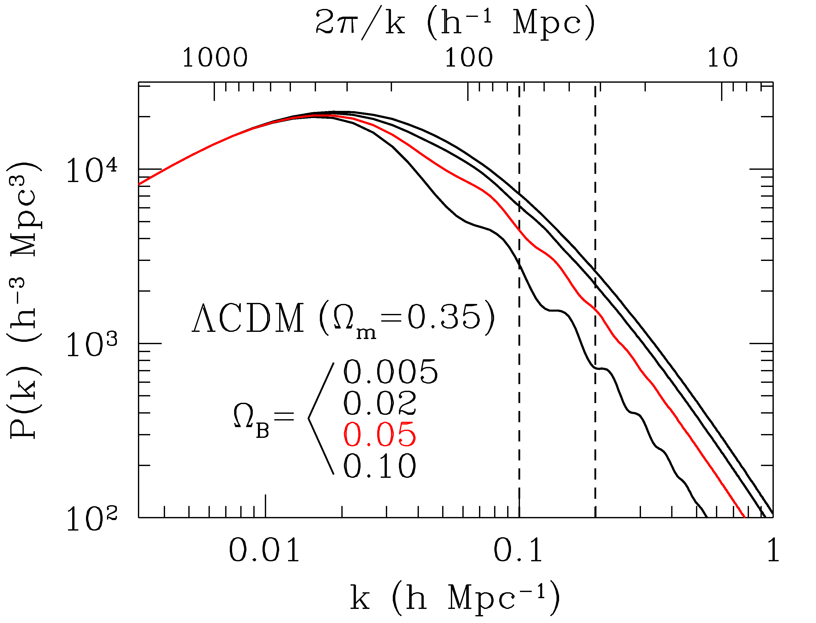
BAO
A robust standard ruler - most systematics free.
Mostly considered in optical/IR surveys.
21cm BAO Internal Review April 26 2010

Slide 3
BAO
In Radio wavelengths?
Very large survey volume easily achievable in a short time
Electronics are cheap and easy to build
Good redshift resolution but poor angular resolution ( arcminutes at best)
21cm BAO Internal Review April 26 2010

Slide 4
BAO
Is 21cm BAO compatible/complimentary to other future surveys?
Feasibility for a ground-based 21cm intensity mapping (Chang et al. 2008, Withe et al. 2008)
=> We consider engineering reality and the effect of angular resolution more seriously.
21cm BAO Internal Review April 26 2010

Slide 5
Outline
Is 21cm BAO compatible/complimentary to other future surveys?
Fiducial CRT telescope
Effect of Angular resolution (Fisher matrix and Monte Carlos)
FoM as a function of CRT telescope parameters
Maximization of FoM
21cm BAO Internal Review April 26 2010

Slide 6
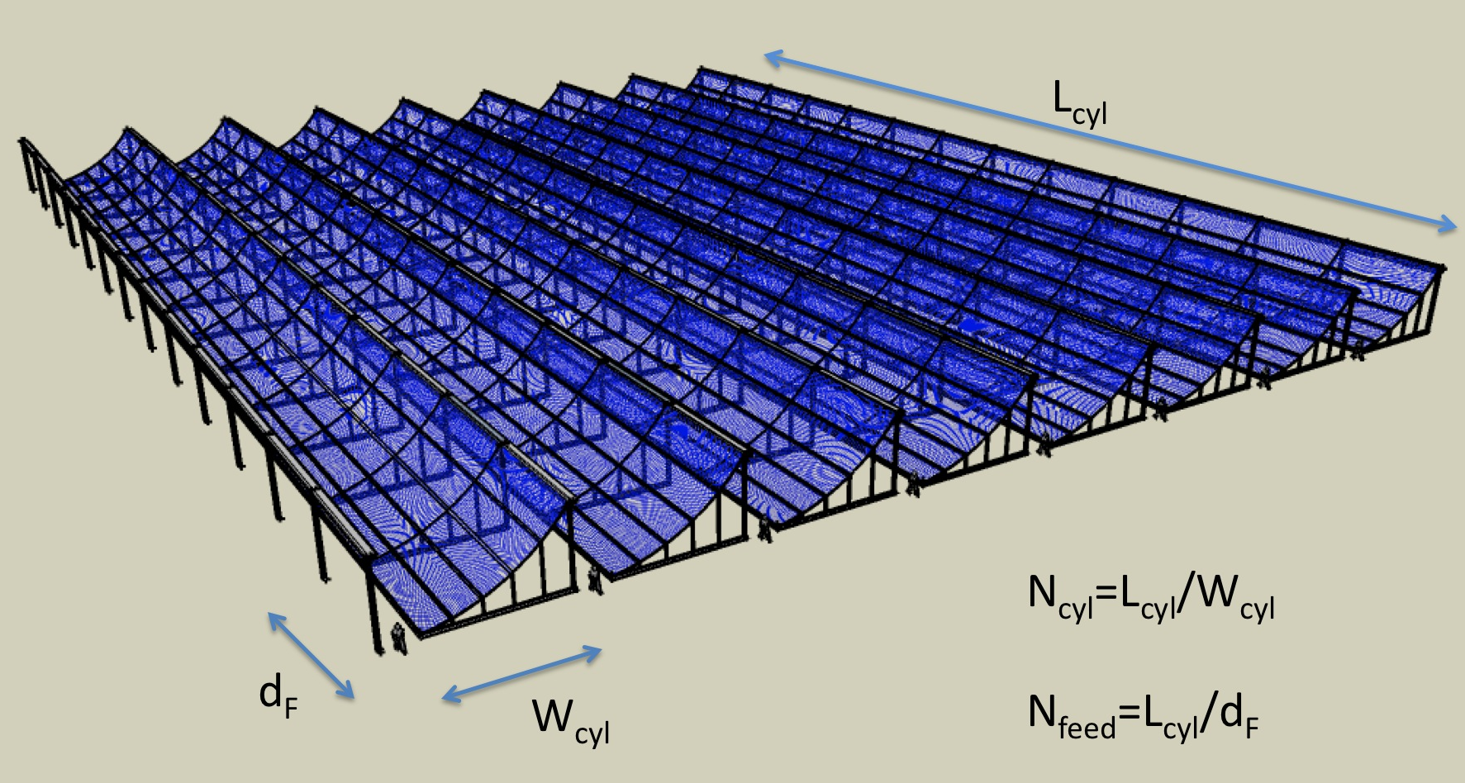
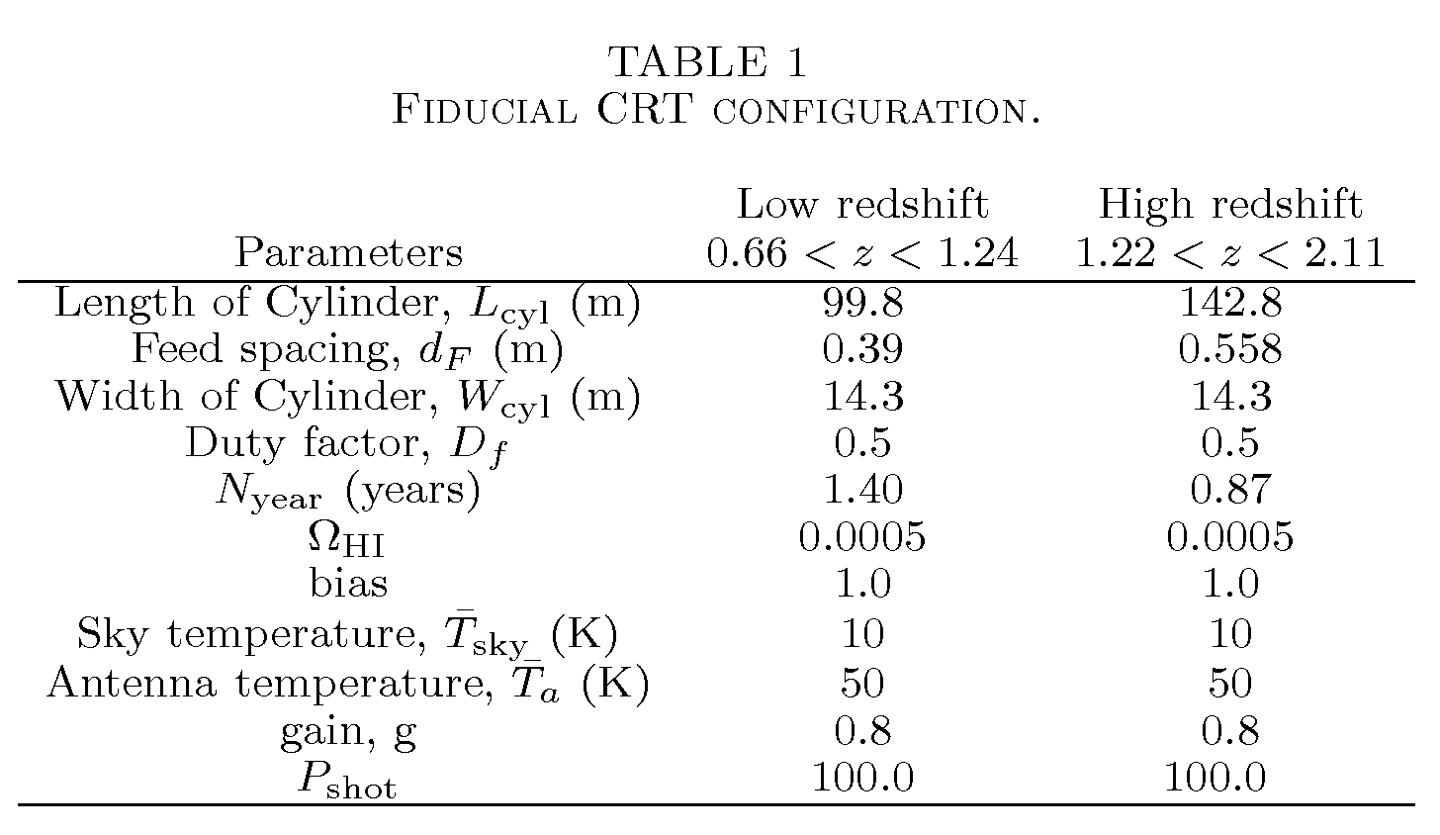
Fiducial CRT Configuration
Assume a packed rectangular CRT array
Δθ=λ/L_{cyl}
A_{survey} = 2πλ/d_{F}
t_{int} = N_{year} D_{f} λ/(2πW_{cyl})
21cm BAO Internal Review April 26 2010

Slide 7
Fiducial CRT Configuration
Power due to the large scale structure of HI
dT/T_{sig}
The total survey volume
Shot noise
21cm BAO Internal Review April 26 2010

Slide 8
Fiducial CRT Configuration
FoM=141 including Stage II
21 without Stage II
Cf) FoM ~ 120 for BOSS BAO (LRG+QSO)
Power due to the large scale structure of HI
dT/T_{sig}
The total survey volume
Shot noise
21cm BAO Internal Review April 26 2010

Slide 9
Effect of an angular resolution
Increases the noise per pixel through V_{R}
Wavenumber cutoff near k_{Nyq}
k_{Z}
k_{Nyq}
k_{Nyq}= π/resolution
k_{DEC}
k_{RA}
Effects on FoM are small for a CRT array with a size of 100-150
meters (i.e., an angular resolution of 10 − 14 arcmin at
z ∼ 1).
21cm BAO Internal Review April 26 2010

Slide 10
Effect of an angular resolution
Increases the noise per mode through V_{R}
Wavenumber cutoff near k_{Nyq}
Monte Carlos
k_{Z}
k_{Nyq}
k_{Nyq}= π/resolution
k_{DEC}
k_{RA}
However, the data are harder to fit reliably with a poor angular resolution – i.e., at z > 1.5 for 100-150m CRT.
21cm BAO Internal Review April 26 2010

Slide 11
FoM as a function of Telescope configuration
Planck + Stage II
Planck
P_{HI}/(P_{N}+P_{shot}) at k=0.2 h Mpc⁻¹
21cm BAO Internal Review April 26 2010

Slide 12
Maximization of FoM
Optimize the CRT telescope configuration while holding the cost fixed. The cost includes, the cost of the digital electronics, the cost of the cylinder feed line, and the cost of the reflector surface.
FoM = 300 can be achieved with $15-20 million according our cost model.
We generated a publicly available optimization tool.
21cm BAO Internal Review April 26 2010

Slide 13
Summary
We tested the feasibility of measuring BAO using a ground-based CRT with an emphasis on the engineering reality and the angular resolution effect.
Angular resolution limits the wavenumber range available for the BAO standard ruler test – for 100-150m CRT telescope, the effect on FoM is small.
On the other hand, the data are harder to fit reliably (z > 1.6 for 100-150m CRT telescope).
We investigated the performance of a telescope as a function of various telescope configuration.
We have optimized the telescope configuration for the maximum FoM – we find that we can achieve FoM~300 for a reasonable cost. We generated a publicly available optimization tool.
21cm BAO Internal Review April 26 2010

