Slide 1

Closing Remarks
2010 Fermilab Users Meeting
Pier Oddone
June 3rd, 2010

Slide 2
We see a great program ahead
Current opportunities: Tevatron, neutrinos, particle astrophysics, LHC
In progress: the energy frontier at LHC, neutrinos and rare decay program at Fermilab, particle astrophysics
Long term: intensity frontier with Project X with potential extensions to a neutrino factory and/or muon collider, possibly ILC

Slide 3
Fermilab in the world
  Three frontiers describe the national and international program in particle physics;
    energy, intensity and cosmic frontiers
  In each Fermilab plays a unique and important role with:
    Current operations and physics accomplishment
    Ongoing construction of new projects
    Long term vision and plans

Slide 4

Energy Frontier: Tevatron
Recent measurement of di-muon asymmetry in DZero

Slide 5
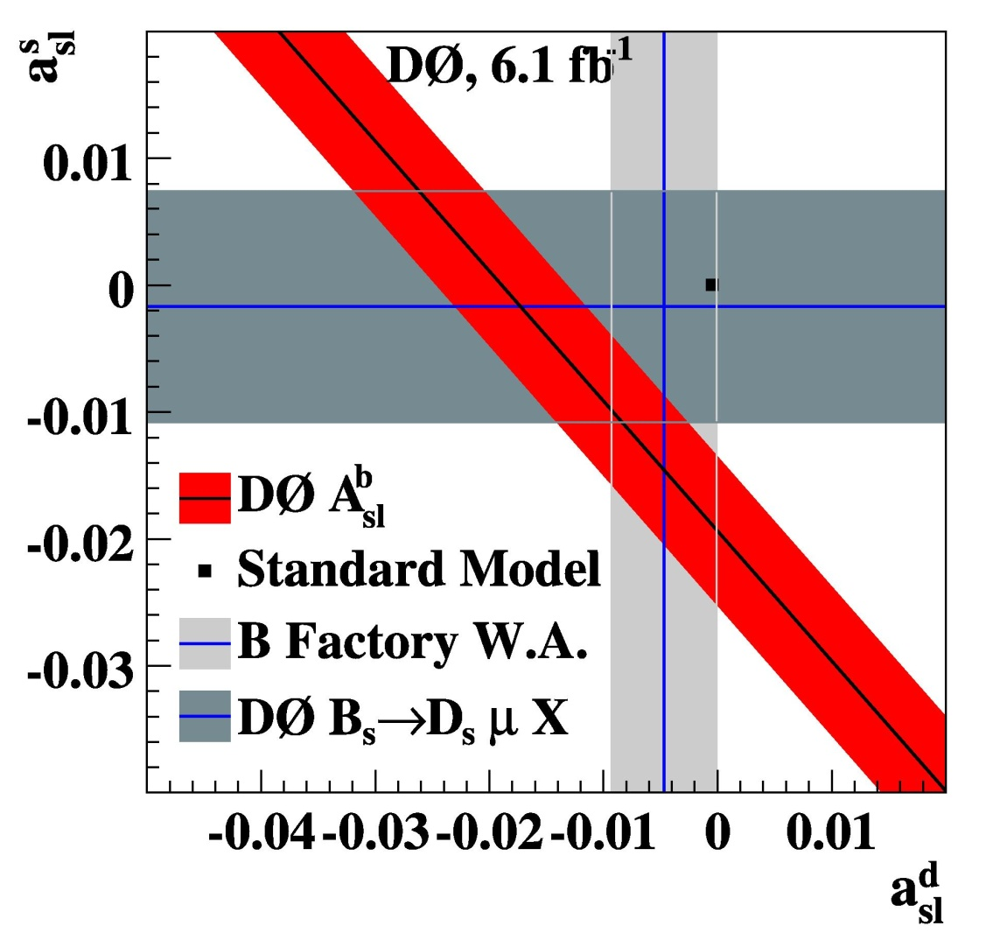
Energy Frontier: Tevatron

Slide 6
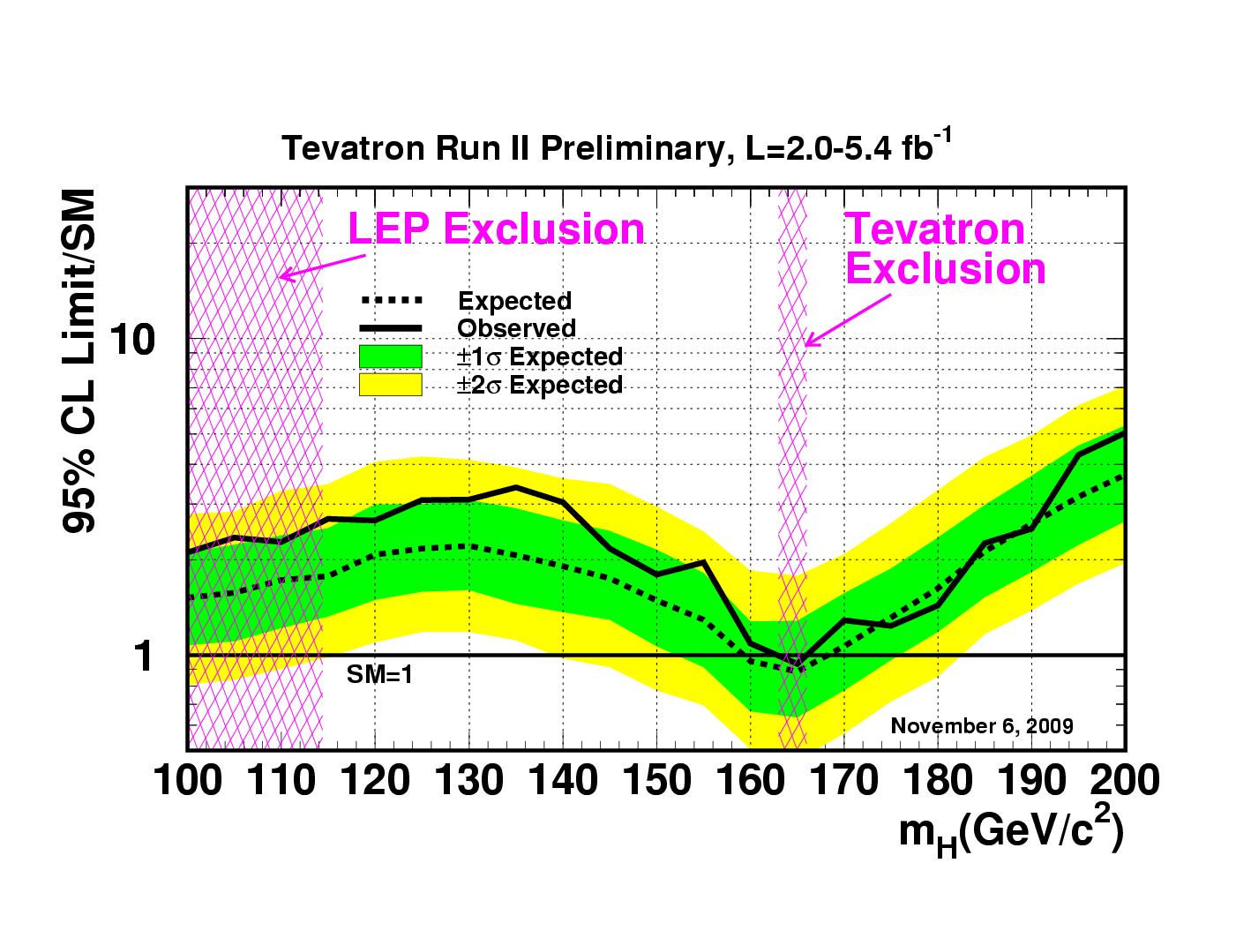
Energy Frontier: Tevatron
Electroweak fits
Predict Higgs Mass Search for Higgs
Tevatron Preliminary (L=2.0 – 5.4 fb⁻¹)
M_{top}: Tevatron
M_{W} : Tevatron+LEP2
80.5
80.4
80.3
100 GeV
200 GeV
M_{W} (GeV)
300 GeV
500 GeV
M_{higgs} =
1000 GeV
150 175 200
M_{top} (GeV)

Slide 7
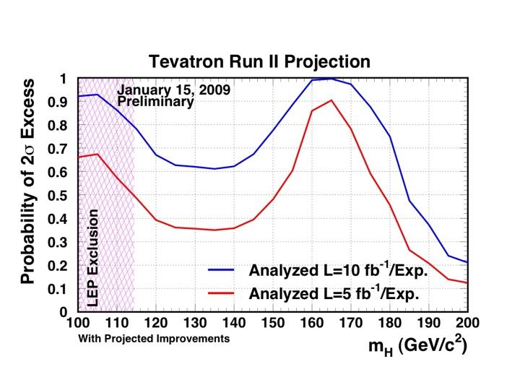
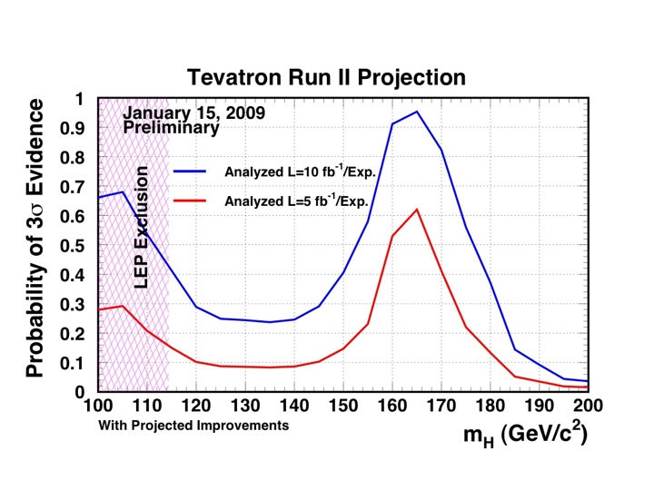
Is there more juice in the Tevatron?
Tevatron graduates 60 PhD per year and produces about a 100 results per year
Major results also in the intensity and cosmic frontiers
Large fraction of the results (40%) at recent conferences come from Fermilab
through FY11
95%CL
exclusion
through FY09
3σ
evidence

Slide 8
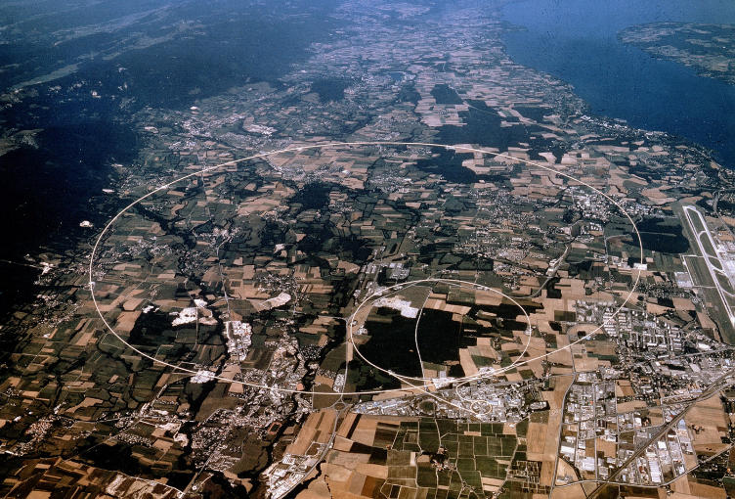
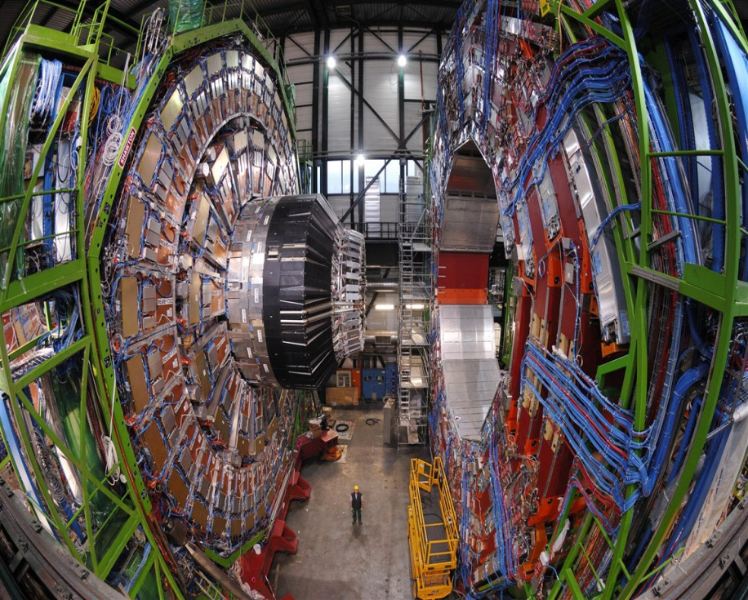
Energy frontier will move to the LHC
Fermilab is the lead US lab on the accelerator and the only US lab in CMS supporting over 50 universities
Play

Slide 9
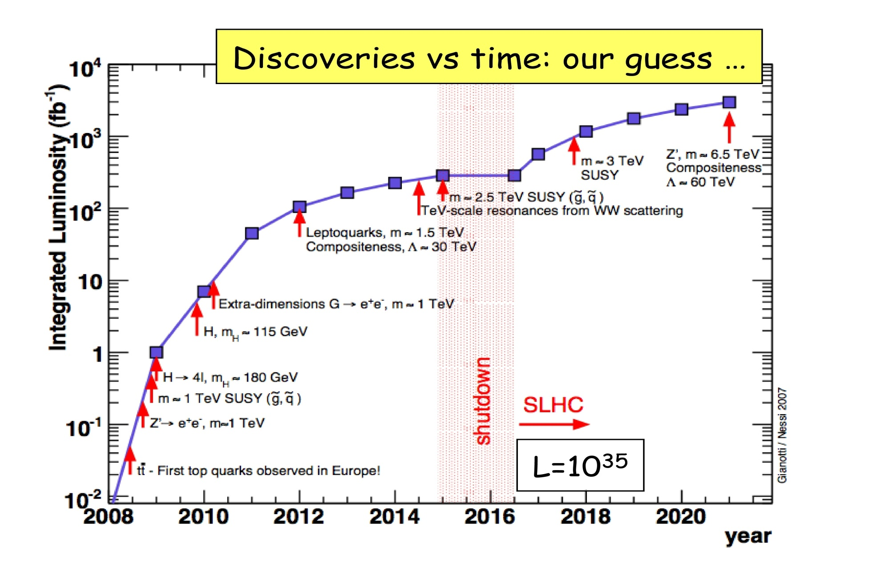
LHC physics reach (3 years ago)
14 TeV
Shifted by >2 years
Courtesy Fabiola Gianotti
[Now displaced by 2+ years]

Slide 10
Biggest decision of the decade !
ILC Enough
By far the easiest!
A Global program
LHC Results
or
CLIC
ILC not enough
or
Muon collider
10
Notes:
10
10

Slide 11
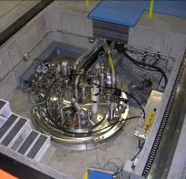
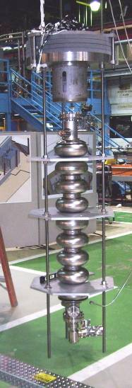
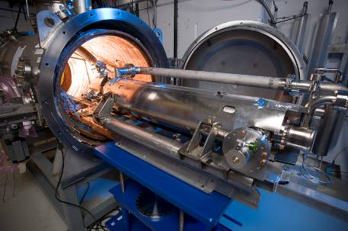
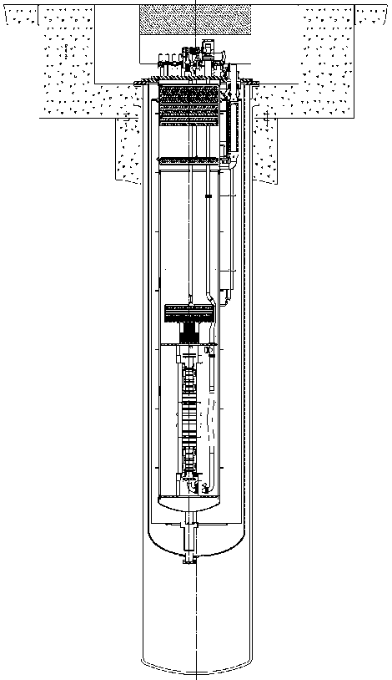
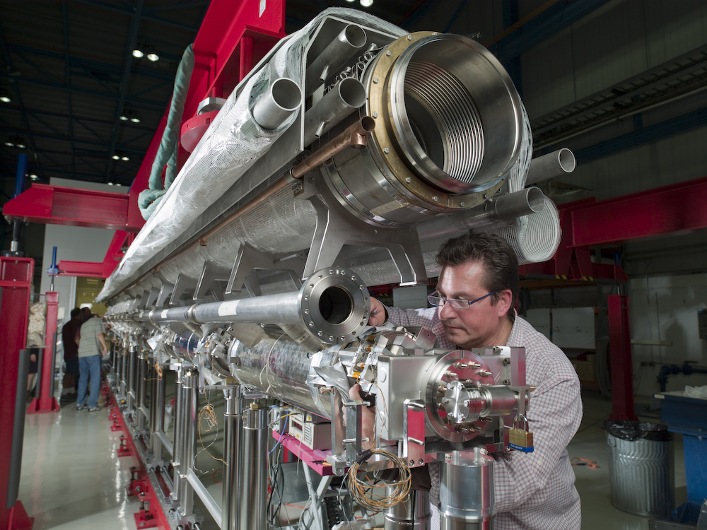
ILC/Project X/XFEL technology
Horizontal Test Stand
1st cryomodule
Vertical Test Stand

Slide 12
If we need higher energies…..
If the energy of the ILC is too small (0.5 TeV or a little higher) we will need another approach: CLIC or muon collider

Slide 13
Muon Collider approach
If the energy of the ILC is too small (0.5 TeV or a little higher) we will need another approach: CLIC or muon collider
Collider based on a secondary beam: we have experience basing colliders on antiprotons. For muons we must do it in 20 msec.
The biggest advantages are: narrow energy spread (no beamstrahlung) and small physical footprint (no synchrotron radiation
DOE OHEP has asked Fermilab to organized the national R&D program

Slide 14
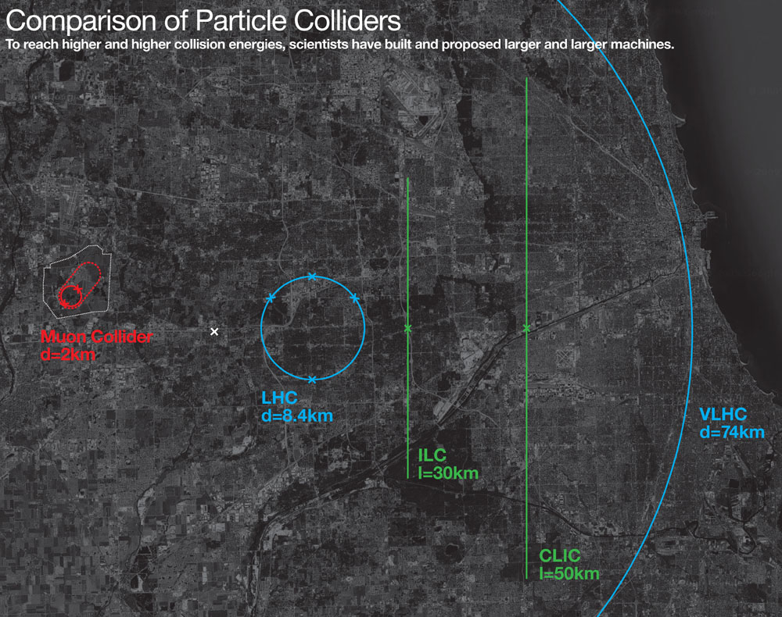

Slide 16
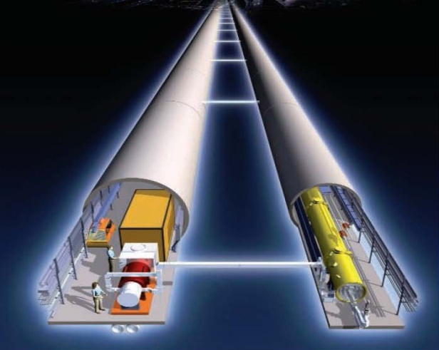
Energy frontier summary
Energy
Tevatron
LHC
LHC
LHC upgrades
LHC
ILC??
LHC
ILC, CLIC or
Muon Collider
Now
2013
2016
2019
2022

Slide 17
Intensity frontier: current
Minos best result on electron appearance
Minos result in middle of June on mixing parameters for anti-neutrinos
MiniBooNE anomalous low energy neutrino cross sections
MiniBooNE anti-neutrino results in the middle of June
Most extensive data set of neutrino interactions in liquid argon TPC with MicroBooNE
MINERvA study of cross sections

Slide 18
Interplay: LHC Intensity Frontier
nothing
Only handle on the
next energy scale
Intensity
Frontier
LHC
Determine/verify
structure of new
physics. Anything
beyond?
Lots

Slide 19
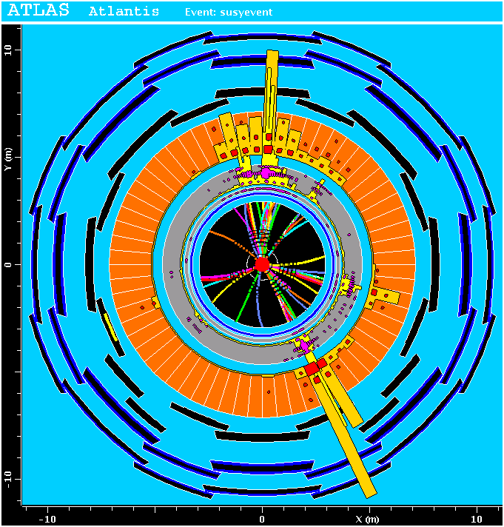
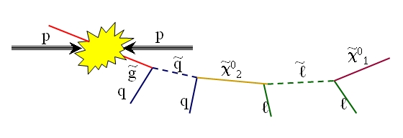
More interplay LHC/Intensity frontier
ATLAS/CMS discovers strongly coupled SUSY
A host of new particles: fit roughly some masses, make assumption on couplings
~
χ⁰₁
Missing E_{T}
dark matter candidate
~
χ⁰₁

Slide 20
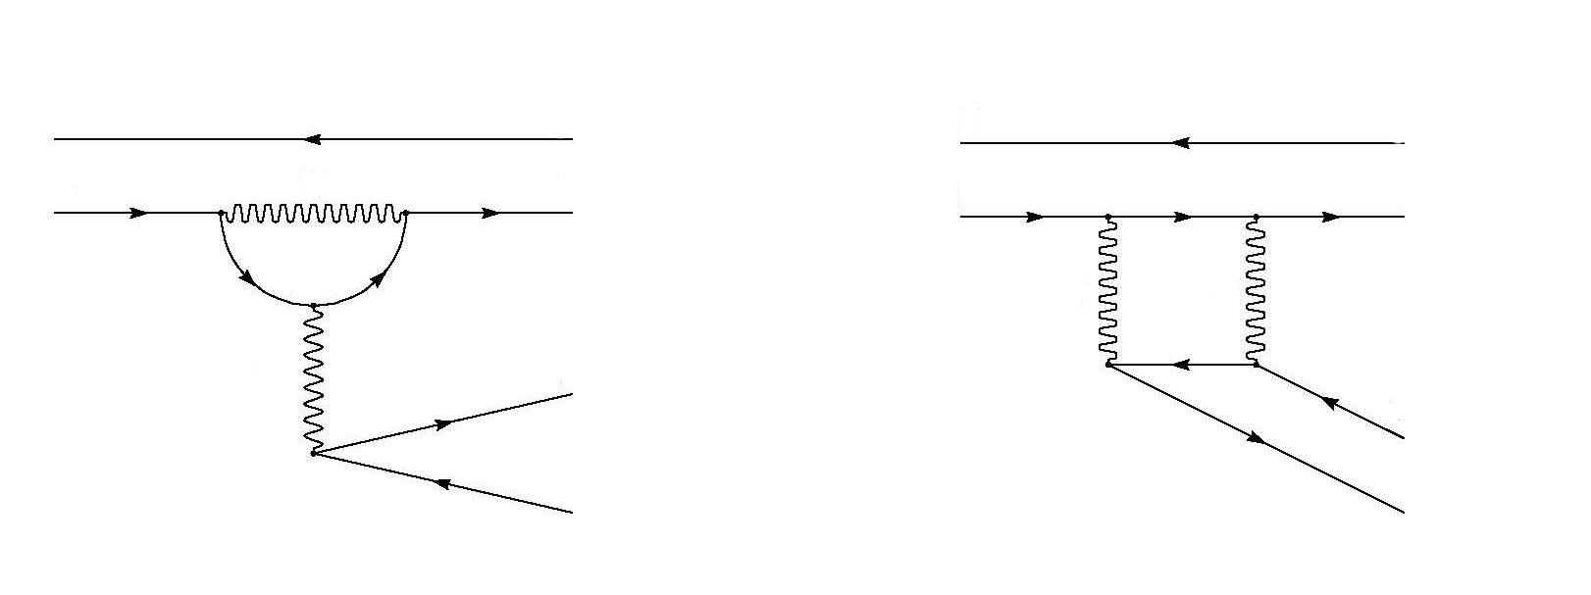
Large effects in kaon decay rates
d
d
d
d
W
s
d
s
quarks
d
quarks
W
W
Z
lepts
ν
ν
ν
SM: Κ_{L} π⁰ ν ν
ν
d
d
d
d
χ
s
d
s
χ
squarks
χ
d
squarks
χ
slepts
ν
ν
ν
BSM: Κ_{L} π⁰ ν ν
ν

Slide 21
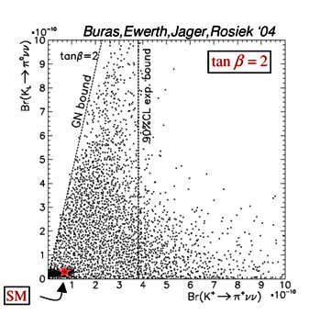
For particular classes of SUSY
Large effect on rare K decay modes highly suppressed with SM particles
Much higher SM backgrounds in B and C decays
(See also Neubert at BF2010)

Slide 22
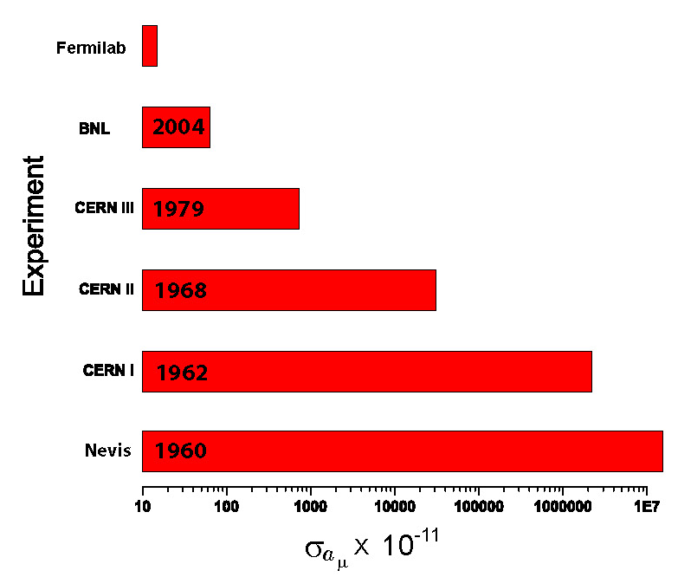
A new (g-2) to error of 0.14*10⁻¹¹
g-2
New Building Design - FESS

Slide 23
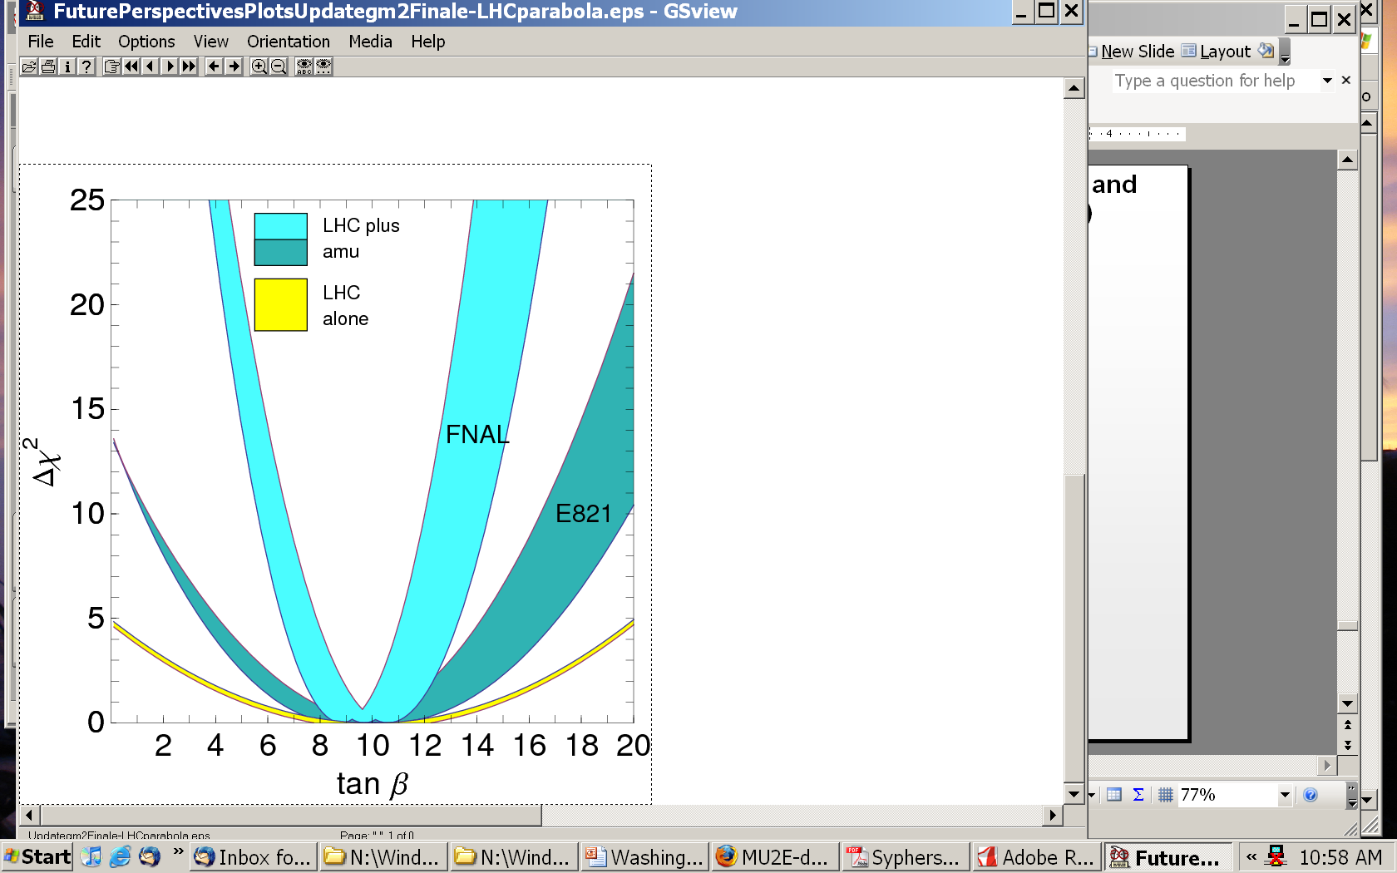
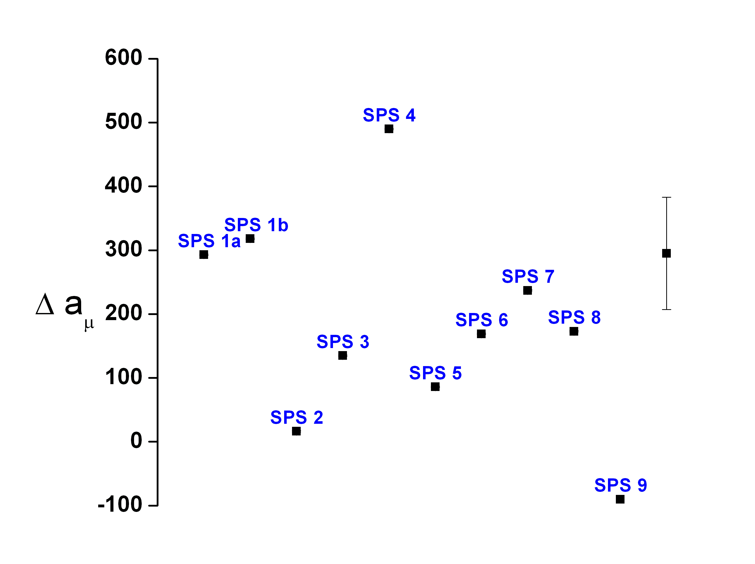
A new (g-2) to 0.14*10⁻¹¹
New g-2
2σ
1σ
LHC
UED
Model

Slide 24
Mu2e can probe 10³ – 10⁴ TeV
New Physics
Scale (TeV)
with Project X
pre-Project X
MEG Experiment
SUSY
Compositeness
Model Parameter
24

Slide 25
Intensity is key for neutrinos
Only weak interactions: very small cross sections >> hard to study
Need large flux of particles and massive detectors
Complementary to LHC: measure neutrino parameters (new symmetries?), neutrino masses, matter-antimatter symmetry violation and surprises.
This route like the energy path depends of what we find in the current generation of experiments

Slide 26
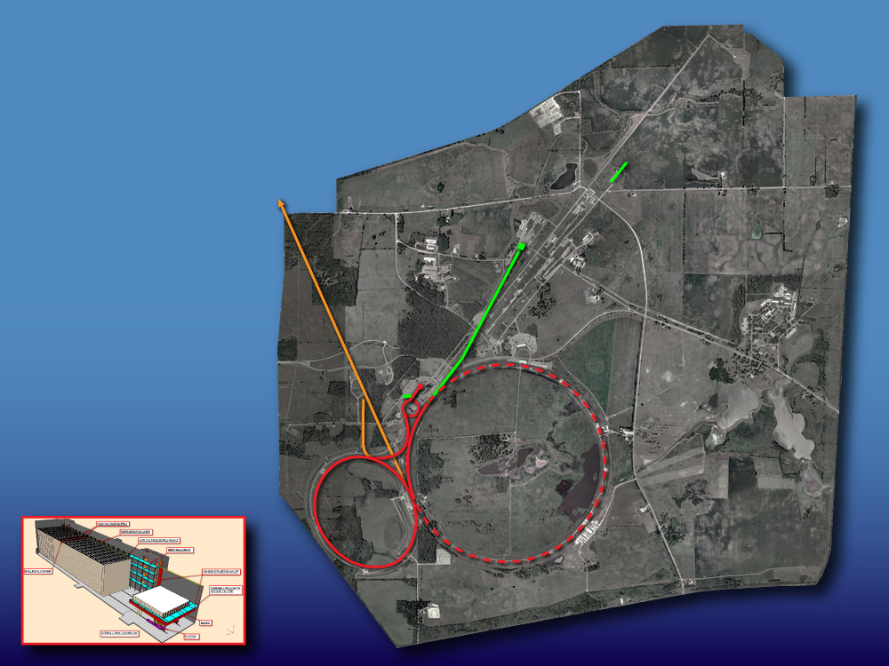
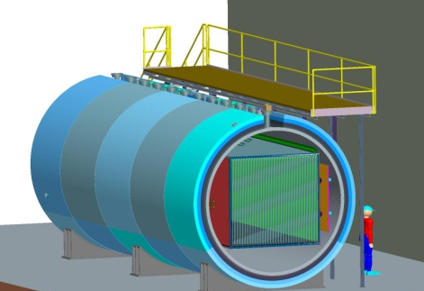
Neutrinos
NOvA (off-axis): θ₁₃, mass ordering, ….
MINERvA
MicroBooNE (LAr TPC)
Neutrinos
since 2013:
NOvA, MINERvA
MicroBooNE
810 km
700 kW
MicroBooNE
NOvA

Slide 27
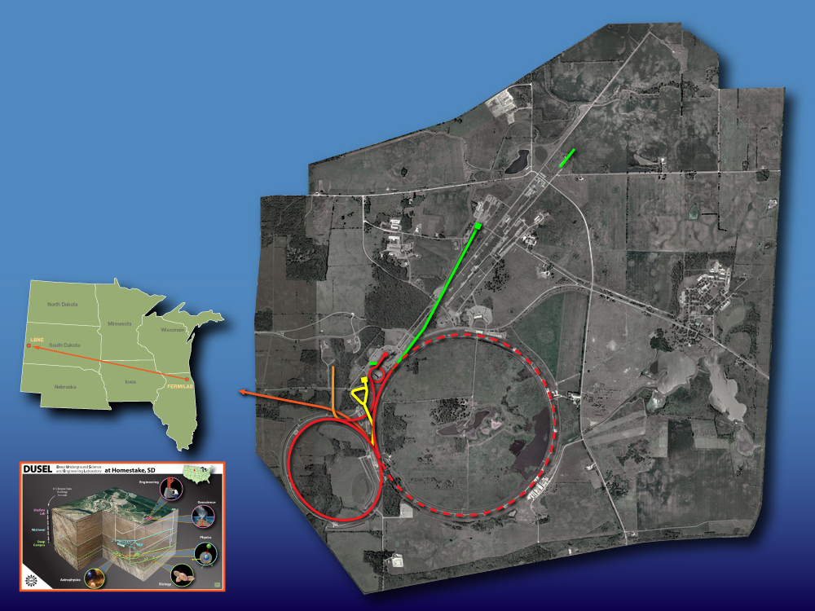
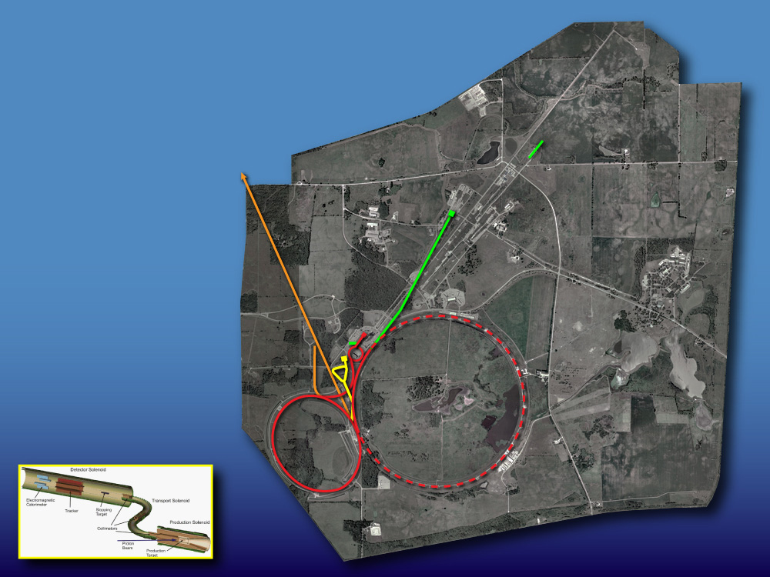
Neutrinos
LBNE: FNAL→DUSEL (+proton decay)
(DOE 1st stage approval)
Neutrinos
LBNE(to DUSEL)
Muons
Mu2e
Neutrinos
to
DUSEL
Muons
Mu2e (DOE 1st stage approval)
Muon g-2/EDM (to be reviewed by DOE)
700 kW
1300 km
Kaons
K⁺ → π⁺νν
(proposed, but …)

Slide 28
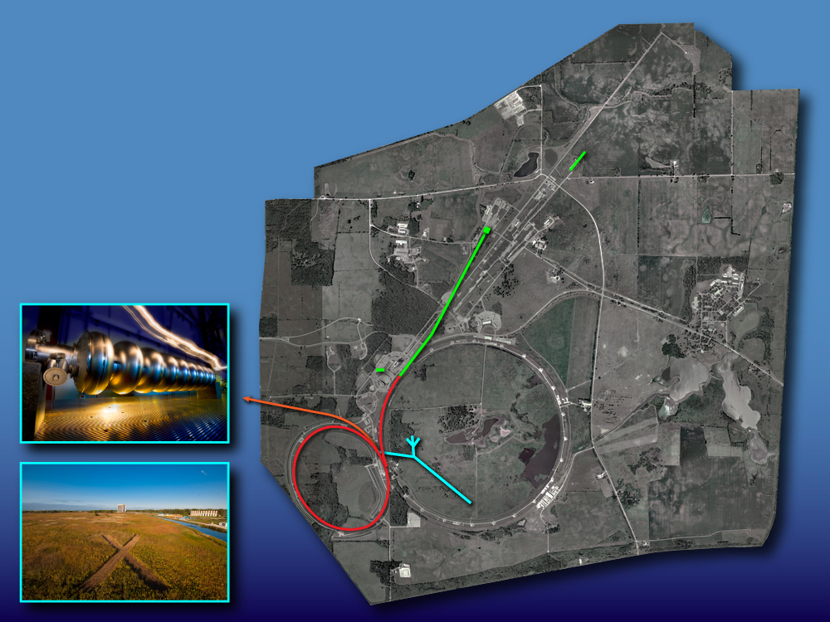
Remove
Accelerators from Cockroft-Walton
though Booster and Booster neutrino.
All the green ones
including MuCOOL stay
Project X
Neutrino physics
Muon physics
Kaon physics
Nuclear physics
Project X
Neutrino physics
Muon physics
Kaon physics
Nuclear physics
Project X
Neutrinos
Muons
Kaons
Nuclei
“simultaneously”
2 MW (60-120 GeV)
1300 km
2 MW at ~3 GeV
flexible time structure
and pulse intensities

Slide 29
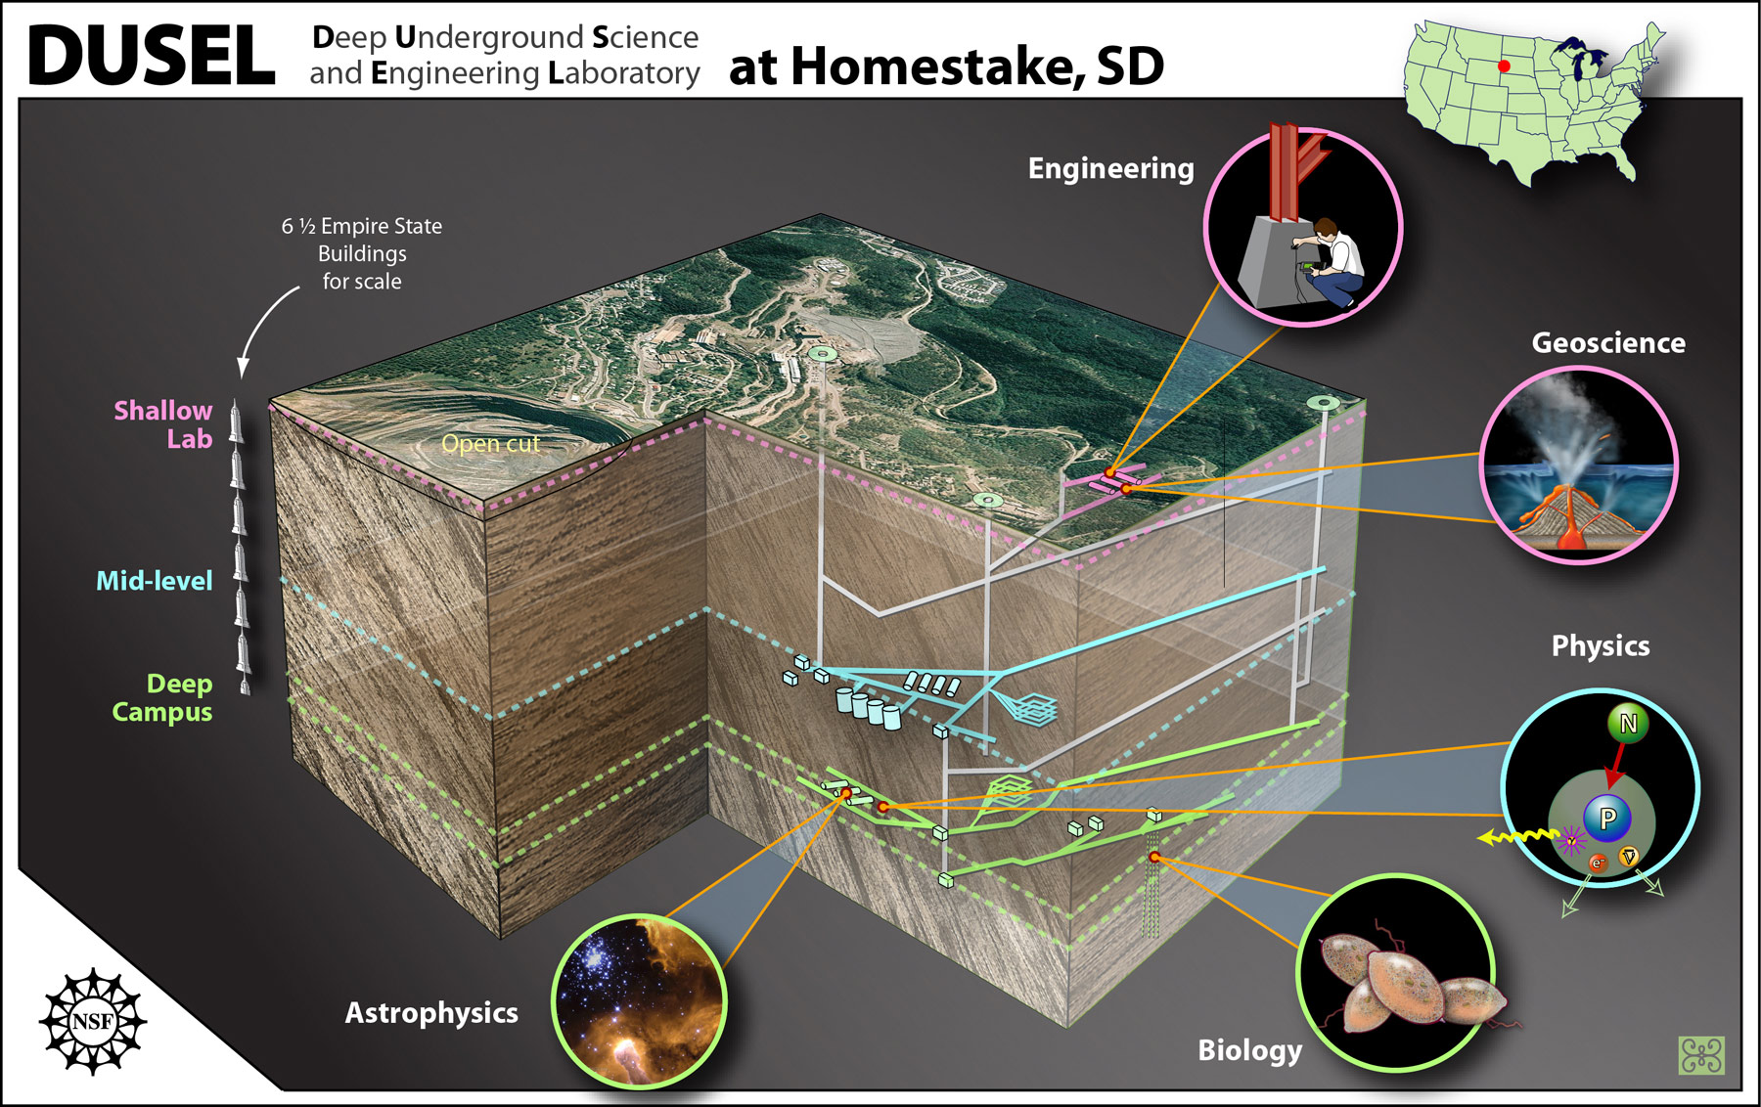
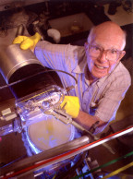
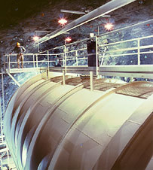
Ray Davis’s Experiment

Slide 30
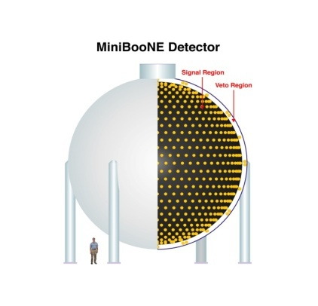
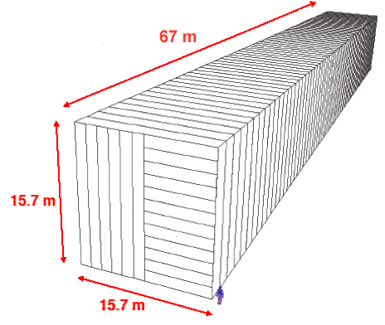
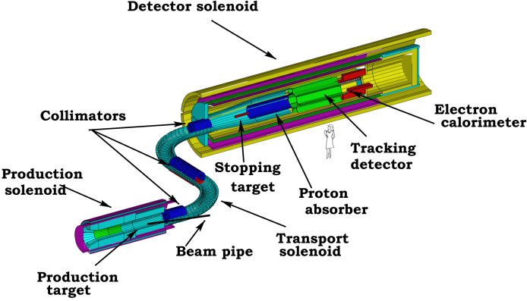
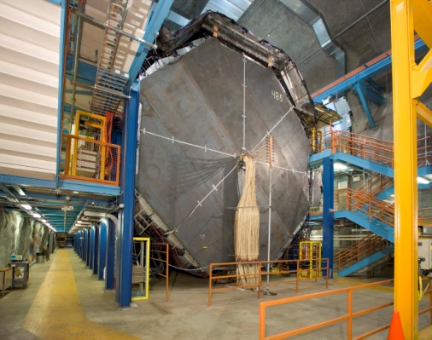
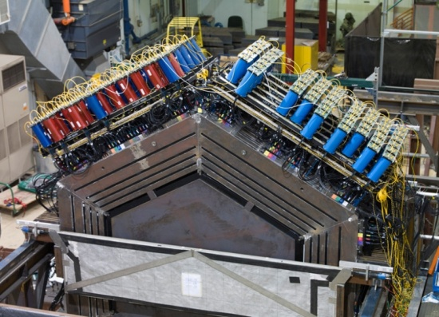
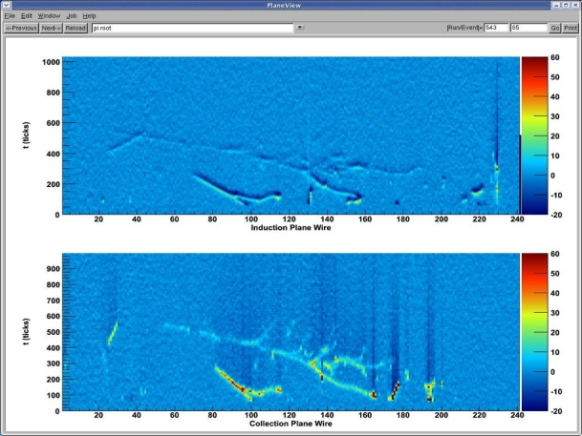
Intensity Frontier Summary
NOvA
MicroBooNE
MINERvA
g-2 ?
Minos
MiniBooNE
MINERvA
LBNE
Mu2e
Project X+LBNE
Mu2e
ν Factory ??
Intensity
Now
2013
2016
2019
2022

Slide 31
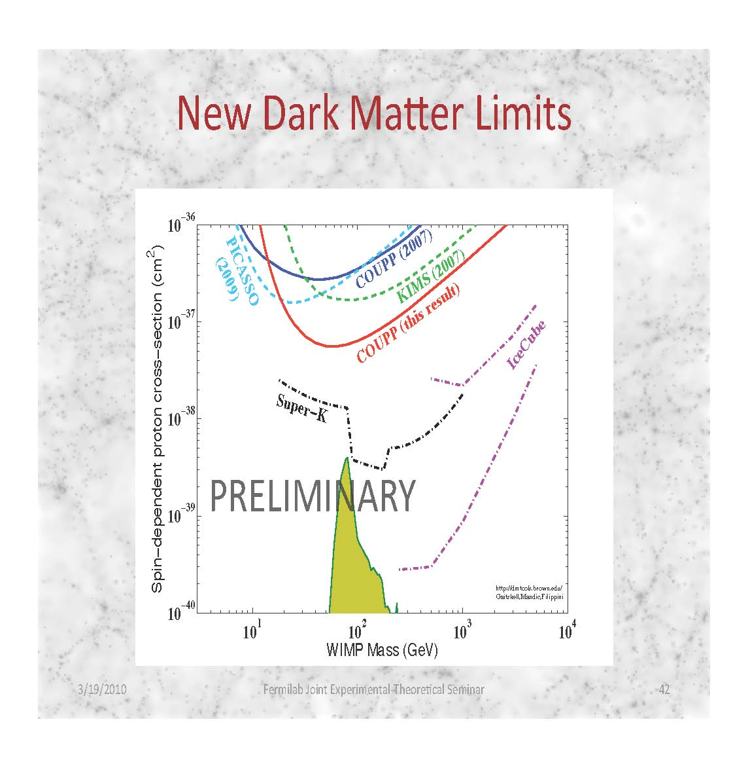
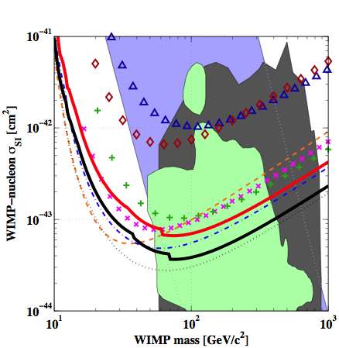
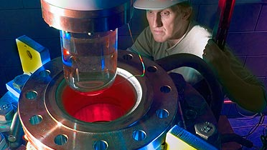
Cosmic Frontier: current results
COUPP (2010)
CDMS
COUPP

Slide 32
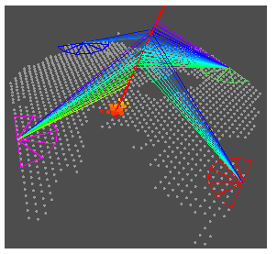
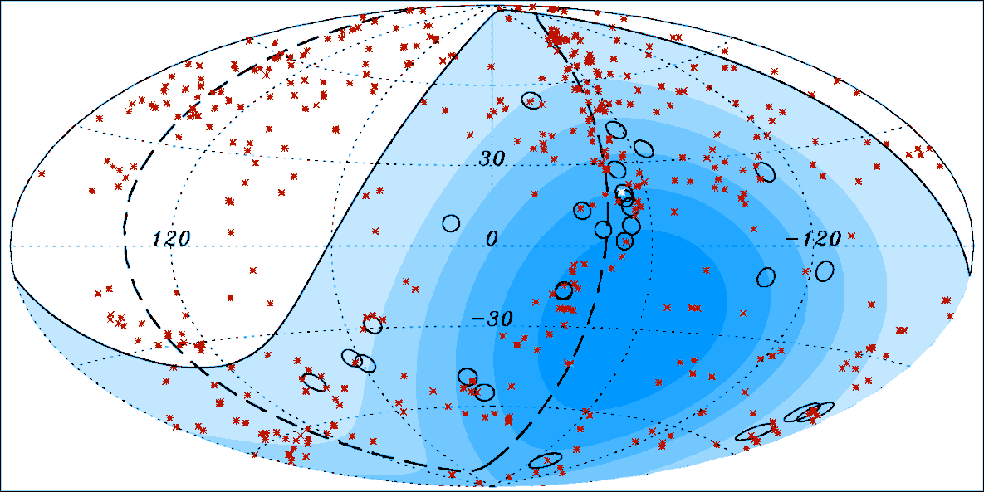
Present results: UHE Cosmic Rays
Auger Observatory
studies ultra-high energy cosmic rays.
o – Cosmic rays with
E > 57,000,000 TeV
x – Active Galactic Nuclei
Correlation

Slide 33
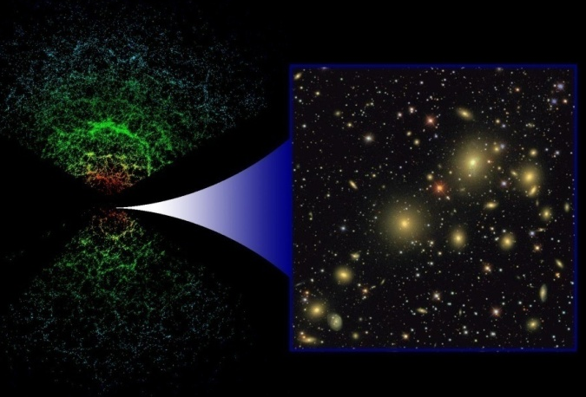
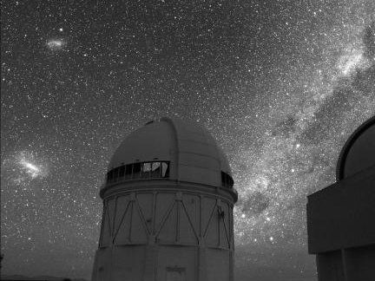
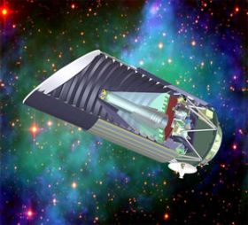
SDSS (Sloan Digital Sky Survey)
  2.5 meter telescope in New Mexico
  Ranks as the facility with the highest impact in astronomy for the 3rd year in a row.
  Power spectrum of galaxies constrain dark energy density parameter.
DES (Dark Energy Survey)
  4 meter telescope in Chile
  DES Camera under construction
  Operation: 2011 – 2016
JDEM (Joint Dark Energy Mission)
  Space telescope
  Fermilab Goal: Science Operation Center
SDSS
DES
JDEM
Notes:
Spectra of thousands of Supernovae
Map the Universe out to even higher redshift
Weak Lensing from space

Slide 34
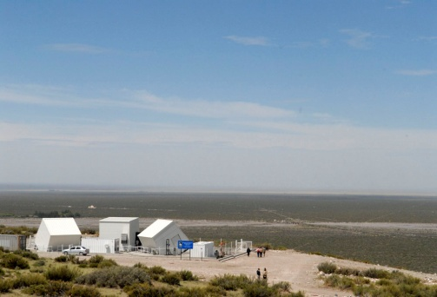
Cosmic Frontier Summary
JDEM
DM searches
Holometer?
P Auger
DM Searches
SDSS
P Auger North?
DM: scalable?
DES
JDEM
Cosmic
Now
2013
2016
2019
2022

Slide 35
Thanks to all of you who have made this meeting a success!

