Slide 1
Perspectives from the
Office of High Energy Physics
Fermilab User’s Meeting
June 2-3, 2010
Batavia, Illinois
Dennis Kovar
Associate Director of the Office of Science
for High Energy Physics

Slide 2
DOE Office of Science (SC)
Office of High Energy Physics (OHEP)
DOE SC OHEP Program is the U.S. Federal Steward of HEP research
providing over 90 % of federal support to
  design, construct and operate the research facilities
  support researchers at universities and laboratories
  develop the advanced technologies and next generation scientific/technical workforce
The Scientific community identifies the scientific opportunities and their priorities
defines the scientific field and future direction
  DOE/NSF chartered High Energy Physics Advisory Panel (HEPAP) Reports
  Other scientific reports (National Academy, AAAC, OECD GSF, etc.)
  Facility PACs, DOE Reviews, etc.
OHEP Mission is to maintain the Nation’s competency/leadership in HEP research
with responsibilities to
  establish a strategic plan that address the identified scientific opportunities
  formulate, justify and defend Budget Requests to implement that plan
  effectively manage the funding obtained to deliver significant outcomes

Slide 3
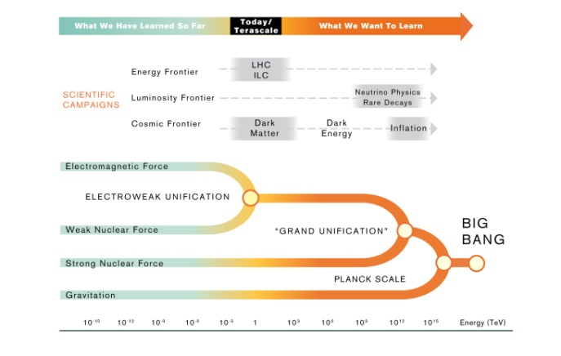
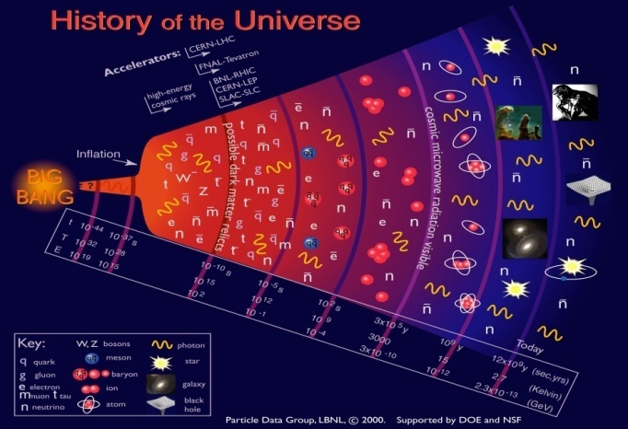
High Energy Physics Today:
The Three Scientific Frontiers
The Energy Frontier, powerful accelerators create new particles, reveal their interactions, and investigate fundamental forces;
  New particles (Higgs, SUSY)
  Extra Dimensions
The Intensity Frontier, intense particle beams and highly sensitive detectors pursue alternate pathways to investigate fundamental forces and particle interactions by studying events that occur rarely in nature
  Neutrino properties
  Matter-Antimatter Asymmetry
  Unification of Forces
The Cosmic Frontier, ground and space-based experiments and telescopes make measurements that will offer new insight and information about the nature of dark matter and dark energy, to understand fundamental particle properties and discover new phenomena
  Dark Energy →new forces ?
  Dark Matter →new particles ?
E = mc²

Slide 4
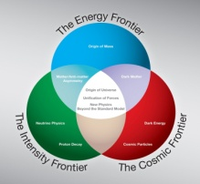
Strategic Plan
Positioning the U.S.
Program Elements Goals 10-year Plan (discoveries/answers to questions)
Energy Frontier Physics New particles (Higgs, SUSY) Complete the Tevatron Program. Extra dimensions Partner with CERN to make discoveries and realize the benefits of investments at the LHC
Intensity Frontier Physics Neutrino properties Implement and carry out a U.S. Matter- antimatter asymmetry world-leading Intensity Frontier Unification of Forces program based at Fermilab and in partnership with NSF
Cosmic Frontier Physics Dark Energy Implement compelling particle Dark Matter astrophysics opportunities for discovery in partnership with other
agencies as appropriate
Advanced Technology R&D Position the U.S. to be at the Maintain and nurture core forefront of accelerator and competencies, encourage technology instrumentation technology transfer, and mount campaigns to make technological breakthroughs that enable HEP and DOE/SC programs

Slide 5
Strategic Plan
Developing Scientific Tools
Tools Today Possible Future Tools
Tevatron
LHC (hadron) LHC upgrades
LHC Detectors LHC Detectors upgrades
(lepton) TeV Lepton Collider
LQCD & SciDAC LQCD & SciDAC
Fermilab/NuMi NuMi (700kW)→ Project X (2000 kW)
MINOS, Minerva NOvA → LBNE
Mu2e
EXO Double Beta Decay
Daya Bay
LQCD & SciDAC LQCD & SciDAC
BOSS ( Dark Energy ) DES, LSST
Supernova Searches ( Dark Energy ) JDEM
CDMS, ADMX ( Dark Matter ) SuperCDMS-Soudan
COUPP-60 ( Dark Matter ) LUX, Large DM experiment
Fermi (GLAST) ( Gammas )
VERITAS ( Gammas ) HAWC, VERITAS-upgrade. AGIS
Pierre Auger South ( Cosmic Rays ) AMS, Pierre Auger – North
SciDAC SciDAC
Energy Frontier
highest energy particle beams
fundamental constituents and architecture of nature
Intensity Frontier
intense particle beams
and highly sensitive detectors
unique investigations of fundamental interactions.
Cosmic Frontier
using particles from space
to explore new phenomena
and nature of dark matter and dark energy

Slide 6
HEP FY2010 Funding
Budget Categories
Research Funding
Program Funding

Slide 7
HEP Budget Overview
HEP FY 2011 Budget Request
FY 2011 Request is a +2.3% increase compared to FY 2010 Appropriation
FY 2010 Appropriations were a +1.9% increase over FY 2009 Appropriations
** The Recovery Act Current Appropriation column reflects the allocation of funding as of September 30, 2009.
Total includes SBIR/STTR: $17,730,000 of which was transferred to the Small Business Innovation Research (SBIR)
program and $2,128,000 of which was transferred to the Small Business Technology Transfer (STTR) program.
7

Slide 8
FY 2011 Program
Highlights
Energy Frontier
Tevatron operates in FY 2011 (possibility of discovery or ruling out over a significant fraction of the allowed mass region for the Higgs boson in the Standard Model at the 95% confidence level).
U.S. LHC program supported (at a level that will allow U.S. researchers to play a leading role in extracting physics from the data obtained and in planned upgrades).
Intensity Frontier
On-going MIE projects (NOvA and Daya Bay) are supported on planned schedules
First investments (MicroBooNE, Mu2e and LBNE) made for next generation U.S. leadership program
Cosmic Frontier
Support ongoing programs (e.g.; Fermi, AMS, VERITAS, Pierre Auger, BOSS, CDMS-II, COUPP, LUX, ADMX)
On-going MIE projects (DES, SuperCDMS-Soudan) are supported on planned schedules
R&D for possible future experiments (guidance from HEPAP (PASAG) and ASTRO2010)
Core Research
EPP Research supported at a level that will maintain scientific workforce and the ability to be productive
Advanced Technology R&D supports high risk, high impact initiatives, development of infrastructure (e.g.; BELLA and FACET) and core competencies important for the U.S.
8

Slide 9
FY 2011 Budget Request
Breakout of Funding
Facility Operations are constant
Core Research and Projects maintained (grow somewhat)
9

Slide 10
FY 2011 Budget Request
Projects
Ramping
up
10

Slide 11
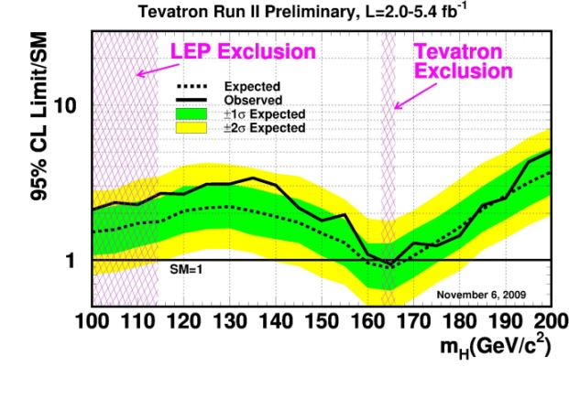
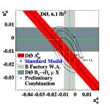
Energy Frontier:
Recent Activities & Plans
Tevatron
Operate Tevatron in FY 2011
Higgs: expand exclusion region or first hints
Surprises welcome!
LHC Program
  Colliding and recording data at 7 TeV!
  CERN is in the process of defining its mid-term plan for the LHC program
    U.S. is planning to participate in the LHC program
    Participation includes detector / accelerator upgrades
    Present US-CERN MOU lasts until 2017
    CERN activities and plans for LHC are driving discussions of global projects
Next generation Lepton Collider
  Decision awaits results from LHC & commitments of interested participants
    Envisioned to happen ~ FY 2012 – now expected to happen somewhat later
    Working with ART to define a US ILC R&D FY2012–2015 program
  Working to establish a five year national muon accelerator R&D plan
    Fermilab has been charged to organize this national effort
  Investments in Plasma Wakefield Acceleration Demonstration Projects
    Recovery Act funding used to proceed on BELLA and FACET projects
11

Slide 12
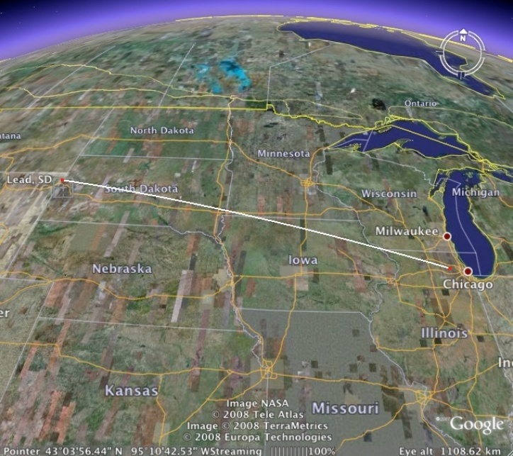
Intensity Frontier Implementation of a World-class Neutrino Program
NOvA
(off-axis)
MINOS (on-axis
NSF’s proposed
Underground Lab.
DUSEL
735 km
1300 km
MiniBooNE
MicroBooNE
MINERvA

Slide 13
U.S. Intensity Frontier Program:
The Neutrino Program
Envisioned “world-class” intensity frontier program entails evolution of the Fermilab accelerator complex
  MINOS/Minerva → NOvA (700kW) → LBNE (700kW) → SLBNE (2000 kW)
  Accelerator infrastructure allow: SLBNE → neutrino factory → muon collider (regain the Energy Frontier)
Envisioned “world-class” intensity frontier program also entails development of an underground detector
  LBNE need a large underground detector (~100-300 ktons)
  A large detector (~300 kton) at the right depth (~5000 ft) detector can also do proton decay
  Physics goals: searches for CP violation and proton decay at factors of 10-100 greater sensitivity
Goals are ambitious and will take significant combined (DOE, NSF, other countries) resources
  NSF is proposing a Deep Underground Science and Engineering Laboratory (DUSEL)
  Europeans have a large underground detector in their strategic planning
  Japanese are also interested in the science
  Indian government has expressed an interest in participation.
DOE and NSF have had discussion with OMB and OSTP on how to coordinate planning
  NSF is supporting the preliminary design of the DUSEL facility and a suite of experiments
  DOE HEP has CD-0 approval for the LBNE (neutrino beam /near and far (large underground) detectors)
    Working towards CD-1 approval in FY11.
  DOE and NSF are working together to coordinate their efforts, avoid duplication, and optimize their investments.
    Holding frequent Joint Oversight Group meetings.
  DOE Undersecretary Koonin and NSF Director Bement submitted joint statement indicating support

Slide 14
Intensity Frontier:
Other Scientific Opportunities
Muon to electron conversion experiment (Mu2E)
  Has received Mission Need (CD-0)
  Broadens Intensity Frontier Program
  Significant funding requested in FY 2011.
Other Opportunities
OHEP has received a report from SLAC on possible US options in SuperB (Italy)
    Provision of reusable PEP-II and BABAR components
    i + additional funding for US participation in detector program
    ii + additional funding for US participation in accelerator program
OHEP expects to get a proposal for participation in Belle-II at SuperKEKB (Japan)
  Participation in detector subsystems
OHEP expects to get a proposal for implementing g-2 experiment at Fermilab
  Utilizes existing Fermilab infrastructure and planned upgrades
  Utilizes BNL D&D
OHEP will conduct peer-reviews of these scientific opportunities
14

Slide 15
Cosmic Frontier:
Guidance from HEPAP (PASAG) Report
  Optimized program over the next 10 years in 4 funding scenarios:
  Similar to P5 funding Scenarios
Prioritization Criteria for Particle Astrophysics
  Science addressed by the project necessary (significant step towards HEP goals)
  Particle physicist participation necessary (significant value added/feasibility)
  Scale matters (particularly at boundary between particle physics and astrophysics)
Priorities are generally aligned with recommendations for Cosmic Frontier in the 2008 HEPAP (P5) Report
  Dark matter & dark energy both remain high priorities
Guidance:
  Dark energy funding (recommended for largest budget portion) should not significantly compromise US leadership in dark matter, where a discovery could be imminent
  Dark energy and dark matter together should not completely zero out other important activities
  HEP (along with NASA and NSF) awaits Astro2010 Report before decisions on proposed major projects (AGIS, Auger-North, BigBOSS, JDEM, LSST).
15

Slide 16
Non-Accelerator Physics:
Recent Activities and Plans
DOE and NASA continue to work to identify the path forward on a Joint Dark Energy Mission
  Two concepts (IDECS and OMEGA) presented to Astro2010 in June 2009.
  Costs are not compatible with current budget projections
  Project Offices (GSFC and LBNL) developing a $650M-capped mission concept
  Advice being provided by the Interim Science Working Group (since December 2009)
  European Space Agency (ESA)has interest in a partnership on their proposed DE mission
  NASA and ESA are studying a partnership
  DOE and NSF charged HEPAP to assess opportunities in particle astrophysics
  HEPAP [Particle Astrophysics Scientific Assessment Group (PASAG)] Report submitted in 2009
  Guidance is being utilized in DOE SC HEP planning
Looking for guidance from Astro2010 - the findings and recommendations:
  Will influence the opportunities for HEP participation
  Will inform OHEP on scientific/technical aspects of particle astrophysics
  (e.g.; optimum dark energy strategy with available resources)
OECD Global Science Forum Astroparticle Physics Working Group
  Global coordination and planning of astroparticle physics experiments
  Study report will be completed in Oct. 2010
16

Slide 17
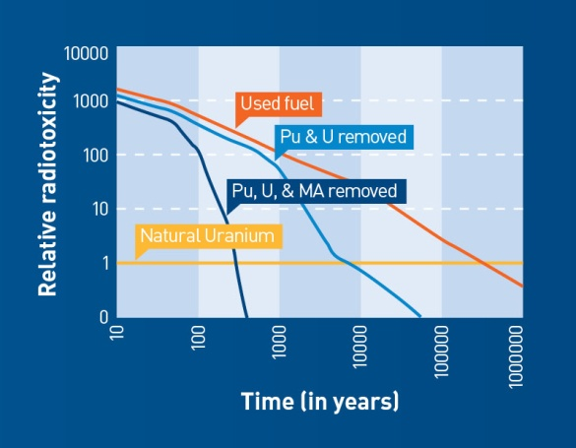
Accelerators for America’s Future Symposium
The HEP sponsored Symposium and Workshop in 2009:
  Opportunities for better connection between fundamental accelerator R&D and applications
  Guidance on the needs of federal programs and the private sector
The Workshop Report will be use in developing plans for Accelerator Science/R&D programs.
    Thanks to Workshop co-chairs (Walter Henning and Charles Shank) and participants
    Thanks to the chief editors – Judy Jackson and Walter Henning.
HEP is considering new initiatives (workshops, R&D centers) based on identified accelerator opportunities , research priorities, and policy issues.
A few opportunities:
  Accelerator Driven Systems
  Treatment of flue gases, waste, and water
  Isotope generation and heavy ion therapy
  Environmentally friendly industrial use
  Defense, cargo interrogation, and monitoring
  Next generation discovery science machines
Some policy issues
  Demonstration facilities
  Improved interagency, agency- industry communication
  Strengthened educational programs

Slide 18
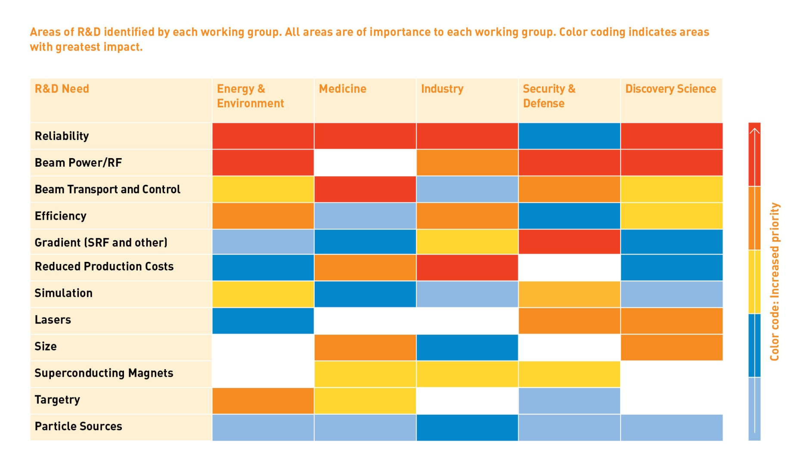
Research Opportunities

Slide 19
Other Program Activities
HEPAP/Advisory
HEPAP Committee of Visitors (COV) to examine/evaluate operations of the DOE SC OHEP
Office of HEP
Two recent appointments
  Fred Borcherding – Program Manager for Instrumentation
  Michael Salamon – Program Manager for Non-Accelerator Physics
Office significantly strengthened by for IPAs & Detailees (a number of appointments ending in FY2010 and FY2011)
Federal Vacancies
Computational HEP Program Manager
Theoretical Physics Program Manager
Accelerator Science Program Manager
Early Career Awards
Funding of $16M provided in FY 2009 ARRA (4 laboratory & 10 university 5-year awards)
Coordinated/managed at Office of Science (SC) level
Steady state funding of ~$16M will be established for such awards in out-years
19

Slide 20
HEP Early Career Program
Supersedes HEP Outstanding Junior Investigator (OJI) program
Breakdown of proposals:
Three HEP panels met in early December:
  Laboratory Experiment
  University Experiment
  Theory
Statistics:
  Theory: Six awards (49 proposals) spanning research frontiers ,mostly focused on LHC physics
  Experiment: Eight awards (105 proposals); Three Energy Frontier; Three Intensity Frontier; Two Cosmic Frontier; One Accelerator R&D
  Gender: Three women; Eleven men
  Geography: Six East; Four Midwest; Four West
  Evenly distributed in year since PhD
 | Experiment | Theory | Total
Lab | 41 | 6 | 47
University | 64 | 43 | 107
Total | 105 | 49 | 154
20

Slide 21
Conclusions
We are working hard as stewards of high energy physics at the three Frontiers.
Exciting progress at the Energy Frontier, investing heavily in medium- and long term initiatives.
Working to establish a world leading U.S. Intensity Frontier program with new facilities centered at Fermilab.
Pursuing some of the most significant and interesting questions at the Cosmic Frontier
Interesting accelerator initiatives offer the opportunity for the discipline to progress while contributing to larger societal issues.

