Slide 1
Recent Results from MINOS Bob Zwaska, Fermilab for the MINOS Collaboration 2010 Fermilab Users Meeting June 2, 2010

Slide 2
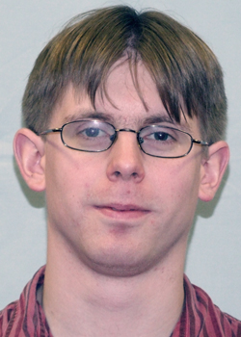
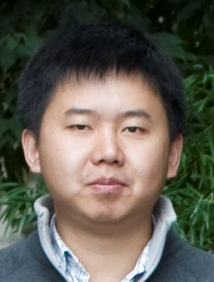
Tollestrup Award
Justin Evans – University College London
Measuring ν_{μ} and ν_{μ} oscillation parameters with MINOS
URA Thesis Prize
Tingjun Yang – Stanford University
Search for ν_{μ} to ν_{e} oscillations in MINOS

Slide 3
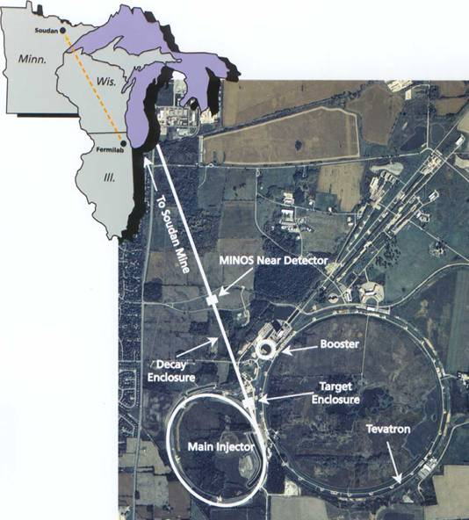
The MINOS Experiment
High-intensity neutrino beam for oscillation experiments
Predominantly ν_{μ} beam
Explore and test the new standard model of neutrinos
Operating since 2005
Neutrino beam travels to northern Minnesota
735 km baseline
Intense source at Fermilab
Oscillated source in Minnesota
Neutrino beam
Near Detector: 980 tons
Far Detector: 5400 tons
5

Slide 4
Overview
Background of the experiment and its physics
Description of the experiment
Focus on the beam and our knowledge of it
Selection of current results
Much more from Justin and Tingjun
Note: a series of new results are in preparation and will be presented on June 14 at a special W&C and at the Neutrino 2010 conference

Slide 5
Physics Approach
Measure oscillation parameters at high precision
Muon-neutrino disappearance
Search for new, unobserved transitions and measure the associated parameters
Electron-neutrino appearance
Mass hierarchy & CP violation
Search for alternative transitions that come from other models and study standard neutrino interactions at high precision
Sterile neutrino searches
Anti-neutrino oscillation measurements
Lorentz violation
Neutrino cross-sections
Rare(r) interactions
ν₃
ν₂
Δm²₃₂ = m₃² – m₂²
ν₁

Slide 6
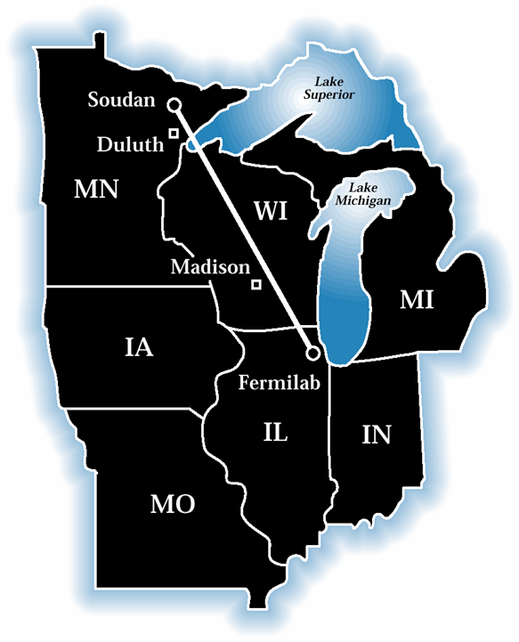
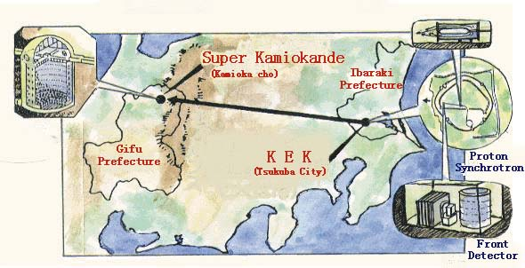
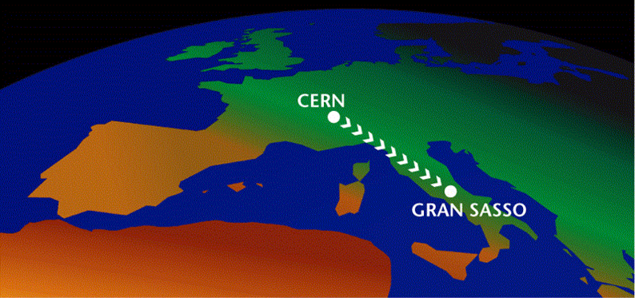
Long Baseline ν Oscillation Exps.
Reproduce atmospheric ν effect using accelerator beams
L ~ 100’s kilometers to match oscillation frequency
Near Detector:
980 tons
Far Detector:
5400 tons
735 km
MINOS
(Fermilab to Minnesota)
L = 735 km 2005
K2K (KEK to SuperK)
L = 250 km Concluded (T2K starting)
CNGS (CERN to Gran Sasso, Italy)
L = 750 km 2006
Notes:
K2K verified SK atmos, but w/ 70 evts – K2K has variety of NDs
CERN has no ND – focused purely on nutau app.
MINOS has ND and lots of nus from MI - disappearance

Slide 7
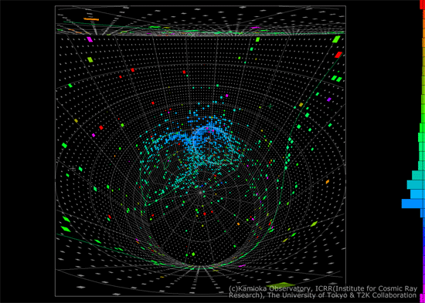
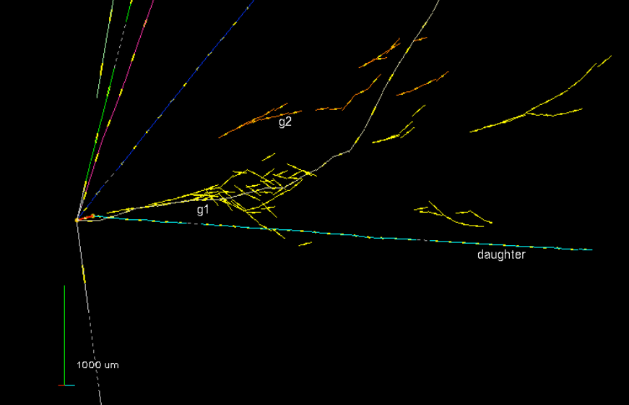
New Players
Neutrino physics is getting busy
T2K: first event in far detector
OPERA: first tau-neutrino observed
Seminar on Friday
Online in the next few years: Double-CHOOZ, Daya Bay, RENO, NOvA

Slide 8
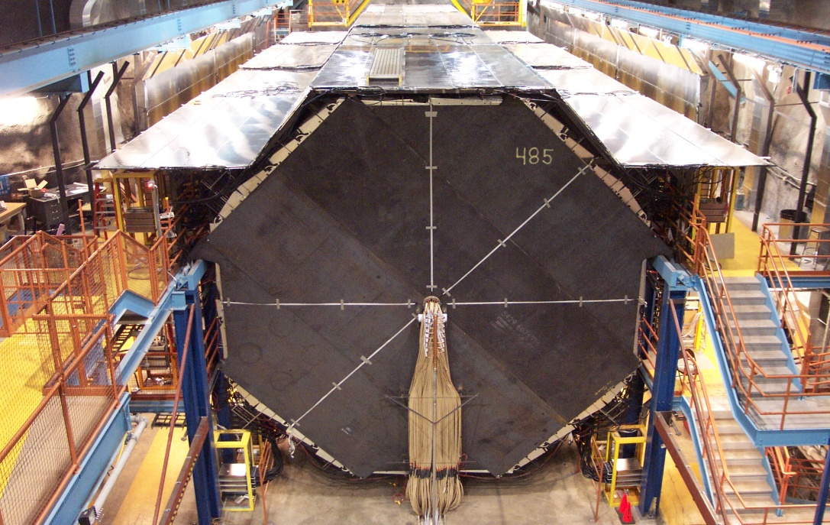
The MINOS Detectors
Near Detector
Steel / Scintillator sandwiches
Magnetized steel
Tracking calorimeters
Alternating planes of scintillator strips
PMT readout
Functionally identical
1 and 735 km from the neutrino production target
980 and 5400 tons
Far Detector
Veto Shield
Coil

Slide 9
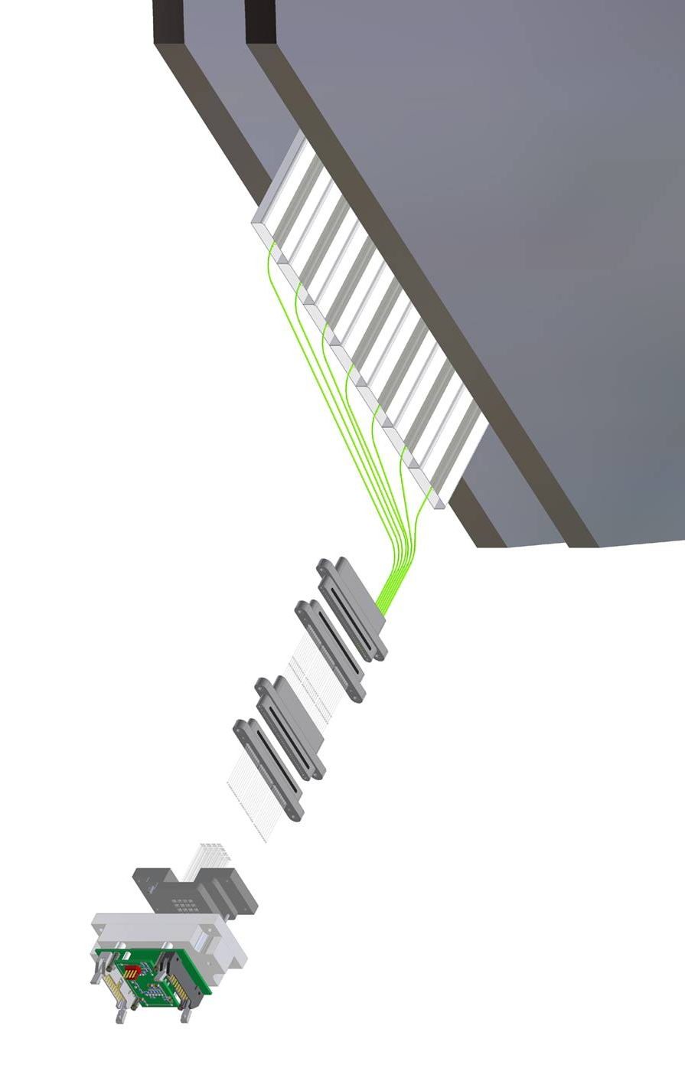
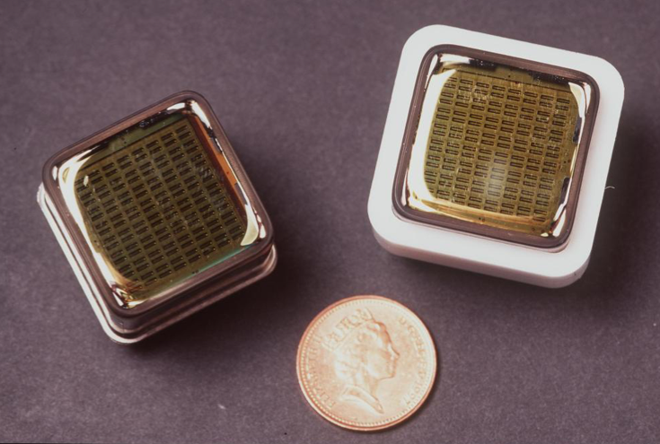
1” steel
MINOS Detectors
Extruded plastic scintillator strips
WLS fibers
Multi-anode PMT

Slide 10
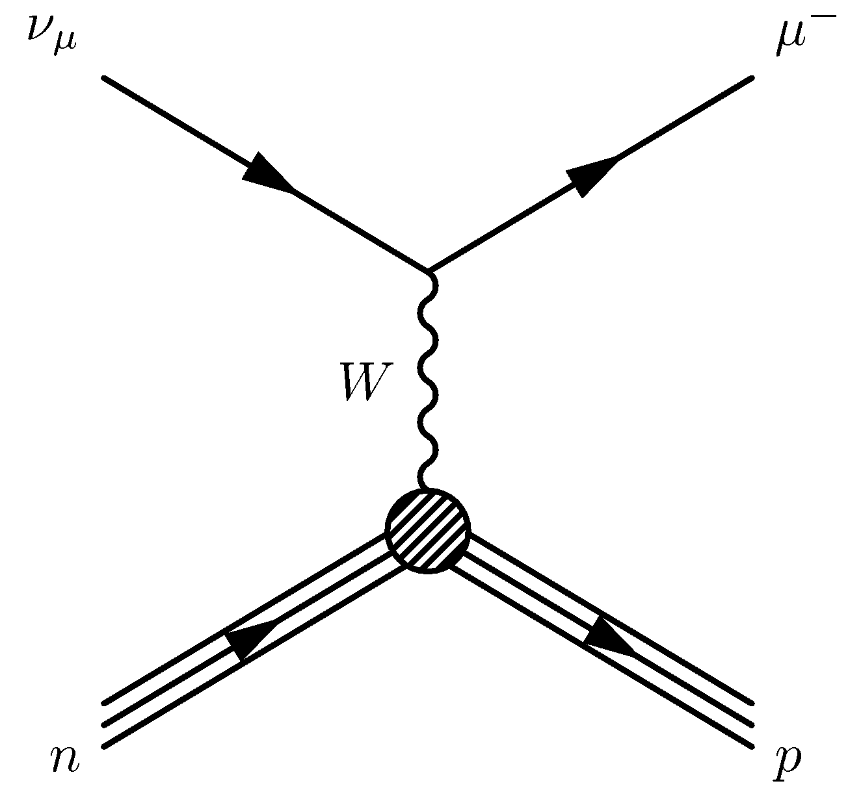
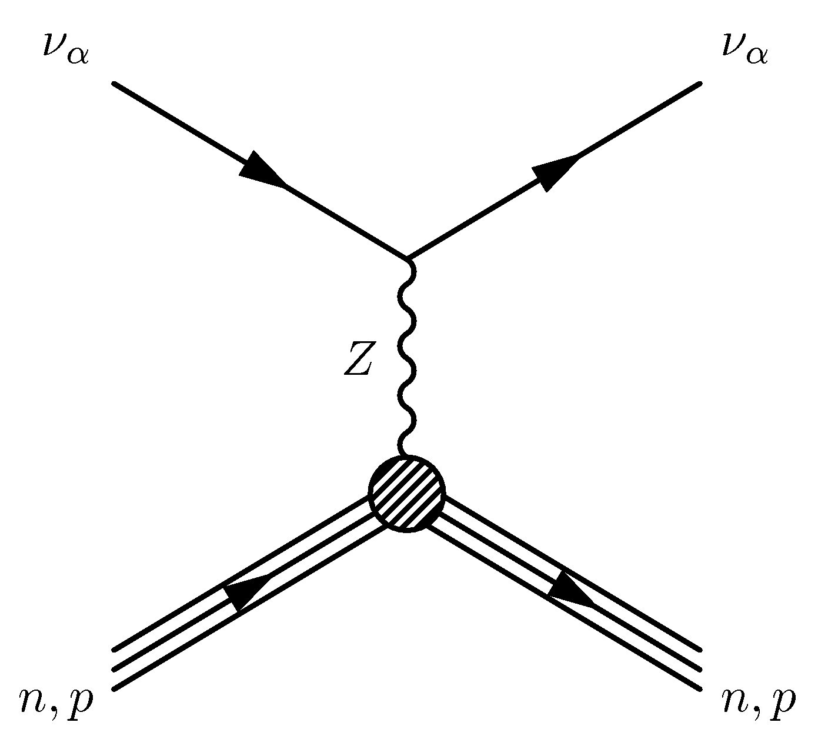
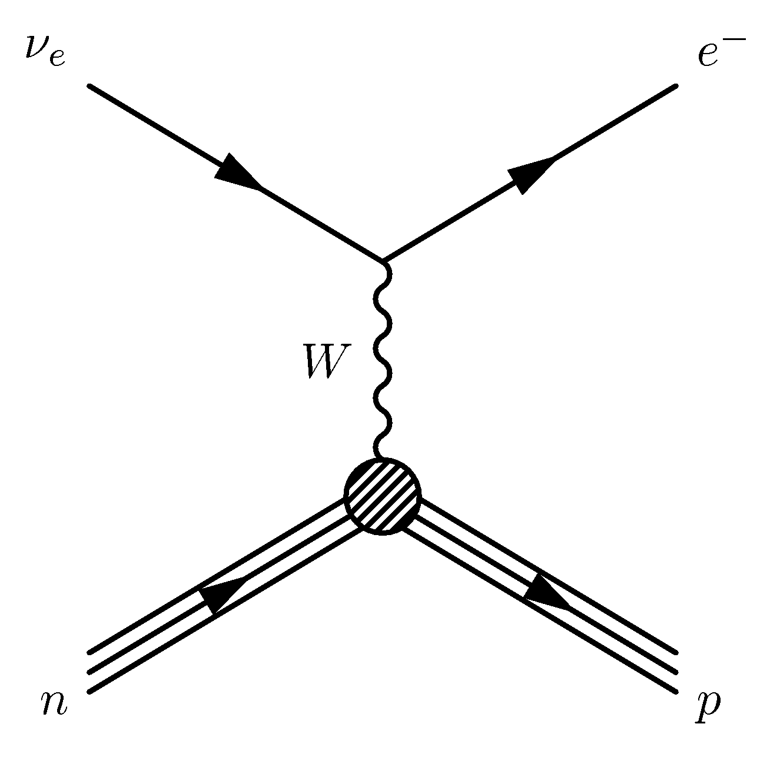
Interaction Types
ν_{μ} CC Event
ν_{μ} CC Event
ν_{e} CC Event
NC Event
ν_{e} CC Event
NC Event

Slide 11
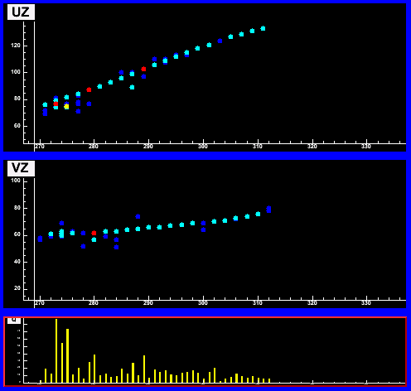
Event Topologies
Monte Carlo
ν_{μ} CC Event
ν_{μ} CC Event
ν_{e} CC Event
NC Event
ν_{e} CC Event
NC Event
UZ
VZ
3.5m
long μ track & hadronic activity at vertex

Slide 12
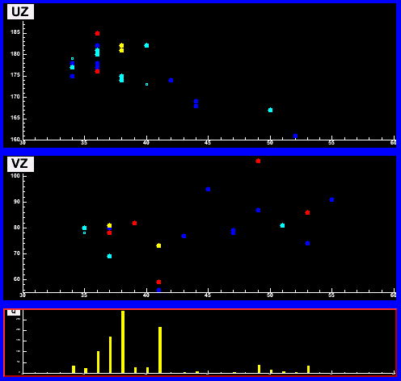
Event Topologies
Monte Carlo
ν_{μ} CC Event
ν_{μ} CC Event
ν_{e} CC Event
NC Event
ν_{e} CC Event
NC Event
UZ
VZ
3.5m
1.8m
long μ track & hadronic activity at vertex
short event, often diffuse

Slide 13
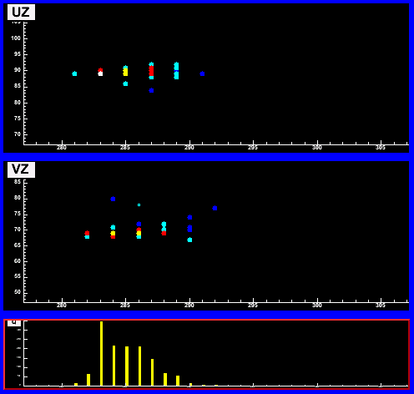
Event Topologies
Monte Carlo
ν_{μ} CC Event
ν_{μ} CC Event
ν_{e} CC Event
NC Event
ν_{e} CC Event
NC Event
UZ
VZ
3.5m
1.8m
2.3m
long μ track & hadronic activity at vertex
short event, often diffuse
short, with typical EM shower profile

Slide 14
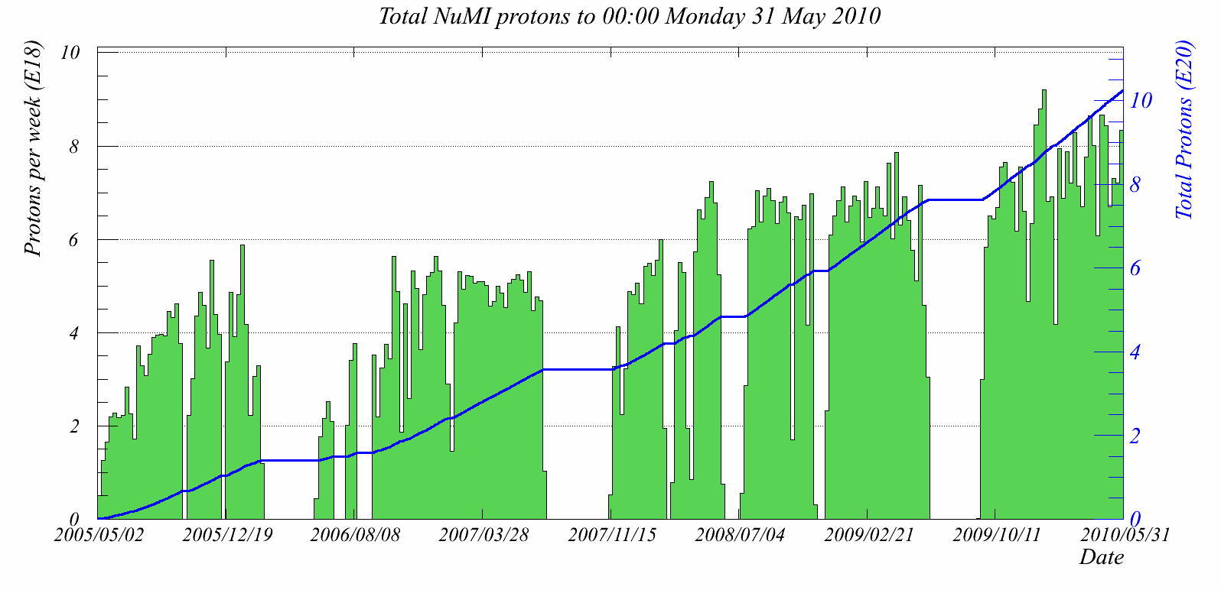
Protons as Raw Material
High-power 120 GeV beam from the Main Injector feeds the neutrino beam
Typical beam power is 310 kW
Occasional running at 400 kW
10e20 total protons passed on May 5
Weekly delivery of protons has continually improved
Thanks to the Accelerator Division

Slide 15
The NuMI Beam “Neutrinos at the Main Injector”
Absorbs 160 kW of protons and other hadrons
Allows high-energy muons to penetrate
2 m diameter
Roughly decay length for 10 GeV π⁺
Evacuated or He-filled & cooled
2 interaction length, C target
Produces π, K mesons
400 kW design average power
σ ∼ 1 mm
Pulsed focusing horns
Toroidal magnetic field
Parabolic inner conductor profile
Focuses meson momentum band
Measure hadron & muon fluxes
Arrays measure distributions
Notes:
Go light on horn description, other details

Slide 16
Neutrino Beam Design
Low Energy Beam
proton
Target
Horn 1
Horn 2
MINOS Data
pME
Pions with
p_{T}=300 MeV/c and
p=5 GeV/c
p=10 GeV/c
p=20 GeV/c
pHE
Vary ν beam energy by sliding the target in/out of the 1st horn
# / 0.5 GeV
LE
E_{ν} (GeV)
High Energy Beam
proton
Target
Horn 1
Horn 2

Slide 17
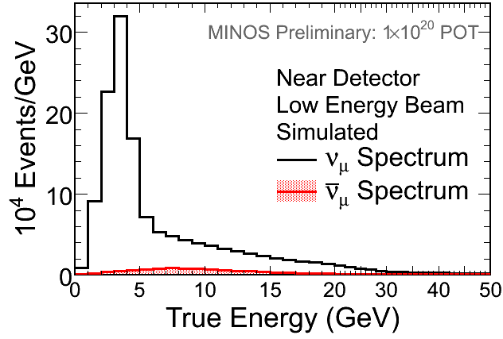
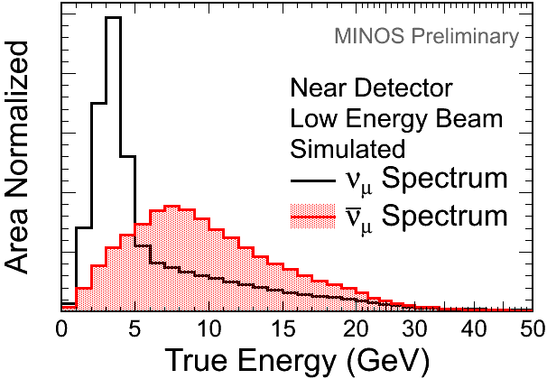
Neutrino Energy Spectrum
Optimal beam configuration for |Δm²₃₂| “Low Energy”
Focusing positive mesons
Beam composition in the Near Detector
91.7 % of ν_{μ}
7.0 % of ν_{μ}
1.3 % of ν_{e} and ν_{e}
Significant difference in energy spectra:
ν_{μ} peaks at 3 GeV
ν_{μ} peaks at 8 GeV

Slide 18
Precision Neutrino Beam
Why is precision needed?
1000s of events in Far Detector, but 100s of millions in Near Detector
Errors must be held to < 2% for oscillation analyses
Short-baseline measurements could do with much better
Why is precision hard?
Meson production cross sections not well known
Neutrino interaction cross sections not well known
Both aggravated by nuclear effects
Beam is produced over a large volume and mesons have numerous opportunities to reinteract
High-power beam can damage components
Heating can also cause components to change position
How do we achieve precision?
Build everything to tight tolerances
Verify those tolerances
Spend a lot of effort on simulation
Incorporate external data
Monitor the beam
Use the enormous amount of Near Detector data with different beam tunes to constrain production

Slide 19
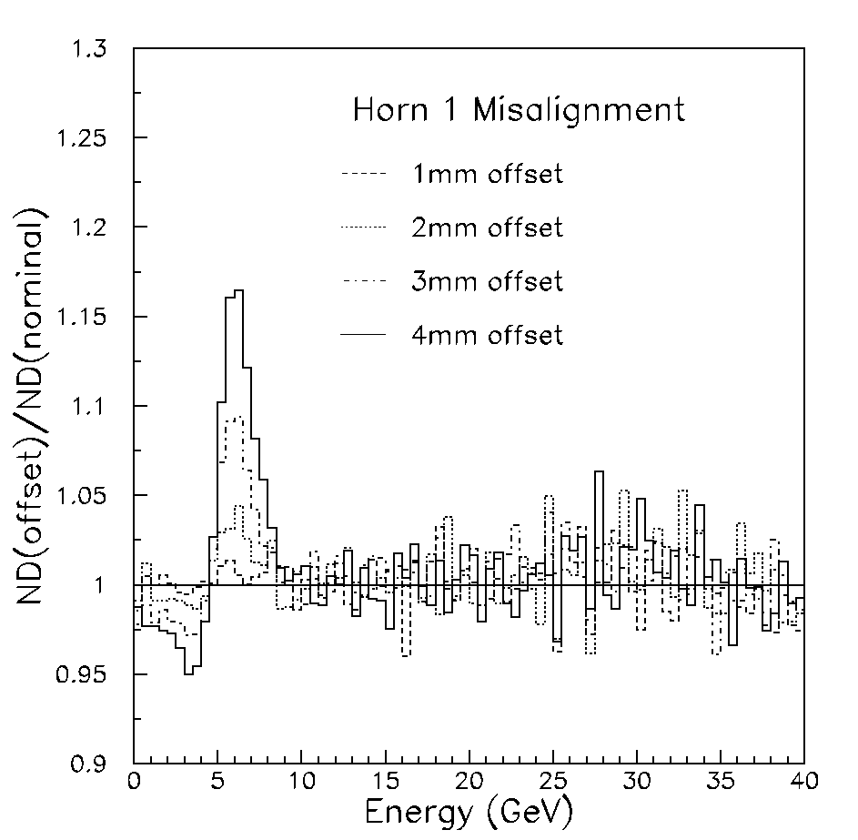
Achieving a Precision ν Spectrum
Component placement affects the ν beam
Beam monitors detect changes in muon & hadron beams
Variation measured spill-to-spill
Beam based alignment for all major components
Horn 1 displacements affect pion focusing
Baffle
Horn
π
p
Target
Baffle
p
Target
π
Notes:
Mention oscillatory shape of distortion

Slide 20
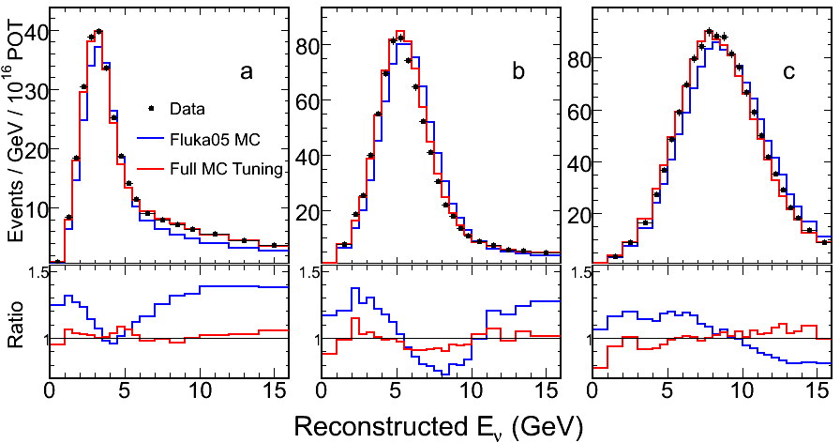
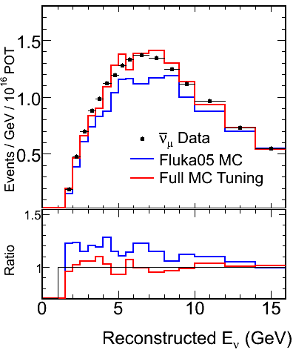
Tuning MC
Fit ND data from all beam configurations
Warp underlying hadron production to match neutrino data
Simultaneously fit ν_{μ} and ν_{μ} spectra
LE010/185kA
LE100/200kA
LE250/200kA
υ_{μ} LE010/185kA

Slide 21
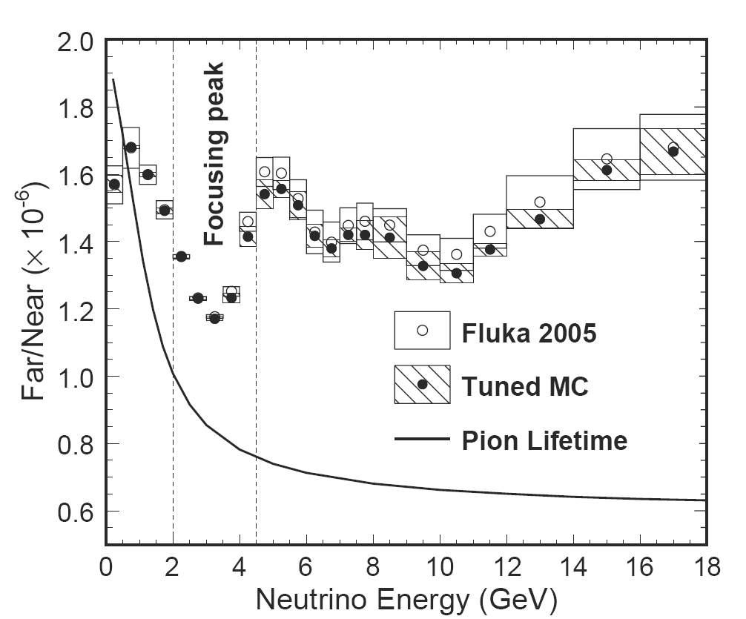
Far/Near Ratio
Point source -> both detectors same flux
Due to finite pion lifetime higher energy pions decay closer to ND
Full simulation includes acceptance effects

Slide 22
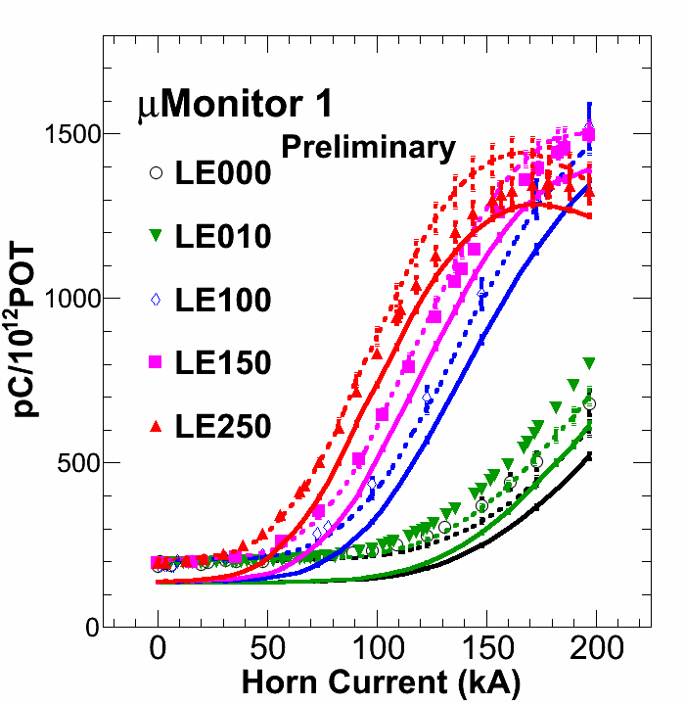
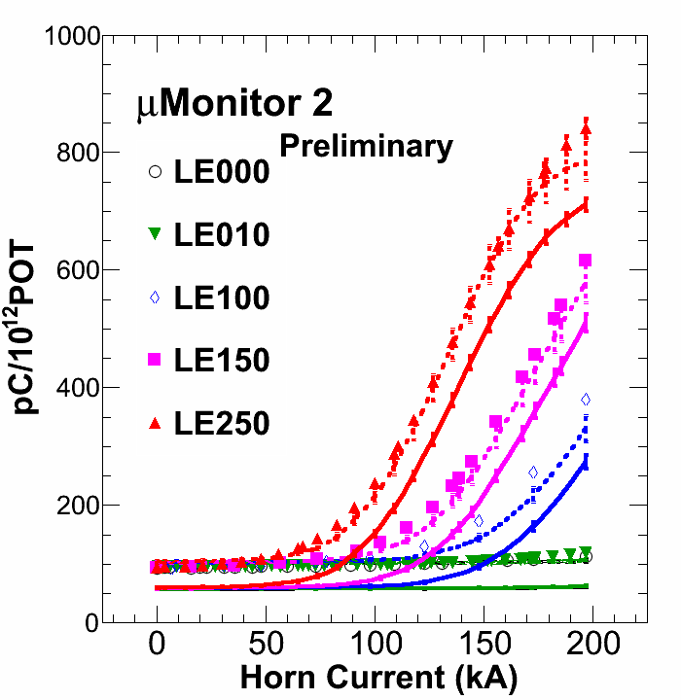
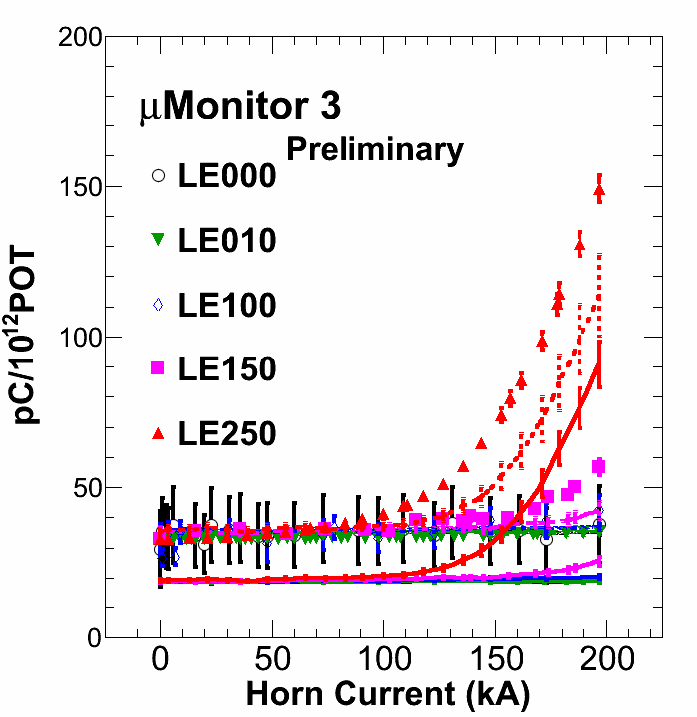
Muon Monitor Tuning
Measure muon fluxes in numerous beam configurations
Vary target position and horn current
Parameterization for hadron production, f(p_{T}, p_{z}).
Warp p_{T} and p_{z} to tune default MC to Muon Monitor data.
Data
Monte-Carlo
Tuned Monte-Carlo

Slide 23
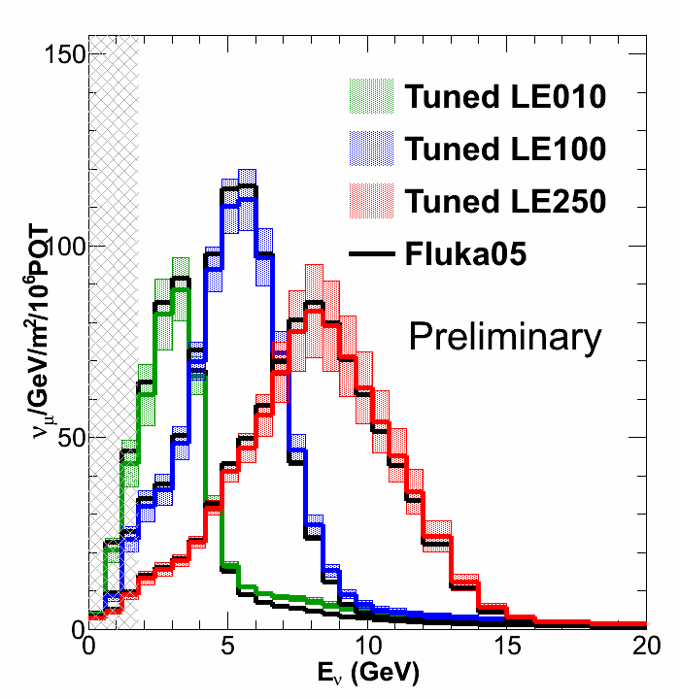
Muon Monitor Flux
Shape only measurement
Large uncertainty in Ionization Scale flux requires normalization to MINOS data for E_{ν} > 26GeV.
Error bars come from...
π+/π- ratio, K/π ratio
Non-linearity
Backgrounds
In situ measurement; accounts for real beamline conditions
Independent of neutrino data
μ Monitor energy threshold.

Slide 24
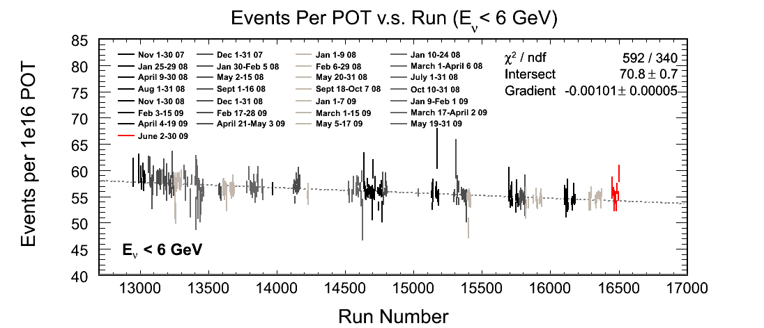
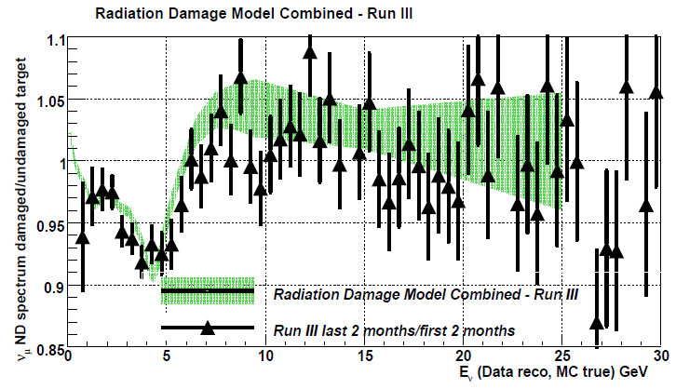
NuMI Target Degradation
Neutrino yield from the NuMI target degraded by ~5% over an exposure of ~ 6e20 protons
Spectral shape also changes
Analyses must allow for a changing beam
This experience will guide the considerations for targets in future experiments

Slide 25
The νμ disappearance analysis: - Run I+II (3.36 x 10²⁰ POT) Phys.Rev.Lett.101:131802,2008 -New analysis in preparation - See Evans talk for more detail

Slide 26
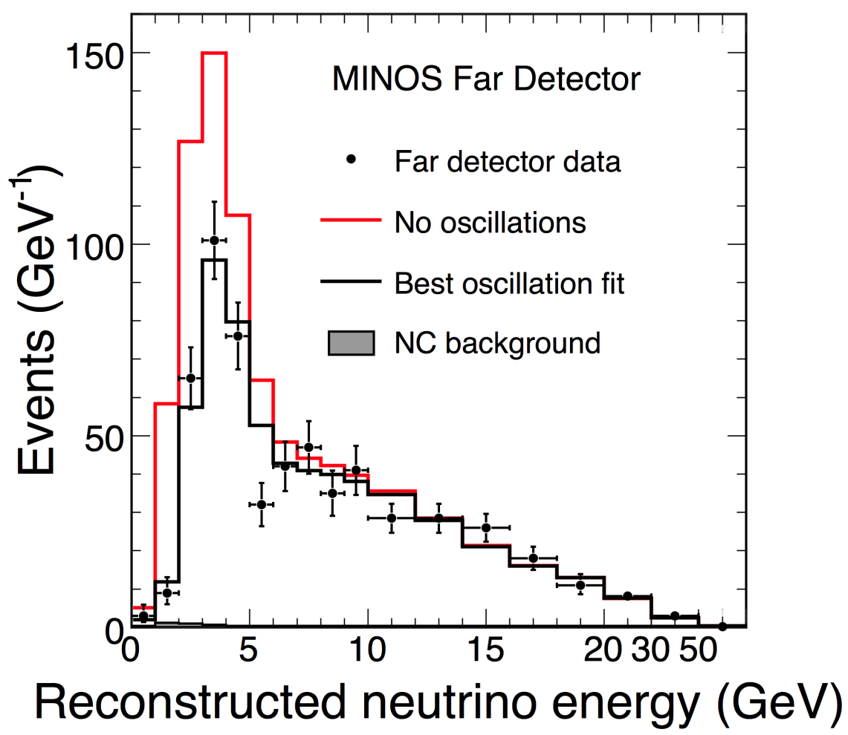
ν_{μ} disappearance
Use both low and high energy beam
Blind analysis
Expected 1065 ± 60 with no osc.
Observed 848 events.
Energy spectrum fit with the oscillation hypothesis

Slide 27
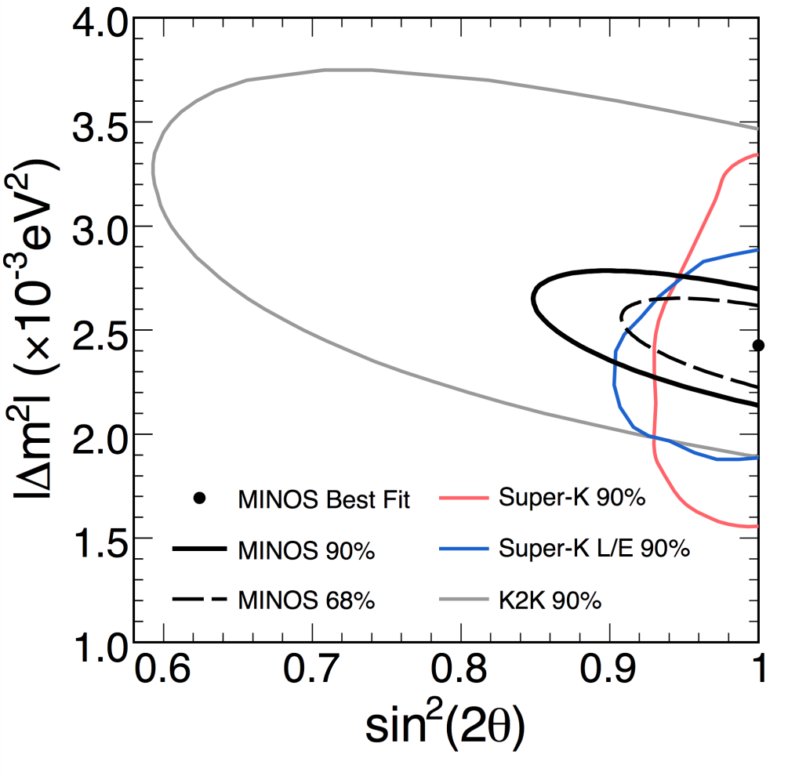
Allowed Parameter Space
Analysis of 7e20 is nearing completion
Improvements:
Looser cuts as systematics are better understood
Combine anti-neutrinos
Add rock muons and the edges of detector
Phys. Rev. Lett. 101, 131802 (2008)
Best fit ( 3.1e20 protons )
|Δm₃₂²| =(2.43±0.13)x10⁻³ eV² (68% C.L.)
sin²(2θ₂₃) > 0.95 (68% C.L.), 0.90 (90% C.L.)

Slide 28
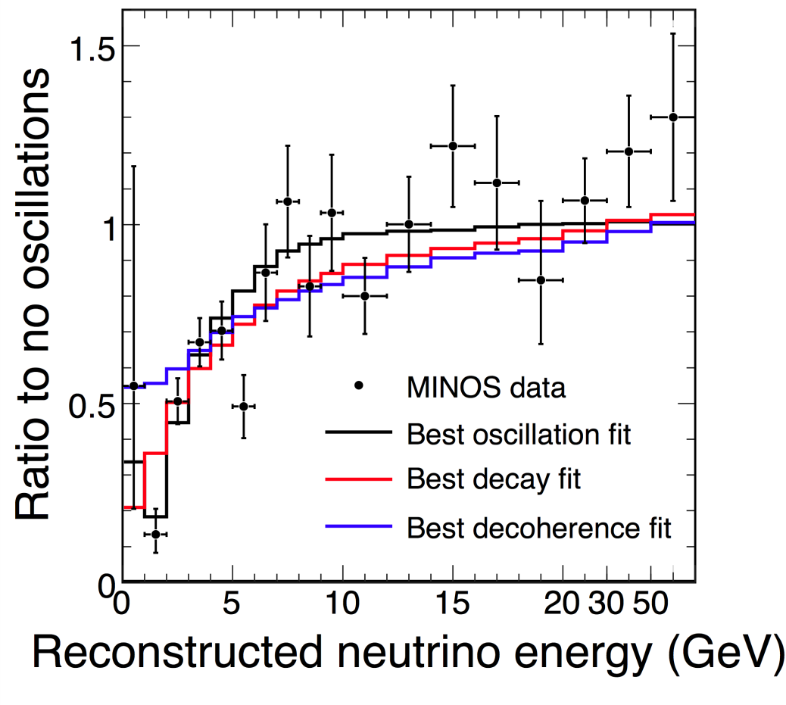
Alternative models
Two alternative disappearance models are disfavored:
[1] Decay without oscillations:
χ²/ndof = 104/97
Δχ² = 14
disfavored at 3.7σ
(5.4σ if combine CC & NC)
[2] Decoherence:
χ²/ndof = 123/97
Δχ² = 33
disfavored at 5.7σ
[1] V. Barger et al., PRL 82, 2640 (1999)
[2] G.L. Fogli et al., PRD 67, 093006 (2003)

Slide 29
Search for active-neutrino disappearance: - Directly test for νs using Neutral Current Interactions with Run I+II: 3.18 x 10²⁰ protons Phys.Rev.D81:052004,2010 New analysis in preparation

Slide 30
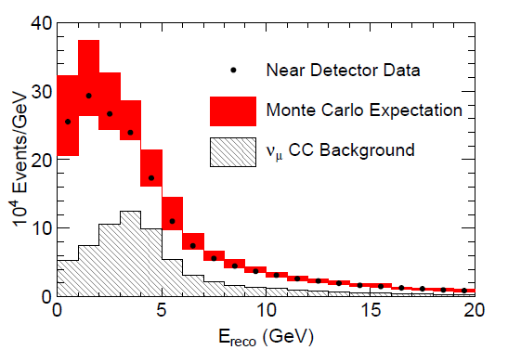
Neutral Current Energy Spectra
NC selected Data and MC energy spectra for Near Detector
Good agreement between Data and Monte Carlo
Discrepancies smaller than systematic uncertainties
NC events are selected with 90% efficiency and 60% purity

Slide 31
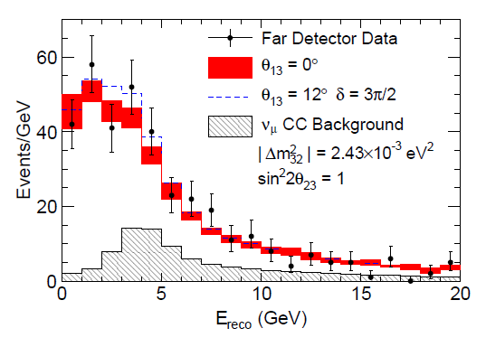
Neutral Current Energy Spectra
NC selected Data and MC energy spectra for Near Detector
Good agreement between Data and Monte Carlo
Discrepancies smaller than systematic uncertainties
NC events are selected with 90% efficiency and 60% purity
Far Detector reconstructed energy spectra for NC-like events
Oscillation parameters are fixed. MC predictions with θ₁₃=0 and θ ₁₃ at the CHOOZ limit are shown
ν_{e} charged current interactions selected as NC in this analysis
Expect 377 ± 19.4(stat) ± 18.5(syst)
Observe 388 events

Slide 32
Search for νe appearance: with Run I+II+III (7 x 10²⁰ POT) Phys.Rev.Lett.103:261802,2009 - See Yang talk for more detail

Slide 33
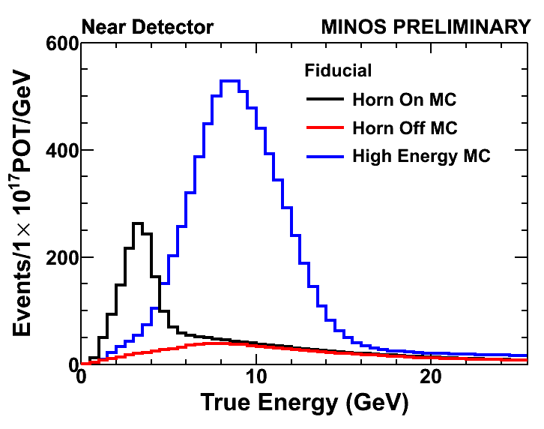
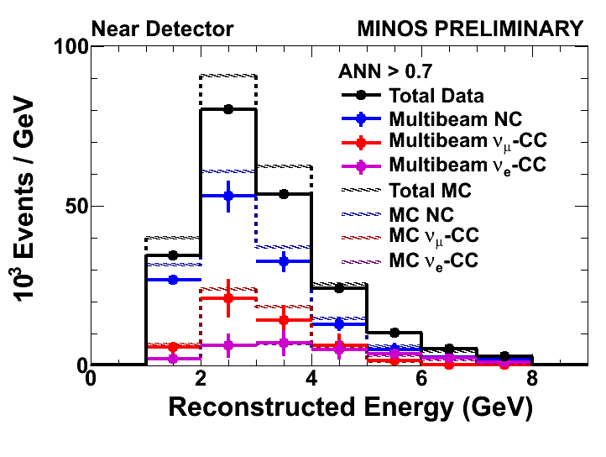
Background - Near Detector Decomposition
Use large Near Detector samples to measure backgrounds
3 different beams allow decomposition into background type
Different backgrounds extrapolate differently to far detector

Slide 34
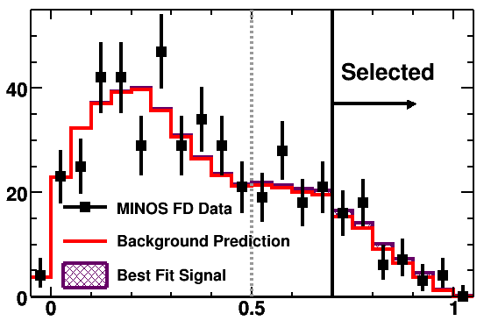
v_{e} Selected Far Detector Data
Far Detector Events
MINOS PRELIMINARY
Events
ANN Selection Variable
Background Prediction: 49.1 ± 7.0 (stat) ± 2.7 (sys)
Observed Data: 54
0.7 sigma excess above background

Slide 35
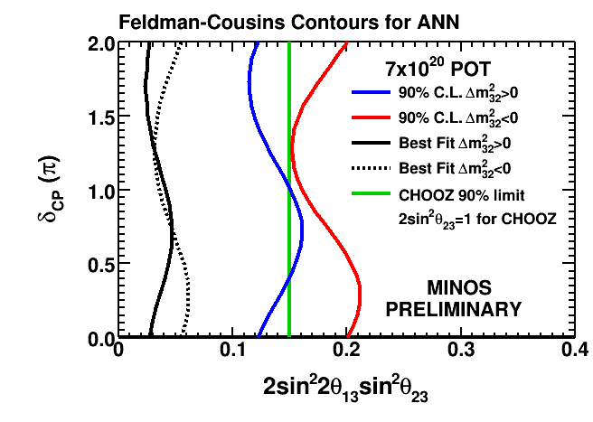
Limits
Set limits based on total selected events
MINOS sets the tightest limits on θ₁₃ assuming a normal mass hierarchy

Slide 36
Antineutrino Disappearance in a Neutrino Beam with Run I+II (3.2 x 10²⁰ POT) New analysis in preparation - See Evans talk for more detail

Slide 37
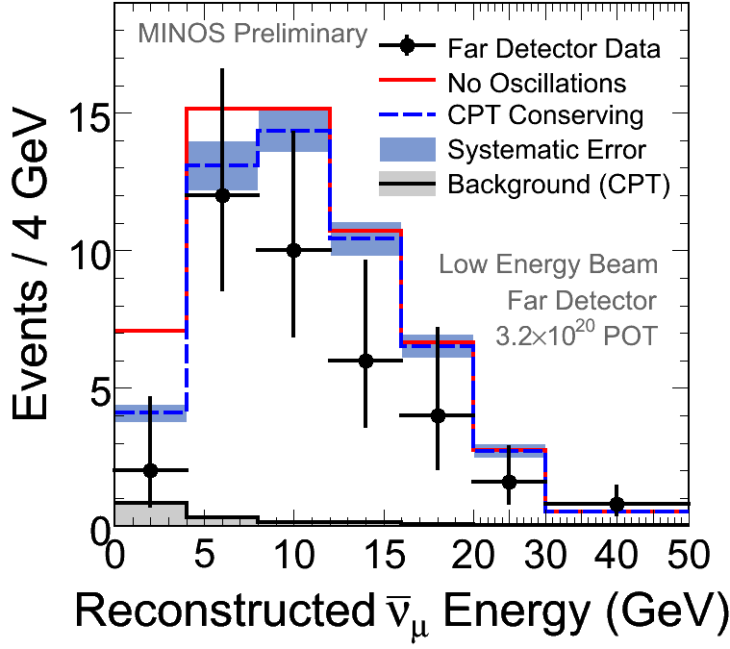
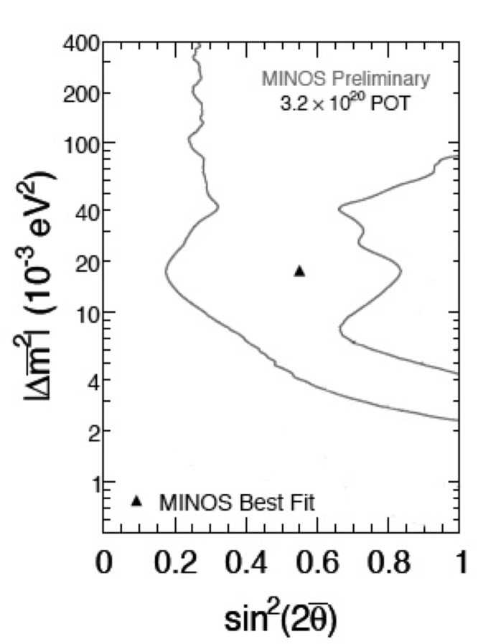
Antineutrinos at the Far Detector
Predict:
- Null oscillations:
64.6 ± 8.0 (stat.) ± 3.9 (syst.)
- CPT conserving oscillations:
58.3 ± 7.6 (stat.) ± 3.6 (syst.)
Observe:
42 events
Examine 7% antinuetrino component
Detector magnetic field allows charge discrimination

Slide 38
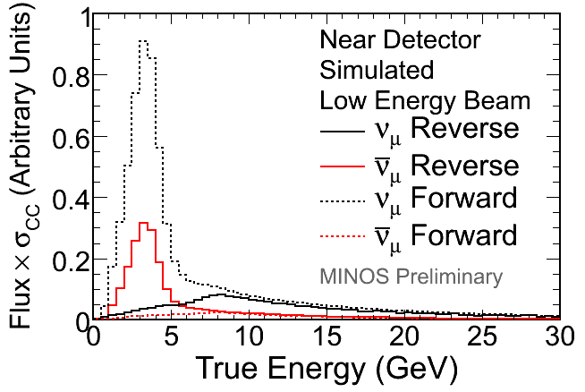
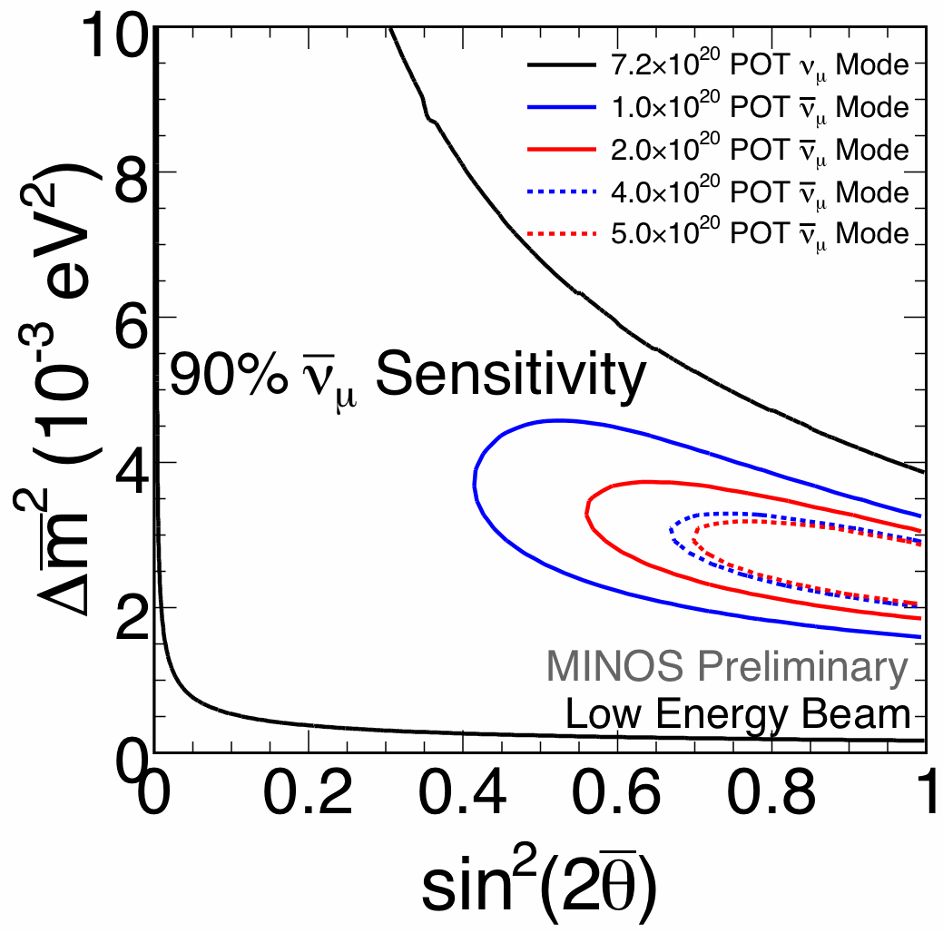
Dedicated Antineutrino running
Reverse current in the NuMI focusing horns.
Obtain a greatly enhanced antineutrino sample below 5 GeV (incl. the oscillation maximum).
Have accumulated 1.76e20 in this mode
Will enable a more precise measurement of the antineutrino oscillation parameters than possible with forward horn current
Analysis is nearing completion

Slide 39
Selection of Additional Measurements
Atmospheric neutrinos
Phys.Rev.D75:092003,2007
New analysis in preparation
Lorentz Invariance
Phys.Rev.Lett.101:151601,2008
New analysis in preparation
Neutrino cross sections
Inclusive charged current: Phys.Rev.D81:072002,2010
Several others under preparation
Sudden Stratospheric Warming (Climate Physics with cosmic rays)
Geophys.Res.Lett.36:L05809,2009
Cosmic ray variation with season
Phys.Rev.D81:012001,2010
Cosmic ray charge ratio
Phys.Rev.D76:052003,2007

Slide 40
Conclusion
MINOS is a mature experiment
Significant effort has resulted in a precisely understood beam
Several of the major goals have been achieved
Muon-neutrino disappearance verified as an oscillation phenomenon
Parameters precisely measured, alternatives rules out
The neutrinos change into a type that interacts via the Neutral Current
Predominantly not ν_{e} – so we presume ν_{τ}
Limits on electron-neutrino appearance have been improved
Improvement still to be made
Better measurements / limits (evidence?)
Exploration of anti-neutrinos
Wide range of additional measurements
Neutrino fluxes / cross sections / interaction types
Cosmic ray physics (and applied to atmospheric physics)
Enjoy the next few talks, and come to the W&C on June 14

Slide 41
Recent MINOS Theses
Bob Armstrong – Indiana university
Muon neutrino disappearance at MINOS
Pedro Ochoa – California Institute of Technology
A search for muon neutrino to electron neutrino oscillations in the MINOS experiment
Steve Cavanaugh – Harvard University
A Measurement of Electron Neutrino Appearance in the MINOS Experiment After Four Years of Data
Anna Holin – University College London
Electron neutrino appearance event selection optimization in the MINIS far detector
David Auty – University of Sussex
Analysis of numubar from the NuMI beam
Laura Loiacano – University of Texas at Austin
Measurement of the Muon Neutrino Charged Current Inclusive Cross Section on Iron
Masaki Watabe – Texas A&M University
Using Quasi Elastic Events to Measure Neutrino Oscillation with the MINOS detectors in the NuMI Neutrino Beam

