Slide 1
Use of Geant4 Simulations to Understand LRO/CRaTER Observations
M. D. Looper, J. E. Mazur, J. B. Blake, The Aerospace Corporation H. E. Spence, M. J. Golightly, University of New Hampshire A. W. Case, Boston University
7th Geant4 Space Users’ Workshop, Seattle, WA
18-20 August 2010

Slide 2
Measuring the Lunar Radiation Environment
The Cosmic Ray Telescope for the Effects of Radiation (CRaTER) was launched in June 2009 aboard the Lunar Reconnaissance Orbiter (LRO)
Nominal lunar orbit is circular at 50 km altitude
Purpose of CRaTER is to characterize radiation environment experienced by astronauts on or near the lunar surface
Not a simple stack of silicon solid-state detectors; instead, two big slugs of Tissue-Equivalent Plastic (TEP) in stack to simulate flesh overlying “blood-forming organs” (BFO, i.e., bone marrow)
Observations of GCRs during solar minimum activity show effects of inert material in stack, lunar and possibly spacecraft albedo

Slide 3
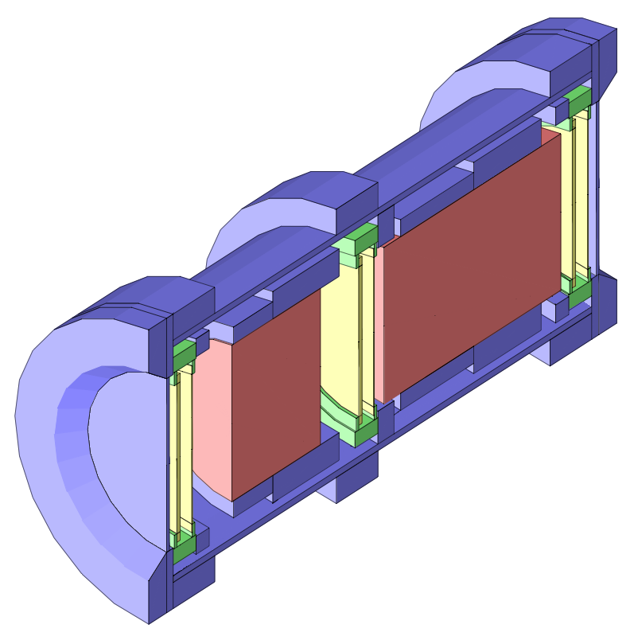
CRaTER Aboard LRO
Six silicon solid-state detectors
D1-D6 from zenith to nadir
Odd numbers 140μ, evens 1mm
Above is simplified Geant4 model
Photo courtesy of NASA
Notes:
Photo shows CRaTER and its electronics box mounted on “diving board” off LRO deck; nominal nadir direction is to the right, bulk of spacecraft to lower left. Diagram shows axisymmetric Geant4 model used (to date); red is TEP, blue aluminum, yellow silicon, green PCB, with nadir to the left.

Slide 4
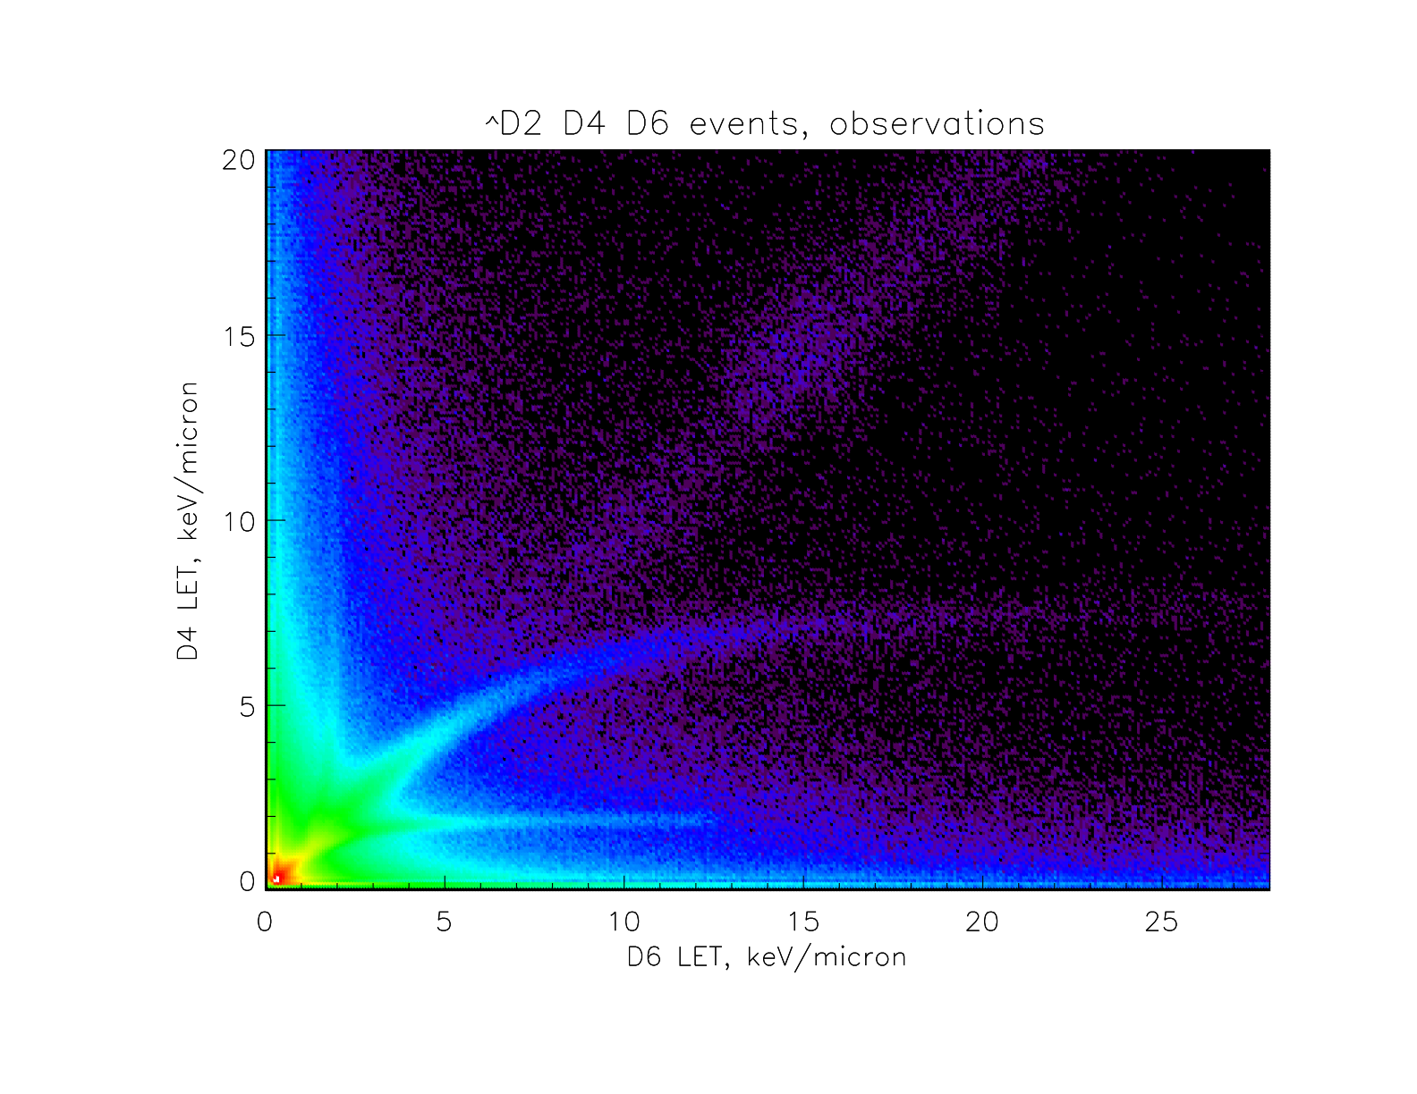
Sample of Observations
Notes:
Here is an example of the complexity of the data returned by CRaTER. This is a scatterplot with a logarithmic color scale showing all D4D6 doubles in the first five months of the mission, for times when the spacecraft was below 80 km and in its nominal attitude. We identify tracks of downward-going protons and alphas (and “puffs” from heavier GCR nuclei along the diagonal, which I won’t address further) and of upward-going protons, but there are also substantial “wings” hugging the axes.

Slide 5
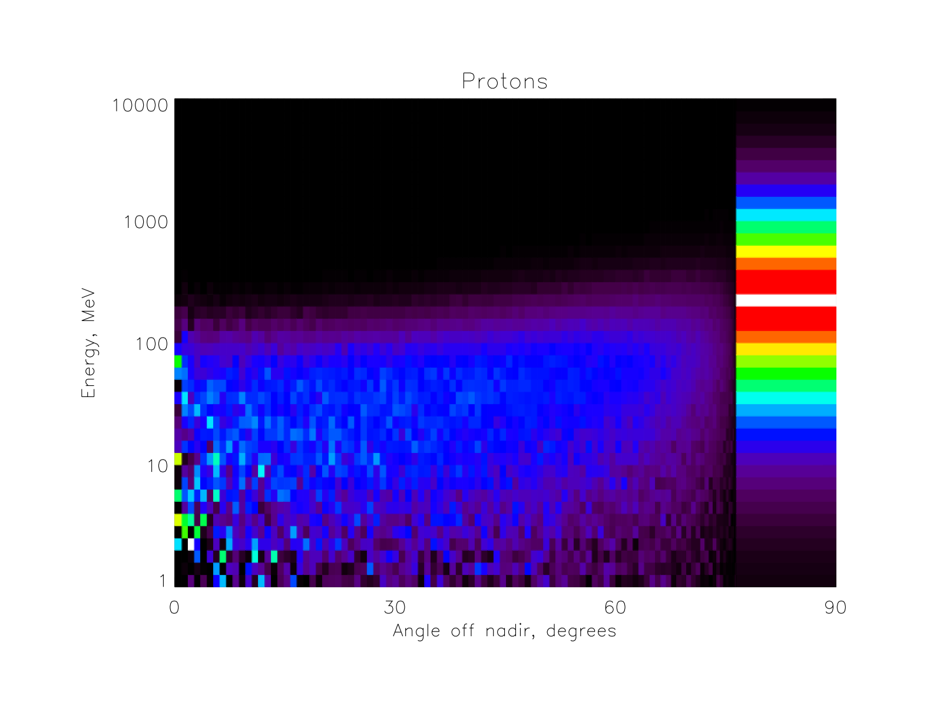
Lunar Albedo Simulations
Notes:
We represent GCR protons and alphas using the Usoskin et al. (JGR 110, A12108, doi:10.1029/2005JA011250, 2005) spectra with a modulation parameter of 290 MV, appropriate to the present deep solar minimum. Lunar albedo was simulated by tabulating particles that came back out when a 1-meter slab of anorthite representing the lunar surface was bombarded by GCR protons and alphas, then mapping the angular distribution to 50 km altitude. This plot shows the energy and angular distribution of primary (band at right) and albedo protons; at 50 km altitude, the lunar limb is about 76 degrees off the nadir (at 0 km, it would be at 90 degrees). In all work shown here, we used Geant4 9.1 and 9.2, with Tatsumi Koi’s space science physics list (http://www.slac.stanford.edu/comp/physics/geant4/slac_physics_lists/space/physlistdoc.html), modified to include low-energy EM processes.

Slide 6
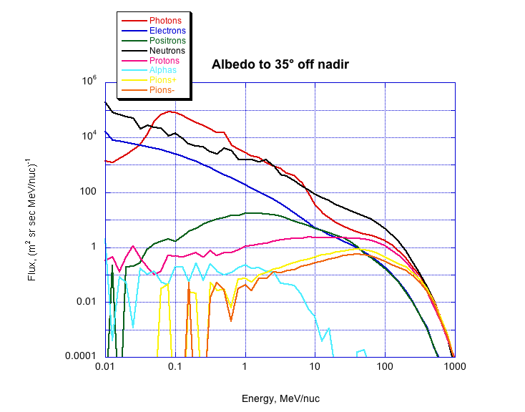
Albedo Spectra at Lunar Surface
Notes:
Since energy/angular distributions were pretty uniform for all albedo species out to an angle corresponding to 35 degrees off nadir at 50 km, we represent spectra by an average over these angles. This subset encompasses the nominal field of view of the D4D6 coincidence measurements in slide 5.

Slide 7
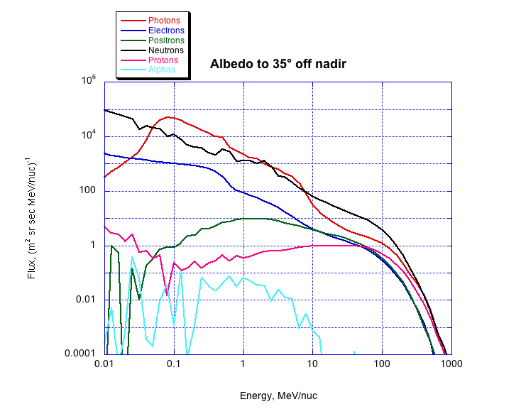
Albedo Spectra at 50 km Altitude
Notes:
But of course pions decay to energetic electrons and positrons on the flight up to 50 km, so we redid the simulation with particles tabulated at a spherical surface corresponding to a 50 km altitude orbit above the 1 meter target slab. (An error in angular distribution of GCRs was also corrected, shifting spectra slightly relative to the previous plot.)

Slide 8
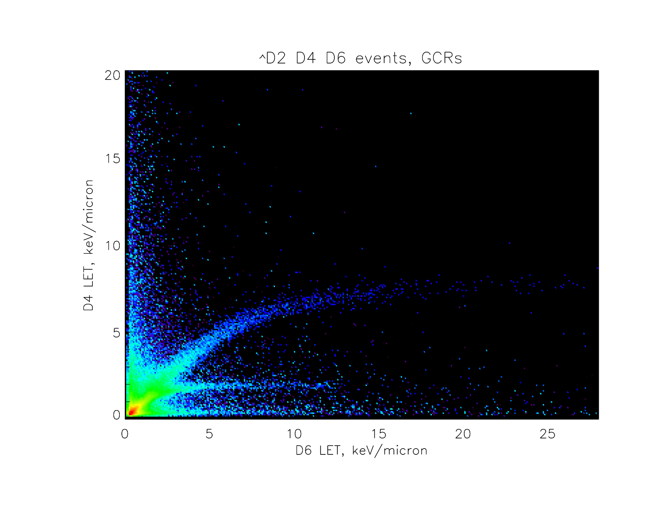
CRaTER Simulated Energy Deposits
Notes:
Here are the results of simulations of the D4D6 doubles crossplots with the Usoskin et al. GCR proton and alpha spectra illuminating the axisymmetric model of CRaTER down to the angle corresponding to the lunar limb. Downgoing proton and alpha tracks are prominent, but also “wings” parallel to the axes due to interactions (electromagnetic and otherwise, i.e., delta rays as well as “shrapnel” from nuclear interactions) in the inert material in and around the stack.

Slide 9
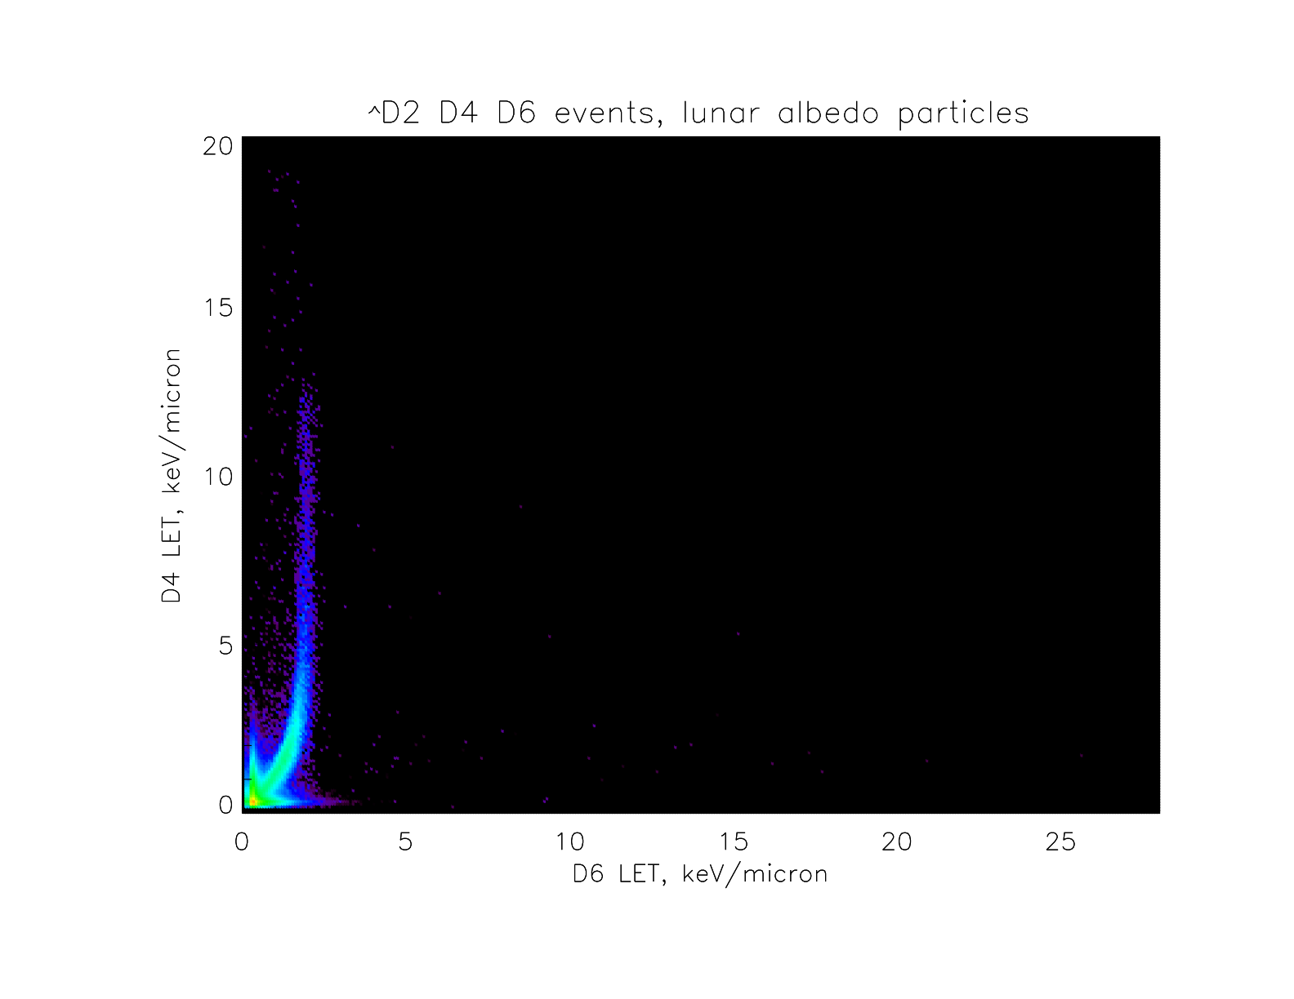
CRaTER Simulated Energy Deposits
Notes:
Here is a crossplot of simulated pulse heights of D4D6 events due to lunar albedo particles illuminating the sensor from the nadir to the lunar limb. The backward-going proton track is the most prominent feature, with stubby “wings” due to electrons and positrons; photon response was weak and alpha and neutron response almost nonexistant.

Slide 10
CRaTER Simulated Energy Deposits
Notes:
Adding these two sets, we see some qualitative similarities to the observations, but the “wings” along the axes are much too weak, with albedo electron/positron contributions lost under primary GCR “wings.” We are missing events that, while they have low energy deposits in one detector, nonetheless have higher energy deposits in the other than even the extremes of the proton tracks.

Slide 11
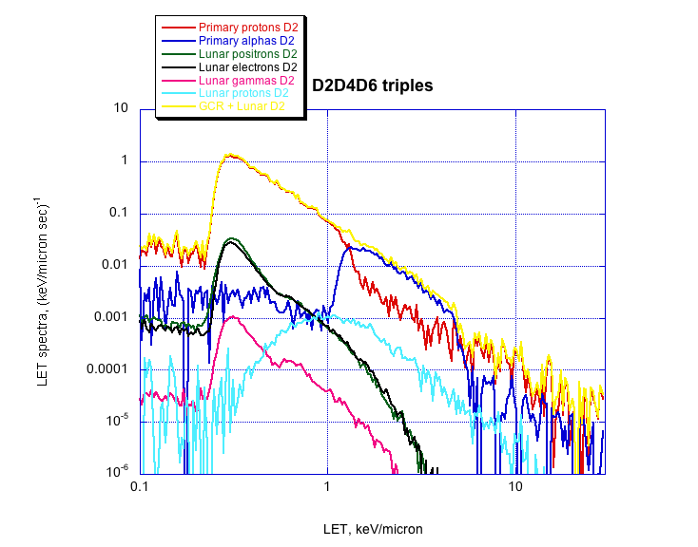
Simulated LET Spectra
Notes:
This is seen more quantitatively in this plot of simulated LET spectra for three-(thick-)detector triples events; the total is dominated by GCR proton and alpha contributions.

Slide 12
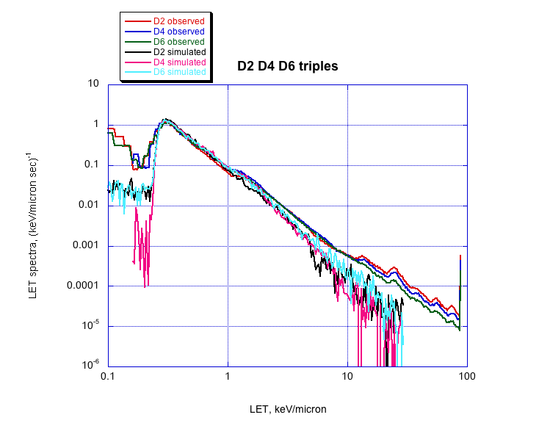
Observed vs. Simulated LET Spectra
Notes:
Comparing with observations, we see that the proton peak matches nicely (with some detector noise at lower channels), but that the simulated totals are systematically below the observations between the helium peak around 1.2 keV/micron and the heavier ions staring about 11 keV/micron. (Spike at high-energy end is sum of particle events saturating these detectors’ PHAs.)

Slide 13
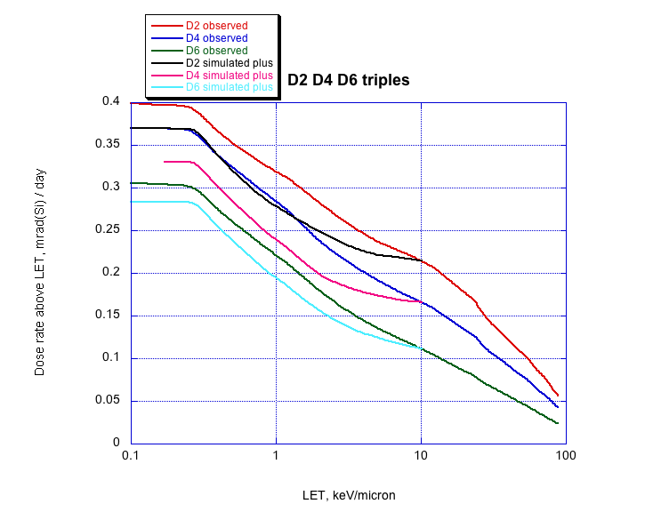
Observed vs. Simulated LET Spectra
Notes:
Here we recast the spectra as integral dose-rate curves. Because the simulations don’t include any GCR primaries heavier than alphas, we adjust the simulated spectra to match the observed totals just below the carbon minimum LET (about 11 keV/micron); still, it is apparent that a noticeable amount of dose is missing in the energy-deposit range between helium and carbon. In terms of the main aim of CRaTER, to understand radiation dose to astronauts, it’s not a large deficit, only about 10%; however, it does reflect a deficit in our understanding.

Slide 14
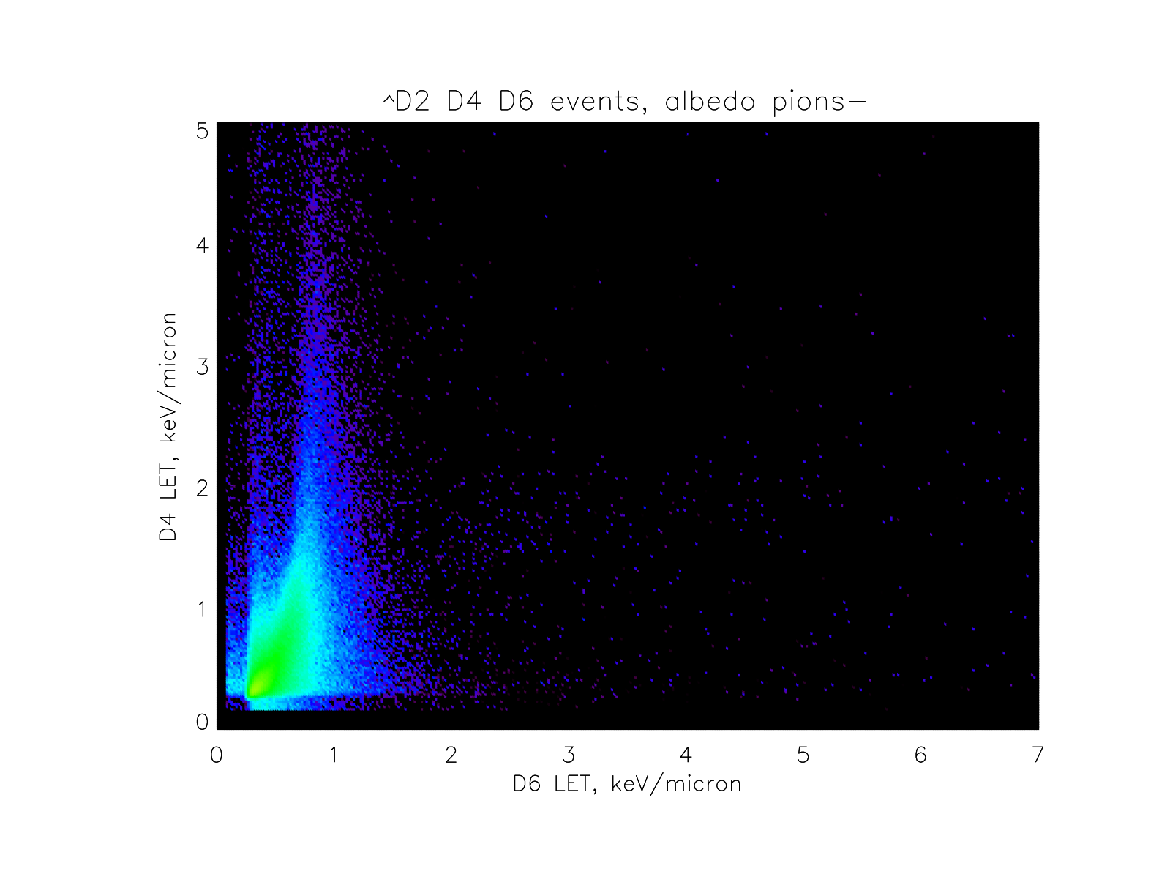
CRaTER Simulated Energy Deposits
Notes:
Before I remembered that lunar albedo pions would decay before reaching 50 km altitude, I simulated the response of CRaTER to these particles. (Note scales are 4x smaller than in previous plots.) This is a scatterplot of simulated energy deposits from negative pions with the same spectrum as at the lunar surface; it would mostly be invisible under the track of albedo protons.

Slide 15
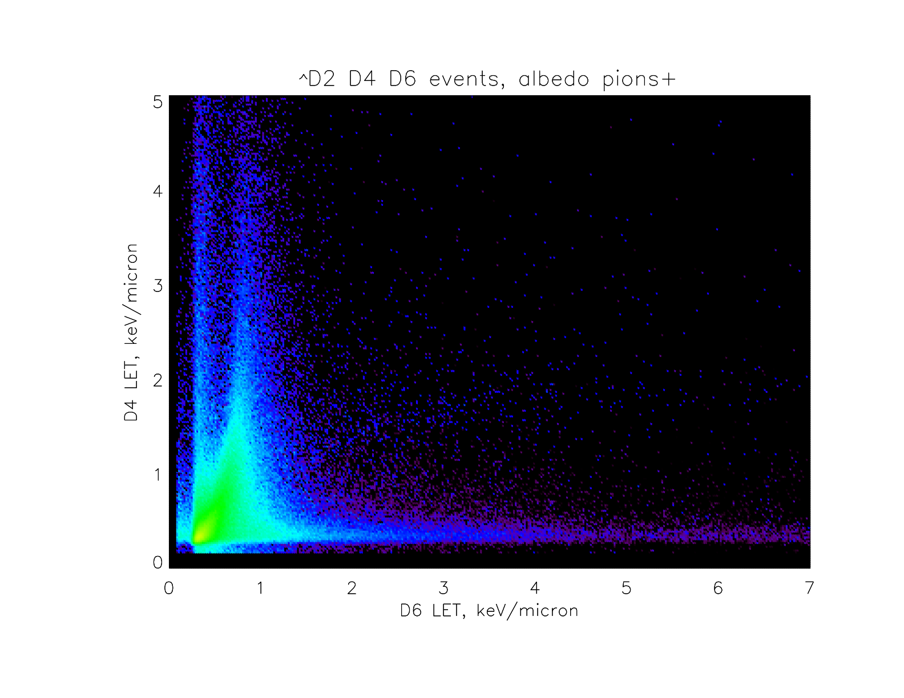
CRaTER Simulated Energy Deposits
Notes:
However, positive pions with the same spectrum as at the lunar surface give strong “wings” right where the simulations are missing them. While lunar pions would not be observable at LRO, pions generated from GCR impacts on the spacecraft itself would be, so the next task was to simulate these.

Slide 16
Geometry for Spacecraft Albedo Simulation
“Assume a spherical cow…”
Cubical shell of aluminum 7 mm thick and 3 meters on a side, mass 1018 kg
In center, a spherical fuel tank of 140 mil titanium, either empty or full of 898 kg of hydrazine (N₂H₄)
GCRs illuminate one face isotropically; tabulate all particles exiting simulation volume through any face
Notes:
We had questions as to how the varying amounts of hydrazine fuel during lunar orbit insertion and orbit adjustments would affect albedo spectra, so I ran simulations with a “fuel tank” either full or empty. Effects were small, a full tank depressing albedo some tens of percent; most species of particles penetrating the spacecraft (i.e., exiting from the face opposite the GCR-illuminated face) were reduced, sometimes significantly (tenfold), except protons, which were moderately enhanced, presumably due to (n,p) reactions from lunar albedo neutrons.

Slide 17
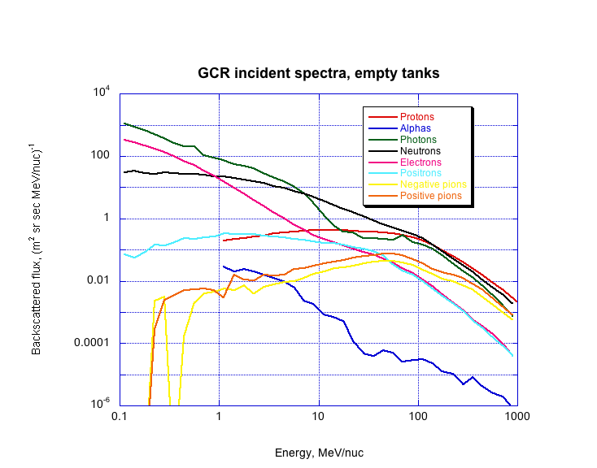
Albedo Spectra from Spacecraft
Notes:
Since most of the illuminated/observed solid angle from the location of CRaTER would contain spacecraft albedo from GCR primaries, rather than spacecraft albedo from lunar albedo particles, we focused on that. Also, mostly due to the softer proton spectrum in lunar albedo vs. GCR primaries, the “double albedo” spectra were much weaker than those of spacecraft albedo due to GCR primaries. (A small solid angle as seen from CRaTER would contain relatively hard particles, including pions, blasting through the spacecraft due to GCRs striking the other side; this needs to be added.) In any case, here are the albedo spectra; pions, unfortunately, are ten times weaker than at the lunar surface.

Slide 18
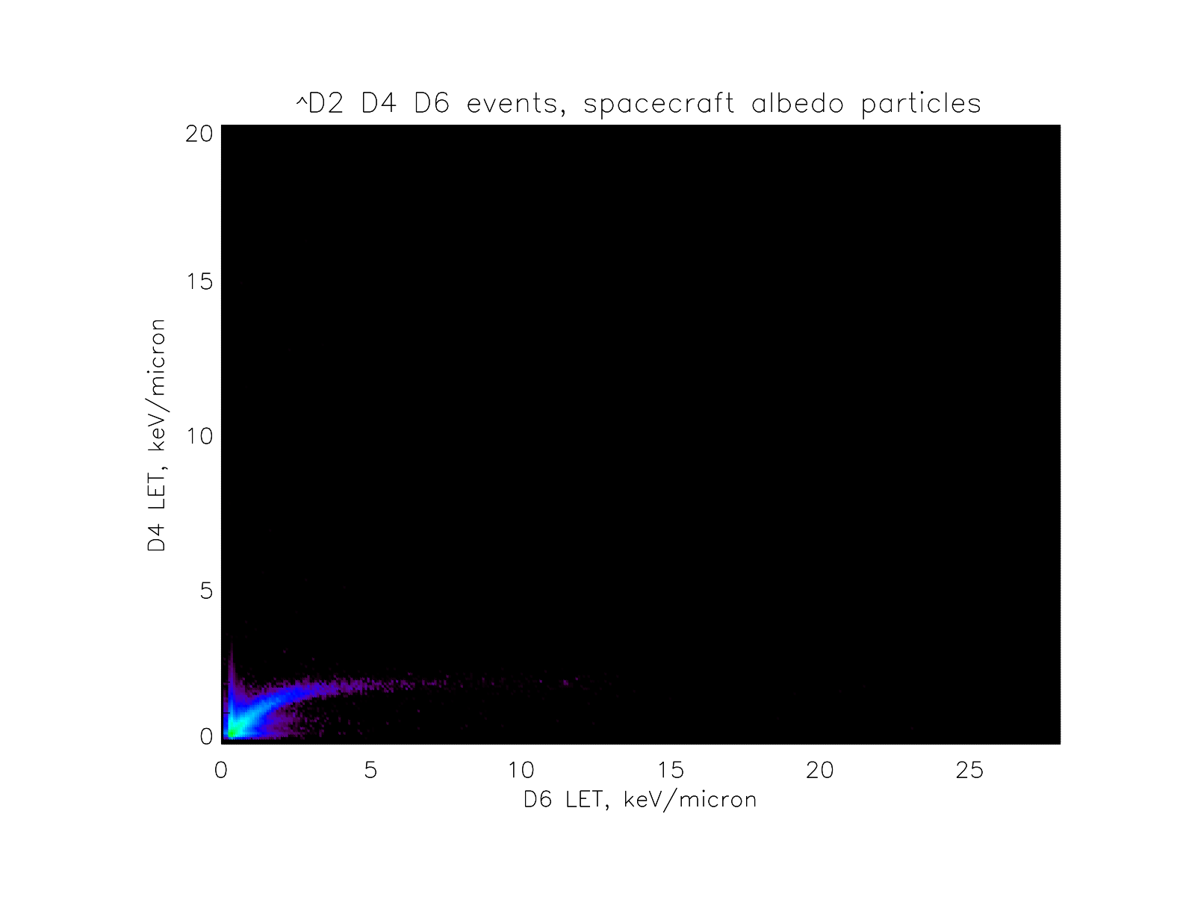
CRaTER Simulated Energy Deposits
Notes:
Consequently, the contribution of all spacecraft albedo particles (represented as covering ¼ of the “sky” as seen from CRaTER) is minor, and lost under the events in a crossplot due to GCR primaries.

Slide 19
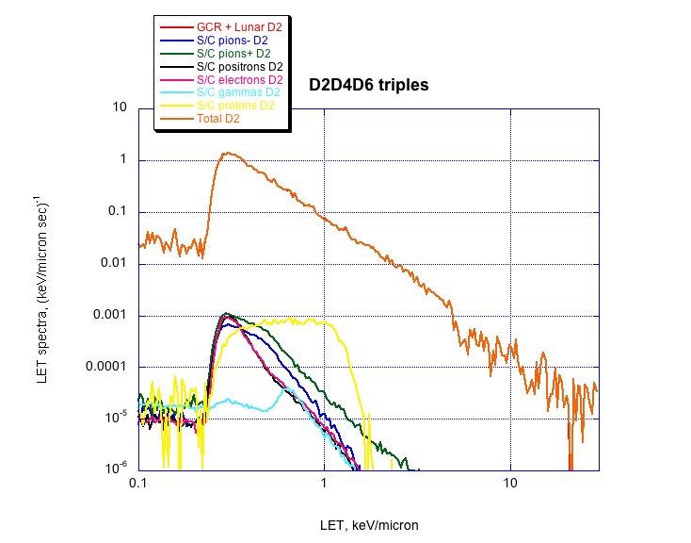
Simulated LET Spectra
Notes:
Again, qualitatively, we see that the spacecraft albedo contributions to the D2 LET spectrum are not significant in comparison with the contributions already modeled.

Slide 20
Ongoing Work
We’ve learned a lot about our data using simple geometric approximations of the sensor head and spacecraft, but clearly a realistic model of the inert mass around the sensor head is needed; this will soon start running on our thousand-core FreeBSD cluster
CRaTER also took data as LRO approached the moon, and on occasions when LRO tilts away from its nominal nadir/zenith orientation; preliminary modeling of these observations shows that a more realistic model is needed here too
We have seen one small SEP event so far, which gave nice proton and alpha tracks in D1 vs. D2 (ca. 10 MeV); we look forward to measuring more, and stronger, events as the solar activity cycle ramps up

