Slide 1

The Radiation Environment
from Galactic Cosmic Rays in a Lunar Habitat
Zi-Wei Lin
with
Yingcui Jia*
Department of Physics, East Carolina University, Greenville, NC
* Now at St. Jude Children’s Research Hospital, Memphis, TN

Slide 2
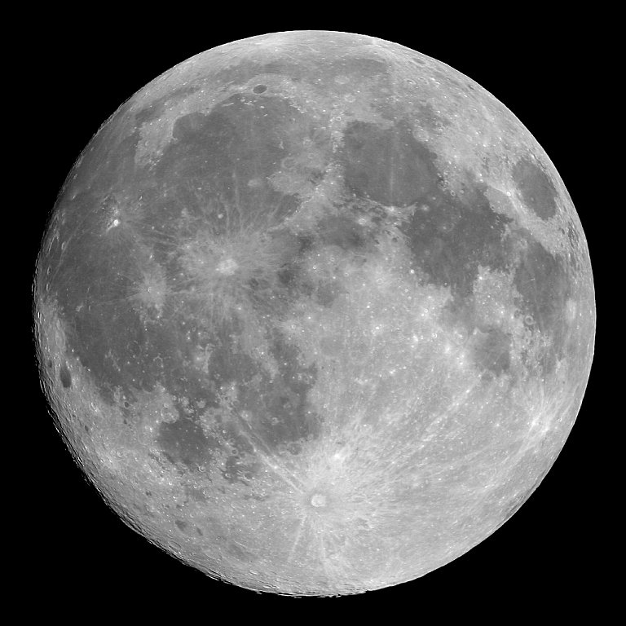
Outline
Introduction
Earlier studies
Simulation geometry & Methods
Results
Summary
These results are published in
Jia & Lin, Radiat. Res. 173, 238 (2010)

Slide 3
Introduction
Galactic Cosmic Rays (GCR) & Solar Particle Events (SPE)
are major risks for long-term human space explorations
Galactic Cosmic Rays:
always present as background, high energy, p to Fe and heavier ions
Solar Particle Events:
random, high fluence for a short time scale, low energy
The fraction of albedo neutrons in the total effective dose (ED)
in SPE << in GCR
→ we only consider GCR here (1977 solar minimum GCR)
Adams et al., Adv. Space Res. 40, 338 (2007)

Slide 4
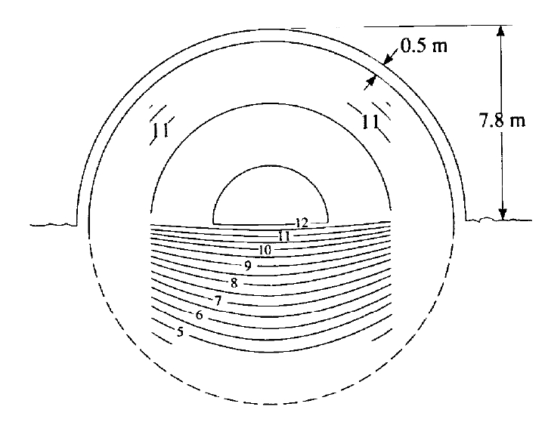
Previous Studies
A hemispherical dome
made of lunar regolith
on the lunar surface
Calculated dose equivalent from
primary GCR ions and fragments
Nealy, Wilson & Townsend,
SAE TP Ser. 891487 (1989);
also in Simonsen & Nealy, NASA-TP 3079 (1991)
Albedo particles were not included

Slide 5
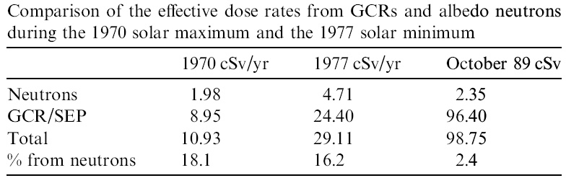
Previous Studies
Effective dose of albedo neutrons on the lunar surface*
Adams et al., Adv Space Res 40 (2007)
Albedo neutrons contribute a larger fraction
in GCR environments than in SPEs
* GCR/SPE effective dose values: taken from other studies, after 1g/cm² Al shielding
* No habitat

Slide 6
Objectives of this study:
calculate effective dose from both downward GCR particles and from upward albedo
study more albedo particles (n, p, γ, π⁺⁻ , e⁺⁻ )
study dependence on the habitat thickness t

Slide 7
Simulation Geometry for Geant4.9.1 Calculations
Source surface:
isotropic GCR particles
generated with GPS
Only downward-going particles
are allowed
7.5m
t :
habitat thickness:
0 to 2.0 m
20m
10m
Lunar regolith (ρ=2g/cm³)
composition from
Gasnault et al., J. Geophys. Res. Planets 105, 4263 (2000)

Slide 8
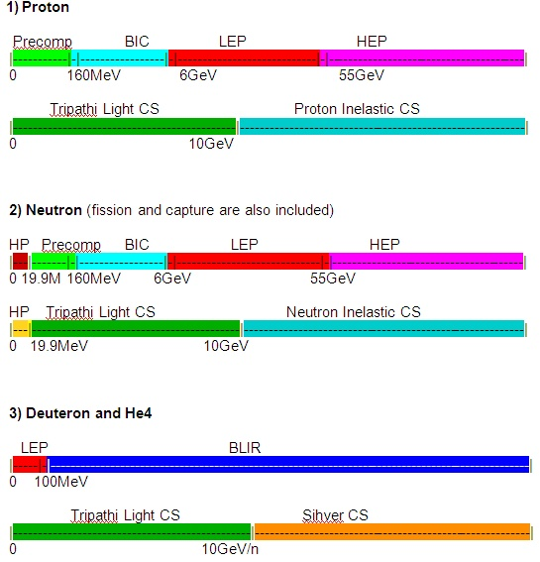
Physics models & cross sections selected: p, n, d, He4
BLIR (Binary Light-Ion Reaction)
model is pushed to higher energies
to include reactions of high energy
GCRs
(GCR primaries are generated
from 0.01MeV/n up to 50GeV/n)

Slide 9
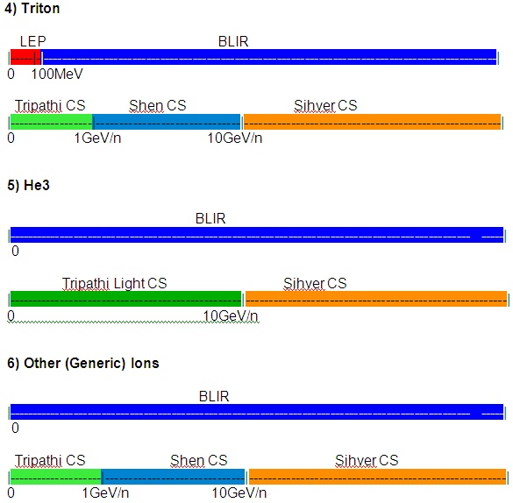
Physics models & cross sections selected: t, He3, generic ions
7) Anti-proton, anti-neutron, pions, kaons, and other hadrons use the default LHEP model.

Slide 10
Check whether geometry is big enough (edge effect)
Results shown in this talk are quantities
averaged over the surface inside habitat
(r<7.5m),
should be free of edge effects
r
r
Primary protons are uniformly distributed over the surface
Effect from edges is small for r<16m

Slide 11
Methods
We made 2 separate calculations for better heavy ion statistics:
1) p & alpha as primary GCR particles
2) heavier ions (Z ≥ 3) as primary GCR particles
the 2 results were then combined with proper weights
For each particle species:
Energy spectrum flow rate across lunar surface
Isotropy is assumed in conversion
from particle flow to fluence
Fluence rate spectrum (E)
Effective dose rate spectrum (E)
C_{iso}
Effective dose rate
C_{iso}: conversion coefficients from fluence to effective dose for isotropic irradiation
from Peliccioni: Radiat. Prot. Dosim. 88, 279–297 (2000),
Sato et al.: Radiat. Prot. Dosim. 106, 137–144 (2003).

Slide 12
Effective dose rate spectra of neutrons
Energetic neutrons from fragmentation of primaries
t
Area under curve
effective dose integral
neutrons from ~0.1 MeV to
~1000’s MeV are important
Result w/o habitat
is consistent with Adams et al.,
albedo neutrons: ~0.1 MeV to ~100’s MeV are important

Slide 13
Effective dose rate of neutrons
Both show peak
at t~50cm
Downward neutrons
> albedo neutrons
for t > ~15cm
t:

Slide 14
Effective dose rate of other particles
Upward & downward particles are combined
Similar shapes as n
Much lower rates than n
t:

Slide 15
Effective dose rate of different ions (Z=1 to 28)
When there is no habitat:
α > p
Caution:
Absolute values of ion ED
have large uncertainties:
Radiation weighting factor w_{R}
vs
quality factor Q-L relation
Revision of w_{R} values

Slide 16
Dependence of effective dose rate on habitat thickness
Dose of ions (Z≥2) decrease strongly with t
→ total dose decrease
strongly with t
Doses from secondary particles
(n, γ, π⁺⁻ , e⁺⁻ , including albedo):
increase with t
reach maxima at t~50cm
fraction in total effective dose
grows strongly with t :
~5% at t=0cm,
~47% at t=50cm
t:

Slide 17
Summary
Average effective doses inside a lunar habitat dome
of different thickness t are calculated
We find:
Effective dose of downward neutrons exceeds
  that of albedo neutrons for t >15cm
Effective doses of secondary particles (n, γ, π⁺⁻ , e⁺⁻)
  first grow with t,
  reach maximum at t ~50cm (or 100g/cm²),
  then slowly decrease
  → they are more important inside a habitat
Their fraction in the total effective dose increases strongly with t
because the total effective dose decrease strongly with t

