Slide 1

DOE Office of Science Planning Meeting
June 10, 2010

Slide 2
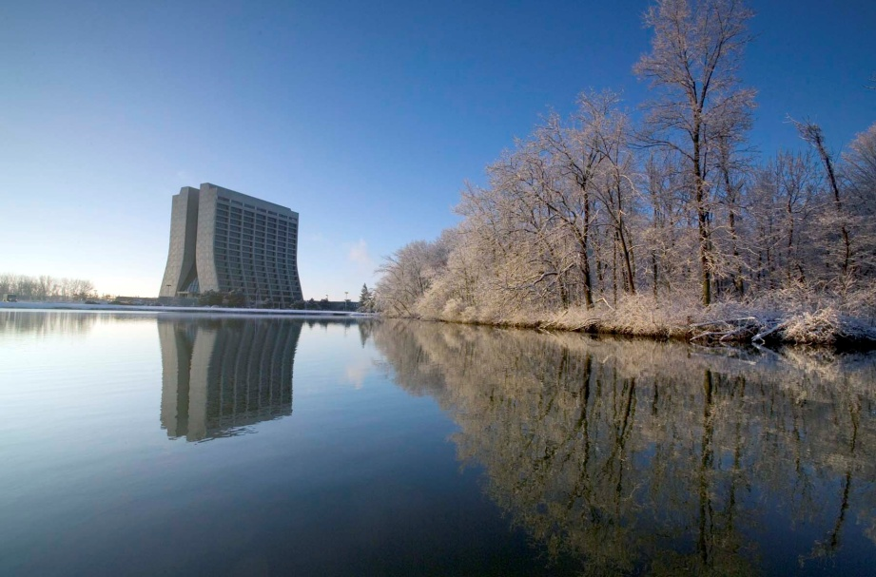
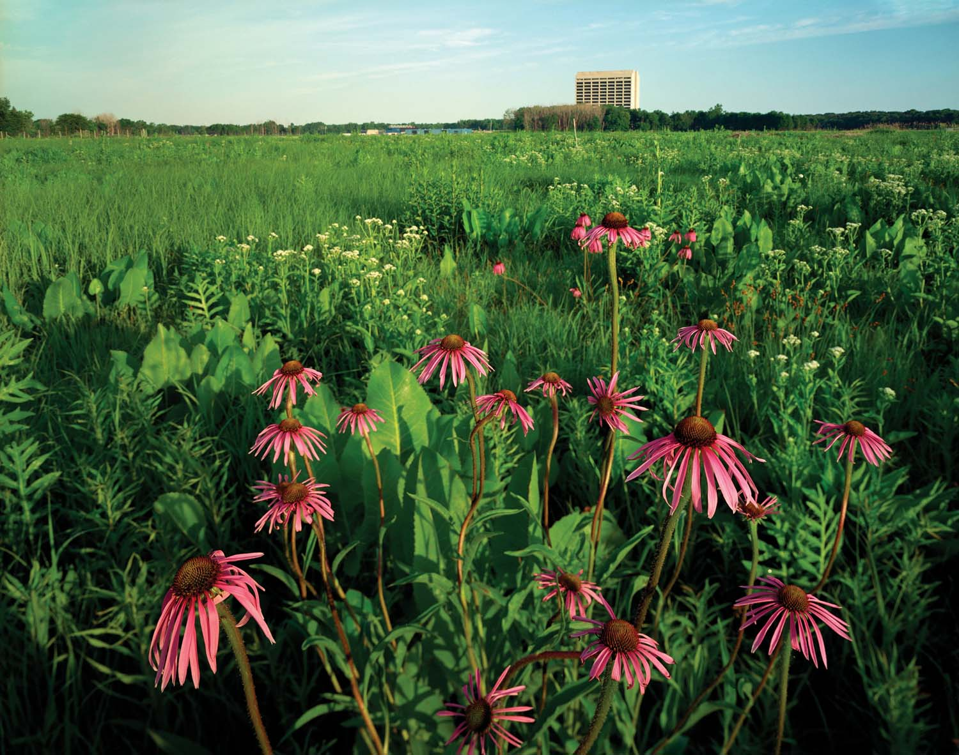
Fermilab characteristics (FY2009)
Highest intensity neutrino beams (low and high energy)
A world class astrophysics , particle theory and computation programs
Advanced detector and accelerator technology
1912 employees; $ 374.7 M
2300 users and visiting scientists
6800 acres, park-like site
Tevatron: most productive collider probably through 2011

Slide 3
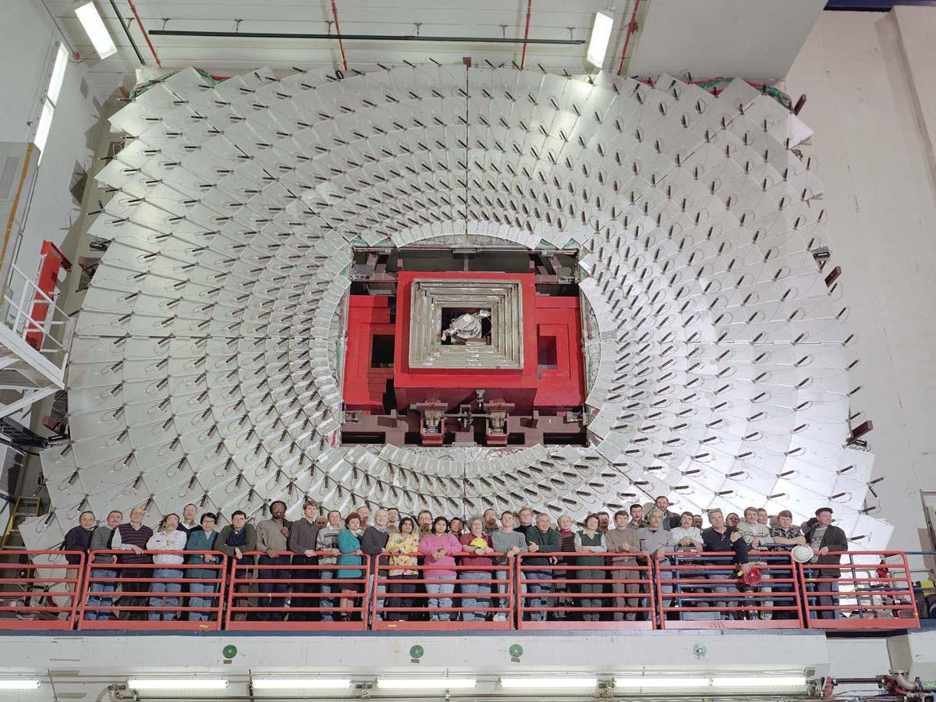
Mission: the national particle physics lab
Enable the US community to tackle the most fundamental physics questions of our era
Interdependence: integrate the universities and other laboratories fully into national and international programs

Slide 4
Program drivers: science
The sense of mystery has never been more acute and evident
  Where does mass come from?
  Are there extra dimensions of space?
  Why only three families of quarks and lepton?
  Why is matter dominant?
  What are the neutrino masses and what do they say?
  Where are the heavy neutrino partners?
  Does nature use supersymmetry?
  Do the forces unify?
  What is dark matter?
  What is dark energy?

Slide 5
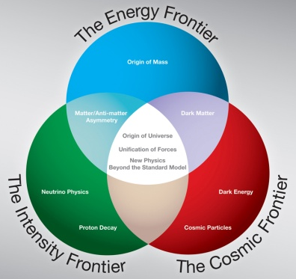
Program drivers: science
These questions fire the imagination of the public and the press
As the national laboratory for particle physics, we place the US in a leadership position in the world
Most elements are in place: exciting opportunities and national strategic plan at each of the three frontiers of particle physics: energy, intensity and cosmic frontiers
Historically many applications in society through development of accelerator, detector and computational technology

Slide 6
Laboratory Total Budget
 | Energy Frontier | Intensity Frontier | Cosmic Frontier
Particle Physics | 11% | 6% | 4%
Accelerator Science | 13% | 6% | 0%
Large Scale User Facilities | 33% | 25% | 2%

Slide 7
World class skills → core capabilities
Skill | Particle Physics | Accelerator Science | Large Scale User Facilities
Theory |  |  | 
Accelerator Technologies |  |  | 
Advanced Instrumentation |  |  | 
Simulation |  |  | 
Data Analysis & Distributed Computing |  |  | 
Systems Integration & Operations |  |  | 
Project Management |  |  | 

Slide 8
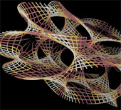
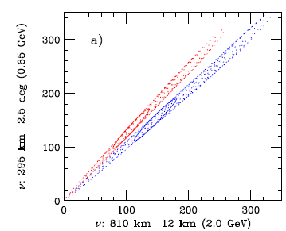
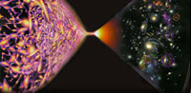
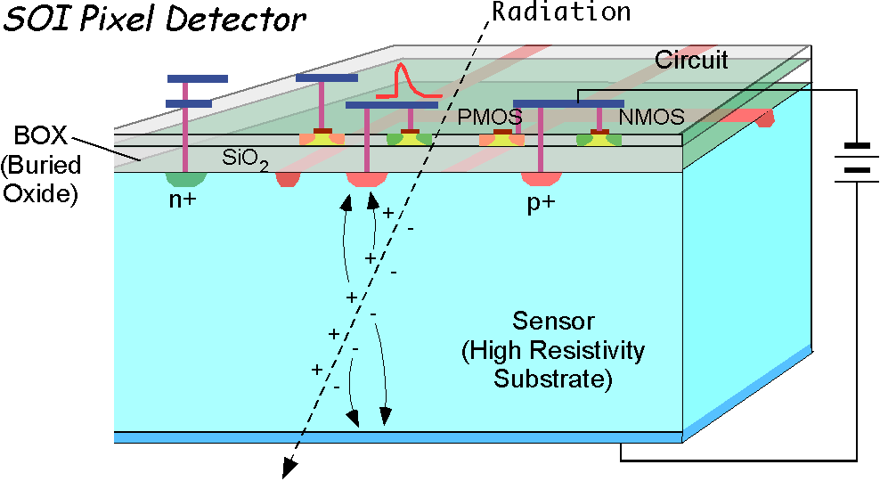
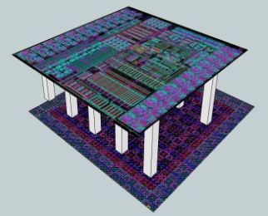
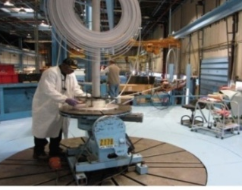
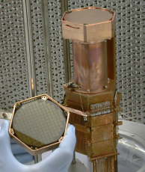
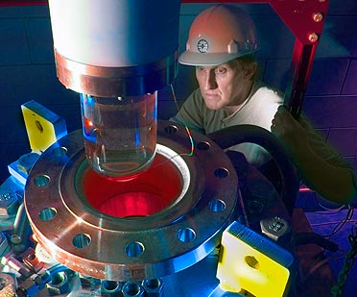
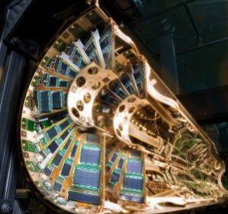
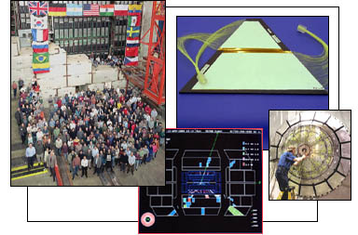
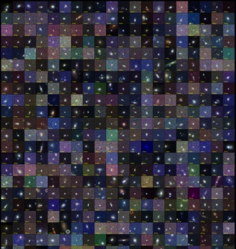
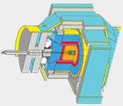
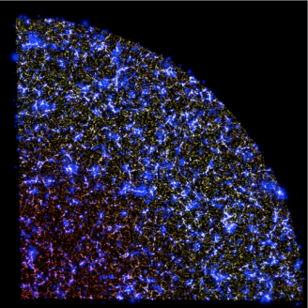
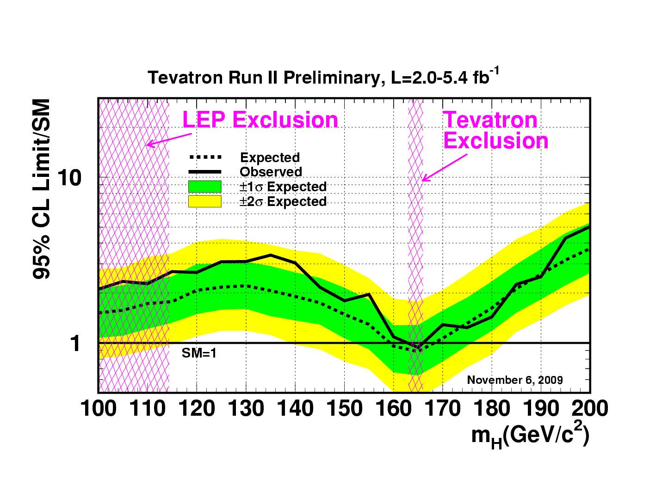
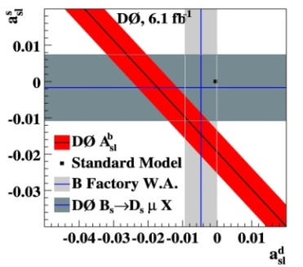
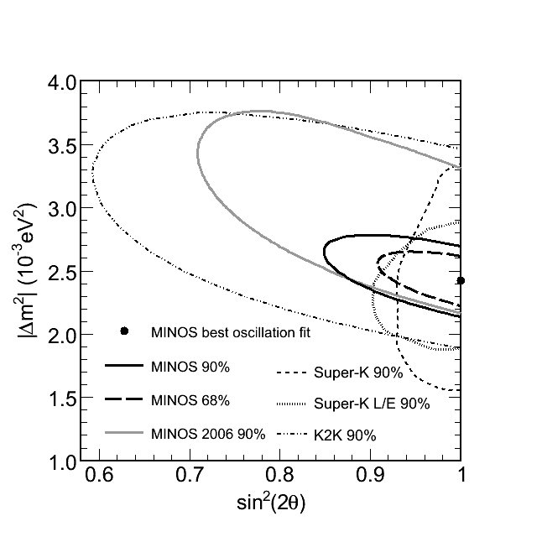
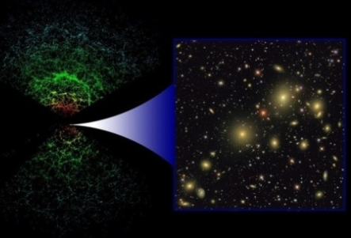
World class skills → Particle Physics
Particle Physics: Skill | Energy Frontier | Intensity Frontier | Cosmic Frontier
Theory | QCD Beyond Standard Model Monte Carlo Generator | Matter dominated universe Neutrino Mixing | Phenomenology and analysis of cosmic frontier experiments
Advanced Instrumentation | Silicon Vertex detectors, 3D ASIC Design | Liquid Argon TPC | Cryogenic detector Bubble chambers CCD packaging Laser Cavities
Simulation | Fast simulation for lepton and hadron colliders, GEANT4 detector simulation, Lattice QCD | Neutrino simulation (a various kinds of detectors) Muon simulation | Large scale cosmological simulation
Data Analysis & Distributed Computing | Analysis of large Tevatron and LHC datasets, World-wide collaboration | Understanding low energy nuclear interactions and flux, World-wide collaboration | Management of data intensive cosmic surveys (SDSS, DES, JDEM, …)

Slide 9
World class skills → Particle Physics
Particle Physics: Skill | Energy Frontier | Intensity Frontier | Cosmic Frontier
Theory | QCD, Beyond Standard Model, Monte Carlo Generator | Matter dominated universe, rare processes, Neutrino Mixing | Phenomenology and analysis of cosmic frontier experiments
Advanced Instrumentation | Silicon Vertex detectors, 3D ASIC Design | Liquid Argon TPC | Cryogenic detector Bubble chambers CCD packaging Laser Cavities
Simulation | Simulation for lepton and hadron colliders, GEANT4 detector simulation, Lattice QCD | Neutrino simulation (a various kinds of detectors) Muon simulation | Large scale cosmological simulation
Data Analysis & Distributed Computing | Analysis of large Tevatron and LHC datasets, World-wide collaboration | Understanding low energy nuclear interactions and flux, World-wide collaboration | Management of data intensive cosmic surveys (SDSS, DES, JDEM, …)

Slide 10
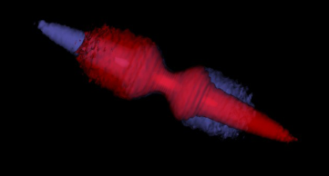
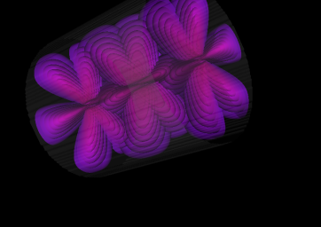
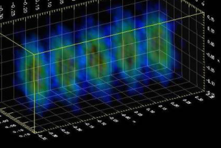
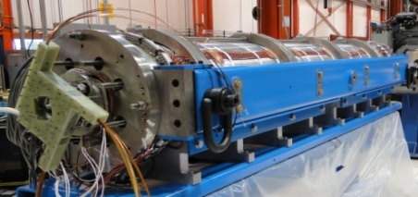
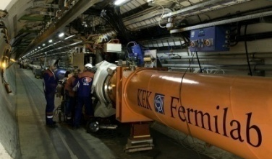
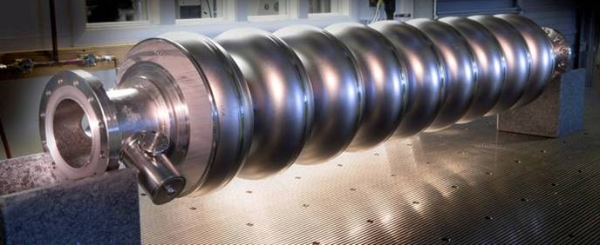
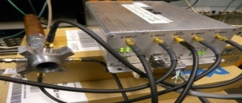
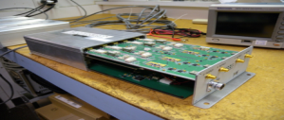
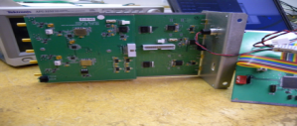
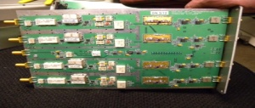
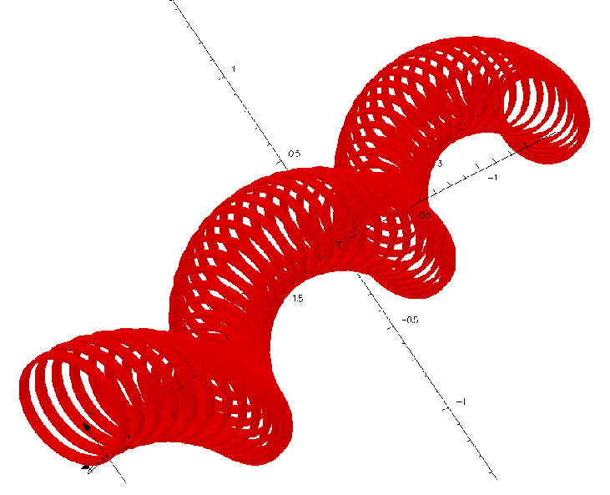
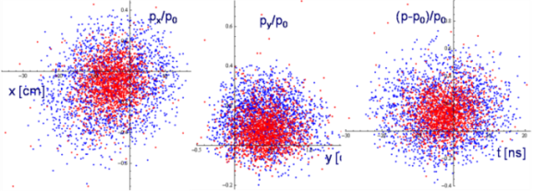
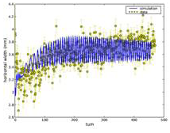
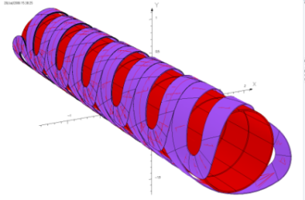
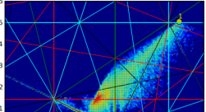
World class skills → Accelerator Science
Accelerator Science: Skill | Energy Frontier | Intensity Frontier | Cosmic Frontier
Theory | Collider beam dynamics (beam-beam, IBS, etc) | Instabilities, loss mitigation (energy deposition)
Accelerator Technologies | SC Magnets (Nb₃Sn, HTS), SC RF (β=1), RF power | SC RF (β<1), Particle Sources, RF power
Advanced Instrumentation | Beam diagnostics and feedback | Beam diagnostics and feedback
Simulation | Integrated accelerator simulations (Synergia, Muon Collider), Energy Deposition (MARS) | Integrated accelerator simulations (Synergia, Muon Collider) Energy Deposition (MARS)
Data Analysis & Distributed Computing | Shot Data Analysis

Slide 11
World class skills → Accelerator Science
Accelerator Science: Skill | Energy Frontier | Intensity Frontier | Cosmic Frontier
Theory | Collider beam dynamics (beam-beam, IBS, etc) | Instabilities, loss mitigation (energy deposition)
Accelerator Technologies | SC Magnets (Nb₃Sn, HTS), SC RF (β=1), RF power | SC RF (β<1), Particle Sources, RF power
Advanced Instrumentation | Beam diagnostics and feedback | Beam diagnostics and feedback
Simulation | Integrated accelerator simulations (Synergia, Muon Collider), Energy Deposition (MARS) | Integrated accelerator simulations (Synergia, Muon Collider) Energy Deposition (MARS)
Data Analysis & Distributed Computing | Shot Data Analysis

Slide 12
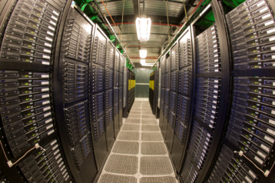
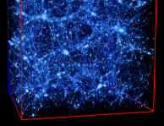
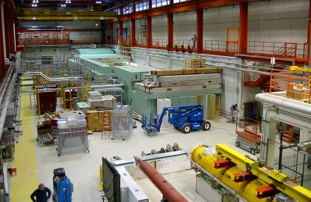
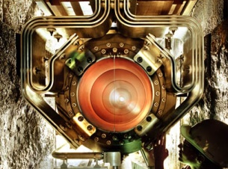
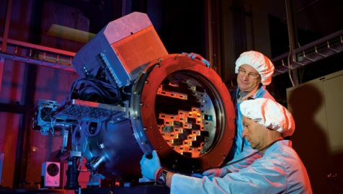
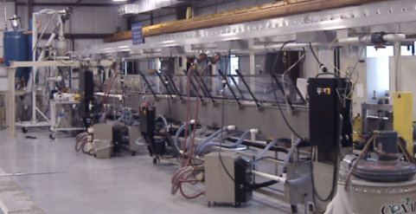
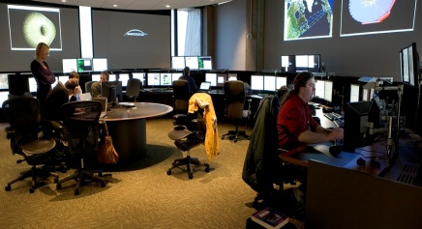
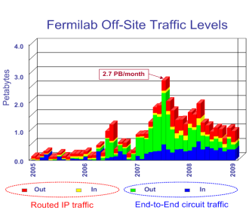
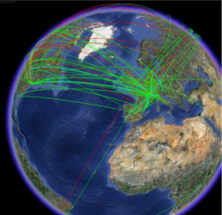
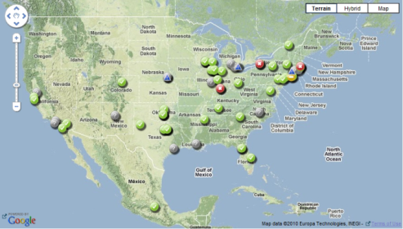
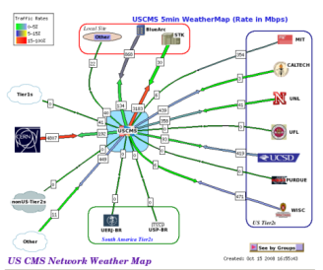
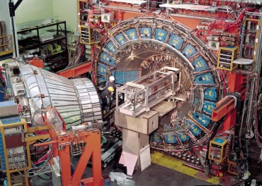
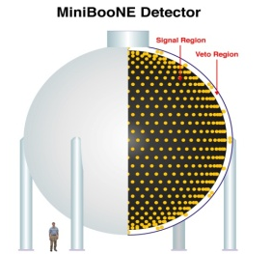
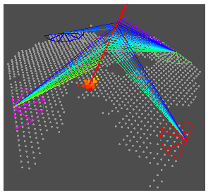



World class skills → Large Scale User Facilities
Large Scale User Facilities: Skill | Energy Frontier | Intensity Frontier | Cosmic Frontier
Theory | Lattice QCD National Facility | Lattice QCD National Facility | Cosmological Computing
Accelerator Technologies | NML Accel Test Facility, MuCOOL Test Area, Muon Collider, ILC | NML Accel Test Facility, NuMI, LBNE, Mu2e, Project X, Neutrino Factory
Advanced Instrumentation | Silicon Detector Facility Center | LAr R&D Facility, Extruded Scintillator Facility | LAr R&D Facility, Silicon Det. Facility Center (DES CCD packaging)
Simulation
Data Analysis & Distributed Computing | LHC Physics Center, Open Science Grid, CMS Tier-1 Center, Advanced Network, Massive Data Storage | Open Science Grid | Survey Data Archive
Systems Integration, Operations, Project Management | Tevatron Complex, CDF/DZero detectors, LHC Remote Oper. Center, Testbeam | NuMI & BNB (ν beams), Neutrino detectors, Soudan Underground Lab, Testbeam / small expt.s | Testbeam, Soudan Underground Lab., Silicon Detector Facility Center, Pierre Auger
12

Slide 13
World class skills → Large Scale User Facilities
Large Scale User Facilities: Skill | Energy Frontier | Intensity Frontier | Cosmic Frontier
Theory | Lattice QCD National Facility | Lattice QCD National Facility | Cosmological Computing
Accelerator Technologies | NML Accel Test Facility, MuCOOL Test Area, Muon Collider, ILC | NML Accel Test Facility, NuMI, LBNE, Mu2e, Project X, Neutrino Factory
Advanced Instrumentation | Silicon Detector Facility Center | LAr R&D Facility, Extruded Scintillator Facility | LAr R&D Facility, Silicon Detector Facility Center (DES CCD packaging)
Simulation
Data Analysis & Distributed Computing | LHC Physics Center, Open Science Grid, CMS Tier-1 Center, Advanced Network, Massive Data Storage | Open Science Grid | Survey Data Archive
Systems Integration, Operations, Project Management | Tevatron Complex, CDF/DZero detectors, LHC Remote Oper. Center, Testbeam | NuMI & BNB (ν beams), Neutrino detectors, Soudan Underground Lab, Testbeam / small expt.s | Testbeam, Soudan Underground Lab., Silicon Detector Facility Center, Pierre Auger
13

Slide 14



Energy Frontier: achievements
Tevatron graduates 60 PhDs per year and produces about a 100 results per year; an example is the recent matter-antimatter asymmetry in DZERO

Slide 15


Is there more juice in the Tevatron?
M_{top}: Tevatron
M_{W} : Tevatron+LEP2
100 GeV
through FY11
95%CL
exclusion
200 GeV
300 GeV
M_{W} (GeV)
500 GeV
through FY09
M_{higgs}
1000 GeV
150 175 200
M_{top} (GeV)
3σ
evidence

Slide 16


Energy frontier will move to the LHC
Fermilab is the lead US lab on the accelerator and the only US lab in CMS supporting over 50 universities

Slide 17

LHC physics reach (3 years ago)
14 TeV
Shifted by >2 years
Courtesy Fabiola Gianotti
[Now displaced by 2+ years]

Slide 18
Biggest decision of the decade !
ILC Enough
By far the easiest!
A global program
LHC Results
or
CLIC
ILC not enough
or
Muon collider
18
Notes:
18
18

Slide 19





ILC/Project X/XFEL technology
Horizontal Test Stand
1st cryomodule
Vertical Test Stand

Slide 20
Muon Collider approach
Collider based on a secondary beam: we have experience basing colliders on antiprotons. For muons we must do it in 20 msec.
The biggest advantages are: narrow energy spread (no beamstrahlung) and small physical footprint (no synchrotron radiation
DOE OHEP has asked Fermilab to organized the national R&D program

Slide 21


Slide 23

Energy frontier summary
Energy
Tevatron
LHC
LHC
LHC Upgrades
ILC??
LHC
ILC, CLIC or
Muon Collider
Now
2013
2016
2019
2022

Slide 24

Intensity frontier: achievements
MINOS:
  Neutrino runs
    best Δm²₂₃
    sin²(2θ₁₃) limit
  Anti-neutrino runs
    CPT test
    “blind analysis” results next week

Slide 25


Intensity frontier: achievements (cont.)
MiniBooNE
  Neutrino runs
    Anomalous
  Antineutrino runs
    New results next week (oscillation and low energy)
neutrino
anti-neutrino

Slide 26



Intensity frontier: achievements (cont.)
MINERvA
  CD-4 June 2010
  ν interactions with various targets
ArgoNeut
  0.3 ton LAr TPC
  New ν detector technology

Slide 27

Intensity is key for neutrinos
Recent Discoveries
  produced much excitement.
Behave so different from other particles
Possibly key to understand the matter-dominate Universe
Unification
Cosmic Connection
This route like the energy path depends of what we find in the current generation of experiments

Slide 28


“Ultimate Goal”
multi MW beam
larger detector (a few 100 kton)
long distance (> 1,200 km)
Remove
Accelerators from Cockroft-Walton
though Booster and Booster neutrino.
All the green ones
including MuCOOL stay
Project X
Neutrino physics
Muon physics
Kaon physics
Nuclear physics
Project X
Neutrino physics
Muon physics
Kaon physics
Nuclear physics
Project X provides:
neutrinos
muons
kaons
nuclei
“simultaneously”
2 MW (60-120 GeV)
1300 km
28

Slide 29



Ray Davis’s Experiment

Slide 30




Intermediate Steps
NOvA (off-axis)
MINERvA
MicroBooNE (LAr TPC)
Neutrinos
since 2013:
NOvA, MINERvA
MicroBooNE
SeaQuest
810 km
700 kW
NOvA
NOvA Construction (ARRA)
30

Slide 31

Intermediate Steps
Neutrinos
LBNE(to DUSEL)
Muons
Mu2e
Neutrinos
to
DUSEL
Neutrinos:
LBNE (ν, proton decay, …)
(CD-0 approval)
Muons:
Mu2e (CD-0 approval)
μ g-2/EDM(DOE review in Aug)
700 kW
1300 km
Kaons:
K⁺ → π⁺νν
(proposed, but …)

Slide 32
Interplay: LHC Intensity Frontier
nothing
Only handle on the
next energy scale
Intensity
Frontier
LHC
Determine/verify
structure of new
physics. Anything
beyond?
Lots

Slide 33

Large effects in kaon decay rates
d
d
d
d
W
s
d
s
quarks
d
quarks
W
W
Z
lepts
ν
ν
ν
SM: Κ_{L} π⁰ ν ν
ν
d
d
d
d
χ
s
d
s
χ
squarks
χ
d
squarks
χ
slepts
ν
ν
ν
BSM: Κ_{L} π⁰ ν ν
ν

Slide 34



A new (g-2) to uncertainty 0.14*10⁻¹¹
Model
LHC
UED

Slide 35
Mu2e can probe 10³ – 10⁴ TeV
New Physics
Scale (TeV)
with Project X
pre-Project X
MEG Experiment
SUSY
Compositeness
Model Parameter
35

Slide 36








Summary: intensity frontier strategy
MINOS
MiniBooNE
MINERvA
SeqQuest
NOvA
MicroBooNE
g-2?
SeaQuest
Project X+LBNE
μ, K, nuclear, …
ν Factory ??
LBNE
Mu2e
Intensity
Now
2013
2016
2019
2022

Slide 37


Cosmic Frontier: achievements
COUPP
CDMS
COUPP (2010)

Slide 38

Present results: UHE Cosmic Rays
Auger Observatory
studies ultra-high energy cosmic rays.
o – Cosmic rays with
E > 57,000,000 TeV
x – Active Galactic Nuclei
Correlation

Slide 39



Dark Energy
SDSS
DES
JDEM
SDSS (Sloan Digital Sky Survey)
  Ranks as highest impact facility in astronomy for the 4rd year in a row.
  Baryon acoustic oscillations
DES (Dark Energy Survey)
  4 meter telescope in Chile
  DES Camera under construction
  Operation: 2011 – 2016
JDEM (Joint Dark Energy Mission)
  Space telescope
  Fermilab: Science Operation Center
Notes:
Spectra of thousands of Supernovae
Map the Universe out to even higher redshift
Weak Lensing from space

Slide 40

Summary: cosmic frontier strategy
DM: ~1 ton
DE: JDEM, ..
Holometer?
DM: ~10 kg
DE: SDSS
P. Auger
DM: ~100 kg
DE: DES
P. Auger North?
Cosmic
DE: JDEM, …
Now
2013
2016
2019
2022

Slide 41
Risks
Energy Frontier
  Physics
  Timeliness in which physics will come
  Cost and feasibility of lepton colliders
Intensity Frontier
  Maintaining the momentum
  International participation
Cosmic Frontier
  Uncertainty on space-based telescope

Slide 42



Work for Others
Work for Others
  Currently small < 0.5%
  Future: open to opportunities aligned with core capabilities and assets

Slide 43



Collaborative Efforts
27 countries
International Collab.s
for our programs
Collaboration among DOE laboratories
  Project X, ILC/SRF, Muon collider, neutrino factory, LHC Accelerator, many particle experiments, …
Work for other DOE laboratories
Argonne-UChicago-Fermilab Collaboration
16 countries
23 countries

Slide 44

Education (K-12, undergrads, public)
http://www.fnal.gov/pub/education/k-12_programs.html
NSF, DOE, Fermilab Friends, Fee-based cost recovery
CY2009: 45,390 teachers, students, general public
        Regular teacher workshop: 98
        Summer interns: 55
        Summer teachers: 22
        Students field trip: 8,693
        Science adventure classes: 1,655
        Visitors to science center: 3,011
        Tours: 3,357 students;127 teachers;7,760 public
        Classroom presentation: 14,689
        Science Chicago Fest: 6,000
        …..

Slide 45
Fermilab Mission Readiness
Major Initiatives, related facilities / infrastructure
  Over five years, capable of performing the mission
  Power / cooling demands for computing remain an issue.
Mission readiness depends on
  SLI Utility Upgrade Project: CD-0 at $34.9M TPC
  $32.1M in ARRA GPP in support of science programs.
FY11-FY15 GPP
  $19.5M total (based on overall lab budget levels)
  Partially addresses needs of comp./det. infrastructure
Great opportunity
  $20M Illinois Accelerator Research Center (IARC) grant: aligned with mission, education, technology transfer

Slide 46
Fermilab Sustainability
Energy consumption reduction
  (excluding programs; 10% of total GHG) - 18.7% from the 2003 baseline; expecting to meet the 30% goal by 2015
Water consumption reduction
  35.6% from the 2007 baseline; exceeds the 16% goal for 2015 – progress mostly from leak reduction pipe repairs
Petroleum fuel reduction
  85% of fleet will be alternatively fueled vehicles by end of FY10; tracking to meet petroleum fuel reduction goal
Green House Gas reduction
  90% of GHG - accelerator complex, detectors, computing
  Significant reduction right after the Tevatron shuts down + increase from new projects.
Notes:
6%: 3rd party financing
1999 – 2003: utility company $16M – a lot of energy saving / improvement of infrastructure
consolidation

Slide 47
Cost of Doing Business
Major Drivers ($M)
 | FY05 | FY06 | FY07 | FY08 | FY09 | FY10
Electric Power | $18.3 | $21.3 | $25.0 | $27.9 | $27.7 | $24.0
IT / Cyber Security | $14.4 | $13.7 | $14.7 | $16.5 | $22.4 | $23.9
Facilities Maintenance | $9.1 | $9.4 | $11.8 | $12.6 | $15.1 | $13.9
Health Care Benefit | $22.0 | $23.2 | $21.5 | $23.0 | $23.9 | $24.0
TOTAL | $63.8 | $67.6 | $73.0 | $80.0 | $89.1 | $85.8

Slide 48
Increase in Major Drivers
Electrical Power:
  Competitive procurements through DOD Defense Energy Supply Center
  Locked in FY10 at low rate due to economy
IT/Cyber Security:
  IT consolidation reclassification of some direct costs
  ISO20000 certification initiative
Facilities Maintenance:
  Significant aging infrastructure (power/water)
  SLI will be effective in reducing this line
  Deal with Batavia on power lines saved $5M
Employee Benefits/Health Care:
  Aging workforce (increase)
  Aggressive negotiation with insurance carriers (decrease)
  Increase cost burden by employees and retirees

Slide 49
Top initiatives competing for overheads
IT Engineering Process Initiative
Consolidation and standardization (ISO20000)
Integrated Quality Assurance Program
Workforce planning
Lab-wide work breakdown structure initiative
ES&H initiatives
Modernization of Information Systems and Business processes
EVMS

Slide 50
Performance To Date
Expect to meet all “Notable Outcomes”
“Beyond Notable Outcomes”
  Towards one laboratory system integration
    Lab’s strategic plan, workforce planning, 10 year facility plan, master plan, lab-wide work breakdown structure, time and labor system, human resources database, project management software, engineering manual
  Better working place
    Focus groups (10% staff + users) and recommendations
    Employee advisory group as a sounding board for proper implementation
  Certified
    EVMS, towards ISO20000

Slide 51
Appendix A: Performance to Date
(Notable Outcomes)

Slide 52
Goal 1.0, 2.0, and 3.0
Obj | Notable Outcome | Status / Projection
1.1 | CDF and D-Zero will improve the exclusion limits on the allowed mass of a standard model Higgs Boson, and continue to study the most pressing Standard Model issues accessible at the Tevatron | On track: in FY2010 so far New Higgs limits 80 new results
2.1 | The Long Baseline Neutrino Experiment will make satisfactory progress toward CD-1 as determined by a peer review held in FY 2010 | Significant progress made; Director’s Review in July to evaluate CD-1 preparations
2.2 | The NOvA Project continue to progress towards completion on time and with budget. | CD-3b in Oct 2009; DOE OECM rating from yellow to green in Nov. 2009; Expect to be complete complete on time and with budget
2.3 | The Tevatron and NuMI will deliver at least as much data as in FY2009 | Tevatron – on track NuMI – already achieved
3.2 | The Laboratory will make progress in matching their staffing to the needs of the planned program. | On track: Lab-wide annual process “OHAP (Organization and Human Asset Plan)” as a tool

Slide 53
Goal 4.0
Obj | Notable Outcome | Status / Projection
4.1 | Lab leadership will develop a strategic plan for the future scientific & technical activities of the Lab, which aligns with the Office of Science and Department goals, and a detailed strategy for executing the plan during the next 2-5 years. | The strategic plan documented, made publicly available; Implementing this plan together with DOE HEP; OHAP – staffing plan to support the strategic plan (Objective 3.2)
4.2 | Lab. leadership will make significant progress in defining and implementing its contractor assurance system. It is expected that a collaborative and uniform approach to this issue among all contractors will be evident. | On track: Completed Root Cause Analysis Training & Graded Approach Suspect/Counterfeit Program Lessons Learned Program Corrective Action / Preventive Action Procedure Management (Self) Assessment Procedure Science As-Is Assessment
4.3 | The contractor will fill all key leadership positions at the Lab in a timely manner. | Appointed: AD for Computing, Science & Technology / CIO AD for Accelerators In search: Head of OPMO

Slide 54
Goal 5.0
Obj | Notable Outcome | Status / Projection
5.1 | Maintain ISO 14001 & OHSAS 18001 Registrations, as evidenced by successful completion of third-party surveillance audits conducted roughly every six months. | Surveillance audit in Oct. 09 Recertification audit in Jun. 10 Many new Initiatives
5.2 | Meet planned FY2010 milestones contained in the Corrective Action Plan that is being developed in response to the Mar 2009 Accelerator Safety Review. | 3 of 4 corrective actions completed on or ahead of schedule The 4th’s completion date is 2014.
5.3 | In support of the Federal Electronics Challenge and the requirements of Executive Order 13423, reduce the environmental impact of using personal computers (including laptops), monitors and printers. During FY2010, establish formal policies & procedures on energy efficient computing. Procurements of computers for scientific programming will include energy efficiency in the evaluation criteria for the procurement. A baseline assessment of the Lab’s EPEAT system performance will be conducted by the end of third quarter, FY 2010. | Oct. 2009 – Jan. 2010: 88% purchase EPEAT registered Feb. 2010 – April 2010: 98% purchase EPEAT registered For large procurements, scientific computing energy efficiency was included in RFP – an awarded point in the bid evaluation process

Slide 55
Goal 6.0
Obj | Notable Outcome | Status / Projection
6.1 | Complete full implementation of the electronic Time and Labor System by the end of 3rd quarter, 2010. | Adopted Kronos timecard Go-live late June
6.1 | Efficiently and effectively manages all activities in conjunction with the ARRA funding in accordance with all rules and requirements. No significant OIG or FNAL Internal Audit findings will serve as the measurement of success in meeting this notable target. | Milestones met; Costing rate accelerating; Procurement kept up. IG report, CH review → no issues identified
6.2 | Demonstrates the effectiveness of its procurement systems as evidenced by achieving a comprehensive score of 90 out of 100 on the DOE approved Procurement Balanced Scorecard. | Achieved so far (94/100); Expect to be 94 or 95 by end FY2010
6.3 | Upgrade its vehicle fleet maintenance software from the current FOCUS database to the Sunflower Maintenance module, thereby replacing an unsupported system with a more modern system that is integrated with other Property management(Sunflower) software. This will ensure the long term viability of the fleet management system | Achieved
6.4 | Design/implement a Succession Plan and Executive Pay Grade Structure for senior management positions (Deputy Director, COO/Associate Director, CFO, and CIOO) by the end of 4th quarter, FY 2010. | Succession Plan expect to be done by June 2010. Pay Grade Structure implementation by July 2010
6.5 | Completes scheduled FY2010 milestones and key activities identified in the DOE approved Quality Implementation Plan for an Integrated Quality Assurance program. Complete the start up of the Assessment Program and have it fully operational by the end of 3rd quarter, FY2010, in addition to implementing the Lessons Learned Program by 2nd quarter, FY2010 | On track

Slide 56
Goal 7.0
Obj | Notable Outcome | Status / Projection
7.1 | Update the FNAL Transformational Energy Action Management (TEAM) Executable Plan (EP) for FSO approval by the date specified in the DOE Guidance. FNAL will meet specific FY 2010 goals established in this EP. | EP updated and approved by the date requested All FY 2010 EP goals expected to be met
7.2 | Develop a Mission Readiness Plan for FY2010 which includes participation in two peer reviews and the development of FNAL Mission Readiness policies and procedures. This plan will be implemented by the end of 3rd quarter, FY2010. | Developed drafts of Director’s Policy on planning that includes mission readiness, and a draft process for the Annual Lab Plan including the Facility Mission Matrix 3 Peer Reviews: ANL (Nov. 2009), PPPL(Jul.2010),TJNAF (Sep.2010)
7.2 | Complete final designs and start construction on ARRA General Plant Projects (GPP) Augmentation covered under Work Authorization Number KA/CH14/9/ARRA-1, consistent with established milestones in the approved Project Operating Plans. | Final designs were completed, and construction is underway on 6 ARRA GPP projects All milestones have been met

Slide 57
Goal 8.0
Obj | Notable Outcome | Status / Projection
8.1 | A joint FNAL/FSO review of the Emergency Management Program will be performed no later than the end of third quarter, FY 2010. Corrective actions and lessons learned will be developed as appropriate. | Review complete Revisited Continuity of Operations Plan, call lists, etc. Fall 2009 with H1N1 Recent event with fatality in Wilson Hall clearly tested the emergency program. Lessons learned are in progress
8.2 | In accordance with the FNAL Corrective Action Plan Addressing S&S Cyber Security Findings, dated May 2009, all computers will be monitored using centrally managed tools to inspect the configuration for compliance with Microsoft Windows Workstation Class Baseline Security Configuration by the end of July 2010. | Tremendous progress made All milestones expected to be met
8.2 | All FNAL employees responsible for handling PII will receive training by the end of first quarter, FY 2010, and a review will be conducted of all applications in the ES&H area to clarify the need to maintain and handle PII. A new set of security plans will be written and approved in response to this review by June 2010. | PII training – Achieved Extensive survey of all ES&H systems were carried out

Slide 58
Appendix B: ARRA Activities
http://www.fnal.gov/recovery/

Slide 59




ARRA: NOvA

Slide 60



ARRA: SCRF
cavity fabricated
by joint venture of Roark and Niowave
Cryostats for SCRF Cavity Testing

Slide 61




ARRA: GPP (NML Extension)

Slide 62


ARRA: GPP (IB-3)

Slide 63


ARRA: GPP (MI-8)

Slide 64




ARRA: GPP (Feynman Comp. Center)

Slide 65


ARRA: GPP(Wilson Hall Generator)

Slide 66





ARRA: LBNE (Seismic Testing &Drilling)

