Slide 1
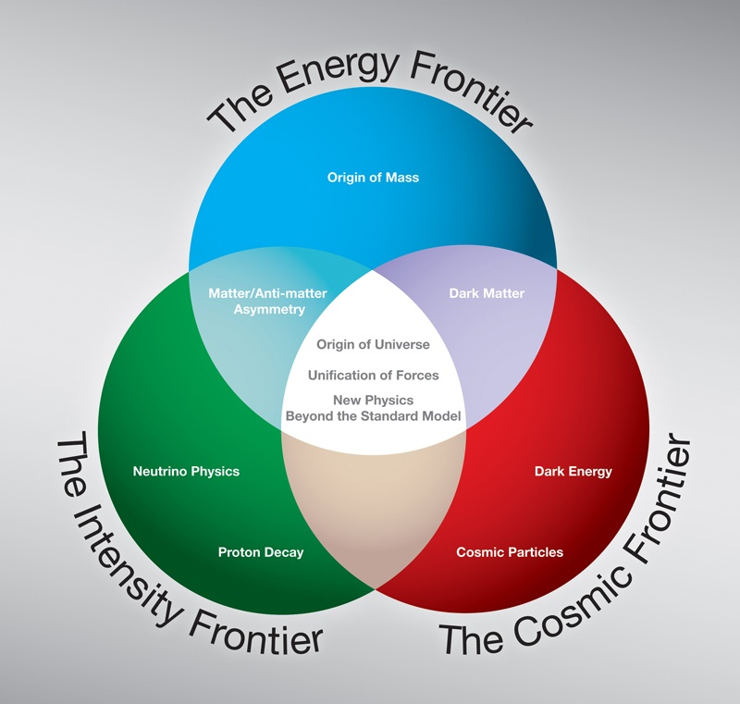
Summary
Workshop on Detector R&D
Hadron Colliders:
Tevatron
LHC
Dark Matter,
Dark Energy,
UHE Cosmic Rays
Neutrinos
Fixed Target
Supernova
Neutrinos

Slide 2
Goals of this workshop
To survey the detector research and development currently being carried out at national laboratories and universities
To identify the areas of detector R&D that hold greatest promise
To identify current challenges and future needs of all stakeholders and discuss the future of detector R&D in the U.S.
“Is there sufficient interest in a national program to
form a group to create a proposal?”
For discussion at the DPF meeting next summer?
Chip Brock

Slide 3
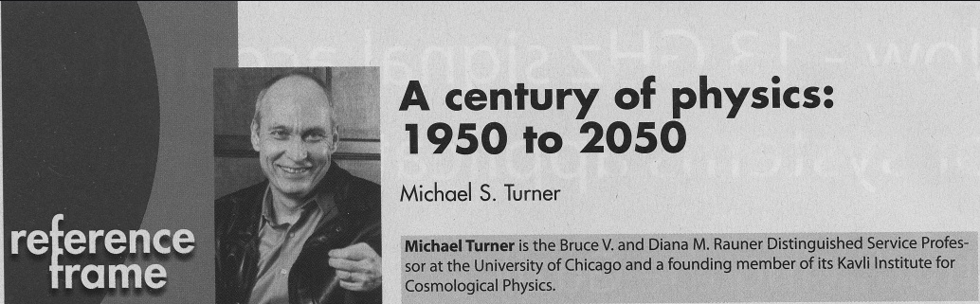
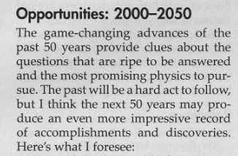
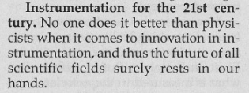
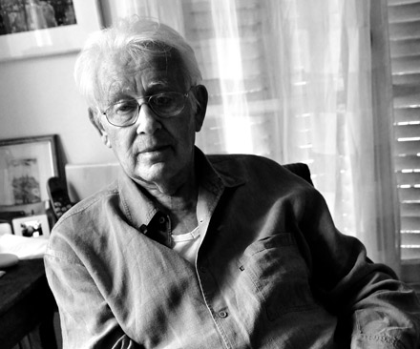
R&D is Important
(Physics Today September 2009)
Nobel Prize 1992
Howard Nicholson

Slide 4
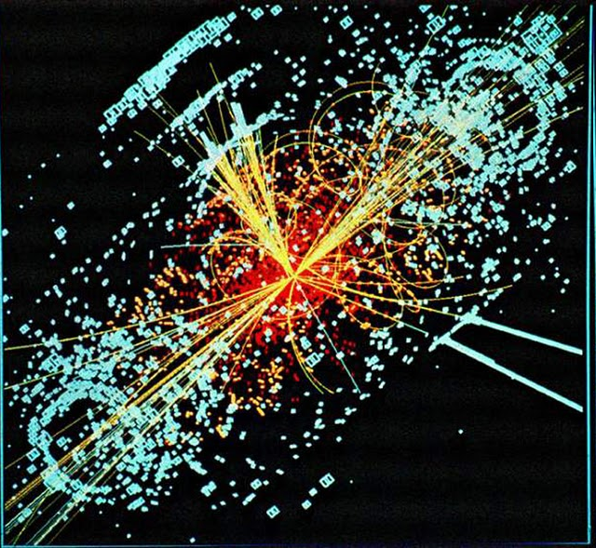
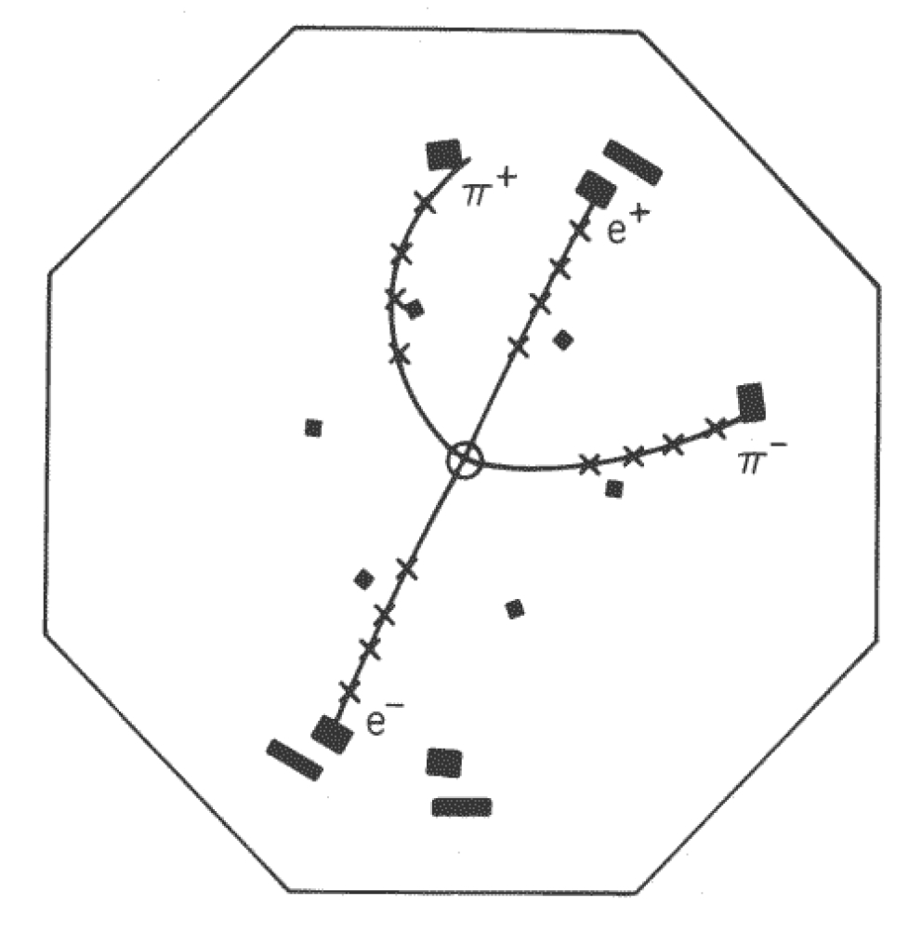
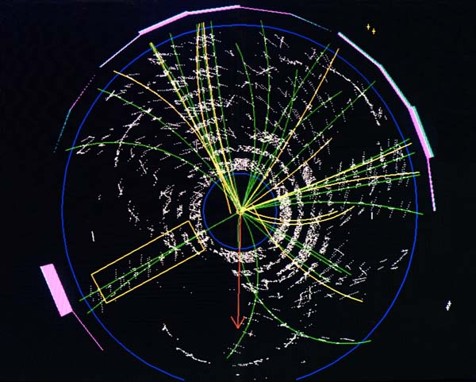
Why are we doing R&D???
Discoveries are getting harder to do!!!!
MARK-I detector (SLAC)
  e+e- @ 3 GeV
  Ψ´ (excited state of J/Ψ)
Top quark discovery at CDF and D0 pbarp @ 1,8 TeV
Simulation:
Higgs boson at LHC

Slide 5
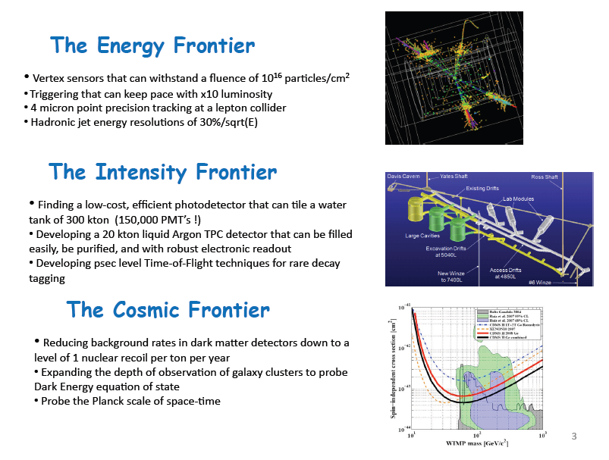
Very Diverse R&D
Erik Ramberg

Slide 6
HEP R&D must be global
We need to learn from industry
We need to interact with other fields (material science, chemistry, ….)
We need to interact with other countries

Slide 7
The energy frontier: SLHC
Phase-0 : 15 months: 2012 to spring 2013
Phase-1 : 12 months: entire 2016
Phase-2 : 18 months: end of 2019-early 2021
L_{int}=3000 fb⁻¹
By 2030
Phase 2
LHC-HL
L_{int}∼300 fb⁻¹
L∼5×10³⁴
Integrated luminosity
Phase 1
L_{int}=10-30fb⁻¹
L=1-2×10³⁴
L_{int}=1fb⁻¹
E_{CMS}=7TeV
E_{CMS}∼14TeV
Phase 0
L∼1×10³²

Slide 8
LHC upgrade challenges
Seiden
Very high rates; have to devise a sufficiently restrictive trigger that doesn’t lose the physics.
High mass physics is unknown so requires measurement of many quantities for both trigger and final analysis: leptons, photons, jets, missing energy, charged particle tracking, vertexing and heavy flavor tagging, particle isolation. Strive for very good resolution and high granularity in detection elements.
Radiation damage as well as rates present serious challenges; these provide major constraints on technologies that can be used.
Size and complexity (cables, power, cooling, and integration)
Smith,
Sciveres,
Lipton,
Li,
Ma+
Labs Talks
“Ultimate goal remains a massless, cheap, infinite granularity, 100% hermetic and efficient, infinite bandwidth, long lifetime detector”

Slide 9
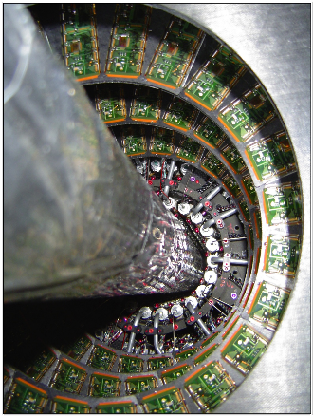
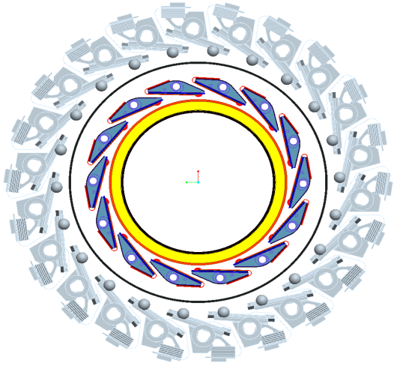
ATLAS IBL
Seiden
IBL inside existing B-layer.
How it looks
today.
Partnership between national laboratories and university is essential
Project Goals:
Improve Physics performance of the present Pixel Detector:
  Reduce material budget to an “aggressive” 50% of the present inner most pixel layer, i.e. <1.5% X/X₀ at η=0.
  Have low R/O inefficiencies at LHC ultimate luminosity.
  Increase radiation hardness by a factor of five to 5x10¹⁵ 1MeV neutrons/cm²
Installation schedule, 2016. 13 U.S. institutions involved.
New roc and new material development

Slide 10
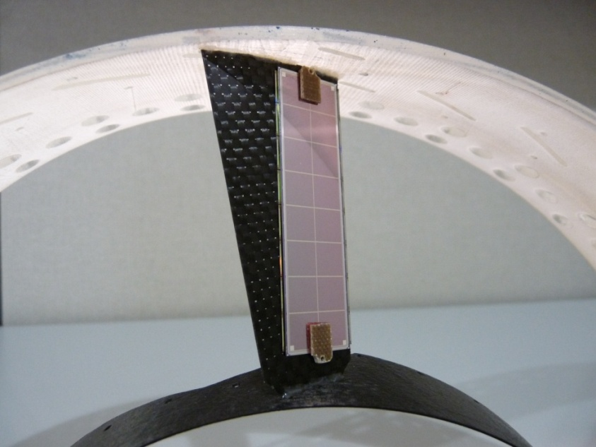
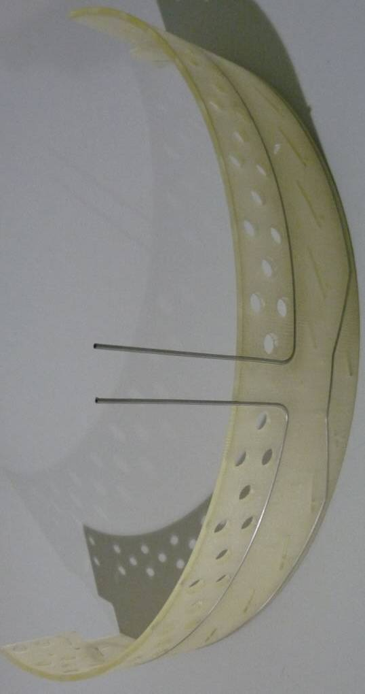
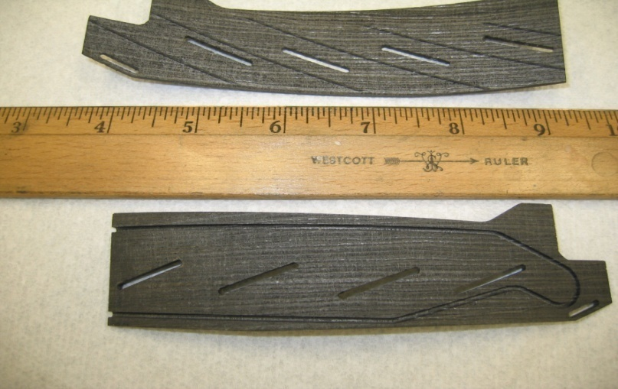
CMS Thermal Pyrolytic Graphite
Seiden
Pyrolytic graphite has a High thermal conductivity (in-plane k = up to 1700 W/m-K) and low density (2.26 g/cc)
Need to stiffen TPG substrate since parts get damaged easily without adding a lot of material while keeping a reasonable thermal performance.
Design of the FPIX support
  One ply of CFRP on TPG as facing sheet.
  To reinforce the structure, perforated holes are drilled on TPG
  CF encapsulation on both sides of TPG,
Heat sink
  Tiny tube for CO₂ cooling are embedded in Carbon-carbon (CC)
  CC is fragile since it is made very thin and therefore there are some machining challenges.
FNAL

Slide 11
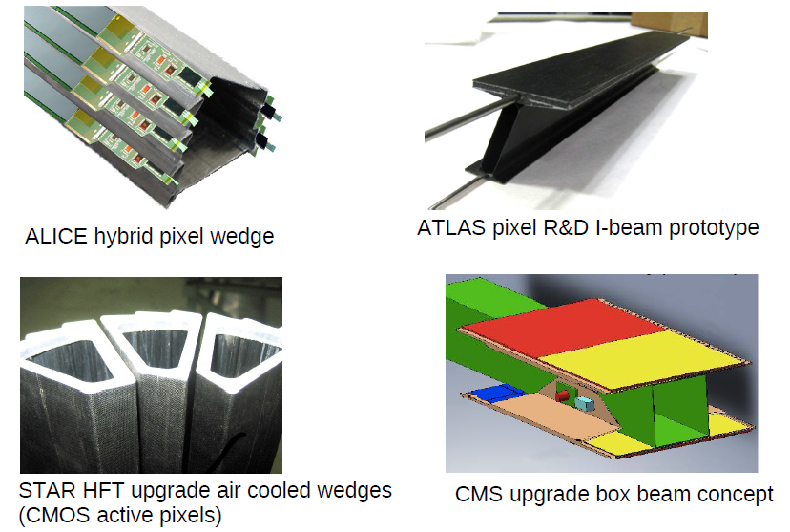
Mechanics Integration
GARCIA-SCIVERES

Slide 12
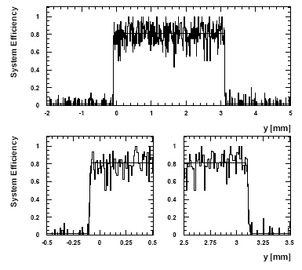
3D architecture for radiation hardness
3D
particle
PLANAR
n⁺
p⁺
n⁺
p⁺
n⁺
p⁺
n⁺
p⁺
n⁺
p⁺
~ 500 mm
-
-
+
300 μm
-
-
+
-
-
+
-
+
-
+
-
+
+
+
+
-
+
-
50 μm
n⁺
Active edge ~4μm
S. Parker, C. Kenney, J. Segal, NIM A395 (1997) 328-343.
Expected width = 3195 +/-5 μm
Measured width =3203 +/-4 μm
FNALWith: Purdue + others for CMS
David Macfarlane
SLAC With: Manchester; New Mexico; Hawaii; Czech Tech. U. Prague; Nuclear Physics Inst. Czech Academy of Sciences; Los Alamos; CERN for ATLAS

Slide 13
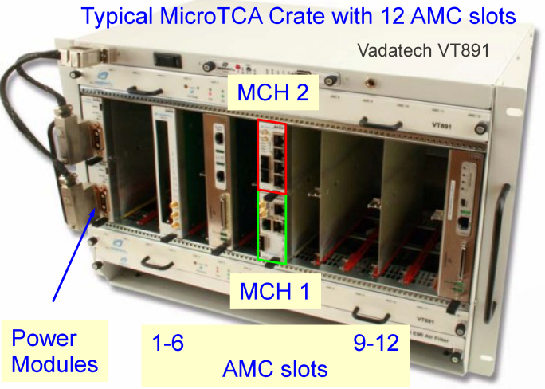
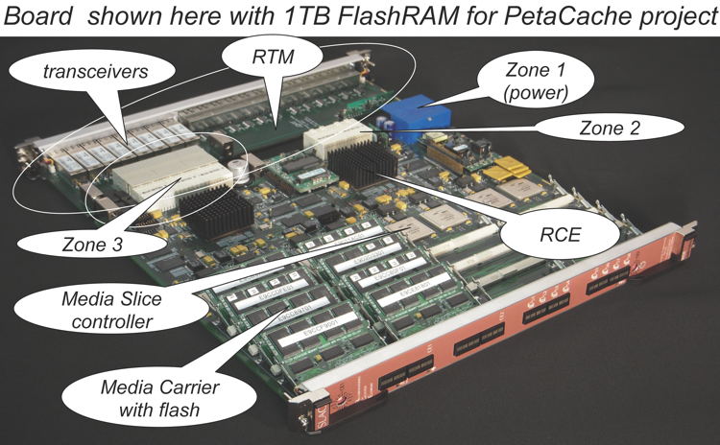
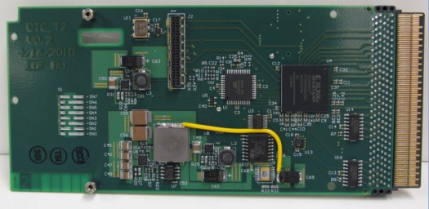
Trigger and DAQ R&D
Both experiments are looking at industry standards
CMS: μTCA Derived from AMC std.
ATLAS: ATCA
  Advanced Telecommunication Computing Architecture
  Crate based, serial backplane
Single Module (shown): 75 x 180 mm
Double Module: 150 x 180mm
Large modern FPGAs for versatile generic DAQ with its core effort named as Reconfigurable Cluster Element (RCEs), implemented on ATCA platform.
Smith, Macfarlane

Slide 14
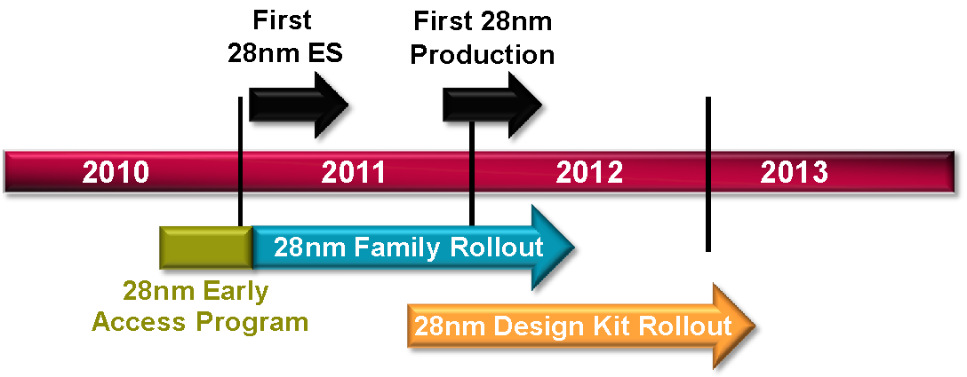
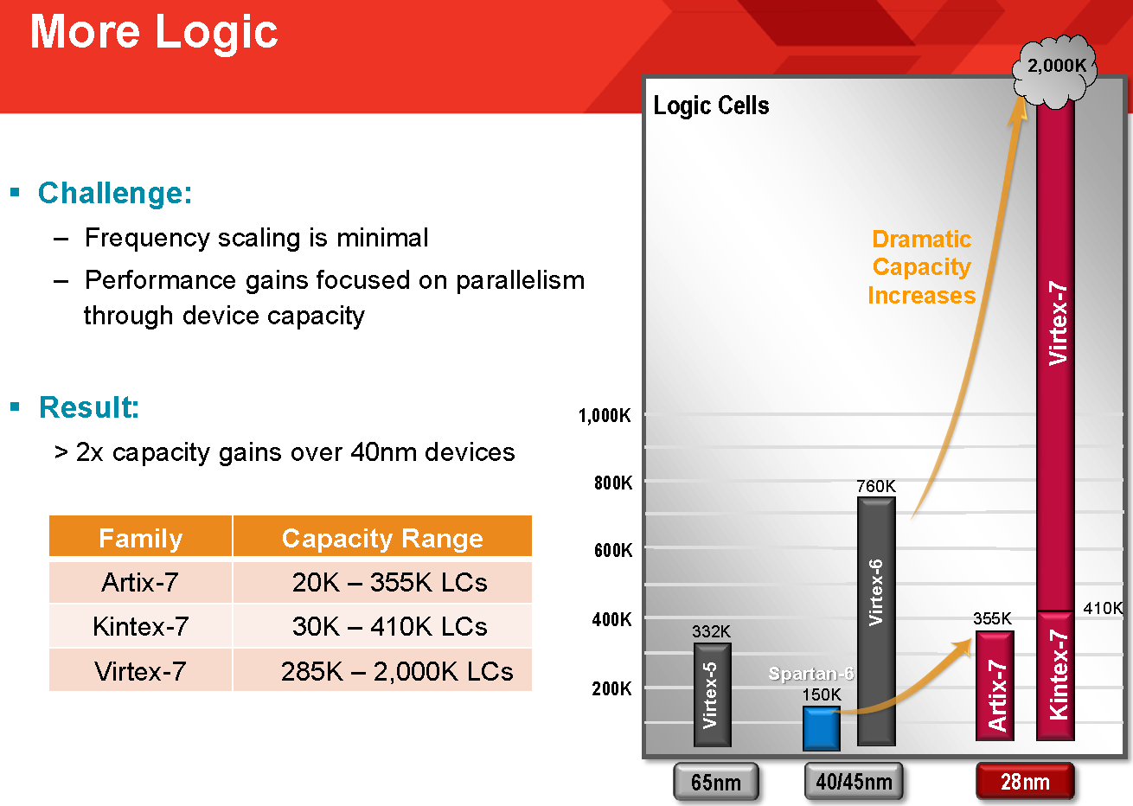

FPGA LOGIC CELLS
Next generation 28 nm:
Wesley Smith

Slide 15
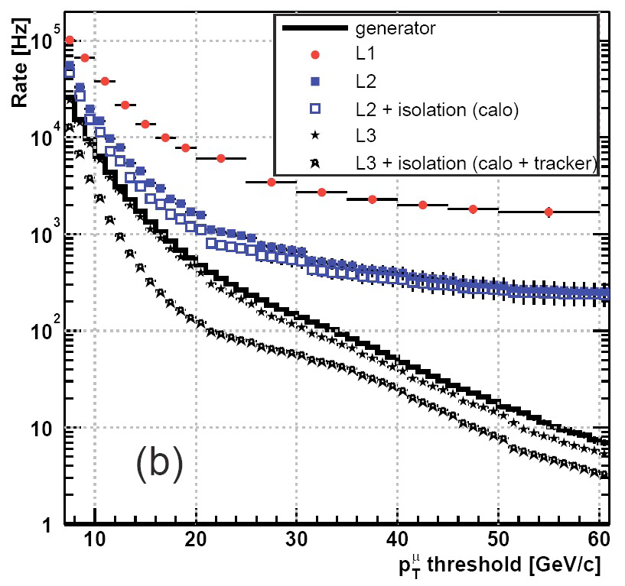
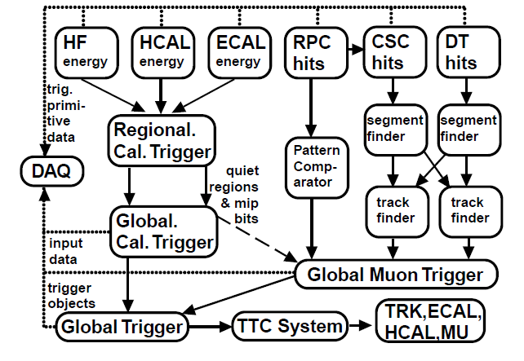
Track triggers
μ, e and jet rates
exceed 100kHz at SLHC
Online trigger CMS (L1) must operate with a maximum 100 kHz rate
  Higher L1 thresholds degrade physics sensitivity .
  Opportunity to use new tracker to provide input to the trigger and augment future trigger with tracking information
L= 10³⁴ cm⁻² s⁻¹
Muon L1 trigger rate
Planning new trigger platform based on μTCA
  Run in parallel with the current trigger until it retires.
  System will use 3.2Gbps links, standard μTCA processing cards using Virtex 5 FPGAs and large signal crosspoint switches.
Seiden, Smith

Slide 16
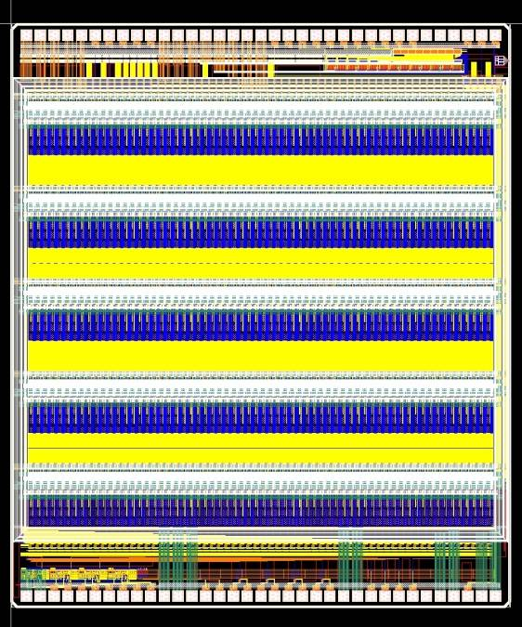
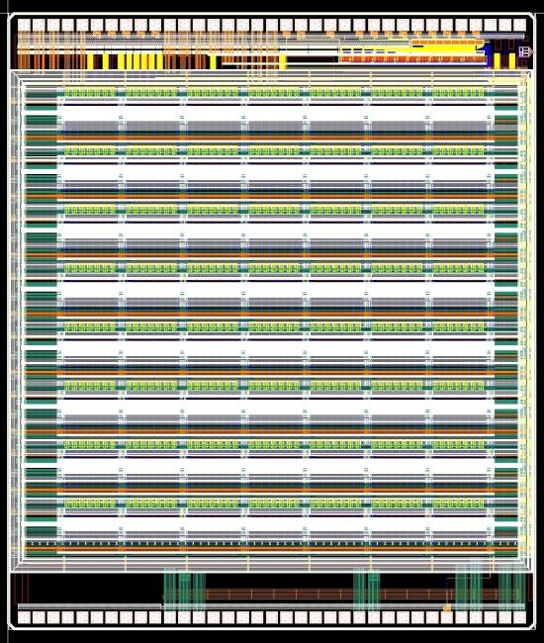
P_{T} module with vertical integration
    A single chip on the bottom tier can
    connect to both top and bottom
    sensors ⇒locally correlate information
    Enabled by “vertical interconnected” (3D) technology.
    Analog information from the top
    sensor is passed to ROIC through the
    interposer
    VICTR Chip intended to demonstrate the ingredients of a 3D-based track trigger
  One layer of chips ⇒No “horizontal” data transfer ⇒ lower noise and power
  Fine Z information is not necessary on the top sensor (~1 cm vs ~1-2 mm) strips can be used to minimize via density in the interposer
Ramberger, Seiden, Smith, Lipton etc.

Slide 17
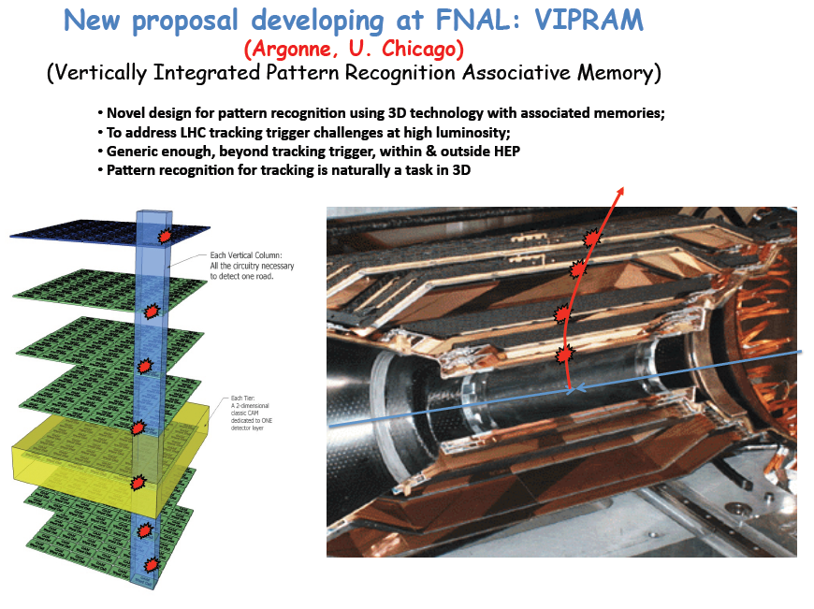
Ramberg

Slide 18
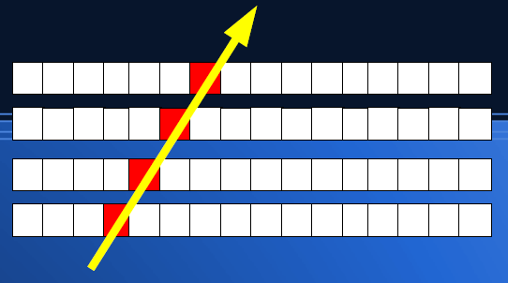
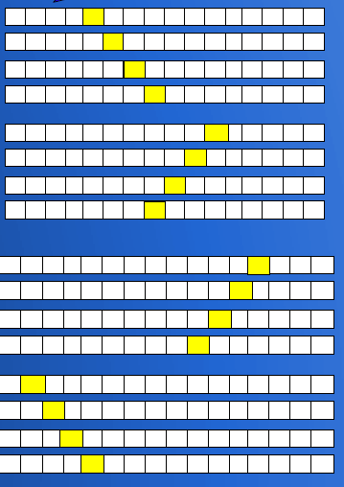
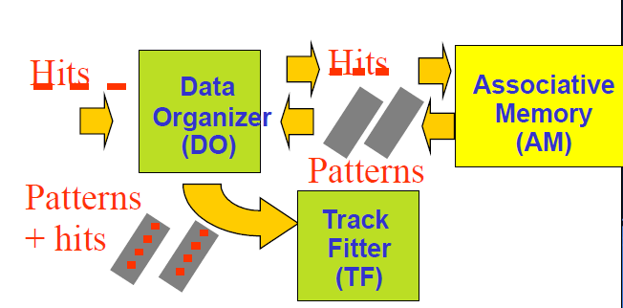
Pattern Matching at L2
Each charged particle generates a hit pattern in a tracker
All possible hit patterns stored in memory (pattern bank)
Hit pattern matching a pre-computed pattern = Candidate Track High degree of parallelism (Associative Memory to provide track info
Implementer in
  Silicon Vertex Tracker at CDF
  Fast Track trigger at H1
Fast TracKer (FTK) in ATLAS
Goal: reconstruct offline-like tracks in time for L2 decision @ 100 kHz (L1 rate).
Adapt SVT (+GF) experience to Atlas
Hit pattern
Pattern Bank
Smith, Seiden

Slide 19
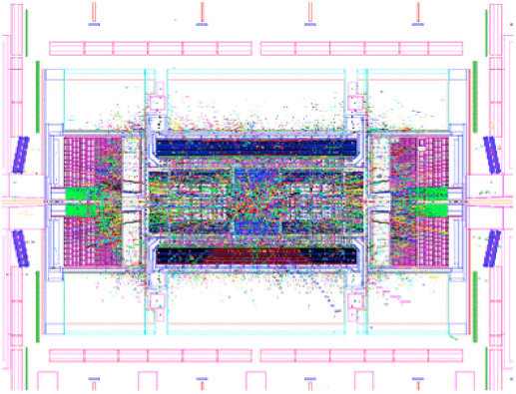
LAR calorimeter upgrade
Develop system architecture capable of maintaining detector performance with a very high pileup rate from minimum bias.
Improve trigger selectivity – which may boost discovery capabilities in physics searches.
  For both lepton and jet trigger thresholds and turn-on curve.
Using a completely digital readout architecture
ATLAS program makes use of three VLSI technologies: SiGe bipolar, 130 nm CMOS, and silicon-on-sapphire.
  Allows an evolution of the calorimeter readout architecture and of the level-1 calorimeter trigger toward a much more powerful trigger with more flexibility.
  R&D activities in the US to date:
    Front-End electronics: ASIC development in SiGe process for analog front-end (BNL and Penn).
    Digitization and multiplexing, ADC under development (Columbia).
    High speed optical links (SMU).
    Radiation hard power supply systems required (BNL).
Seiden

Slide 20
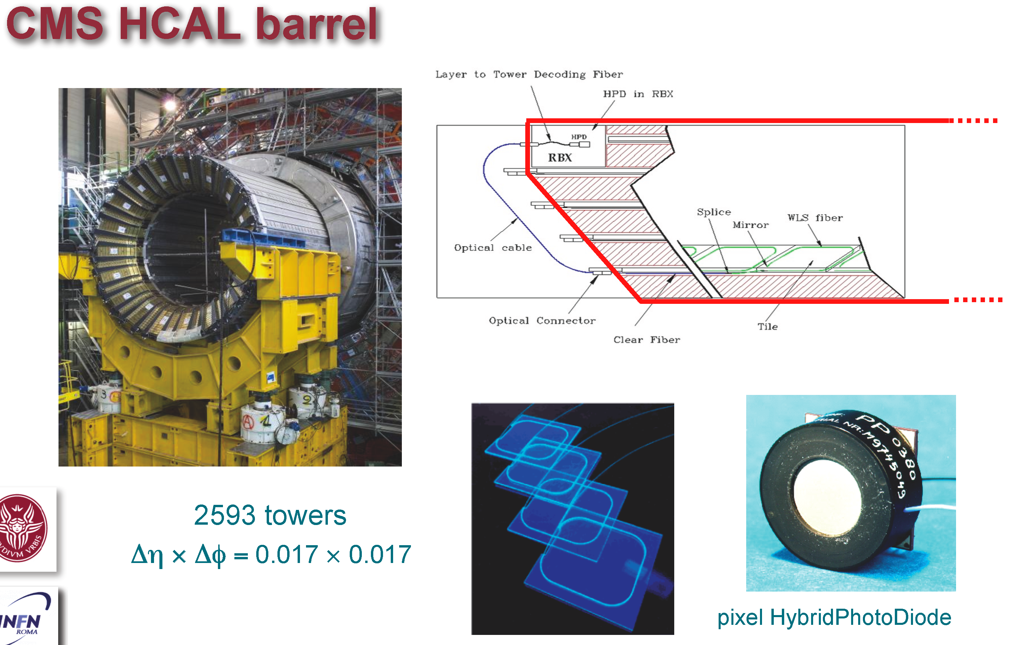
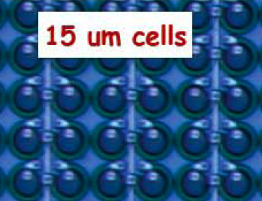
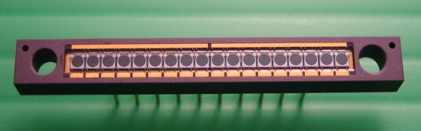
CMS SiPM R&D
SiPMs have the potential to create a revolution in photo-detection applications from HEP research to PET scanners to Innovative new applications
SiPM devices enhance the performance of existing LHC tile-fiber calorimeters in important ways:
  High photodetection efficiency (20-35%) + high pixel gain (x10⁴-10⁶) in a compact package:
    High Signal/Noise for High Granularity Longitudinally Segmented Readout and In situ MIP Calibration
    Low leakage noise and high PDE for “quiet” Lepton ID vetoes and isolation variables (e/pi separation, muon/jet separation, tau/jet separation)
    Eliminates orientation sensitivity to magnetic field
    Provide fast analog signals for precision timing/TDC
Collaboration with Industry on SiPm Development
  Evaluated devices from Zecotek, HPK, CPTA and FBK for PDE, response time, neutron sensitivity and radiation hardness
  Boston University, FNAL, Iowa, Northeastern, Notre Dame, Maryland, Minnesota, Princeton
HPK 2010
Seiden, Ramberg
Zecotek 2009

Slide 21
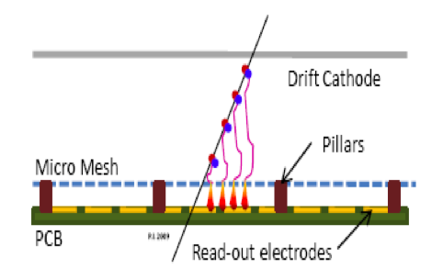
Micromegas and MPGD
Advantages of (Bulk) Micromegas
  Large active areas achievable (~m²)
  Standard Industrial PCB processing
  Excellent spatial resolution
  Capable of operating in high rate environments
  Well suited for upgrade of ATLAS forward μ chambers or other future large area muon spectrometers
R&D Program
  Signal formation calculation; readout anode optimization; studies through test beams at CERN (RD51)
  Development of front-end ASIC optimized for both position and time resolution
  Partnership with industries for large area (>1m²) detector structures
High eta Muon detection at the LHC
  Precise control of amplification gap is achieved by insulating pillars fabricated with standard PCB laminating, masking, and etching techniques.
Littenberg, Yu
21

Slide 22
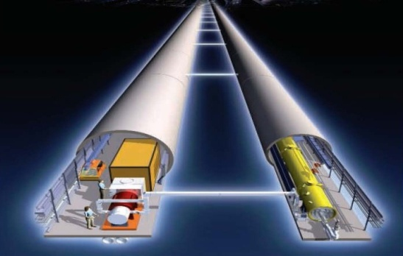
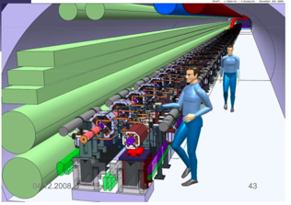
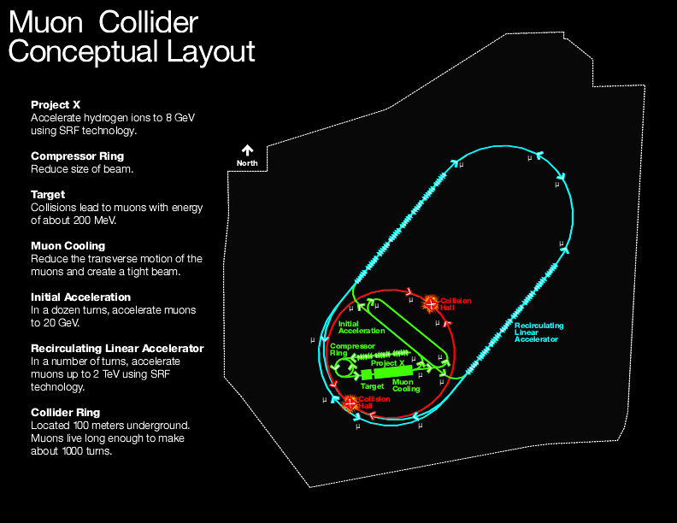
The Energy Frontier: lepton colliders
ILC 0.5-1.0 TeV e+e- linear collider
Superconducting RF accelerating cavities
Technology demonstrated, ready to propose ~2012
Physics/Detectors well studied, R&D ready ~2012
CLIC 3 TeV e+e- linear collider
Two beam acceleration with warm RF
R&D underway, but technical demonstrations needed
Machine and Detector CDR in 2011, TDR in 2018-20?
Muon Collider 3 TeV µ+µ- storage ring
Fermilab’s Muon Accelerator Proposal will study
technical feasibility and cost of the machine
Conceptual design ~2016-17
Technical design and demonstrations 20??
Jaros
22

Slide 23
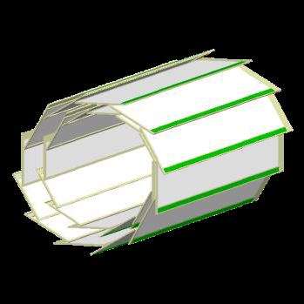
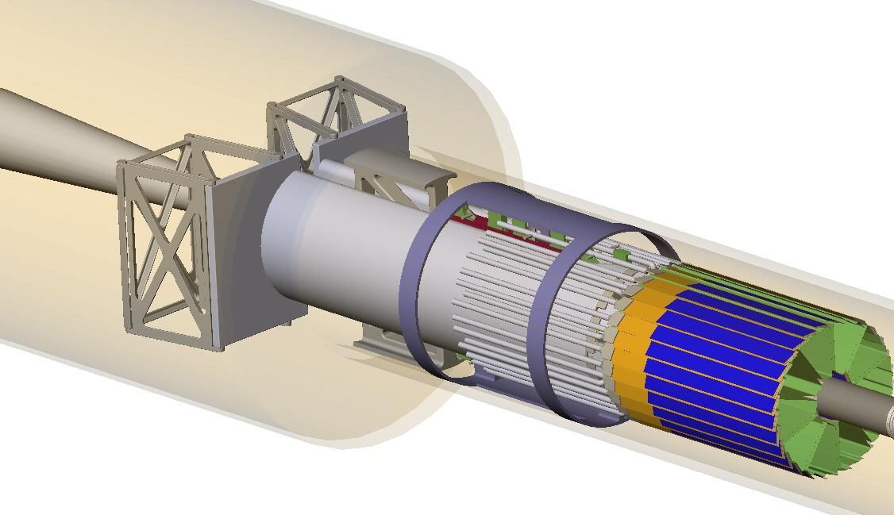
Monolithic Pixels
 | LHC | ILC
Event rates | 1GHz | 1KHz
Beam Structure | 25 ns, cont | 340ns, 0.5% Duty Factor
Triggering L1 L3 | 40 MHz 100Hz | no hardware 15kHz → 100Hz
Radiation | 10..50Mrad/year | 10..50Krad/year
Resolution | 10 μm | 3 μm
ILC
Belle New central pixel double-layer using DEPFET
  R&D (for ILC) ongoing for >10 years
  DEPFET
    recently (2008): baseline for a 2 layer detector for SuperBelle
  Monolithic Active Pixels (MAPS-epi)
    2 (or 3) pixel layer detector for STAR@RHIC
    EUDET
    Layer 0 of the SuperB SVT
  Monolithic Active Pixels (MAPS-SoI)
STAR Pixel upgrade (MIMOSTAR) total area: 0.16m²

Slide 24
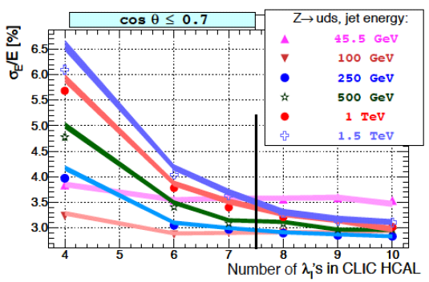
CLIC Challenges
Vertex Detector Challenges (above and beyond ILC)
Multi-hit capability with 10 ns time-stamping
Read out full bunch train (300 bunches)
DAQ between bunch trains (20 ms)
Calorimetry Challenges
Good resolution at highest
energies → 7.5 λ Hcal
Excellent segmentation to
separate particles in HE jets
Time stamping ~5-10 ns
Pandora PFA used for Hcal Studies
Jaros

Slide 25
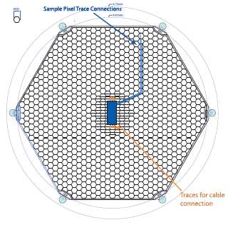
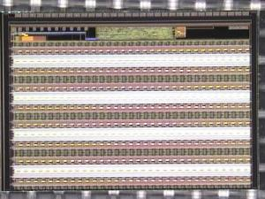
Developing A Particle Flow EM Calorimeter
Pixel Sensor with KPiX (with U Oregon)
Kapton Cables (with UC Davis)
1 mm readout gap ⇒
13 mm effective Moliere radius.
Very compact showers
Mechanical Design (SLAC/Oregon/UC Davis)
256-channel KPiX

Slide 26
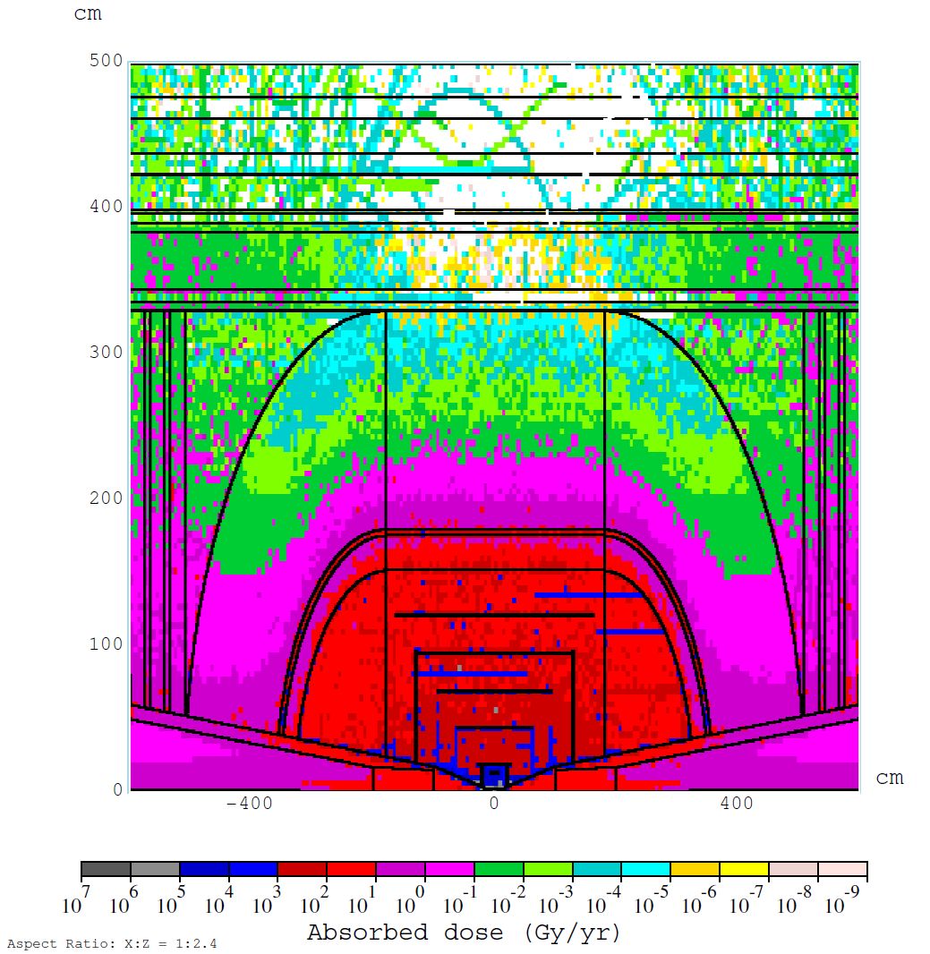
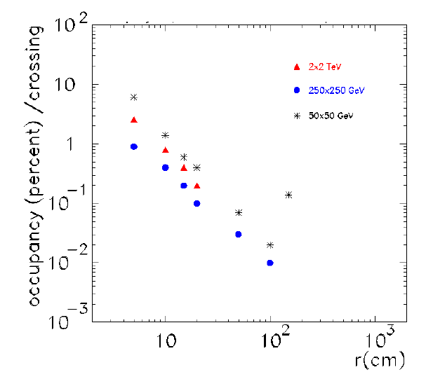
MUC Challenges
Total Absorbed Dose ~ LHC
Total absorbed dose in Si at r = 4cm
  Muon Collider: 0.1 MGy/yr
Vertex Radius
Backgrounds limit
min radius to ≥ 5 cm
Vertex Occupancy
1.3% occupancy in
inner layer with
300 x 300 μm² pixels.

Slide 27
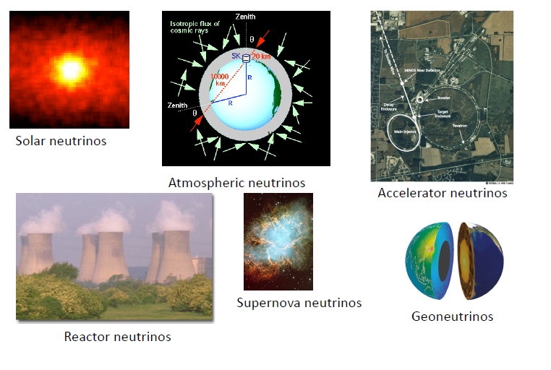
Diversity of neutrino physics

Slide 28
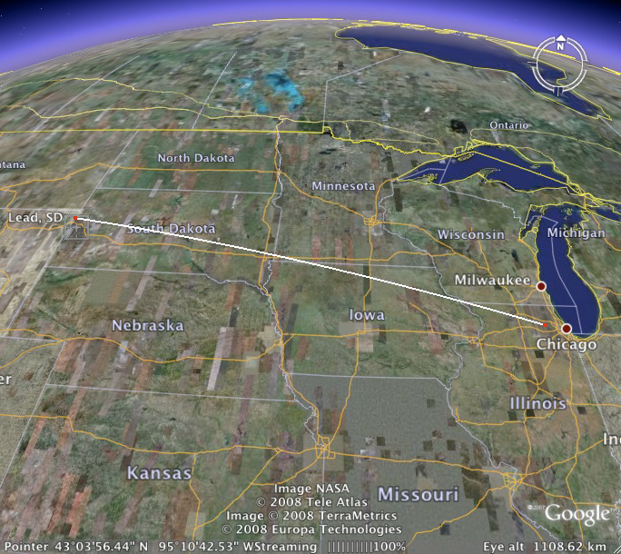
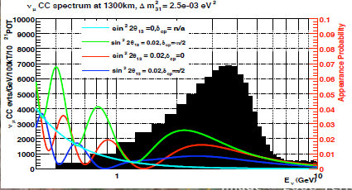
The intensity frontier
Neutrinos Experiments – Rameika
Intensity frontier experiments – Molzon
ArgoNeut – Soderberg
New scintillator - Yeh
Long Baseline Neutrino Experiment

Slide 29
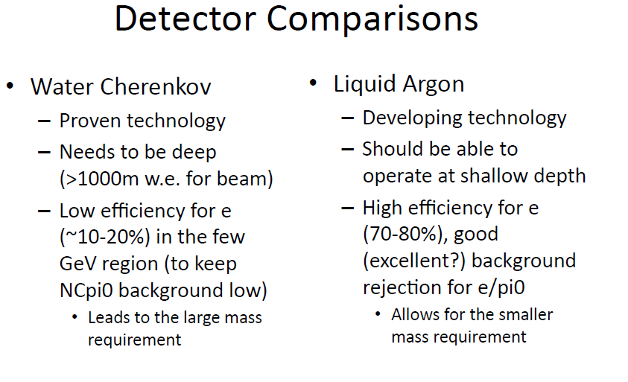
Two detector options for LBNE
Rameika

Slide 30
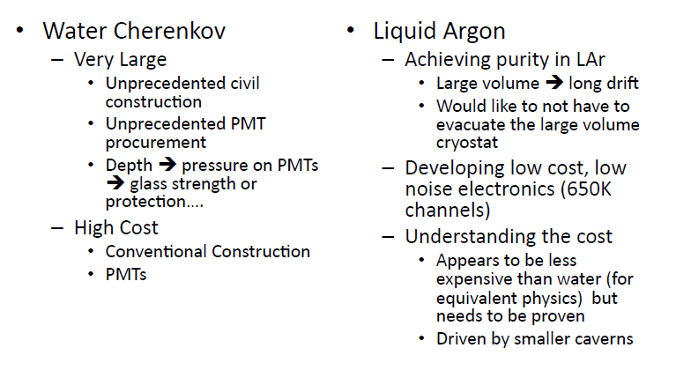
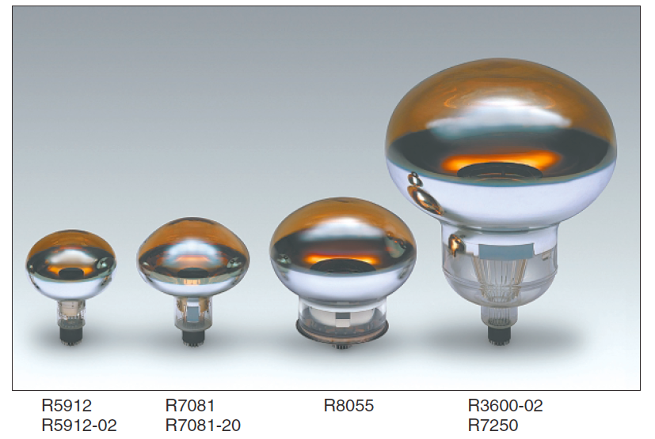
Challenges
50,000 PMT
Schedule pressure
Difficult to demonstrate capability and feasibility of Lar
Long lead procurement (6‐8 yr delivery schedules) we would need to place orders for PMT’s shortly after CD‐2 which might happen in 2013

Slide 31

A Working Liquid Argon TPC in a neutrino beam
Ramberg, Soderberg

Slide 32

ArgoNeuT Neutrino Events

Slide 33

Liquid Argon Purification
Ramberg, Soderberg

Slide 34

Cold readout electronics for LAr TPCs - functional outline
Cold electronics allows:
  Best SNR
  Few cables in LAr
  Few cryogenic feedthroughs
  Few interconnects & simple cabling
  Scalability: since the electrode and cryostat design are decoupled from the readout design, noise is independent of the detector volume (cable lengths).
High degree of multiplexing (1/128-1/1024) with redundant links for reliability
Littenberg
34

Slide 35
Cold CMOS: Results from New FE ASIC (1st prototype cycle)
2) Signal after preamp+shaper changes little with temperature:
3) Integrated charge calibration capacitance - little change with temperature
Measured with high-precision external capacitance
Littenberg
LAr Meeting - 09/2010 - De Geronimo - 35/24

Slide 36


Molzon
Goal of new experiment is to detect μ-N→e-N if R_{μe} is at least 2 X 10⁻¹⁷ with one event providing compelling evidence of a discovery.

Slide 37


Slide 38



Non Accelerator experiments
Carter, Collar, Macfarlane, Ramberg, Klein, Varner, Siegrist, Littenberg

Slide 39

Background rejection

Slide 40

Improving Ge Detector Fabrication
Germanium has been successfully used in CDMS
SNOLAB requires 100 kg sensitive mass; GeODM proposes a 1.5 tons
  Requires scaling from 25mm thick x 76mm diameter to 33mm thick x 100 (150)mm diameter germanium wafers
Mass of such thick wafers is 90 times that of standard silicon wafers
  Must develop and automate new procedures and tools to meet this challenge (e.g. resist coaters run ~3000 rpm)
Work with manufactures to grow such heavy boules
Maintain low-radioactivity cleanliness
100 kg ~ 80 crystals of large diameter and thickness
(100 mm by 33 mm)
100 kg ~ 180 crystals of small diameter and thickness
(76 mm by 25 mm)
SuperCDMS Soudan detectors
SuperCDMS SNOLAB detectors
Macfarlane

Slide 41
Radioactive “free” Optical FE Module
SLAC has designed, implemented and is currently testing electronics and DAQ for EXO-200
  Example of system design effort with electronics is external to chamber
Problem with electronics inside chamber for underground experiments due to radioactive contamination
  R&D towards radioactive free integrated front-end module inside the detector would provide substantial benefit
Advantages
Minimize interconnection length between sensors and front-end electronics
Minimize input capacitance and thus electronics noise
Reduce space required for data interconnections
Minimize impact on the chamber architecture
No need for AC coupling
Bulk silicon and some CMOS technologies have been proven to be radioactive “free” (ex. TSMC 0.25um)
“free” = negligible radioactivity levels ~ 10⁻¹² levels of U, Th, and K40
Optical Components: VCSEL - PIN
Photovoltaic cell
ASIC
Silicon PCB
Optic Fiber
Macfarlane

Slide 42

Analytical technique for Xenon Purity
Carter
Prototype at Maryland

Slide 43

Low radiactive photon detectors
Carter

Slide 44



LBNL CCDs
Thick, fully-depleted CCDs were invented and first fabricated at the LBNL MicroSystems Lab (MSL) in the mid 1990’s
  More sensitive at red wavelengths (=high redshifts)
  Very radiation tolerant for space
  HV-compatible design has very good point resolution
Partnership with DALSA semi.
Deployed at many telescopes
Siegrist

Slide 45

CCD
Siegrist

Slide 46

CCD R&D
Thinner CCDs using TiN metal for reduced diffusion, improved yields
Charge multiplying CCD for single photon sensitivity
Lower noise output transistors
Higher speed output transistors
Combination of the above in a single device, e.g. an LSST
prototype with multiple readouts, low noise and thin substrate using TiN.
Fast CCD with multiple outputs for soft x-ray detection at ALS
JDEM / WFIRST heterogeneous focal
plane prototype
32-detector silicon carbide focal plane prototype
Space qualified Near Infrared (NIR) detectors
Space qualified fully-depleted CCDs from MSL
Instrument now assembled and undergoing electrical tests.
Siegrist

Slide 47
R&D in the US
Laboratories
Universities

Slide 48




Facilities: P3MD
A DoE/NSF/University Partnership
Purdue Particle Physics Microstructure Detector Facility (P3MD) “A national resource” – 2 DoE panels 3000 sq ft clean space design/test/assembly of
    MPGD
    CLEO III SVX
    CDF Run II SVX
    CMS Fpix
    CMS upgrade Fpix
    SLHC/ILC R&D
    LSST corner rafts
Constructed with university & matching funds for (Bortoletto NSF CAREER and Shipsey NSF NYI,) mid 90’s
Annual support DoE & Projects
3 dozen undergrads + many grad. students contributed to P3MD projects
Training in instrumentation, electronics, DAQ, CAD, lithography, VLSI design
PSL at Wisconsin (Feyzi), Argoneut (Soderberg), Large Area Photo Detector (Frisch)

Slide 49





Facilities ( within Argonne)
Weerts
Atomic Layer Deposition(ALD) systems in MSD, owned by HEP
Unique capabilities in new materials, SC materials, sensor development, micro fabrication.
CNM, MSD, APS
ES ALD machines
Argonne wide:
Unique & Strong collaborations with HEP.
Advanced Photon Source (APS)
HEP.
New unique plasma enhanced ALD system
Center for Nanoscale Materials (CNM)
49
49

Slide 50

Weerts, Frisch, Wagner
LAPPD
Three Goals of a New (~1 yr-old) Collaborative Effort:
Large-Area Low-Cost Photodetectors with good correlated time and space resolution (target 10 $/sq-in incremental areal cost)
Large-Area TOF particle/photon detectors with psec time resolution ( < 1psec at 100 p.e.)
Understanding photo-cathodes so that we can reliably make high QE, tailor the spectral response, and develop new materials and geometries (QE > 50%, public formula)
Produce commercializable modules in 3 year R&D program.
Collaboration (unique)
3 National Labs, 6 Divisions at Argonne, 3 US small companies, 3 universities
Possible future Applications
PID at colliders, (LBNE) water Cherenkov --- HEP
Security, Medical Imaging, X-ray science --- non-HEP

Slide 51




Fermilab facilities
What ever the user wants!!!!
Ramberg

Slide 52


Ramberg

Slide 53

Ramberg

Slide 54



IC design at Labs
Siegriest, Macfarlane, Ramberger, Littenberg

Slide 55


End Station A Test Beam (ESTB)
ESTB will be a unique HEP resource
  World’s only high-energy primary electron beam for large scale Linear Collider MDI and beam instrumentation studies
Kicker Magnet Coils and Connections
Macfarlane, Hast

Slide 56

BNL Silicon Detector Development Capabilities for HEP
Instrumentation Division’s Semiconductor Detector Development and Processing Lab (SDDPL) is a unique US R&D center for development and production of silicon sensors for HEP applications
Focus
New detector concepts
Radiation hard materials
Defect analysis
New defect analysis techniques
Infrastructure
600 square feet fully qualified class 100 cleanroom
Design and process simulation
All detector processing steps (with exception of ion implantation)
2D and 3D detector simulation
History of design and development of detectors for HEP experiments
This facility for detectors on high resistivity Si (~5-10 kohm-cm) is unique in the U.S. for university and Lab researchers to have prototype and test devices designed and fabricated. No commercial source exists in the U.S.
56

Slide 57
R&D In Europe
Recent development
Emergence of “global” projects without a central host laboratory where the project taking place, e.g. ILC, Neutrino factories, etc.
Scale of the detector R&D is becoming large, e.g. CALICE: Calorimeter R&D for ILC 336 physicists/engineers from 57 institutes and 17 countries from the 4 regions (Africa, America, Asia and Europe)
Funding starts to be an issue
Concerns by some national funding authorities on the review processes
ECFA R&D panel to review R&D efforts for orphan accelerator based particle physics projects such as LC’s, neutrino, B factories, etc.-
Nakada

Slide 58
Funding for R&D in Europe
EU funding for the detector R&D
  EUDET: “Detector R&D Towards the International Linear Collider”
    21.5 MEUR total, of which 7 MEUR from EU(30 institutes)
  AIDA: “Development of Detectors” submitted in 2009
    27 M€ total, of which 8 M€ from EU (70 institutes)
    Targeting a wider area; i.e. CLIC, ILC, neutrinos, SLHC, flavour factories
  What are the pro and contra?
  Extra funding outside of usual particle physics funding
  Selection is somewhat unpredictable for our community ⇒professional advice for the proposal?
  Heavy administrative work before and after ⇒after can be included in the funding request
  It is meant to be for infrastructure and not for the actual R&D
  EU review process, decoupled to the rest of the particle physics community
Nakada

Slide 59

R&D is poorly funded in the US
See the example below of the ILC R&D
ILC Detector Research and Development
Status Report and Urgent Requirements for Funding (2006)
 | USA | EU | EURO ZONE
GPD in T$ | 14.58 | 16.41 | 12.45

Slide 60
US R&D
University Program ($3.66M/year) Lab Program ($21.7M/year)
ADR Program ($0.75M) LDRD programs (except Fermilab)
Short term support for new ideas. Short term support for new ideas.
Base funding ($1.55M) Base funding ($18.6M)
Support for longer term Detector R&D Support for infrastructure and Detector R&D
One shot funding ($0.31M) One shot funding ($0.15M)
Opportunistic funding based on availability Opportunistic funding based on availability
Special Projects Special Projects
ILC Detector R&D (Some Lab – $0.9M) Large Area Photodetectors¹ ($2.24M)
Compensated calorimetry ($0.15M) Water Base Liquid Scintillator ($0.20M)
LHC Detector Development² ($2.0M) Wireless Detector Readout³ ($0.23M)
Test Beam – SLAC ($1.5M)
¹Includes $1M of FY09 ARRA funding.
² Planned for 2011
³FY09 funding released in FY10.
Howard Nicholson

Slide 61
2009 Review of the Lab Detector R&D Program
Reviewers were asked for suggestions for a future national detector R&D program
  Establish an annual conference/workshop in generic detector R&D which would be useful to increase communication and encourage collaboration between laboratories and universities, both in the U.S. and abroad. It should also serve to identify future physics detector needs which are not currently being addressed and help to coordinate the lab R&D efforts.
  Develop a mechanism to provide overall coordination of the R&D activities in the laboratories to increase efficiency and optimize the use of the ~$20M spent on laboratory generic R&D.
  Create a National Instrumentation Advisory Board which meets on a yearly basis and advises DOE and Labs on their instrumentation program from a national and international perspective.
  Allocate funding for “Grand Challenges” to encourage the formation of multi-lab and multi-disciplinary approaches to new and important problems (such as the large-area photo-detector project).
  Create a National Instrumentation Fellowship directed at Ph.D. students and postdocs to encourage them to pursue research in instrumentation.
Howard Nicholson

