Slide 1
The CERN High Field magnet program
Gijs de Rijk

Slide 2
HFM options for an LHC luminosity upgrade
An LHC luminosity upgrade envisages in ~ 10 years:
Inner Triplet quadrupoles
  Aperture ∅ ~ 120 mm (150 mm), G ~ 175 T/m (140 T/m) , L = 8 m - 10 m
Dispersion Suppressor twin aperture dipoles
  Aperture ∅ = 60 mm, B = 11 T, L = 11 m
D1 separation dipole
  Aperture ∅ = 150 mm, B = 8 T, L = 3.5 m
  Note all fields and gradient are operational values (20% margin usually taken)

Slide 3
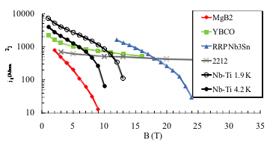
Conductors for HFMs
To meet these requirements one has to switch from Nb-Ti to Nb₃Sn conductors
Courtesy E. Todesco
Engineering current density in practical superconductors

Slide 4
CERN program on High Field Magnets
HFM program aim: High field magnets technology (dipoles and quads) for LHC upgrades and future accelerators
Priorities: - Conductor is the heart of the magnet
        - Magnet design and tests
First step (2004 – 2012):
    Conductor technology development
    Magnet technology development
    Personnel training on existing technologies
Second step (2009 – 2014):
    Conductor test facilities upgrade to 15 T
    Magnet models (IR quad and DS dipole models)
    Magnet concepts from 15 T to 20 T
Third step (2014 – 2016):
    LHC Inner triplet quadrupole prototype
    LHC Dispersion Suppressor dipole prototype

Slide 5
CERN program on High Field Magnets: implementation
HFM program medium term aim:
Technology readiness by 2016 for:
  Large aperture high gradient quadrupole magnets for the LHC inner triplets upgrade (∅ ~ 120 mm, G ~ 190 T/m) (~2018)
  Twin aperture Dispersion Suppressor dipole (∅ = 60 mm, B = 11 T, L = 10.8 m) (~2018)
  Separation Dipole D1 (∅ = 180 mm, B = 10 T, L = 5 m) (~2018)
First step (2004 – 2012):
  Conductor development base program (CERN + Fr in-kind contr.)
  Short Model Coil (collaboration CEA, RAL, CERN, LBNL)
  test of TQS & HQ at CERN (Collaboration CERN- LARP-LBNL)

Slide 6
CERN program on High Field Magnets: implementation
Second step (2009 – 2014):
  EuCARD WP7-HFM project (collaboration with 13 partners)
    High field model to upgrade the cable test facility Fresca (∅ 100 mm, B=13-15 T)
    Very high field HTS insert to approach 20 T domain
  Models for IR quadrupole:
    LARP program in US
    CERN program: model 2012-2013
  Models for DS dipole: CERN program and/or collaboration
  Models for D1 dipole: CERN and/or collaboration
Third step (2014 – 2016):
  Inner triplet quadrupole prototype (LARP)
  DS twin aperture dipole prototype
  D1 prototype

Slide 7
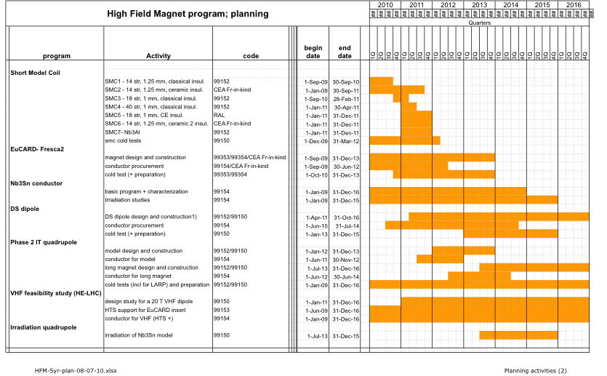
CERN HFM program planning

Slide 8
HFM R&D for an LHC luminosity upgrade: IT Quad
R&D in the US (LARP):
Up to now achieved (LQ): Aperture ∅ = 90 mm, G = 200 T/m, L = 3.4 m
Now testing (HQ): Aperture ∅ = 120 mm, G = 190 T/m, L = 1 m
Conductors used:
OST-RRP-54/61 and OST-RRP-108/127
Cable 27 strands, ∅ = 0.7 mm , sub-elements ∅ = 50 μm
Open issues:
Inter-strand resistance in the cable is low and variable : field quality
Stability of the strand at 1.9 K to be confirmed
In the sub-element diameter of 50 μm small enough ?
Length limit at 3.4 m, should be 8-10 m
  Radiation hard insulation
  Heat removal from the coil

Slide 9
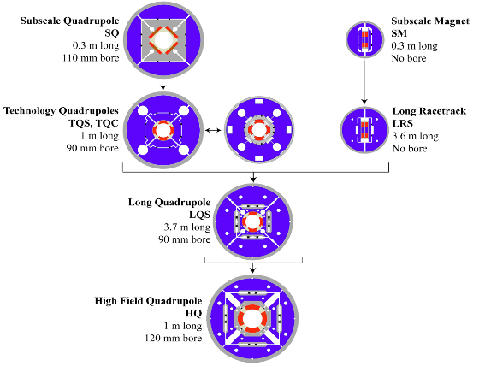
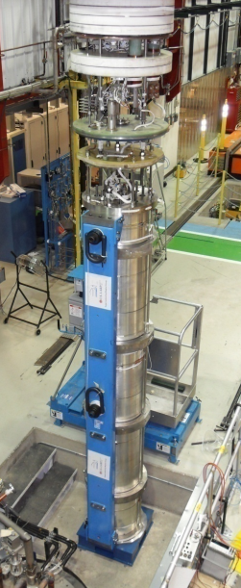
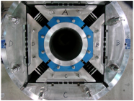
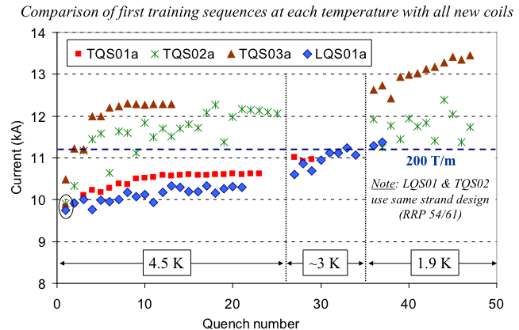
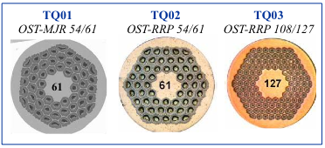
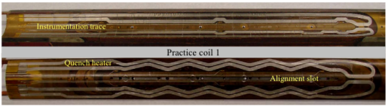
LARP IT quad development program
Achieved with Nb₃Sn:
TQ: 1 m, 220 T/m, 90 mm aperture
LQ: 3.8 m, 200 T/m, 90 mm aperture
To be tested in May 2010:
HQ: 1 m, 190 T/m, 120 mm aperture
with alignment features
Plan:
4 m prototypes for LHC

Slide 10
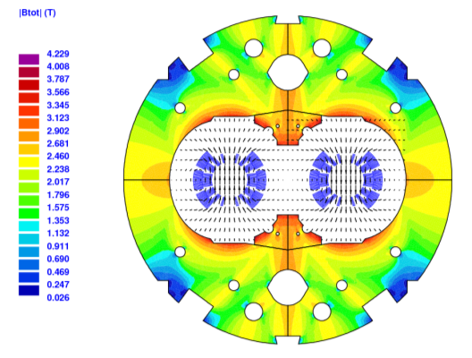
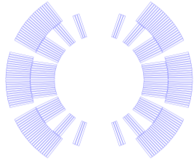
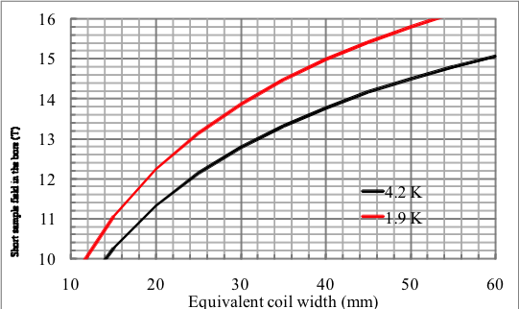
HFM R&D for an LHC luminosity upgrade: DS dipole
  Feasibility study recently started for a twin aperture ∅ = 60 mm, B = 11 T, L = 10.8 m dipole magnet.
  First estimates:
  47 strands of 0.65 mm
  2 layers 17.5 mm width cable
  B=11.0 T at 80% I_{ss}, T=1.9 K, I=11850 A
  Open issues:
  Coil length 10.8 m
  Stability of the strand at 1.9 K
  LHC dipole like collar structure
  Radiation hard insulation
  Heat removal from the coil
  Inter-strand resistance in the cable : field quality
  Is sub-element diameter 50 μm small enough ?

Slide 11
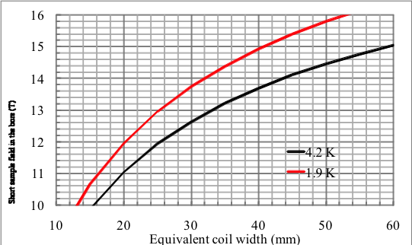
HFM R&D for an LHC luminosity upgrade: D1 dipole
  Feasibility study recently started for ∅ = 180 mm, B = 10 T, L = 5 m dipole magnet.
  First estimates:
  ~30 mm coil width
  4.2 K operational temperature
  20% operational margin
  Open issues:
  Coil length 5 m
  Stability of the strand at 1.9 K
  Inter-strand resistance in the cable : field quality
  Is sub-element diameter 50 μm small enough ?
  LHC dipole like collar structure
  Radiation hard insulation
  Heat removal from the coil

Slide 12
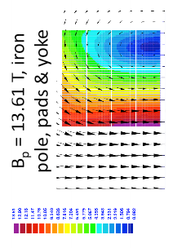
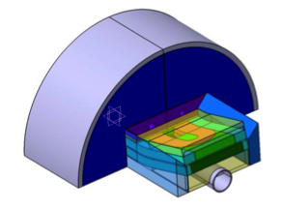
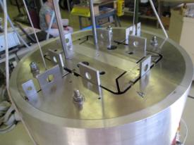
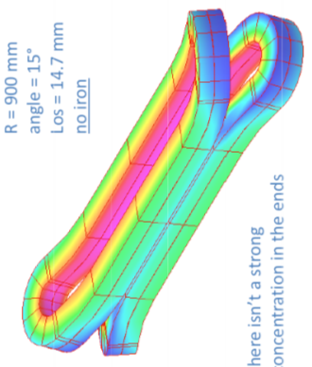
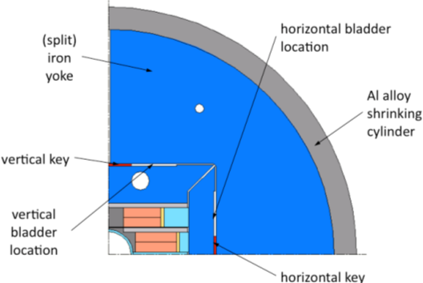
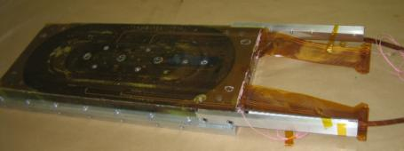
EuCARD HFMs: Fresca2 dipole
EuCARD WP7 on High Field Magnets, 13 partners, 6 tasks: 13 T dipole, HTS insert, HTS link, helical undulator; April 2009 – April 2013
Dipole for cable test station aperture 100 mm, 13 T
Nb₃Sn 1 mm strand, 40 strand cable (RRP or PIT)
Preparation: Short Model Coil: test in August
Design: 9/2009-12/2010 ; coil winding start 05/2011;
first assembly 05/2012;
first cold test 2nd half 2012
P. Manil
.
A. Milanse
A. Milanse

Slide 13
Radiation resistance
The radiation resistance of the Nb₃Sn magnets has to be fully proven
In the EUCARD program we have a task of the High Field Magnets work package dedicated to these issues
  Radiation tests on Nb₃Sn conductor carried out in Vienna, Russia [L. Oberli, R. Fluckiger, et al.]
  Radiation tests on Nb₃Sn insulation carried out in Poland [J. Polinski, R. Fluckiger, et al.]
  Possible synergy with LARP
The validation of the radiation resistance of all material used in LARP Nb₃Sn magnet should be assessed as soon as possible to avoid surprises and delays
  If a material has to be replaced this can have an impact on magnet design and performance
  This can considerably delay the project
  Time is a relevant variable … our goal is integrated luminosity
  For instance: e-glass not acceptable (large remnant radioactivity), s-glass ok

Slide 14
HFM R&D items: Dynamic effects in conductors (1)
For both the IR quad and the dipole, there are questions on the conductor performance :
Inter-strand resistance in the cable
Stability of the strand at 1.9 K (10 % performance increase is not negligible)
In the sub-element diameter of 50 μm small enough ?
We do not yet know what the present 0.6 – 1.0 mm conductors will do.
3 options to measure these effects:
On the Strand: characterization: stability and magnetization
    Program at the test stations at CERN up to 15 T (ongoing)
On the cable: stability and loss measurements
    Program at CERN in Fresca up to 10 T (ongoing)
On magnets: loss measurements and fast magnetic measurements
    On TQS at CERN (ongoing)
    On HQ at CERN (summer 2010)

Slide 15
HFM R&D items: Dynamic effects in conductors (2)
Based on measured losses and field decay effects in 2010 on the strand, cable and magnet level by the second half of 2010 we should be able to launch:
- R&D on cable inter-strand resistance control, 2 options
    Cored cable
    Coated strands
Based on the fast magnetic measurements to see persistent current effects on the magnets by the second half of 2010 we should be able to launch:
- R&D contracts on strand with smaller sub-elements (towards 20 μm)

Slide 16
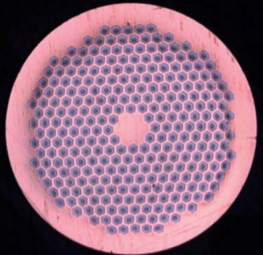
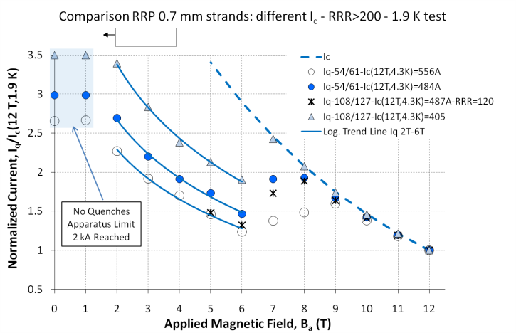
Conductor R&D - NED and post-NED strands
The NED program achieved Nb3Sn 1.25 mm strands with J_{C} of 1500 A/mm² at 15 T and 4.2 K, filament diameter of 50 μm, and RRR regularly in excess of 150
The HFM program has since focussed on issues of cable production and degradation, and thermo-magnetic stability
Bruker-EAS PIT, 288 subelements, (Nb-Ta)₃Sn
An improved understanding of the thermo-magnetic stability has led to the decision to:
  Reduce strand diameter (1 mm)
  Limit strand critical current density (1250 A/mm² at 15 T and 4.2 K)
  Maintain a strict requirement on RRR and filament diameter
Courtesy L. Bottura, B. Bordini

Slide 17
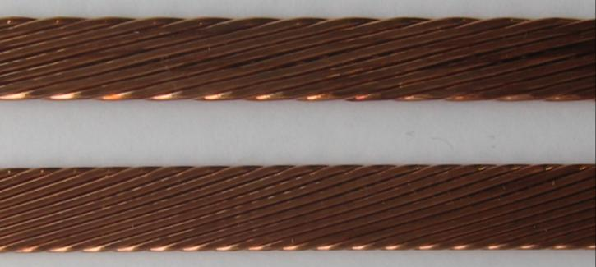
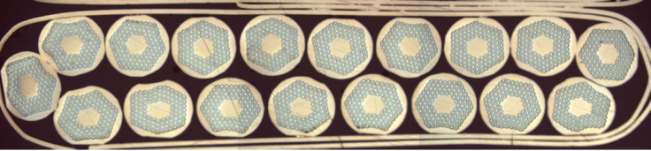
Conductor R&D - Cable variants
Cabling tests were performed on several variants of strands/cable sizes to explore the space of parameters, and among others: dimensions, compaction, twist pitch, cabling angle and cabling force, …
Cabling degradation was reduced from 45 % (worst case) to negligible (within the scatter of measurements of extracted strands)
SMC-class cables
  Cu dummies
  14 strands, 1.25 mm
    PIT (EAS), IT (Alstom)
  18 strands, 1 mm
    IT (OST-RRP)
Fresca2-class cables
  Cu dummies
  40 strands, 1 mm
    PIT (EAS)
17

Slide 18
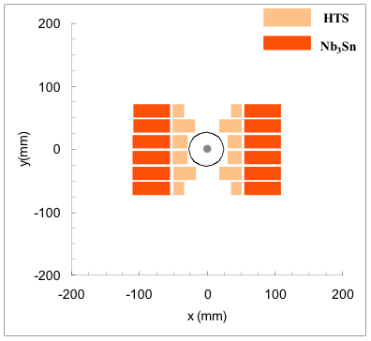
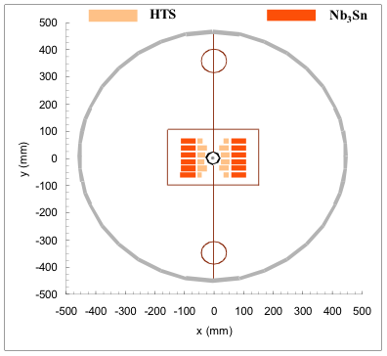
A glimpse on the future: HFM for a ~17.5 TeV LHC?
Any possible increase in the LHC energy would be a mostly new machine HE-LHC in ~ 25 years:
To have at least a factor two increase, one probably needs HTS conductors
Example: twin aperture dipole ∅ = ~50 mm, B ~ 20 T (17.5+17.5 TeV)
All other magnets at ~2.5 field, but lower field could be obtained with longer lengths
New study effort at CERN (EuCARD Workshop in Oct in Malta)
Courtesy E. Todesco

Slide 19
Conclusions
CERN HFM program is preparing for HL-LHC and later HE-LHC
Collaboration oriented
  LARP
  EuCARD
  ...

