Slide 1
View from CERN/CERN Schedule
Gijs de Rijk on behalf of Lucio Rossi and the Upgrade study working group

Slide 2
Content
Luminosity...
PhaseI project
The new upgrade plan HL-LHC
Hardware needed for the upgrade
HE-LHC

Slide 3
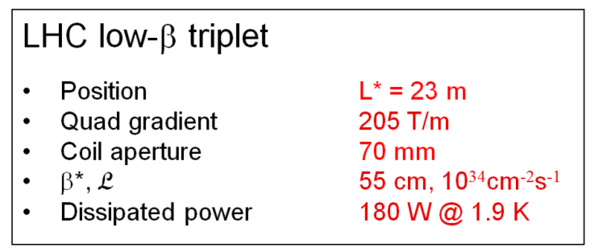
Luminosity...
Constants Beam intensity Beam focusing
Beam intensity
    N_{b}: number of particle per bunch [1.15 ×10¹¹]
    n_{b}: number of bunches [2808]
Beam focusing
    β*: beta function in the IP (transverse size of the beam) [55 cm]
    F: geometrical loss reduction factor [0.86]
Nominal Luminosity
1· 10³⁴ cm⁻²s⁻¹
The experiments are though only interested in
Integrated Luminosity
Peak luminosity is posing problems when very high (pileup)

Slide 4
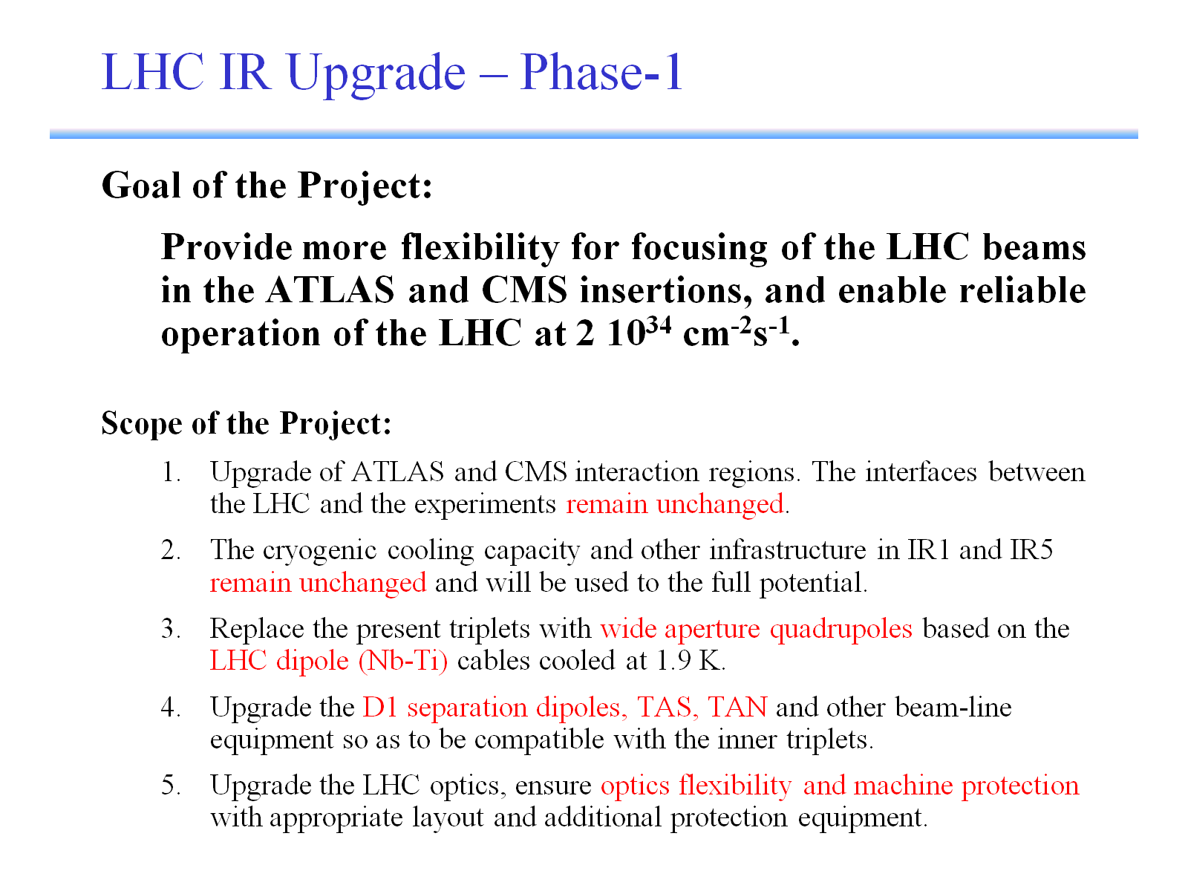

Slide 5
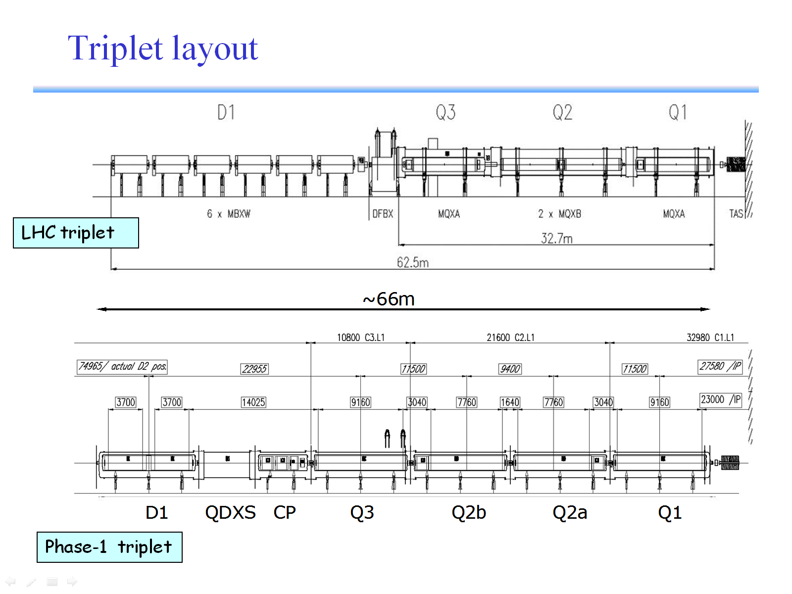

Slide 6
Main Magnets : MQXC
Coil aperture 120 mm
Gradient 127 T/m
Operating temp 1.9 K
Current 13.8 kA
WP on load-line 85%
Inductance 5.2 mH/m
Yoke ID 260 mm
Yoke OD 550 mm
Magnetic length 9160 mm (Q1,Q3)
7760 mm (Q2)
LHC cables 01 and 02
Porous cable polyimide insulation
Yoke OD identical to MB
Self-supporting collars
Single piece yoke
Welded-shell cold mass

Slide 7
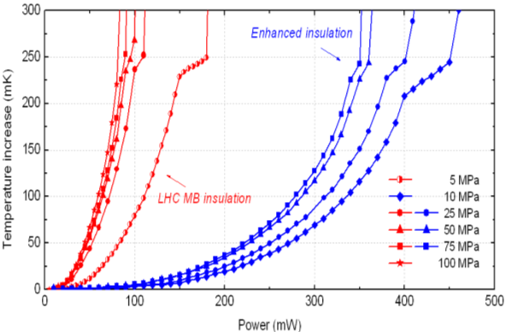
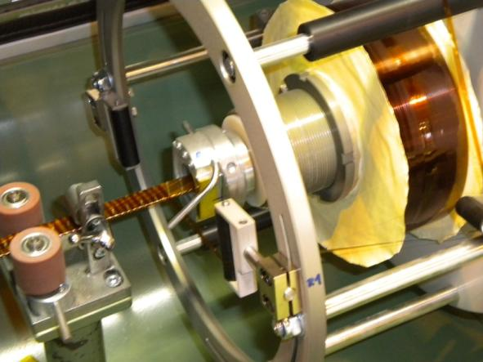
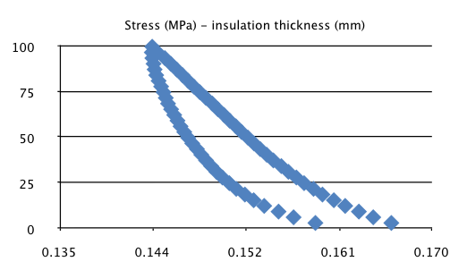
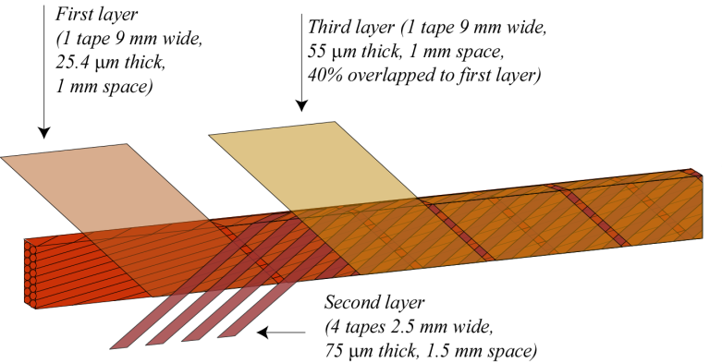
New features : porous cable insulation

Slide 8
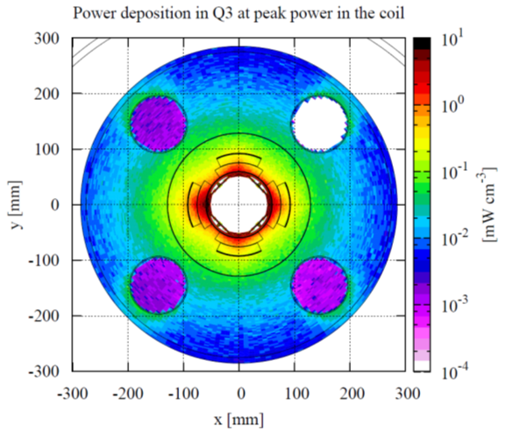
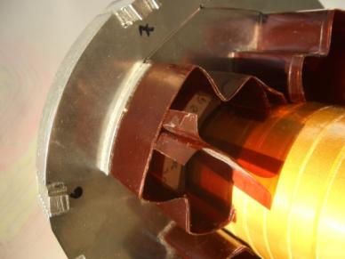
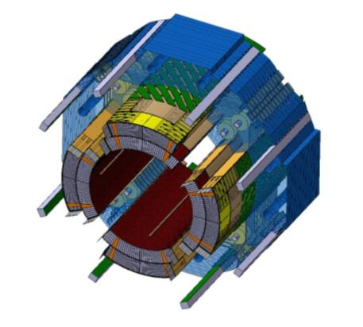
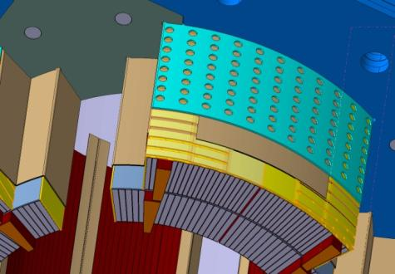
Porous inter-layer insulation
Conventional ground insulation
Open KCS ground insulation

Slide 9
Phase I : performance possibilities
More aperture to reach Nominal Luminosity
  or
Lower β* (> 30 cm) for twice peak nominal Luminosity (2.10³⁴ cm⁻²s⁻¹)
and
New IR quads to replace old ones which reach radiation limits (correctors most affected)
But
Optically a completely new machine
Chromaticity correction is limited
Matching section the next aperture limit
Integrated Luminosity per year gain risks to be limited (20% - 35% ?)

Slide 10
Luminosity increase : plan Spring 2010 (BC)

Slide 11
Phase I and schedule
Before 2018 2 long shutdown periods needed for collimation and splices(to go to 7 TeV) : no time for anything else
Because of new schedule radiation damage is not an issue until 2020
In the new schedule the Triplet cannot be built before 2016 at best.
A year long shutdown is needed to install the new triplets
Phase I might only give at maximum a yearly integrated Lumi +35%
Conclusions: no integrated Luminosity gain with Phase I

Slide 12
The new upgrade plan, HL-LHC
Task force recommendation (L. Rossi et al):
  Stop the phase 1 project
  Keep going with the R&D of Phase 1 which is necessary because of long lead time development;
  Decision in 2013/2014, after LHC behaviour near nominal will be known, the best technology for upgrade. Decision in 2013/2014 to have it by 2018-2020.
  Put the IT upgrade in a global pictures, preceded by all consolidation or improvement needed to make it most effective and compatible with other equipment. Aim for L_{peak}= 5 .10³⁴ cm⁻²s⁻¹
APUL D1: hibernation of the project is the correct choice, if we need the fallback solution of Nb-Ti we probably need them again

Slide 13
What could be needed for L= 5 .10³⁴ cm⁻²s⁻¹ ? (1)
  High Gradient/Large Aperture Quads, with B_{peak} 13-15 T.
    Higher field quadrupoles translate in higher gradient/shorter length or larger aperture/same length or a mix.
     as small as 22 cm are possible with a factor 2.5 in luminosity by itself,
    Necessarily coupled with a mechanism to compensate the geometrical reduction.
    If a new way of correcting chromatic aberration could be found,  as small as 10-12 cm can be eventually envisaged

Slide 14
What could be needed for L= 5 .10³⁴ cm⁻²s⁻¹ ? (2)
  Crab Cavities:
    best candidate for exploiting small  (for  around nominal only +15%).
    However today Crab Cavities are not validated for LHC , not even conceptually: the issue of machine protection should be addressed with priority.
    Global Scheme. 1 cavity in IP4, Proof on LHC, good for 1 X-ing. Semi-global; it may work! (JP Koutchouk)
    Local scheme; 1 cavity per IP side. Maybe local doglegs needed.
  D1: 8 T , 3.5 m long , 150 mm aperture
  Early Separation Scheme could be an alternative (or a complement)
  SC links to replace at the surface electronic equipment today in the tunnel and exposed to high radiation
  New Cryoplants in IP1 & IP5: for power AND to make independent Arc- IR: 2.8 kW @ 1.8 K scales as 5.2 kW @ 2 K (for 1 set of cold compressor)

Slide 15
What could be needed for L= 5 .10³⁴ cm⁻²s⁻¹ ? (3)
  Improve some correctors
  Commissioning the lattice sextupoles @ 600-650 A
  New MQT corrector scheme using existing spare 600 A bus bars
  Re-commissioning DS quads at higher gradient
  Review MSs
  Change of New Q5/Q4 (today 2x70 mm : we need larger aperture!), with new stronger corrector orbit, displacements of few magnets
  Larger aperture D2
  (may be other actions, more quads in points 6 and 7)
  Displacement of Power Converters & DFBs at least of Inner Triplets but also of OTHER equipment on surface by means of SC links.
  Cryo-plant for RF in point 4 : 5-7 kW @ 4.5 K
  For extra collimators: 11 m, 11T DS dipoles

Slide 16
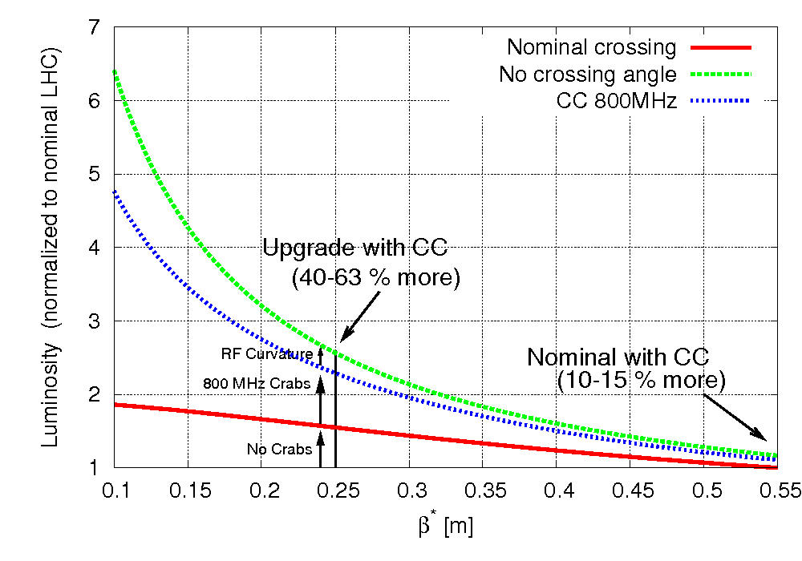
« Coupling » between HG Quad magnets and Crab Cavities

Slide 17
Hardware shopping list for the upgrade.
A selection of the most important items. (with an eye on collaborations...)
IT Quadrupoles
  IR 1 and 5
11 T – 11 m Twin Dipole for Dispersion suppressor
  IR 3, 7 and 2 To make space for additional (cryo) collimators
Crab Cavities
  Local (IR 1 and 50 or global
Early separation dipole
  IR 1 and 5
Superconducting current links
  IR 1 and 5 (3 & 7)
Q4/Q5 twin aperture Quadrupoles
  IR 1 and 5

Slide 18
IT Quadrupoles
Ongoing LARP development. Crucial for Nb₃Sn option for the upgrade << the LARP quadrupole program has to succeed for the upgrade>>
We (CERN) count on this
The final parameters for the IT quad can only be stated when we have experience with 2808 Nominal bunches per beam at 7 TeV (after the startup in 2013)
A preliminary specification can be given keeping some parameters open
Assumptions:
  The experiments expect a final integrated Luminosity for the full LHC lifetime of 3000 fb⁻¹
  Similar magnet lengths and positions as for PhaseI
  Radiation and heat load studies scaled up from PhaseI

Slide 19
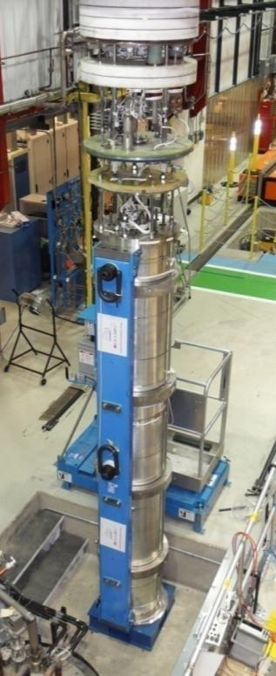
HF Nb₃Sn Quad
Nb₃Sn is becoming a reality (first LQ long -3.6 m – quad 90 mm)
This year we expect a second test of LQ-1 and test of LQ-2
200 T/m
Note: LQS01 & TQS02
use same strand design
(RRP 54/61)
4.5 K
~3 K
1.9 K

Slide 20
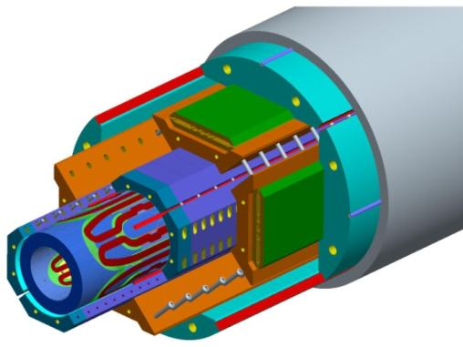
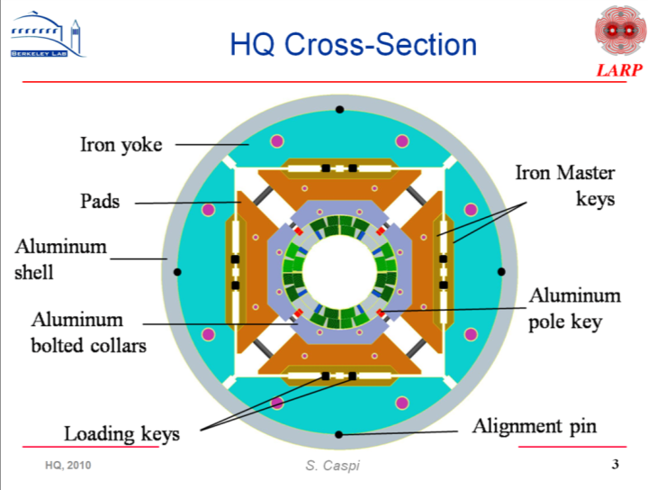
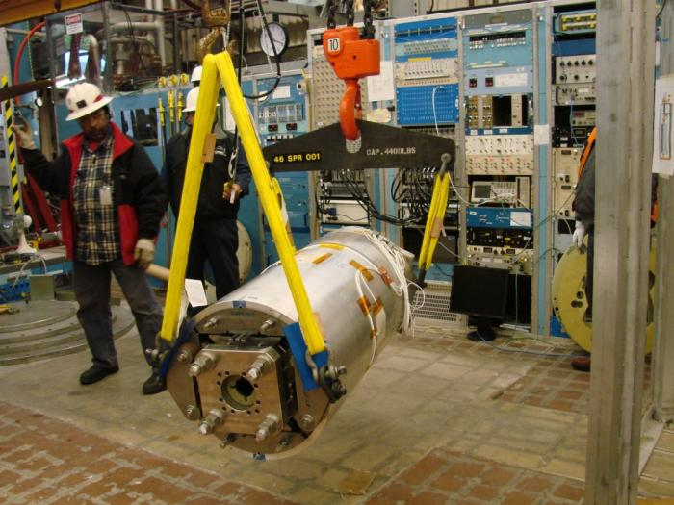
NB₃Sn : HQ
HQ: a 1 m long - 120 mm aperture model
whose second test is under way

Slide 21
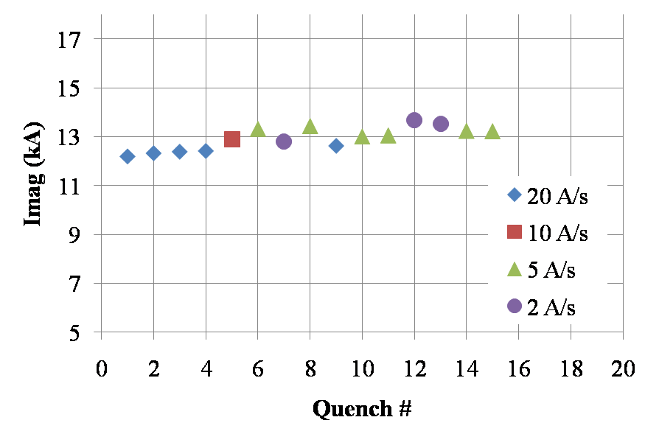
First HQ test
already above the minimum goal (Phase-1)
Max critical current
Goal HL-LHC (G=180 T/m)
Goal Phase 1 (G=127 T/m)

Slide 22
IT quadrupole preliminary specification (1)
Aperture A = 120 mm – 150 mm (t)
Gradient G = 175 T/m – 140 T/m (t)
Cold mass length 8 m – 10 m (t)
Maximum cold mass outer diameter = 600 mm (s)
Operation temperature 1.9 K (option 4.4 K) (t)
Operational current ≤ 13 kA (s)
Angular straightness (tilt) 1 mrad rms
Radiation hardness for (e) (with shielding):
  50 MGy
  2.10¹⁶ protons/cm²
  3.10¹⁸ neutrons/cm²
Maximum heat load
  Local 15 mW/cm³ in 10 cm length parts
  Global 50 W/m
Cold mass pressure tested at 26 bars (NB: t = tbd later, s = soft, e = estimate)

Slide 23
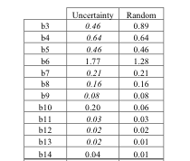
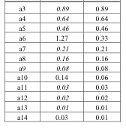
IT quadrupole preliminary specification (2)
Integrated gradient spread between magnets = ±20 units (e)
Gradient delay during ramp @15 A/s ΔG = 10 units (e)
Multipoles (s) (see ref)
Ref: Electromagnetic Design of the 120 mm Aperture Quadrupole for the LHC Phase One Upgrade,
F. Borgnolutti, P. Fessia and E. Todesco, sLHC Project Report 0001, 18 May 2009

Slide 24
IT quadrupole: acceptance criteria and scenarios
Acceptance criteria: (what do we call success ?) (t)
  < 3 quenches to reach nominal gradient
  < 10 quenches to reach 110% of nominal gradient
  Maximum 1 quench after thermal cycle to reach nominal gradient
Scenario for IT Quad
  HQ 1 m short models (ongoing)
  (3.4 m or) 6 m long models by mid 2013
  8 m or 10 m production readiness by end 2014 (1+ working magnet)
  Production between ½ US , ½ CERN or 100% US (t)
    CERN wants to master the technology in any case
  String test at CERN needed (preferably all CM tested at CERN) (t)
  HW ready for installation by 2018

Slide 25
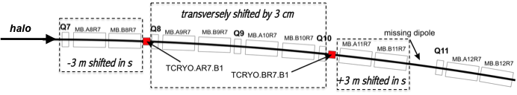
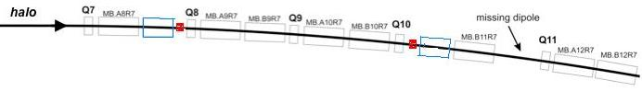
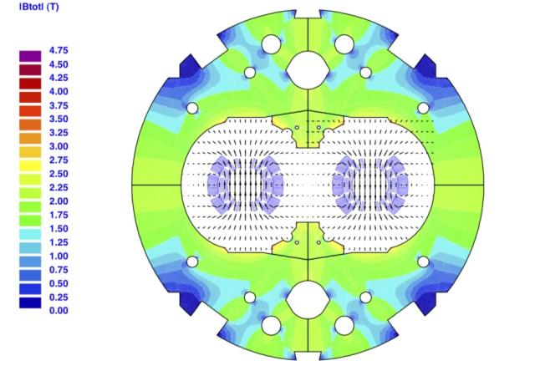
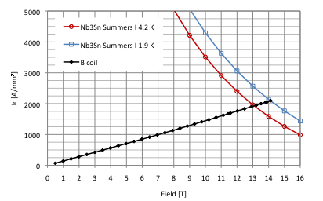
11 T – 11 m Twin Dipole for DS
Shift in the magnet position requires to make room for collimators (red squares).
Alternative option based on stronger and shorter magnets (blue rectangles).

Slide 26
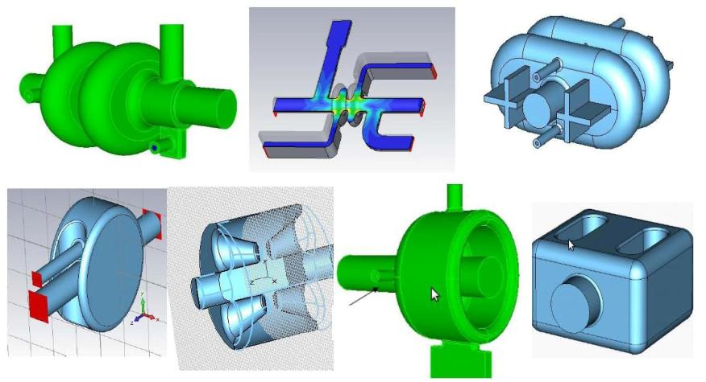
Crab Cavities
θ_{c}
Elliptical 800 MHz not far from being designed. Require 400 mm beam-beam
400 MHz small cavity under conceptual study, they can (?) fit in 194 mm beam-beam. Required for final solution
Ref. : F. Zimmermann, Ed Ciapala

Slide 27
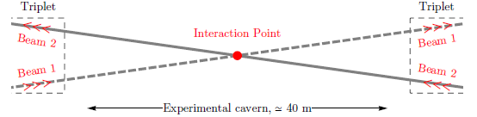
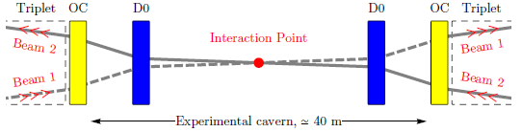
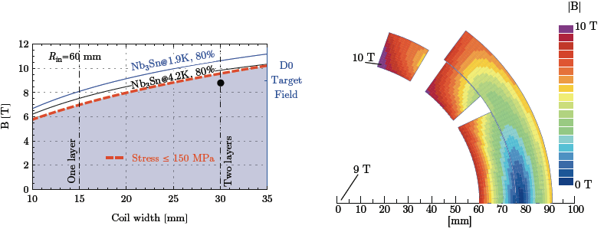
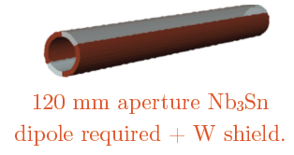
Early separation scheme possible alternative/complement
Nb3Sn at 8.5 T to have margin for heat deposition
13 m from IP
Integration difficult but not impossible
Leveling very easy…
Ref. :
JP Koutchouk and G. Sterbini

Slide 28
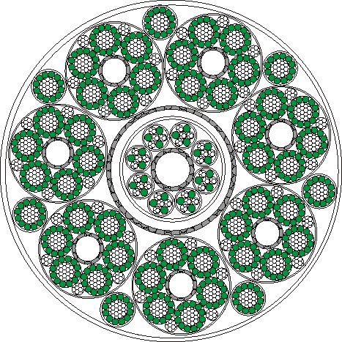

SC link to remove Po.Conv. from H.Rad.
1.1 mm
MgB₂ wire
Vertical link
H = 100 m
Semi-horizontal link (100-700 m)

Slide 29
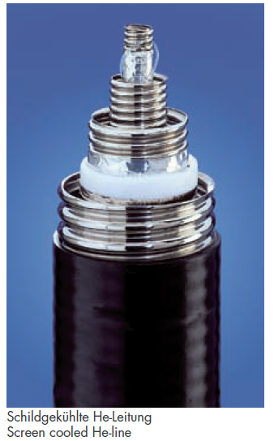

SC link scheme
Φ∼220 mm
He
Vacuum insulation
plus MLI
He
MgB₂ strand
Thermal shield
Cu stabilizer
Superconducting 200 kA MgB₂ multi-circuit assembly (Φest∼60 mm)
100 electrically insulated cables 120 A, 600 A and 7000 A

Slide 30
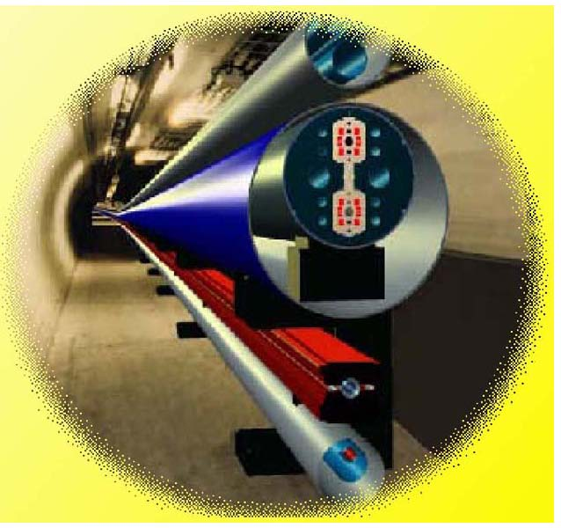
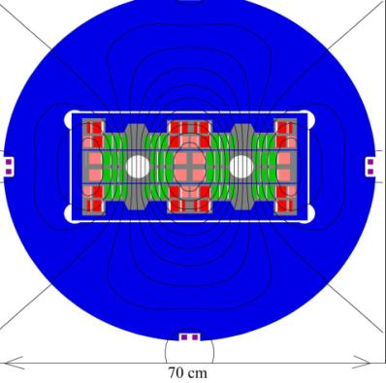
HE-LHC
The High Luminosity LHC or HL-LHC is the route that will enable the way to the Farthest Energy Frontier : an HE-LHC based on 20 T magnets for a 33 TeV c.o.m. collider
HE-LHC Workshop 14-16 October in Malta
Nb₃Sn + HTS
magnets
transmission
line magnets
of new injector
P. McIntyre, Texas A&M, 2005

