Slide 1
Multi-Tier Xrootd Disk Storage
@ ATLAS Western Tier 2
Wei Yang
SLAC

Slide 2
Why Disk Storage with Multiple Tiers
Save Money (or try to)
Target Analysis jobs
Assuming that analysis jobs from different users will access same
(popular) data multiple times.
Already deployed large # of 7200 RPM spindles for Frontend, in small boxes
Relatively good in handling random IOs
Host recently accessed data
Backend storage only deal with whole file transfers
Host recently untouched data
Require less random IO performance
Use 5400 RPM hard drives
Use less head nodes
Hope will not sacrifice performance by too much

Slide 3
Difference between Multi-Tier Disk Storage and (Conventional)
Tape backed storage
Multi-tier disk storage places data on either frontend or backend
But not both, data are moved between tiers automatically
Users can access both frontend and backend, or frontend only, depend
on needs and accessing pattern
Tape backed storage systems store all data on tapes
Frontend is a disk cache
New data on frontend are copied to backend ASAP.
Frontend is cleaned when free disk space is needed
Users only see frontend (tapes are too slow to be exposed to users, file
catalog may be needed)
Deletion from tape is very expensive
The backend doesn’t have to be tape, it can be disk
Similar to (and better than) multi-tier disk storage, but cost more
Xrootd’s File Residency Manager (FRM) can be used for both types

Slide 4
Multi-Tier Xrootd Disk Storage Architecture (one of many)
Production (no repeated data access)
DDM (SRM/GridFTP/xrootdfs)
Only xrootd/cmsd
interface is needed
Top (meta) rdr
Analysis (repeated data access)
GridFTP (write)
All job outputs
Front rdr
back rdr
copy-in
copy-out
Data server w/ FRM
Data server
Data server w/ FRM
Data server
Data movement (FRM copy-in and copy-out) driven by frontend
FRM calls simple shell scripts using xrd, xrdcp, xrdadler32
Backend does not have to be Xrootd system
in this case, something able to joint top (meta) redirector will work
Can have multiple backends in parallel. E.g.
put ATLASLOCALGROUPDISK path on tape
Stage-in over WAN
Back-back-end …
Top redirector sees all of them

Slide 5
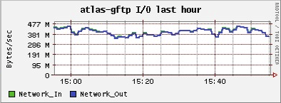
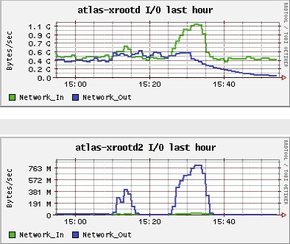

Slide 6
Details and Issues:
Run Adler32 for all data movements
Frontend (20 Thumpers / Thors) runs ZFS to guard against silent data corruptions
Run all three redirectors on one machine
Separated by instance name and port #
Frontend and backend use same namespace (to make life easier)
A single, simple xrootd configuration file shared by all machines
To access all storage: root://top-redirector:port4top//path
To access front storage: root://front-redirector:port4front//path or
root://top-redirector:por4top//path?
tried=+backend_cluster_id&oss.cgroup=SPACE_TOKEN
To access backend storage: …

Slide 7
Details and Issues, cont’d
Top redirector doesn’t know internal data movement
Think of accessing sequence stat(top), read(front),
stat(top, by the next jobs)
Second stat() may get “No server has the data file” error
It is a just bug, not an xrootd limitation
Work around by shorten top redirector caching time to minimum
FRM operations create .lock files
Xrootd internal file
.lock file’s timestamps are used by FRM to mark copy-out status
Interactive users mess up with .lock files
New XrootdFS will hide .lock files
Future xrootd releases will use different name scheme for internal files
With both issues addressed, the WT2 operation has been smoothly

