Slide 1
Storage at SMU
OSG Storage
9/22/2010
Justin Ross (ross@smu.edu)
Southern Methodist University

Slide 2
Tier 3 Hardware
20 Dell C6100 (80 nodes)
32 Dell M610
16 Dell M610 with Infiniband
10 Gb Cluster Network Backbone, 1Gb to each node
6 GB RAM per core
14 Dell C6100 (56 nodes) just delivered
Dell 8024F and 6248 switches
Experiments: ATLAS, NoVA, CDMS, BaBar, D-Zero, Biology, Math, Mechanical Engineering, Statistics

Slide 3
Tier 3 Config
Lustre FS
ext3 FS on individual file systems
NFS
Special case use
BeStMan SRM
Condor for batch
SGE for parallel jobs
Nagios monitoring

Slide 4
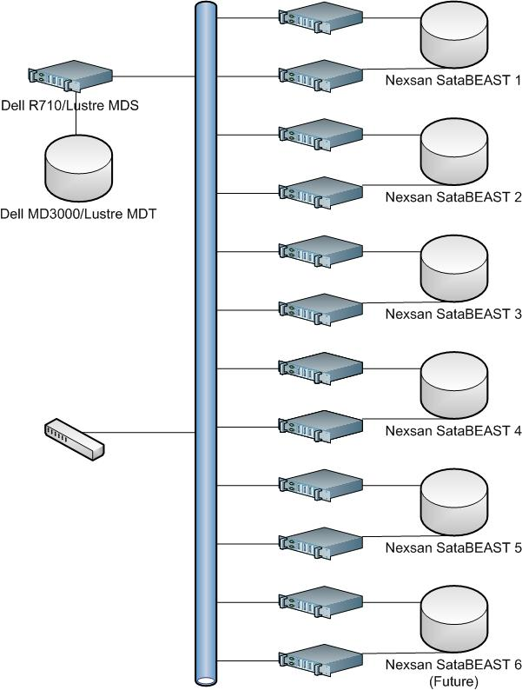
Lustre Layout
Dell MD3000 MDT
14 15K RPM SAS drives
Snapshots for MDT backup
Nexsan SataBEAST OST
42 2TB SATA drives
Single controller
2 4Gb fibre ports
Dell R710 servers
2 5540 Intel CPU
2 500GB SATA HD RAID1 for OS
16G RAM
4 1Gb bonded NIC
Qlogic 4Gb HBA/6Gb SAS HBA

Slide 5
Config
Lustre provided kernel on all MDS/OSS
Patchless kernel module on clients.
Every time a new kernel is released you need to compile the module.
Performance is good.
Performance increases when more OSS/OST are added.
The one drawback is small files.
Biology Professor has millions of small files and uses NFS.

Slide 6
Startup/Shutdown
Lustre is like a freight train it is big and takes a long time to start and stop
To start just mount everything
mount /mdt
mount /mgs
mount /[2345]-ost[123456] on appropriate server
Shutdown
umount /[2345]-ost[123456] on appropriate server
umount /mdt
umount /mgs

Slide 7
Traffic Flow/Monitoring

Slide 8
[ross@smuhpc lustre]$ pwd
/proc/fs/lustre
[ross@smuhpc lustre]$ cat devices
0 UP mgc MGC10.1.1.40@tcp 124b7d77-8f53-3871-10cf-80a0098aa43b 5
1 UP lov smuhpc-clilov-ffff810c6f802000 e6d03b78-edcd-a8ee-7046-8970c81b2fa0 4
2 UP mdc smuhpc-MDT0000-mdc-ffff810c6f802000 e6d03b78-edcd-a8ee-7046-8970c81b2fa0 5
3 UP osc smuhpc-OST0000-osc-ffff810c6f802000 e6d03b78-edcd-a8ee-7046-8970c81b2fa0 5
4 UP osc smuhpc-OST0001-osc-ffff810c6f802000 e6d03b78-edcd-a8ee-7046-8970c81b2fa0 5
5 UP osc smuhpc-OST0002-osc-ffff810c6f802000 e6d03b78-edcd-a8ee-7046-8970c81b2fa0 5
6 UP osc smuhpc-OST0003-osc-ffff810c6f802000 e6d03b78-edcd-a8ee-7046-8970c81b2fa0 5
7 UP osc smuhpc-OST0004-osc-ffff810c6f802000 e6d03b78-edcd-a8ee-7046-8970c81b2fa0 5
8 UP osc smuhpc-OST0005-osc-ffff810c6f802000 e6d03b78-edcd-a8ee-7046-8970c81b2fa0 5
9 UP osc smuhpc-OST0006-osc-ffff810c6f802000 e6d03b78-edcd-a8ee-7046-8970c81b2fa0 5
10 UP osc smuhpc-OST0007-osc-ffff810c6f802000 e6d03b78-edcd-a8ee-7046-8970c81b2fa0 5
11 UP osc smuhpc-OST000b-osc-ffff810c6f802000 e6d03b78-edcd-a8ee-7046-8970c81b2fa0 5
12 UP osc smuhpc-OST000c-osc-ffff810c6f802000 e6d03b78-edcd-a8ee-7046-8970c81b2fa0 5
13 UP osc smuhpc-OST000d-osc-ffff810c6f802000 e6d03b78-edcd-a8ee-7046-8970c81b2fa0 5
14 UP osc smuhpc-OST000e-osc-ffff810c6f802000 e6d03b78-edcd-a8ee-7046-8970c81b2fa0 5
15 UP osc smuhpc-OST000f-osc-ffff810c6f802000 e6d03b78-edcd-a8ee-7046-8970c81b2fa0 5
16 UP osc smuhpc-OST0010-osc-ffff810c6f802000 e6d03b78-edcd-a8ee-7046-8970c81b2fa0 5
17 UP osc smuhpc-OST0011-osc-ffff810c6f802000 e6d03b78-edcd-a8ee-7046-8970c81b2fa0 5
18 UP osc smuhpc-OST0012-osc-ffff810c6f802000 e6d03b78-edcd-a8ee-7046-8970c81b2fa0 5
19 UP osc smuhpc-OST0013-osc-ffff810c6f802000 e6d03b78-edcd-a8ee-7046-8970c81b2fa0 5
20 UP osc smuhpc-OST0014-osc-ffff810c6f802000 e6d03b78-edcd-a8ee-7046-8970c81b2fa0 5
21 UP osc smuhpc-OST0015-osc-ffff810c6f802000 e6d03b78-edcd-a8ee-7046-8970c81b2fa0 5
22 UP osc smuhpc-OST0016-osc-ffff810c6f802000 e6d03b78-edcd-a8ee-7046-8970c81b2fa0 5
23 UP osc smuhpc-OST0008-osc-ffff810c6f802000 e6d03b78-edcd-a8ee-7046-8970c81b2fa0 5
24 UP osc smuhpc-OST0009-osc-ffff810c6f802000 e6d03b78-edcd-a8ee-7046-8970c81b2fa0 5
25 UP osc smuhpc-OST000a-osc-ffff810c6f802000 e6d03b78-edcd-a8ee-7046-8970c81b2fa0 5
26 UP osc smuhpc-OST0017-osc-ffff810c6f802000 e6d03b78-edcd-a8ee-7046-8970c81b2fa0 5
27 UP osc smuhpc-OST0018-osc-ffff810c6f802000 e6d03b78-edcd-a8ee-7046-8970c81b2fa0 5
28 UP osc smuhpc-OST0019-osc-ffff810c6f802000 e6d03b78-edcd-a8ee-7046-8970c81b2fa0 5
29 UP osc smuhpc-OST001a-osc-ffff810c6f802000 e6d03b78-edcd-a8ee-7046-8970c81b2fa0 5
30 UP osc smuhpc-OST001b-osc-ffff810c6f802000 e6d03b78-edcd-a8ee-7046-8970c81b2fa0 5
31 UP osc smuhpc-OST001c-osc-ffff810c6f802000 e6d03b78-edcd-a8ee-7046-8970c81b2fa0 5
32 UP osc smuhpc-OST001d-osc-ffff810c6f802000 e6d03b78-edcd-a8ee-7046-8970c81b2fa0 5
33 UP osc smuhpc-OST001e-osc-ffff810c6f802000 e6d03b78-edcd-a8ee-7046-8970c81b2fa0 5
34 UP osc smuhpc-OST001f-osc-ffff810c6f802000 e6d03b78-edcd-a8ee-7046-8970c81b2fa0 5
35 UP osc smuhpc-OST0020-osc-ffff810c6f802000 e6d03b78-edcd-a8ee-7046-8970c81b2fa0 5
36 UP osc smuhpc-OST0021-osc-ffff810c6f802000 e6d03b78-edcd-a8ee-7046-8970c81b2fa0 5

Slide 9
[ross@smuhpc ~]$ lfs df -h
UUID bytes Used Available Use% Mounted on
smuhpc-MDT0000_UUID 656.2G 3.6G 652.6G 0% /lustre[MDT:0]
smuhpc-OST0000_UUID 4.5T 3.6T 907.1G 80% /lustre[OST:0]
smuhpc-OST0001_UUID 4.5T 3.6T 919.7G 79% /lustre[OST:1]
smuhpc-OST0002_UUID 4.5T 3.6T 897.7G 80% /lustre[OST:2]
smuhpc-OST0003_UUID 4.5T 3.6T 872.7G 80% /lustre[OST:3]
smuhpc-OST0004_UUID 4.5T 3.6T 915.9G 80% /lustre[OST:4]
smuhpc-OST0005_UUID 4.5T 3.6T 911.2G 80% /lustre[OST:5]
smuhpc-OST0006_UUID 4.5T 3.6T 915.5G 80% /lustre[OST:6]
smuhpc-OST0007_UUID 4.5T 3.6T 872.0G 80% /lustre[OST:7]
smuhpc-OST0008_UUID 4.5T 22.8G 4.5T 0% /lustre[OST:8]
smuhpc-OST0009_UUID 4.5T 22.5G 4.5T 0% /lustre[OST:9]
smuhpc-OST000a_UUID 4.5T 22.0G 4.5T 0% /lustre[OST:10]
smuhpc-OST000b_UUID 4.5T 3.5T 1023.2G 77% /lustre[OST:11]
smuhpc-OST000c_UUID 4.5T 3.5T 1013.0G 77% /lustre[OST:12]
smuhpc-OST000d_UUID 4.5T 3.5T 1008.0G 78% /lustre[OST:13]
smuhpc-OST000e_UUID 4.5T 3.5T 1012.5G 77% /lustre[OST:14]
smuhpc-OST000f_UUID 4.5T 3.2T 1.3T 70% /lustre[OST:15]
smuhpc-OST0010_UUID 4.5T 3.2T 1.3T 70% /lustre[OST:16]
smuhpc-OST0011_UUID 4.5T 3.1T 1.4T 69% /lustre[OST:17]
smuhpc-OST0012_UUID 4.5T 3.2T 1.3T 70% /lustre[OST:18]
smuhpc-OST0013_UUID 4.5T 2.9T 1.6T 64% /lustre[OST:19]
smuhpc-OST0014_UUID 4.5T 2.9T 1.6T 65% /lustre[OST:20]
smuhpc-OST0015_UUID 4.5T 2.8T 1.6T 63% /lustre[OST:21]
smuhpc-OST0016_UUID 4.5T 2.8T 1.6T 63% /lustre[OST:22]
smuhpc-OST0017_UUID 4.5T 16.7G 4.5T 0% /lustre[OST:23]
smuhpc-OST0018_UUID 4.5T 11.9G 4.5T 0% /lustre[OST:24]
smuhpc-OST0019_UUID 4.5T 16.8G 4.5T 0% /lustre[OST:25]
smuhpc-OST001a_UUID 4.5T 15.5G 4.5T 0% /lustre[OST:26]
smuhpc-OST001b_UUID 4.5T 12.4G 4.5T 0% /lustre[OST:27]
smuhpc-OST001c_UUID 4.5T 12.6G 4.5T 0% /lustre[OST:28]
smuhpc-OST001d_UUID 4.5T 11.5G 4.5T 0% /lustre[OST:29]
smuhpc-OST001e_UUID 4.5T 14.1G 4.5T 0% /lustre[OST:30]
smuhpc-OST001f_UUID 4.5T 16.1G 4.5T 0% /lustre[OST:31]
smuhpc-OST0020_UUID 4.5T 11.2G 4.5T 0% /lustre[OST:32]
smuhpc-OST0021_UUID 4.5T 9.3G 4.5T 0% /lustre[OST:33]
filesystem summary: 152.2T 67.0T 85.2T 44% /lustre
[ross@smuhpc lustre]$ pwd
/proc/fs/lustre
[ross@smuhpc lustre]$ ll
total 0
-r--r--r-- 1 root root 0 Sep 17 08:43 devices
-r--r--r-- 1 root root 0 Sep 17 08:43 health_check
dr-xr-xr-x 4 root root 0 Sep 17 08:43 ldlm
dr-xr-xr-x 3 root root 0 Sep 17 08:43 llite
dr-xr-xr-x 3 root root 0 Sep 17 08:43 lov
dr-xr-xr-x 2 root root 0 Sep 17 08:43 lquota
dr-xr-xr-x 3 root root 0 Sep 17 08:43 mdc
dr-xr-xr-x 3 root root 0 Sep 17 08:43 mgc
dr-xr-xr-x 36 root root 0 Sep 17 08:43 osc
-r--r--r-- 1 root root 0 Sep 17 08:43 pinger
-r--r--r-- 1 root root 0 Sep 17 08:43 version

