Slide 1
WLCG and Data management Prototypes September 2010 Ruth Interested in what people want OSG to do in this area…

Slide 2
History
Initialized by CMS (Ian Fisk) and ATLAS (KB) on March 14 to WLCG and IT
“We would like to invite CERN IT to discuss with us a way towards a better solution for data storage on the grid. There have already been quite a few studies elsewhere and experience from those should not be neglected. Moreover HEP is no longer unique with its requirements and interesting commercial components have become available. We should use 2010 and 2011 to develop a more complete solution and focus on having some new components to be installed and tested in the year of the LHC shutdown in 2013. “

Slide 3
From Kors Bos slides to the Overview Board – I cannot do better than him

Slide 4
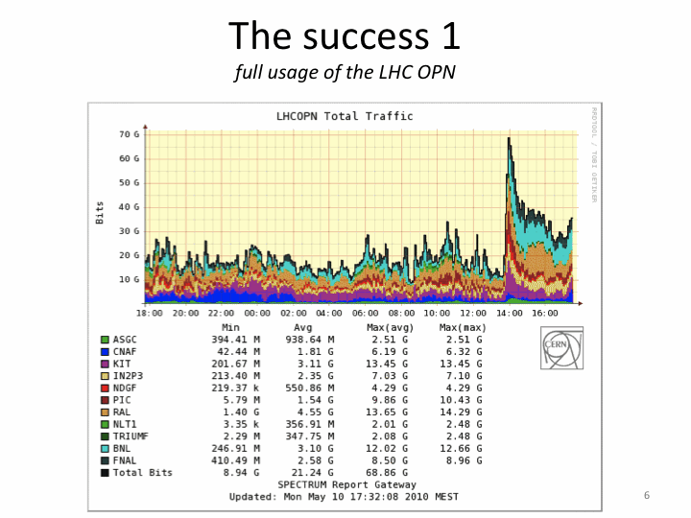

Slide 6
Planning for Networks

Slide 7
Summary of workshop in Ian Bird Document
General points
• Today use of available resources, particularly network bandwidth and disk storage is probably not optimal, and reasonable step can be taken to make the existing resources more effective.
• Using the network to access data when it is not available locally is a reasonable mechanism to improve the efficiency of data access (e.g. 95% of files may be available at a site, the other 5% can be retrieved or accessed remotely, presumably with local caches too).

Slide 8
Storage
It was clear that traditional HEP use of tape (write once, read very often) is no longer supportable. It clearly cannot support the almost random access patterns typical in all but organised production scenarios, and there is a distinct mismatch in performance between tape and the consumers.
• The (tape) archives should be separate from the caching layers, and treated as a true archive where data is written and rarely read. The exception is when entire datasets may be brought online by a production manager, or when data has been lost from disk and needs to be recovered.
• This should simplify the interfaces to both the archive layer and the caches. The interface to the archive can be based on a simple subset of SRM, to enable explicit move of data between archive and cache (essentially including bulk operations).
• This will also allow the use of industrial solutions for managing the archives, and puts the use of the large tape systems into the operational mode for which they were designed (as opposed to the way in which HEP traditionally uses them).
• This also removes the direct connection between cache and archive, avoiding that general users can trigger random tape access

Slide 9
Data Access Layer
Improving the efficiency of user access to data, particularly for analysis, was one of the major drivers behind this workshop.
• It should no longer be assumed that a job will find all the files that it needs at a site. Missing data should be accessed remotely or fetched and cached locally. Which is the better mechanism should be investigated.
• It cannot be assumed that a catalogue is completely up to date, and hence it is important that missing data be fetched on demand.
• Effective caching mechanisms can reduce or optimise existing usage of disk space. Several caching mechanisms and ideas were discussed. Particularly interesting are proxy caches where a proxy at a site manages the interaction between requestors and remote access. o It is important that the caching tools and caching algorithms be treated separately. A variety of algorithms may be required in different circumstances and should be supported by the tools.
• A combination of organised pre-placement of data and caching may be one option.
• Alternatively it could be that no pre-placement is needed and that data popularity will define what gets into the caches.
• The desired model of data access by the application is that of the file system. I.e. the job should be able to open, read, etc. and not have to concern itself with the underlying mechanisms. Complexities such as SRM should not be visible to the user.

Slide 10
Data Transfer
There are several data transfer use cases that must be supported:
• A reliable way to move data from a job to an archive, asynchronously. A job can finish and give its output file to a service and be sure that the data will be delivered somewhere and catalogued. (The tools perhaps should separate the two operations – i.e. catalogue updates should not be in the transfer tool).
• A mechanism to support organised data placement.
• A mechanism to support data transfer into caches.
• Support for remote access to data not at a site, or to trigger a transfer of data to a local cache.
Several specific requirements on improving FTS were made, which should also apply to any other transfer mechanism:
• Well defined recovery from failure.
• Ability to do partial transfers, or to transfer partial files, particularly to recover from failure
• Ability to manipulate chunks of data (many files, datasets) as a single entity

Slide 11
Namespaces, Catalogues, Authorization, etc.
• The need is for dynamic catalogues that reflect the changing contents of storage, and must be synchronized with the storage systems (asynchronously)
• The experiment computing models must recognise that this information may not be 100% accurate. Again back to the need to recover from this by remotely accessing (or bringing from remote sites) the missing files.
• Technologies for achieving the catalogue synchronisation could be based on something like LFC together with a Message Bus, or perhaps the “catalogue” could be actually a dynamic information system (e.g. Message Bus, Distributed Hash Table, Bloom Filter, etc.).
• There is a need for a global namespace, based on both LFNs and GUIDs depending on usage.
• ACLs should be implemented once (e.g. in Catalogue) but back doors into storage systems must not be allowed.
• The Alien FC was proposed as a general solution for a central catalogue, with many other features.

Slide 12
Global Home Directory facility
Such a facility seems to be required. The Alien FC has this as an integral part. Other solutions could be based on commercial or opensource technology (drop boxes, Amazon S3, etc.).
Other Considerations
• Monitoring and metrics essential to understand system behaviours
• Is it possible to have a simulation of the data management and job distribution system? Or a testbed?
• Networking needs better planning. Set up group to plan network requirements. The OPN group should then provide a network design.
• The system should be designed to include dynamic resource provisioning

Slide 13
Proposed Demonstrator projects - updated
Agreed that these proposals should be fleshed out by the July WLCG workshop or dropped.
Nothing was officially “dropped”. All demonstrators will report at the October Grid Deployment Board including milestones. Some decision on WLCG work and endorsement in Feb.
Hearing about US ones today/tomorrow..
1. Brian Bockelman: xrootd-enable filesystems (HDFS, Posix, dcache + others) at some volunteer sites. Global re-director at 1 location, allow the system to cache as needed for Tier 3 use.
2. Doug Benjamin - very similar proposal with same use cases for ATLAS. Also include job brokering. Potential to collaborate with 1)?
3. Graeme Stewart: Panda Dynamic Data Placement.
4. (name?): LHCb/Dirac – very similar ideas to 3).
5. Gerd Behrman: ARC caching technology: propose to improve the front-end to be able to work without the ARC Control Tower, also to decouple the caching tool from the CE.
6. Jean-Philippe Baud: Catalogue synchronisation with storage using the Active MQ message broker. a) add files, catalogue them and propagate to other catalogues; b) remove entries when files are lost if a disk fails; c) remove a dataset from a central catalogue and propagate to other catalogues.
7. Simon Metson: DAS for CMS. Aim to have a demo in the summer.
8. Oscar Koeroo: Demonstrate that Cassandra (from Apache) can provide a complete cataloguing and messaging system.
9. Pablo Saiz: Based on Alien FC – comparison of functionality, and demonstration of use in another experiment.

Slide 14
Proposed Demonstrator projects - updated
10. Jeff Templon: Demonstrate the Coral Content Delivery Network – essentially as-is. Proposed metrics for success.
11. Peter Elmer: wants to show workflow management mapping to the available hardware (relevant to use of multi-core hardware).
12. Dirk Duellmann/Rene Brun: prototype proxy-cache based on xrootd. Can be used now to test several things.
13. Jean-Philippe Baud+Gerd Behrman + Andrei Maslennikov + DESY: use of NFS4.1 as access protocol.
14. Jens Jensen + (other name?): simple ideas to immediately speed up use of SRM and to quickly improve the lcg-cp utility.

Slide 15
Driving ideas that all prototypes strive for:
• Decouple disk and tape.
• Accommodate large memory in the service nodes (not the WNs). Few nodes with very large memory to keep track. 100 Gigabytes.
• Aggregate high throughput no need for very individual high throughput.
• Reducing the latency.
• Push or pull model from higher tiers to reduce the latency and increase the efficiency of storage usage.
Each demonstrator is looking at one capability and will need something round it to ensure the coherence;
Note that the integration architecture is not defined.

Slide 16
CMS/US ATLAS: (Brian, Doug): xrootd-enable filesystems (HDFS, Posix, dcache + others) Integration with the CERN proxy-cache demonstrator??
CERN: Dirk Duellmann/Rene Brun:
prototype proxy-cache based on xrootd.
EOS : xroot large disk based storage element – disconnected from CASTOR.
Disk pool more reliable across disk failures. Single disks with multiple copies against failure.
Namespace service, memory based, plugin XROOTD; 1 Petabyte.
ATLAS trying to show can deal with a disk based storage system and manage it. More defined split between Tape and Disk. Separate grid site. Populate with subscriptions with Pool.
Based on idea that memory size growing on boxes so can have the full namespace in memory.
Changelog and failover to second node; recovery procedure to recreate the memory cache. Google hash table. Do not lose performance while recovery reliability up.
Want to test with Hadoop or GPFS after the new year

Slide 17
Interested in what people want OSG to do in this area…
Sure to be more at CHEP

