Slide 1
ATLAS Data Management
Hironori Ito
Brookhaven National Laboratory

Slide 2
ATLAS DDM
DDM central services
Subscription
Dataset catalogs
List of files in a dataset
Replica catalogs
List of sites in a datasets
Deletion
Popularity
Count access of datasets
Blacklist
Allow/disallow transfer to/from sites
DQ2 Site service
Request queues for particular sites
Submit FTS transfers
Deletion site services
Similar to DQ2 SS, but manage deletion instead of transfers
Cloud FTS
Channels: defined for SRM end points
Sites information are obtained from LCG BDII

Slide 3
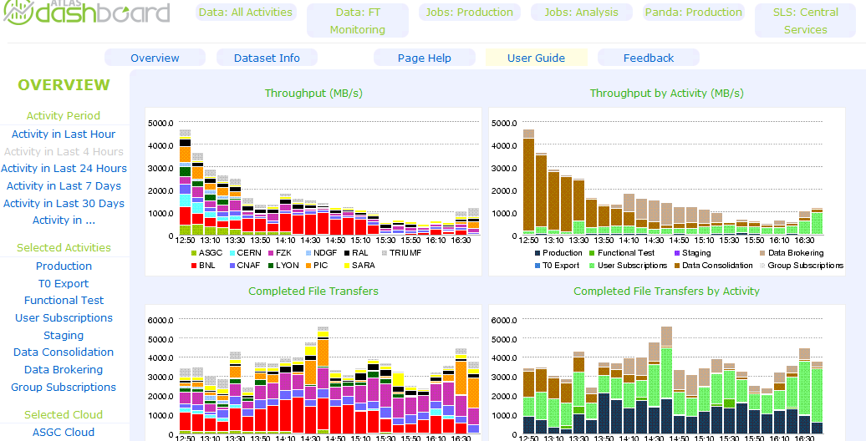
Typical transfers

Slide 4
Basic diagram of file transfers
Central Services
Requests
Replica
Catalog
DQ2 SS A
DQ2 SS B
DQ2 SS C
LFC(s)
File Catalog
FTS
a
FTS b
FTS c
FTS d
SE n
SE m

Slide 5
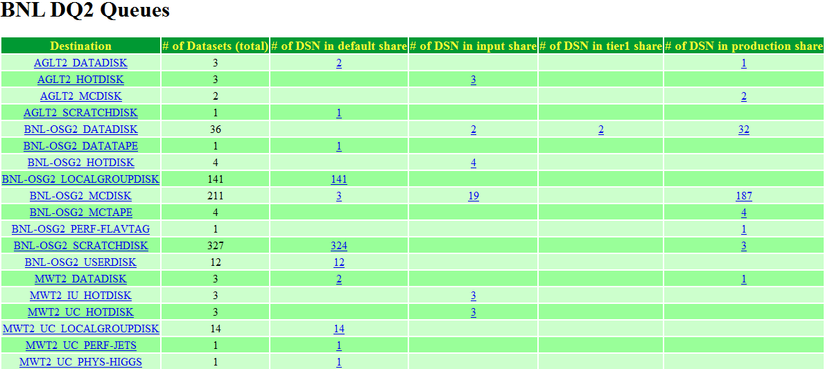
DQ2 SS Queues

Slide 6
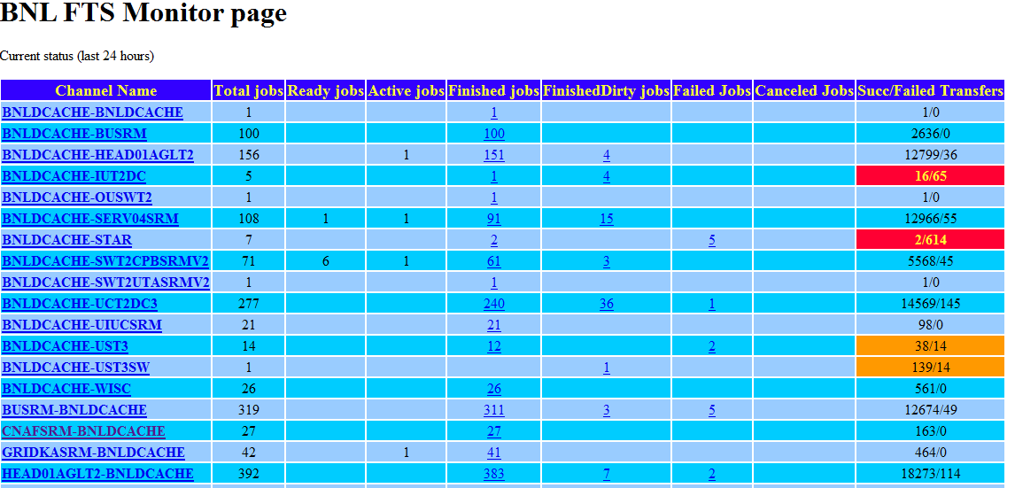
FTS Queues

Slide 7
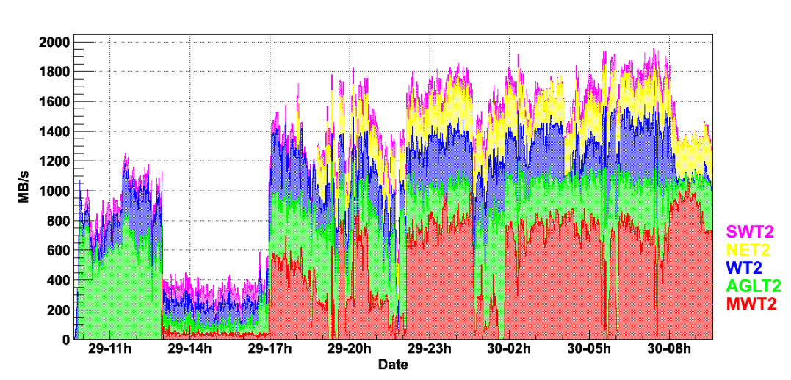
Good Throughput to US T2s from BNL
It works as it was designed.

Slide 8
Transfer models
Pre-determined sets of data are sent to all T2s regardless of their needs.
Pre-placement
Inter-clouds transfers are limited exclusively between T1s/T0
User datasets (output of analysis jobs) are located at the sites where the jobs were run.

Slide 9
Problem
Pre-placement requires high bandwidth network and large storage spaces
A site with even 10Gb/s can not keep up with the expectation of users.
Network and/or disk IO bottle neck can happen everywhere.
A site can quickly runs out of space due the large amount of data sent to them
Automated deletion can not catch-up with delivery of data.

Slide 10
Problem (continue…)
Strict hierarchical transfer models require T1s to have extra temporary space and network bandwidth because all traffic must go through T1s when transfers are done between two different T2s.
Deletion of temporary files at T1s can become problematic.
T1s can possibly become network bottleneck.

Slide 11
Problem (continue…)
Users generally want to have their datasets at (or close to) their own institution instead of sites where jobs were run.
Users must request transfers once jobs are done.

Slide 12
Modified Transfer Model
Stop pre-placement of data.
Large fraction of data were never used at T2s while the small fraction of data were used repeatedly.
PANDA dynamically send input datasets to T2s from T1.
All user analysis jobs without input datasets at any of T2s will be run at T1 first.
At the same time, the input datasets of these jobs will be sent to T2(s) because of the expectation that they will likely be used again.

Slide 13
Modified Transfer Models (continue…)
Allow some inter-clouds transfer outside of T1s.
Reduce number of hopping=Reduce maintenance.
T1 A
T1 B
T1 A
T1 B
T2 A1
T2 A2
T2 B1
T2 B2
T2 A1
T2 A2
T2 B1
T2 B2
Monitoring and debugging of long distance, inter-clouds network can become very problematic.

Slide 14
Transfers to non-DDM sites
Although DDM is a nice automated system, DDM requires certain minimum requirements at a storage site:
SRM end points with specific space tokens and checksum capabilities.
Registration of sites to various information systems: oim, bdii and atlas (ToA)
Must pass regular tests.
SAM and ATLAS functional test
If failed, sites can/will be temporary blocked.
Must respond to a problem ticket issued by a shifter within reasonable time period.

Slide 15
Transferring to non-DDM sites
The most T3s are expected to lack expertise and/or man-power needed to become ATLAS DDM sites.
However, data still needs to be transferred to T3s.
Users want to keep their own datasets.
Users want to use own institutional clusters for their analysis jobs (debugging and testing especially).

Slide 16
Some requirements for non-DDM managed transfers
To avoid chaotic situations caused by large number of transfers from many individual users, some controls are needed.
Avoid DOS at T0/T1s/T2s production sites!!!
Use already existing tools as much as possible.
Minimize the man power.
Transfers must be reasonably fast (or at least, it should work as good as user’s expectation.)

Slide 17
One possible solution
USE dq2-client (dq2-get) with FTS plugin.
Submit request directly to FTS (compare with dq2-get)
Provide the protection and control for T0/T1s/T2s.
Requests are queued.
Logs are visible.
Performance can be monitored.
Some things must be done by users (since DQ2 SS and central services are not there.)
User must specify source sites.
User should know the total size of data and make sure that the site has enough space.
User should have some reasonable expectation of delievery time.
User must check if all transfers successful.

Slide 18
T3 file catalog?
No LFC file catalog (in default).
US T3s can use BNL T3 LFCs if desired.
SE must become file catalog.
Directory structure should become catalog.
In ATLAS DDM, files are stored with certain directory structures, identified by name of datasets: project name, version
Performance can be issue?

Slide 19
Other management issues
Deletion is a pain.
Deciding what to delete.
How fast files can be deleted.
Synchronizing various catalogs can be problematic.
Dataset catalog, replica catalogs, file system on storage.

