Slide 1
LSST Simulations on OSG
Overview
OSG Engagement of LSST
LSST Simulation Workflow Requirements
System Architecture
Resource Utilization
Operational Experience
Results Validation
September 22, 2010
Parag Mhashilkar, Gabriele Garzoglio for the OSG Task Force on LSST
Computing Division, Fermilab
Notes:
1

Slide 2
Introduction
LSST at Purdue (Ian Shipsey) and OSG are collaborating to explore the use of the OSG to run LSST computations
Integrated the current LSST image simulation with OSG
In September, Bo Xin (LSST Purdue) has…
produced 150 image pairs and is working on 350 more
validated the OSG production against one official reference (PT1) image

Slide 3
OSG “engagement” of LSST
Goal of the effort: OSG to empower LSST to use OSG resources independently
Engagement phase: OSG provides experts for a limited time to help with
commissioning a submission system (software & resources) to run LSST workflows on OSG resources
supporting the integration of LSST applications with OSG
supporting the initial LSST operations

Slide 4
History
Feb 2010 – Proof of principle of 1 LSST image simulated on OSG
Jun 2010 – OSG EB forms an OSG task force for LSST
Goal of the project is to simulate one night of image taking (500 image pairs)
Jul 2010 – Commissioning of the LSST submission system on OSG
Using an old application release (svn-11853), 1 person produced 183 times the same image in 1 day
Aug 2010 – Integrated “current” LSST release (svn-16264) with the system
Sep 2010 – LSST operator (Bo Xin) ran operations to produce 529 pairs.

Slide 5
Workflow Requirements
LSST simulation of 1 image: 189 trivially parallel jobs for the 189 chips
Input to the workflow:
SED catalog files: 15 GB uncompressed, pre-installed at all sites
Catalog files (SED files + wind speed, etc.): 500 MB compressed per image pair
Workflow:
Trim catalog file into 189 chip-specific files
Submit 2 x 189 jobs: 1 image pair (same image w/ 2 exposures)
Output: 2 x 189 FITS files, 10 MB each compressed

Slide 6
Production by Numbers
Goal: simulate 1 night of LSST data collection: 500 pairs
200k simulation jobs (1 chip at a time) + 500 trim jobs
Assume 4 hours / job for trim and simulation (over-est.) → 800,000 CPU hours
Assume 2000 jobs DC → ~50,000 CPU hours / day
17 days to complete (w/o counting failures)
12,000 jobs / day i.e. 31 image pairs / day
50 GB / day of input files moved (different for every job)
300 GB / day of output
Total number of files = 400,000 (50% input - 50% output)
Total output compressed = 5.0 TB (25 MB per job)

Slide 7
Architecture
2
Glidein
VO Frontend
Submit
Monitor
5
Submitter
3
Condor
Collector
User
Interface
DAG
OSG Glidein Factory
Create
1
Submit
3
1
Glidein
WN Info
Local Disk
Condor
Scheduler
CE
Grid Site
Hadoop
Job &
Data
4
Binaries and SED files pre-installed via OSG MM

Slide 8
Operations
Current setup: Central machine hosts
glideinWMS VO Frontend
User Pool (collector), Condor Scheduler
Unmanaged dedicated storage
If LSST became a stand-alone VO
it could benefit from managed public storage
upload input data to OSG and download output data from OSG public storage
data maintenance could be done through metadata (e.g. remove trim and catalog input files for all workflow that have an output)
data processing would not depend on the availability of a single resource

Slide 9
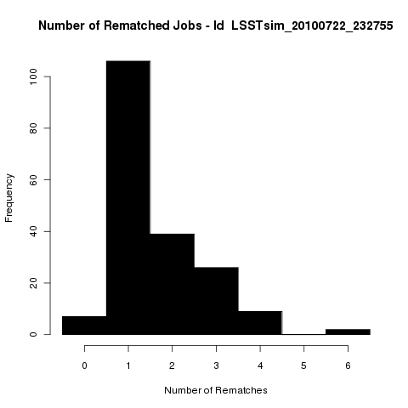
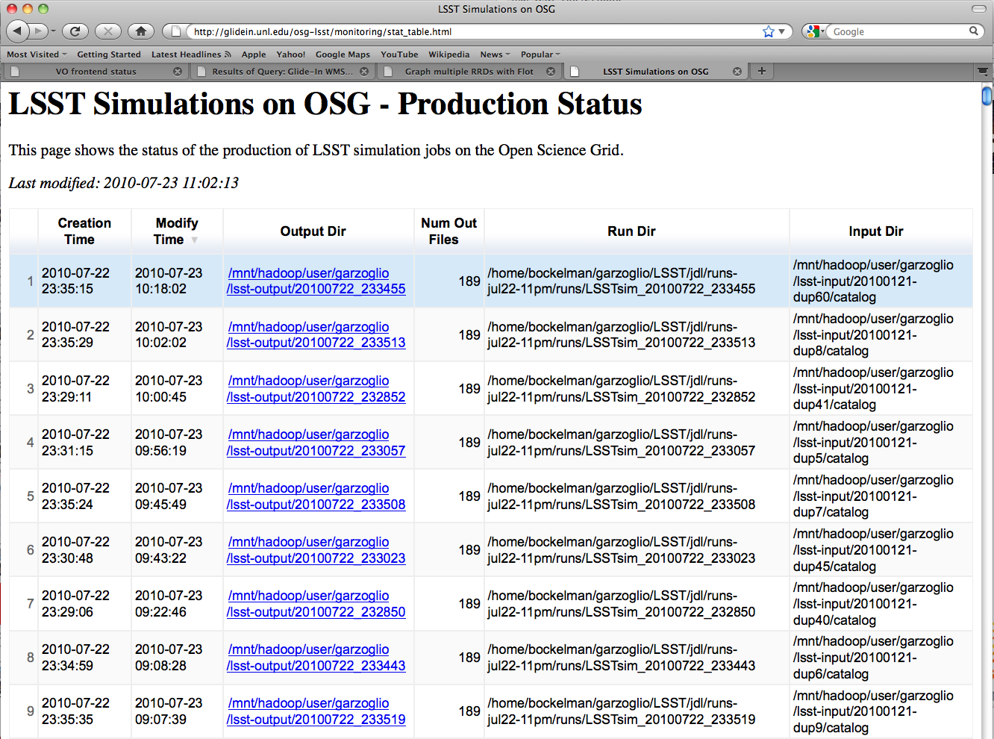
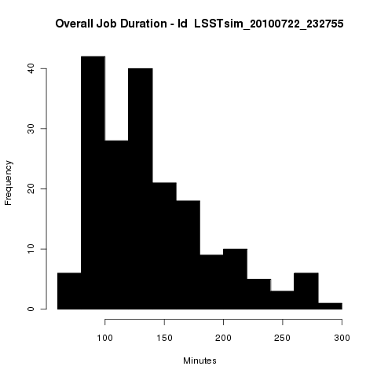
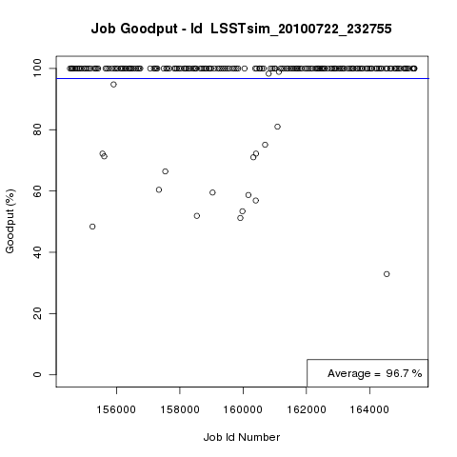
Monitoring Operations
If job exits due to system failure → automatically resubmit indefinitely
If job exits due to app. failure → resubmit 5 times
Periodically look at the output dir
…

Slide 10
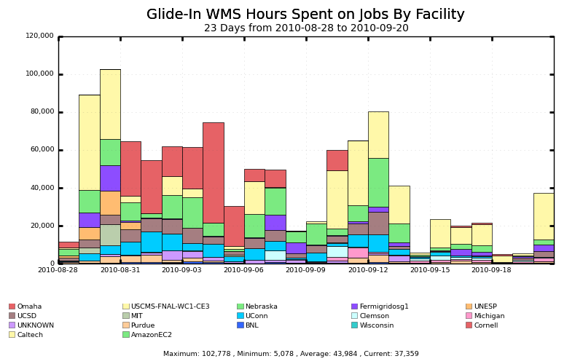
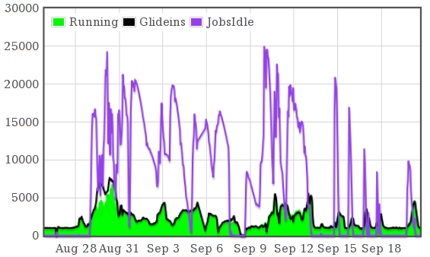
Resource Utilization
By September 3, produced 150 pairs in 5 days using 13 sites.
Now 400 / 529 pairs are produced (some chips job may require recovery)
150 pairs
produced
Gratia Resource Utilization plots
Frontend Status: Jobs & Glideins

Slide 11
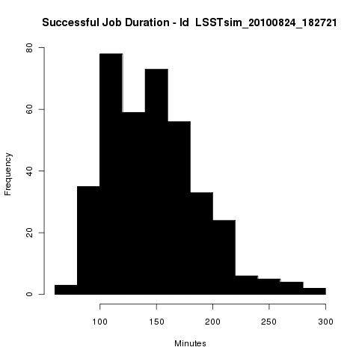
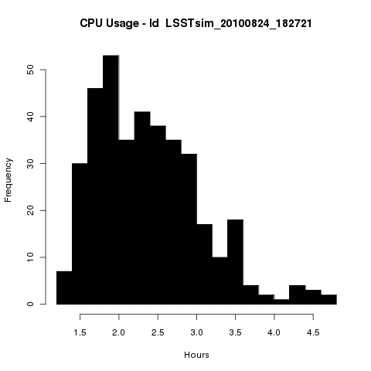
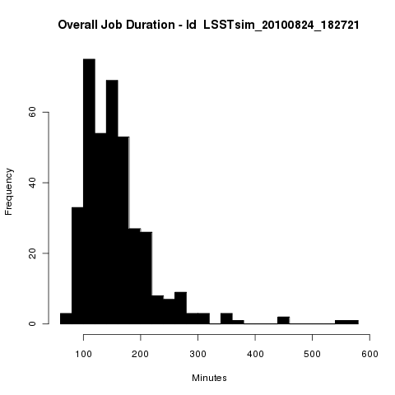
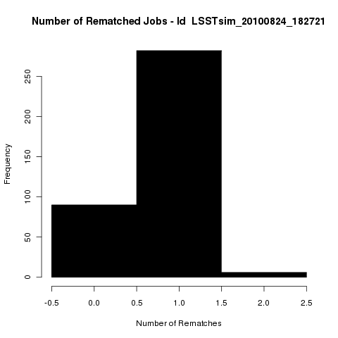
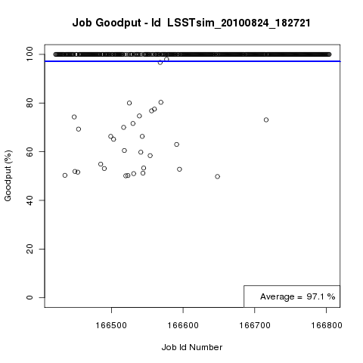
Typical Workflow Statistics

Slide 12
Operational Challenges
LSST binaries were not Grid-ready
Application assumed writable software distribution
Application assumed path-lengths too short for the Grid
Orchestration script did not exit with failure upon error (required manual recovery until fixed)
Typical failures at sites:
Job required more memory than the batch system allotted
Storage unavailable due to maintenance at some of the most productive sites
Limited disk quota on the submission machine
After the production of 150 pairs, the operator was mostly traveling and had limited time to dedicate to the operations

Slide 13
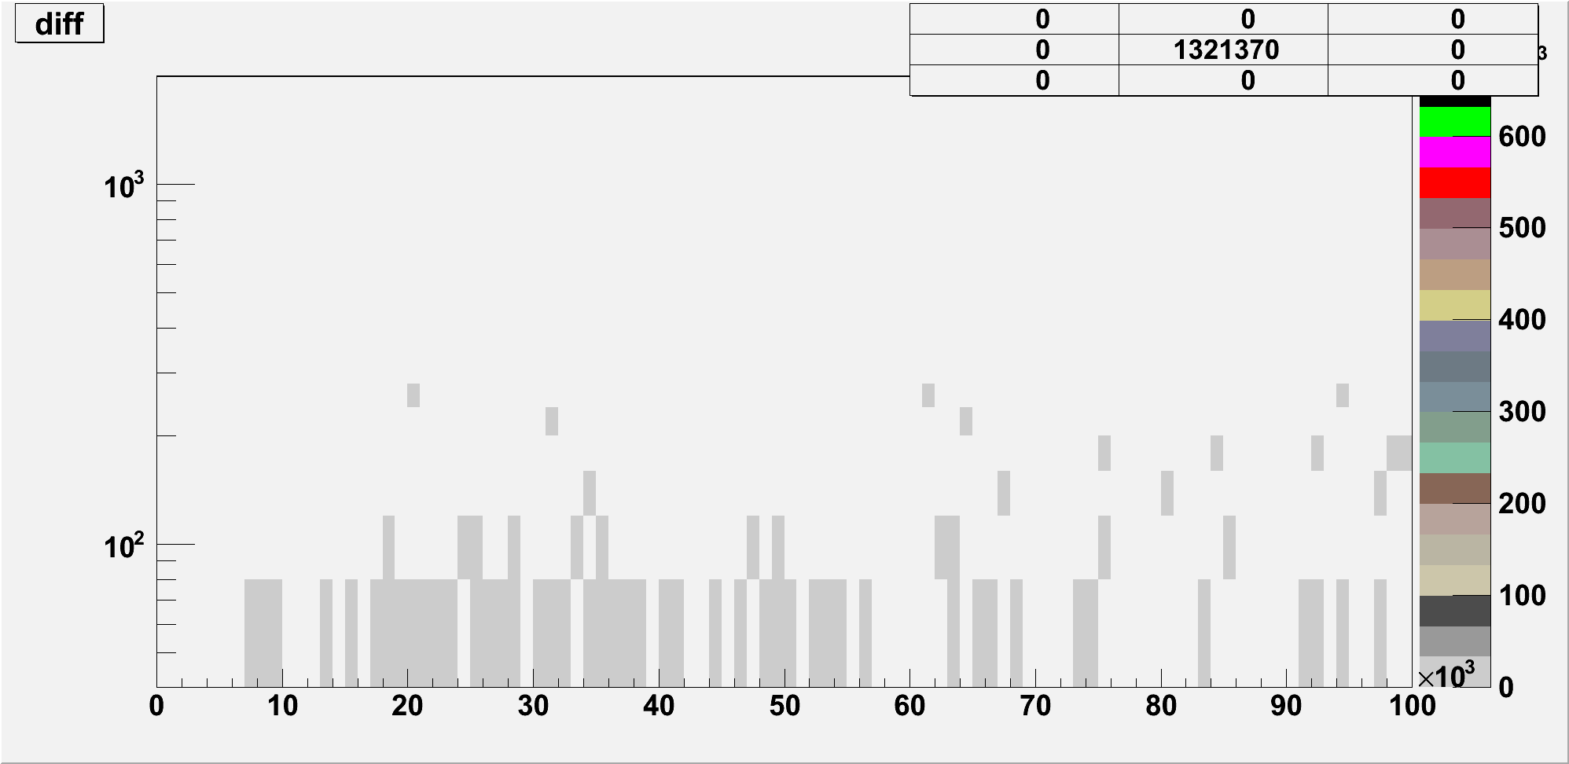
Validation: comparison with PT1
Validation Mechanism:
Subtract an image pixel by pixel from a reference image.
Produced 2 different images twice on OSG, each on a different mix of resources.
In both cases, the pixel-subtraction is consistently 0.
We compared 1 image pair (378 chips) with an “official” reference (PT1).
For 374 chips the pixel-subtraction is consistently 0.
For 4 chips it is negligible*.
More investigations are under way. Study done by Bo Xin.

Slide 14
Conclusions
This project has demonstrated that OSG is a valuable platform to simulate LSST images
1 LSST person, Bo Xin, with expert support has produced 150 image pairs in 5 days, using in average 50,000 CPU h / day.
Bo is currently finishing the production of 529 pairs (400 done with possible needs for recovery)
Image simulation is the first application integrated with OSG. The integration of data-intensive applications might follow
If LSST became a stand-alone VO, it could benefit from managed public storage supported by OSG
Thank you to the OSG Task Force
Especially to Brian Bockelman and Derek Weitzel

