Slide 1
Storage experiences at MWT2 (US ATLAS midwest tier2 Center)
Aaron van Meerten
University of Chicago
Sarah Williams
Indiana University
OSG Storage Forum, Sept 21-22, 2010

Slide 2
Introduction to MWT2
Notes:
Midwest Tier2 primarily runs ATLAS jobs, both Monticarlo and User Analysis. We also run dzero and HCC jobs opportunistically when we have free job slots.
Primary Datastore – dcache
Experimental datastore- xrootd

Slide 3
Network Configuration at MWT2
10 GB UPLINK
Full Duplex
Notes:
The link to campus comes in via a single 10GB link through the 6509 (for Force 10 for IU)
Storage nodes all have 10Gb/s links
6509 provides 720Gb/s bandwidth across the backplane
Expanding with commodity compute nodes & storage connected via commodity switching as compromise in cost vs. ideal performance

Slide 4
Storage Services at MWT2
x10
Notes:
We run dCache across 3 head nodes, with 10 storage nodes

Slide 5
Storage Hardware at MWT2
Notes:
SSD drives in DC4 are 3 x Intel E-class 64GB disks
DC4 and S-nodes are both HyperThreaded, giving 16 logical cores per node
C-nodes with storage are only operational at IU
S-nodes are Dell R710 with 6 MD1000’s attached

Slide 6
Storage Cabling at MWT2
Front View
Single Cabled
Dual Cabled
Notes:
Note that dual-cabling requires that all drawers have power, for pass-through. This makes dual-cabled redundant-pathed but not actually more resilient to failure.
2 Perc6/E controllers, 4 available SAS ports per machine
Single-cabling allows 4 MD1000s to be direct cabled, with 2 daisy-chained
Dual-cabling connects 2 channels per shelf, each subsequent shelf is connected via 2 channels as well
Allows for faster data access (25%) and better use of connections

Slide 7
DD Benchmarks at MWT2
Notes:
Testing of Dell R710 with MD1000
First column in chart is “Average”, other 5 runs are individual tests

Slide 8
Bonnie++ Benchmarks at MWT2
Notes:
Testing of Dell R710 with MD1000
First column in chart is “Average”, other 5 runs are individual tests

Slide 9
Hardware Blessing at MWT2
Notes:
All nodes must pass blessing before they are placed into production
Not all nodes got a 40-thread srmcp read/write test

Slide 10
Typical Benchmarks at MWT2
Notes:
9.92 Gb/s were only possible between machines with an MTU of 9000
Focus of throughput group has been writes, so we do an SRM write test here
10Gb/s dedicated circuit between UC and BNL through ESNet

Slide 11
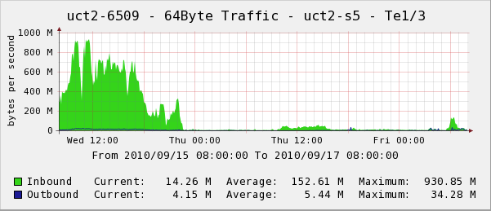
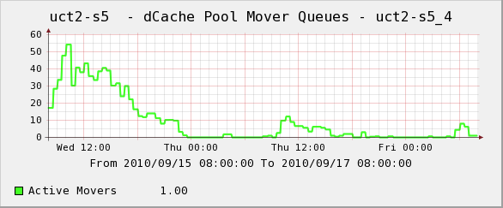
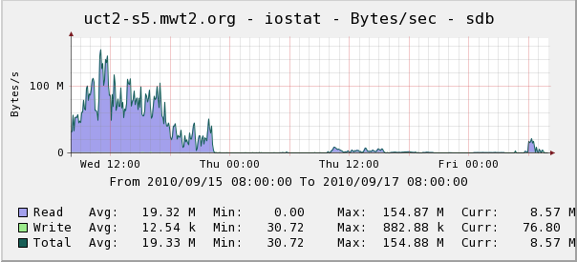
Typical Performance at MWT2
Site Transfers per Hour over 2 days
Network Throughput for a single node
Movers on a single pool
Site Transfers on Uplink over 2 days
Disk Throughput on a single pool
Notes:
All graphs for this slide share the same timeframe
These graphs show data flowing out of our site as a whole, and specifically from a single pool.
Site Transfers shows Outbound as a blue outline

Slide 12
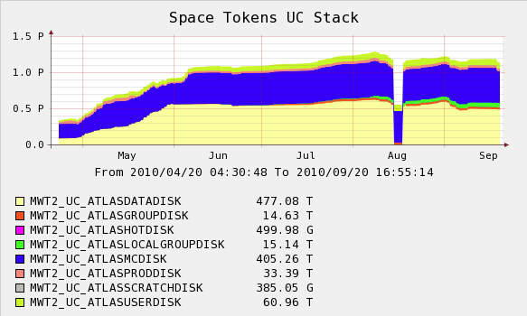
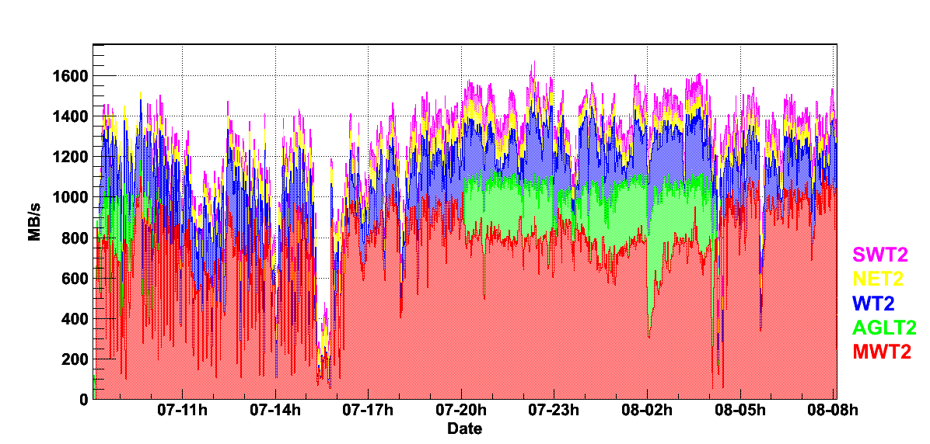
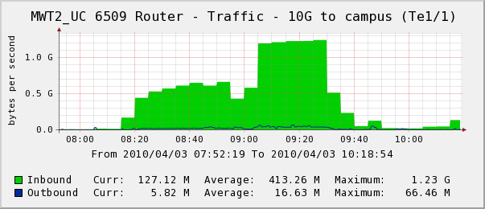
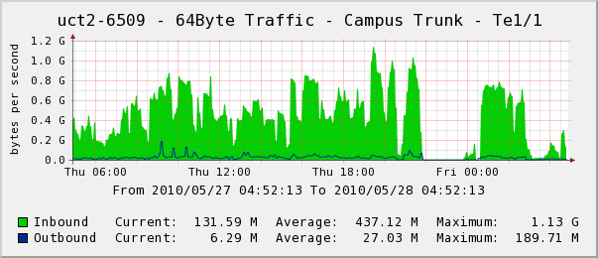
Throughput Performance at MWT2
Space Token Sizes for 5 Months
Throughput to Tier-2 sites from BNL
Storage Load Test writing from IU to UC
Typical High-Throughput Day
Notes:
The storage load test consisted of 100 worker nodes at IU writing into storage at UC, using direct-to-pool writes (not through GridFTP doors)
The throughput to Tier-2 sites was during a long period of high-throughput to MWT2 while our newly available storage was being filled. Often we’d see 800-1000MB/s 10-12 hours or more at a time

Slide 13
Lessons at MWT2
Notes:
MTU 9000 can cause other problems, so restrict its use to nodes that are sure to need it, such as storage pools

Slide 14
Challenges at MWT2
Notes:
Data management tools from Charles Waldman very helpful (dynamic space token
balancing, consistency checker, libdcap studies & optimization, pcache, local site movers)

Slide 15
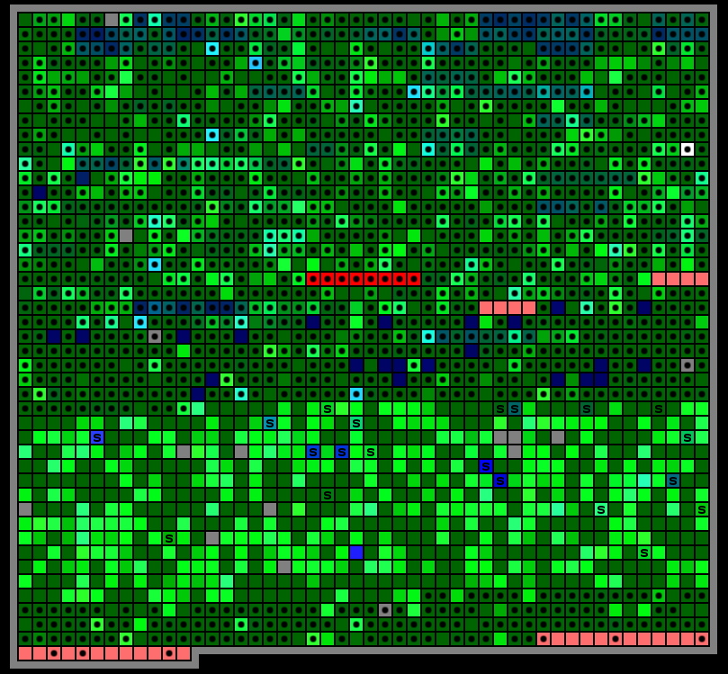
Thanks from MWT2

Slide 16
Additional slides follow

Slide 17
Storage Services at MWT2 - IU

Slide 18
HammerCloud at MWT2
Direct Access HC with only UC workers
Direct Access HC with IU and UC workers

