Slide 1
ATLAS Tier-2 Storage Status AGLT2 OSG Storage Forum – U Chicago – Sep 22 2010 Shawn McKee / University of Michigan

Slide 2
AGLT2 Storage: Outline
Overview of AGLT2
Description, hardware and configuration
Storage Implementation
Original options: AFS, NFS, Lustre, dCache
Choose dCache (broad support in USATLAS/OSG)
Issues
Monitoring needed
Manpower to maintain (including maintaining custom scripts)
Reliability and performance
Future storage systems
dCache or NFSv4(.x) or Lustre (1.8.x+) or Xrootd or ???

Slide 3
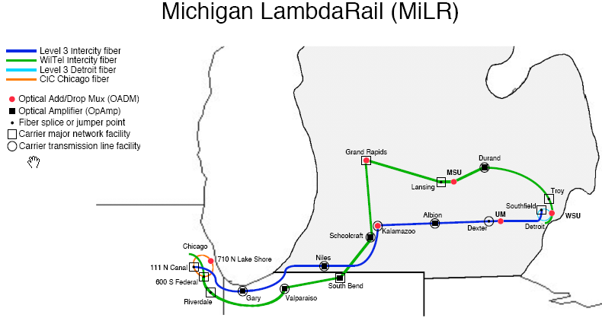
The ATLAS Great Lakes Tier-2
The ATLAS Great Lakes Tier-2 (AGLT2) is hosted at the University of Michigan and Michigan State University.
Currently about 2800 job slots, 1.16 PB of Tier-2 storage
We have a flat model with a single “site” spanning two locations

Slide 4
AGLT2 Design Components
Build upon “commodity” Dell storage and compute components
Inexpensive building blocks
Deploy inexpensive high-capacity storage systems with large partitions using the XFS filesystem --- Still must address SRM
Storage node is a headnode + 4-6 RAID6 shelves (detailed later)
Incorporate 10GE networks for high-performance data transfers
Initially SR fiber (2006/7)
Then CX4 (copper) (2008/9)
Next SFP+ (copper, very inexpensive) (2010)
Evolving toward more 10GE ports as they become more inexpensive
Utilize 2.6 custom kernels (UltraLight) and SL5 x86_64

Slide 5
AGLT2 Storage Configuration
AGLT2 has 18 dCache storage nodes distributed between MSU and UM. Node storage sizes 40TB, 52TB and 104TB.
Total dCache production storage is 1157TB
We use space-tokens to manage space allocations for ATLAS and currently have 11 space-token areas.
We use XFS for the file system on our 77 pools. Each pool varies from 10-26 TB in size.
dCache version is 1.9.5 -19 using Chimera
We also use AFS (1.4.12), NFSv3 and Lustre 1.8.4

Slide 6
Current AGLT2 Storage Node 1/2
UMFS05
Current Node
2xE5450 processors
32GB, 10GE Myricom CX4
1TB disks (15 disks/shelf)
4xRAID6 array (13TB each)

Slide 7
Current AGLT2 Storage Node 2/2
Current Node
2xE5560 processors
32GB, 10GEx2 Myricom CX4
2TB disks (15 disks/shelf)
4xRAID6 array (26TB each)

Slide 8
New AGLT2 Storage Node
New Node
2xE5620 processors
48GB, 10GEx2 Intel X520 SFP+
2TB disks (12 disks/shelf)
6xRAID6 array (20TB each)
New node is 12-14U
100-120TB
Uses redundant cabling
Improves performance
NL SAS disks (6 Gbps) instead of SATA
Adding 700TB (Sep 2010)

Slide 9
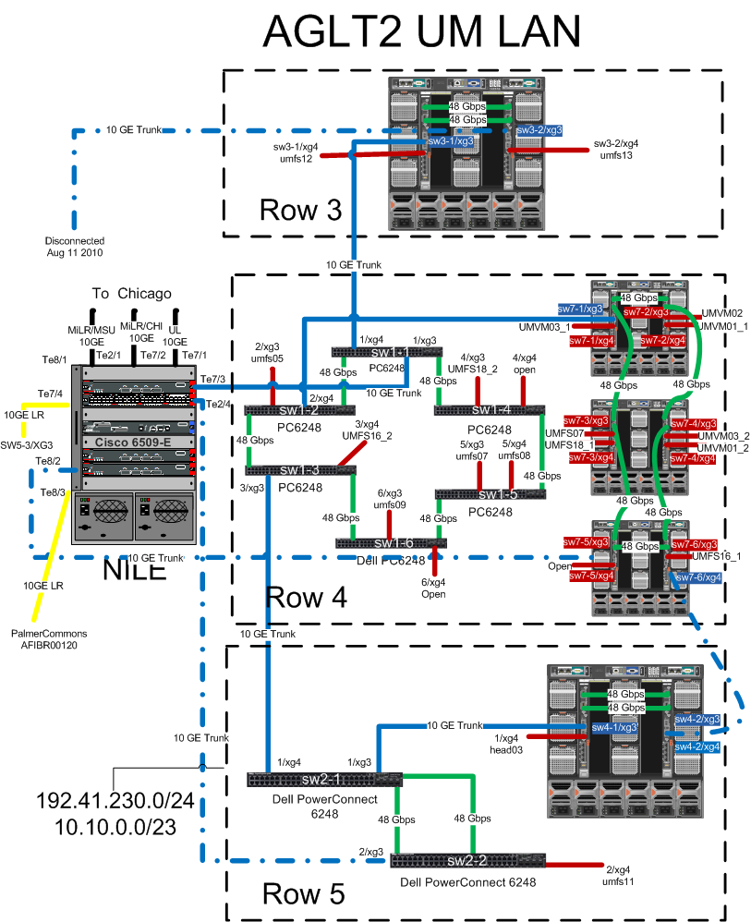
AGLT2 Network Architecture Example
Good pricing from Dell for access layer switches:
Original PC6248/M6220
Managed with 10GE ports, lots of 10/100/1000 copper ports
QoS and layer 3 capabilities, redundant power supplies
New PC8024F
24 10GE ports SFP+
4 “combo” ports (choose)
About $125/port!

Slide 10
New UM Storage Network Backbone
New network will build upon
Two 8024F switches. Uses “twinax” SFP+ cabling
Four SR optics “uplinks” to Cisco. Four “twinax” links
Between 8024F units. Each node has an SFP+ link to each 8024F
Designed to inexpensively give us significantly increased inter-node bandwidth.
MSU migrating toward a dual-uplink “star” network as well

Slide 11
dCache at AGLT2
Choose dCache for a number of reasons
We wanted a way to tie multiple storage locations into a single user accessible name-space providing unified storage.
Broad support; BNL and OSG both support it.
Robust --- no major data loss AGLT2 in our few years of use
The price is right!
But lots of manpower and attention has been required
Significant effort required to “watch for” and debug problems early
For a while we felt like the little Dutch boy…every time we fixed a problem, another popped up!
1.9.5/Chimera has improved the situation. Much less labor intensive during the last year.
Transition from “hard” space-tokens by pool groups to a single large pool group was also a huge improvement for manageability.

Slide 12
AGLT2 Lustre Storage
We have been exploring options for alternative storage systems. POSIX filesystems are interesting
“Direct” access to data using the filesystem
Broadly used and supported
Potentially good performance
BestMan can provide the needed SRM interface
Lustre was originally tested by us in 2007: Too early!
In 2009 we setup a 200TB (4 server) Lustre configuration with dual MDT+MGS headnodes configured with heartbeat using V1.6.6
Performance very good (faster for clients than /tmp)
Some “issues” with huge load on one storage server
In 2010 we have installed Lustre 1.8.3 for our Tier-3 users
Recently upgraded to 1.8.4 which fixed some issues we had
Uses 4 servers (each with 32GB RAM or more) and 10GE network
Needs more testing. Will soon add 2 more servers (OSS’s)
Total space 170TB, soon to added 144TB more

Slide 13
Monitoring Storage
Monitoring our Tier-2 is a critical part of our work and storage monitoring is one of the most important aspects
We use a number of tools to track status:
Cacti
Ganglia
Custom web pages
Email alerting (low space, failed auto-tests, specific errors noted)
See http://head02.aglt2.org/cgi-bin/dashboard or https://hep.pa.msu.edu/twiki/bin/view/AGLT2/Monitors

Slide 14
Scripts to Manage Storage
As we have found problems we sometimes needed to automate the solution
Rephot – Automated replica creation developed by Wenjing Wu scans for “hot” files and automatically adds/removes replicas
Pool-balancer – Rebalances pools within a group
Numerous scripts (cron) used for maintenance
Directory ownership
Consistency checking, including Adler32 checksum verification
Repairing inconsistencies
Tracking usage (real space and space-token)
Auto-loading PNFSID into Chimera DB for faster access

Slide 15
Diagnosing AGLT2 Storage Issues
Information is scattered across server nodes and log files
Java based components have verbose output which makes it hard to find the real problem
With dCache we find the large number of components have a large phase-space for problems
Errors are not always indicative of the real problem…
Is syslog-ng a part of the solution?
Can error messages be significantly improved?

Slide 16
Inter-site Network Use
An important consideration for AGLT2 is the needed inter-site bandwidth. Storage and compute are roughly equally split between sites interconnected via a 10GE triangle.
How long will this be sufficient given the increase in computing and storage located at each site?

Slide 17
Future AGLT2 Storage Alternatives
We are interested in comparing our current dCache to BestMan+X where ‘X’ is
NFSv4
Lustre 1.8.4
Xrootd
We are interested in these characteristics for each option:
Expertise required to install/configure
Manpower required to maintain
Robustness over time
Performance (single and multiple read/writer)
Our plan is to test these during the coming year…how do they compare to dCache for us?

Slide 18
Summary, Issues and Considerations
AGLT2 has a large storage component that is working well
Storage (and compute) is evolving/growing:
Concerns about power, space and cooling
…but also about needed “bandwidth” (network and I/O) keeping up
For any hardware/technology/software always concerned about “manpower” costs.
Data access model is important. Default of stage-in to local disk may not be the best model for much of our data, especially some kinds of analysis jobs . Testing direct access to dCache didn’t show any difference at AGLT2 but we didn’t use libdCap++. Ongoing work here
Scaling the network, especially between sites, as the resources grow is an ongoing challenge.

Slide 19
?Questions?

