Slide 1
integrated Rule-Oriented Data System: iRODS
Leesa Brieger
Notes:
RENCI: a research unit of UNC-Chapel Hill

Slide 2
iRODS
Developed by the Data Intensive Cyber Environments (DICE) group at UCSD and UNC
Based on decade-long experience of the Storage Resource Broker (SRB) development
Community-driven
Open source (BSD license)
Supported by RENCI at UNC: iRODS@RENCI
DICE

Slide 3
The Issues
Data…
collection (physical or virtual)
sharing/publishing
security/integrity
auditing/accounting
metadata management
curation (of remote and local data)
preservation (remotely and locally)
In a nutshell: data management, i.e. the application of data policy across the data life cycle
Notes:
Data life cycle:
creation
active phase (analyzing, sharing, publishing)
preservation phase (reference collection)
archival phase (repurposing, retention or deletion)

Slide 4
The Issues - Examples
Genome centers:
petabytes of data
researchers sharing data
derived data products from workflows
requirements for traceability and reproducibility (provenance and metadata management)
NOAA’s National Climate Data Center (NCDC)
repository management
publishing public data
delivery of services with the data (to the public and to researchers)
support for climate modeling (at ORNL, …)

Slide 5
The Issues – More Examples
Streamline (automate) data movement (OSG)
distributed jobs
collect data results to a central location for sharing/post-processing
archive data output
Institutional repositories
collect a variety of data from a multitude of disparate sources
manage collections independently:
some public collections
some collections shared between select user or institutional groups (across administrative boundaries)
varying life spans
some privacy-protected data (legal issues)
different integrity requirements
break-the-glass scenarios (emergency management) – access permissions change as a function of state information
Notes:
Manage collections independently:
1.) different institutions manage their data differently
2.) collections are independent from each other

Slide 6
iRODS as a Data Grid
Sharing data across:
geographic and institutional boundaries
heterogeneous resources (hardware/software)
Virtual collections of distributed data
Global name spaces
data/files
users
storage
Metadata catalogue (iCAT) manages mappings between logical and physical name spaces
Beyond a single-site repository model
Notes:
Users:
single sign-on to reach data distributed among many sites
no requirement to hold unix accounts at each site to access data (the data grid manages its users’ authorization)

Slide 7
iRODS Virtual Collection
iRODS View of Distributed Data
User Client
User sees a single collection
My Data:
disk, tape, database, filesystem, etc.
My Data:
disk, tape, database, filesystem, etc.
Partner’s Data
remote disk, tape, filesystem, etc.
iRODS installs over heterogeneous data resources; users view and manage distributed data as a single collection.

Slide 8
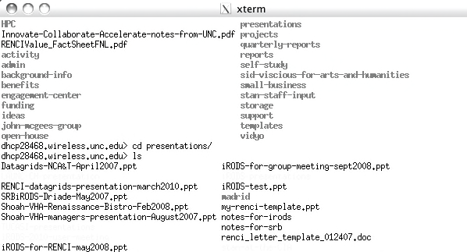
An iRODS Overview
iRODS HDF
Viewer
HDF
Visualization
iRODS Rich
Web Client
WebDAV
On iPod
Windows
Browser
Command Line Client
DropBox
Client
FUSE Client
Multiple iRODS Clients
iRODS Servers: resource servers, metadata catalogue,…
DB
Schedule &
Compute Queue
Message
Queue
iCAT Metadata
Catalogue
Storage Resources: File Systems, Archives,
Databases, Sensor Systems, Clusters,…
Notes:
The iCAT contains the mapping between logical names and physical paths, resources, users, …
Command line client: icommands
Data virtualization: access interface -> data grid -> storage system, storage protocols, transfer protocols

Slide 9
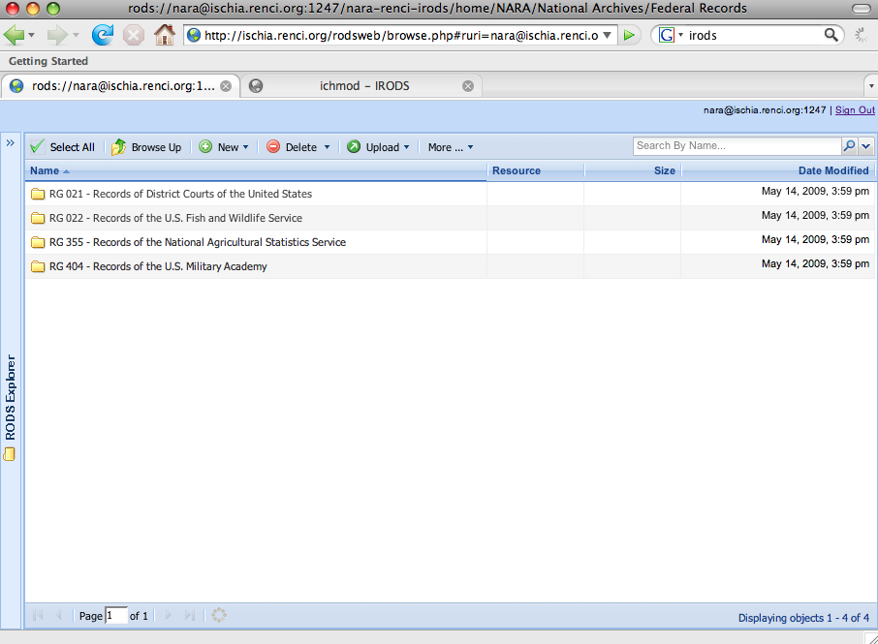
RENCI VO Data Grid
Duke
NCSU
iRODS Server
iRODS Server
DB
ECU
UNC-A
RENCI, Europa Center
UNC-CH
iRODS Server
iRODS Server
Metadata Catalog (iCAT)
iRODS Server
iRODS Server
Client asks for data – request goes to an iRODS server
Server contacts the iCAT-enabled server
Information (location, access rights, etc) is
retrieved from the iCAT
Server containing data is signaled to send data to authorized client

Slide 10
iRODS Command Line Client: icommands
ils
icp
irepl
irsync
iput
iget
imeta – add, modify, read metadata
iquest – query the iCAT database

Slide 11
Data Grid Security
Authenticate each user access
PKI, Kerberos, challenge-response, Shibboleth
Use internal or external identity management system
Access controls as constraints imposed between name spaces
Controls on: Files / Storage resources / Metadata
Access controls remain invariant as files move within the data grid
Authorization of operations
ACLs (Access Control Lists) on users and groups
Conditional rule execution
ACLs on services not yet implemented, but coming
Notes:
PKI: Public Key Infrastructure (certificates)

Slide 12
iRODS Rules and Microservices
Functional unit: microservices (C programs)
185 microservices provided out-of-the-box
Workflows of microservices: rules
iRODS Rule Base set by iRODS administrator (a file that contains the data grid rules: core.irb)
Remote execution - run where the data reside
Delayed execution (eg daily synchronization)
Notes:
The Rule Engine interprets rules and calls the underlying micro-services as needed for execution.

Slide 13
iRODS Rules and Microservices
User communities customize a data grid by writing their own microservices and rules
Modules of new microservices shared with the larger user community
Modularity increases sense of community architecture
User-defined rules can be composed of provided microservices and run on command line (irule)
Notes:
The Rule Engine interprets rules and calls the underlying micro-services as needed for execution.

Slide 14
iRODS HDF
Viewer
HDF
Visualization
iRODS Rich
Web Client
WebDAV
On iPod
Windows
Browser
Command Line Client
DropBox
Client
FUSE Client
Multiple iRODS Clients
iRODS Servers: resource servers (hosting microservice modules), metadata catalogue, rule engine, etc.
DB
Schedule &
Compute Queue
Message
Queue
iCAT Metadata
Catalogue
Storage Resources: File Systems, Archives,
Databases, Sensor Systems, Clusters,…

Slide 15
Microservice Examples
msiGetCollectionACL
get AC list for a collection
msiGetDataObjAVUs
retrieve metadata AVU triplets for a data object and return as an XML file
msiGetAuditTrailInfoByKeywords
msiCopyAVUMetadata
copy triplets from one data object to another
msiRecursiveCollCopy
Core microservices + modules of custom microservices
Notes:
ACL: Access Control List

Slide 16
Rules
Syntax:
rule_name | condition | workflow-chain | recovery-chain
Contained in core.irb file
getATInfoByObjPath.ir
Get Audit Info By Object Path||writeLine(stdout,'<?xml version="1.0" encoding="ISO-8859-1"?>')
##writeLine(stdout,"<audit_trail>")
##msiIsData(*objPath,*objID,*foo)
##msiGetAuditTrailInfoByObjectID(*objID,*BUF,*Status)
##writeBytesBuf(stdout,*BUF)
##writeLine(stdout,"</audit_trail>")|nop
*objPath=/dcape-dev/home/leesa/foo.txt
ruleExecOut
RuleGen parser for easier syntax

Slide 17
Policy-driven Data Management
Actions: event-triggered rules
acCreateUser – services to run when creating a new user
acPreProcForDataObjOpen
acPreProcForCollCreate
acPostProcForPut
acPostProcForCopy
acPostProcForCreate
acSetPublicUserPolicy - set the list of operations that are allowable for the user "public"
Data administrator determines policy by defining actions and by providing rules and services to users.

Slide 18
iRODS Data Management
Sharing & publishing data
Virtual collections
Security controls for data access
Metadata
Provide services with the data
Remote services - that run where the data reside
Policy that follows the data anywhere in the data grid - can even use this to implement your policy on cloud storage

Slide 19
National Archives and Records Administration Transcontinental Persistent Archive Prototype (TPAP)
Federated Data Grids
Federation of Seven Independent Data Grids
NARA I
NARA II
Georgia Tech
Rocket Center
UNC
UMD
UCSD
iCAT
iCAT
iCAT
iCAT
iCAT
iCAT
iCAT
Extensible environment: can federate with additional research & education sites
Each data grid uses different vendor products.

Slide 20
Current iRODS Applications

Slide 21
High Availability iRODS System KEK: High Energy Accelerator Research Organization, Japan
Redundancy and load balancing with Pgpool and Director
Notes:
pgpool-II: middleware that works between PostgreSQL servers and a PostgreSQL database client

Slide 22
iRODS at Centre de Calcul de l’Institut de Physique Nucléaire et de Physique des Particules (CC-IN2P3), France
iRODS setup
9 servers:
3 iCAT servers (metacatalog): Linux SL4, Linux SL5
6 data servers (200 TB): Sun Thor x4540, Solaris 10
Metacatalog on a dedicated Oracle 11g cluster
HPSS interface
Use of fuse-iRODS:
For Fedora-Commons
For legacy web applications
TSM: backup of some stored data
Monitoring and restart of the services fully automated
Automatic weekly re-indexing of the iCAT databases
Accounting: daily report on web site
Notes:
TSM: Tivoli Storage Manager (IBM)

Slide 23
CC-IN2P3
Communities: High Energy Physics, astrophysics, biology, biomedical, Arts and Humanities
TIDRA: Rhône-Alpes area data grid
biology, biomedical applications
animal imagery, human data
automatic bulk metadata registration in iRODS based on DICOM files content
Coming soon: synchrotron data (ESRF – Grenoble)
3 million files registered
up to 60,000 connections per day on iRODS
authentication: using password or grid certificate
Beginning:
Neuroscience: ~60 TB
IMXGAM: ~ 15 TB ( X and gamma ray imagery)
dChooz (neutrino experiment): ~ 15 TB / year
Coming soon LSST (astro): For the electronic test-bed: ~ 10 TB
Notes:
DICOM: Digital Imaging and Communications in Medicine

Slide 24
PetaShare and the Louisiana Optical Network Initiative (LONI)
Petashare: a distributed data archival, analysis and visualization cyberinfrastructure for data-intensive collaborative research, connected through LONI; NSF-funded
iRODS for distributed data management and storage infrastructure
Novel approach: Treat data storage resources and the tasks related to data access as first class entities just like computational resources and compute tasks
Key technologies being developed: Data-aware storage systems, data-aware schedulers (i.e. Stork), and cross-domain meta-data scheme

Slide 25
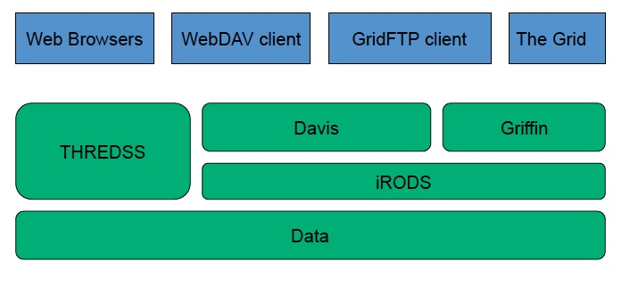
Australian Research Collaboration Services (ARCS)
Services: data, compute, collaboration (web, video), authorization
Architecture

Slide 26
ARCS
Web Interface (Davis)
Basic file operations
Metadata editing
Permissions
Dynamic objects
Configurable interface to run rules or for displaying information
WebDAV (Davis)
Turns data fabric into a local folder
Works on Windows, Mac & Linux
Easy to use: drag and drop folders/multiple files
Griffin: the GridFTP to iRODS interface; developed by ARCS
Notes:
WebDAV: Web-based Distributed Authoring and Versioning

Slide 27
Further and Future Possible Applications
NASA JPL (evaluation), Goddard
OOI (Ocean Observatories Initiative)
NOAA (National Climate Data Center)
Genomics: Broad Institute, Sanger Institute (UK)
NARA
Bibliothèque Nationale de France
OSG
…

Slide 28
Some Current iRODS Development
Access to external databases
Netcdf integration
iDrop client (drag and drop)
Integration with storage vendors (plug-in data grids)
Metadata capture systems (bioinformatics)
Workflow integration
RENCI now begins significant support to the DICE group in these and similar efforts.

