Slide 1
Collider Detector Development
Marcel Demarteau
Fermilab
DOE KA12 Review
June 22-23, 2010

Slide 2
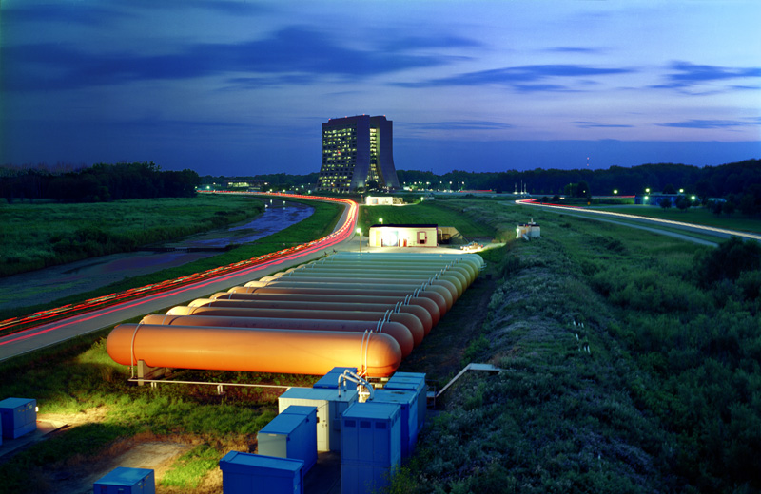
Outline
Introduction and overall strategic direction
  Fermilab core capabilities
  KA12 resources
Scientific leadership provided by KA12 in:
  Silicon Sensors
  Pixilated Photon Detectors
  Calorimetry
Three year plan

Slide 3
KA12
Our KA12 budget presentations have two components
  Existing support for the scientific leadership in the development of e⁺e⁻ detector concepts and new detector technologies
  Request for additional support in future years, mainly in the area of simulation, for the development of a physics and detector program for the Muon Collider

Slide 4
Current KA12
Our KA12 budget has supported the scientific leadership in the development of new lepton collider detector technologies
  This was done in the framework of the ILC
Our FY10 budget in this category is $756k
(mainly SWF)
Description of current activities

Slide 5

Strategy
Key word is: “To Enable”
Emphasis is placed on innovation
  scaling of current technologies is not a viable option
Goals:
  Develop novel detector technologies; emphasis on “transformational” technologies, i.e. “high-risk” and “high-payoff”
  Improve performance of existing technologies by factor of
  ~ (log) 10
    Mass budget, radiation hardness, resolution, cost
  Invest in technologies with broad range of applicability
  Maximize synergy and coordination among projects
  Transfer technology to system design

Slide 6
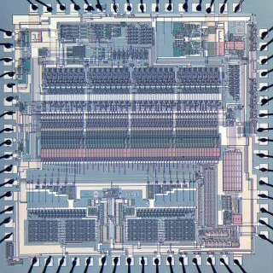
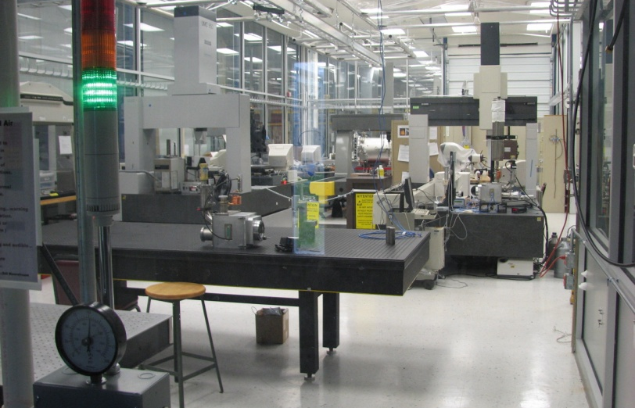
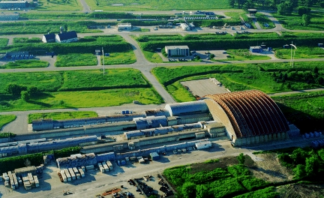
Core Capabilities
End-to-End Mechanical Engineering
  Mechanical structures, cryogenics, FEA
End-to-End Electrical Engineering
  Front-End ASIC
  High speed DAQ
Assembly Facilities
  Silicon Detector Center
  Scintillator extrusion
  Thin film deposition
  Chamber stringing
  CNC routing
  Metrology
Test Facilities
  Test Beam at Mtest
  LAr cryogenics

Slide 7
Identification of R&D Areas
Which R&D areas to focus on?
Identified those areas that are experimental science drivers, which would benefit most from innovative ideas that match our core strengths
  Completely driven by scientists supported by KA12
Higgs and Flavor Physics at LHC, b-factories
  Vertex and Tracking detectors
  Critical science enablers, issues with mass, power, dead zones, dead time, occupancy, precision, …
Jet Energy Resolution and Scale
  Limits nearly any measurement involving jets
Scientific Opportunities at new facilities, concept detectors
  e⁺e⁻, μ⁺μ⁻ detector concepts

Slide 8
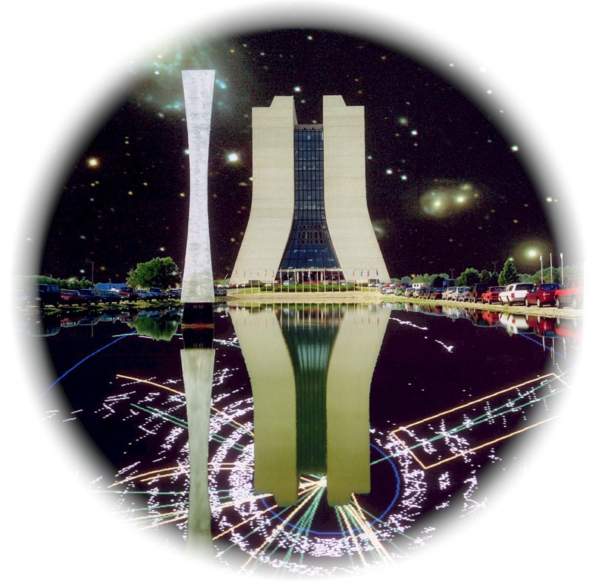
Activities in Detector R&D
Leverage our core capabilities
Research diagonalized along technologies
Scintillator
Imaging
3D
Silicon
Si Photo
Diodes
Simulation
Simulation
Vertex
Tracker
Calorimetry
Dual
Readout

Slide 9
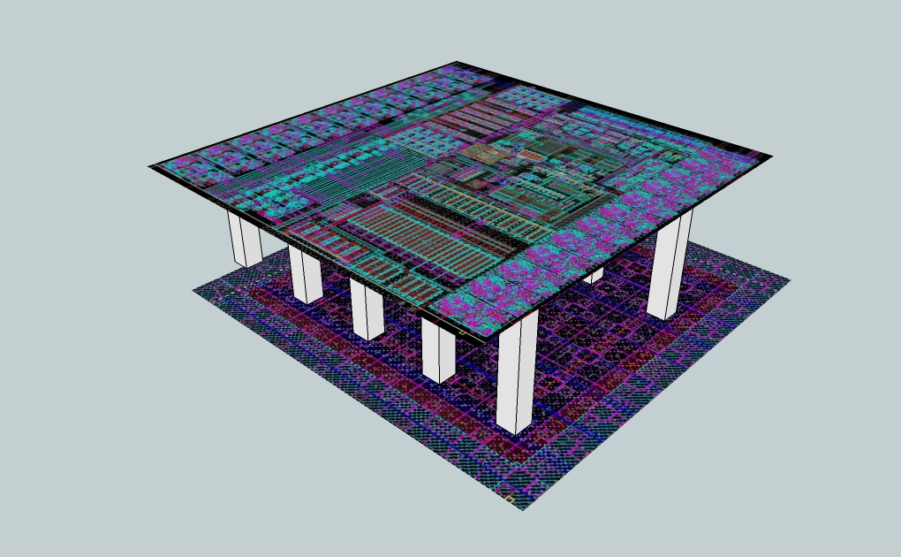
3D Silicon
Key scientists:
Dave Christian, Bill Cooper, Marcel Demarteau, Ron Lipton, Lenny Spiegel

Slide 10
Vertical Integration – 3D
Vertical integration of thinned and bonded silicon tiers with vertical interconnects between the IC layers
Technology driven by industry; offers potential for transformational new detectors
Conventional MAPS
3-D Pixel
Diode
pixel
Detector
3T
pixel
Addressing
ROIC
Processor
Addressing
A/D, CDS, …

Slide 11
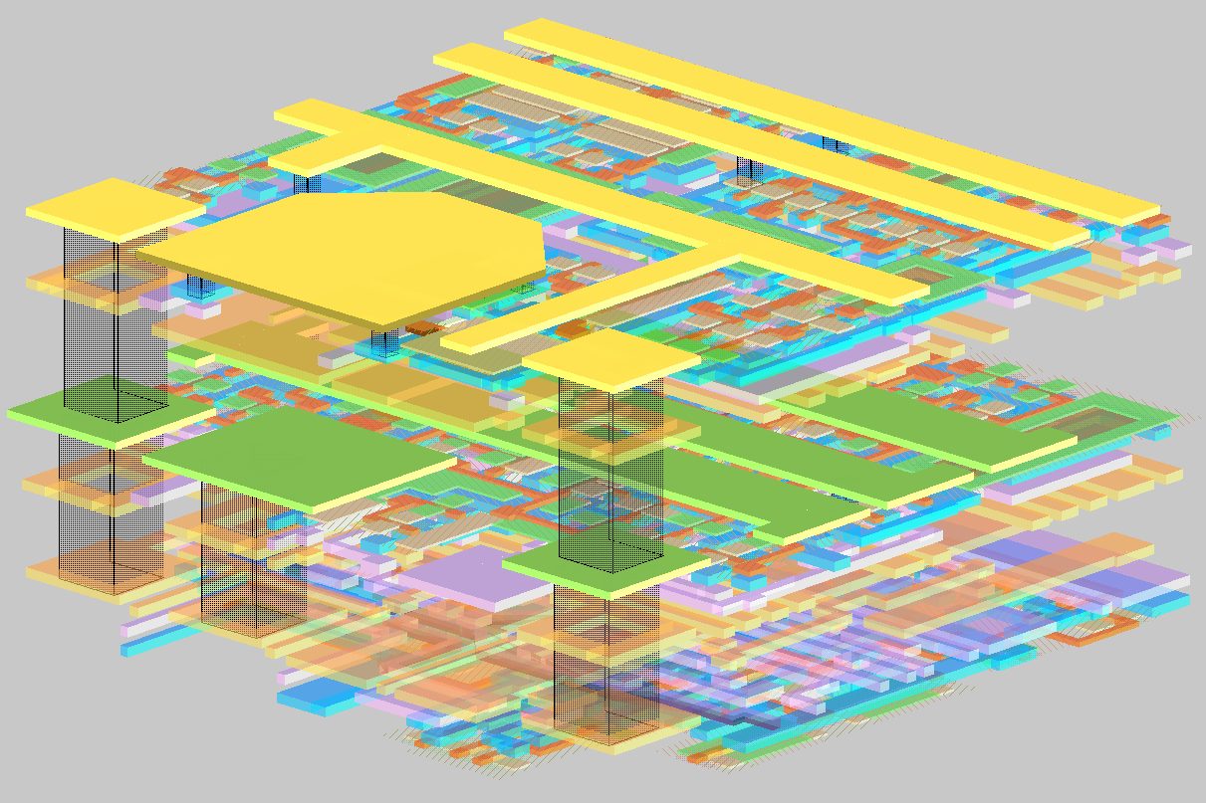
3D Demonstrator Chip
Fermilab started to actively pursue the 3D technology in early 2006 in collaboration with MIT-LL
  MIT-LL offered several DARPA funded three-tier multi-project wafer (MWP) runs
Designed Vertical Integrated Pixel (VIP) Chip for ILC detector readout
VIP-I Design
  3D design in three-tier, via last, 0.18 μm SOI process
  64 x 64 pixel array, 20x20 μm² pixels, scalable to 1M pixels
  Data sparsification, 5-bit digital and analog time stamp, high speed token passing
  Analog output
  No integrated sensor
Fermilab VIP-I
Input bond pad
FE + discriminator + sampling
20μm
Time stamp
Sparsification
20μm
20μm

Slide 12
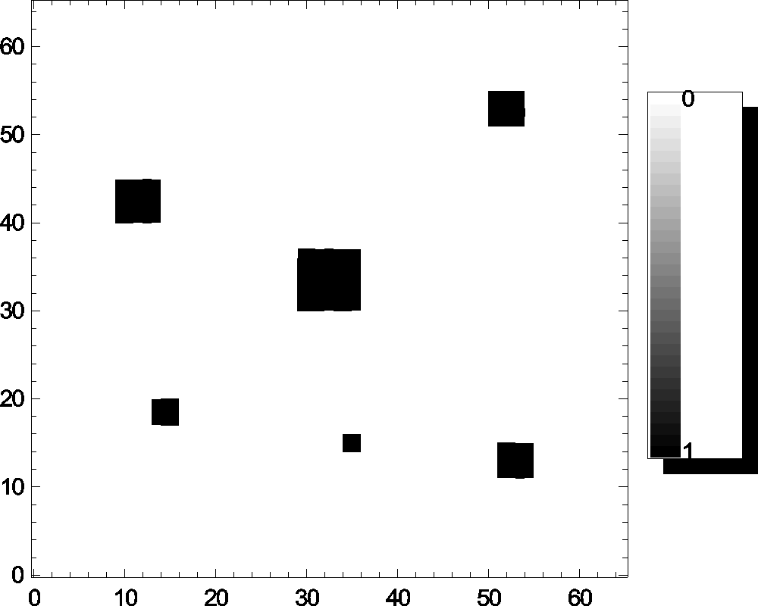
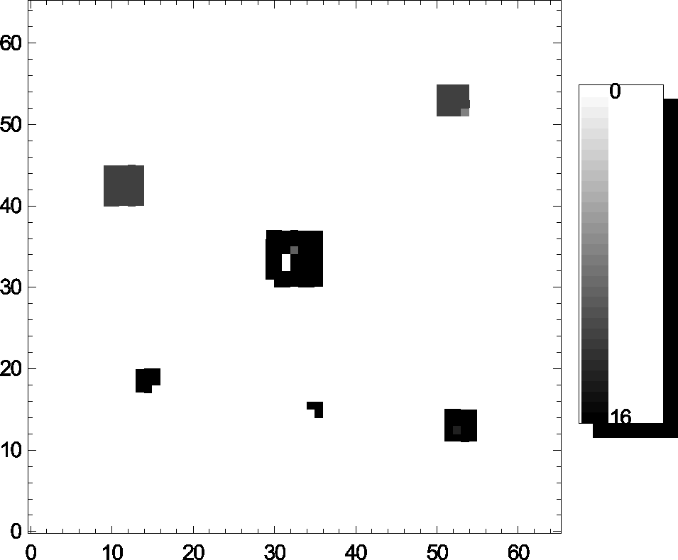
VIP-1 and VIP-2a
Data readout using data sparsification scheme on full array
VIP-1 chip submitted Oct. 2006; ~20 devices
delivered late 2007; chip works !
Major breakthrough in the development of
advanced ASICs and integrated detector
systems
An improved version of VIP-1 has been
submitted to MIT-LL on October 13, 2008
(150nm, SOI, 3 tiers): VIP-2a
  Different power and grounding layout;
  Redundant vias and larger traces in critical paths
  Added diagnostics
  Slightly larger pixels
Preselected Injection (top) and Readout (bottom) pattern of pixels reported as hit using data sparsification

Slide 13
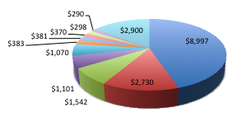
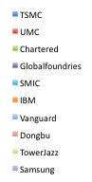
Collaboration with Industry
3D technology driven by industry
We started an initiative with local vendor, Tezzaron, willing to accept MPW runs
Tezzaron:
  One of the leaders in developing 3D technology
  Wafers are fabricated by Chartered in Singapore
    Chartered bought by GlobalFoundries in 4Q09
  3D assembly is completed by Tezzaron in Singapore
Advantages:
  Existing rules for vias and bonding
  Relatively fast turn around
  One stop shopping for wafer fabrication, via formation, thinning, bonding
  Process is available to all customers
  Low cost
Semiconductor Total Market Share 2009
22.6 B$ (Source: EE-Times, April 2010)

Slide 14
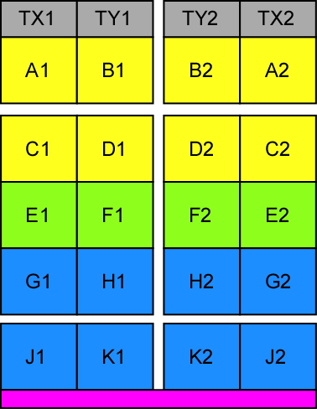



Fermilab 3D Multi-Project Run
Fermilab formed a 3D collaboration and hosted a 3D
multi project run with Tezzaron
  Two layers of electronics fabricated in the Chartered
  130 nm process, useful reticle size is 16x24 mm
  Wafers will be bonded face to face
  Submission closed September 2009
17 Participating institutions in the MPW run
  Fermilab host
  14 European institutions
  Two US institutions (LBNL, BNL)
  Application for b-factory, ILC, CMS, ATLAS, imaging, …
Frame divided into 12 sub-reticules for consortium members; more than 25 two-tier designs
Upper tier
Lower tier
Reticle Layout

Slide 15
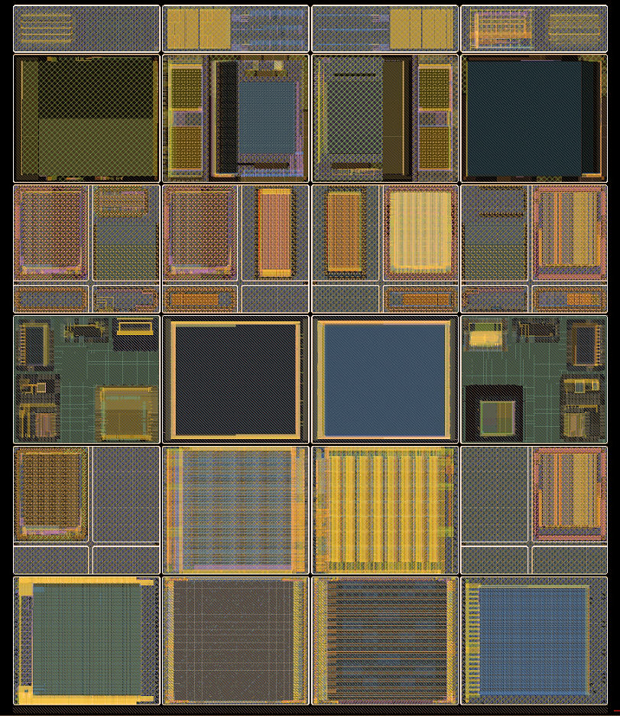
MWP Full Frame Layout
Test chips:
TX, TY
2.0 x 6.3 mm
Notice
Symmetry
about vertical
center line
Subreticules:
A, B, C, D,
E, F, G, H, I, J
5.5 x 6.3 mm
H
H*
I
J
J*
I*
Top tiers
Bottom Tiers

Slide 16
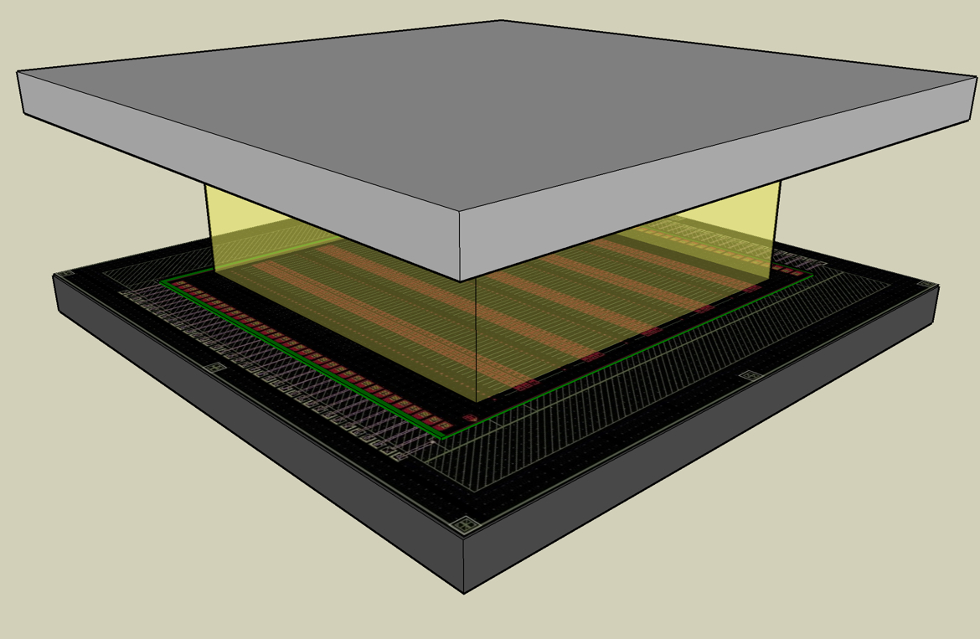
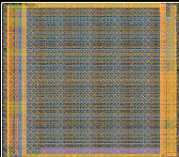
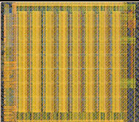
Fermilab 3D Project: VICTR
Vertical Integrated CMS TRigger chip
Form a track-trigger at the first trigger
level for sLHC
  Momentum filter using a pair of
  Si sensors separated by ~1mm
Data flow is vertical !
  Hits from two sensors correlated
Chip design:
  The top tier looks for hits from long strips to provide phi information
  The bottom tier looks for coincidence between phi and shorter z strips connected to bottom tier through interposer
Could be used for hit correlations at Muon Collider
Long strip (5mm) sensor
8 mm
.5 mm
Interposer
Short strip
DBI bonds
Bond pad redistribution
Short strip (1mm) sensor
ROIC
H Left H Right

Slide 17
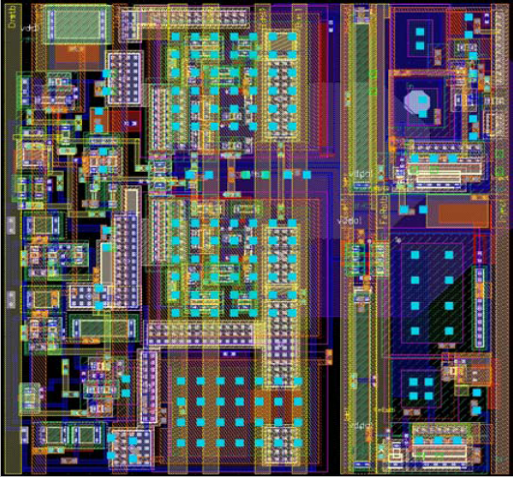
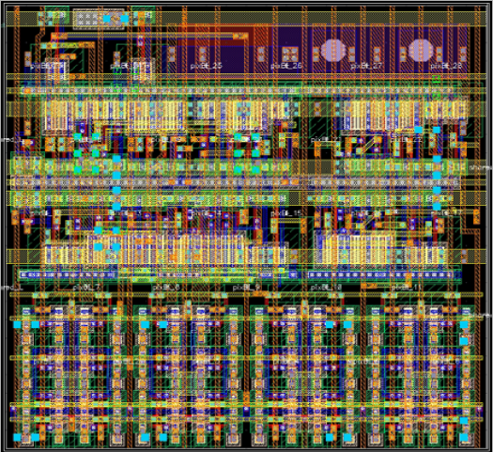
3D Project: VIP-2b
Top Tier (analog)
The ILC 3-tier VIP2 design (MIT-LL) converted to a 2-tier design (VIP-2b)
  192 x 192 array, 24x24 μm² pixels
  Removed analog time stamp
  Increased digital time stamp from 5 bits to 8 bits for ~3.9 us resolution
  Switch for collection of h⁺ or e⁻
Through silicon vias implemented
  Allows for I/O connections through either the top or the bottom of the chip.
Connections to vias on the bottom side can lead to four side buttable layouts with absolute lowest circuit and sensor mass.
Bottom Tier (digital)

Slide 18
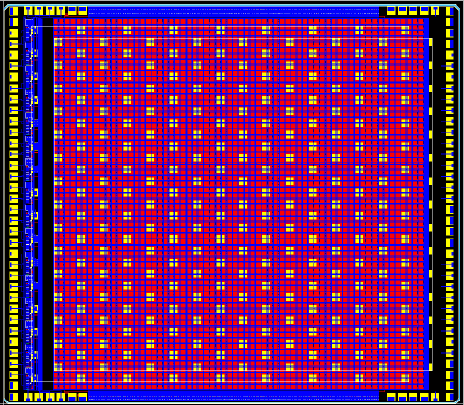
3D Project: VIPIC
X-Rays
Vertical Integrating Pixel Imaging Chip (VIPIC)
  Evaluating application for X-ray photon correlation spectroscopy (XPCS) in collaboration with BNL to calculate autocorrelation function per pixel
Functionality
  64x64 array of 80x80 μm² pixels
  γ flux: 1000 γ/pixel/s
  Dead timeless, triggerless operation
  Sparsified data readout
  Binary readout (no energy information)
  High speed frame readout time
  16 serial high speed LVDS output lines
Pads for backside bump bonding allows for 4-side buttable arrays
VIPIC
(25μm thick)
Sensor
Circuit board
Bottom tier (digital) with bond pad pattern

Slide 19
Timeline and Schedule
All designs were received by Fermilab in May 2009
June 2009 – March 2010 spent preparing and reviewing the submission(s)
  Note, this was the first time for Fermilab and Tezzaron to organize a MPW run and there were a large number of ‘growing pains’
    Frame and street definitions
    Design kit incompatibilities, software bugs
    TSV issues: protection, spacing, bond interface
March 6, 2010: Fabrication started
Awaiting return of 2D and 3D wafers from 1st MPW run in
mid-July

Slide 20

Future
New consortium members have been added and space for the next MPW run is fully booked
Our success has not gone unnoticed by industry: MOSIS (US), CPM (Europe), CMC (Canada) have entered into an arrangement with Tezzaron to offer 3D MPW runs
  Development and organization of tools is being lead by CPM with support from CMC
  MOSIS will act as direct interface to Tezzaron, and organize the MPW frame for submission
In our humble opinion, this would not have occurred if it had not been for the DOE KA12 sponsored HEP program at Fermilab
The consortium will continue to provide a venue to discuss design issues and compare test results and collaboration in general

Slide 21
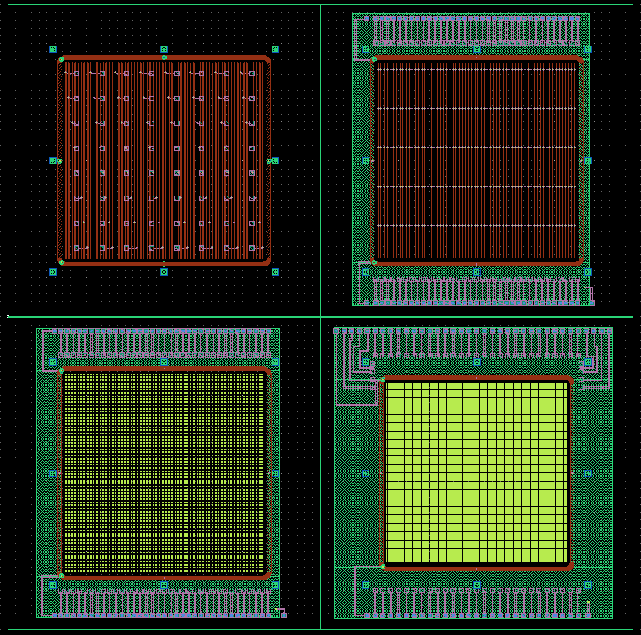
Sensor Design
Sensors need to be developed to be mated to the 3D circuits
  Will allow for complete testing of technology
    3D circuits and
    bonded devices
    Integrated devices
    with interposer
    Test beam
    characterization
Four sensors designed to
be fabricated at BNL
  CMS short strips
  CMS long strips
  (not DBI bonded)
  VIP
  Imaging sensor
VICTR (long)
VICTR (short)
VIPIC
VIP

Slide 22
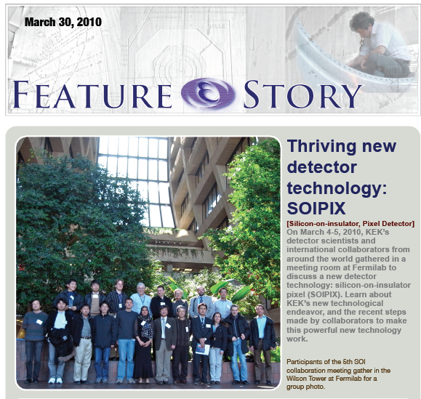
Silicon on Insulator (SOI)
Investigating SOI as alternative for integration of sensor-electronics and alternative bonding technique
  Program strongly
  supported by
  US-Japan fund
  SOIPIX Workshop
  held at Fermilab
  in March 2010
  First time outside
  of Japan

Slide 23
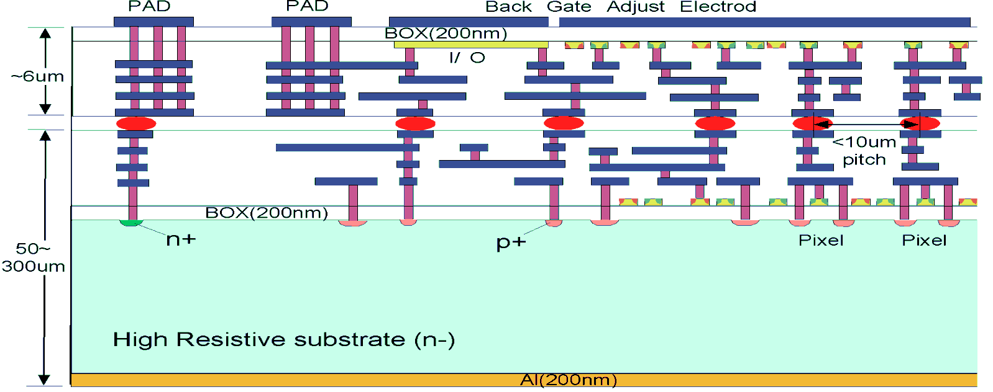
Silicon on Insulator (SOI)
Investigating SOI as alternative for integration of sensor-electronics and alternative bonding technique
  Program strongly supported by US-Japan fund
MAMBO III chip
  Two tiers in KEK/OKI 200nm SOI process
1st SOI wafer

Slide 24
Silicon on Insulator (SOI)
Investigating SOI as alternative for integration of sensor-electronics and alternative bonding technique
  Program strongly supported by US-Japan fund
MAMBO III chip
  Two tiers in KEK/OKI 200nm SOI process
Tier 1 contains only diodes and shielding metal
1st SOI wafer

Slide 25
Silicon on Insulator (SOI)
Investigating SOI as alternative for integration of sensor-electronics and alternative bonding technique
  Program strongly supported by US-Japan fund
MAMBO III chip
  Two tiers in KEK/OKI 200nm SOI process
2nd SOI wafer

Slide 26
Silicon on Insulator (SOI)
Investigating SOI as alternative for integration of sensor-electronics and alternative bonding technique
  Program strongly supported by US-Japan fund
MAMBO III chip
  Two tiers in KEK/OKI 200nm SOI process
2nd SOI wafer
Micro-bumps
Tier 1 contains only diodes and shielding metal
1st SOI wafer

Slide 27
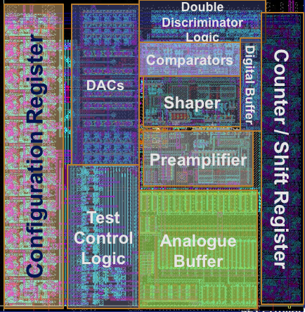
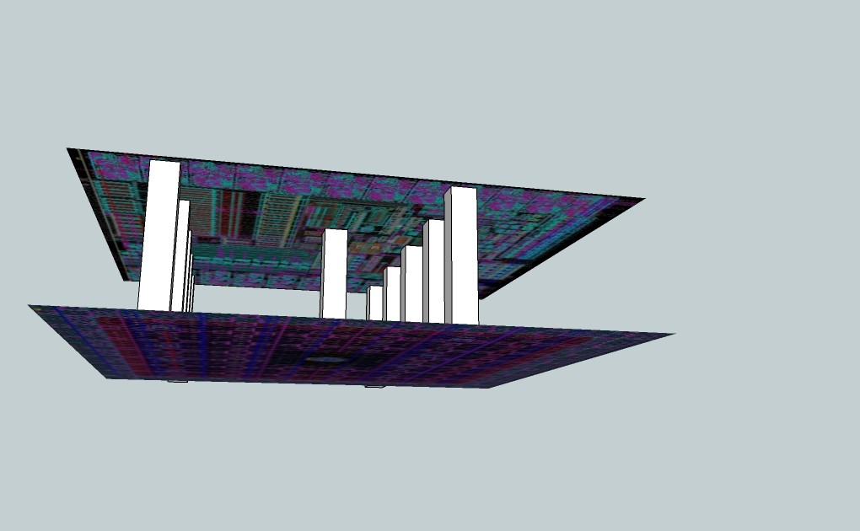
Silicon on Insulator (SOI)
MAMBO III : Top chip
MAMBO III: pixel counting chip
  Chip size: 5mm x 5mm
  1936 pixel matrix (44x44) of
  100x100 um² pixels
  8-bit DAC, 12 bit counter/shift reg.
Bonding done by T-micro (formerly ZyCube)
  Sponsored by US-Japan funds
  One bond per pixel, with 10 redundant bonds
Bottom chip: connections only made through micro bump pads
Top chip: Pads with back metal opening
100μm
MAMBO III
100μm

Slide 28
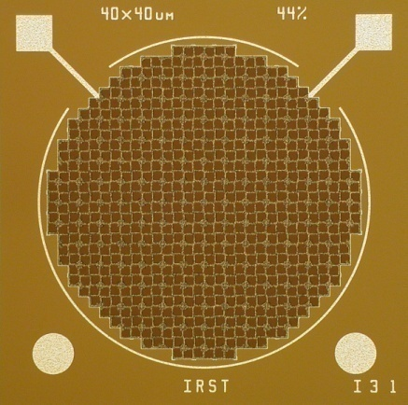
Photo Detectors
Key scientists:
Gene Fisk, Adam Para

Slide 29
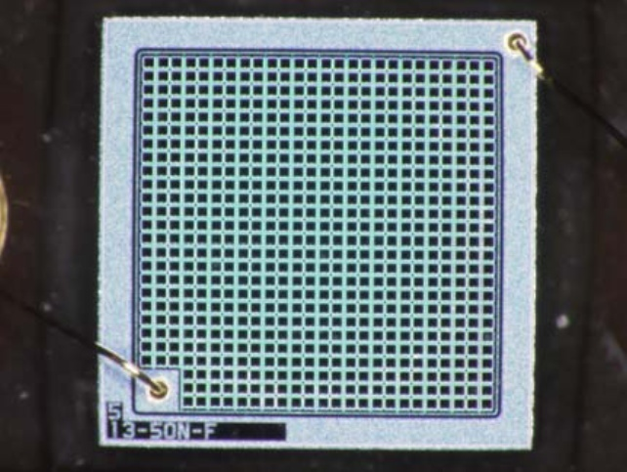
PPD or Silicon Photo-multiplier
Pixelized Photon Detector (PPD) is avalanche
photodiode operating in Geiger-mode
  Array of pixels connected to a single output
  Digital device read out in analog way
    Pixel is either on or off
  Signal = Sum of all cells fired
  Devices compact, insensitive to B-field
  low bias voltage
The availability of PPDs has opened
up many avenues that were until now
closed
Developed general facility for
characterization of PPDs
  Dark and photo response

Slide 30
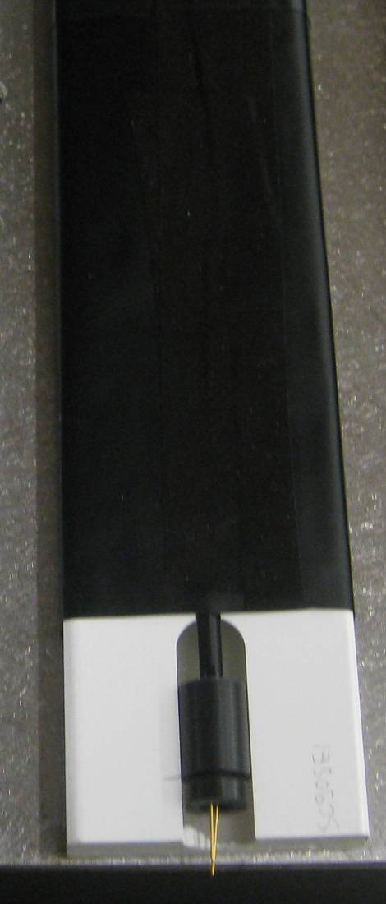
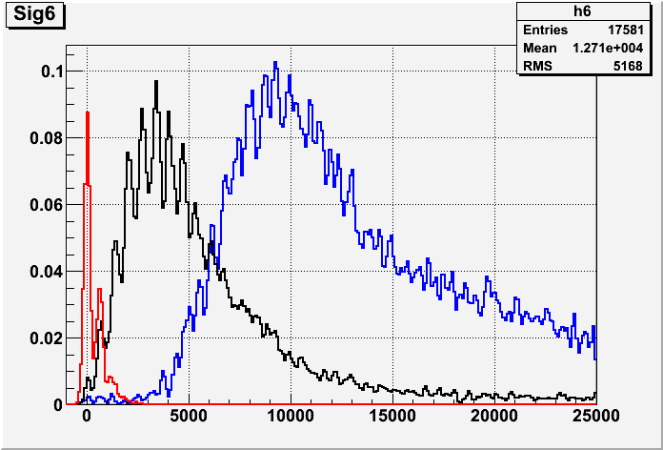
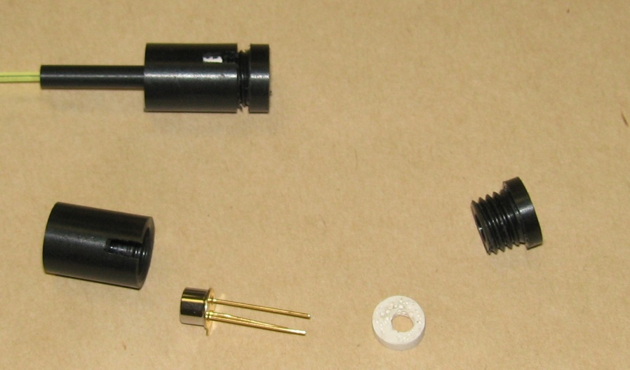
Scintillator Application
Studied, within the context of the SiD detector, the applicability for muon detector system
Double strip tested in test beam
Minos die
extruded scint.
361x4.1x1cm³
WLS + SiPM
A
B
x = 0.1 m
L = 3.6m
2/20/2010
Peds + dark cnt
6
12
16
4
NEAR end
~10cm from beam
2
9
1.2 mm Kuraray WLS fiber
1.2mm SiPM
FAR end
~7m from beam

Slide 31
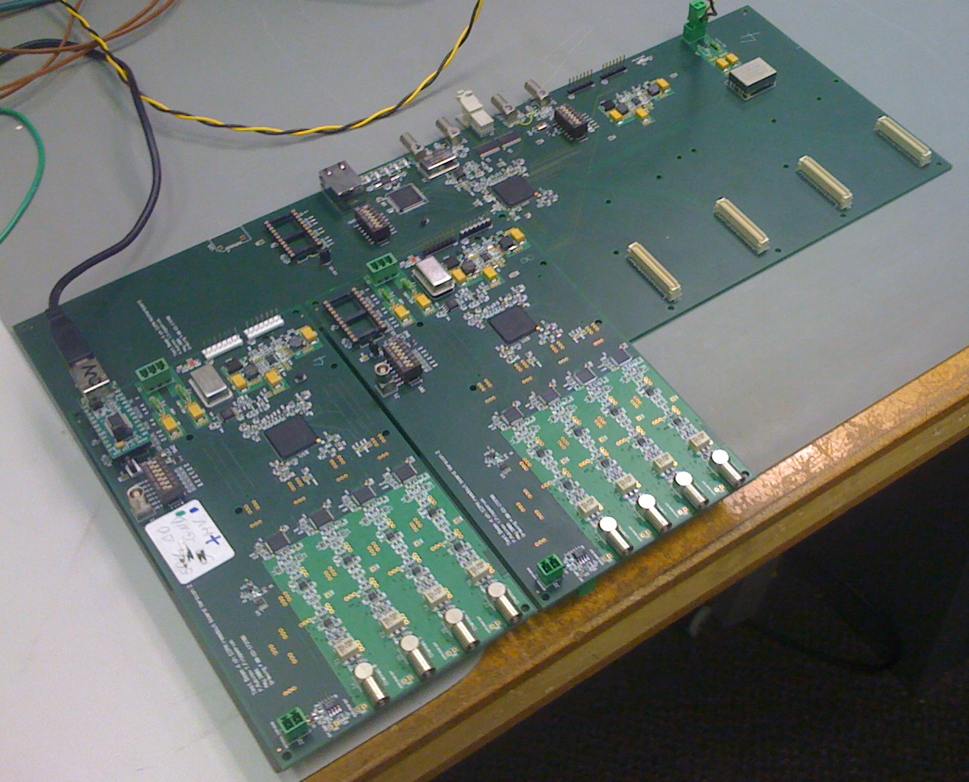
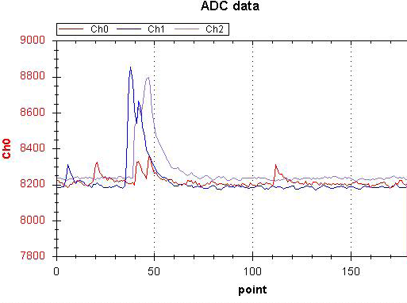
PPD Readout
Developed TB4 (test beam 4-channel) readout
  12bit ADC (large dynamic range)
  212 MSPS (4.7ns)
  ~100MHz bandwidth
  Bipolar signals
  USB setup, readout Ethernet
  On-board bias generation
  Allows for online signal processing
Used by collaborators at Notre
Dame, WSU, Munich, Shinshu, …
Developing plans for dedicated
ASIC for PPD readout
180 digitizations * 4.708ns
i.e. 847ns
Digital scope per channel!

Slide 32

Dual Readout
Key scientists:
Marcel Demarteau, Gene Fisk,
Adam Para

Slide 33
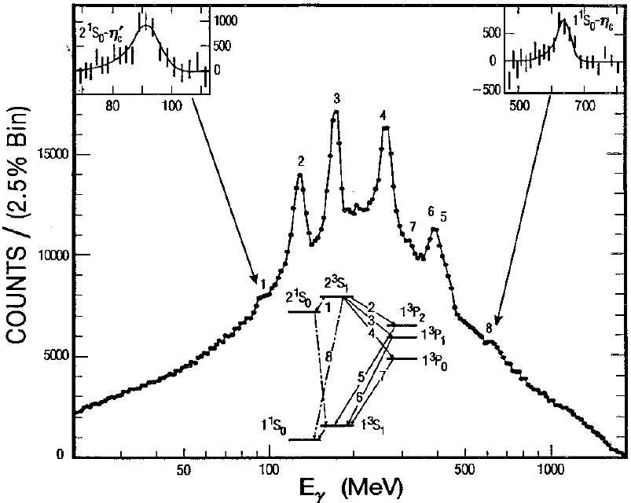
Total Absorption Hadron Calorimetry
Total absorption calorimetry
proven to be highly successful
for EM calorimeters
Extend to hadron calorimeters
  Photo-detectors (SiPM)
  Dual readout
  Simulation and beam tests
  Dense radiators
International effort exploring material
development
  3rd workshop at IEEE, Knoxville
  Collaborative effort with scintillator facility
  and HEP at LBL
Crystal Ball
Υ-spectroscopy
NaI
W/Z separation in
hadronic decays
m_{Z}
m_{W}
Marcel Demarteau, Steve Derenzo, Auffray Etiennette, Jun Fang,
Alexander Gektin, Paul Lecoq, Michele Livan, William Moses,
Adam Para, Yifang Wang, Marvin Weber, Tianchi Zhao, Ren-yuan Zhu

Slide 34

Dual Readout Calorimetry
Dual-readout calorimetry: measure every shower twice
  Scintillation light: from all charged particles
  Čerenkov light: β=1 particles, mainly EM
Correct on a shower-by-shower basis using the
correlation of the total observed ionization (S)
and Čerenkov (Č) light
From Monte Carlo studies:
  Energy resolution (0.1-0.2)/√E (Gaussian)
  No constant term up to 200 GeV
The enabling technology is pixelized photon detectors

Slide 35
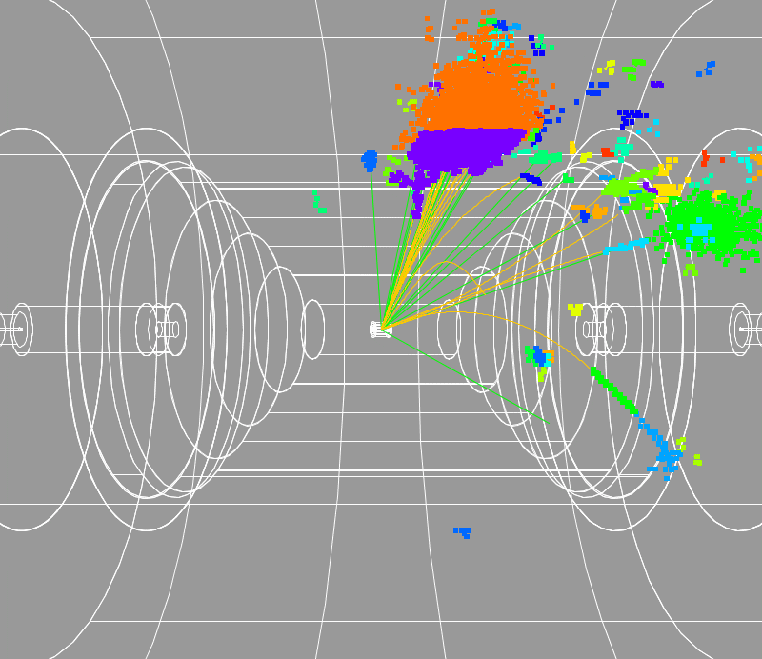
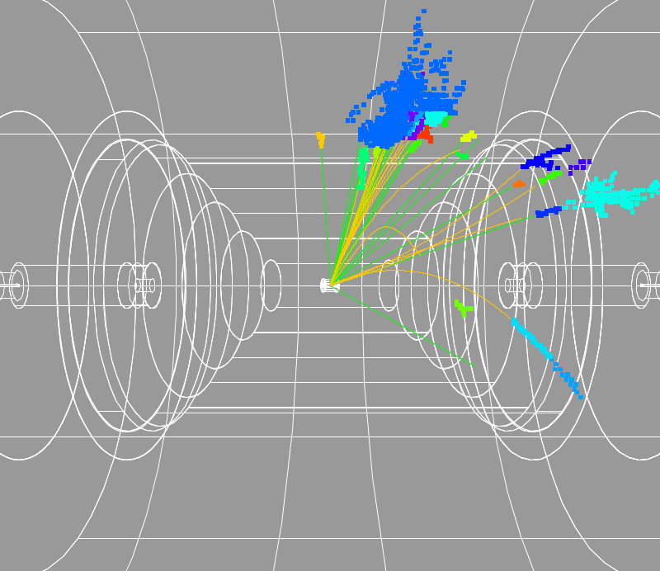
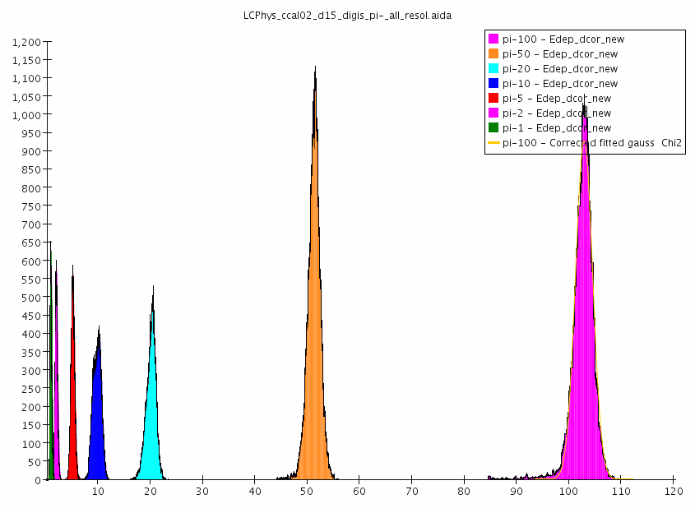
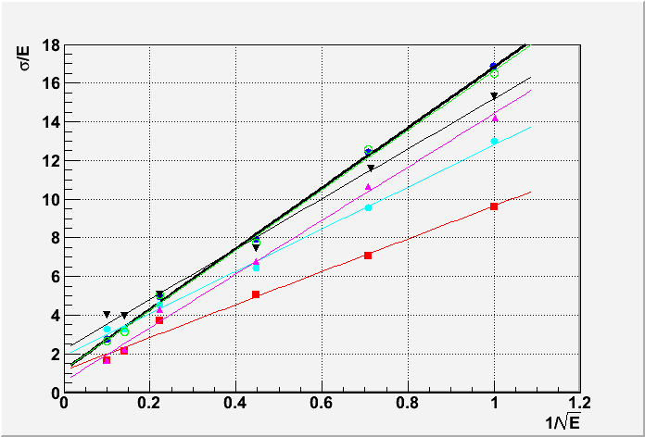
Simulation
Implemented crystal calorimeter in SiD detector in slic framework
Z → qqνν
Z → qqνν
BGO dense (15 g/cm³)
scintillation
Cherenkov
Events
SiD
SiD
10
20
50
100
Calor 2010
After scintillation/Cherenkov correction
  Response linear
  Energy resolution ~15%/√E
    Depending on physics model

Slide 36
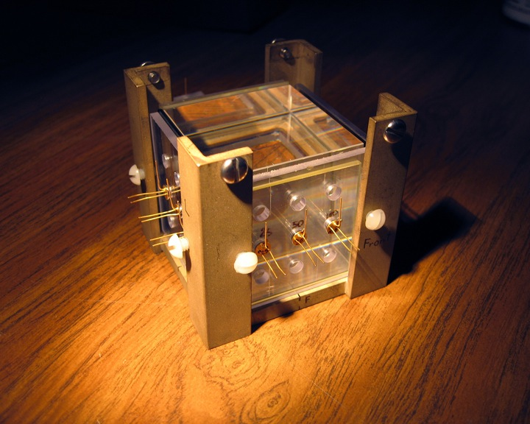
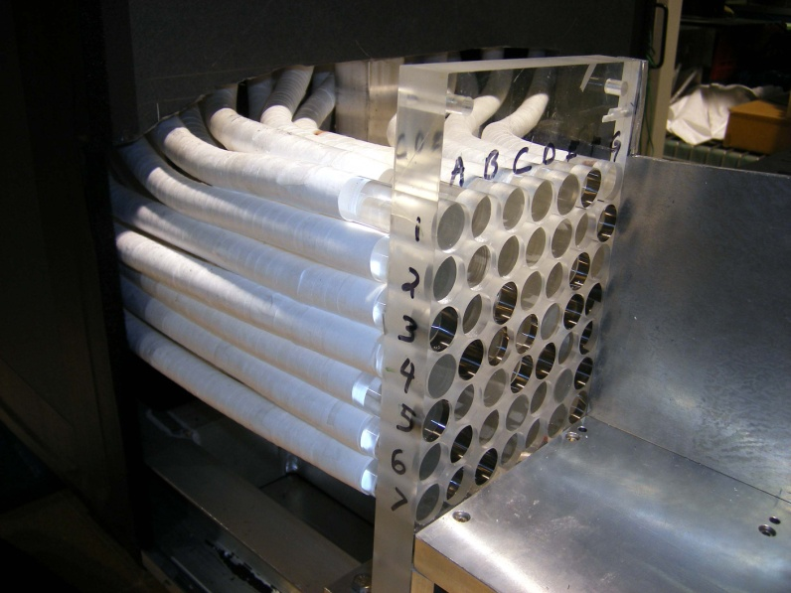
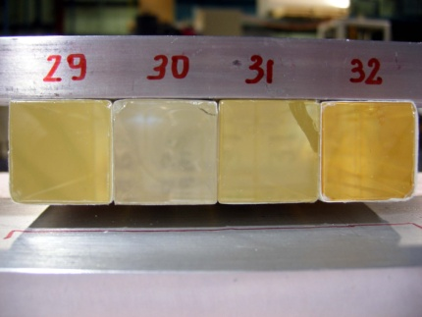
Bench and Beam Tests
Investigate and characterize crystals and response:
  Crystals, photodetectors, geometries, surface treatment, filters
  Separation of Č / S, light collection, uniformity; Č light yield; angular dependence of Č signal.
Crystal stack
  PbWO₄ crystals (Iowa), former CMS test beam calorimeter
  7 x 7 crystal array, tested in test beam T-1004 (Argonne, Cyprus, Caltech, Fermilab, Iowa)
Single crystal exposure to cosmic rays and beam tests
Internal review in July

Slide 37
Summary of Activities
Coherent, successful scientific leadership of a challenging detector R&D program
  maximizes leverage of each branch
  Broad reach: vertex detectors, power, scintillator
  R&D targets key limitations of the current generation of detectors
  If successful, these new technologies could lead to transformational new detectors
Leadership recognized outside of our own program

Slide 38



Other Activities
Detector R&D Workshop at Fermilab, Oct. 7-9, 2010
  Chairs: Chip Brock (MSU), MD
International Panel to promote Vertically
Integrated Silicon technology (VIPS)
  Junji Haba (KEK), Hans-Günther Moser, Valerio Re, MD
  Organized successful 1st workshop: VIPS 2010
CERN, KEK, Fermilab Detector
school being organized, Jan 31 – Feb 10, 2011 at CERN
  Advisors: Adam Para, Erik Ramberg, MD
Fermilab hosting TIPP 2011 workshop,
June 9-14, 2011 in Chicago (chair: MD)
Internationally recognized leadership supported by KA12
EDIT 2011

Slide 39
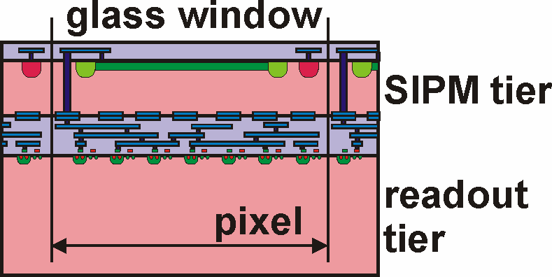
Future
Silicon 3D and SOI devices will be available mid-July.
  Effort to date had strong engineering component. Need strong scientific effort to test devices
Next MPW run scheduled for FY11
  Needs scientific guidance for implementation of different architectures (such as for CLIC, MuC, …)
The opportunities of our R&D, especially the 3D silicon effort, are immense
  Explore other areas of applicability
  and areas of broad societal
  implications
Unique opportunity to further develop this truly transform-ational technology initiated by KA12 support

Slide 40
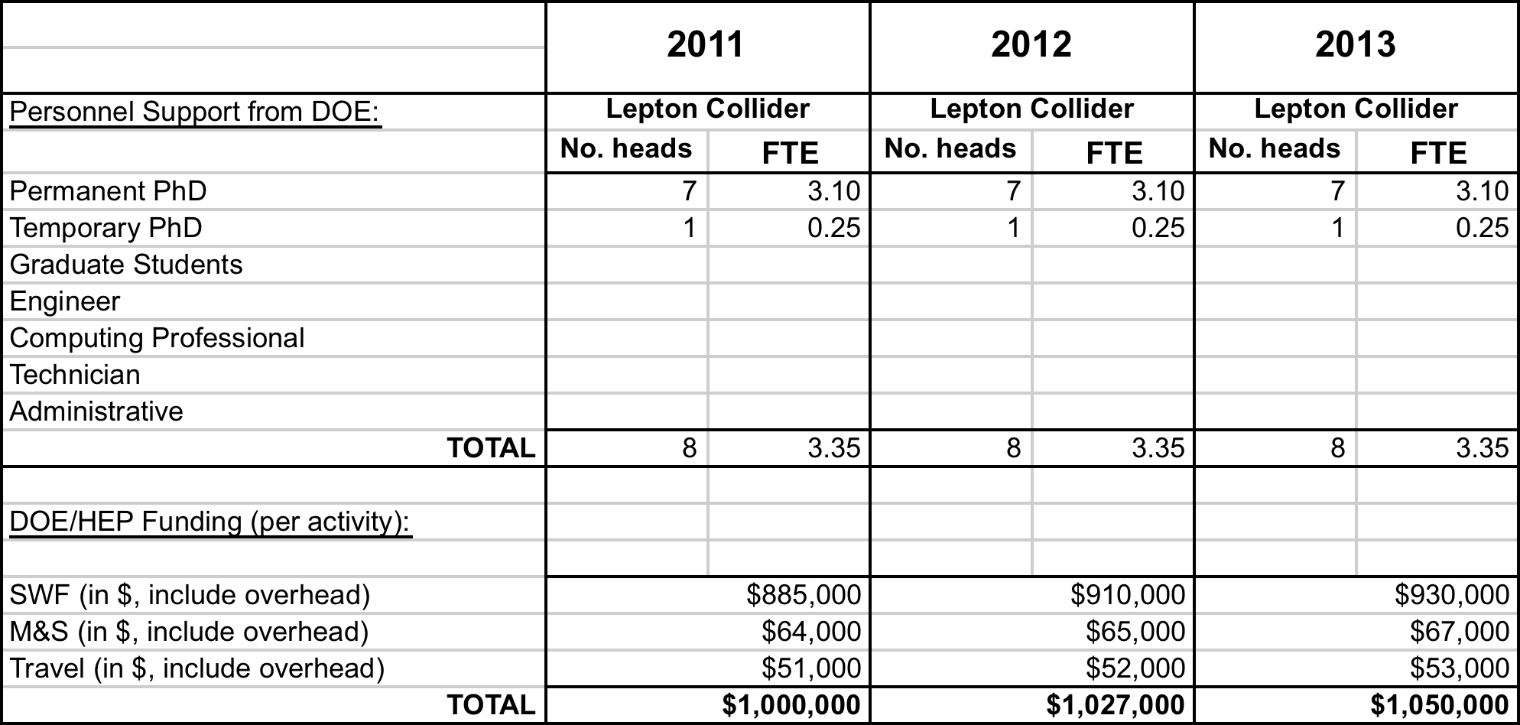
Proposed Funding Profile
To retain the momentum and capitalize on the transform-ational opportunities, request support for one more FTE
  FY10 budget $756k

Slide 41
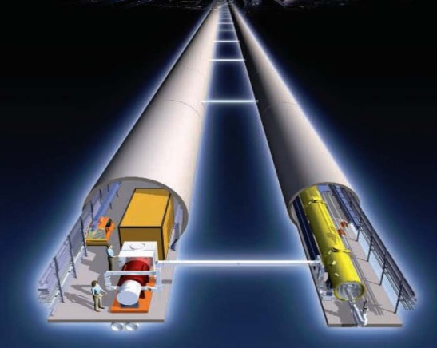
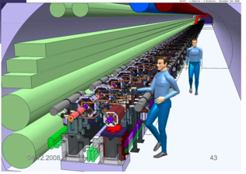
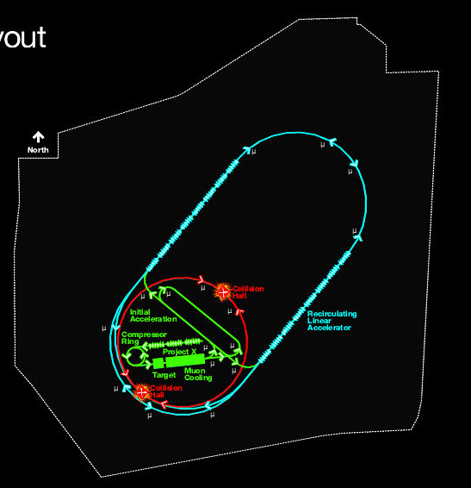
Lepton Collider Projects
Three major future lepton collider projects are being discussed at the moment:
  ILC: International Linear Collider
    e⁺e⁻ collider based on SRF technology
    √s = 500 GeV – 1 TeV
  CLIC
    e⁺e⁻ collider based on warm X-band
    √s = 3 TeV
  Muon Collider
    √s = 3 TeV
ILC
CLIC
μC

Slide 42
Synergies
Lepton collider projects are synergistic:
  The overall physics goals of a future lepton collider are similar for ILC/CLIC/MuC
  Analysis techniques are essentially the same
  Some detector technologies are shared
  Software infrastructure could be common
Need to develop an objective comparison of the options in terms of physics performance so that the relevant information is available to enable a well-informed choice for a future energy frontier lepton collider

Slide 43
Muon Collider
A Muon Accelerator Program (MAP) to address the technical challenges and feasibility issues for a future Neutrino Factory and multi-TeV Muon Collider has been submitted to DOE
This technical program needs to be accompanied by a physics and detector study
The physics program at a MuC is promising; the challenges are controlling the backgrounds and evaluating their impact on the physics reach

Slide 44
Following Presentations
Nikolai Mokhov:
  Background Studies at a Muon Collider (20’)
Marcel Demarteau:
  Plans and Summary (10’)

Slide 45
Backup Slides

Slide 46
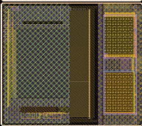
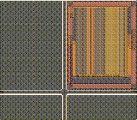
Sub-Reticules
Sub-reticule A (Strasbourg, Saclay, Pavia) :
  FE to be bonded to sensors from XFAB
Sub-reticule B (CMP, Strasbourg, Saclay):
  MAPS for ILC
Sub-reticule C (CPPM, Bonn):
  ATLAS 2D pixel design (FEI4)
Sub-reticule D (CPPM, Bonn, LAL)
  ATLAS 3D pixel design
Sub-reticule E (Roma, Pavia, Bergamo, Pisa):
  3D MAPS
Sub-reticule F (Pavia, Bergamo):
  3D MAPS
Sub-reticule G Sub-reticule G (Orsay/LBNL)
  ATLAS Pixel FE
Sub-reticule H (FNAL/CPPM/LBNL):
  Vertically Integrated CMS TRigger chip
Sub-reticule I (FNAL):
  VIP, adapted to two layers
Sub-reticule J (FNAL/AGH-UST/BNL):
  VIPIC: demonstrator for X-ray Photon Correlation Spectroscopy
B Right
G Right

Slide 47
Parts Count
Procured one lot of 31 wafers, with 28 full reticules per wafer
Partition of wafers:
  3 wafers will be used for 2D
  wafer testing
  Available for 3D bonding
  28 wafers, which yields
  14 3D wafers
There are 14 3D assemblies
per wafer
If one assumes a yield of 50%,
seven working 3D wafers available
98 assemblies of each sub-reticule
A lot of work ahead !

Slide 48
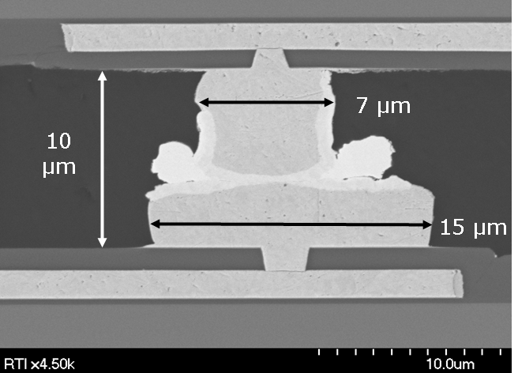
Integrating Detectors
Ultimate goal is to have integrated unit of front-end and thin (~50μm thick) detectors with very fine pitch (~20μm):
  How to bond ultra-thin devices?
  How to bond at very fine pitch?
Study I: developed with RTI (NC)
bump bonding process at 20 μm
pitch
  CuSn bonded to Cu; good yield
  SnPb bonded to Ni/Au
  Demonstrated the feasibility of CuSn bonding for fine pitch (20 µm) assembly of 3D circuits (ignoring mass budget requirements)
Study II: developed with Ziptronix (NC) Direct Bond Interconnect (DBI) process, that provides greater flexibility and constitutes much lower mass
CuSn Bond
10.5 µm
Misalignment ~ 1 um

Slide 49
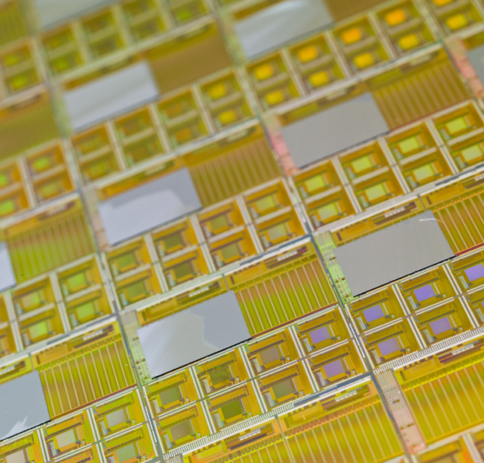
Integrating Detectors
DBI bonded BTeV FPIX2.1 readout
chips to pixel sensors
  22x128 pixel cells of 50x400μm²;
  Edgeless trenched pixel sensors
  50 μm deep n⁺⁺ trench at the edge
  Masks designed at Fermilab
  Fabricated by MIT-Lincoln Lab
Above two items DBI bonded at
Ziptronix; after bonding sensors
thinned to 100 μm (can go as low
as 50μm)
  Very strong bond with good yield
  Devices have full readout; issues
  understood
  Method valid for pitch down to
  ~ 5 μm
Sensors on FPIX wafer
Sensor readout

Slide 50
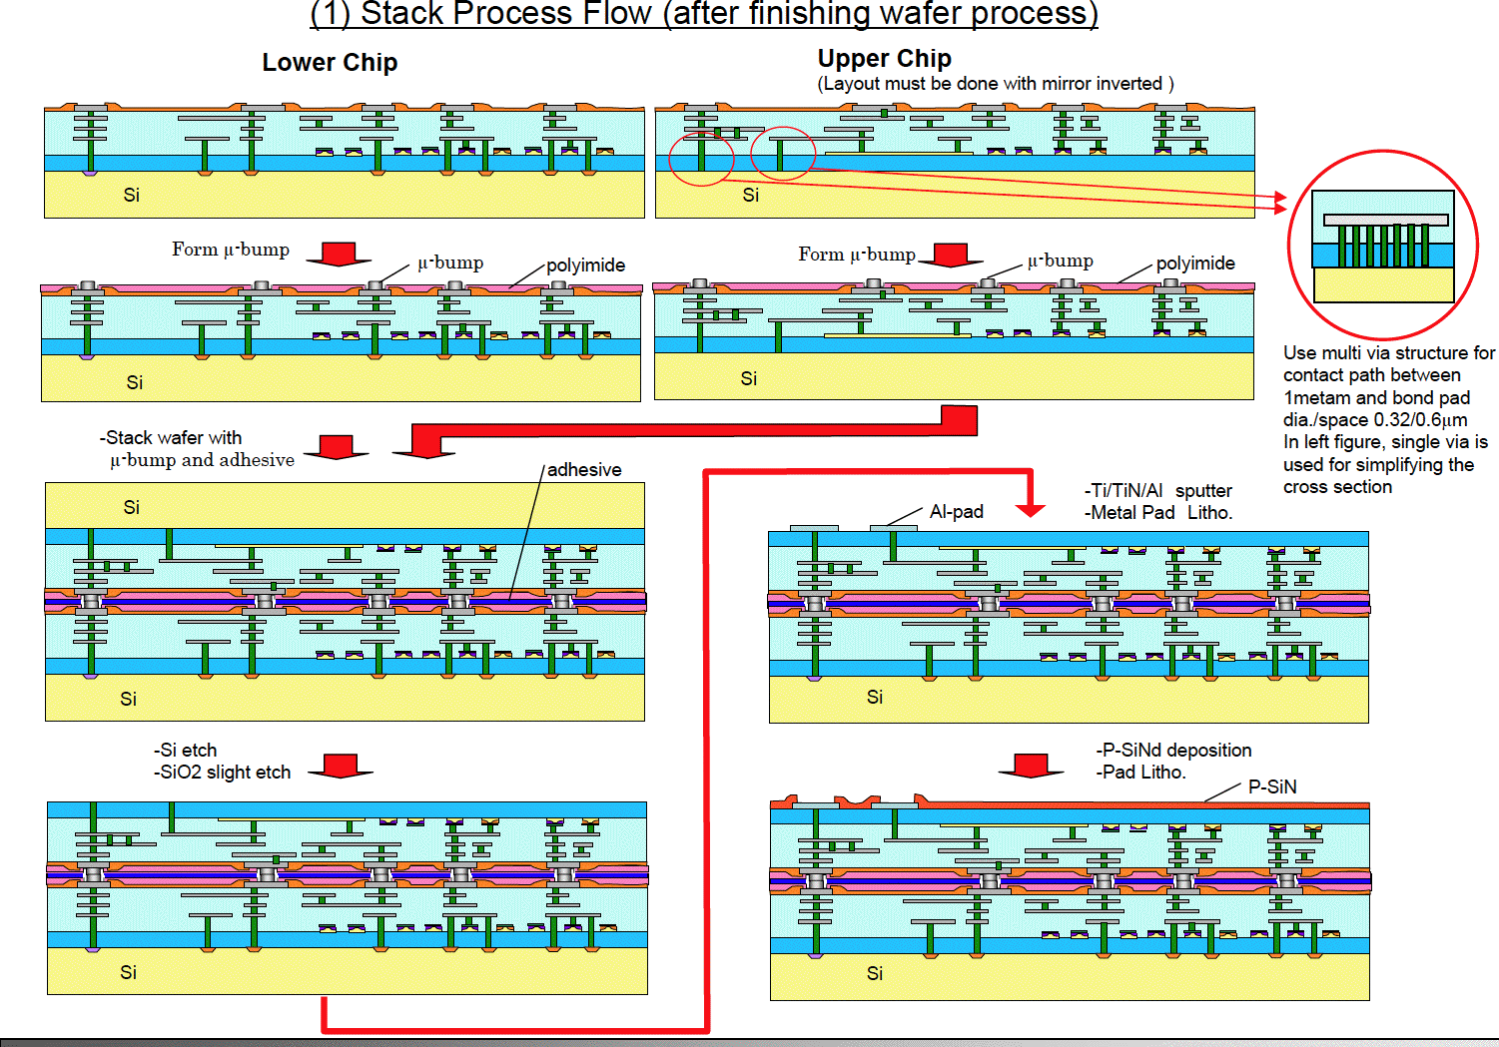
T-Micro 3D Process

Slide 51
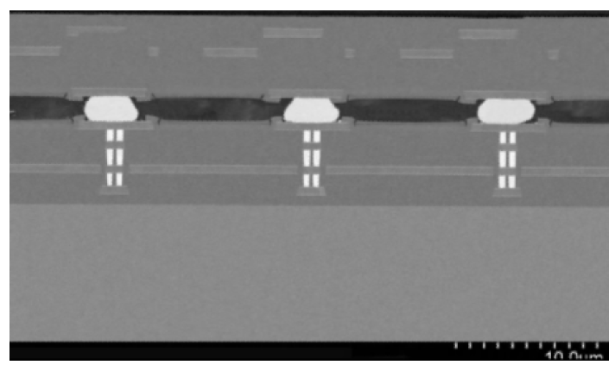
T-Micro Prototype
10 μm
© T-Micro , VIPS 2010

Slide 52


Fermilab 3D Project: VICTR
Vertical Integrated CMS TRigger chip
  R&D project to study viability of the 3D technology for sLHC experiments
The problem: at the sLHC triggers saturate the available bandwidth
  Muon trigger rate at L1 > 20 kHz at
  L=10³⁵ cm⁻²s⁻¹, flat in p_{T}
A solution: tracking information available at L1
  Collect info from 10⁸ pixels in 200m² of silicon at 40 MHz
  Power and bandwidth to send all of the data off-detector is prohibitive
An implementation: stacked modules that provide a momentum filter

Slide 53

Scintillator R&D
Scintillators have wide applicability and will continue to play a critical role as detector particle physics
  Low cost, large area experiments
  Veto walls (e.g. dark matter experiments)
R&D centers around the following strategic areas:
  Development of the scintillator/fiber co-extrusion
  Preparation of high Z and
  neutron-sensitive extruded
  plastic scintillator
    Initial studies on BaF₂
  Investigation of the use of an
  environmentally-friendly
  solvent for liquid scintillator
  applications
    Initial studies on Titanium dioxide
Key people:
Alan Bross, Anna Pla-Dalmau

Slide 54


Spin-off: TOF at Test Beam
Determination of timing resolution with
Silicon Photomultipliers (SiPM) and
quartz bars
  Eight Hamamatsu SiPMs, 3mm x 3mm
  In beam with quartz Cherenkov radiators
  several thicknesses (4 – 12mm),
  mirrored and not mirrored.
Under best conditions: σ(t) ~ 33 – 37 ps
10-15 photoelectrons
Channels
Pulse height slewing correction applied

Slide 55


SiPM CMS Synergy: HCAL
CMS HPD replacement step 1:
Outer Calorimeter (~2011)
  ~3,000 PPDs
  Each fiber in bundle (18) guided to its
  own SiPM
  Readout by QIE ASIC (Fermilab)
CMS HPD replacement step 2:
Whole calorimeter (Phase I)
  ~110,000 PPDs
  Allows for longitudinal segmentation
  SIPM tailored to HCAL
  New ADC = new ASIC (QIE10)
Strong overlaps
CMS

Slide 56


Single Crystal Setup
BGO crystal (from Caltech)
Visible and UV filters
Two PMT’s
20 Hamamatsu SiPM’s
TB4 readout boards

Slide 57
An Aside: PET
Two University of Chicago – Fermilab seed grant proposal submitted ($100k/yr for 2 years) for PET
PET: Crystals + PMT
Proposal to develop front-illuminated SiPM with through-silicon-vias (diameter <2μm) to connect to 3D circuit with back-to-front bonding
  Allows for individual pixel control and much more functionality

