Slide 1
View from Washington and Germantown
Vincent Dattoria
ESnet Program Manager, Facilities Division, Office of Advanced Scientific Computing Research
July 14th, 2010

Slide 2
Talk Outline
ASCR Organization
Next-Generation Networks
SBIR/STTR
ASCR ARRA Projects
Upcoming Activities

Slide 3
ASCR Organization Structure As of December 2009
Office of Advanced Scientific Computing Research
Associate Director – Michael Strayer
Administrative Specialist – Melea Baker
Senior Advisor – Walt Polansky
Advisor – Barbara Helland
Financial Analyst – Julie Scott
Program Analyst – Lori Jernigan
ASCAC Administrative Support – Vacant
Computational Science Research and Partnerships Division (SciDAC)
Small Business Research Division
Facilities Division
Program Manager – Vacant
Program Analysis – Carl Hebron
Management Analyst – Chris 0’Gwin
Physical Scientist – Dave Goodwin (on detail from Facilities Division)
Administrative Assistant – Jackie Stone
Continued on next page

Slide 4
Continued from previous page
.
Computational Science Research and Partnerships (SciDAC) Division
Director – Vacant
Program Support Specialist – Vacant
Program Support Assistant - Teresa Beachley
Facilities Division
Director – Vacant
Senior Advisor – Dan Hitchcock
Program Support Specialist – Sally McPherson
Applied Mathematics
Computer Science
Distributed Network Environment
Partnerships
Facilities
Operations
Mathematician
(Base)
Alexandra Landsberg
Sr. Tech Mgr for CS
Vacant
Physical Scientist
(Biology)
Christine Chalk
Computer Scientist
(Network Res.)
T. Ndousse-Fetter
Computer Scientist
(NERSC)
Yukiko Sekine
Computer Scientist
(Project Mgr.)
Robert Lindsey
Mathematician
(Multi-Scale)
Karen Pao
Computer Scientist
(Data & Visual.)
Lucy Nowell
Physical Scientist
(SC Programs)
Lali Chatterjee
Computer Scientist
(Collab./Midware)
Rich Carlson
Computer Scientist
(OLCF)
Vacant
Physical Scientist***
(User Programs)
D. Goodwin (on Detail to SBIR)
Computer Scientist
(File Systems)
Vacant
Computer Scientist
(CSGF/HBCU)
G. Seweryniak
Physical Scientist
(non-SC/Programs)
Vacant
Computer Scientist
(Fault Tolerance)
Vacant
Computer Scientist
(ESnet)
Vince Dattoria
Mathematician
(SciDAC)
Vacant
IT Specialist
(User Programs.)
Vacant
Physical Scientist
(SC Programs)
Vacant
Computer Scientist
(HPC Sci & Apps)
Vacant
Mathematician
(Peta/Exascale)
Vacant
Computer Scientist
(ALCF)
Betsy Riley
Computer Scientist
(SciDAC)
Vacant
Physical Scientist
(non-SC Programs)
Vacant
General Engineer
Vacant
Mathematician
(Cybersecurity)
Vacant
Computer Scientist
(Extreme Scale)
Vacant
Computer Scientist
(R&E Prototypes)
Vacant

Slide 5


Next-Generation Networks Program
The next-generation networks program supports R&D activities to develop advanced networks to enable distributed high-end science
Program elements:
  Network research – core network research
  Middleware research – Grid technologies
The program coordinates with ESnet to develop and deploy networks that enable scientists to push the limits of today’s networks
Next-generation network technologies has enabled the efficient and rapid distribution of massive data generated by the LHC experiment and climate modeling
Terabits Networks for Petascale Science

Slide 6
Next-Generation Networking
Recent FOA
  31 proposals from 56 institutions
  5 selected at $2.7M for 3 years
New FOA planned for FY11
Magellan-ANI Testbed well underway
Please join us and contact members of the Next-Gen team for further information
  Thomas Ndousse, Susan Turnbull, Rich Carlson

Slide 7
ASCR Technical Approach for SBIR/STTR
ASCR SBIR focus is now technology-centric, not science-centric.
Engaged people with entrepreneurial and venture capital experience in all stages
Engaged Lab personnel to assist with writing topic descriptions, identify reviewers, and assist with commercialization.
More info at: http://www.science.doe.gov/sbir/
Notes:
7

Slide 8
ASCR SBIR/STTR Proposals
Phase I:
  Received 153 proposals
  Awarded 22 SBIR (^$3.3M)
  Awarded 3 STTR (^$400k)
Phase II:
  Received 24 proposals
  Selected 10 for award (^$9.2M)
  Award anticipated by end of FY10
Anticipate next SBIR/STTR FOA ^November.
Rich Carlson is ASCR Portfolio Manager.

Slide 9
American Recovery and Reinvestment Act
9
ASCR’s Recovery Act Projects ($154.9M)
  Advanced Networking Initiative ($66.8M)
    Testbed to demonstrate and build tools for 100Gbps optical networking technologies
  Leadership Computing Facility Upgrades ($19.9M)
    Six-core upgrade to Oak Ridge LCF machine delivered 2.2 Petaflops
  Advanced Computer Architectures ($5.2M)
    Research on next generation technologies
  Magellan ($33M)
    Research to demonstrate and build tools to enable scientists to utilize cloud computing resources for mid-range computing needs
  SciDAC-e ($30M)
    Supplement and leverage existing SciDAC investments to advance the high performance computational capabilities of the BES - Energy Frontier Research Centers; Extra user support for Energy related projects at the Leadership Computing and NERSC facilities; Applied mathematics research in support of DOE electricity grid efforts.
Notes:
9

Slide 10

ANI: Advanced Networking Initiative
DOE Science Network challenges:
  72% annual growth in traffic since 1990
  compared to 45% at AT&T
  Growth is accelerating, rather than moderating
  Scientific collaborations were becoming more international, e.g. CERN, ITER, EAST Tokamak, etc.
Advanced Networking Initiative (ANI):
    Evaluate transport technologies for optical fiber backbone
    Deploy prototype 100Gbps capable network connected to NERSC, ALCF, OLCF and transatlantic peering point in New York
    Develop and support an experimental network environment allowing researchers to test new concepts in networking

Slide 11
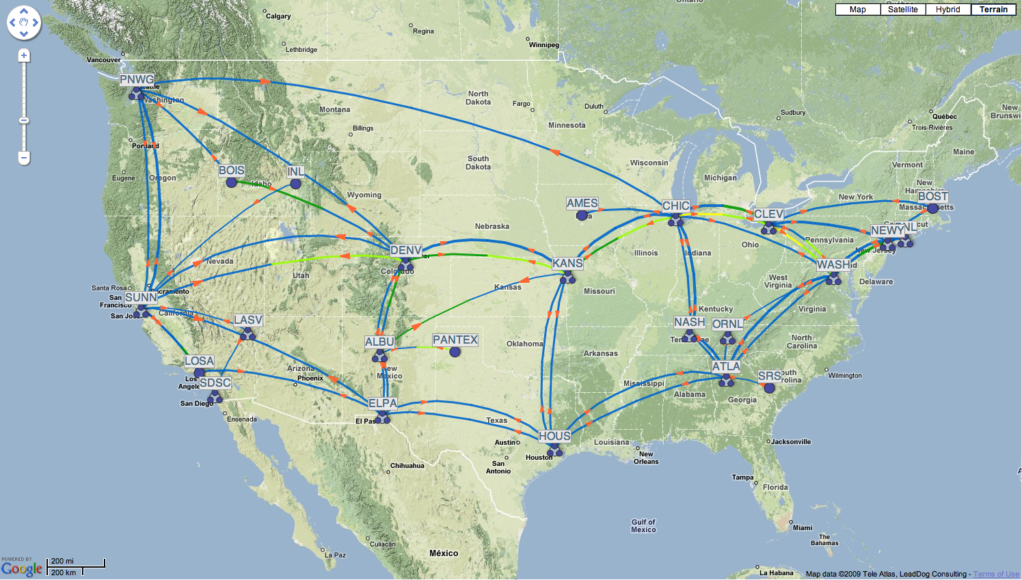
Advanced Networking Initiative
Prototype 100G cards for testing
Network Test bed is soliciting research projects
Transport RFP issued by LBNL
ALCF / ANL
Chicago
NYC
NERSC / LBNL
Sunnyvale
Nashville
OLCF / ORNL
100 G/l ANI Testbed (ARRA)
11

Slide 12
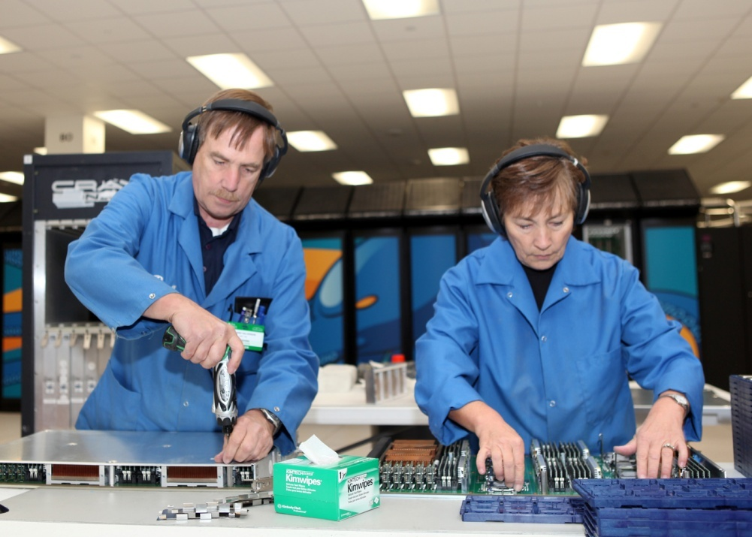
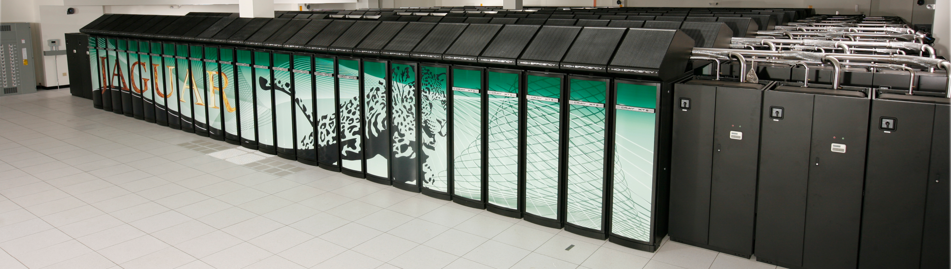
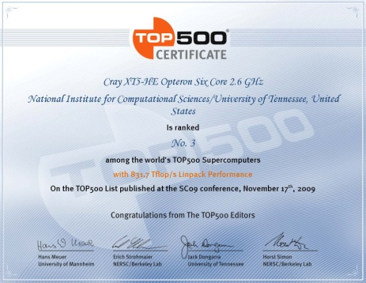

Leadership Computing Upgrade
Upgrade activities result in less than 10% unscheduled downtime for current users. (2009)
OLCF Completed acceptance test for quad-core to six-core upgrade of Cray XT5 at Oak Ridge (Q1).
November, 2009 and June 2010, Jaguar “World’s Most Powerful Computer” according to TOP500 list
12

Slide 13
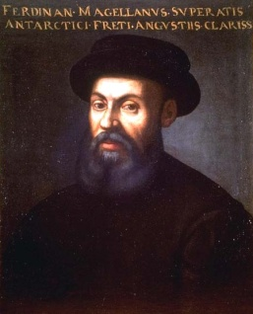
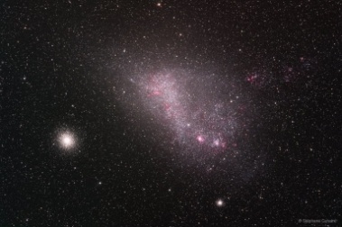
DOE Explores Cloud Computing
The ASCR Magellan Cloud for Science
  NERSC and ALCF
  100 TF/s across sites
  Petabyte-scale storage
  Open questions:
  Can a cloud serve DOE’s mid-range computing needs?
  What hardware and software are needed for a “Science Cloud”?
  How is this unique?
13

Slide 14
SciDAC-e
Complex mathematics for smart grids
14
Applied mathematics research in support of DOE electricity grid efforts.
  Robust Optimization for Connectivity and Flows in Dynamic Complex Networks, Lead PI: Balasundaram (Oklahoma State)
  Reconfiguring Power Systems to Minimize Cascading Failures: Models and Algorithms, Co-PIs: Bienstock (Columbia), Wright (UW-Madison)
  Approaches for Rare-event Simulation and Decision Making, Lead PI: Shortle (GMU)
  Analysis and Reduction of Complex Networks under Uncertainty, Marzouk (MIT), Knio (JHU), Ghanem (USC), Najm (SNL)
  Optimization and Control of the Electric Power Systems, Co-PIs: Meza (LBNL), Thomas (Cornell), Lesieutre (UW-Madison)
  Advanced Kalman Filter for Real-Time Responsiveness in Complex Systems, Co-PIs: Huang (PNNL), Welch (UNC-Chapel Hill)
  Extending the Realm of Optimization for Complex Systems: Uncertainty, Competition and Dynamics, Lead PI: Shanbhag (UIUC)
All awards made and work has begun.
Plan to conduct programmatic and expert review of progress and results.

Slide 15
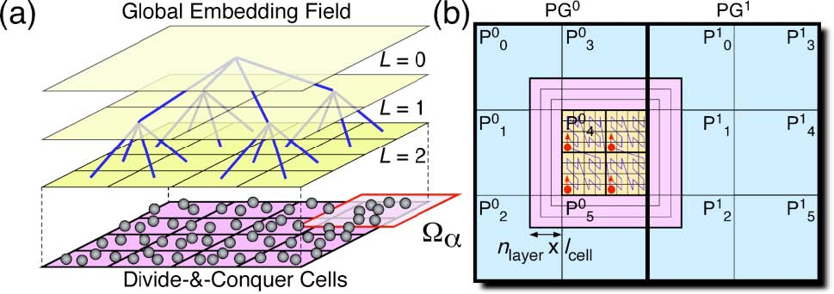
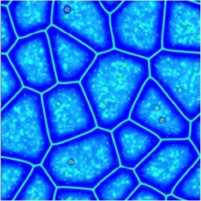
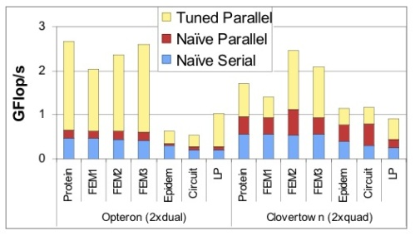
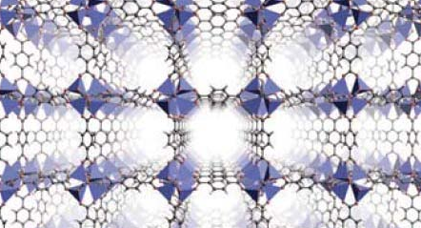
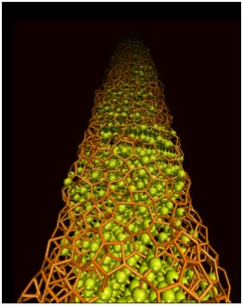
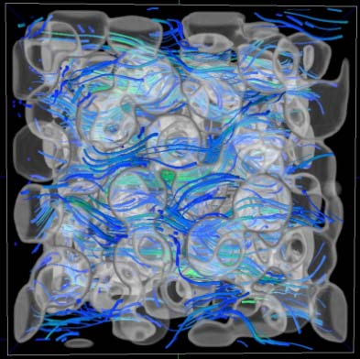
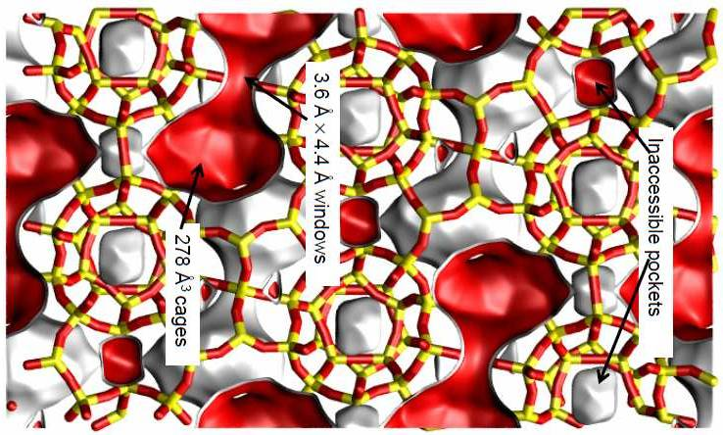
SciDAC-e
EFRC Collaborations
Supplemental awards to SciDAC CETs & Institutes to support BES EFRCs to develop a high-performance computing capability relevant to the goals of the EFRC
    14 awards made with Recovery Act funds in 2010 to APDEC, VACET, IUSV, TOPS, ITAPS, PERI, SDM
EFRC Category | # Unique EFRCs | # EFRC Collaborations | Award ($K)
Materials Under Extreme Conditions | 2 | 3 | 1,095
Geological Flows & Carbon Storage | 3 | 6 | 3,931
Solar & Photovoltaics | 5 | 5 | 3,379
Material Design | 1 | 2 | 951
Others | 4 | 4 | 1,540
TOTAL | 15 | 20 | 10,895
15

Slide 16
Vision for ASCR Facilities
1000
# of Petaflops
Future
R&E Prototypes for ALCF3
and OLCF-4
OLCF-4
100
ALCF-3
DARPA HPCS
Program
50 PF NERSC-8
20 PF OLCF-3
10
10 PF ALCF-2 / IBM Blue Gene Q
ANL/LLNL
/IBM R&D
Contract
7-10 PF NERSC-7
OLCF-2 / Cray XT5
1
NERSC-6 / Cray XT5
ALCF / IBM Blue Gene P
Cray XT4
0.1
2010 2011 2012 2013 2014 2015 2016 2017 2018 2019 2020 2021
Fiscal Year
16

Slide 17
Advanced Architectures
What it is:
  New effort to provide early access to DOE researchers of technologies emerging from IBM PERCS effort.
  Enhancement of University of California, Berkeley RAMP effort to provide focused research on flexible simulations of performance of scientific applications on next generation microprocessors.
  Both proposals were in hand and were peer reviewed.
Progress:
  Funding in place at ORNL for IBM PERCS effort
  Grant Paperwork for RAMP effort submitted to Chicago for processing

Slide 18
Upcoming Activities
ASCAC (Wash, AGU): Aug 24-25
NERSC/FES requirements workshop (Wash): Aug 3-4
ESnet/BER requirements workshop (Wash): Sep 22-23
NERSC/np requirements workshop (Wash): TBD
ASCR/HEP USLHCnet Analysis: Sep/Oct

