Slide 1
OSG Presentation Layer - following an introduction
Ruth Pordes
OSG Executive Director
Associate Head for Grids and Outreach, Fermilab Computing Division,

Slide 2
Who and What?
The Open Science Grid aims to promote discovery and collaboration in data-intensive research by providing a computing facility and services that integrate distributed, reliable and shared resources to support computation at all scales.
Consortium,
Project,
Collaboratory
All Hands Meeting

Slide 3
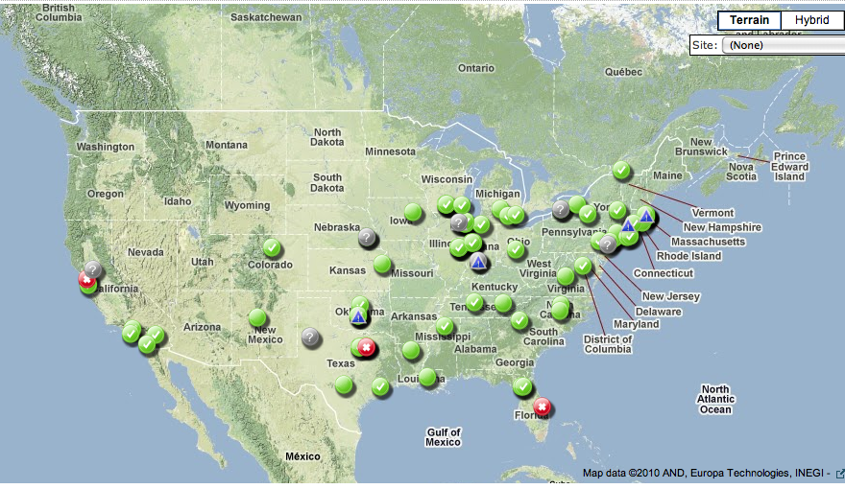
~70 Universities + 5 DOE Labs
Every site has OSG proponent and collaborators in place.
All sites support owner and OSG-mgmt VOs + at least one other.
113 interfaces to clusters (small to large),
55 interfaces to data caches,
8 campus “grids”
http://tinyurl.com/3x4gujs

Slide 4
Communities both large & small
Physics: ATLAS, ALICE, CDF, CMS, DayaBay, Dzero, GlueX, IceCube, ILC, LBNE, LIGO, STAR.
Facilities: BNL, Fermilab, JLAB, SLAC.
Single community Non-Physics: CIGI, CompBioGrid, DES, GROW, I2U2, JDEM, nanoHUB.
Multi-Disciplinary: DOSAR, Engage, GLOW, GPN, HCC, NEBioGrid, NWICG, NYSGrid.
OSG managed: MIS, OSG, OSGEDU.
Significant users of ESNET CA, see Steve’s talk yesterday

Slide 5
Support, Services and Software - as well as Community Extensions and R&D
~½ staff– including security, hosted services, servicedesk, user support, metrics, measurements.
OSG is a “Laboratory” at-scale production infrastructure including extended Integration Testbed resources and “overlay” on the production infrastructure for scaling, usability, s/w releases, services, new communities.
Work with many sotware development groups to extend the capabilities and scale (CS, application, international..)
Satellites are cooperating projects contributing to the mission e.g. ANI application research project
High throughput parallel computing – allocate/use all cores on a CPU.
Resource reservation across sites.

Slide 6
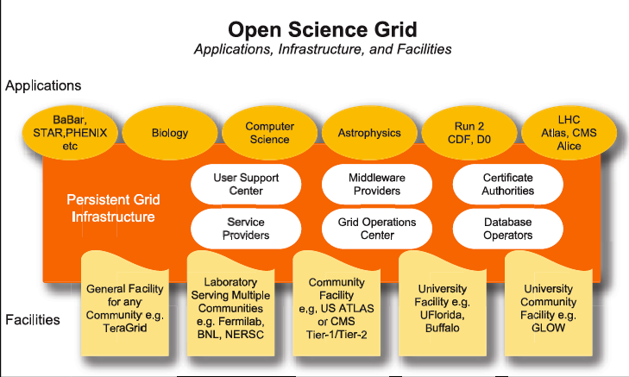
“Horizontal” Common Shared Infrastructure
Completely dependent on the underlying network fabric from ESNET, Internet2 and LHCNet.
Virtual Organizations
Common Services & Software
Resources, Sites, & Campuses

Slide 7
An “Eco-System”
Communities are international & use multiple infrastructures
Bridging Services
End-to-end System for Each community/group.
Structure hidden from end users.
Resource owners deal with community
Backbone across multiple clouds
Facilities can also be Clouds

Slide 8
Software is the enabler
Software packaged, tested, supported through the Virtual Data Toolkit (VDT)
…
Science Applications
VO Specific common collections
…
VO software & services
OSG software & services
Common Collections
aim to facilitate common s/w & reuse
…
Site fabric:
OS, batch, storage
…
Site Specific Middleware
Network,Hardware

Slide 9
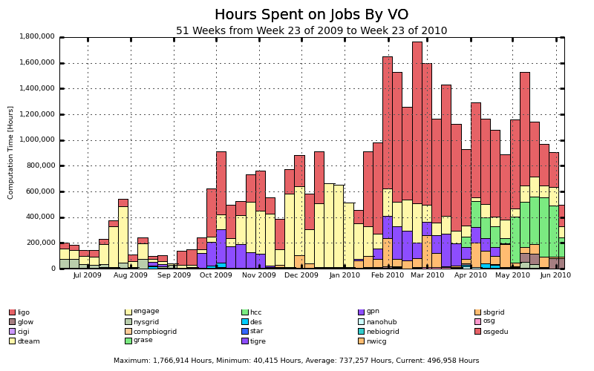
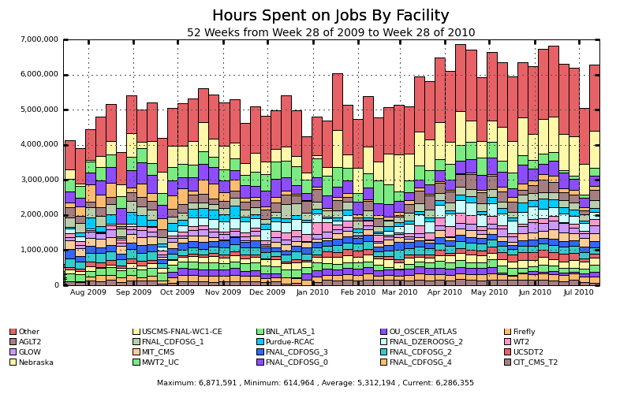
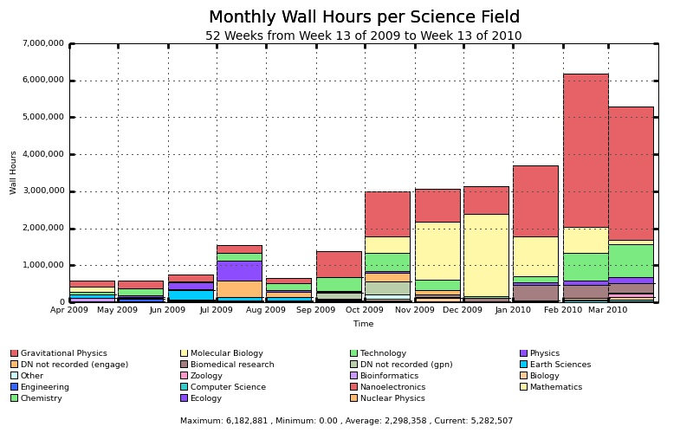
Lots of information collected – various disconnected displays
Non-hep

Slide 10
Outreach presentation layer… “For Vince”
Current production release:
http://display.grid.iu.edu/
In test displayed today
Goes into production in ~1 week.
http://dev.grid.iu.edu/~hayashis/display/

Slide 11
1000 foot view of OSG delivery

Slide 12
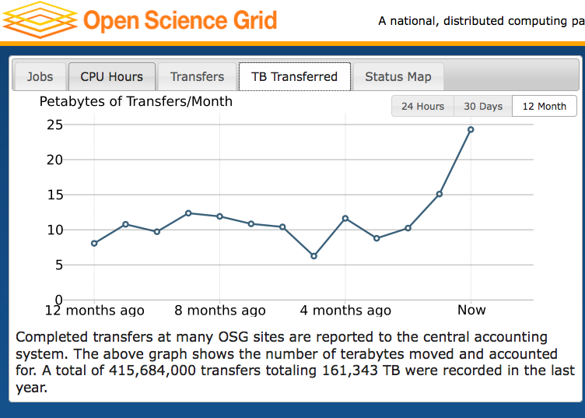

Slide 13
A few off-shore sites..

Slide 14
USA only

Slide 15
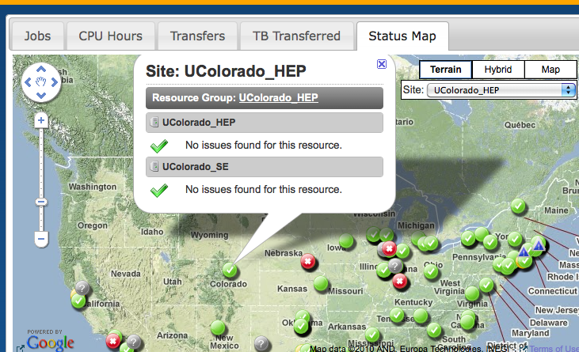
Drill down

Slide 16
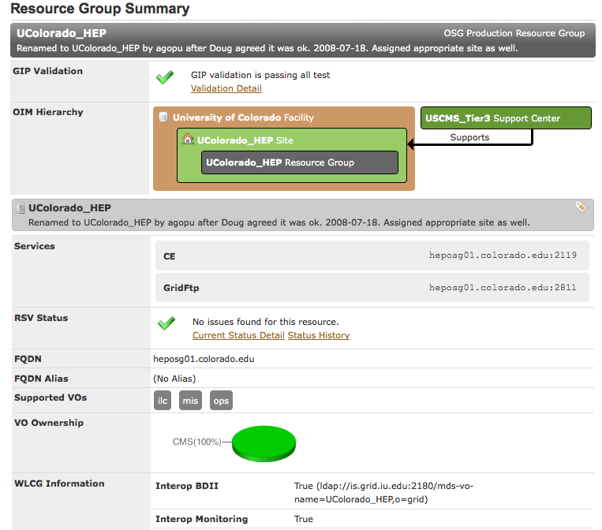
Drill Down to specific Test/Validation information

Slide 17
!! Feedback Useful !!

