Slide 1
Tier 3 Plan and Architecture
OSG Site Administrators workshop
ACCRE, Nashville
August 10-11 2010
Marco Mambelli
marco@hep.uchicago.edu
University of Chicago
THE UNIVERSITY OF
CHICAGO

Slide 2
Tier 3 or Small Sites
The name Tier 3 originates from the computing hierarchy of the LHC experiments
Sometimes referred as small sites. Definitely not connected to the importance. Actually they are or will be soon the majority of the sites.
Site or cluster: something bigger than a single workstation used by one scientist
Sites that often do not have a lot of dedicated IT personnel and satisfy mainly the needs of local scientific groups. Usually not hosting vital resources for the VO.
OSG saw commonalities: standardization and partnership can help

Slide 3
Tier 3
In ATLAS and CMS Tier 3 systems typically provide one or more of the following capabilities:
access to local computational resources using a batch queue
interactive access to local computational resources
storage of large amounts of data using a distributed file system
access to external computing resources on the Grid
the ability to transfer large datasets to and from the Grid
Tier 3s can also offer computing resources and data to fellow grid users

Slide 4
Summary
Definition, Communities
Plan, example
Some ideas
System administrator
Who to talk
Infrastructure
Components
Options for the cluster, topologies
Batch system, Storage systems
Grid services
Notes:
Philosophy of Tier 3 documents: suggestion if needed – if you know better ignore it

Slide 5
Many communities
Campus
Local resources and support
Virtual Organization (science experiment)
Direction and requirements
OSG
Tools and solutions for Grid computing
Specific components (common needs)
Ideas from a wider community
Support
T3

Slide 6
Plan
Start with requirements from local community and scientific collaboration (VO)
Define what you need
See what you can leverage
Consider the infrastructure
Plan for expansion
Have experts checking your plans
Purchase needed resources
Install and maintain
Notes:
Experts in the different communities: local, VO and OSG

Slide 7
Example of Tier 3 definition - ATLAS
Classify Tier 3s depending on the level of interaction with the Grid and the VO
Example of activities for a T3g:
Run Athena jobs interactively on small data samples.
Submit jobs to Grid using pathena (or prun) and retrieve the output
Get substantial amount (several TB) ATLAS data to a local storage and keep them.
Analyze, using athena or root, a large (TB) data sets in a short time (~1day) in an local batch system
Generate and reconstruct Monte Carlo samples locally.
Run root jobs interactively for final steps of the analysis.

Slide 8
Example of Tier 3 definition -CMS
University cluster, not Tier 1-2, unique site design depending on local needs, resources and capabilities
CMS prefers Tier 3s with full grid access: you can run CRAB jobs on it in exactly the same way as on a Tier 2 or 1
Easier to verify a proper setup, e.g. by running identical jobs on the same datasets at Tier 3 vs Tier 2
Will provide confidence to physics analysis groups when approving official results
The USCMS Tier 3 hypernews is an excellent resource for asking questions about what to do in your special situation.

Slide 9
Select a Tier 3 manager
A T3 requires an initial setup effort and a smaller continuous maintenance effort
If you can get experienced help at your institute, you should do so.
A person with a clear responsibilities for the T3 cluster is needed. It cannot be a group responsibility.
Assign one person from your group and a backup, to the T3 setup effort. If at all possible, the same persons should be responsible for T3 administration when T3 is operational.
Having a backup person will be important. Although the maintenance tasks is envisioned to be light, some of these will have to be done daily or weekly, or it may not be able to wait until the admin returns. Think about rotation of responsibilities after a while.

Slide 10
People you need to know
Department or university system administrator who manages computers in your environment already; bring him/her into the discussion from the beginning. He/she may be able to actively participate in the setup; or take a part of the responsibility for running the cluster. Effort has been made to separate the “root” type tasks from the non-privileged “VO-admin” tasks to make this easier. In any case he/she needs to stay informed.
Space, Power and Cooling; depending on the size of your installation, you will need to take into consideration space, power and cooling needs for your cluster. Probably your department sys. admin will be able to help you on these issues. Typically there is another set of people to contact about infrastructure; the contact needs to happen after the initial decision about the size of the cluster is made.
Notes:
You will need to establish contact with following people.

Slide 11
People you need to know (cont)
University person who is responsible for networking. After you have an initial decision about the size and scope of your cluster. You will need to obtain IP addresses for your cluster as well as discuss with this person any connectivity issues that might come up.
Campus computer security officer: responsible for the local computer security. He/she needs to be contacted early on in the cluster set up process.
VO collaborators: e.g. “nearest” Tier 2 and Tier 1 that may provide services to you.
Hardware representative: most likely it will be convenient to use group agreements from your campus or your VO that will provide you the right contact.
VO support and coordination (e.g. US CMS or US ATLAS T3 coordination).

Slide 12
OSG role in initial contacts
Help you to identify your needs
Provide with vocabulary and examples that make it easier to interact with local experts
Put you in touch with experts
Provide intermediaries that can act on your behalf or on your side specially for the initial contact
Share experiences and solutions
Notes:
E.g. Help translating functional requirements in numbers
Through the documentation
Internet2 people are available for suggestions or to provide formation
OSG security team helping to get the cluster accepted on campus

Slide 13
Some notes about infrastructure
Critical to a well functioning cluster
Examples of Infrastructure include:
Networking
Physical space and associated hardware (Racks)
Electrical Power and Cooling
Computer security / data security
System administration and maintenance

Slide 14
Physical space
Prior to making your computer purchases determine where you will put your hardware
Keep in mind:
1 Rack of computers is heavy > 1000 lbs
Rack of computers is noisy and generates a lot of heat
Does your University department have a computer room that you can use part of?
Do you have space for eventual expansion?
Do you have easy access to machines for repairs?
Are there costs involved?

Slide 15
Electrical power
What type of electrical power is available? (110 or 220 V) How much current? (number of circuits)
Each Dell R710 (used by LHC T3) draws 300W (max) 200W (nominal). i.e. 10 servers in a rack will draw 3000W
Consider other equipment as well. E.g. UPS.
Check the load with local safety. Usually 50-70% of the total circuit capacity can be assigned
Will you have to pay for electricity?

Slide 16
Cooling
Sufficient cooling important to operation of your cluster
Some AC systems require a steady load
Some reference cluster used by LHC T3:
23U, 927lbs (837 HEPSPEC, 72 cores, 48 TB) - storage on worker nodes – 4745 W (@220V) ~ 16000 BTU/hr ~ 1.4 tons AC (1 ton AC = 12000 BTU/hr; 1 W ~ 3.4 BTU/hr)
27U, 1279lbs- (837 HEPSPEC, 72 cores, 96 TB) - storage on worker node + extra centralized storage – 5245 W ~17800 BTU/hr ~ 1.5 tons of AC
Will you have to pay for cooling?

Slide 17
Networking
How far are you from the edge of campus?
Determine the available bandwidth between your computers and campus backbone?
Determine the available bandwidth across the campus backbone?
Determine the available campus bandwidth to Internet 2?
Is the amount of available bandwidth sufficient for your needs? ( 100 MB/s ~ 1 TB /day)
Determine how much networking infrastructure you will have to purchase? Can you use a specific brand of switches? Does your campus require Cisco or another vendor?
Will you have to pay for bandwidth used?

Slide 18
Networking (cont)
How many public IP address can you get?
What is the campus firewall policy?
Some places have several networks
Public/restricted to the campus or department
Open/limited, e.g. behind a firewall or a traffic shaper
Do you need a private network for your cluster?
Tier 3 examples have public and private networks
Added complexity with advantages
“No” firewall on private network.

Slide 19
Security
Who is the department computer security contact? Meet with them.
Secure computers are vital to our ability to produce science results.
What are your campus/department computer security policies?
What will be your role for your cluster?
We do not want to be the weak link in the computer security chain. - Computer security should not be ignored
You will hear more in Igor’s talk later

Slide 20
System administration
How centralized is your campus?
Who is responsible for machine installation? And for up keep (hardware and software)?
Does you department have system administrators who can help you?
Can they administer the machines (OS/ accounts etc)?
Will you have to do it all but they provide expert guidance?
What is your data preservation plan? What is your backup strategy

Slide 21
Hardware has compromises
Hardware selection and tuning is difficult
Using known configuration or tapping into other people experience may simplify the task
Some VO, e.g. US-ATLAS, provide hardware recommendations and standard setups aiming to reduce maintenance (e.g. aiming to 1 FTE-week setup and .25 FTE maintenance)
It’s always possible to spend effort instead of money and obtain a more powerful cluster or vice versa.
It is difficult to estimate the manpower cost of such an effort. Depends largely on the expertise and the commitment of the person doing it.

Slide 22
Classes of machines
Service nodes (as needed):
NFS, Cluster Monitoring, Cluster Management
Batch Management, User Management, User authentication, CE
Data Gateway/buffer, Web data buffer, Data Management, SE
Interactive nodes (one or more):
User login, interactive analysis, submission to local batch and Grid.
local user storage area.
Batch nodes (one or more—two or more for a meaningful batch system):
Parallel batch processing queues
Storage space for data
Dedicated storage nodes
For a very light installation, you can consider an interactive only cluster (nodes may run services and store data)

Slide 23
E.g. US-ATLAS T3g machines
2 Service nodes:
1 server for: NFS, Data Gateway/buffer, Cluster Monitoring, Cluster Management
1 server for: Batch Management, Data Management, User Management, Web data buffer
Interactive nodes (one or more):
User login, interactive analysis, submission to local batch and Grid.
local user storage area.
Batch nodes (one or more—two or more for a meaningful batch system):
Parallel batch processing queues.
Storage space for data.
Depending on you needs you might add
Storage nodes for data.
For a very light installation, you can consider an interactive only cluster.
Service nodes, in this case will most likely only 1 server (not all services will be needed) or even be a part of an interactive node.

Slide 24
E.g. CMS $100k Tier 3
Assumptions: (Rob Snihur, Ian Fisk 2009)
6 physicists, (1.4 + 1) TB each
Process sample in 24 hrs → 16 nodes w/ 8 cores each
Flush & update sample in 12 hrs → 600 Mb/s networking
Upgradeable RAID chassis ($33k)
16 worker nodes ($41k)
24-port Gigabit switch ($12k)
3 server nodes ($9k)
Racks and infrastructure ($5k)
Notes:
The size of the cluster depends on the science needed

Slide 25
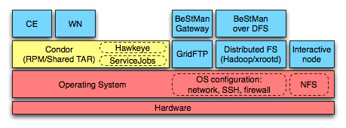
OSG documentation
Reference documents on the TWiki in ReleaseDocumentstion
Tier3 Web on the TWiki
Covers mainly Grid services
Some suggestions on other components of a Tier 3
User contributions

Slide 26
Some notes about the OS
VDT supported platforms (for the services) http://vdt.cs.wisc.edu/releases/2.0.0/requirements.html
RHEL 5 (and variants) most common platform
Don’t forget time synchronization (NTP) https://twiki.grid.iu.edu/bin/view/Tier3/ClusterTimeSetup
More notes in the Tier 3 documentation (phase 1) https://twiki.grid.iu.edu/bin/view/Tier3/ModulesIntro

Slide 27
Cluster components
Shared File System (general purpose)
Usually NFSv3/NFSv4 (safer) Server. Using NFS to create a shared file system is the easiest way to set up and maintain a Tier 3. NFS is likely to cause performance issues. Read about NFS tuning/setup. Lustre or other commercial solutions (GPFS) can be an alternative.
Condor Batch Queue
A batch queue system is strongly recommended for Tier 3s. Tier 3 documents only provide the installation of Condor (selected because it is one of the most familiar internally to the OSG and hence easily supported by the OSG), but other systems can be used and may be preferable, for example if there is local expertise available in another batch queuing system. The general OSG documentation provides some help for different systems.
Distributed File System (for data)
An optional capability that can be helpful for moving efficiently VO data and other files across the worker nodes. It may also provide data-locality performance improvements to scientific applications. This document covers the installation of Xrootd, a DFS optimized for ROOT files used in the HEP community, although other systems may be used. Tomorrow you will see Hadoop.

Slide 28
Cluster components (cont)
Cluster deployment and configuration management
Provides automatic deployment and some management operations.
Some CMS sites use Rocks, a free cluster management solution based on a 'clean reinstall' model. Modifications to the default distribution are done by editing xml files in an admin-friendly way, creating a new distribution, then reinstalling the compute/worker nodes. Rocks has one head node which serves the distribution and numerous other services and which does not require regular reinstall. Nodes can be broken into groups of Rocks appliances, where each group is served a different distribution according to your directions. The 'clean reinstall' model can be convenient for guaranteeing system integrity as compute nodes are working on a very clean and well-defined system. It can pose difficulties when compute nodes are used as interactive nodes or when a particular appliance requires frequent updates, necessitating frequent reinstalls.
Some ATLAS sites use Puppet, Ruby-based, is a declarative language for expressing system configuration, a client and server for distributing it, and a library for realizing the configuration. It is more a configuration management tool and allows changes without reinstalling the system.
Bcfg2, Cfengine, Cobbler, Modules, Perceus/Warewulf and Quattor are other alternative systems.
Monitoring
Ganglia, Cacti and Nagios are useful monitoring and alarm tools.
http://www.linuxjournal.com/magazine/taming-beast?page=0,0

Slide 29
Site services
Authentication Service
enables grid users to authenticate with your site using their grid or voms proxies
Compute Element
enables grid users to run jobs on your site
Worker Node Client
enables grid jobs running on worker nodes to access grid tools
Storage Element
enables grid users to store large amounts of data at your site
VO Management Service
provides functionality for VO Managers to manage the membership information of their users

Slide 30
Authentication Service
enables grid users to authenticate with your site using their grid or VOMS proxies
Alternatives:
grid-mapfile (edg-mkgridmap)
a simple program that contacts VOMS servers and creates a grid-map file
easy to install and maintain
does not support voms proxies
GUMS
a web service providing sophisticated controls of how users authenticate
supports voms proxies (groups, roles)
requires Tomcat to be run as a web service

Slide 31
Compute Element
enables grid users to run jobs on your site
Services
GRAM: Globus service for job submission
GridFTP: grid authenticated file transfer
Optional services
GRAM-WS: web service implementation of GRAM
Squid: caching Web proxy
Managed-fork jobmanager

Slide 32
Worker Node Client
enables grid jobs running on worker nodes to access grid tools
Options
Shared or local installation
On worker nodes and compute element
Required?

Slide 33
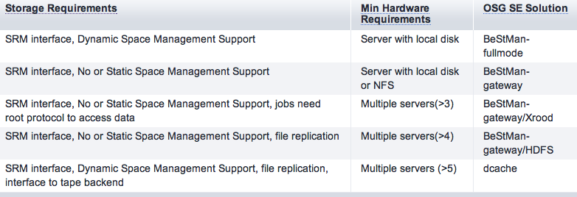
Storage Element
enables grid users to store or access large amounts of data at your site
Interfaces
Storage Resource Manager (SRM)
Dynamic Space Management Support (dyn)
No or Static Space Management Support (st)
GridFTP
Tanya’s talk tomorrow and https://twiki.grid.iu.edu/bin/view/ReleaseDocumentation/StorageInfrastructureSoftware
Several options

Slide 34
VO Management Service
provides functionality for VO Managers to manage the membership information of their users
Each VO needs to provide one VOMS
You need it only if you manage a VO
If you need groups you can request them to your VO

Slide 35
Server names
NFS – shared file system (general purpose)
WN-nn – batch system worker nodes
HN – batch system head node
CE – compute element
SE – storage element
SN-nn – storage node
UI-nn – user interface (interactive node)
Squid – Web proxy
NAT - firewall
GUMS – user management

Slide 36
Network topologies
Intranet (private) + Extranet (public)
More independent (IP addresses)
Manage dual homed hosts
All on one network

Slide 37
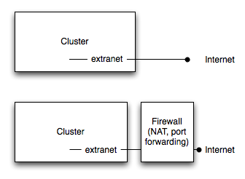
Connection to the public internet
Connected directly to the internet
Behind a firewall
Cluster more protected
Requests to open ports for outgoing or incoming connections
May have bandwidth limitations

Slide 38
Virtual machines
Allow to install services on their own machine
Isolation and easy load balancing
No conflicts for ports or other resources
Standard configuration
Some penalties
Installation and management
IO penalty
Slower response time (e.g. Xrootd redirector)

Slide 39
Compute and Storage Element
provide dedicated hardware for the Compute and the Storage Element
use as many CPUcores and main memory as possible
avoid running other grid services such as GUMS on the Compute and the Storage Element
avoid running a file server on the Compute and the Storage Element

Slide 40
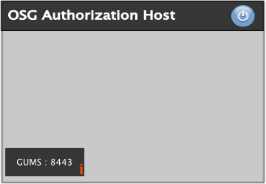
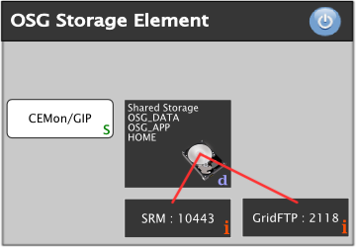
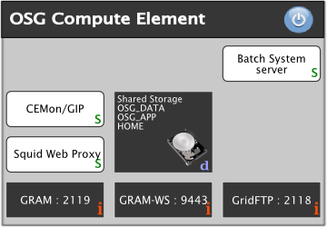
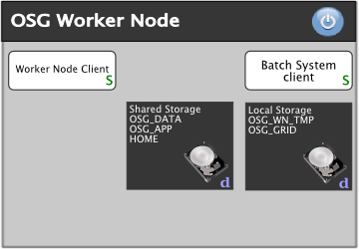
An OSG site

Slide 41
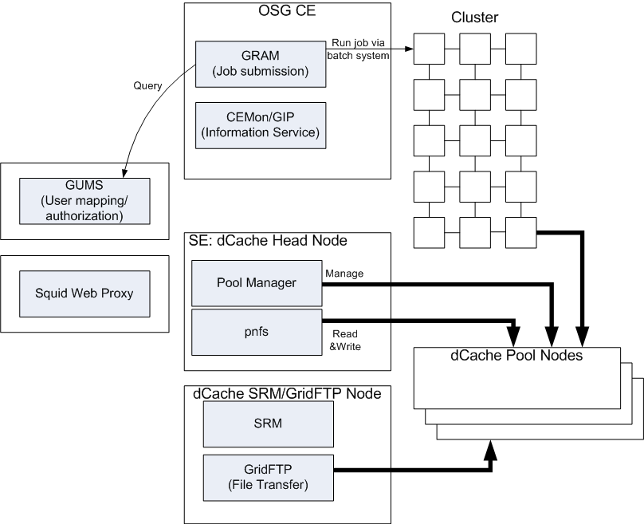
An OSG site (CE, GUMS, dCache)

Slide 42
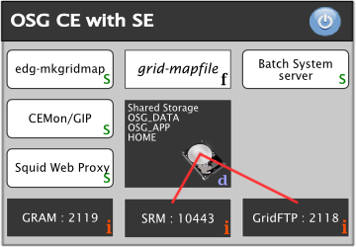
A more compact OSG site

Slide 43
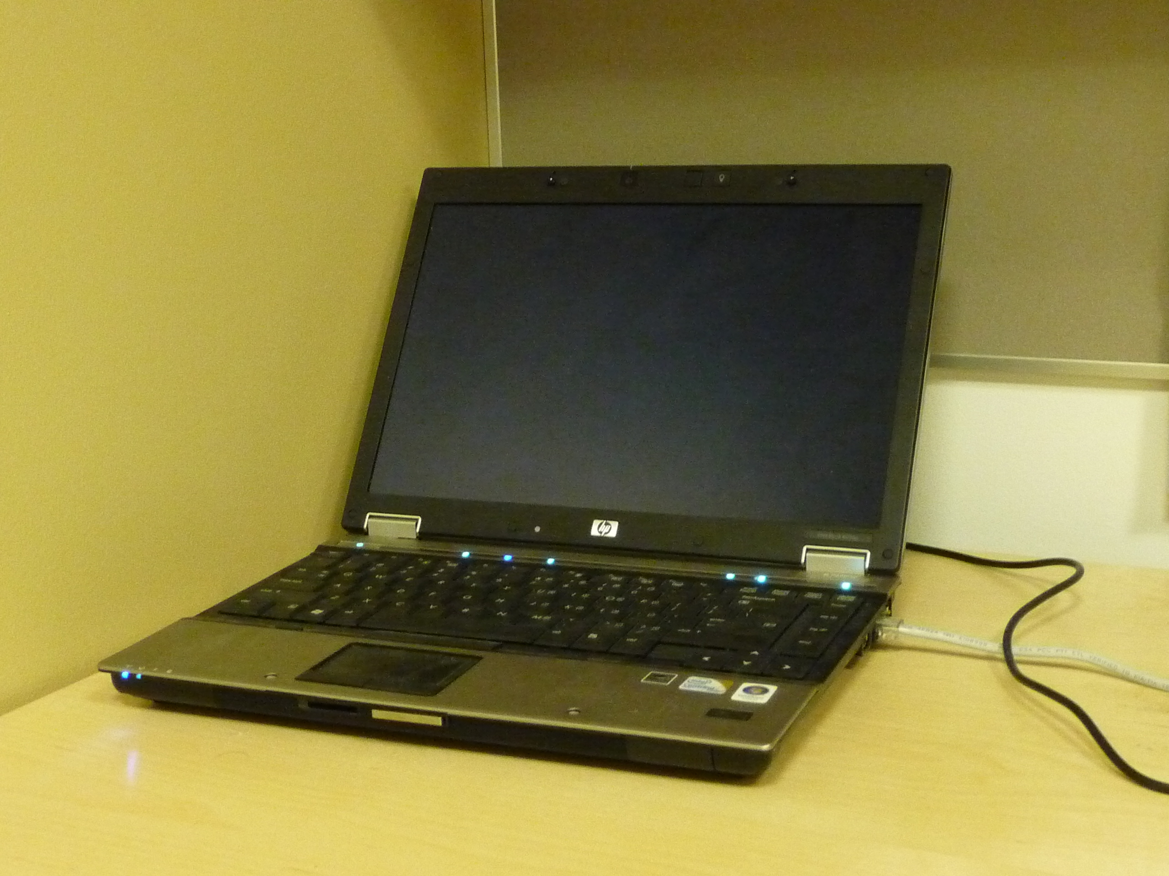
And for testing
Full cluster on VMs (GUMS, CE, SE, …)
Deploy different configurations

Slide 44
?
!

Slide 45
Useful links
Release documentation
https://twiki.grid.iu.edu/bin/view/SiteCoordination/SiteAdminsWorkshopAug2010
Tier 3 documents
https://twiki.grid.iu.edu/bin/view/ReleaseDocumentation/HandsOn
OSG Site planning guide
http://indico.fnal.gov/conferenceDisplay.py?confId=3429
http://indico.fnal.gov/conferenceTimeTable.py?confId=3429
Workshop public TWiki:
https://twiki.grid.iu.edu/bin/view/ReleaseDocumentation/SiteAdminsWorkshopTutorialsAug10

Slide 46
Credits
Thank you to Doug and Rik from the ATLAS Tier 3 coordination
Thank you to Rob Snihur from the CMS Tier 3 coordination
Thank you to people writing OSG documentation, specially Site planning Guide

