Slide 1

Progress of High Pressure Hydrogen Gas Filled
RF Cavity Test
Katsuya Yonehara
Accelerator Physics Center, Fermilab
Muon Accelerator Program Review
Fermilab, August 24-26, 2010
1

Slide 2
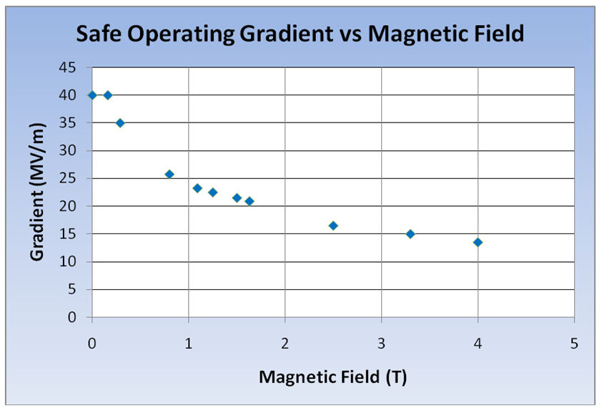
Advantage of using high pressure hydrogen gas
Challenge in MAP RF program
We have a problem to operate RF cavities under strong magnetic fields in ionization cooling channels
Field emission electron plays an important role to induce RF breakdown although the breakdown mechanism is not fully understood yet
By filling RF cavity with dense hydrogen gas, field emission electron has a short mean free path in the cavity and breakdown probability is greatly reduced
R.P. Johnson and D.M. Kaplan, MuCoolNote0195
2

Slide 3
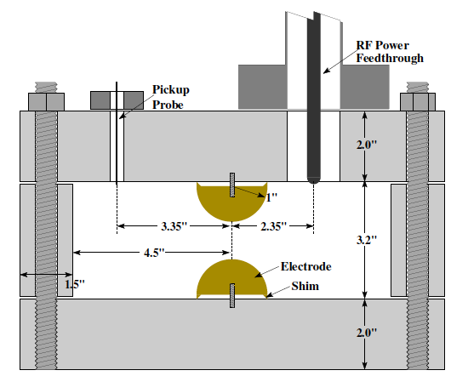
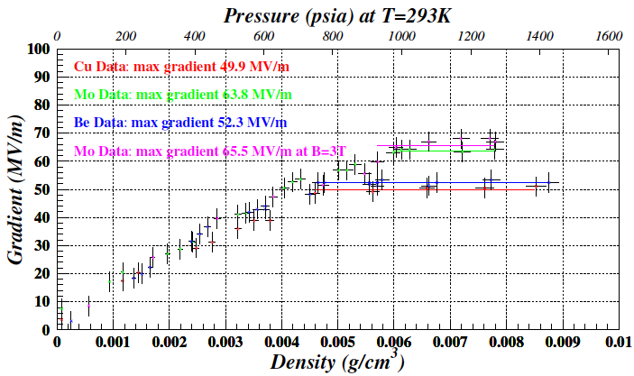
Historic result in high pressure RF cavity
High Pressure RF (HPRF) cavity has been successfully operated in strong magnetic fields
Maximum electric field in HPRF cavity
Schematic view of HPRF cavity
Gas breakdown:
Linear dependence
Governed by electron mean free path
Metallic breakdown:
Plateau
Depend on electrode material
No detail study have been made yet
Metallic breakdown
Operation range (10 to 30 MV/m)
Gas breakdown
P. Hanlet et al., Proceedings of EPAC’06, TUPCH147
3

Slide 4
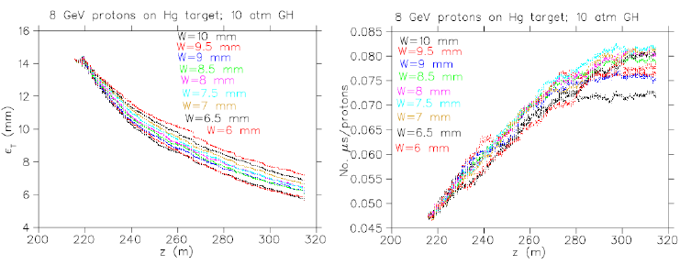
Apply HPRF cavity in front end channel
Dense hydrogen gas can be used as an ideal buffer to
suppress breakdown and also be used as an ionization
cooling absorber
GH2 cools down RF windows
Simulation of muon emittance in hybrid front end channel
Hybrid: LiH (various widths (6~10 mm) in simulation)
+ 10 atm GH₂
Be pressure safety window is included
Schematic drawing of HPRF cavity in frontend pre-cooler channel
Results are comparable with
vacuum front end channel
J.C. Gallardo & M.S. Zisman et al., Proceedings of IPAC’10, WEPE074
4

Slide 5
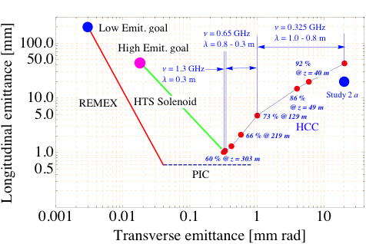

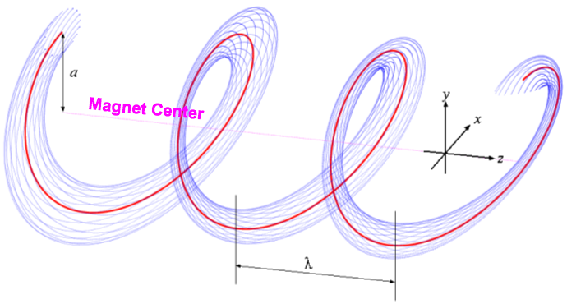
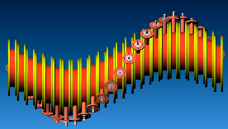

Apply to Helical 6D Cooling Channel
Particle tracking in helical cooling channel
HPRF cavity
Simulation of muon emittance evolution in helical cooling channel
Apply HPRF cavity (p = 200 atm)
in helical 6D cooling channel
6D cooling factor > 10⁵ in 300 m
Transmission efficiency 60 %
Helical solenoid coil
CAD drawing of helical cooling channel
K. Yonehara et al., Proceedings of IPAC’10, MOPD076
5

Slide 6
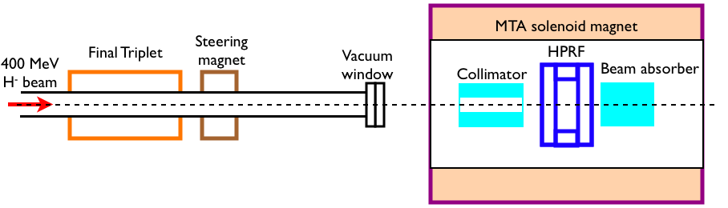
HPRF beam test:
MTA Beam line
Final beam absorber
MTA experimental hall
Beam profile
Deliver 400 MeV protons in the MTA exp. hall
10¹² to 10¹³ protons/pulse
Tune beam intensity by collimator and triplet
(reduce factor 1/10)
MTA solenoid
magnet
400 MeV
H⁻ beam
6

Slide 7
Possible problem:
Beam loading effect in HPRF cavity
Simulated RF pickup signal in HPRF cavity with high intensity proton beam passing though the cavity
Beam loading effect:
Beam-induced ionized-electrons are
produced and shaken by RF field and
consume large amount of RF power
Such a loading effect was estimated as
a function of beam intensity
Recombination rate, 10⁻⁸ cm³/s are
chosen for this simulation
Scientific goals:
RF field must be recovered in few nano seconds
Measure RF Q reduction to test
beam loading model
Study recombination process in
pure hydrogen gas
Study attachment process with
electronegative dopant gas
Study how long does heavy ions
become remain in the cavity
M. Chung et al., Proceedings of IPAC’10, WEPE067
7

Slide 8
Recombination in pure GH2:
Polyatomic hydrogen
Tollestrup et al., FERMILAB-TM-2430-APC
Polyatomic hydrogen cluster:
H_{n}⁺ are formed from H₂⁺ and H⁺ in very short time
Recombination of H_{n}⁺ is < 1 μs that has been observed in dilute condition
No measurement has been done in dense hydrogen environment
Careful RF Q reduction measurement with beam (as shown in previous slide) will indicate
recombination rate with polyatomic hydrogen cluster
8

Slide 9
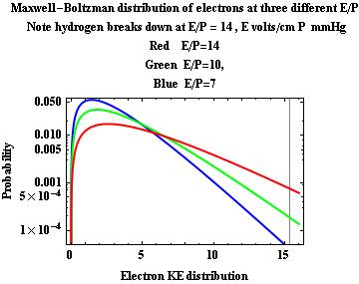
Study breakdown in HPRF cavity:
Breakdown probability
E/p=14
E/p=10
E/p=7
previous result
Operation gradient: 10 to 30 MV/m
Breakdown probability around boundary
The data was systematically taken with copper electrodes
K. Yonehara et al., Proceedings of IPAC’10, WEPE069.
9

Slide 10
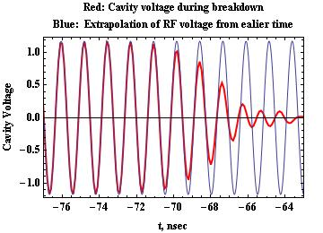
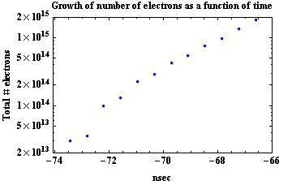
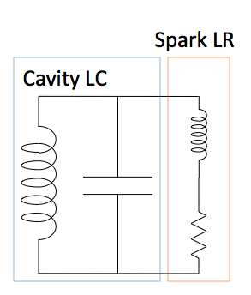
Study hydrogen plasma dynamics:
Analyze RF pickup signal
RF pickup signal in breakdown process
Electron density from RF pickup signal analysis
Equivalent resonance circuit
Resonance circuit of normal RF
cavity consists of L and C
Breakdown makes streamer
It produces additional L and R
Resonance frequency is shifted
by them
Current can be estimated from L, R and
drift velocity of electrons in hydrogen plasma
A. Tollestrup et al., FERMILAB-TM-2430-APC,
K. Yonehara et al., Proceedings of IPAC’10, WEPE069
10

Slide 11
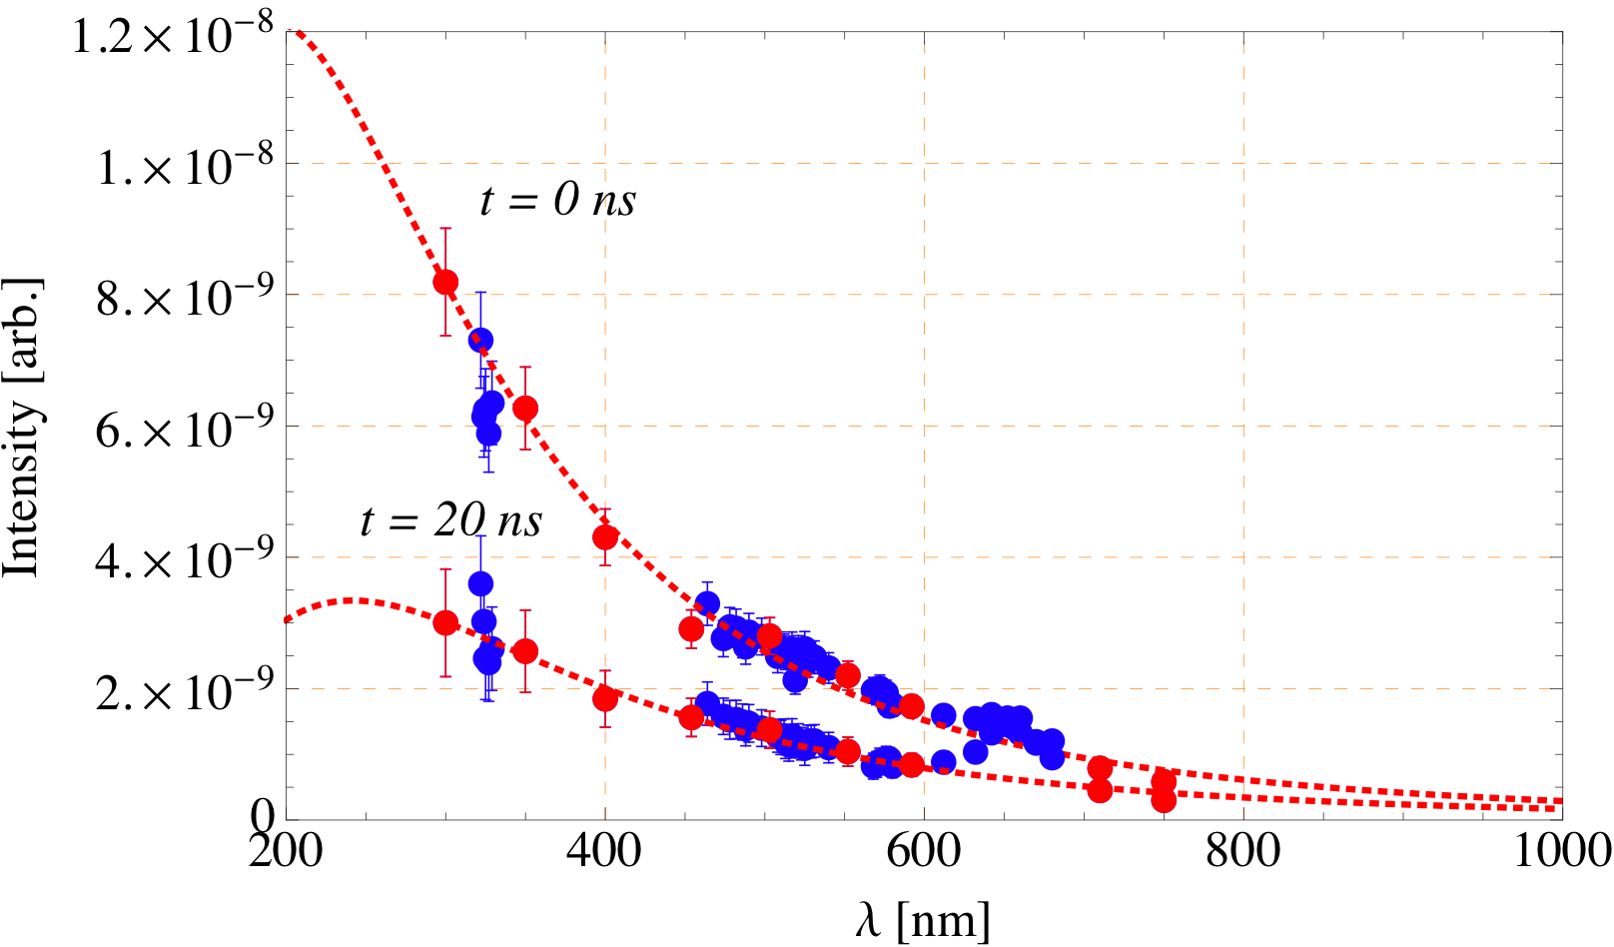
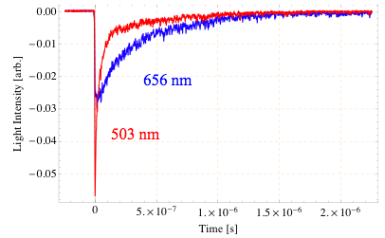
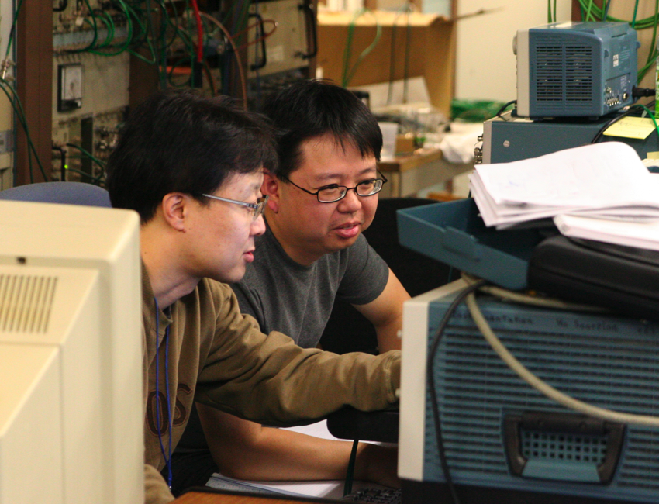
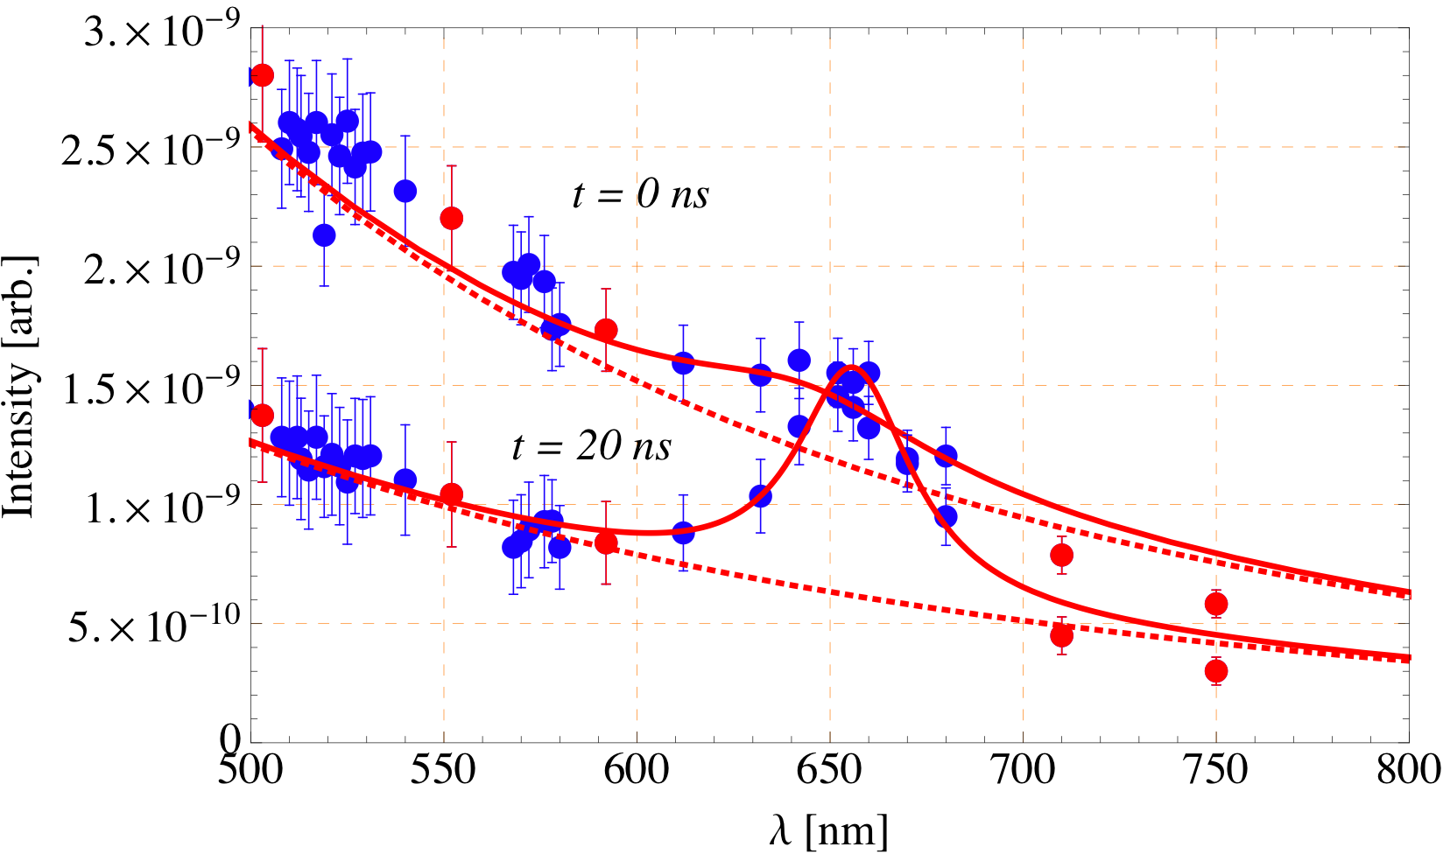
Study hydrogen plasma dynamics:
Spectroscopy of breakdown light
Spectroscopy in the high pressure RF cavity
Thermal radiation:
Broken line is a least square fitting of thermal
radiation formula by taking into account red points
which is on neither any hydrogen nor copper
resonance lines
“0 ns” is a peak light intensity
Plasma temperature is raised up to 18,000 K in 5
ns and down to 10,000 K in 50 ns
Using fast data
acquisition system
Spectroscopy at Balmer line
Spontaneous emission:
Solid line is a least square fitting of Lorentz
function by taking into account all points
Timing delay due to lifetime of de-excitation
Broadened Balmer line is observed
Stark effect well-explains resonance broadening
Plasma density 10¹⁸~10¹⁹ electrons/cm³
K. Yonehara et al., Proceedings of IPAC’10, WEPE069
11

Slide 12
Critical issues for down selection
RF field must be recovered in few nano seconds
DC to 800 MHz, Hydrogen breaks down at E/P = 14. It indicates we can use DC data as a framework to explain results.
  Need higher frequency measurements to test frequency dependence
Electrons move with a velocity, . Current .
Power dissipation due to electrons in phase with RF and dissipate energy through inelastic collisions =
Measurements with beam verify mobility numbers and verify our loss calculation
Electrons recombine with positive ions and removed. If this is very fast they don’t load cavity, if slow cause trouble
  Beam measurement will give the recombination rate
Solution: use electronegative gas(es) to capture electrons and form negative ions
  Beam measurement will verify attachment rate
A+e →A⁻ heavy negative ions. How long do these hang around and do they cause the breakdown voltage of the cavity to be lowered
  Beam measurement will give necessary answers
Feasibility, including a hydrogen safety analysis, also must be assessed
12

Slide 13
Conclusion
High pressure RF cavity is a potential element for muon
ionization cooling channel
- Successful HPRF cavity tests in strong magnetic fields have been
done
- Physics rich subject: Not only accelerator physics but also
plasma & atomic physics topics are involved in R&D
Beam test is scheduled to demonstrate HPRF cavity in high
radiation condition
- First 400 MeV proton beam test will be finished at the end of 2010
- Study recovery time of RF field
- R&D will be finished in FY11
Start building prototype high pressure RF cavity for real
cooling channel in FY12 if this technology is selected
13

