Slide 1
MAP Magnet R&D Program
J. Tompkins
Technical Division, Magnet Systems Dept.
Fermilab

Slide 2
Outline
Overview
HCC – Helical Cooling Channel
HTS – High Field Final Cooling Solenoid & SBIR – BNL/PBL R&D HTS Solenoid
Collider Ring Magnet Design
Summary

Slide 3
MAP Magnet R&D
Very High Fields Required
  Conductor dominated
    High J_{c} at high fields (>25 T)
    Must support high stresses
  HTS materials
    Bi2212 – round strand ⇒ cables
    YBCO – flat tape (⇒ Roebel cables…)
    Different technologies - both present challenges…
Challenging geometries
  Helical solenoids
  Collider ring magnets
Challenging environments
  Target solenoid
  Collider ring
    Muon decay e±
Overall effort is largely design / calculation / modeling based

Slide 4
Overview, cont.
SBIR funding plays an important role
  Muons, Inc.
  BNL / PLB 40 T R&D HTS solenoid
  Support of lab & industry HTS development
‘Leverage’ from other high field programs - mainly LARP
  Large aperture quadrupoles
  Experience with less forgiving materials…
    Wind & react
    High temp heat treatments
    Brittle materials
Ongoing programmatic interest/support at DOE labs in HTS materials for very high field magnets
  LBNL, BNL, FNAL R&D programs
  VHFSMC (DOE/ARRA funding) - includes the above, plus FSU-NHFML/ASC, LANL, NIST, & TAMU

Slide 5
Overview, cont.
DOE/ARRA funding through VHFSMC - $4M total
  Direct support of HTS R&D for HEP applications
  Funding now in 2nd / final year
  Focus on Bi2212
    Suitability for cabling ⇨ potential for range of HEP magnet requirements (dipoles, quads, etc.)
  Support of further conductor development – TBD
• HTS is the ‘enabling technology’ for a Muon Collider: an ongoing conductor development program must continue beyond VHFSMC
  A conductor development program similar to that for Nb₃Sn?

Slide 6
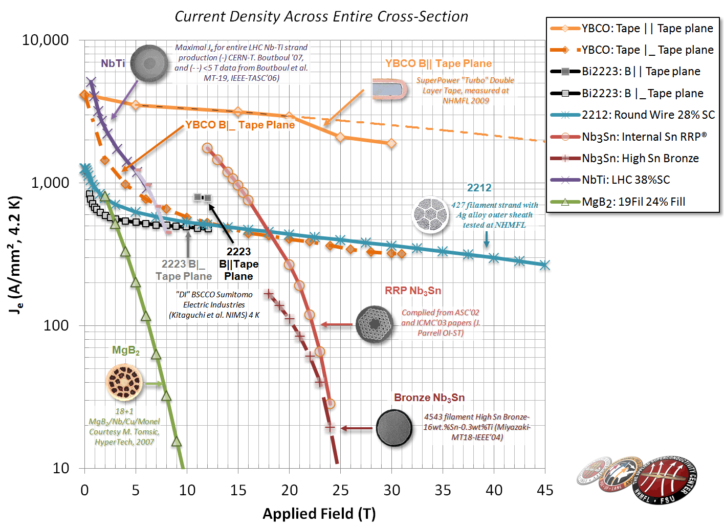
FSU-NHMFL/ASC
Superconductors - “the best” plot
OST published data
1m, 0.1 uV/cm
Original process with 521 TAS V17 p.2262 2007
Where MAP conductor needs to be…
Peter Lee, FSU-NHMFL

Slide 7
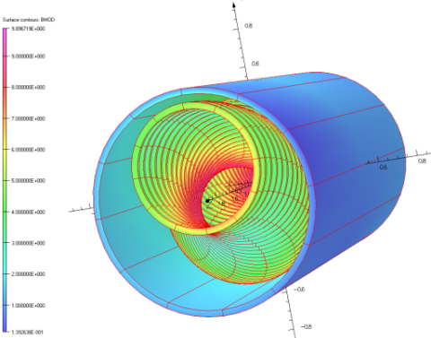
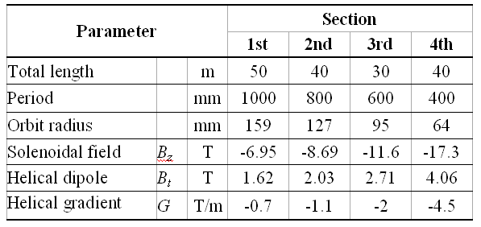
Helical Cooling Channel
The helical solenoid (HS) concept concept (FNAL/Muons Inc.) :
    Coils follow the helical beam orbit generating solenoidal, helical dipole and helical quadrupole fields
    Multi-section HCC
  Would require 160 meters of magnets
  Wide range of fields, helical periods, apertures
  Room for RF system
  Field tuning is more complicated at high fields
  NbTi, Nb₃Sn/Nb₃Al and HTS in final stage
Early Specs, ca. 2006-K. Yonehara, S. Kahn, R. Johnson et al.

Slide 8
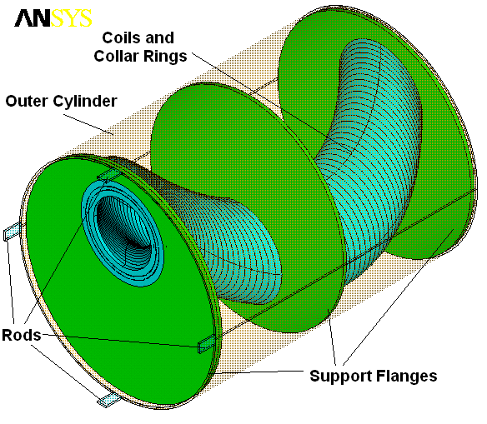
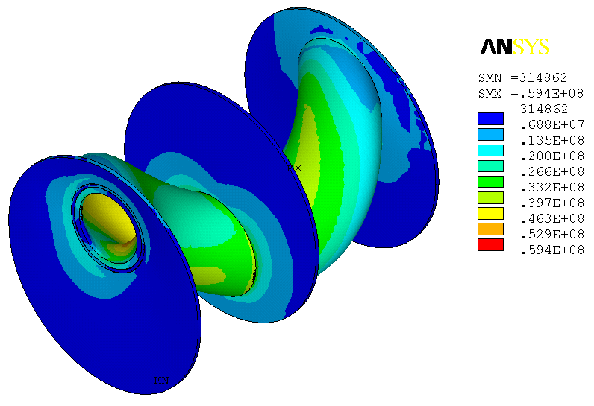
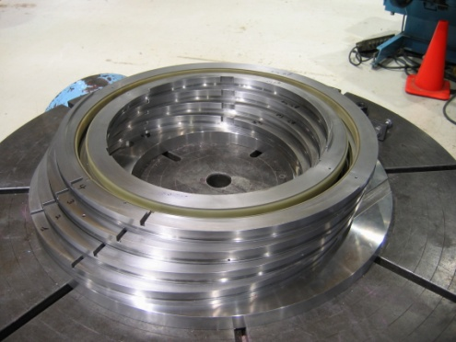
HS Mechanical Concept
(FNAL)
Hoop Lorentz forces intercepted by stainless steel rings around the coils
Transverse Lorentz forces intercepted by support flanges
Outer LHe vessel shell provide mechanical rigidity to the structure
The peak stress is ~60 MPa
The first model built and successfully tested

Slide 9
4-Coil NbTi Model Fabrication 2010
A second model HSM02 has been built to improve the solenoid manufacturing technology and performance.
HSM02 baseline magnetic and mechanical design is the same as for HSM01
Improved:
  mechanical structure and insulation
  cable geometry and insulation
  coil winding and impregnation procedures
SSC cable re-sized (flattened):
    Cable test => no degradation
HSM02 status:
  Test at Fermilab MTF later this year (Sept/Oct…)

Slide 10
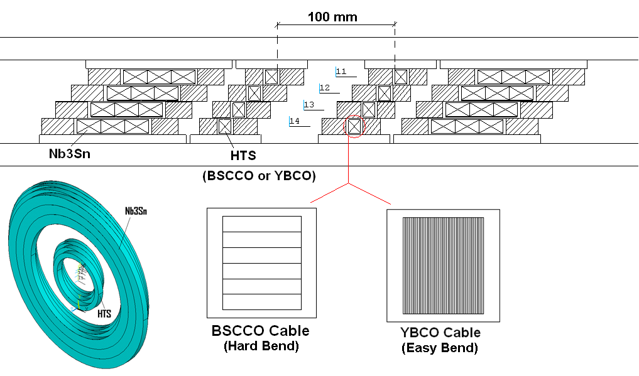
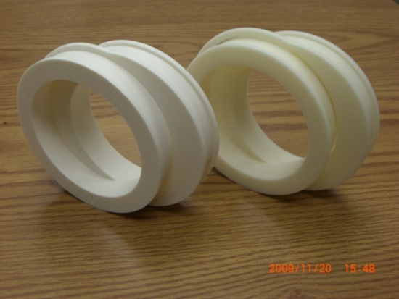
HCC - Hybrid HS Model
This work is partially funded and performed in collaboration with Muons Inc. (SBIR funded)
Conceptual design study shows that a Hybrid HS may be needed for HCC
The goal - develop mechanical design and technology for HTS section based on G2 tape/cable and its assembly with RF and Nb₃Sn section
Support structure was designed and prototyped
12-mm YBCO tape procurement has been initiated by Muons Inc.

Slide 11
HCC – MAP Program
  Model magnet program to support HCC Development
  4 coil magnet NbTi
    Rebuild of first model to fix programs (year1= now)
      Rebuild complete – awaiting test
    Assuming full period, do quench protection study to determine amount of stabilizer required
    Design magnet with proper amount of stabilizer
  4 coil magnet with Nb₃Sn
    design tooling, build magnet with Nb₃Sn (Year 2 ) Needed for higher field sections
    incorporate magnet with indirect cool (as are going be needed for these magnets) (year 3 )
  HTS magnets
    design tooling, build magnet with Nb₃Sn (year 2 )
    build 2 coil model using YBBCO tape. Test in self field (year 1)
    build several more models (year 2 )
    successful 4 coil HTS (year2 )
  Hybrid
Build using 4 coil NbTi or HTS AND HTS hybrid. Test combined model (year 3 )

Slide 12
High Field Solenoid Conceptual Design
Activities
Conceptual Design
Conductor development
Cable R&D
Insert coil studies
Approach - graded design
Outer coils – lower field region – NbTi
Intermediate layers – up to ~20T – Nb₃Sn
Highest field regions – HTS materials
  YBCO
  Bi2212
Key design issues
Superconductor (HTS )
J_{c}, effect of field direction
(in case of HTS tapes)
stress management
quench protection
cost
Conceptual design
Hybrid coil design
Coil sections

Slide 13
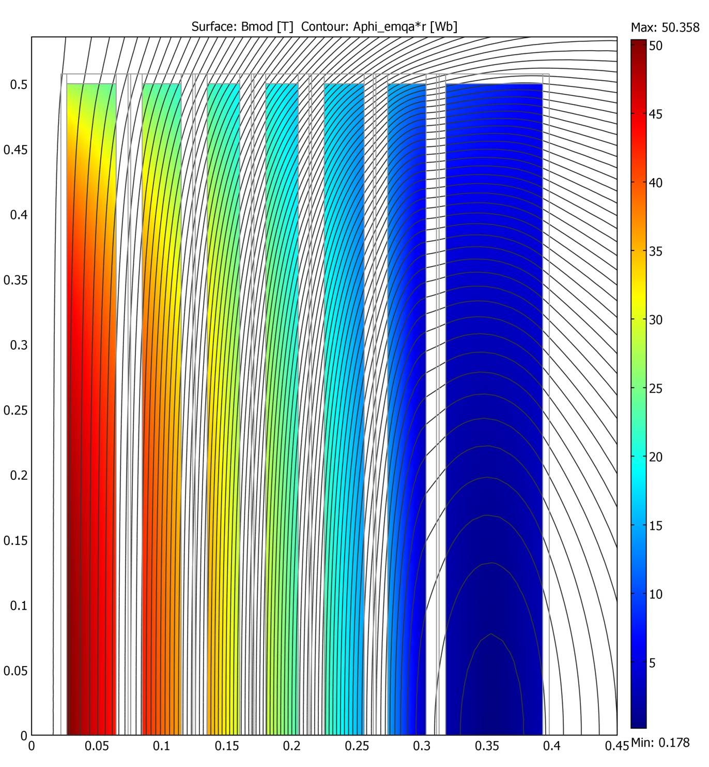
High Field Final Cooling Solenoid
50T Solenoid Conceptual Design
5
NbTi
Basic Parameters
  Inner bore diameter 50 mm
  Length 1 meter
  Fields 30 T or higher ➔ HTS materials
Key design issues:
superconductor type
J_{c}, effect of field direction (in the case of HTS tapes)
stress management
quench protection
cost
Conceptual design:
hybrid coil design
coil sections
Nb₃Sn
B
YBCO / BSCCO
Coil radius, m

Slide 14
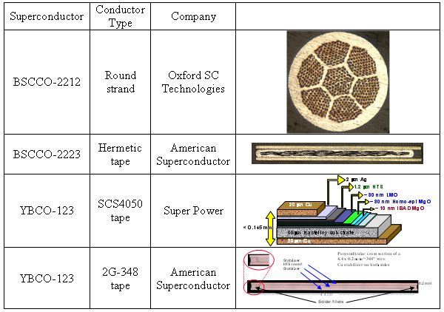
Strand and Tape Examples

Slide 15
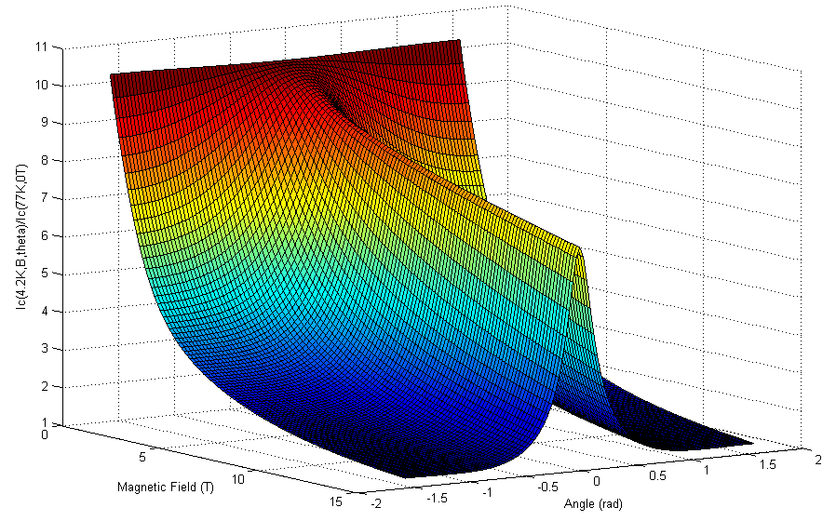
HTS/HFS Conductor R&D
Monitoring industry progress to provide input to magnet design.
This includes studies of the engineering current density (J_{e}) as a function of:
magnetic field => up to 28 T (FNAL-NIMS)
temperature => from superfluid He to LN
field orientation (for tapes)
bending strain
longitudinal
transverse pressure

Slide 16
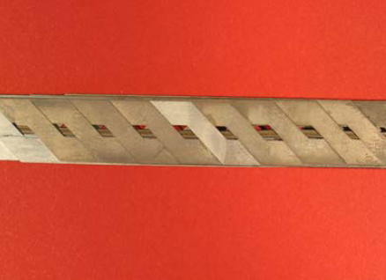
HTS cable R&D
G1 cable:
In FY07-08 fabricated and tested several Rutherford cable designs based on Bi-2212 strand (OST)
  cabling technology
  effect of cable packing factor
Starting from FY2009 continue this work as part of National HTS program
G2 cable:
In FY09 started G2 Roebel cable studies

Slide 17
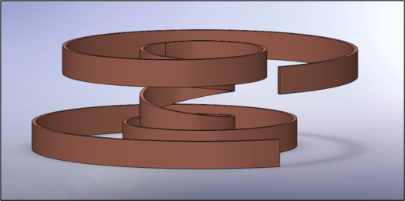
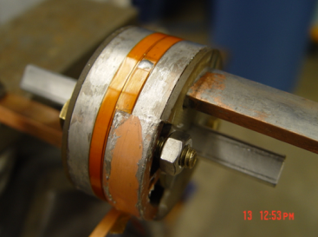
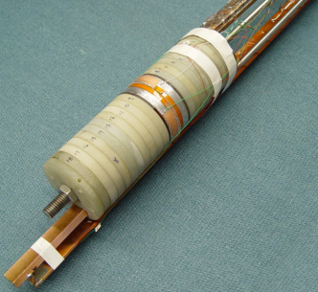
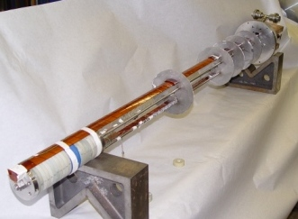
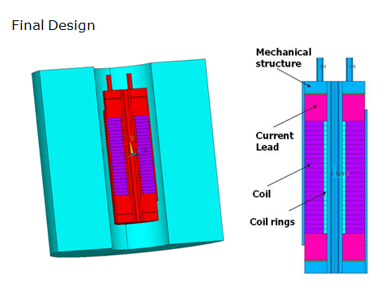
Insert Coil R&D
Present focus on single and double-layer pancake coils based on HTS tapes.
~20 single and double-layer pancake coils (YBCO and Bi-2223) were built and tested in self-field and external solenoid
  Study tape splicing techniques, effect of coil impregnation, coil preload
A modular HTS Insert Test Facility to test up to 14 double-layer pancake coils inside the 14 T/16 T solenoid (B>20 T)
For the second phase of the coil program, larger multi-section HTS coils will be designed, fabricated and tested to achieve higher magnetic field and force levels.

Slide 18
Fermilab Test Facility for Conductor and Inserts
 | Oxford Teslatron #1 | Oxford Teslatron #2 | Oxford Teslatron #3 | Oxford Teslatron #4
Bz_max | 15 T (4.2K) 17 T (2.2K) | 14 T (4.2K) 16 T (2.2K) | Not equipped with solenoid for external field generation. | 8.5 T (4.2K) 10 T (2.2K)
External Nb3Sn/NbTi Fully SC Magnet Geometry | Cold Bore: 68 mm OD: 192 mm Height: 167 mm | Cold Bore: 77 mm OD: 218 mm Height: 180 mm | Max Magnet OD: 253 mm (accommodates up to 4 DP helical units) | Cold Bore: 147 mm OD: 224 mm Height: 240 mm
2 kA power supply (5 kA on order), data acquisition for quench monitoring and cryogenic monitoring

Slide 19
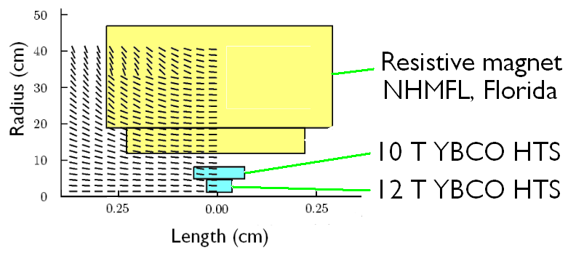
SBIR R&D – BNL & PBL
    YBCO HTS Solenoid at ~40 T - BNL, PBL (Particle Beam Lasers)
    [Information from talks by Bob Palmer (7/2010) at FNAL & Ramesh
    Gupta at ASC2010 (8/2010)]
    Requirements for final cooling (from Bob Palmer talk)
The program
  First Phase 2 SBIR
    Build 10 T Solenoid 10 cm diameter bore
    Chose to use YBCO to explore very high current densities – compact
  Second Phase 2 SBIR
    Build 12 T YBCO Solenoid 2.5 cm diameter bore that fits inside #1
    Test both solenoids in 19 T magnet at NHMFL

Slide 20
SBIR R&D – BNL & PBL, cont.
They are winding, assembling, and testing coils
  2G tape from SuperPower
    Outer Solenoid
      100 mm dia. Coils (“pancakes”)
      240 turns
    Inner Solenoid
      25 mm
      260 turns
Issues
  At present, one splice per coil is allowed => cost/yield reasons
  2G tape has excellent strain tolerance in transverse direction
  Axial strain tolerance is less well known, and perhaps an order of magnitude worse
  Other material properties need further investigation (thermal shock, low temp/high current performance, fatigue)

Slide 21
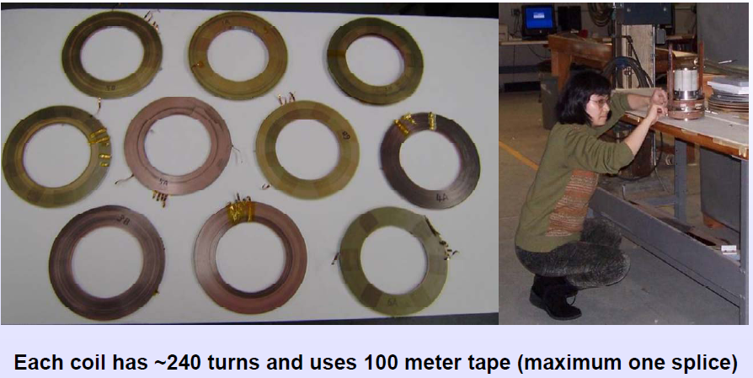
SBIR R&D – BNL & PBL, cont.
YBCO coils at BNL

Slide 22
Interaction between the SBIR HTS Solenoid and the MAP Program
No direct support of PBL/BNL 40 T Solenoid Program has been included in the proposed MAP budget. The PBL/BNL effort’s narrow focus on a 40 T demonstration solenoid is complementary to the broader based approach taken by the MAP program. Technology developments in MAP will be available to, and could play a significant role in the PBL/BNL effort. A strong interchange of information, ideas, and expertise is expected, including topics such as quench detection and protection, studies of structural and conductor materials, and magnetic design.

Slide 23
40-50 T Solenoid MAP Program
Conductor R&D (emphasis on FY10-FY13)
  Procure state of the art conductor (first 3 years)
    YBCO (R&D topics)
      high strength, improved J_{c}, doping to reduce angular dependence
    Bi 2212 wire (R&D topics)
      improve J_{c}, reaction cycle studies, improved strain tolerance
    Nb₃Sn, Nb₃Al
      As needed for outsert studies
  Test Program (first 4 years)
    Jc function of external field, field orientation and temperature
    Virgin strand
    Cable/extracted strand (Rutherford and Roebel)

Slide 24
40-50T Solenoid MAP Program
Coil Technology/Inserts
  Conductor Choice
    YBCO studies – conductor engineering/angular dependence (end effects in solenoids)
    YBCO Roebel cable
    BSSCO single wire & cable studies (use in end regions)
  Coil Studies
    Test axial compression on insert coil
    Develop ways to cause a local quench
    Develop ways to observe these quenches
    Test cyclical tension on tape
    Test radial compression
These tests need to be performed by FY13 to support the conceptual design

Slide 25
40-50T Solenoid MAP Program
Demonstration Magnet (a FY 13 magnet milestone)
  Develop magnet insert to demonstrate state-of-the-art conductor and magnet fabrication technology. Target:
    Maximum self field coil to fit into Fermilab 147 mm aperture 8T Teslatron
      Estimated self field 20 T
    Conductor parameters will be complementary to PBL insert
    Possible design consideration
      Graded coils with YBCO, Bi2212 to accommodate end field effects
      Cable vs. strand to minimize inductance
  Strand, cable and insert program will continue through “high field solenoid” conceptual design phase which begins in FY13

Slide 26
Collider Ring Magnets
The Collider Ring - in keeping with all other parts of μ collider - presents a challenge to the magnets (and detectors as well)
  μ eνν decays create a serious e± background
Dipole requirements and operating conditions call for either an open mid-plane design approach with absorber placed outside the coil, or a large aperture design with absorber within the aperture
  Nb₃Sn has the most appropriate combination of the critical parameters J_{c}, T_{c}, B_{c2} for this application
Conceptual designs developed to evaluate different options to deal with competing requirements
  Open midplane - both cosθ-like and ‘block coil’ designs considered
  Cosθ design large aperture w/ absorber within aperture
    LARP-like design

Slide 27
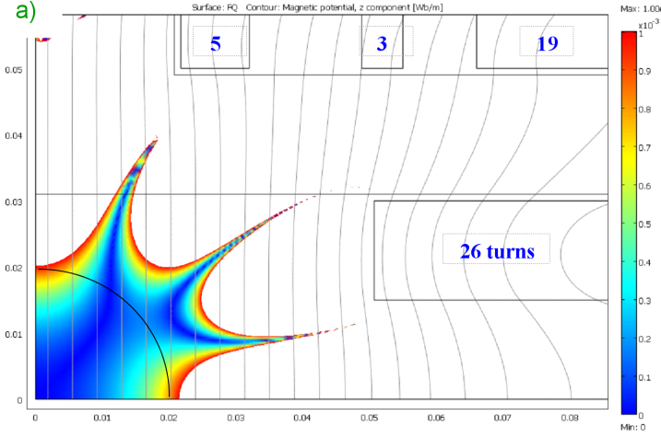
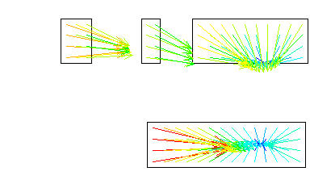
Open Midplane Designs
Good field region
2 double-pancake coils, a vertical split yoke, with a thick stainless steel outer skin with two alignment keys and two control spacers
Fx=3796 kN/m
Fy=-1694 kN/m
Similar work is being carried out at BNL

Slide 28
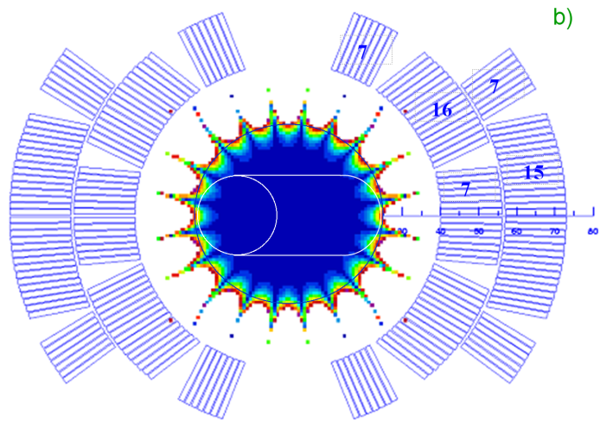
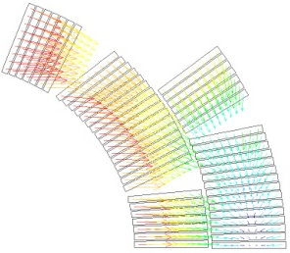
Large Aperture Shell-type Structure Dipole
Note beam shifted pipe and internal absorber is in the uniform field area
The collars are thin stainless steel
Support structure similar to that used in Fermilab’s high field 90 mm Nb₃Sn quadrupole models
Fx=3033kN/m
Fy=-1498kN/m
From paper 5LPM03 – ASC2010, A. Zlobin, FNAL

Slide 29
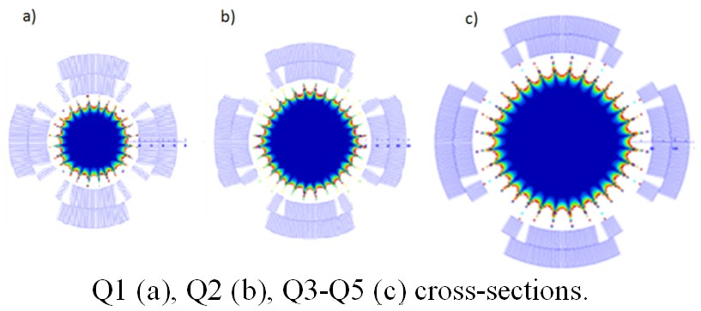
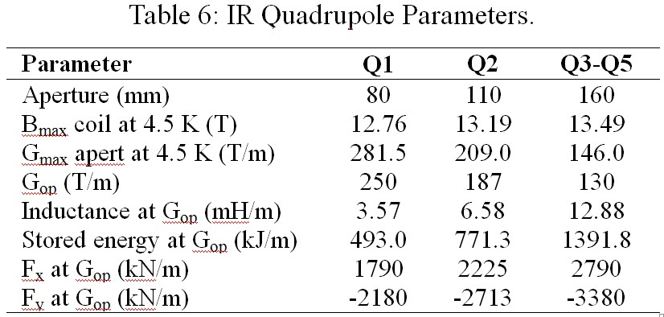
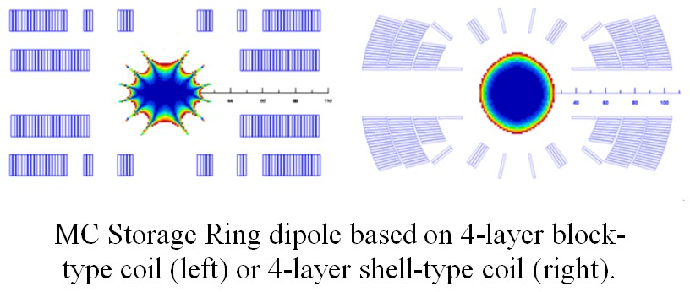
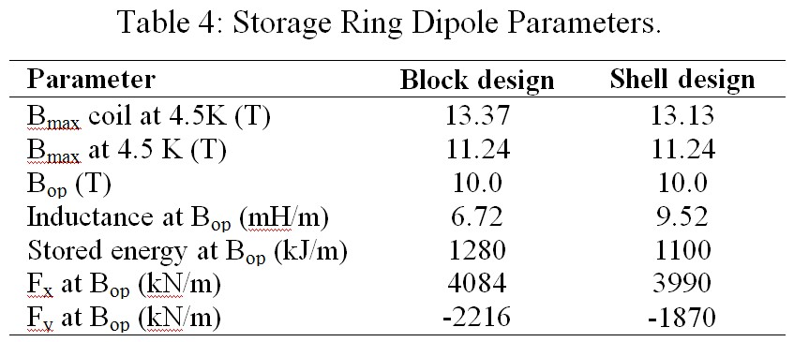
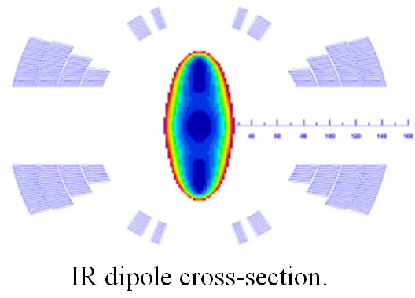
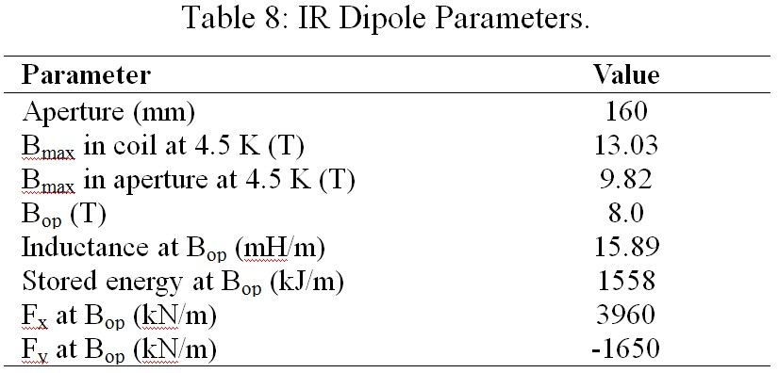
Collider Ring Dipoles & Quadrupoles
MOPEB053 Proceedings of IPAC’10, Kyoto, Japan

Slide 30
Collider Ring Magnets Design Status
Several design options studied for Collider Ring magnets to avoid mid-plane electron flux
  Block design with open mid-plane
  Shell (cosθ related) design with open mid-plane
Open mid-plane designs present structural as well as field quality ‘challenges’
A large aperture, cos(θ) approach, with a support structure similar to Fermilab’s 90 mm Nb₃Sn quadrupole models, allows
  Acceptable good field region for beam pipe off-center in the aperture
  Room for internal absorber
  Management of forces on the coil structure

Slide 31
Collider Ring Magnets MAP Program
Ongoing design studies for Collider Ring magnets in close collaboration with Collider Ring design group
  Magnets will be based on Nb₃Sn conductor – (ongoing)
    Significant investment in conductor development – DOE CDP and LARP
  Magnet R&D is beneficially coupled to the LARP magnet program – (ongoing)
    Similar apertures and field gradients
    Thermal studies
  More realistic magnet designs as Collider parameters mature (years 3-4)

Slide 32
Summary
Critical path for the Muon Collider is through magnets
Conceptual solutions exist ‘on paper’ for magnets varieties in HTS and Nb₃Sn
  Aggressive designs
  Based on advanced HTS conductors
  Some are quite advanced
R&D has begun on several key magnet designs
  Early HCC prototype work
  YBCO coil fabrication for final cooling section solenoid study
  All appear plausible at this time
Magnet R&D depends on Conductor R&D
  Dependent on HTS materials
    Fundamental properties – J_{c} (H,T)
    Strain sensitivity
    Uniformity
  Piece length, $, etc.
R&D still at an early stage for high field magnets
  Coils, model magnets, R&D (pre-)prototypes, … needed

Slide 33
Acknowledgements
The ongoing design effort for Muon Collider magnets has a large list of contributors. I had help from many people - they include:
  Emanuela Barzi Arup Ghosh Arno Godeke
  Ramesh Gupta Rolland Johnson Steve Kahn
  Vadim Kashikhin Vladimir Kashikhin Mike Lamm
  David Larbalestier Mau Lopes Ken Marken
  Igor Novitski Bob Palmer Alvin Tollestrup
  Miao Yu Sasha Zlobin
  the members of VHFSMC, and many others…

Slide 34
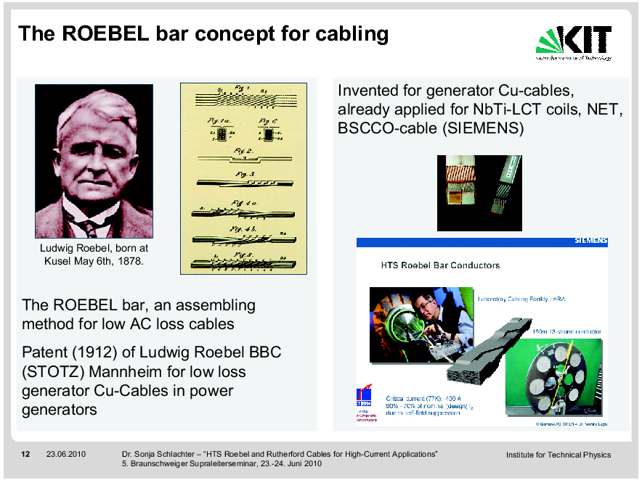
Origin of Roebel Cable
Karlsruhe Institute of Technology

