Slide 1
NCRF R&D Plan
Derun Li
Center for Beam Physics
Accelerator and Fusion Research Division
Lawrence Berkeley National Laboratory
Muon Accelerator Program Review
Fermilab, August 24 - 26, 2010

Slide 2
Outline
Introduction and Goals
Brief review of NCRF programs
RF R&D Plan
Experimental Studies at 805-MHz
RF gradients (pillbox cavity with and without RF buttons) in multi-Tesla magnetic fields
Cavity with magnetic insulation to study ExB effect
High pressure RF cavity + Beam test at the MTA
Atomic layer deposition (ALD) cavity
RF breakdown studies
MuCool 201-MHz cavity tests
Baseline design for MICE
RF cavities for MICE
Status
Milestones
Cavity down selection
Summary

Slide 3
Introduction I
Muon capture, bunching, phase rotation and ionization cooling require
Low frequency normal conducting RF cavities
High RF gradient operation in up to 6 T magnetic fields

Slide 4
Introduction II
We have learned a great deal about the NCRF for muon acceleration
Cavity design, engineering and construction
805-MHz open-cell cavity
805-MHz pillbox cavity
Be windows for 805-MHz and 201-MHz cavities
Pillbox cavity with RF buttons
805-MHz HP RF cavity (Muons Inc.)
Two 805-MHz box cavities
201-MHz cavity with Be windows for MuCool (baseline for MICE)
Ten 201-MHz cavities with Be windows for MICE (two spares)

Slide 5
Introduction III
High power RF tests with/without magnetic field
805-MHz open cell cavity
Pillbox cavity + Be windows + RF button
805-MHz HP RF cavity (Muons Inc.)
One box cavity
201-MHz cavity with Be windows for MuCool
What we have learned from the high power tests so far
Achievable accelerating gradients degrade due to external magnetic fields (by approximately a factor of 2 at 3-Tesla magnetic field)
External magnetic fields in association with RF fields cause damage on cavity surfaces
Operation of RF cavity in strong B field is a challenge
Goal: Find a workable solution through targeted R&D

Slide 6
Goals
Develop a workable solution for high gradient NCRF operating in B fields between approximately 3 and 6 T.
Support sub-assembly prototyping for the 6D cooling bench test.
Guggenheim
FOFO Snake
HCC

Slide 7
Multi-Institute Collaboration
RF R&D has been a successfully operating collaborative effort:
Fermi National Accelerator Laboratory
Lawrence Berkeley National Laboratory
Brookhaven National Laboratory
Jefferson Laboratory
Illinois Institute of Technology
Argonne National Laboratory
University of Mississippi
SLAC National Accelerator Laboratory
Muons Inc.
Tech-X Corp.
RF test facility, MTA at Fermilab

Slide 8
NCRF Cavity for Muon Beams
RF cavity options, why and how we got here:
Muon beams are born with large emittance and decay and must be confined by strong magnetic field
Must use NCRF
Pillbox-like cavity with beam irises terminated by thin Be windows (muons can penetrate)
High RF electric field between two “parallel” planes
TiN coating at high electric field region
A factor of 2 higher cavity shunt impedance
Two times less RF power for a given gradient
Independent cavity phase control
RF heating on thin Be windows could detune the cavity
Two double-curvature windows pointing in the same direction

Slide 9
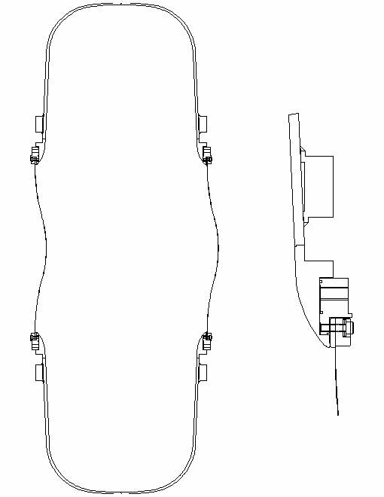
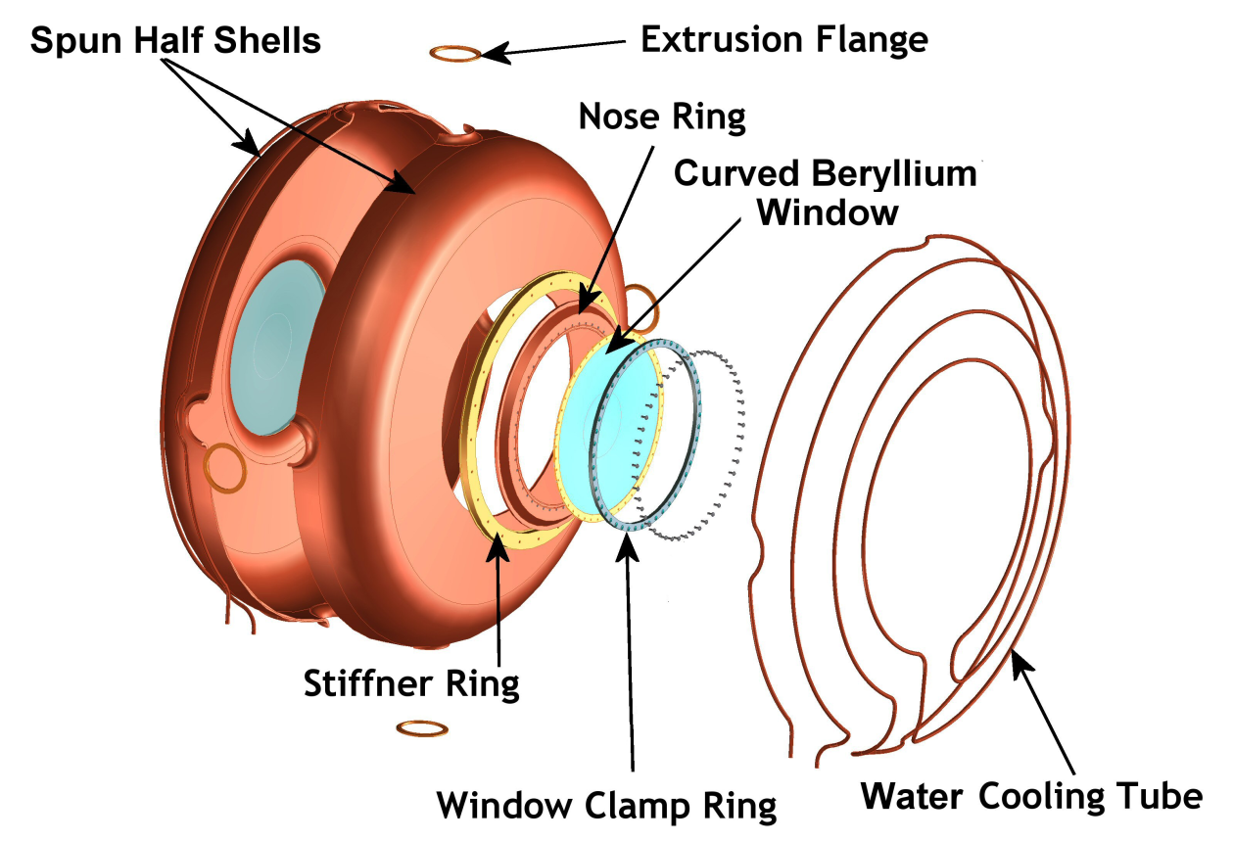
NCRF Cavity for Muons
Cavity has been tested successfully without magnetic fields
Be windows can withstand high RF power in strong magnetic field without damage

Slide 10
RF Cavity Design Parameters
The cavity design parameters
Frequency: 201.25 MHz
β = 0.87
Shunt impedance (VT²/P): ~ 22 MΩ/m
Quality factor (Q₀): ~ 53,500
Be window diameter and thickness: 42-cm and 0.38-mm
Nominal parameters for MICE and (cooling channels) in a neutrino factory or muon collider
8 MV/m (~16 MV/m) peak accelerating field
Peak input RF power: 1 MW (~4.6 MW) per cavity
Average power dissipation per cavity: 1 kW (~8.4 kW)
Average power dissipation per Be window: 12 watts (~100 watts)

Slide 11
NCRF Cavity with External B Field
RF challenge
Achievable RF gradient decreased by more than a factor of 2 at 4 T
An efficient front-end system of a neutrino factory or muon collider requires high gradient NCRF cavity operation in a multi-tesla magnetic field
Targeted R&D programs to understand the RF breakdown problems in magnetic fields → a workable solution
Physics models and numerical simulations,
Experimental programs and new techniques:
The 805-MHz with RF buttons
High pressure cavity
ALD to eliminate field emission
Be wall cavity
Box cavity to study E x B effects
Magnetic field insulated cavity
Physics model to understand RF
breakdown in magnetic fields

Slide 12
Overview of R&D Plans
Continue experimental RF breakdown studies at 805-MHz
The 805-MHz pillbox cavity has been refurbished and is ready for more button tests for RF breakdown studies
New high pressure cavity and test with beam at MTA
Magnetic insulation
Box cavities to study E x B effects
High pressure cavity at different frequencies
Beryllium wall cavity
Atomic layer deposition (ALD) cavity
Physics model to understand RF breakdown in magnetic fields
201-MHz cavity program
Test of 201-MHz MuCool cavity with magnetic fields
RF cavities for MICE
Design ,construction and tests of a vacuum vessel for a 201-MHz cavity at MTA
Superconducting coupling coil required for MuCool RF breakdown studies at MTA, Fermilab

Slide 13
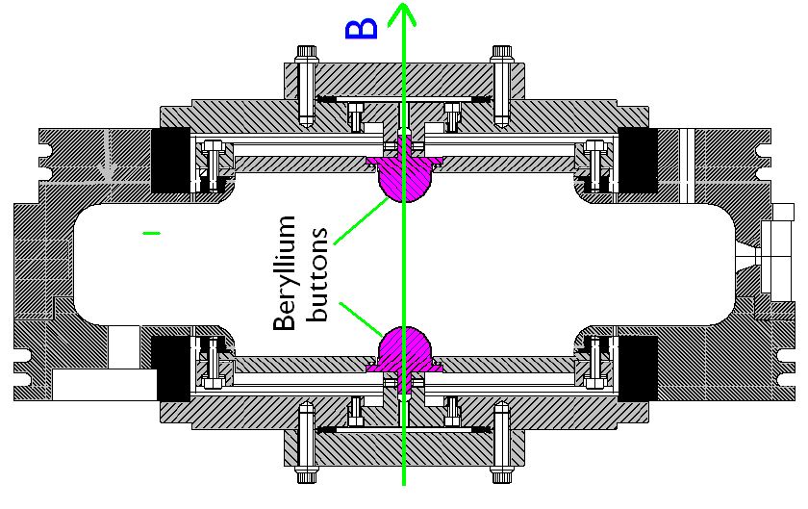
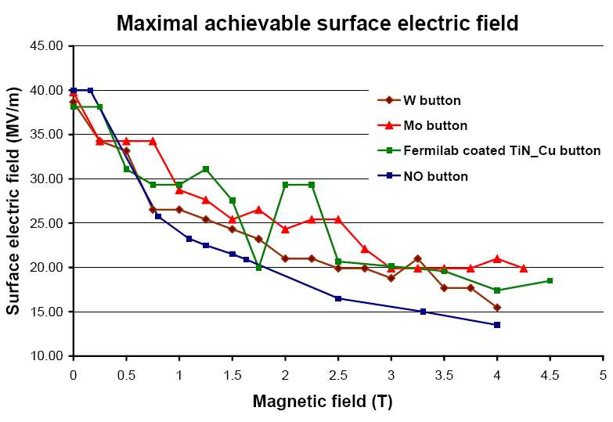
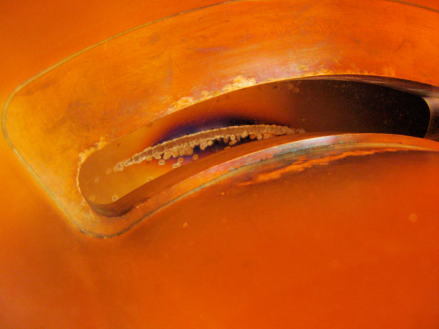
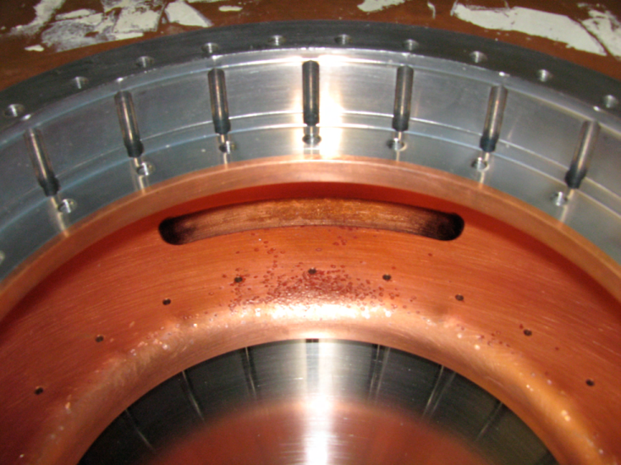
RF Button Tests at 805-MHz
Continue experimental studies using RF button cavity at 805-MHz
The cavity has been refurbished at Jlab and ready for Be-Be button test
Enhanced button design with 3 times higher peak fields
Be-Be button configuration: higher fields w/o surface damage
Single button test results
Scatter in data may be due to surface damage on
the iris and the coupling slot

Slide 14
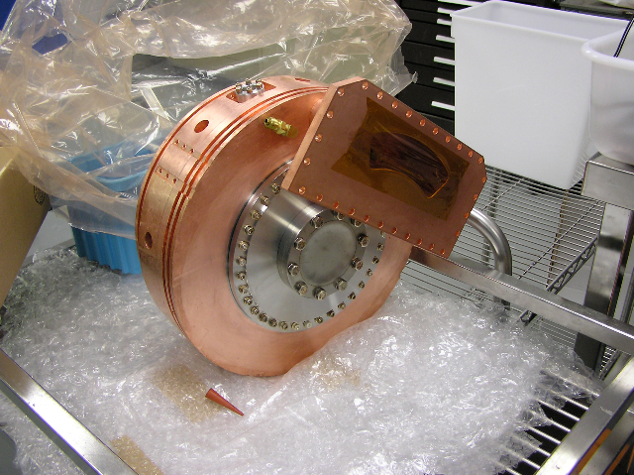
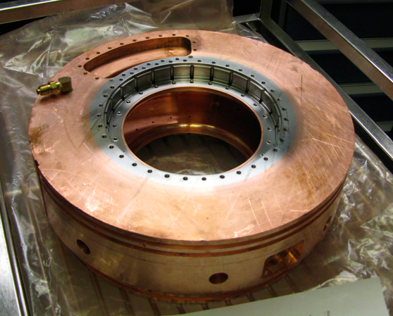
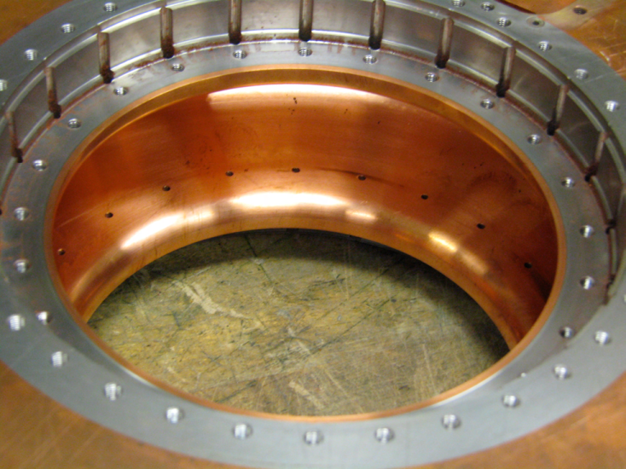
RF Button Tests at 805-MHz
The pillbox cavity has been refurbished at Jlab and is ready for RF button tests

Slide 15
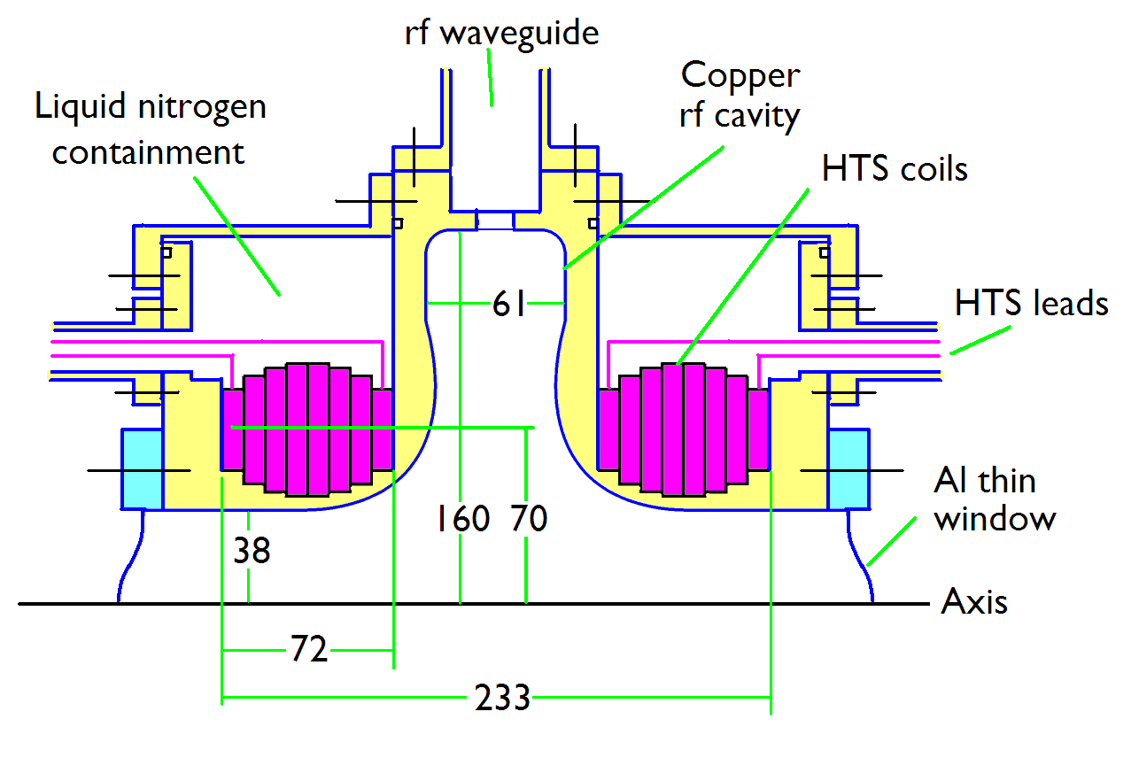
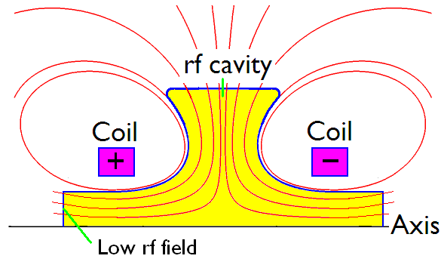
Magnetically Insulated RF Cavity
Cooling channel concept with magnetic field insulated RF cavity
Understanding of RF breakdown in magnetic field
Box cavity test at MTA under way now and will be continued
Note: Magnetically shielded cavity is not as efficient in RF power usage as the pillbox

Slide 16
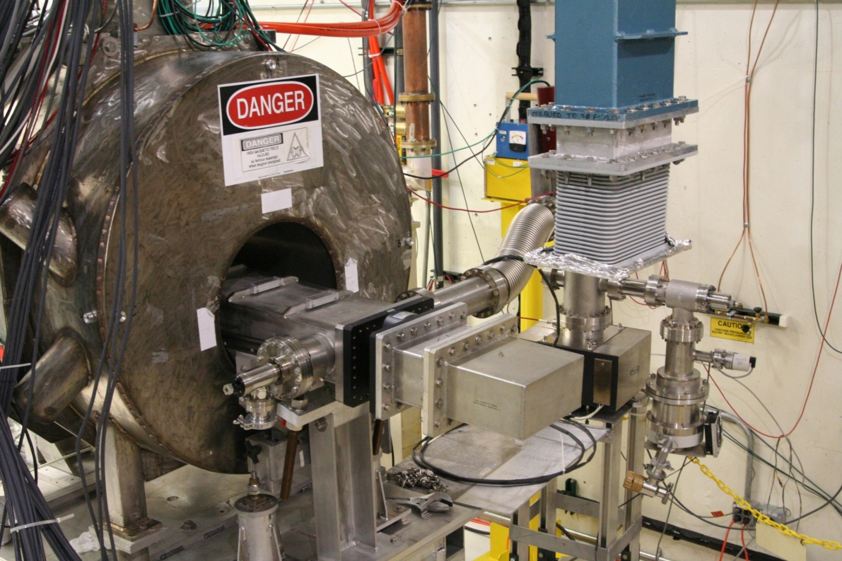
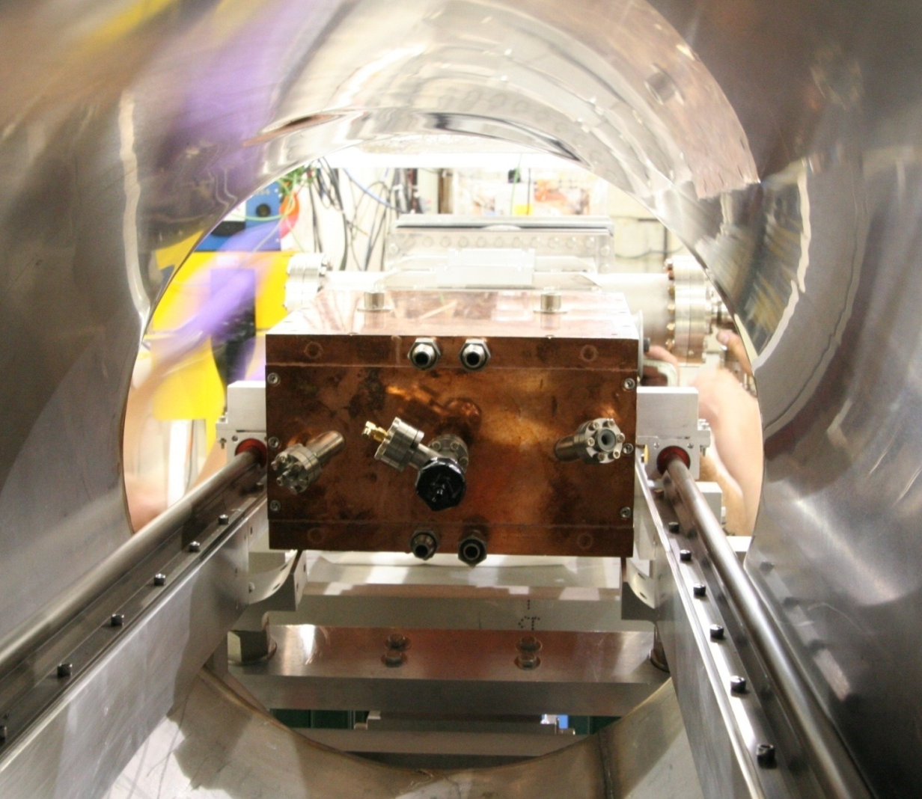
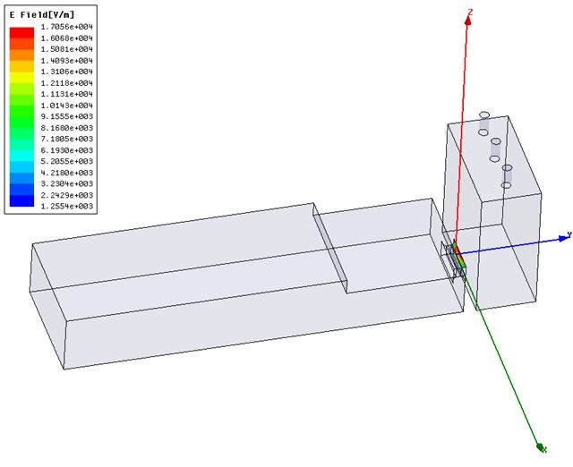
Box Cavity Tests at 805-MHz
Continue experimental studies of magnetic insulation at 805-MHz
Box cavity has been tested at 0 (E perpendicular to B) to 4 degrees at 3 T
Cavity inspection did not show any surface damage
Continue tests using the second cavity with E parallel to B
Preliminary data, analysis is under way

Slide 17
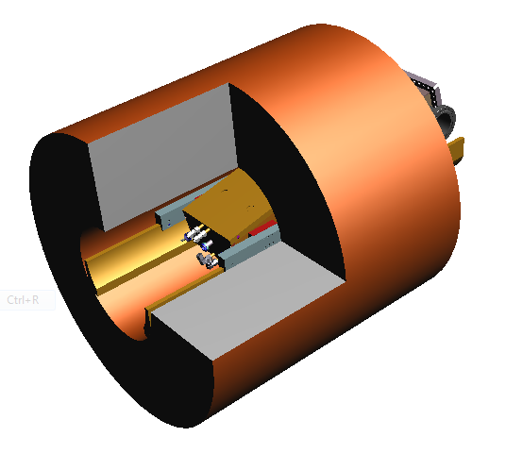
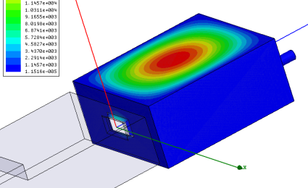
Box Cavity Tests at 805-MHz
Increase gradient gradually to the blue curve (sparking rate < 1/20,000)
Reduce to lower gradient and increase again
Repeat several times until the gradient stays at
the red curve (sparking rate < 1/200,000)

Slide 18
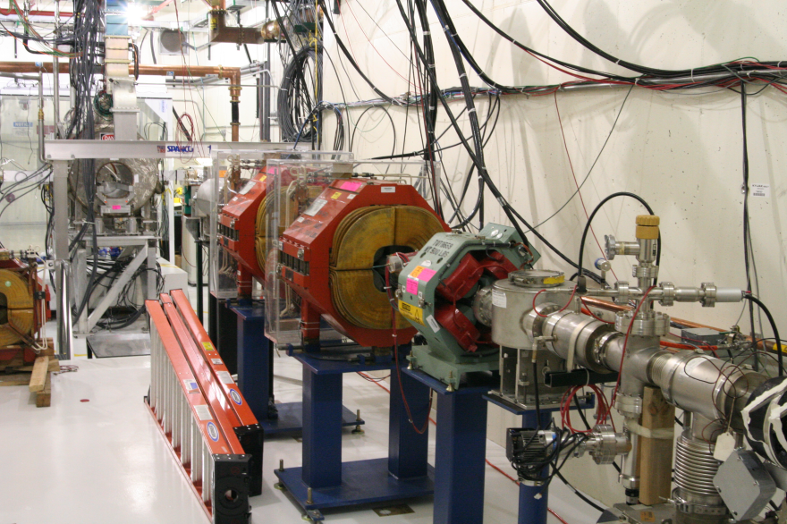
HP Cavity Tests at 805-MHz
Continue experimental studies of HP RF cavity at 805-MHz (Yonehara’s talk)
RF gradient not affected by external B field
New test cell being designed, built to test with 400 MeV proton beam
Verify theoretical predictions

Slide 19
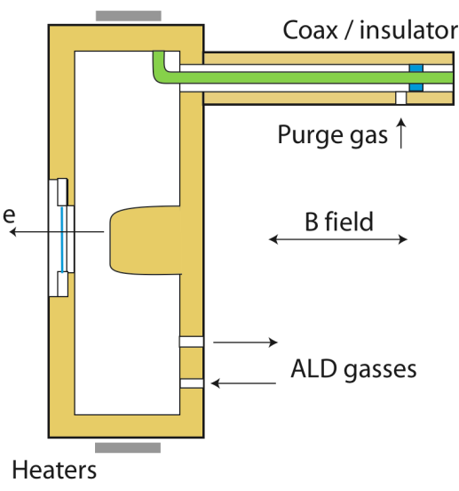
ALD to Eliminate Field Emission?
Single-cell SC cavity ALD coated at ANL
Alumina barrier layer plus niobium oxide coating
Cavity prepared and tested at JLab
Result equaled best previous performance with no field emission
Encouraging results and the coating process is conformal, can coat compounds (e.g. NbN, and multi-layer Gurevich structure)
Design and test of a cavity that is “RF breakdown-proof”
ALD can conformally coat emitters & breakdown sites during operation,
Increasing local radii
Reducing the local field, E_{l} ~ 1/r
Field emission, ~E_{l}^{~14}
Breakdown rate ~ E_{l}^{~30}
The experiment will be conducted in the Fermilab MTA
Continue exploring the ALD technique on NCRF cavity
Field emission can be monitored during the process

Slide 20
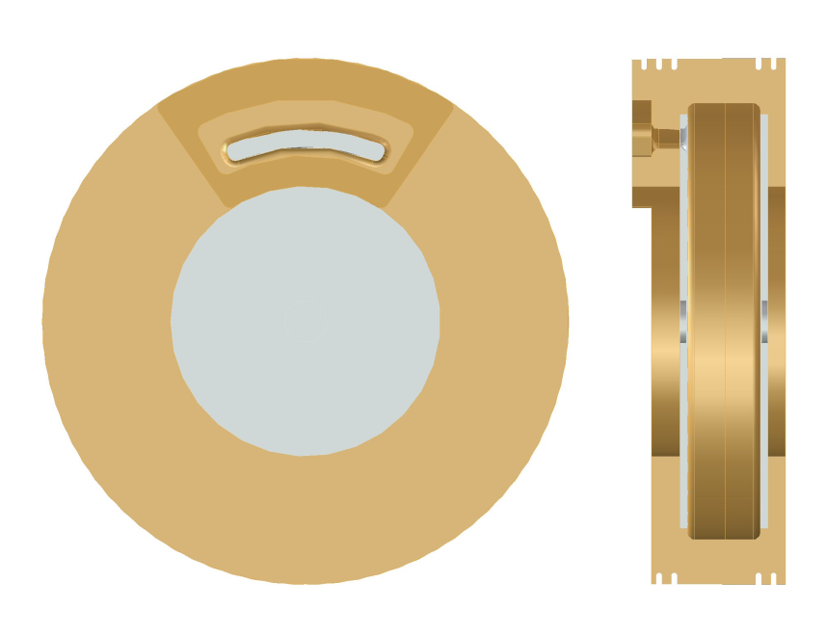
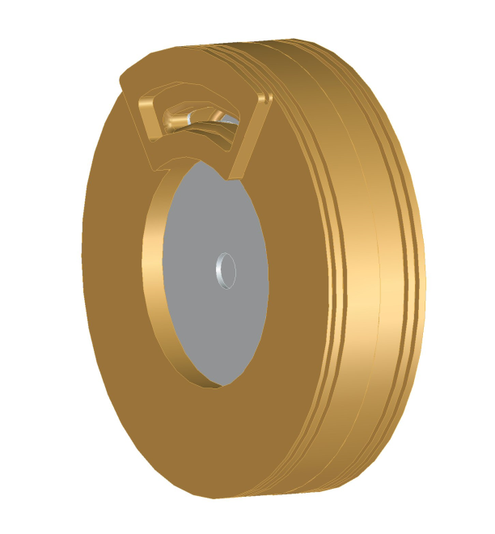
Beryllium Wall RF Cavity
Based on the physics model, Beryllium is the ideal material for the cavity surface
Operation at low temperature
Aluminum is significantly better than Copper
Common characteristics
Two bolted halves w/RF and vacuum seal
Main body is Cu plated Hastelloy or solid Cu
Cavity inner side walls are beryllium (TiN coated)
Slotted coupling port in side wall
Beryllium side wall options
Thin Be foil (∼500 um) brazed to side walls
Thick Be plates (∼ 6 mm) brazed to side walls
Solid Be side walls (no brazing)
Bolted cavity assembly
offers accessibility advantages
Conceptual cavity design and
Engineering design are under way

Slide 21
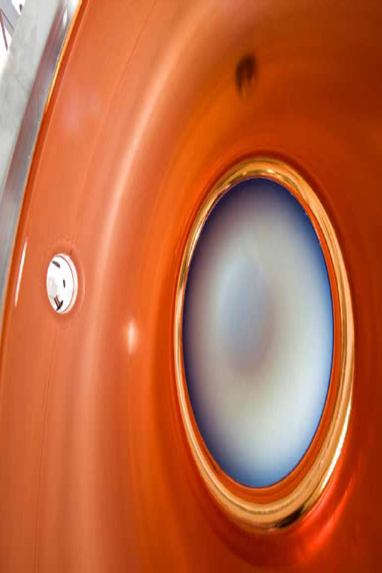
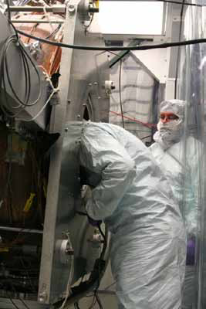
Tests of 201-MHz RF Cavity I
SRF cavity post-processing techniques help NCRF
No surface damage found in recent inspection of the 201-MHz MuCool cavity
Tests will resume using the fringe fields of Lab G magnet
More realistic and systematic studies require Coupling Coil magnet
(will be available by 2011)

Slide 22
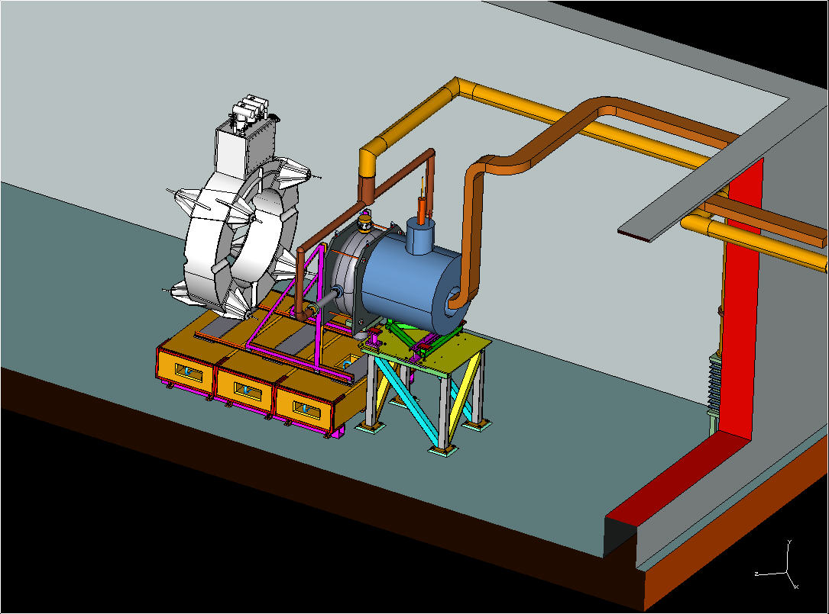
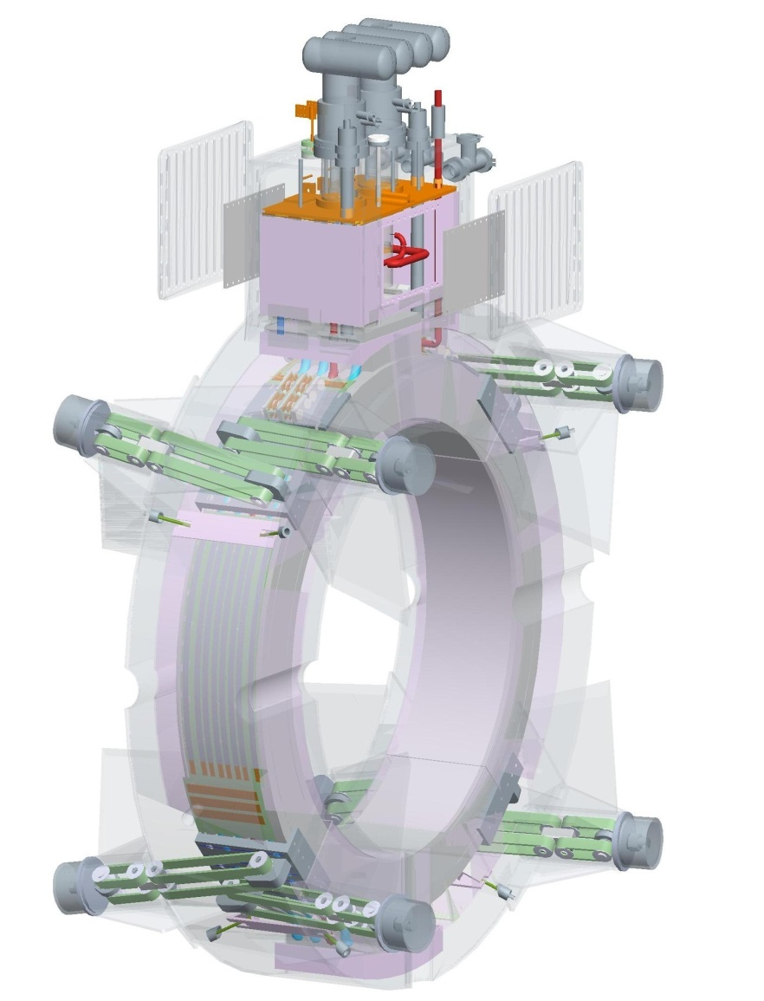
Tests of 201-MHz RF Cavity II
Tests of the 201-MHz cavity with magnetic fields
Initial 201 MHz operation in B Field
Limited to a few hundred Gauss
SC CC magnet available by end of 2011
Using Fringe Field of 4T magnet (in blue)
5T – Solenoid Mode
SC CC magnet
201-MHz Cavity
Lab G Magnet

Slide 23
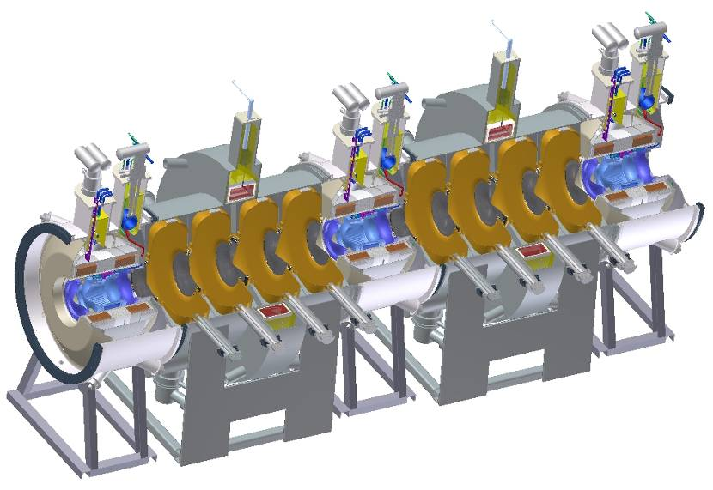
RF Cavities for MICE I
Eight 201-MHz cavities in the MICE cooling channel
First five cavities arrived at LBNL last year and have been measured
Second batch of five cavities will be complete by Oct. 2010

Slide 24
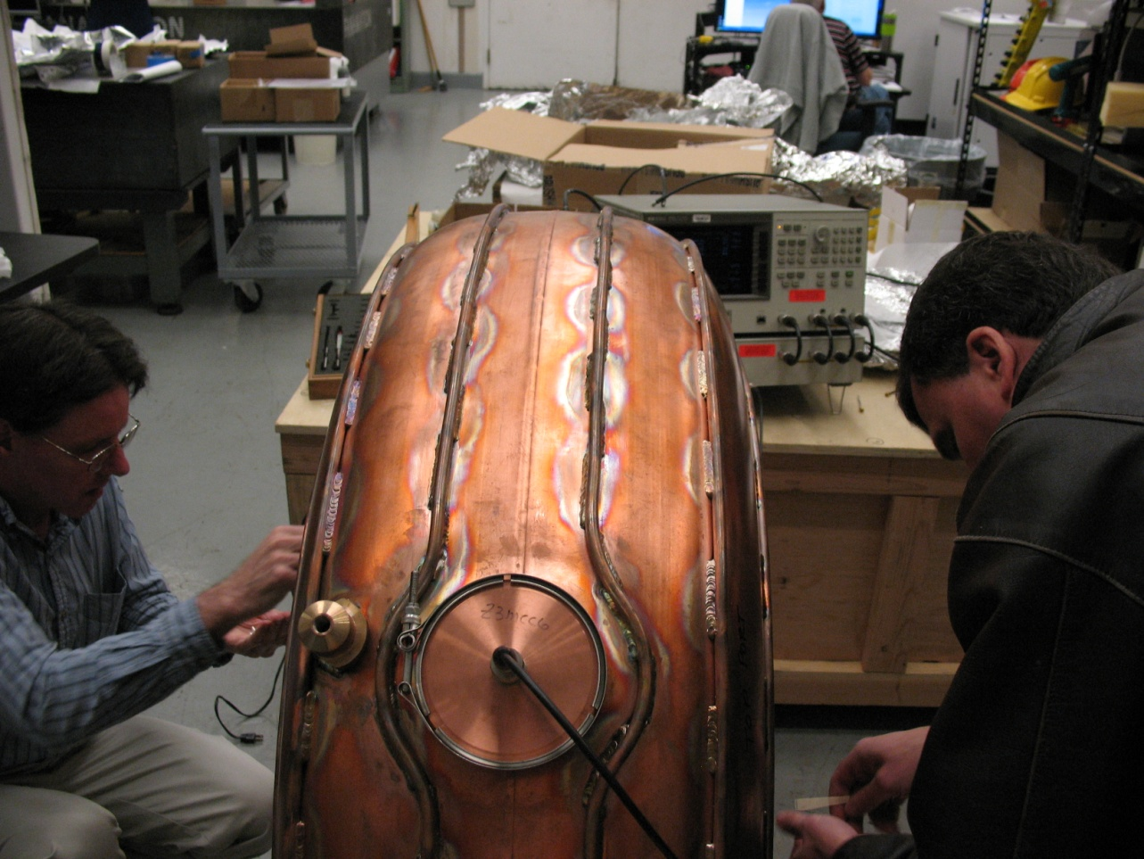
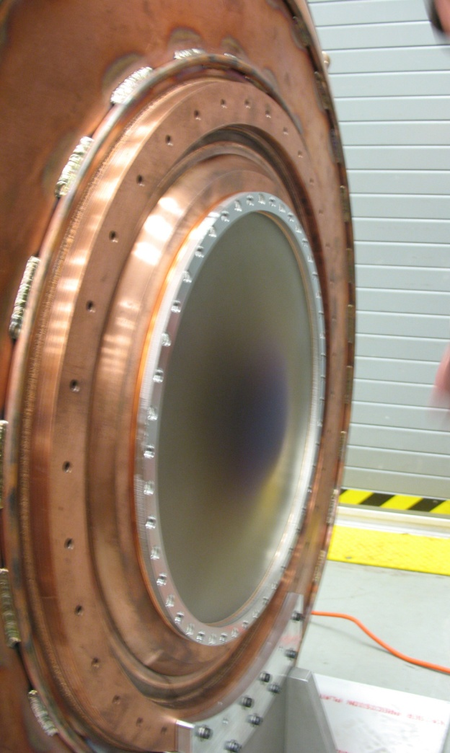
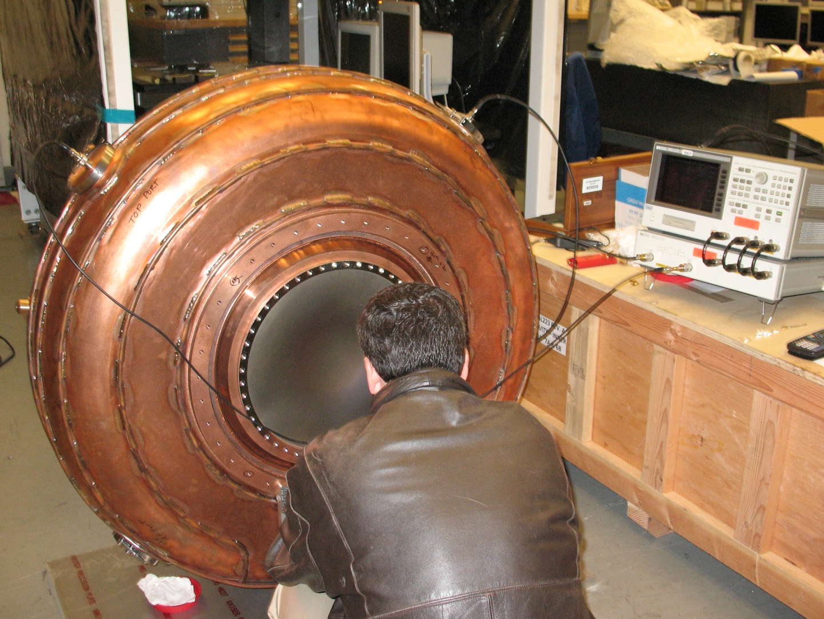
RF cavities for MICE II
The first five MICE cavities have been measured in three different window configurations using Be windows #1 and #2 (reference windows)
*no water cooling tube brazed to the cavity body
Cavity # | 1 | 2 | 3 | 4 | 5 (spare)*
Freq. (MHz) | 201.084 | 200.888 | 201.247 | 200.740 | 201.707

Slide 25
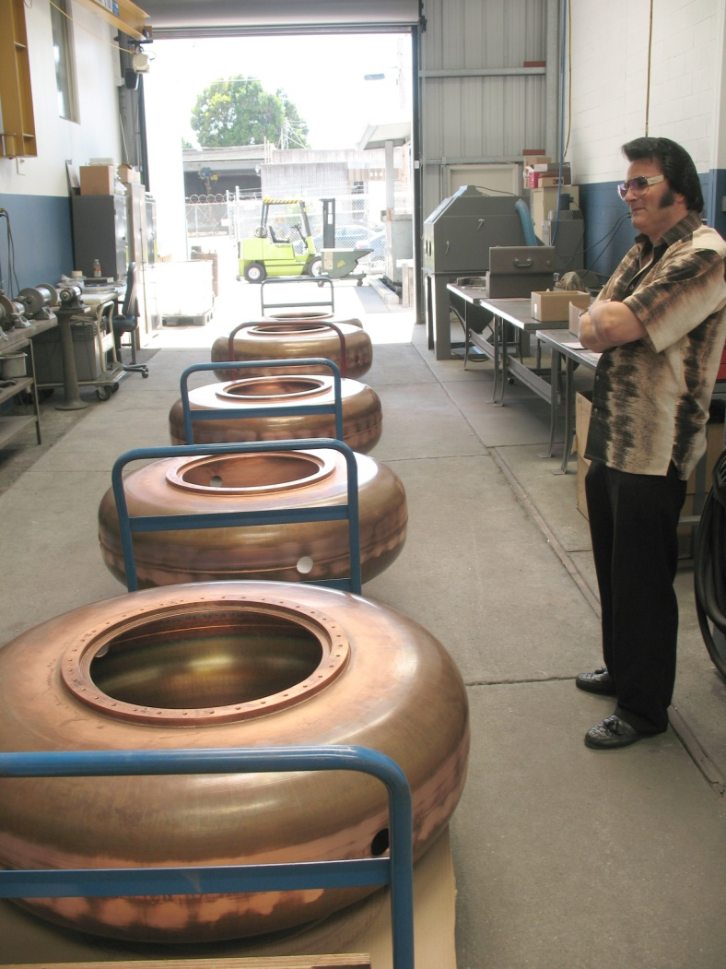
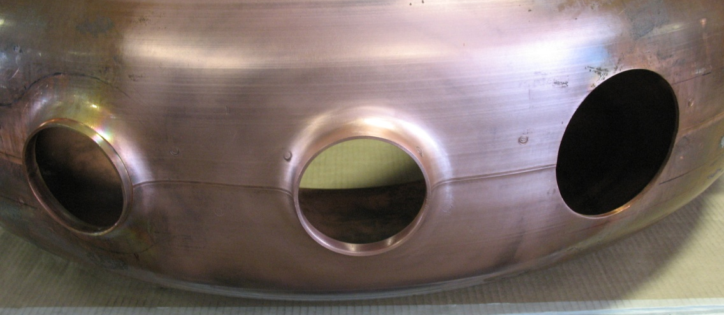
RF cavities for MICE III
Production of the second batch of five MICE cavities going well at Applied Fusion Company in California
Nose rings
Port extruding and flanges
Brazing water cooling tubes
Modified extruding technique
Experimented using the test cavity
Need argon gas purge to prevent
oxidation of cavity surface
Measure oxidation layer thickness

Slide 26
Milestones I
FY10 Complete engineering design for Be-wall RF cavity
Complete initial HPRF cavity beam test
Test magnetically insulated “box” cavity
Complete Be-wall cavity design
Demonstrate experimentally that RF breakdown in a multi-tesla magnetic field can be mitigated at 805 MHz
~ 30 MV/m surface gradient
Test HPRF cavity with 400 MeV proton beam at the MTA
New test cavity design, fabrication and installation + beam test
Understanding physics of beam-gas-RF interaction in HPRF cavity
Understand RF breakdown physics in magnetic field insulated cavity
Complete box cavity tests of E x B studies

Slide 27
Milestones II
FY11 Fabricate Be-wall RF cavity
Use base materials that are more robust to the heating caused by focused beamlets in the magnetic field
Cavity bodies made from Be or possibly Mo
Design, engineering and fabrication of Be-wall cavity
FY12 Test new HPRF cavity at 805 MHz
Complete Be-wall RF cavity tests at 805 MHz
Test 201-MHz cavity with coupling coil in MTA
Cavity down-selection
Systematic experimental studies of RF breakdown physics in vacuum and HP gases at 805 MHz
RF breakdown at material surface
Physics of beam, gas and RF interaction

Slide 28
Milestones III
FY12 Test new HPRF cavity at 805 MHz
Complete Be-wall RF cavity tests at 805 MHz
Test 201-MHz cavity with coupling coil in MTA
Cavity down selection
SC Coupling Coil magnet available by end of 2011
Demonstrate the required RF gradient at 201 MHz in a more realistic magnetic field
RF breakdown scaling
Stored energy
Electron energy
Frequency
Verify conditioning and operation at 201 MHz in a multi-tesla magnetic field

Slide 29
Milestones IV
Down-selection of RF cavities will be based on
Outcome of these experimental studies
The cavity must work at an acceptable RF gradient in a multi-tesla magnetic field
Phase rotation
Bunching
Initial cooling
Final cooling
Engineering, fabrication and integration
Cost of the cavity
Cost of RF power

Slide 30
Milestones V
FY14 Prepare RF test cavity with ALD coating
Potentially reduces or eliminates surface field emission
Proven technology for nano-fabrication of materials
Succeeded in a SC RF cavity test in increasing FE limit and Q at high field
Can apply almost any ALD deposited metal
Design and test of a cavity that is “RF breakdown-proof”
A DOE supplemental funding award for FY10 should allow us to move this milestone forward significantly

Slide 31
Summary
Muon front-end system requires normal conducting RF cavity operating at high gradient in a few Tesla magnetic field
Remains a challenge
R&D plans developed to find a workable solution
Plans for RF breakdown studies
Vacuum cavities
High pressure RF cavity tests with beam at the MTA
201-MHz RF cavities for MICE progressing well
We believe our targeted R&D programs will lead to a workable RF cavity solution in magnetic field!

